Slide 1
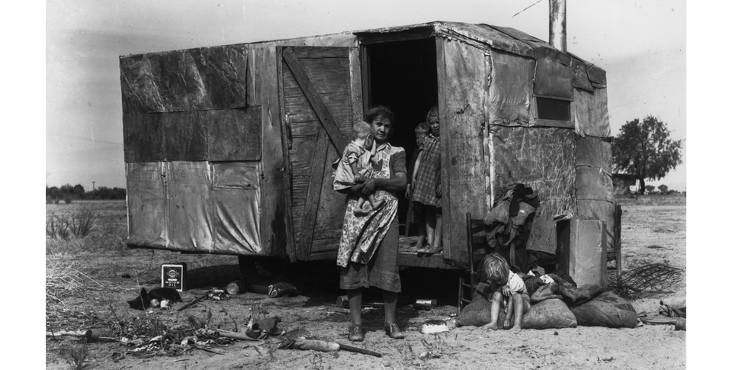
[ 9.2 ] Fiscal Policy Options

Slide 2
[ 9.2 ] Fiscal Policy Options
Learning Objectives
Compare and contrast classical economics and demand-side economics.
Analyze the importance of John Maynard Keynes and his economic theories.
Explain the basic principles of supply-side economics and the importance of Milton Friedman.
Analyze the impact of fiscal policy decisions on the economy of the United States.

Slide 3
[ 9.2 ] Fiscal Policy Options
Key Terms
classical economics
John Maynard Keynes
Productive capacity
demand-side economics
Keynesian economics
multiplier effect
automatic stabilizers
Supply-side economics
Arthur Laffer
deficit spending
John Kenneth Galbraith,
Milton Friedman

Slide 4
Classical Economics
Picture the scene: It’s the Great Depression. Families everywhere are poor and hungry. Factories, shops, and even banks are closed, and millions are unemployed. People are not just anxious—they are desperate.

Slide 5
Classical Economics
During the Great Depression, government spending helped people like the family shown here. Generate Explanations Why do you think some people turn to the government for aid when times are difficult?

Slide 6
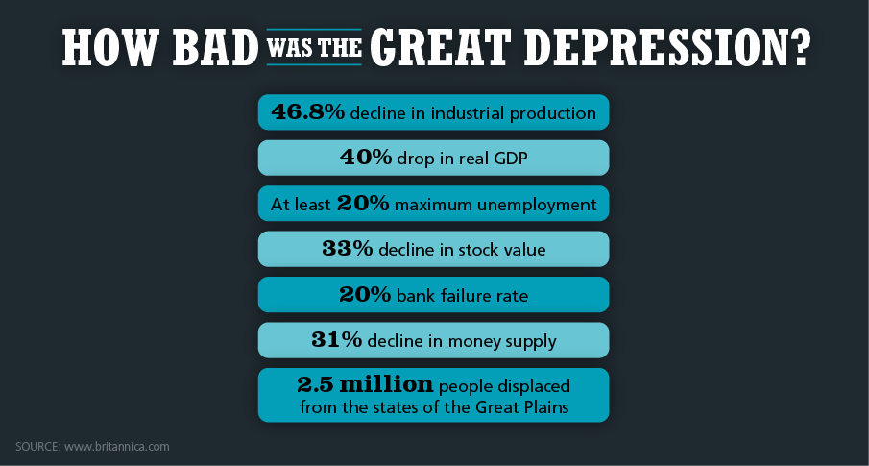
Classical Economics
Classical economics taught that a struggling economy would recover on its own. But the Great Depression lasted for many years. Analyze Data Why do you think the economy took so long to recover during the Great Depression?

Slide 7
Keynesian Economics
British economist John Maynard Keynes developed a new theory of economics to explain the Great Depression. Keynes presented his ideas in 1936 in a book called The General Theory of Employment, Interest, and Money. He wanted to develop a comprehensive explanation of macroeconomic forces. Such an explanation, he argued, should tell economists and politicians how to get out of economic crises like the Great Depression. In sharp contrast to classical economics, Keynes wanted to give government a tool it could use immediately to boost the economy in the short run. His theories have had a huge impact on the changing role of government in the U.S. free enterprise system.

Slide 8
Keynesian Economics
Keynes Versus Classical Economics
Changing Government’s Role in the Economy
Avoiding Recession
Keynes and Inflation
The Multiplier Effect
The Role of Automatic Stabilizers

Slide 9
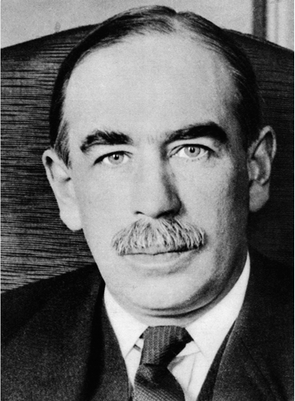
Keynesian Economics
Ideas put forth by British economic philosopher John Maynard Keynes have had a lasting impact on the free enterprise system.

Slide 10
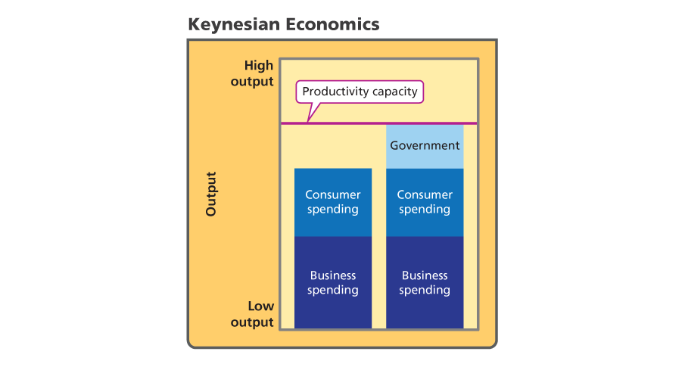
Keynesian Economics
Keynes sought to achieve the full productive capacity of the economy. Analyze Graphs According to Keynes, what could fill the gap between low output and full productive capacity?

Slide 11
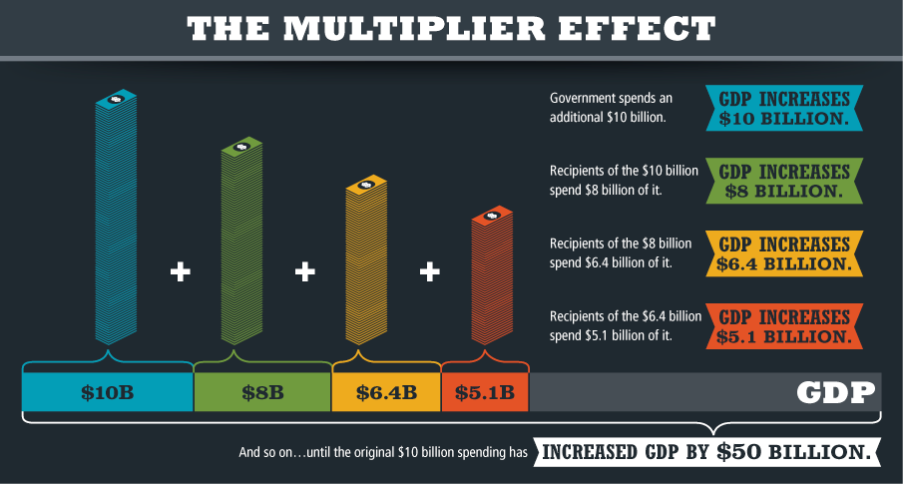
Keynesian Economics
The multiplier effect helps explain how government spending boosts the economy. Synthesize Explain how the multiplier effect supports Keynesian theory.

Slide 12
Supply-Side Economics
Another school of economic thought promotes a different direction for fiscal policy. Supply-side economics is based on the idea that the supply of goods drives the economy. Whereas Keynesian economics tries to encourage economic growth by increasing aggregate demand, supply-side economics relies on increasing aggregate supply. It does this by focusing on taxes. In recent years, supply-side economics has had a significant impact on the U.S. economy and free enterprise system.

Slide 13
Supply-Side Economics
Analyzing the Laffer Curve
The Relationship Between Taxes and Output

Slide 14
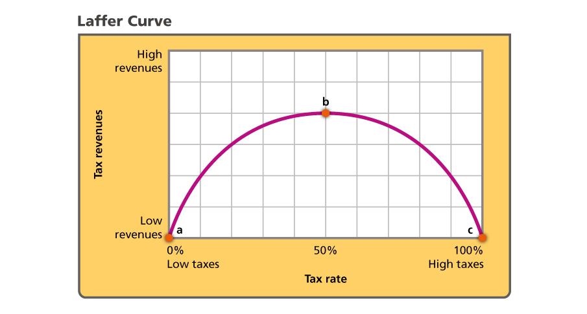
Supply-Side Economics
The Laffer curve shows the theoretical effect increasingly higher tax rates have on tax revenues. Analyze Graphs According to the Laffer curve, what do both a very high and a very low tax rate produce?

Slide 15
The Recent History of U.S. Fiscal Policy
As you recall, Keynes presented his ideas at a time when the world economy was engulfed in a severe economic downturn. President Herbert Hoover, a strong believer in classical economics, thought that the economy was basically sound and would return to equilibrium on its own, without government interference. His successor, President Franklin D. Roosevelt, was more willing to increase government spending to help boost the economy.

Slide 16
The Recent History of U.S. Fiscal Policy
World War II
Postwar Keynesian Policy
Supply-Side Policy in the 1980s
A Return to Keynes

Slide 17
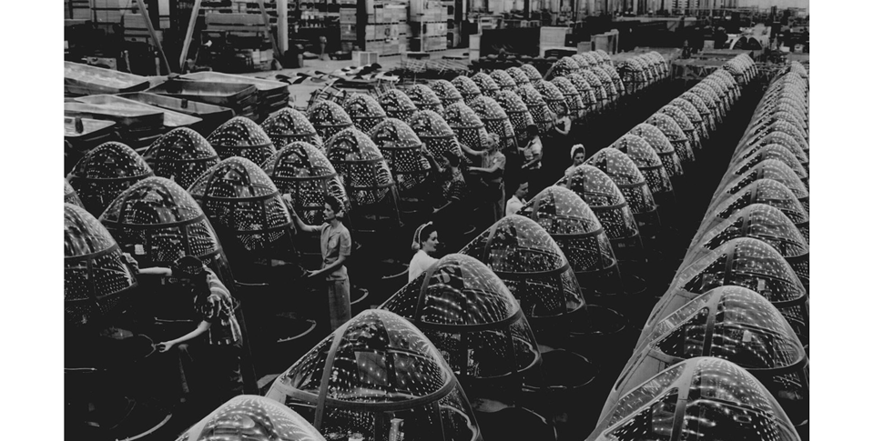
The Recent History of U.S. Fiscal Policy
Women workers during World War II complete the assembly of nose cones for attack bombers. Government spending funded factories like this one all across the United States.

Slide 18
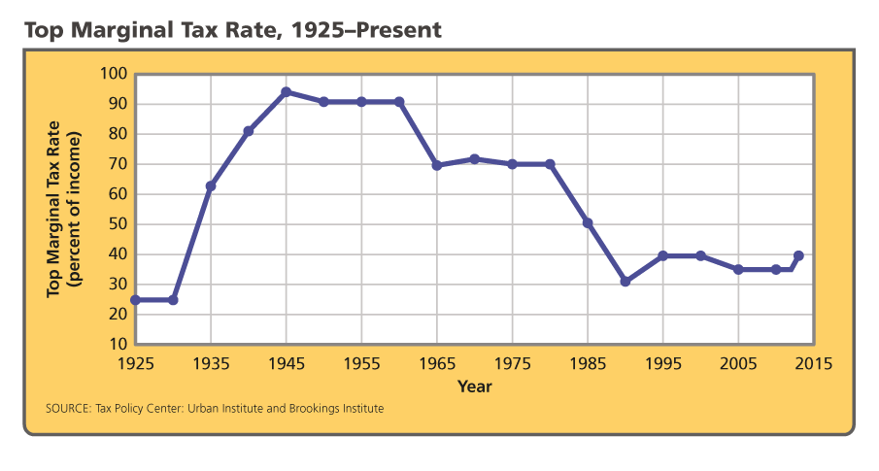
The Recent History of U.S. Fiscal Policy
The top marginal tax rates—rates affecting the highest incomes—have varied widely over the last century. Analyze Graphs What has been the general trend in the top marginal tax rate since 1945?

