Slide 1

Terrorism

Slide 2
What is terrorism?

Slide 3
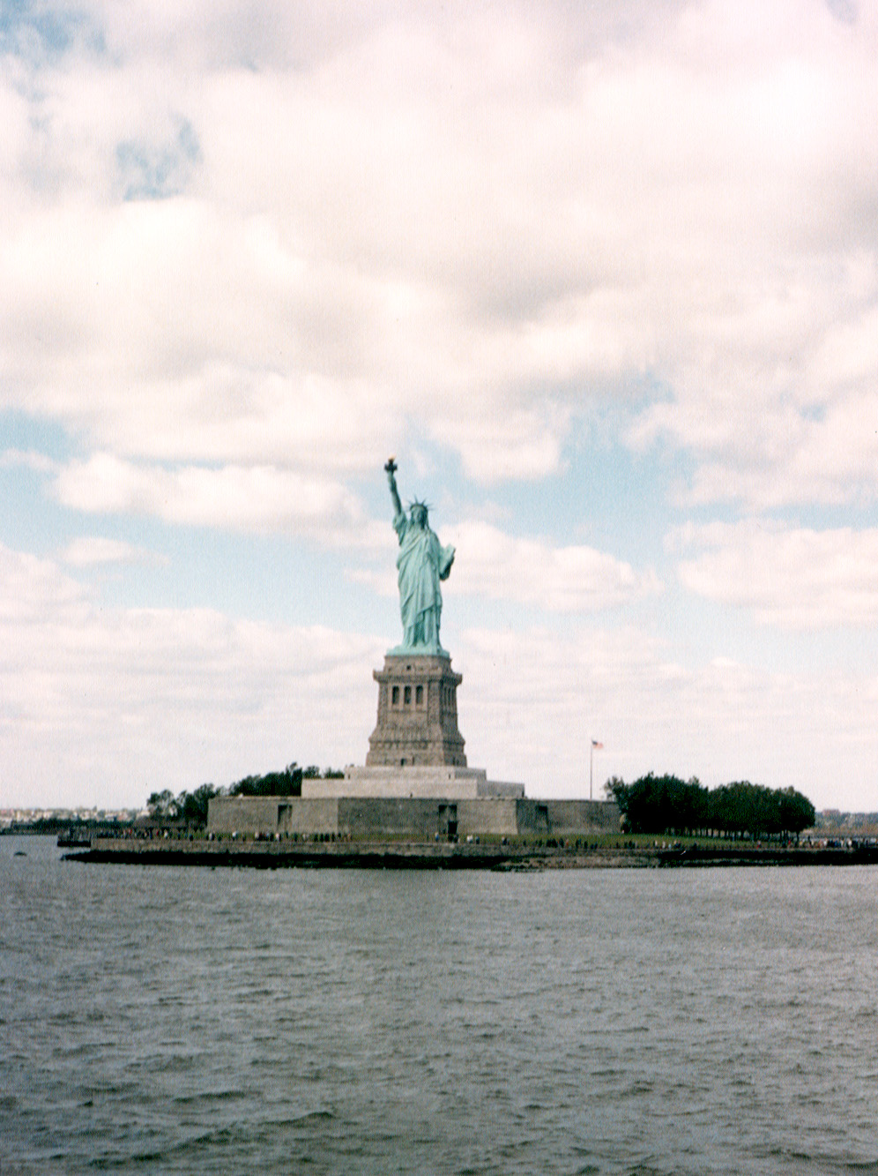
Definitions

Slide 4
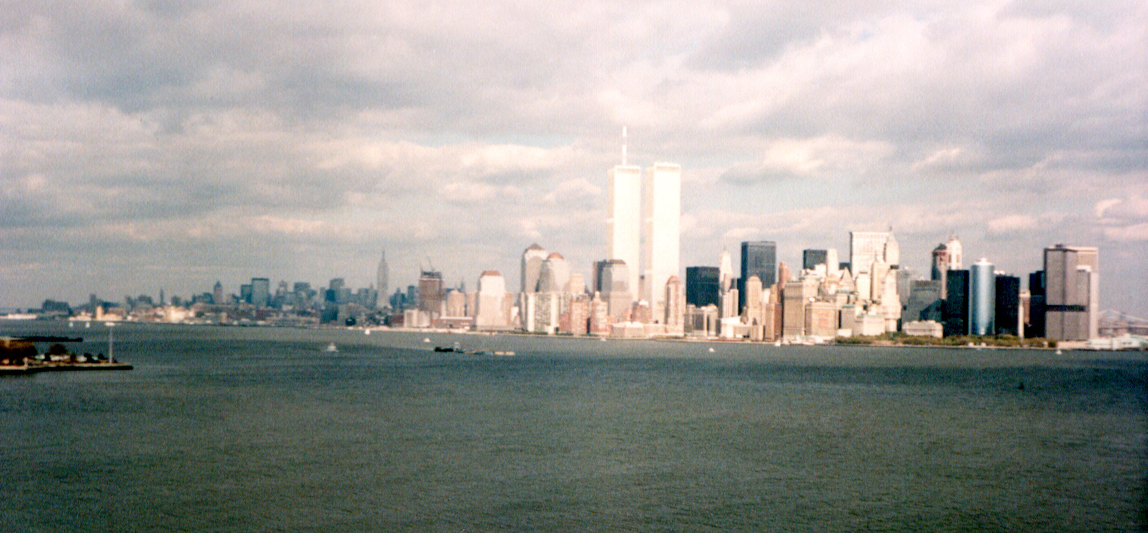
Encyclopedia Britannica
“The systematic use of terror (such as bombings, killings, and kidnappings) as a means of forcing some political objective. When used by a government, it may signal efforts to stifle dissent; used by insurrectionists or guerrillas, it many be part of an overall effort to effect desired political change.”

Slide 5
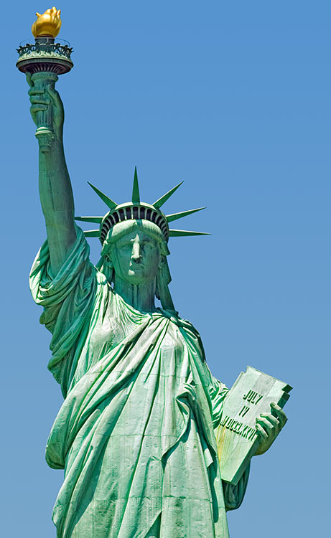
Federal Bureau of Investigation
“Terrorism is the unlawful use of force or violence against persons or property to intimidate or coerce a government, the civilian population, or any segment thereof, in furtherance of political or social objectives.”

Slide 6
League of Nations Convention (1937)
“All criminal acts directed against a State and calculated to create a state of terror in the minds of particular persons or group of persons or the general public.”

Slide 7

History of Terrorism

Slide 8
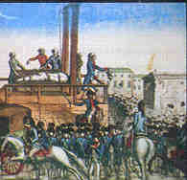
French Revolution
The term “terrorism” evolved during a phase of the French Revolution known as the “Reign of Terror”. From 1793 to 1794, one group of the Revolution used violent methods to weed out “traitors” and to spread “terror” throughout the country. In just 6 weeks, more than 1,300 people were guillotined in Paris alone.

Slide 9

Terrorism is on the rise in recent years.

Slide 10
Time Line
1995 Murrah Building bombed, Oklahoma City
Oklahoma
1997 Shopping mall bombed, Jerusalem Israel
1979 Diplomats held hostage, Tehran, Iran
1988, Pan Am #103 bombed, Lockerbie Scotland
1996, Truck bomb, Manchester England
1972 Israeli athletes taken hostage, Munich Germany
1984 Golden Temple seized, Amritsar India
1992
Two car bombs explode, Lima, Peru
1998
U. S. Embassies bomed,
Kenya and Tanzania
1995 Nerve gas released, Aum Shinrikyo
2001 Four airplanes hijacked and crashed, Washington, DC & New York City

Slide 11

Recent Terrorism
1970s
1972 Israeli athletes taken hostage, Munich Germany
1979 Diplomats held hostage, Tehran, Iran

Slide 12
Munich Olympics, 1972
11 Israeli athletes held hostage by Palestinians who demanded 235 prisoners in Israel released
Hostage situation televised to the world
Terrorists discovered the power of the media in spreading their actions with high-profile targets

Slide 13
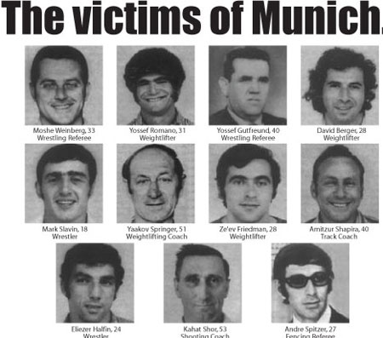

Slide 14
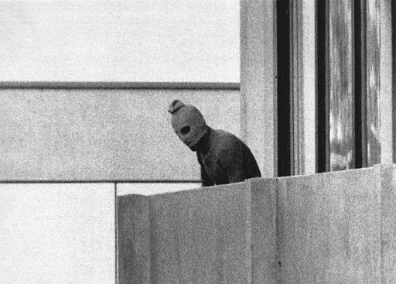
Terrorist’s picture that was broadcast around the world

Slide 15
Tehran Iran November, 1979
After exiled Shah was admitted into the U.S. for medical treatment, angry Iranian students seized the U.S. embassy in Tehran
79 American diplomats taken hostage.
13 hostages were released shortly thereafter
66 others were held for 444 days.

Slide 16
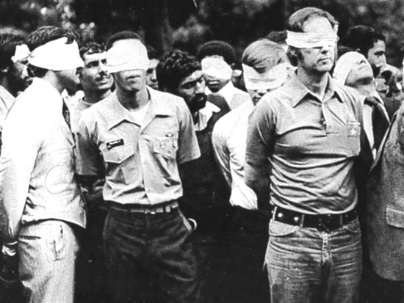

Slide 17
Recent Terrorism
1984
1984 Golden Temple seized, Amritsar, India

Slide 18
Amritsar India, June 1984
In an effort to establish an independent state, Sikh terrorists seized the Golden Temple in Amritsar, India.
Prime Minister Indoor Gandhi ordered a military campaign to drive out the terrorists.
Hundreds were killed.

Slide 19
Recent Terrorism
1988-1995
1995 Murrah Building bombed, Oklahoma City, OK
1993
World Trade Center Car Bomb Explosion
1988, Pan Am #103 bombed, Lockerbie, Scotland
1995 Nerve gas released, Aum Shinrikyo
1992 Two car bombs explode, Lima, Peru

Slide 20
Lockerbie Bombing/ Pan Am 103
December 21, 1988
Flight from London to New York, bomb exploded on board an hour into flight
Explosion separated nose section from rest of plane
All 259 people on board killed, along with 11 on ground in Lockerbie, Scotland (189 Americans, 35 were students from Syracuse University in NY)
2 different radical Islamist groups claimed responsibility

Slide 21
Libyan Involvement
In 1991, US & UK courts believed Libyan Abdelbaset al-Megrahi was man responsible
Libyan leader Muammar Gaddafi refused to extradite him
Al-Megrahi was found guilty in 2001
In January 2011, an ex-Libyan official said Gaddafi personally ordered bombing

Slide 22
Motives
In April 1986, a bomb exploded in a West Berlin nightclub frequented by US military, 3 killed, 230 injured
In response, the US bombed Libya, killing Gaddafi’s adopted daughter
US also supported Chad in its war against Libya

Slide 23
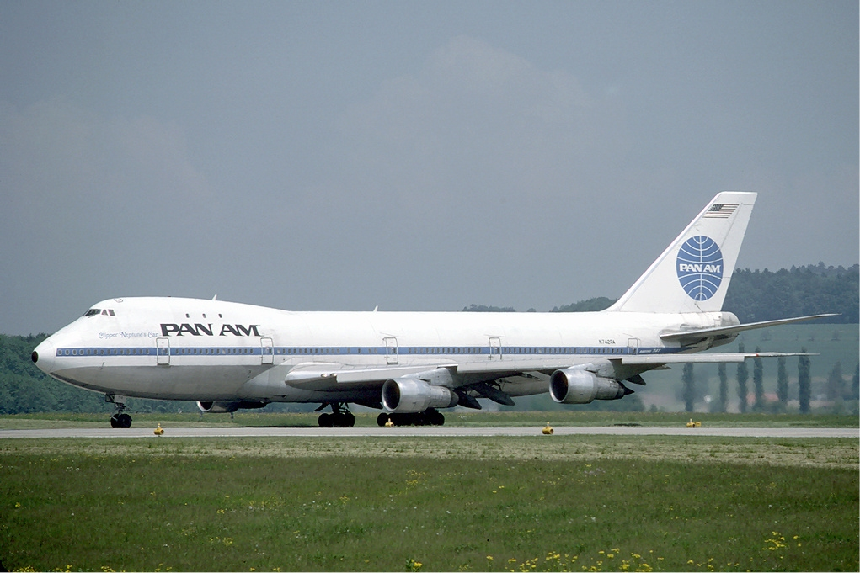
Bomb exploded under the P in Pan Am

Slide 24
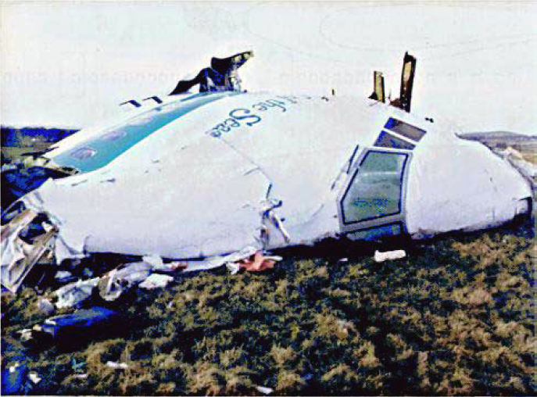
Nose section of flight 103

Slide 25
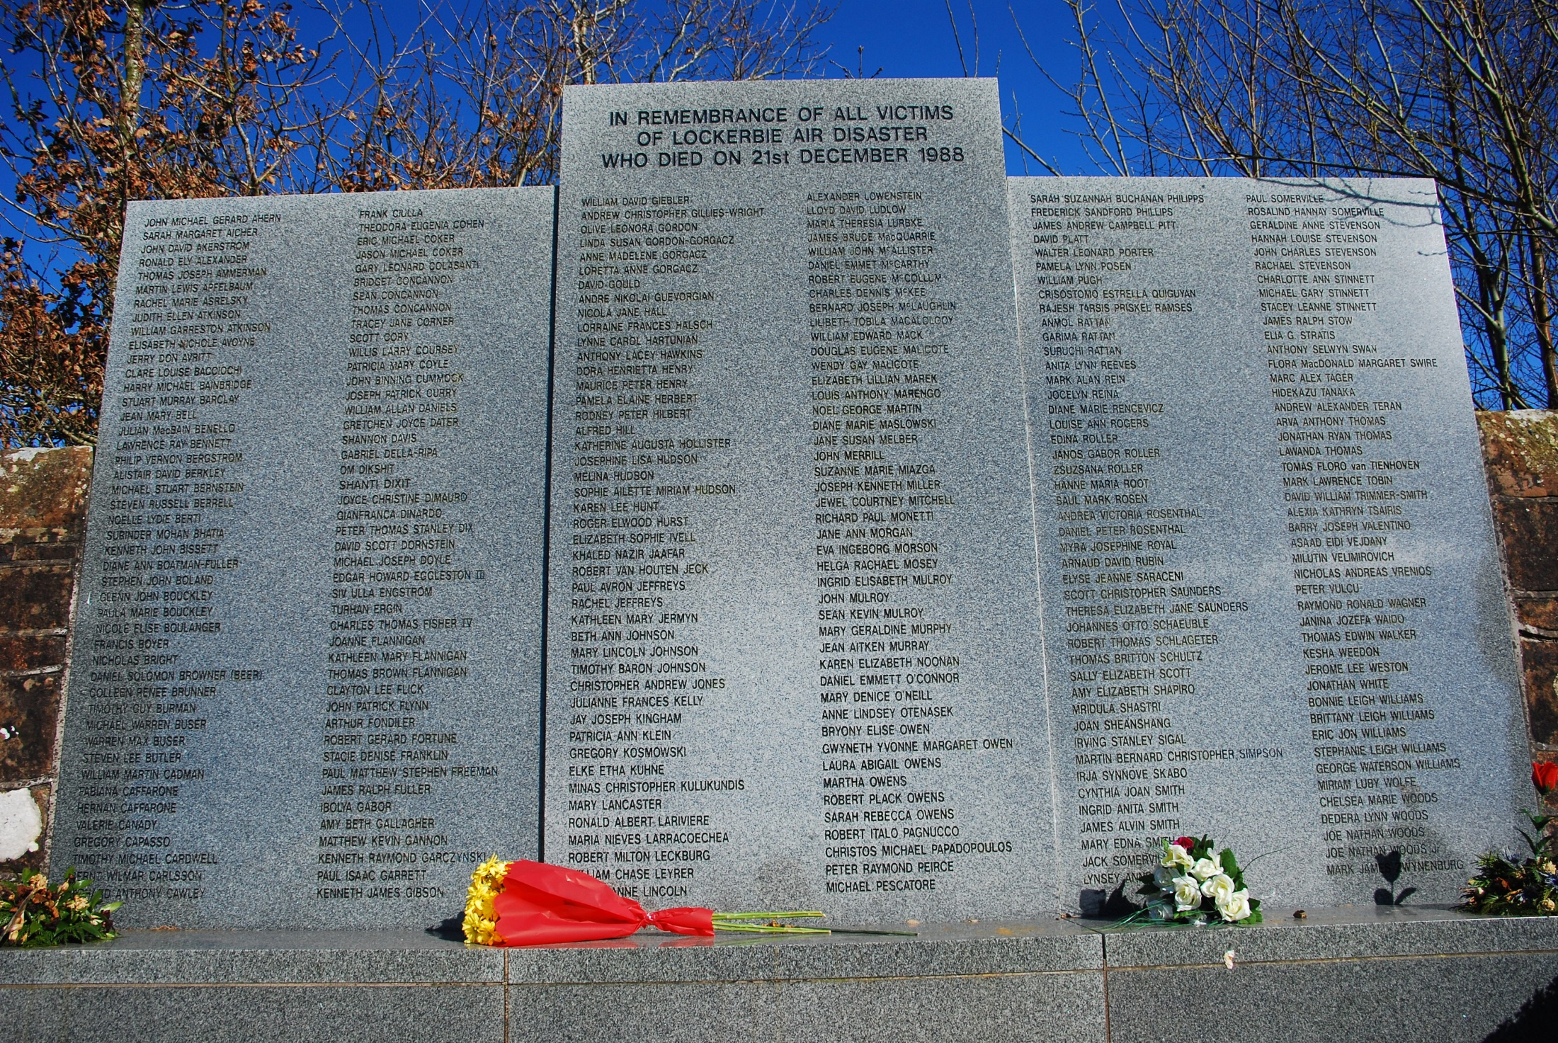

Slide 26
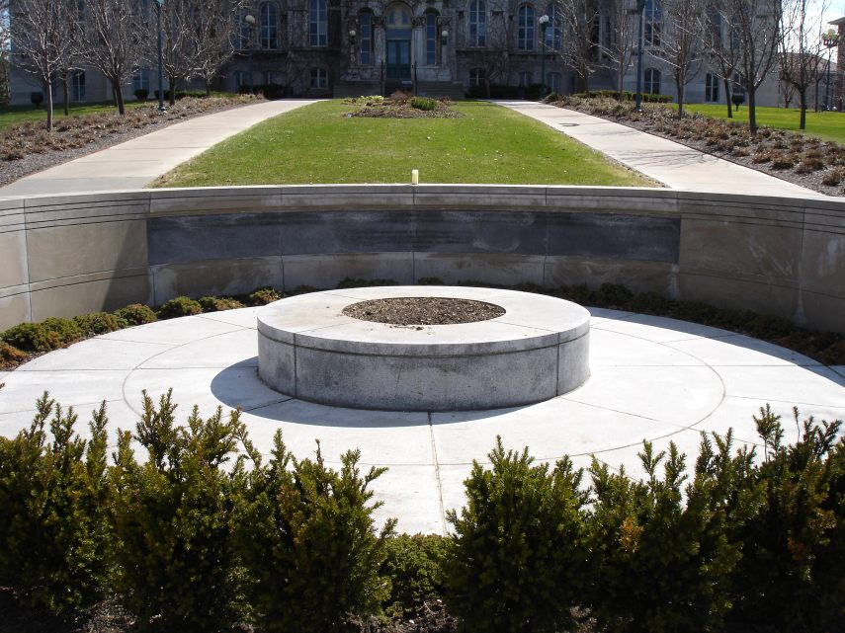
Memorial at Syracuse University in New York for the 35 students who were on their way home for Christmas break after spending the 1st semester studying abroad in London

Slide 27
Oklahoma City Bombing, April 1995
Murrah Federal Building
U.S. Army veteran Timothy McVeigh, hated the federal, detonated bomb in rental truck
Killed 168 people, including 19 kids under 6
Injured more than 680 other
Worst act of terrorism in U.S. until Sept 11th

Slide 28
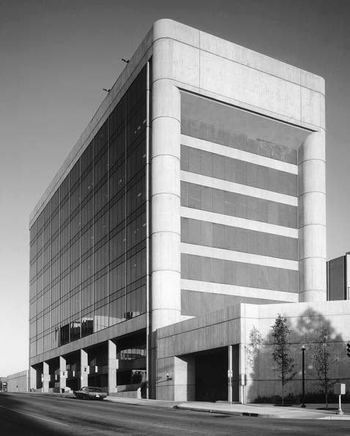
Murrah Federal Building before the bombing

Slide 29
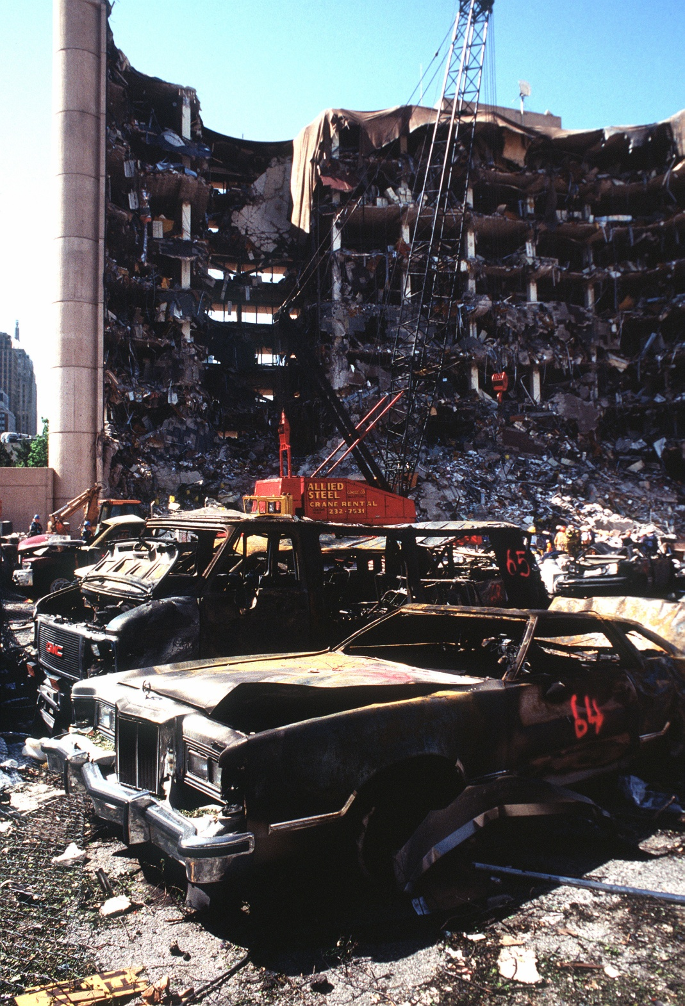

Slide 30
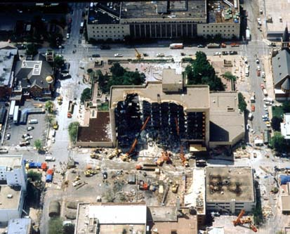

Slide 31
1993 World Trade Center Car Bomb
February 26 – truck bomb exploded in the North Tower of the World Trade Center
Ramzi Yousef claimed responsibility for the attack. He spent time at an al-Qaeda training camp in Afghanistan
  He said that this would be the first of many attacks on the WTC

Slide 32
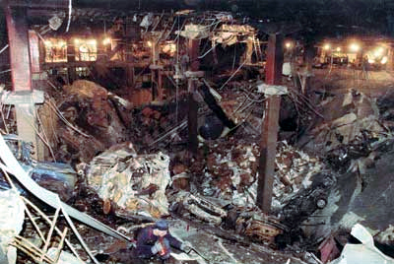
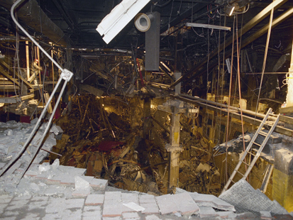
WTC Truck Bomb 1993 Damage

Slide 33
Recent Terrorism
1995-2001
1996, Truck bomb, Manchester, England
2001 Four airplanes hijacked & crashed, Washington, DC and New York City
1997 Shopping mall bombed, Jerusalem, Israel
1998 U. S. Embassies bombed, Kenya &Tanzania

Slide 34
New York City & Washington, D.C., USA
19 Islamist terrorists with al-Qaeda flew 2 planes into the World Trade Center in New York & 1 into the Pentagon in D.C.
Within 2 hours, Twin Towers collapsed
Almost 3,000 people from 80 countries killed

Slide 35
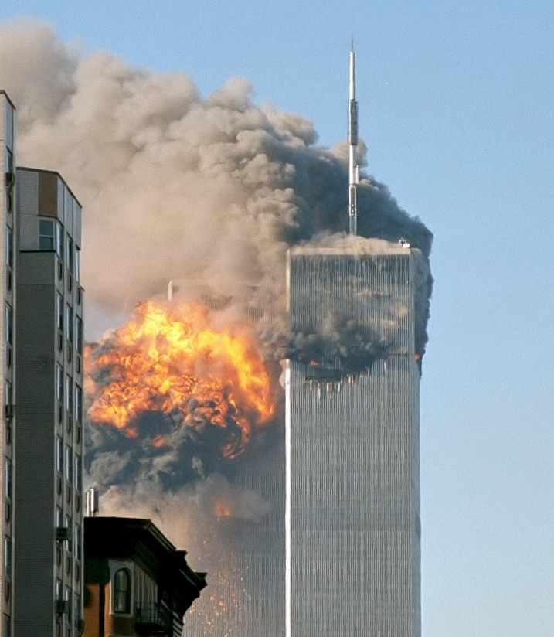

Slide 36
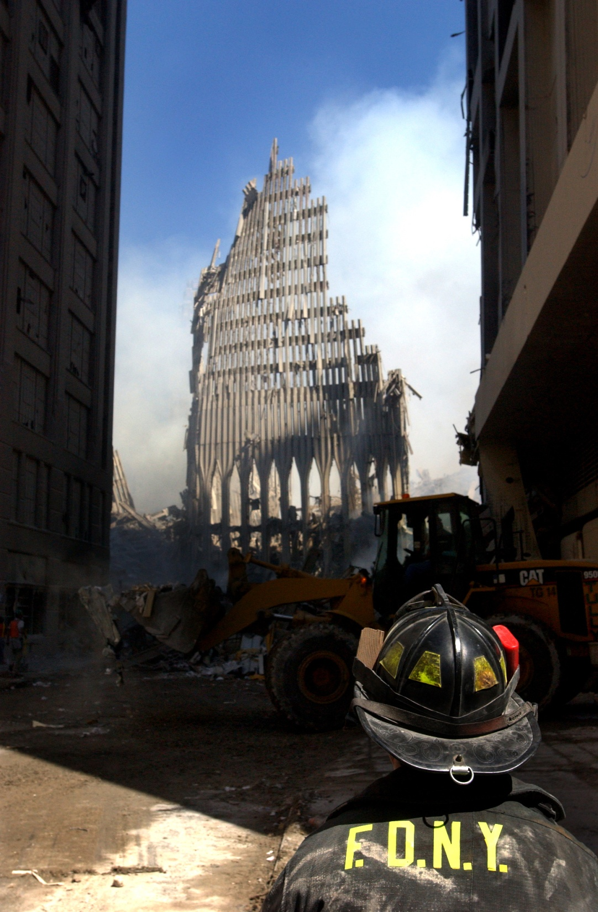

Slide 37
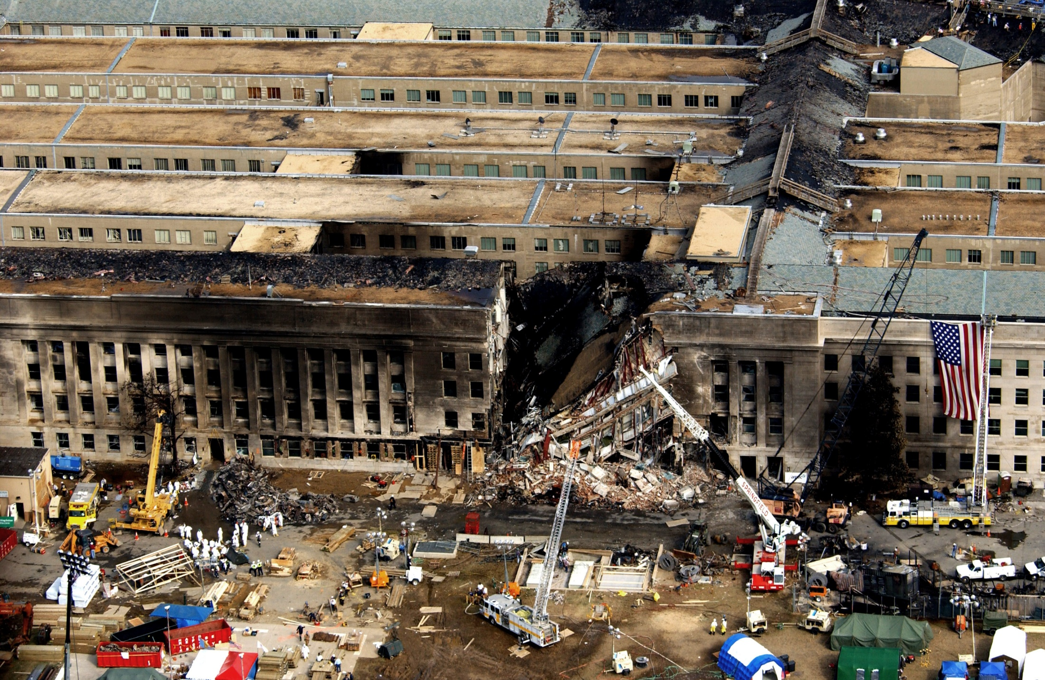

Slide 38
What can we do about Terrorism?

Slide 39

The spread of terrorism world wide must be stopped through education.
Education about the terrorist groups and why the terrorist incidents happen is crucial, so that these acts can be stopped before they happen.
People worldwide need to join together in not allowing these criminals to use intimidation as a means of achieving their goals.

