Slide 1
Afghanistan A Brief History…
“Where empires go to die”- Mike Malloy

Slide 2
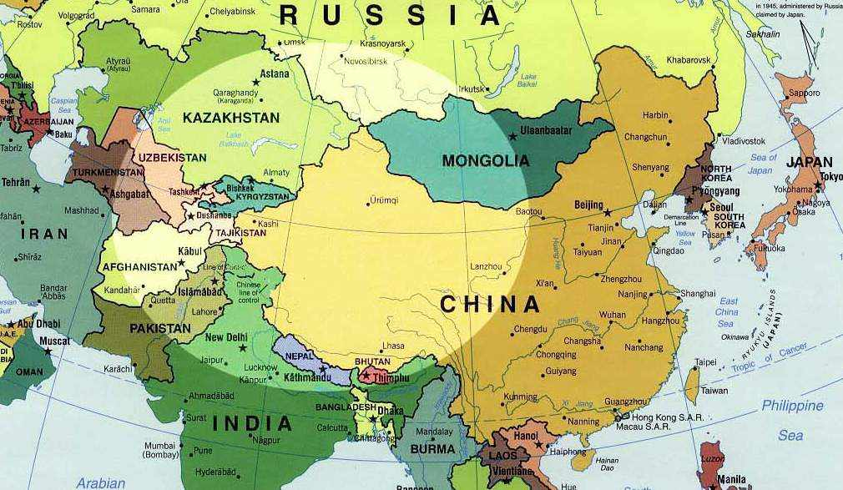
The “Great Game”
During the 19th century, Imperial Russia and the British Empire in India competed for control of Afghanistan

Slide 3
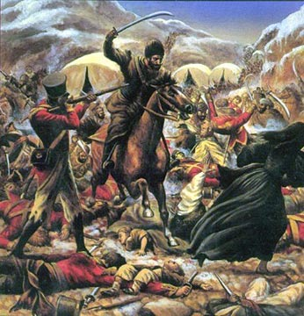
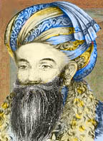
British Fight for Control
1838-42 - British forces invade, install King Shah Shujah. He is assassinated in 1842. British and Indian troops are massacred during retreat from Kabul.

Slide 4
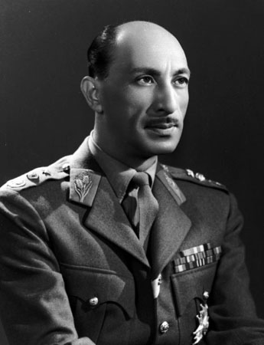
Afghans Fight for Independence
1933 - Zahir Shah becomes king and Afghanistan remains a monarchy for next four decades.

Slide 5
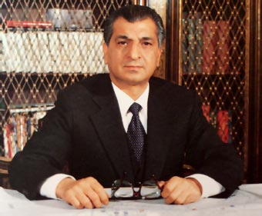
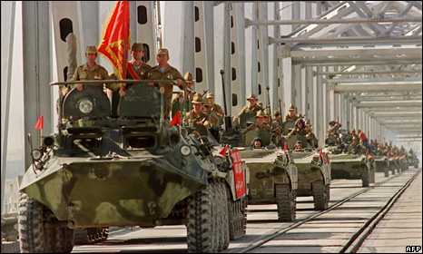
The Soviets Try to Control
1979 December - Soviet Red Army invades and props up communist government.
1980 - Babrak Karmal installed as ruler. He is a friend of the Soviet Union. Many Afghans want to be free from foreign control and fight back. This resistance is called Mujahideen or “struggle”.

Slide 6
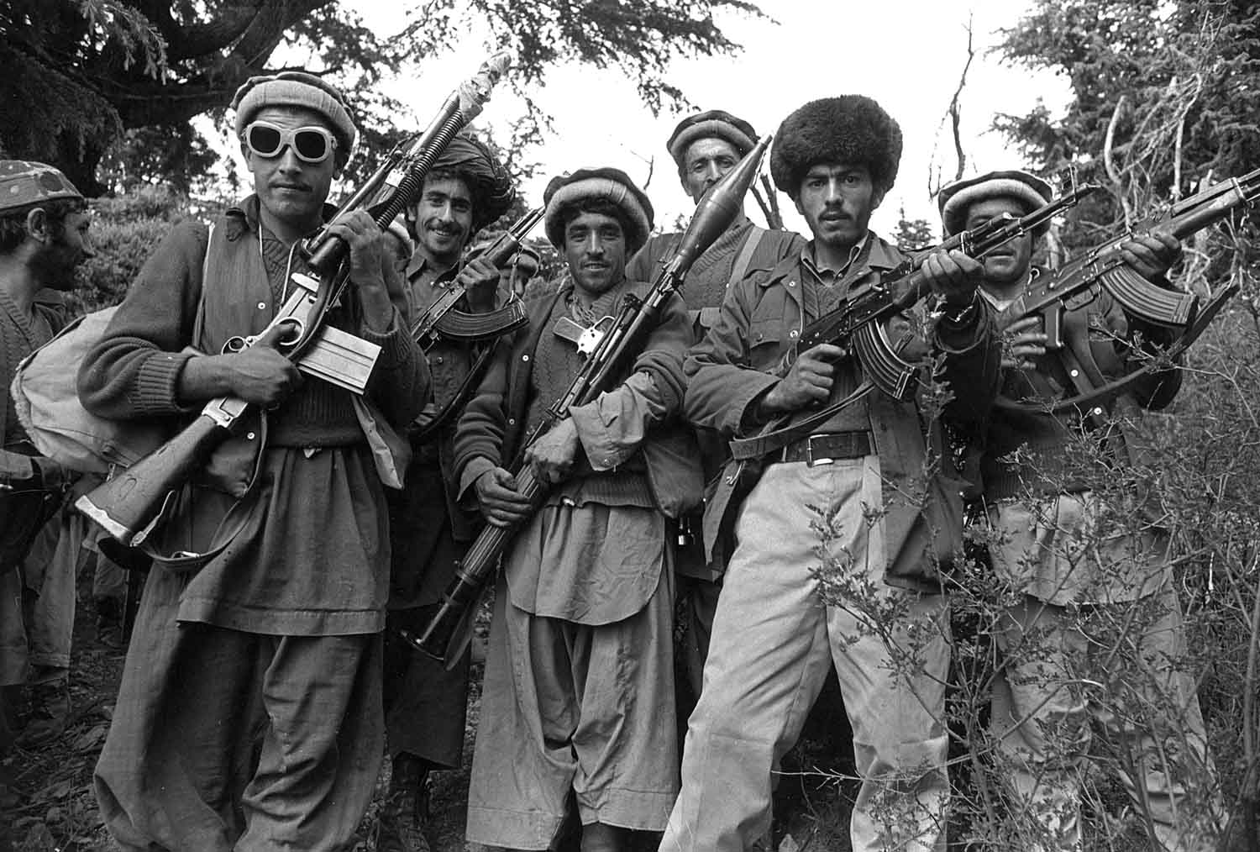
Mujahideen
The mujahideen were significantly financed, armed and trained by the United States Central Intelligence Agency (CIA) during the administrations of Jimmy Carter and Ronald Reagan
Remember, this is the during the Cold War. The US wanted to contain the spread of Communism

Slide 7
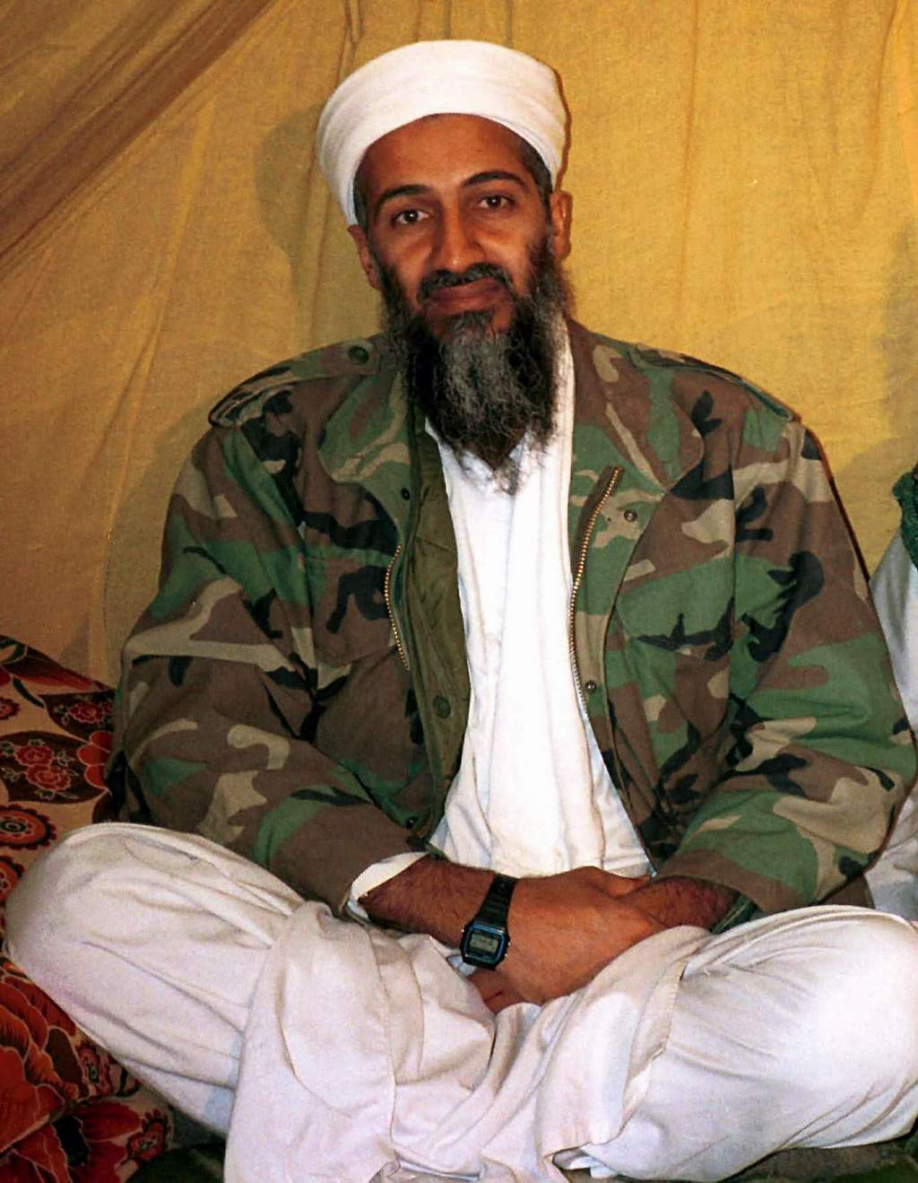
Mujahideen continued…
A wealthy Saudi Arabian was also heavily involved in organizing and funding Muslims fighting against the Soviets. His name was Osama bin Laden

Slide 8
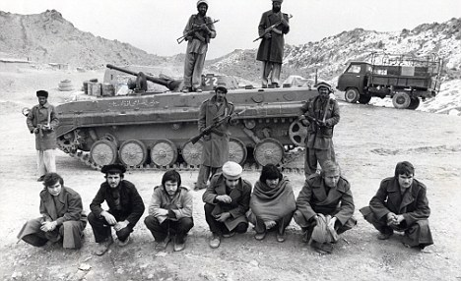
Mujahideen continued…
1989 - Last Soviet troops leave, but civil war continues as mujahideen push to control the new government

Slide 9
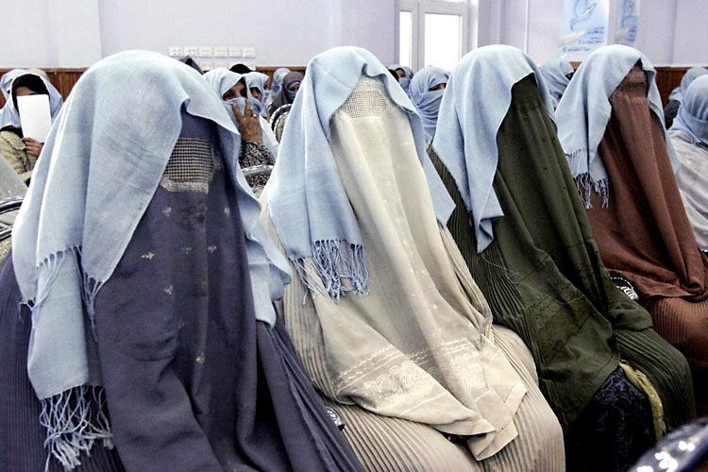
Taliban Come to Power
1996 - Taliban seize control of Kabul and introduce hard-line version of Islam, banning women from work, and introducing Islamic punishments, which include stoning to death and amputations.

Slide 10
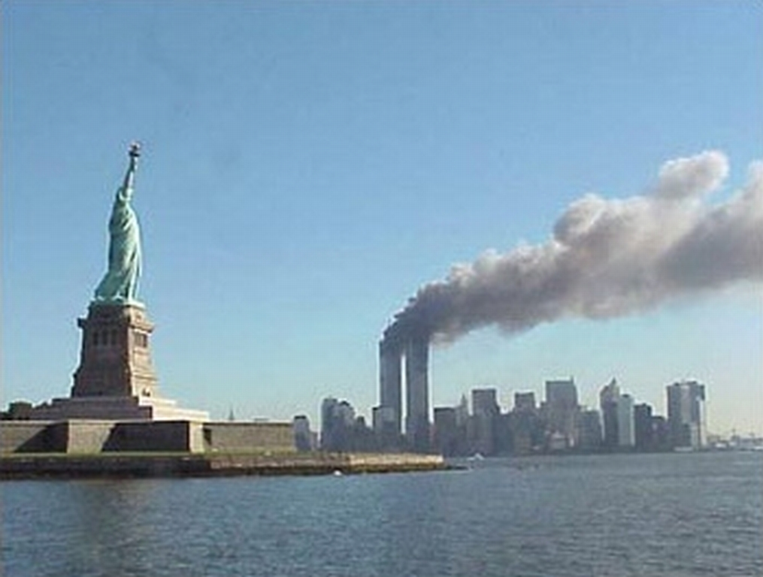
The United States Gets Involved
2001 October - US-led bombing of Afghanistan begins following the September 11 attacks on the United States. Anti-Taliban Northern Alliance forces enter Kabul shortly afterwards.

Slide 11
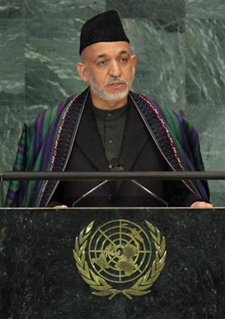
US Involvment continued…
2002 June - Loya Jirga, or grand council, elects Hamid Karzai as interim head of state. Karzai picks members of his administration which is to serve until 2004.
2004 October-November - Presidential elections. Hamid Karzai is declared winner and is still currently president.

Slide 12
US Involvment continued…

Slide 13
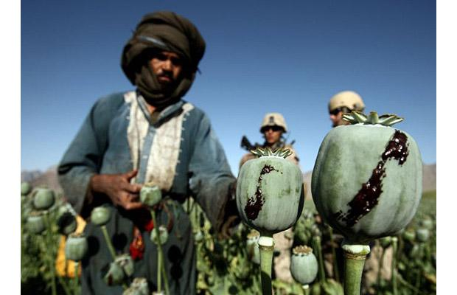
US Involvment continued…
2007 August - Opium production in Afghanistan has soared to a record high, the UN reports.
Many Afghans see Karzai and his US-backed government as corrupt.

Slide 14
Longest Running War in US History
US goals in Afghanistan include:
Remove the Taliban from power
Disrupt Al-Qaeda terrorist network that was responsible for 9-11
Capture/Kill Osama bin Laden
Establish a democratic state that can be responsible for it’s own security

Slide 15
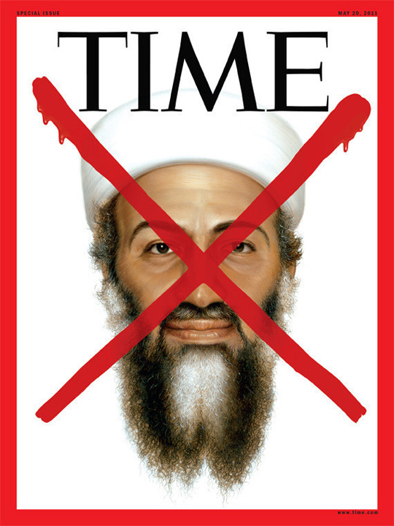
The US Eventually Found Him…
May 1st 2011, Osama bin Laden was killed by a group of 25 Navy SEALS in a mansion located just miles away from Pakistan’s most prestigious military academy.

Slide 16
Costs of US War in Afghanistan
http://costofwar.com/en/
http://icasualties.org/oef/
Source-BBC, ABC News

Slide 17
http://www.pbs.org/wgbh/pages/frontline/opium-brides/
Ch.18 sec.5 and Ch.20 sec.4 deal with Central Asia and Terrorism respectively.

