Slide 1
Détente: Thawing of Cold War Tensions

Slide 2
The Soviet-Chinese Split
In 1950, Mao and Stalin sign friendship treaty, but tensions grow
• Chinese and Soviets each want to lead world
communism
• Khrushchev ends economic aid and refuses to
share nuclear secrets

Slide 3
Brinkmanship Breaks Down
Brinkmanship: going to the brink (edge) of war
Brinkmanship causes repeated crises; nuclear
war a constant threat

Slide 4
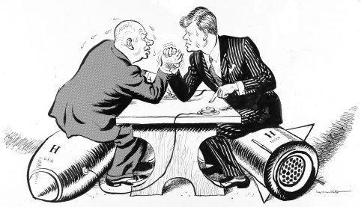
Khrushchev & Kennedy

Slide 5
The United States Turns to Détente
Vietnam-era turmoil fuels desire for less
confrontational policy
• Détente—policy of reducing Cold War tensions to avoid conflict
• Richard M. Nixon—U.S. president who launches détente

Slide 6
Nixon Visits Communist Powers
Nixon visits Communist China and Soviet Union, signs SALT I Treaty
• SALT—Strategic Arms Limitation Talks—limit nuclear weapons

Slide 7
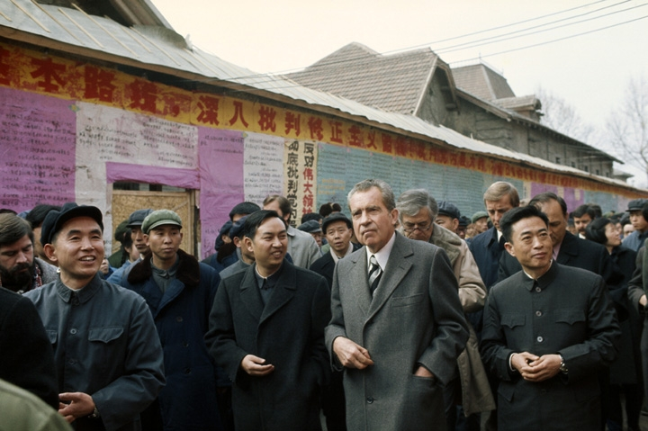
Nixon in China

Slide 8
Soviets Invade Afghanistan
Soviets invade Afghanistan in 1979, seek to make it part of empire
• Rebels forces form mujahideen to fight Communist rule, backed by the U.S.

Slide 9
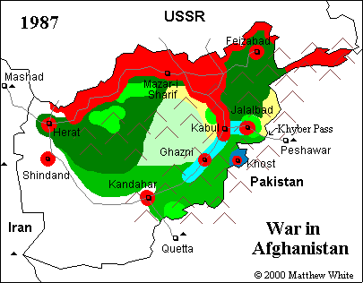

Slide 10
The Collapse of Détente
• Congress will not ratify SALT II due to Soviet invasion of Afghanistan

Slide 11
Reagan Takes an Anti-Communist Stance
• Ronald Reagan—anti-Communist U.S. president takes office in 1981
• Increases military spending
• In 1985, new Soviet leadership allows easing of Cold War tensions

Slide 12
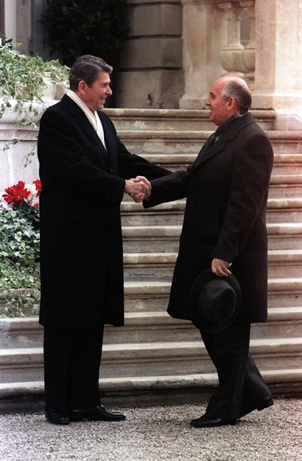
U.S. President Ronald Reagan & Soviet Leader Mikhail Gorbachev

