Slide 1
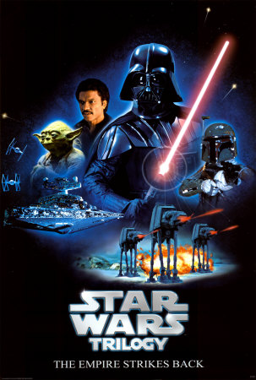
Empire Building in the 1930’s

Slide 2
Japan
Manchuria, 1931
wanted an empire like European countries
Rest of China, 1937
Rape of Nanking, December 1937
Japanese army looted the city, raped & tortured thousands and killed 300,000

Slide 3
Japan con’t
Southeast Asia, 1940- 42
When Europe went to war in 1939, saw chance to take European & American colonies here
Wanted resources, particularly oil & rubber

Slide 4
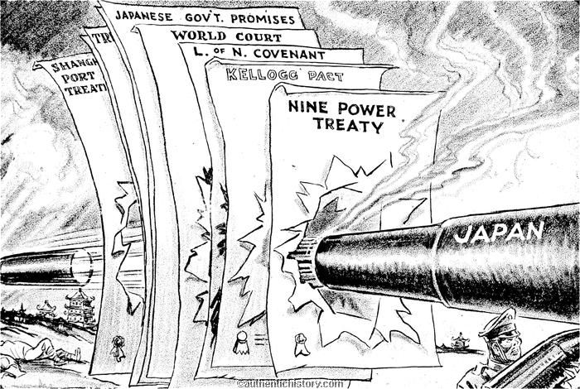

Slide 5
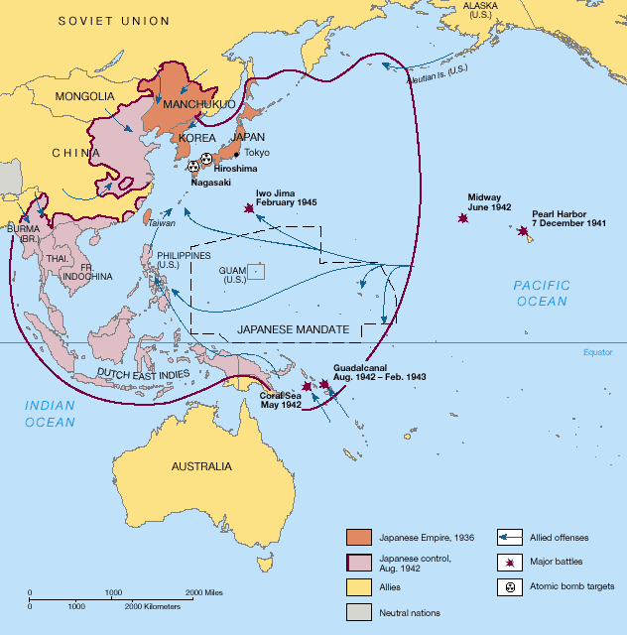

Slide 6
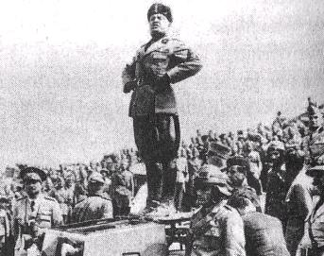
Italy
Ethiopia, 1935
Mussolini wanted to use his new military & thought Italy needed an empire to be an important country

Slide 8
Germany
“Living space” (Lebensraum) & Nationalism
Hitler thought Germany should expand into Eastern Europe & remove the Slavs
He thought Slavs were sub-human
Thought all German people should be in the Third Reich (Nazi Germany)

Slide 9
Austria, March 1938
unified Austria with Germany, the Anschluss
violated the Treaty of Versailles
Sudetenland, September 1938
3 millions Germans lived in this area of Czechoslovakia
Hitler told France & Britain this was all he wanted, they appeased him (give into the demands of an aggressor)

Slide 10
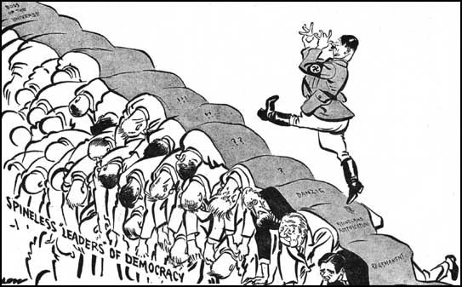

Slide 12
Germany, con’t
Czechoslovakia, March 1939
Hitler took the rest 6 months later
Nazi-Soviet Pact, August 1939
Non-aggression treaty, neither would fight if the other went to war
Secretly, it divided Poland between the two countries

Slide 13
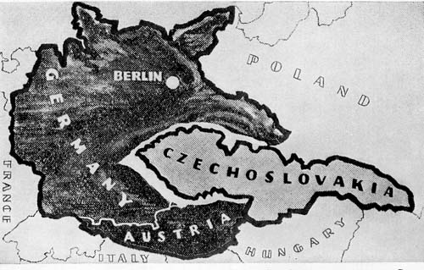

Slide 15
“Wonder how long the honeymoon will last?”

