Slide 1
Results
of
World War II

Slide 2
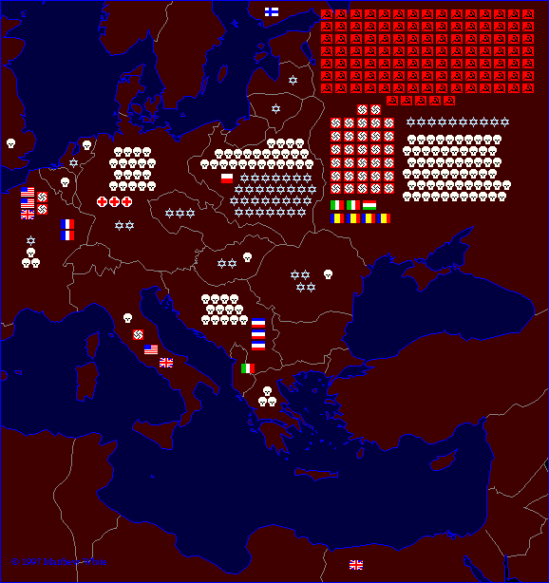
WWII Casualties: Europe
Each symbol indicates 100,000 dead in the appropriate theater of operations

Slide 3
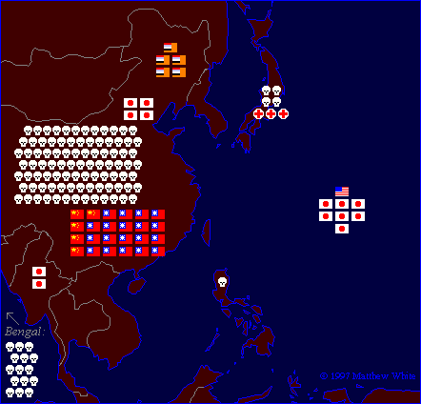
WW II Casualties: Asia
Each symbol indicates 100,000 dead in the appropriate theater of operations

Slide 4
WW II Casualties
Military
Civilian
USSR
13,600,000
7,000,000
Germany
4,800,000
500,000
Japan
1,200,000
600,000
Yugoslavia
400,000
1,300,000
USA
300,000
6,000
Poland
300,000
4,200,000

Slide 5
Country | Men in war | Battle deaths | Wounded
Australia | 1,000,000 | 26,976 | 180,864
Austria | 800,000 | 280,000 | 350,117
Belgium | 625,000 | 8,460 | 55,513¹
Brazil² | 40,334 | 943 | 4,222
Bulgaria | 339,760 | 6,671 | 21,878
Canada | 1,086,343⁷ | 42,042⁷ | 53,145
China³ | 17,250,521 | 1,324,516 | 1,762,006
Czechoslovakia | — | 6,683⁴ | 8,017
Denmark | — | 4,339 | —
Finland | 500,000 | 79,047 | 50,000
France | — | 201,568 | 400,000
Germany | 20,000,000 | 3,250,000⁴ | 7,250,000
Greece | — | 17,024 | 47,290
Hungary | — | 147,435 | 89,313
India | 2,393,891 | 32,121 | 64,354
Italy | 3,100,000 | 149,496⁴ | 66,716
Japan | 9,700,000 | 1,270,000 | 140,000
Netherlands | 280,000 | 6,500 | 2,860
New Zealand | 194,000 | 11,625⁴ | 17,000
Norway | 75,000 | 2,000 | —
Poland | — | 664,000 | 530,000
Romania | 650,000⁵ | 350,000⁶ | —
South Africa | 410,056 | 2,473 | —
U.S.S.R. | — | 6,115,000⁴ | 14,012,000
United Kingdom | 5,896,000 | 357,116⁴ | 369,267
United States | 16,112,566 | 291,557 | 670,846
Yugoslavia | 3,741,000 | 305,000 | 425,000
WW II Casualties
Civilians only.
Army and navy figures.
Figures cover period July 7, 1937 to Sept. 2, 1945, and concern only Chinese regular troops. They do not include casualties suffered by guerrillas and local military corps.
Deaths from all causes.
Against Soviet Russia; 385,847 against Nazi Germany.
Against Soviet Russia; 169,822 against Nazi Germany.
National Defense Ctr., Canadian Forces Hq., Director of History.

Slide 6
WWII Costs in Billions of $
United States: $338
Germany: $272
Soviet Union: $192
Great Britain: 112
Italy: 94
Japan: 56
Total cost to all nations: $1.1 trillion

