Slide 1
Causes and effects of WWI on the Home Fronts

Slide 2
Quick recap of what's happening

Slide 3
2. Militarism & Arms Race
Total Defense Expenditures for the Great Powers [Ger., A-H, It., Fr., Br., Rus.] in millions of £s.
1870 | 1880 | 1890 | 1900 | 1910 | 1914
94 | 130 | 154 | 268 | 289 | 398
 | 1910-1914 Increase in Defense Expenditures
France | 10%
Britain | 13%
Russia | 39%
Germany | 73%

Slide 4
1. The Alliance System
Triple Entente:
Triple Alliance:

Slide 5
Two Armed Camps!
Allied Powers:
Central Powers:

Slide 6
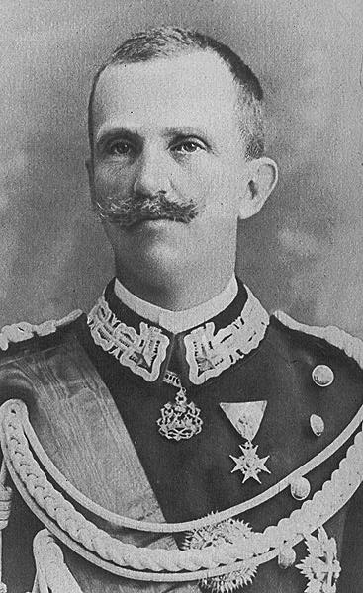
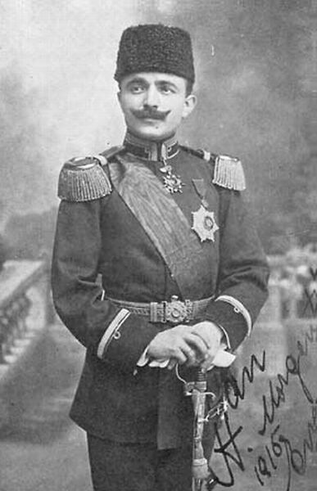
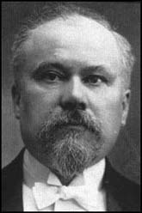
The Major Players: 1914-17
Allied Powers:
Central Powers:
Nicholas II [Rus]
Wilhelm II [Ger]
George V [Br]
Victor Emmanuel II [It]
Enver Pasha [Turkey]
Pres. Poincare [Fr]
Franz Josef [A-H]

Slide 7
3. Economic & Imperial Rivalries

Slide 8
Europe in 1914

Slide 9
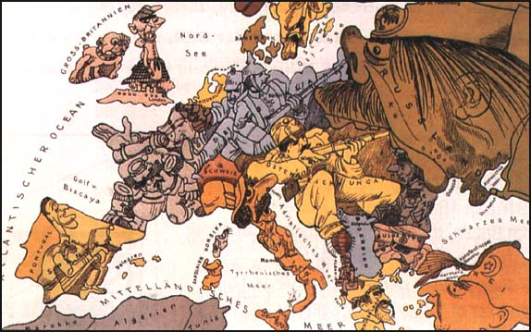
4. Aggressive Nationalism

Slide 10
The Schlieffen Plan

Slide 11
Nationalism & Mobilization
Home by Christmas!
No major war in 50 years!
Nationalism!
It's a long way to Tipperary,
It's a long way to go;
It's a long way to Tipperary,
To the sweetest girl I know!
Goodbye, Piccadilly,
Farewell, Leicester Square,
It's a long, long way to Tipperary,
But my heart's right there!

Slide 12
The M.A.N.I.A of WWI!
Militarism
Alliances (Both Open & Secret)
Nationalism
Imperialism (and Industrial Revolution)
Assassination (F. Ferdinand in Sarajevo)

Slide 13
Total War

Slide 14
Definition of “Total War”
All able members of society working for the war effort.

Slide 15
Government Responsibilities
Find needs of the war and fill them
Direct war effort by…
Paying companies to build materials
Obtain the materials and labor if needed
Govt. also directs rations and requirements to society
What kind of examples can you think of?

Slide 16
Financing the War

Slide 17
Munitions Workers

Slide 18
French Women Factory Workers

Slide 19
German Women Factory Workers

Slide 20
Societal Responsibilities
Working people must work in a job that supports the war or the society.
Teachers, police and fire, medical, etc.
Civilian volunteers help however possible.
Women knitted socks and beanies.
Organized the gathering of resources!
What sort of things could civilians organize?

Slide 21
Red Cross Nurses

Slide 22
Women in the Army Auxiliary

Slide 23
Russian Women Soldiers

Slide 24
Rationing Responsibilities
Food controlled by Govt. Like what?
Meat, milk, coffee, tobacco, sugar, shoes, clothing, gas, rubber, cars, steel, etc.
Given tickets for when to buy items based on family size. No discounts!
Govt. promoted “Liberty gardens” to free up resources.
Because of Govt. control, some items don’t get produced. What would be sacrificed?

Slide 25
Working in the Fields

Slide 26
The “Colonial” Fronts

Slide 27
Colonial Contributions
Empires expected their colonists to serve.
Some volunteered, others were drafted.
Service did not mean equal rights afterward.
How would this affect peoples’ ideas of fairness and equality when thinking about those who enlisted them i.e. the empires?
What could potentially happen in the long-term future?

Slide 28
Sikh British Soldiers in India

Slide 29
Fighting in Africa
Black Soldiers in the German Schutztruppen [German E. Africa]
British Sikh Mountain Gunners

Slide 30
Fighting in Africa
3rd British Battalion, Nigerian Brigade

Slide 31
Fighting in Salonika, Greece
French colonial marine infantry from Cochin, China - 1916

Slide 32
A Young Australian Recruit

Slide 33
Recruits of the Central Powers
A German Soldier Says Farewell to His Mother
Austro-Hungarians

Slide 34
New French Recruits

Slide 35
A German Boy Pretends to Be a Soldier

Slide 37
What products did women produce from rationing?

Slide 38
French Renault Tank

Slide 39
British Tank at Ypres

Slide 40
U-Boats

Slide 41
The Airplane
“Squadron Over the Brenta” Max Edler von Poosch, 1917

Slide 42
Looking for the “Red Baron?”

Slide 43
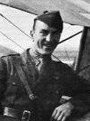
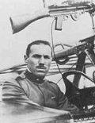
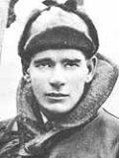
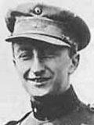
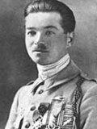
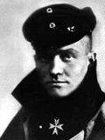
The Flying Aces of World War I
Eddie Rickenbacher, US
Francesco Barraco, It.
Eddie “Mick” Mannoch, Br.
Rene Pauk Fonck, Fr.
Manfred von Richtoffen, Ger. [The “Red Baron”]
Willy Coppens de Holthust, Belg.

Slide 44
Curtis-Martin U. S. Aircraft Plant

Slide 45
The Zeppelin

Slide 46
Flame Throwers
Grenade Launchers

Slide 47
Poison Gas
Machine Gun

