Slide 1
Daily POV
“Give me enough medals, and I’ll win any war.”
-Napoleon Bonaparte

Slide 2
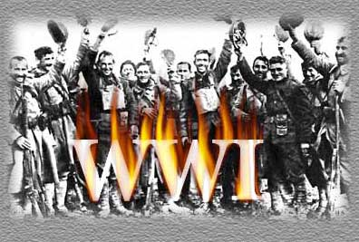

Slide 3
Inevitability of war
June 28, 1914 Archduke Francis Ferdinand of Austria assassinated
July 5, 1914 Germany issues A-H “blank check”
pledging military assistance if A-H goes to war against Russia
July 23, 1914 Austria issues Serbia an ultimatum

Slide 4
1914 – 1915 Illusions and Stalemate
Many Europeans were excited about war
“Defend yourself against the aggressors”
Domestic differences were put aside

Slide 5
1914 – 1915 Illusions and Stalemate
War would be over in a few weeks
Ignored the length and brutality of the American Civil War
(prototype to World War I)

Slide 6
1914 – 1915 Illusions and Stalemate
Belief that modern industrial war could not be conducted for more than a few months
“Home by Christmas”

Slide 7
1914 – 1915 Illusions and Stalemate
“Fatal attraction of war”
Exhilarating release from every day life
A glorious adventure
War would rid the nations of selfishness
Spark a national re-birth based on heroism

Slide 8
The Schlieffen Plan’s Destructive Nature

Slide 9
The Schlieffen Plan
Invade western front 1st
After defeating France concentrate on the Eastern front
Avoid fighting a 2 front war

Slide 10
The Schlieffen Plan’s Destructive Nature
Germany made vast encircling movement through Belgium to enter Paris
Underestimated speed of the British mobilization
Quickly sent troops to France

Slide 11
The Battle of Marne
Sept 5-12, 1914
After 7 day a stalemate emerges
British entry stalled the Plan
Beginnings of the Western Front

Slide 12
The Trenches

Slide 13
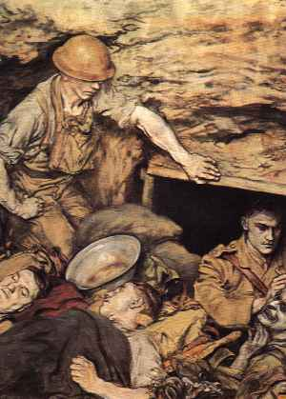

Slide 15
Life in the Trenches
Elaborate systems of defense
barbed wire
Concrete machine gun nests
Mortar batteries
Troops lived in holes underground

Slide 16
Life in the Trenches
Horrible Conditions
Constant noise and fear
Trench rot
No facilities
Rats routinely ate the dead
Swampy, disgusting conditions

Slide 17
Life in the Trenches
Trench warfare baffled military leaders
Attempt a breakthrough
Enemy fends off attack
Millions of young men sacrificed trying to breakthrough

Slide 18
The Eastern Front
Russian army moved into Eastern Germany on Aug 30, 1914
Defeated
The Austrians kicked out of Serbia
Italy attacked Austria in 1915
G. came to Austrian aid, pushed Russians back 300 miles into own territory

Slide 19
The Eastern Front
Much more mobile than the West
But loss of life still very high
1915: 2.5 million Russians killed, captured, or wounded

Slide 20
Battle of Tannenberg
Russian forces not ready (Little supplies, poor leadership)
Entire Russian 2nd army destroyed
Aug 23-31, 1914
125,000 Russians perish; only 13,000 Germans

Slide 21
“Death is everywhere”
“We all had on us the stench of dead bodies.” Death numbed the soldier’s minds.
Shell shock
Psychological devastation

Slide 22
“Death is everywhere”
Mustard gas
Carried by the wind
Burned out soldier’s lungs
Deadly in the trenches where it would sit at the bottom

Slide 23
Battle of Verdun
Feb 20- Dec 15, 1916
France v. Germany
GER bombed Verdun for 24 hours
Hoped to force FRA to surrender
July: FRA pushed GER back

Slide 24
Battle of Verdun Importance
French casualties reached 315,000
German deaths were 285,000
Very little accomplished except a huge loss of life.
Became a symbol of French resistance

Slide 25
Battle of Verdun

Slide 26
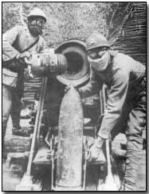
The changes of war
New weapons crippled the “frozen front”
Poison gas (mustard gas)
Hand grenades
Flame throwers
Tanks
Airplanes
Tanks
Subs

Slide 27
Battle of Somme
Attempt to move Germans out of Verdun
Massive #’s of casualties
Results…(July1-Nov18, 1916)
Germans forced from Verdun
GBR & FRA lose over 615,000
British lose 60,000 in one day

Slide 28
Battle of Jutland
North Atlantic Sea battle
Britain vs. Germany
British-6000 men & 14 Ships
Germans-2500 men & 11 Ships
GER vessels never leave port again.
Britain owns the seas outright.

Slide 29
The Home Front
Censorship
Not told about high death toll
Romanticized the battlefields
“soldiers have died a beautiful death, in noble battle, we shall rediscover poetry…epic and chivalrous”

Slide 30
The Home Front
Censorship
“Newspapers described troops as itching to go over the top.”
“Government reported to the press that life in the trenches promoted good health and clear air”

Slide 31
The Home Front
“On Leave”
Troops would stay together so they could sympathize with each other

Slide 32
The Home Front
Impossible to hide death
Women in mourning
Badly wounded soldiers returned home
Opposition began to emerge

Slide 33
Death Toll of War
Allied Powers | Central Powers
42 million served | 23 million served
23 million casualties | 16 million casualties

Slide 34
Social Impact
Men lost limbs and were mutilated
Birthrate fell markedly
Disabled unable to work
Ethnic hostility
Influenza epidemic (50-100 million died)
Spread because of war

Slide 35
Psychological impact
“Never such innocence again”
Bitterness towards aristocratic officers whose lives were never in danger

