Slide 1
The Interwar Period
The Changes of Life Between the World Wars

Slide 2
Disillusionment
“Lost innocence”, “Disheartened”, “Brought Down”
Because of all the political, economic, & social problems that happened during WWI (especially the mass amount of death & destruction) people felt disillusioned.
The reality of war & death greatly affected the people & it changed the way they viewed life.

Slide 3
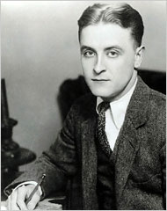
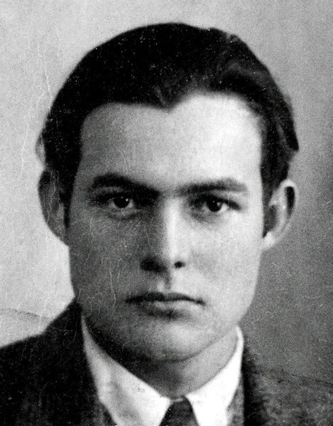
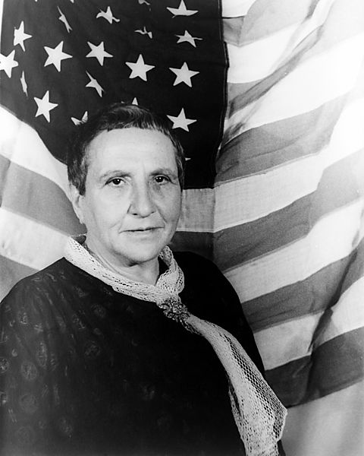
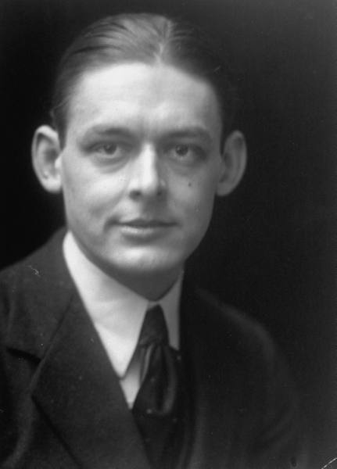
“The Lost Generation”
Authors who wrote about disillusionment of everything after the war
F. Scott Fitzgerald
The Great Gatsby (1925)
Ernest Hemingway
A Farewell to Arms (1929)
Gertrude Stein
T. S. Eliot
The Waste Land (1922)

Slide 4
Searching for meaning in an uncertain world…
Existentialism: Jean Paul Sartre
There is no universal meaning to life. Each person create his/her own meaning in life though choices made and actions taken.

Slide 5
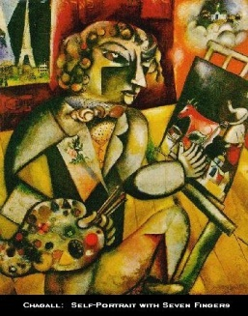
Art: Rebellion Against Tradition
Focused on dream-like qualities because of psychology becoming more studied
Surrealism: beyond or above reality. Depiction of the inner world of emotion and imagination
Marc Chagall: Self Portrait

Slide 6
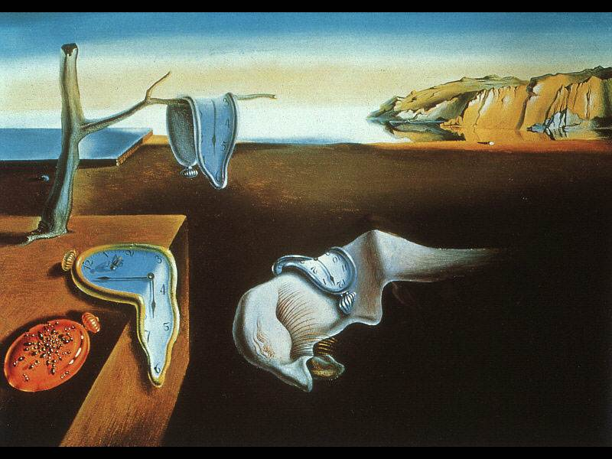
Salvador Dali: The Persistence of Memory

Slide 7
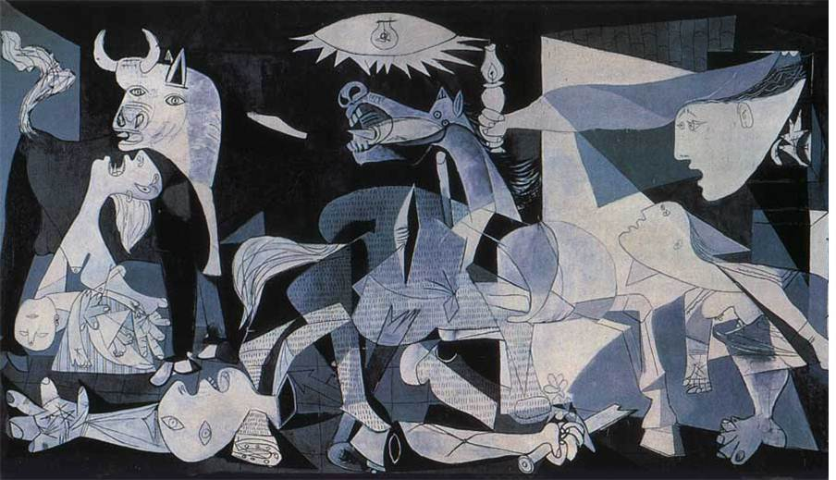
Pablo Picasso: Cubism & Abstract
Guernica

Slide 8
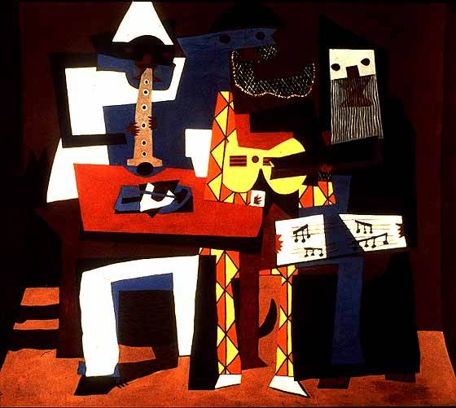
Picasso: Three Musicians

Slide 9
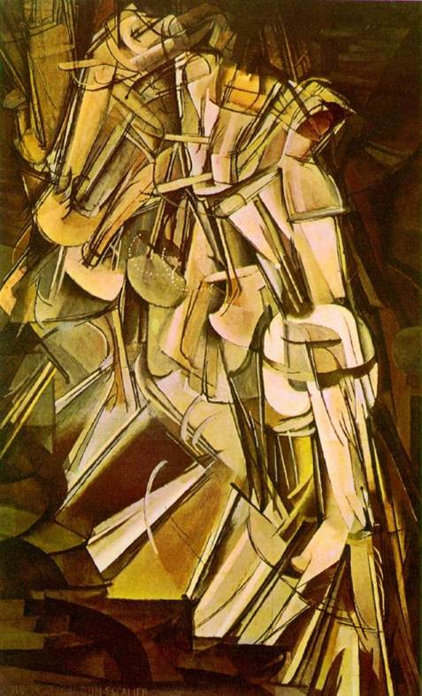
Piet Mondrian & Marcel Duchamp

Slide 10
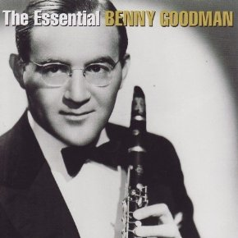
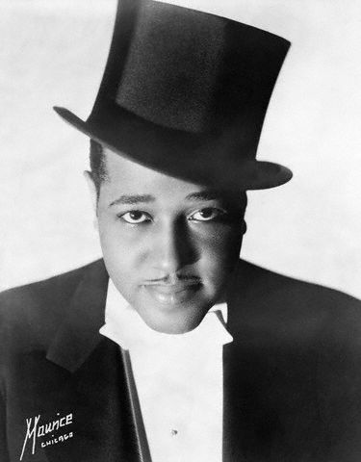
Music: The move away from tradition
Big Band Era
Duke Ellington
Satin Doll
Benny Goodman
Sing, Sing, Sing

Slide 11
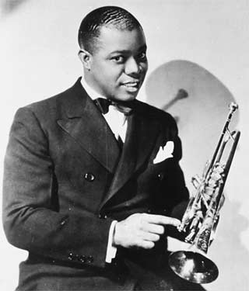
Music Cont.…Jazz
Louis Armstrong
St. Louis Blues & Weather Bird

Slide 12
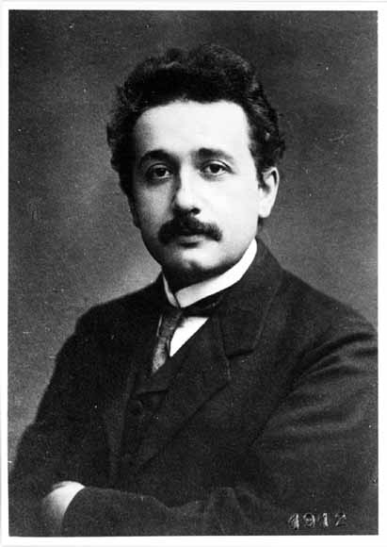
Technology/Science
Albert Einstein
Theory of Relativity
Sigmund Freud – Psychology
Treated patients with psychological problems
How does Freud’s idea of the “psychological” echo “surrealism”?

Slide 13
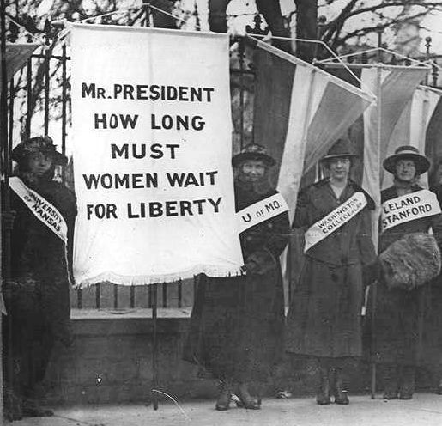
Women’s Suffrage: U.S., GB, Germany, Sweden, & Austria
U.S. 1920: The 19th Amendment passes
The right of citizens of the United States to vote shall not be denied or abridged by the United States or by any state on account of sex
Susan B. Anthony
Elizabeth Cady Stanton
Margaret Sanger
Emma Goldman

