Slide 1
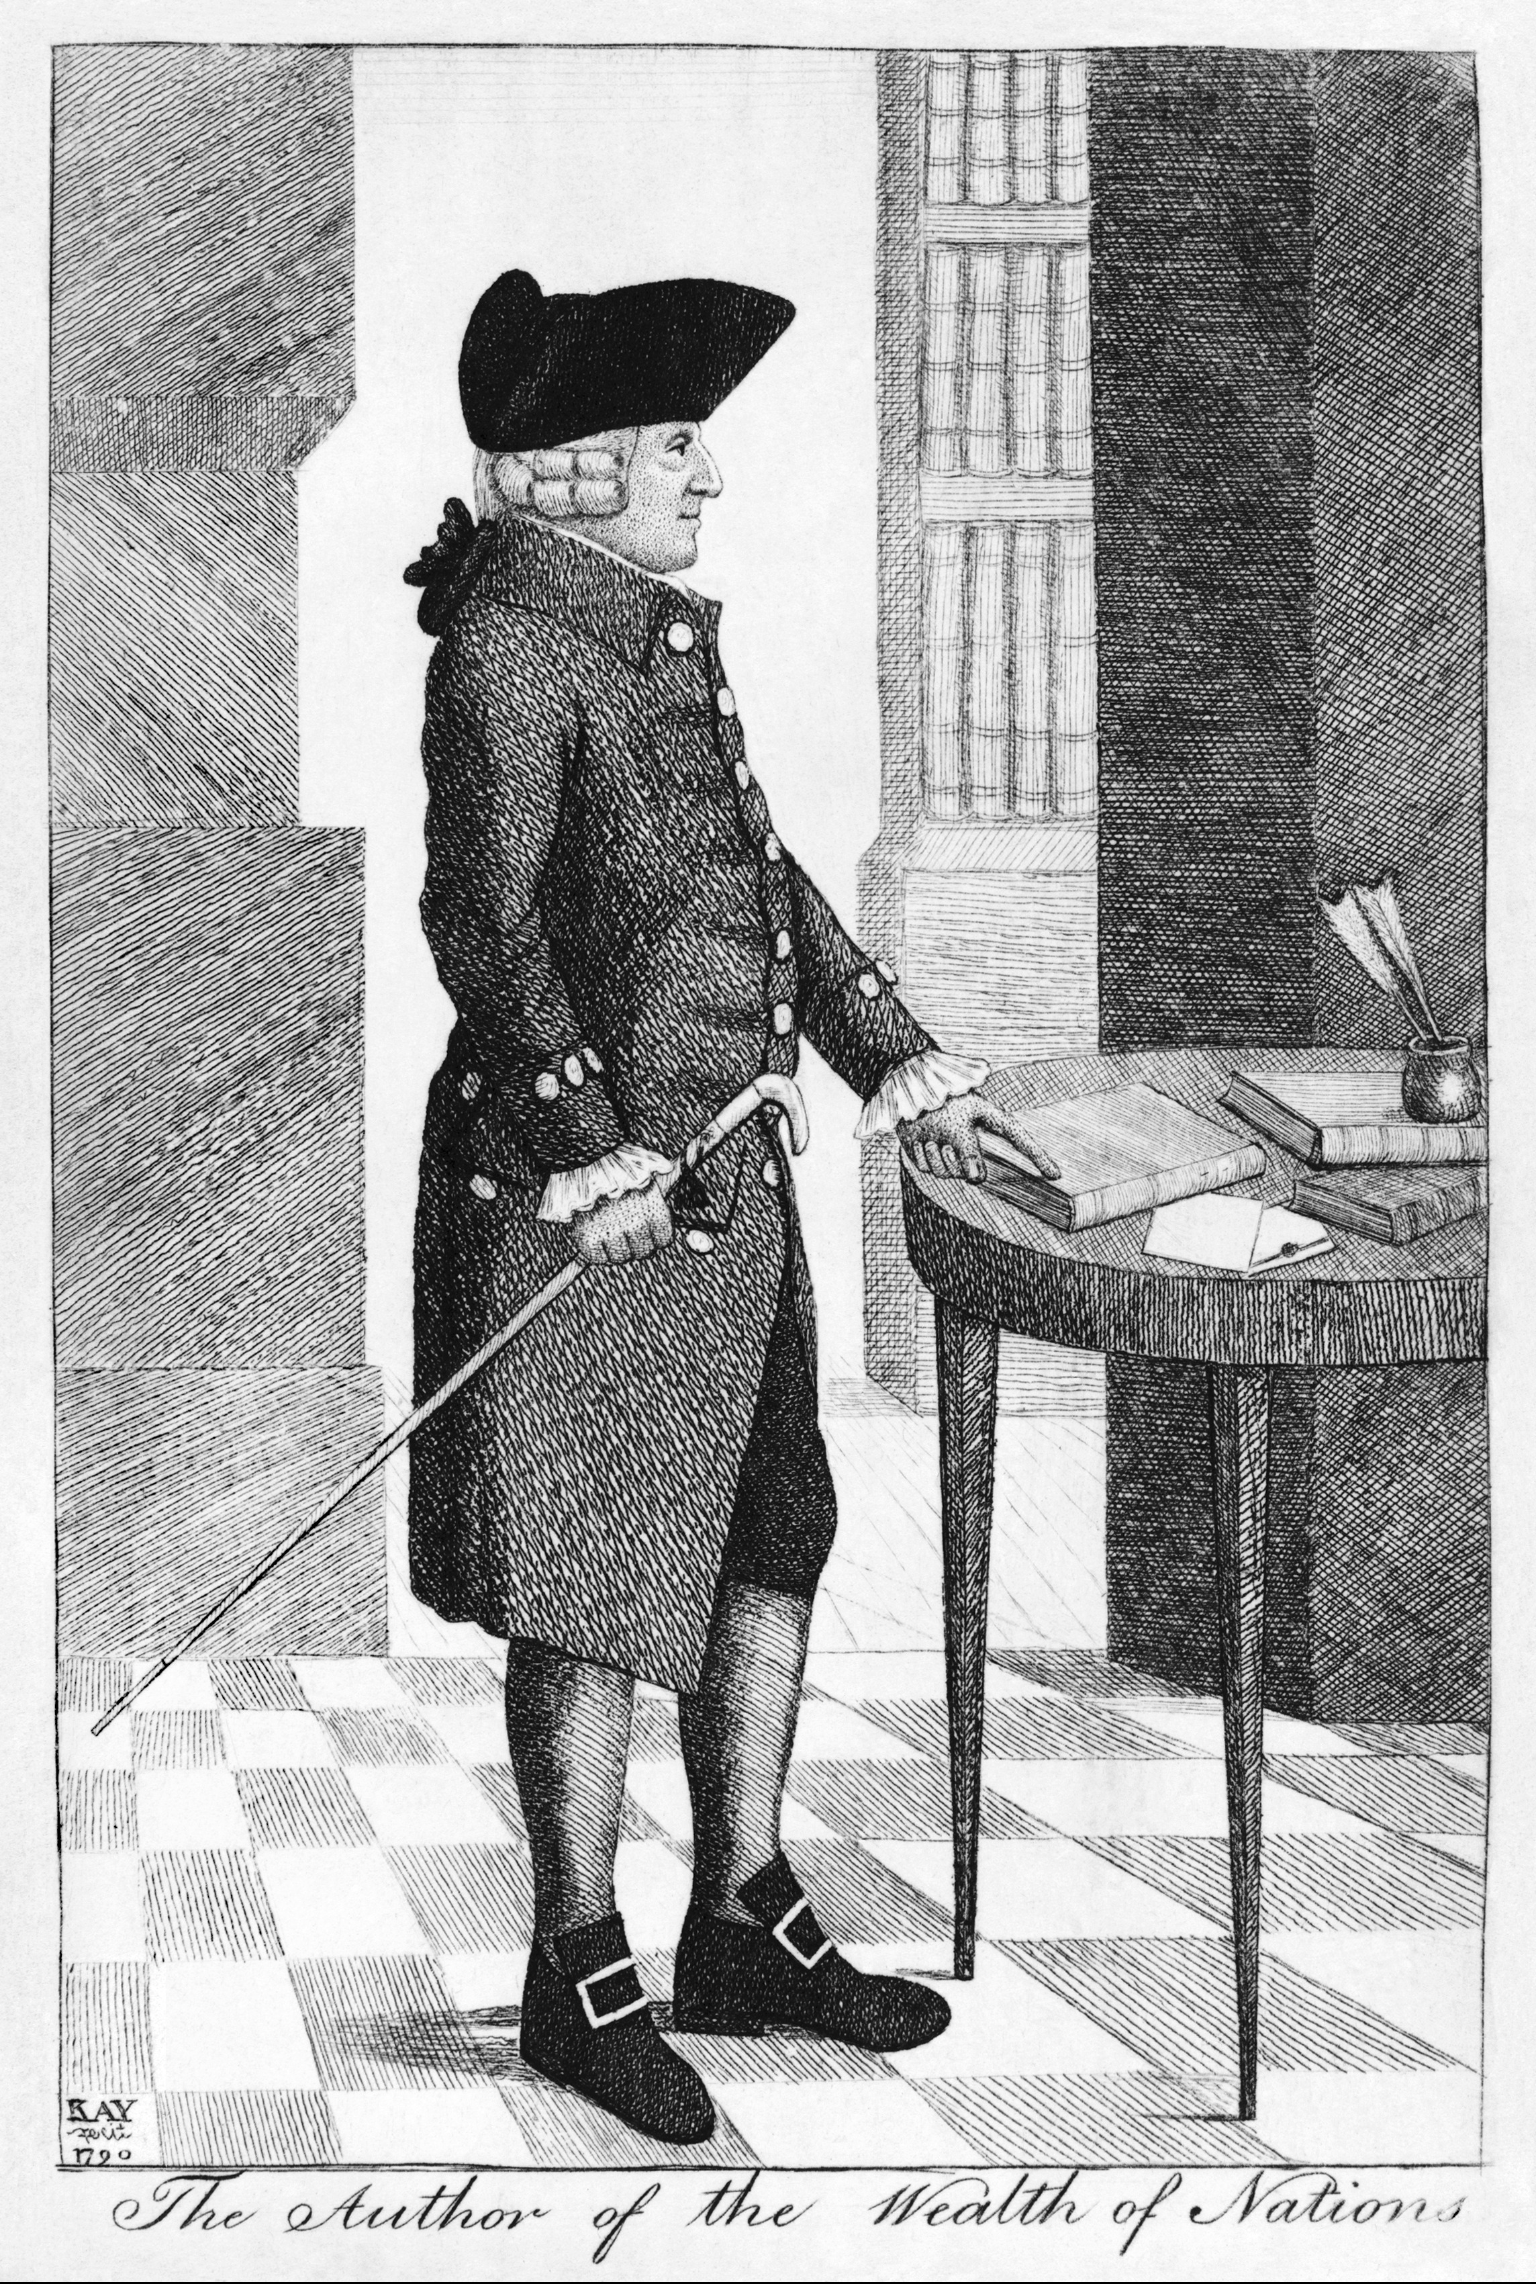
Adam Smith (1723- 1790)

Slide 2
Wrote book called The Wealth of Nations
Created idea of Capitalism
Progress results when:
Individuals follow their own self-interest.
Competition: results in goods and services that are better and less expensive.

Slide 3
Consumers compete with one another to purchase the best goods at the lowest prices.
Market economy aims to produce the best products and the lowest prices.
Government should not interfere in the economy.

Slide 4
Karl Marx
Wrote The Communist Manifesto (1848) with Fredrich Engles
Social order is divided into classes with conflicting economic interests.
The Industrial Revolution intensified the class struggle.

Slide 5
In capitalism, the exploited worker suffers from: physical poverty, low wages, & monotony
The proletariat is an unhappy worker.
That there would be a violent overthrow of the capitalists, the bourgeoisie.

Slide 6
Marx argued that profits were wages stolen from workers.
He wanted to do away with the private ownership of the means of production.
The capitalist system will eventually destroy itself. A classless society will develop in its place.

