Slide 1
Democratic Philosophers

Slide 2
The Encyclopedia
Edited by Denis Diderot & Rene D’Alembert
Written by different people to share the new ideas
Very controversial

Slide 3
Diderot’s Encyclopédie

Slide 4
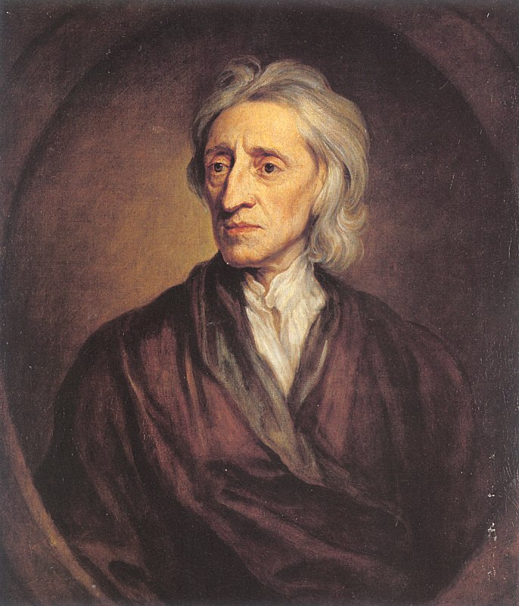
John Locke(1632-1704)
Two Treatises of Government, 1690

Slide 5
John Locke’s Philosophy (I)
Governments created with the consent (approval) of the governed (its people) to protect their rights/liberties

Slide 6
John Locke’s Philosophy (II)
Certain natural rights that are endowed by God to all human beings.
”Life, liberty, and pursuit of property”
If government violates those rights people have a DUTY to change it
He favored a republic as the best form of government.

Slide 7
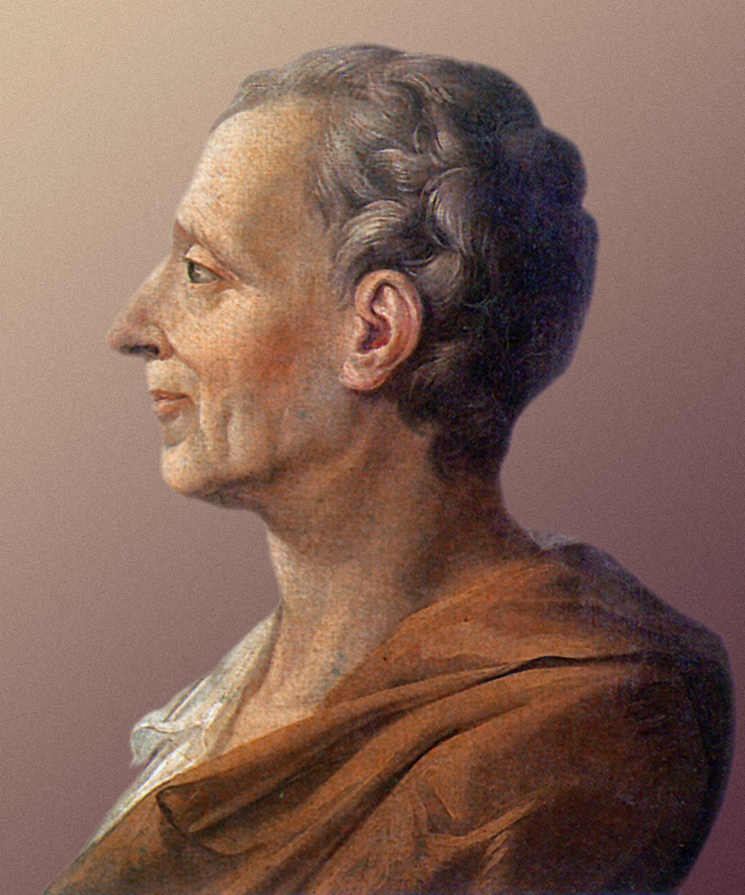
The Baron de Montesquieu (1689-1755)
On the Spirit of Laws, 1758

Slide 8
Montesquieu’s Philosophy
Monarchy with limited powers makes a country secure & stable
A separation of political powers ensured freedom and liberty.
Government divided into 3 branches so none could gain too much power & threaten liberty

Slide 9
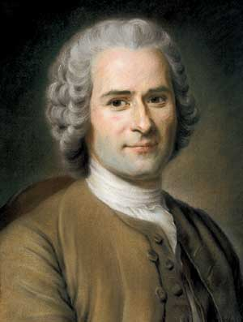
Jean Jacques Rousseau (1712-1778)
The Social Contract, 1762.

Slide 10
Rousseau’s Philosophy (I)
ALL rights and liberties to the people
People would be most free with direct democracy.

Slide 11
Rousseau’s Philosophy (II)
In The Social Contract:
“General Will”: not majority rules, what’s best for all members of society
Individuals enter into a social contract not with their rulers, but with each other.

Slide 12
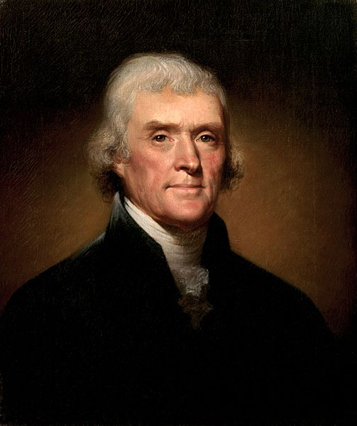
Thomas Jefferson (1743-1826)
Wrote the Declaration of Independence (1776)
1st part: set natural laws, 2nd part: how king broke laws, 3rd part: establish US now that Social Contract broken

Slide 13
Jefferson’s Philosophy
Believed people had “certain inalienable rights”
Governments get power from “consent of the governed”
Government can’t give liberty, but can take it away
Wanted Bill of Rights to protect rights of people

Slide 14
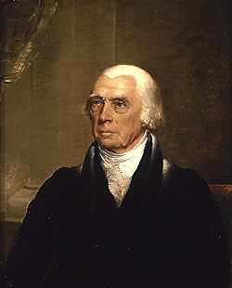
James Madison(1751-1836)
Wrote The Constitution & The Bill of Rights
Called Father of the Constitution, though didn’t think he was

Slide 15
Madison’s Philosophy
Believed a republican government best at protecting from a tyranny
Government should have an executive separate from the legislative body
Lower house of legislature directly elected by the people

Slide 16
Madison’s Philosophy (II)
Didn’t want Bill of Rights, thought people didn’t need as many rights as Jefferson did
Later wrote them to help get The Constitution ratified

Slide 17
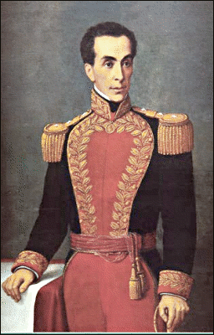
Simón Bolívar (1783-1830)
South American revolutionary & liberator
Led Columbia, Bolivia, Ecuador, Venezuela, & Panama to independence from Spain

Slide 18
Bolívar’s Philosophy
Admired American & French Revolutions & Jefferson
Was against slavery (unlike Jefferson)
Believed in a republic, but knew US style republic wouldn’t work in Latin America
Believed in a strong executive & a hereditary Senate (upper house of legislature)

