Slide 1
Farm to Fork
Week 17 Global Food
People and Carrying Capacity

Slide 2
Agenda Week 17 People & Carrying Capacity
Monday: Computer Lab Room 801, Activity :Who controls the Food?
Tuesday: Computer Lab: Finish Vocabulary and grade Notebooks
Wednesday: WU – Garden & AVID Class
Thursday: Watch the Lorax, Feed McAllister☺

Slide 3
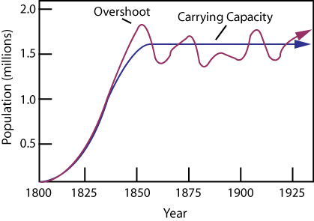
12/14 Earth’s Carrying Capacity
Obj. TSW learn how the increase in world population will have an impact on them. P. 74
Approximately how many people live in CA?
Approximately how many people live in the US?
Approximately how many people live on the Planet?

Slide 4
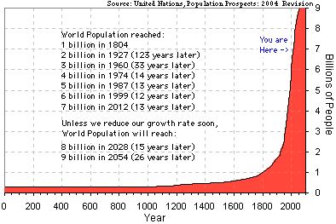
Earth’s Human Population Growth

Slide 5
Activity: Population Growth Analysis
Introduction of Reindeer to St. Matthews Island in Alaska.
Analyze the graph of the growth of Reindeer from the original 29 that were introduced to St. Matthew’s Island.
Answer the 5 Preview questions.
Answer the analysis questions in complete sentences.
Finally, is there any relevance between this example of overpopulation and the human population on the Planet? 2 – 3 sentence answer.

Slide 6
United Nations
Integrating Population Issues into Sustainable Development

Slide 7
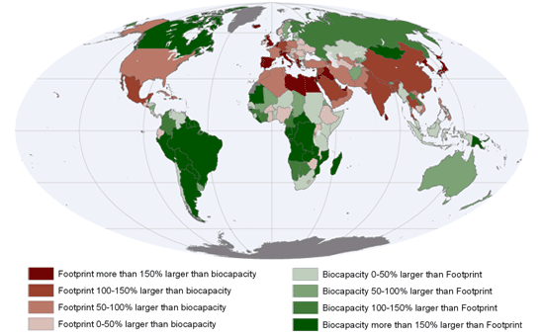
12/15 Earth’s Carrying Capacity
Obj. TSW understand that Biocapacity of countries and the carrying capacity of the planet are interlinked. P. 76 NB
What are limiting factors in a Carrying Capacity graph?
What are some Density Dependent Factors?
What are some Density Independent Factors?

Slide 8

12/16 Sustainability Worldwide
Obj. TSW apply and discuss why it is important for sustainable practices to be enforced worldwide. P. 78 NB
Describe sustainability.
Describe 3 sustainable practices you have learned in this class.
What are the implications of increased population growth if sustainable practices are not enforced?

