Slide 1
Lesson 3: Old School Remedies
UNIT 3 Global Food/ Food Equity

Slide 2
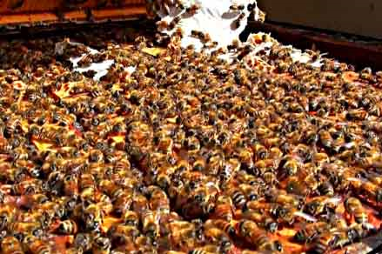
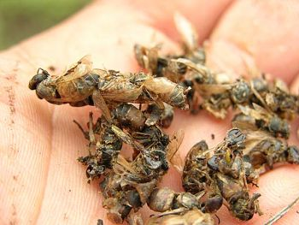
4/11 Honey, Can it help with Allergies? Obj. TSW learn about the possible benefits of eating local honey. P. 28 NB
What do you know about honey?
What do you know about bees?
What do you know about Colony collapse disorder?

Slide 3
Online Honey Bee Research Activity p. 27 NB
What are the benefits to eating locally grown honey?
What are different types of Bees?
What breed of bees are in our local area?
What is Colony Collapse Disorder, What are the possible causes? How does it impact us?

Slide 4
Guest Speaker - Bees
Write a page of notes about Honey bees p. 29 NB
What are honey bees?
Give an example of what they do.
Explain how their social structure with the Queen, worker and drones are organized.
Why is it important to learn about Colony Collapse Disorder?

Slide 5
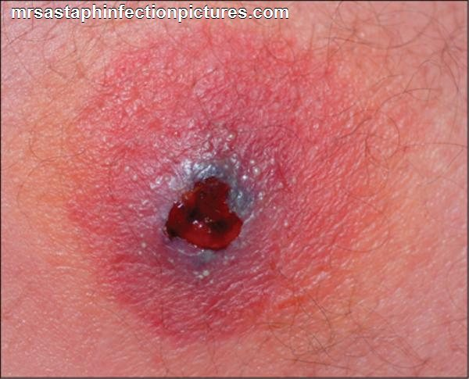
4/12 Antibiotic Resistance – MRSA Obj. TSW learn why antibiotic resistant bacteria can be so threatening. P. 30 NB
What does it mean to have a resistance?
MRSA stands for: Multiple – Resistant Staphylococcus Aureus. Why is this type of bacteria so concerning?
What happens when we run out of effective antibiotics to treat diseases?

Slide 6
4/13 Antibiotic Resistance – Cattle/ Livestock Obj. TSW understand why large CAFO’s medicate their animals even though they are not sick. P. 32 NB
The picture to the left is a bacteria with three ways it develops a resistance to antibiotics. Describe one of them.
What is a plasmid in a bacteria?
What is an enzyme?
Discussion: How have Bacteria developed three ways to resist antibiotics?

Slide 7
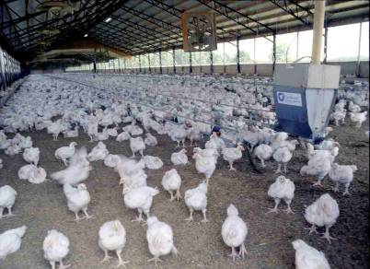
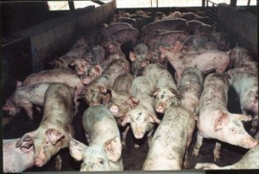
CAFO Concentrated Animal Feedlot Organizations

Slide 8
Cattle Feedlot

Slide 9
Activity: Choose any of the following domesticated Farm animals and research antibiotic resistance p. 31 NB
Cattle, Sheep, Pigs, Chickens, Goats
How are the animals given the medication?
What bacterial infections are they being protected against? What are the most common types of diseases your particular farm animal gets?
Why do we care about antibiotic resistant strains of bacteria in our livestock?
Cite your Online Resources in your NB. You will need at least three resources.
https://owl.english.purdue.edu/owl/section/2/10/

Slide 10
4/14 Old School Remedies Obj. TSW think of things they have heard family members say that work to get healthy. P. 34 NB
What old school remedies does your family have?
What plants, herbs, can help fight some illnesses?
Why is it important that we not forget our ancestors and their solutions to staying healthy?

Slide 11
Family Old School Remedies p. 35NB
Describe one of your family’s Old school remedies.

Slide 12
How is your garden growing? Obj. TSW analyze how their garden is growing and what they could do better. p. 36 NB
How are your plants growing?
What would you do differently?
Next Saturday is Earth Day. We will need 100’s for plants for the event. Will you be able to help? City Hall 10 – 2.

