Slide 1
Farm to Fork 1 Notebook Semester 2: UNIT 3 Our Carbon Footprint and UNIT 4 Feeding the World
Open your Notebook to the Center where the book is sewn.
Number the Right side of the page 1
Turn the page, number the left side of the page 2
Odd’s on the right, Evens on the left
Number to page 8

Slide 2
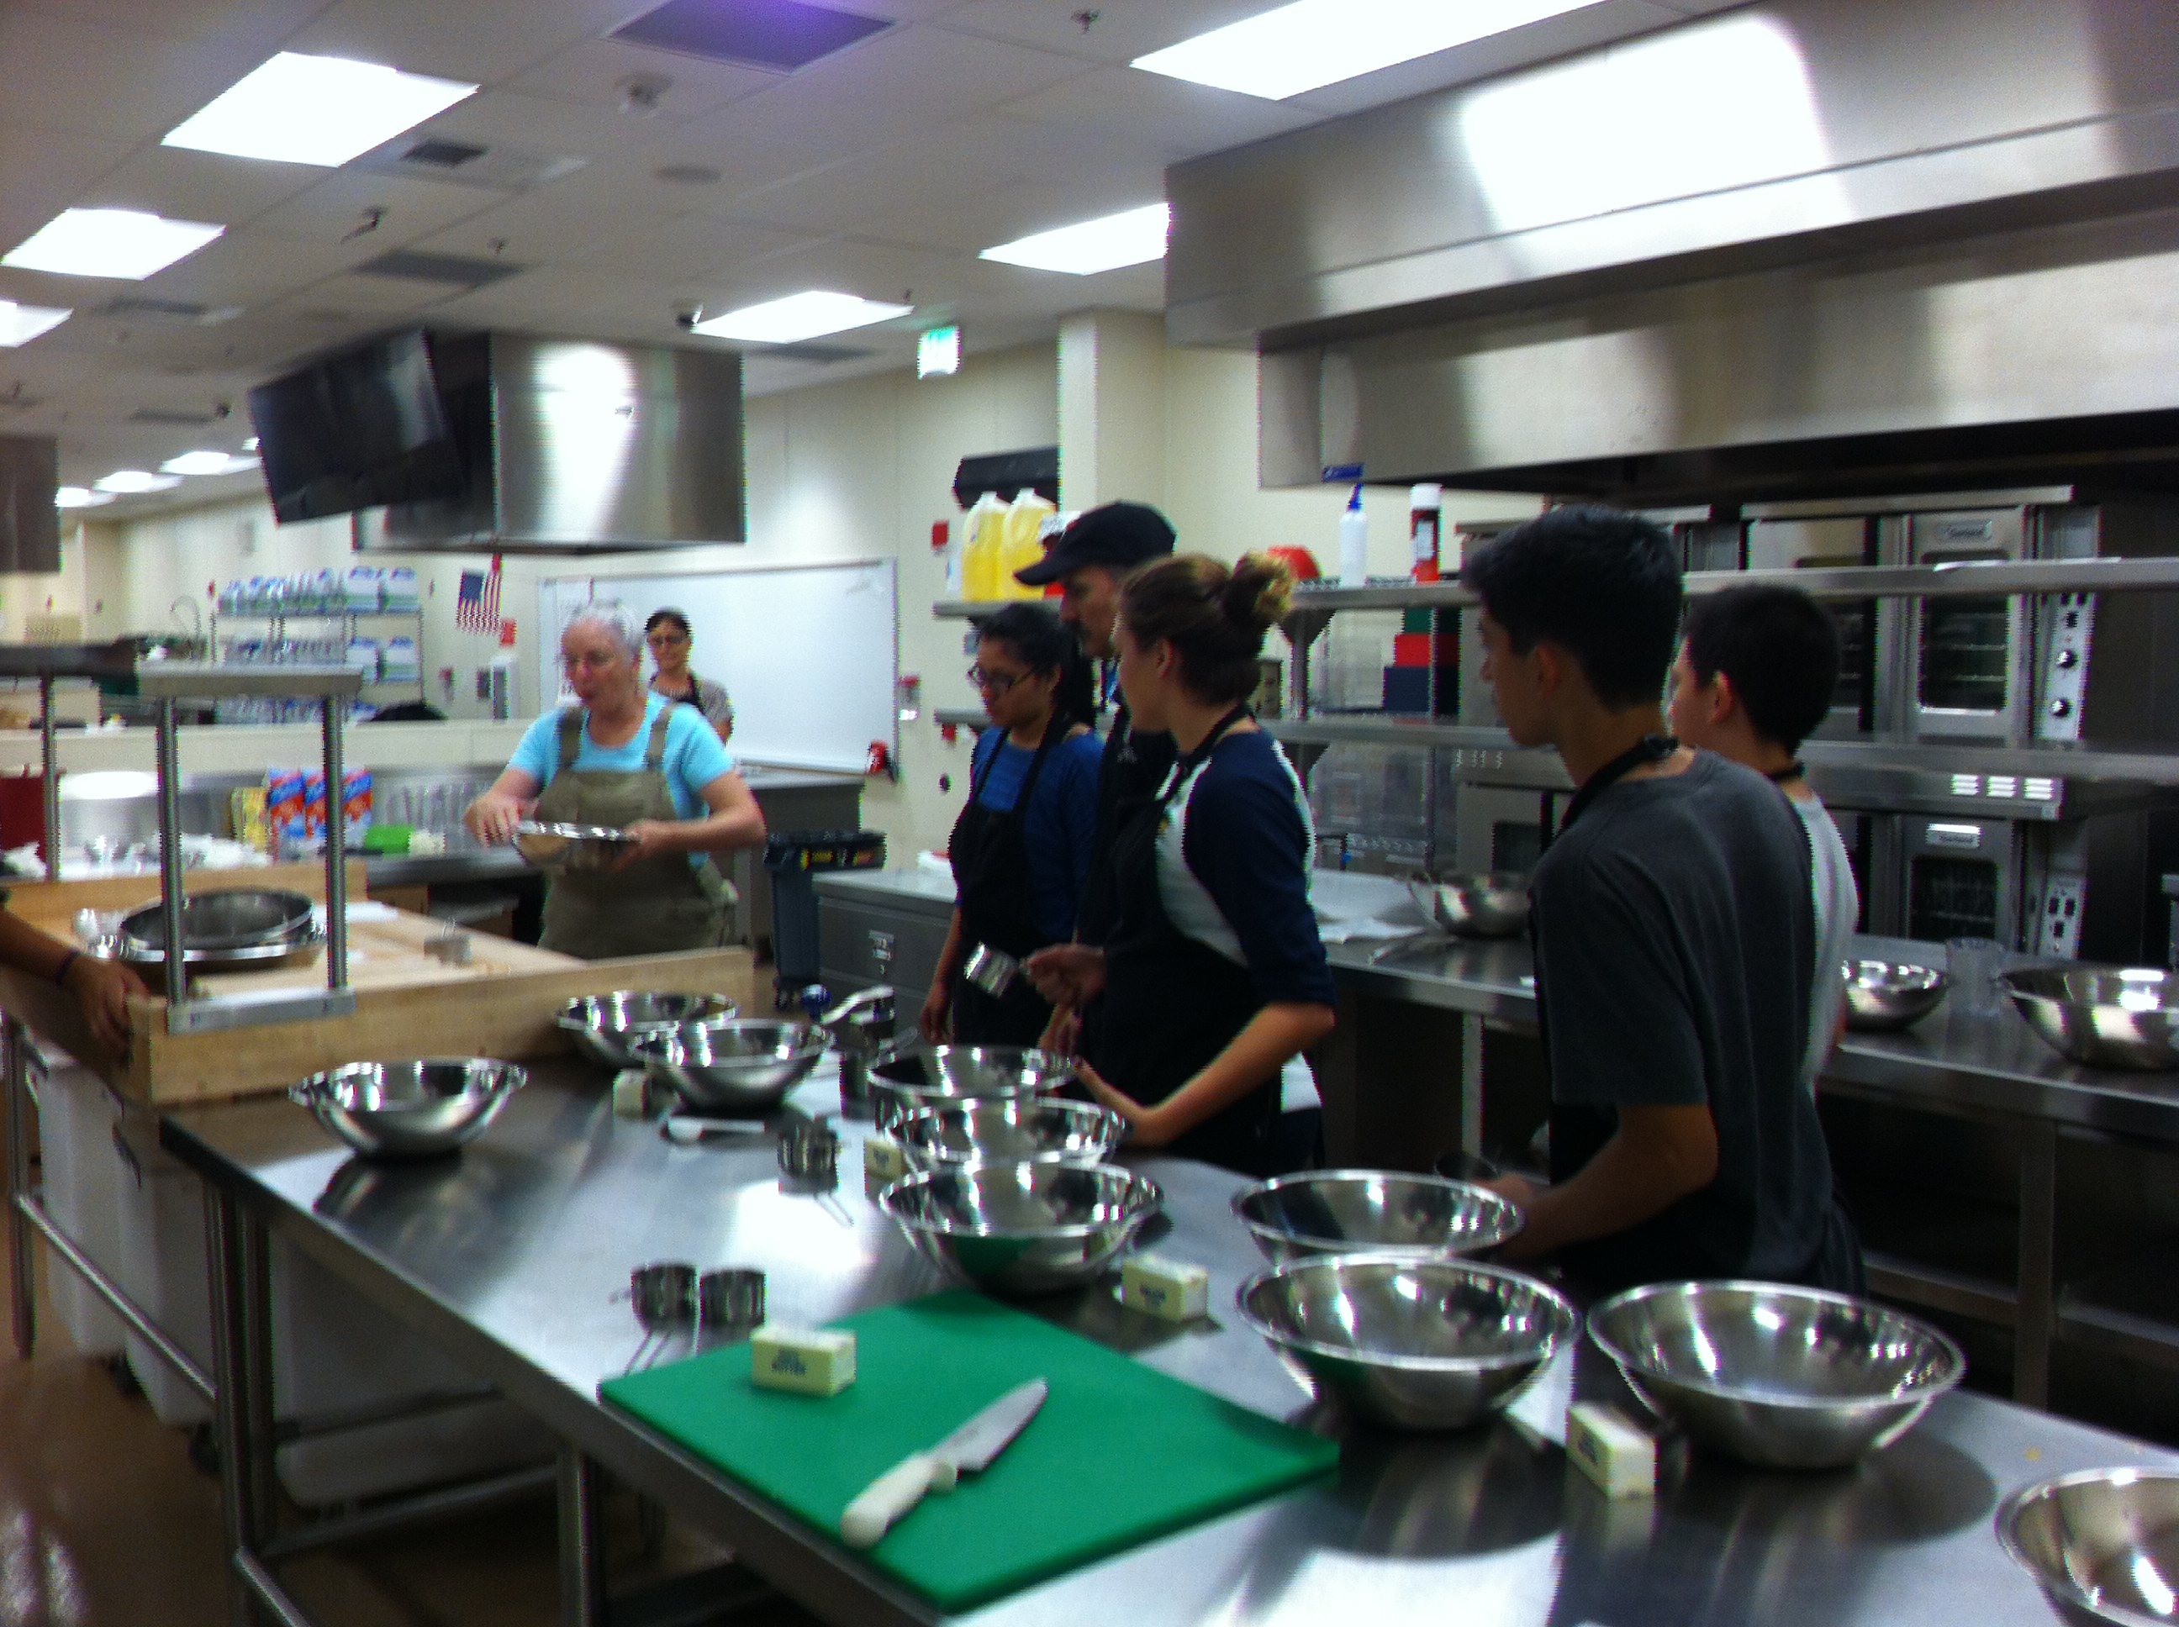
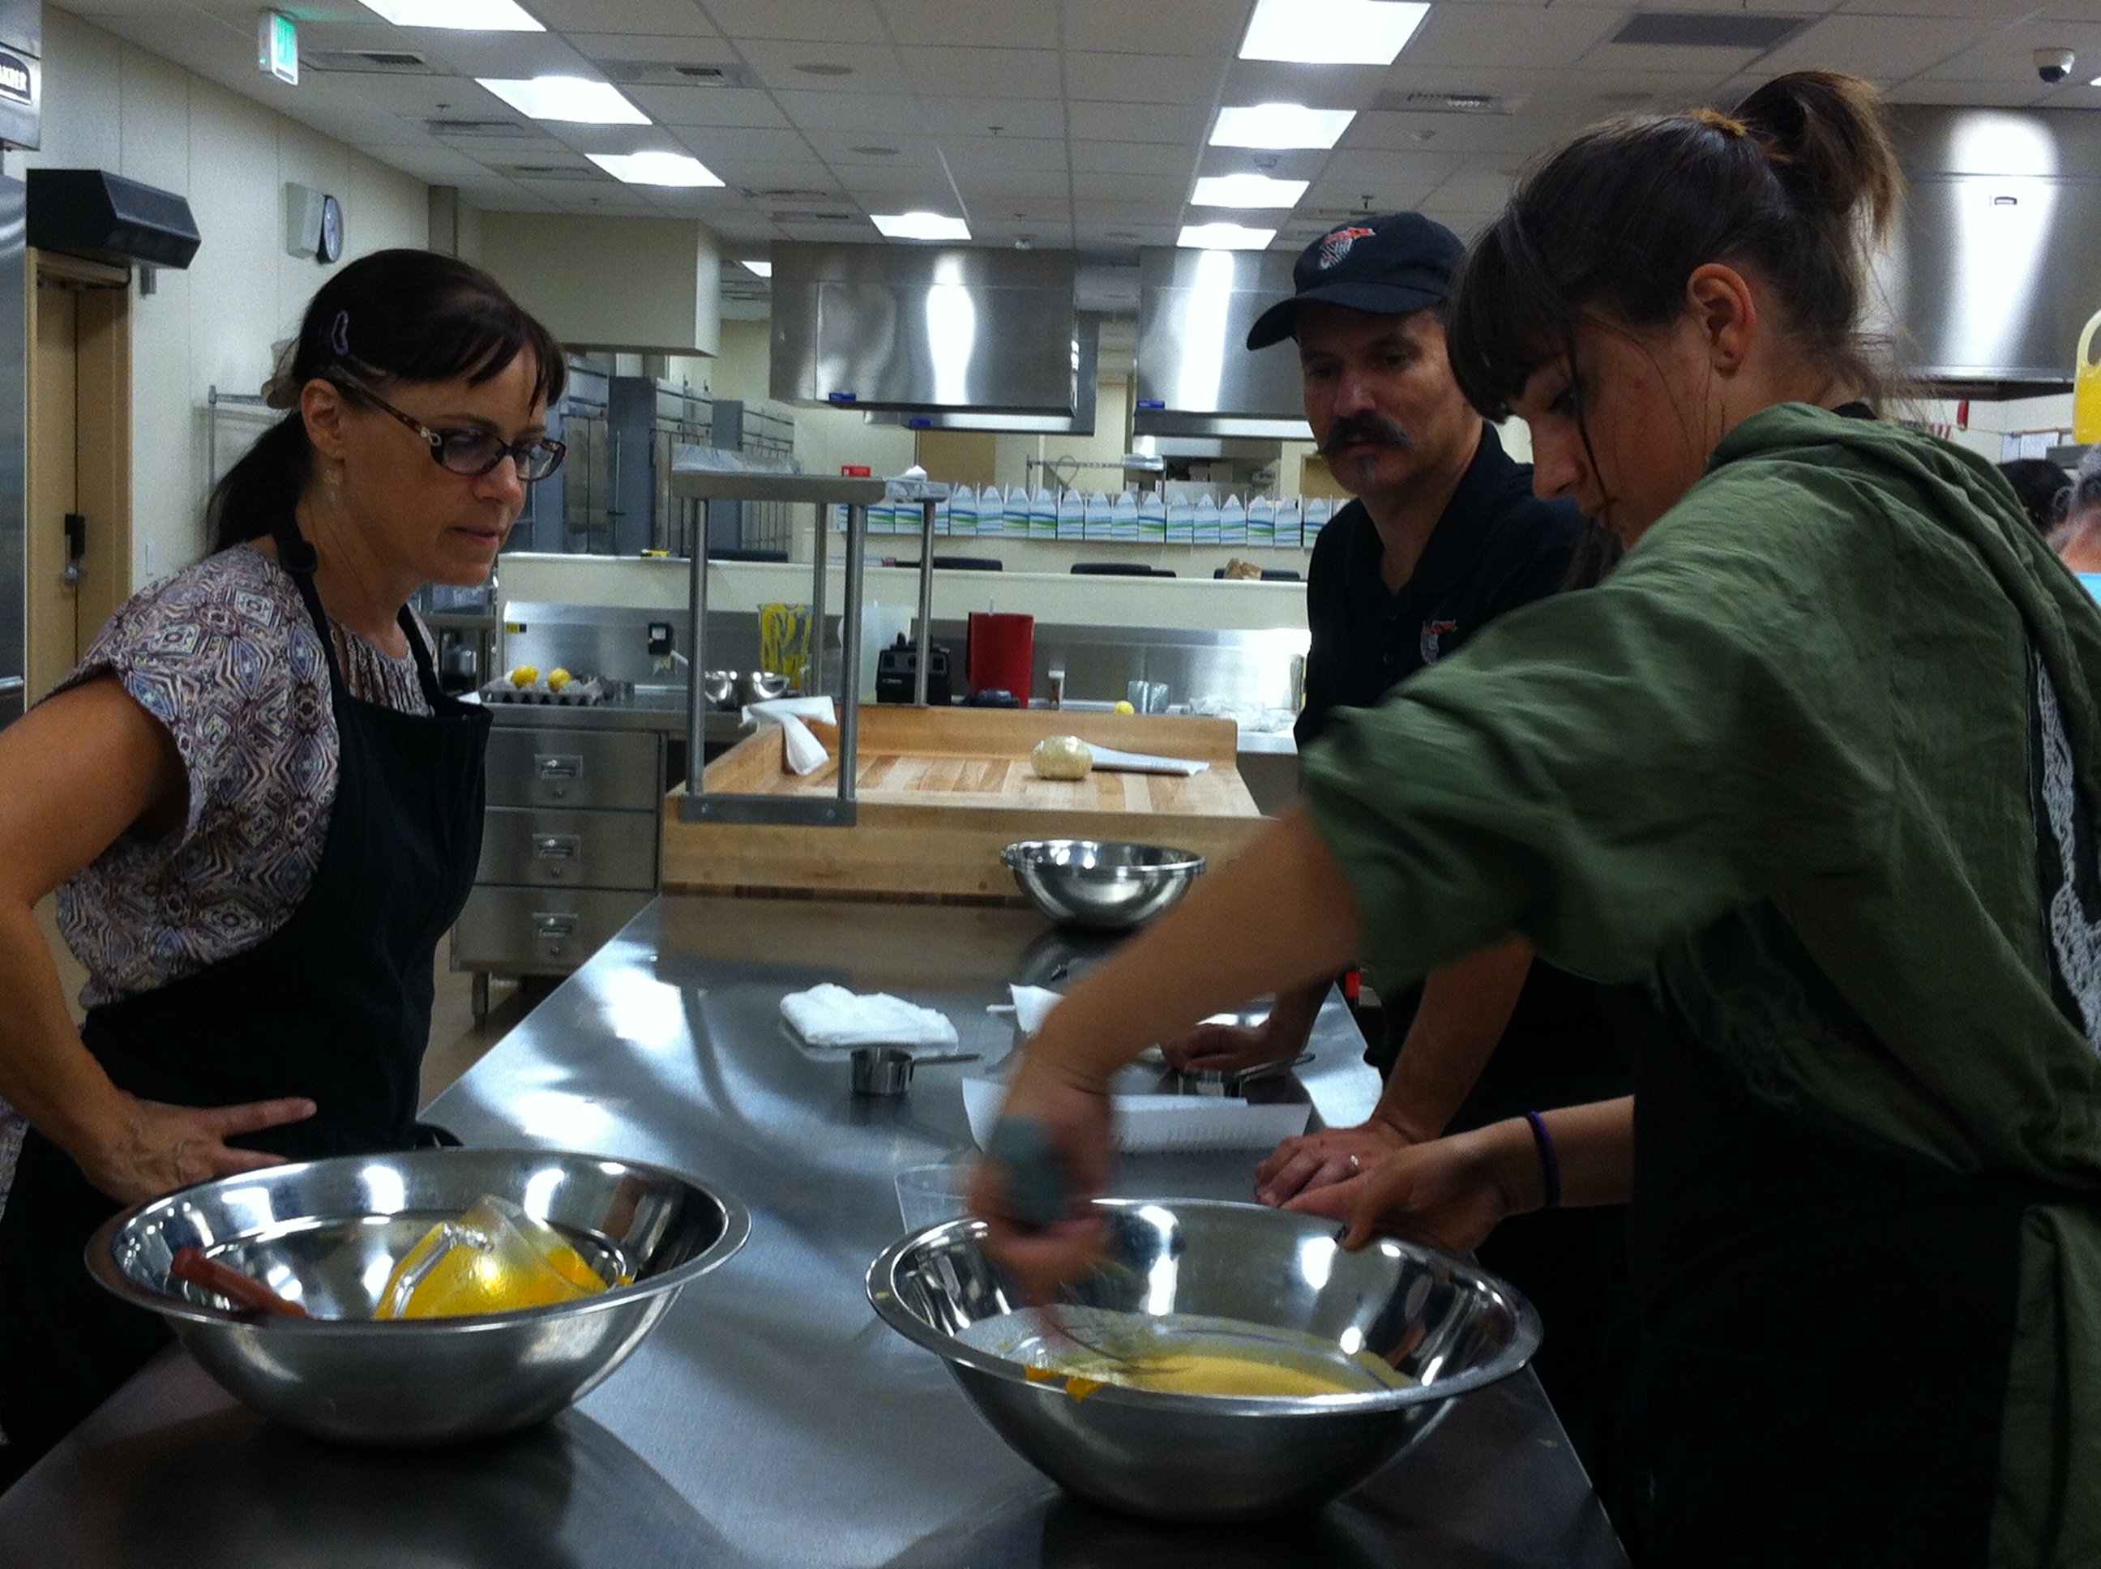
Pumpkin Pie Making Culinary Arts & Farm to Fork Education CAFFE

Slide 3
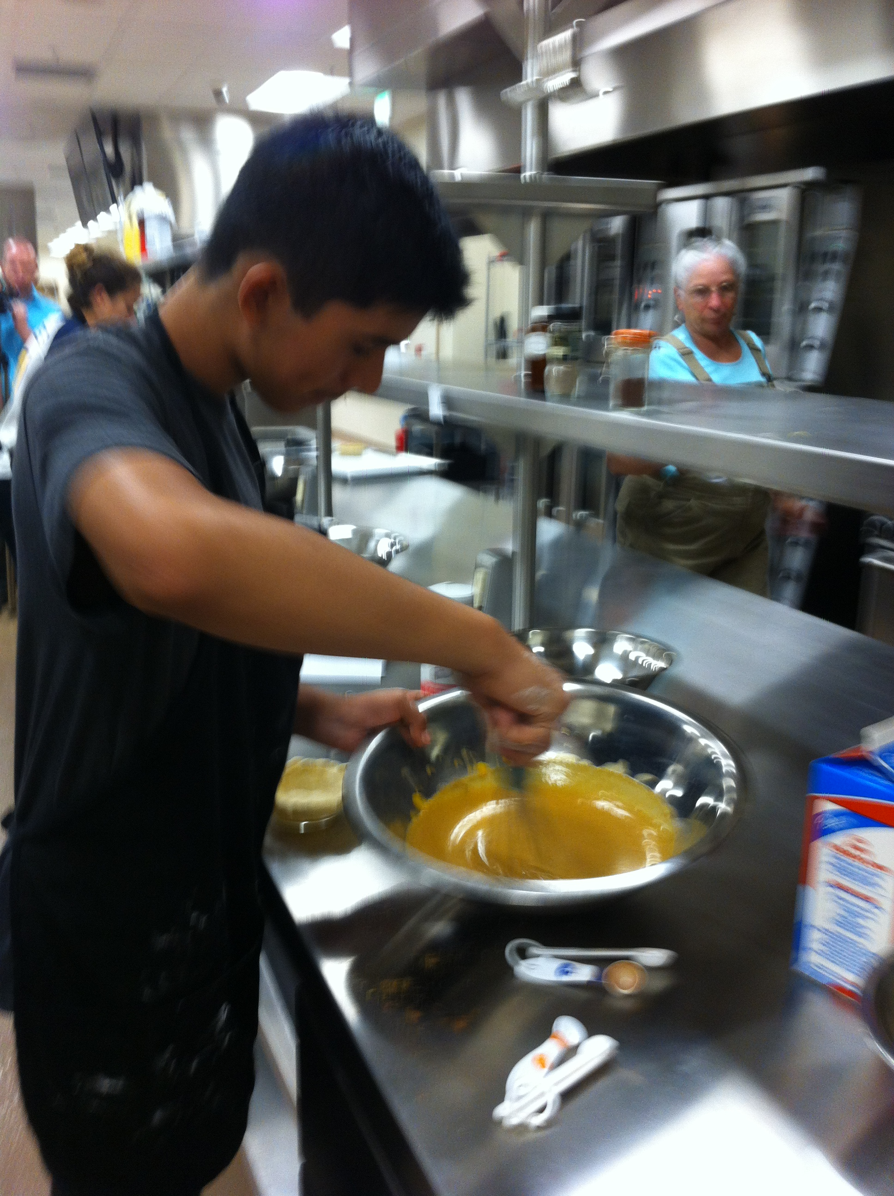
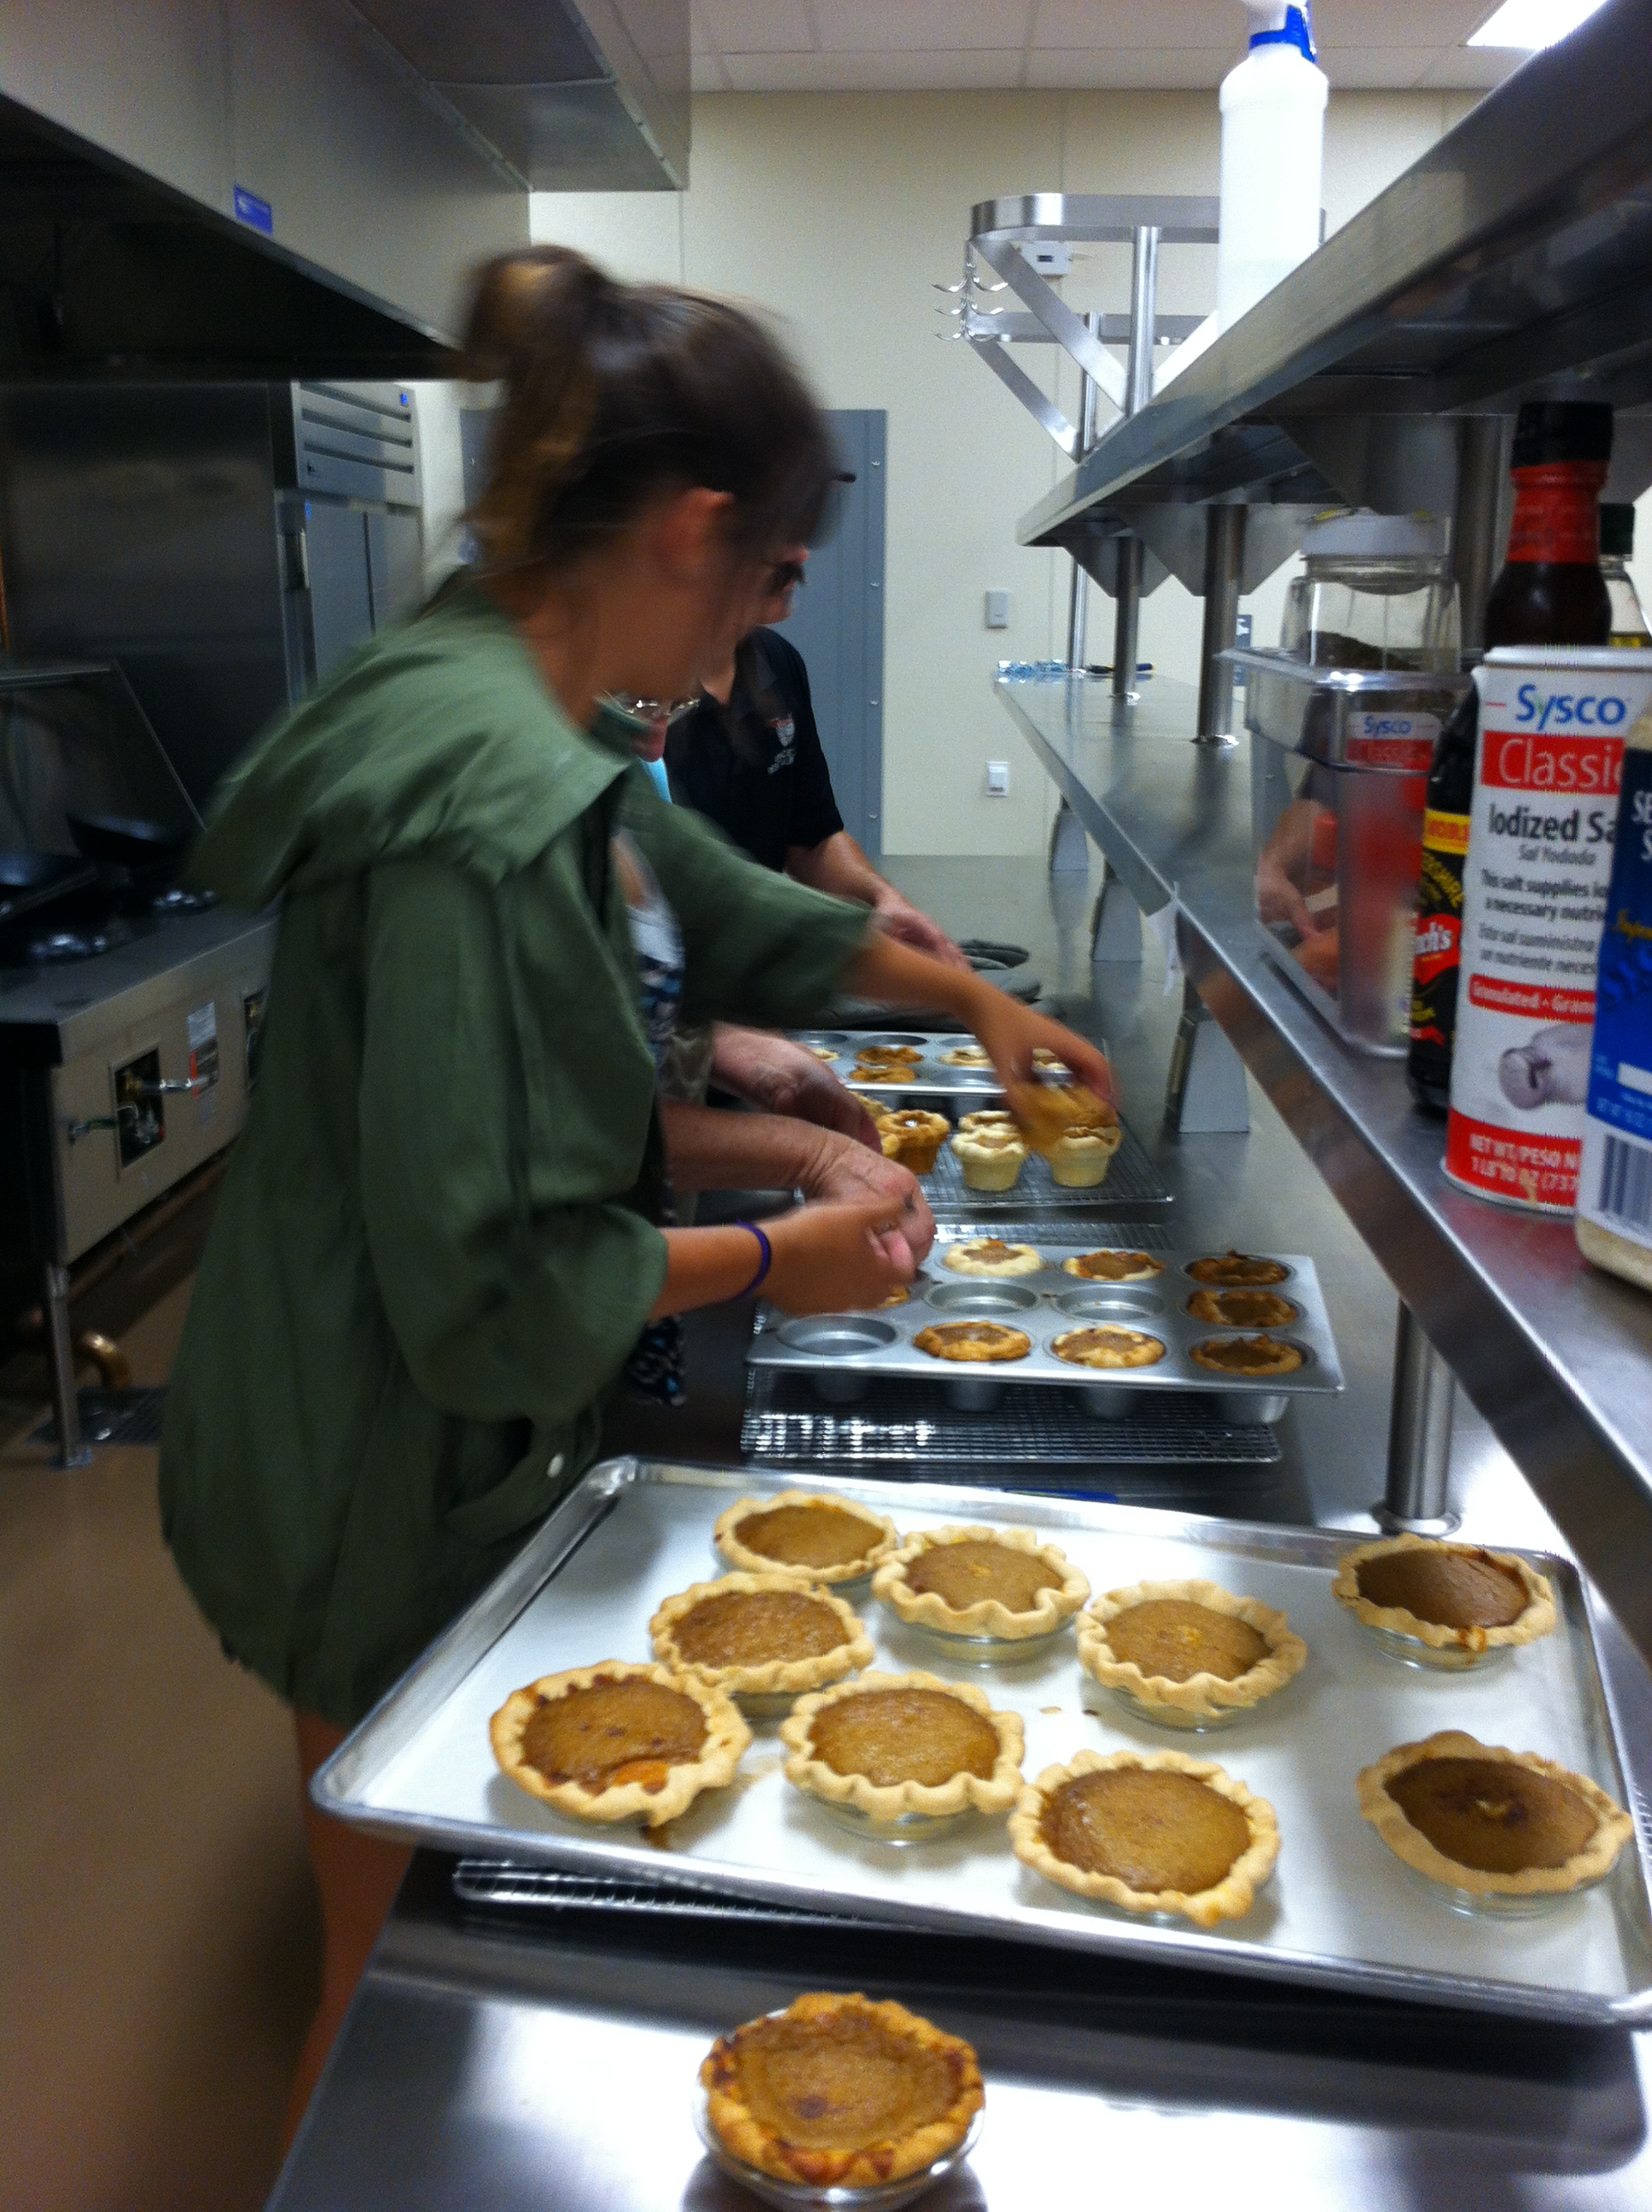
Pumpkin Pie Making Culinary Arts & Farm to Fork Education CAFFE

Slide 4
Pumpkin Pie Making Culinary Arts & Farm to Fork Education CAFFE

Slide 5
And ended with this…

Slide 6
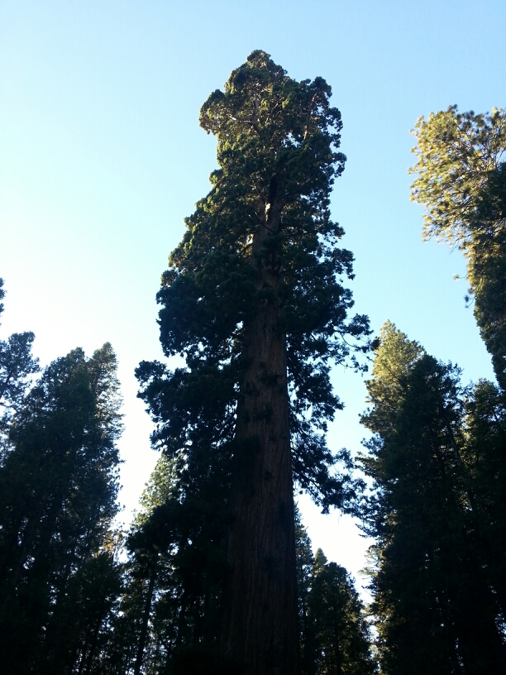
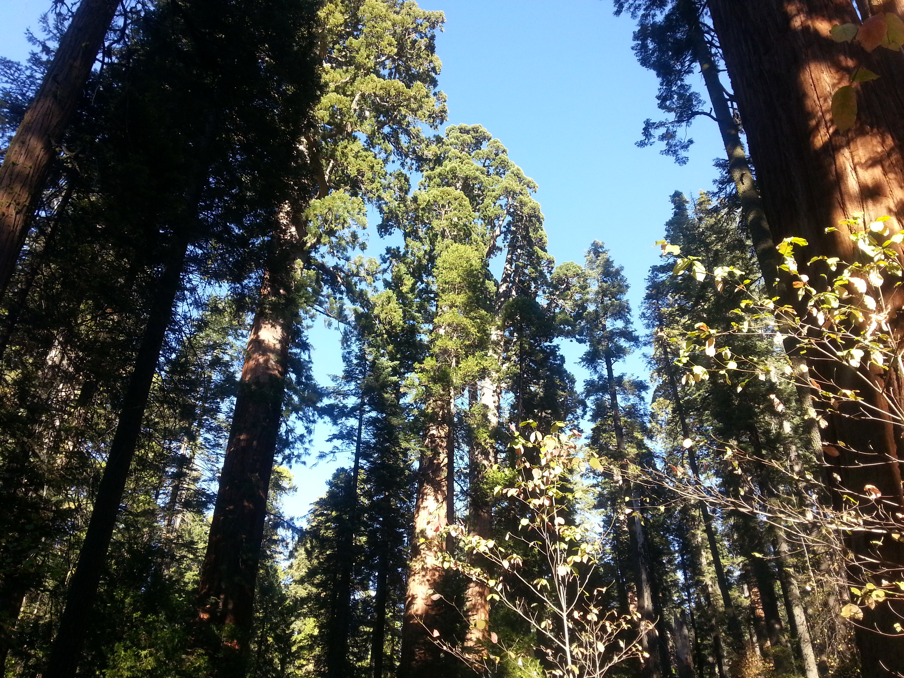
Sequoia Trees – Oldest & largest Organism on earth – 2000 years old.

Slide 7
Farm to Fork
UNIT 3: Our Carbon Footprint
Lesson 1: Resource Management Week 11

Slide 8
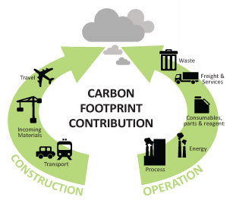
10/24 Our Carbon Footprint: Resources Management Obj. TSW understand and explain how our resources can be limited and our actions have negative impacts on the planet. P. 8 NB
What resources do we need to live our lives?
How are these resources managed?
How is pollution created as a result?
At the Garden:
Finish Irrigation, water, weed, fertilize.

Slide 9
Omnivore’s Dilemma October 24 – October 28
Read Chapters 10 & 11 by Friday. Part II Industrial Organic Meal
We will discuss the chapters.

Slide 10
Processed Corn Products 10% of US corn p. 68 – 69 Omnivore’s Dilemma
Sweetener for soft drinks
Starch for hamburger bun
Corn oil, used for cooking or salad oil
Margarine – hydrogenated trans fats
Mill starch make animal feed
Cornstarch is made
High Fructose Corn Syrup discovered by Japanese chemists
Maltodextrin – used to make pudding & gravy
Fermented starch can be used to make plastic

Slide 11
Wet Mill – industrial digestive system
Corn is broken down into different parts.
25 major wet mills in the US
Cargill and Archer Daniel Midland own the majority of them
At the mills the corn is grinded , soaked in acid & reduced to sugars

Slide 12
$ Breakfast Cereal & Fast Food $
General Mills – a box od cereal contains 4 cents worth of corn, but sells for $4.
McDonalds make $ by selling a “Chicken Nugget” not a recognizable piece of chicken because it is processed.
“ There’s money to be made in food, unless you’re trying to grow it.” George Naylor
For every $1 the consumer spends on eggs, the farmer earns 40 cents.
For every $1 the consumer spends on HFCS in Soft drinks, or cereal, the farmer only earns 4 cents.

Slide 13
2016 National FFA Convention
Jason Brown Speaker
Colin Ryan – Keynote Speaker
https://www.calaged.org/docs/29453_Ag%20Biology%20Lab%20Manual%20Complete.pdf
Ag Ed Lesson plans:

Slide 14
Footprintnetwork.org p. 9 NB
# of Earth’s Activity
Calculate your own ecological footprint in the USA by taking this lifestyle survey regarding: food consumption, energy usage and transportations choices.
Write # of Earth’s it takes to live your lifestyle in your Notebook.
What steps could be taken to realistically decrease your footprint.
Then do the Activity again but, with a different country.
Why is your Ecological Footprint different is different countries? Who is one of the largest contributors to pollution?

Slide 15
FFA Creed Practice P. 9 NB
Open the Official FFA Manual to page 35.
After watching the National competitors, read through the FFA Creed to yourself.
How does the FFA Creed support the “Transform” idea for the National FFA?
For each of the paragraphs, state the meaning of that paragraph in your Notebook.
Practice with a partner to recite a paragraph of your choosing.

Slide 16
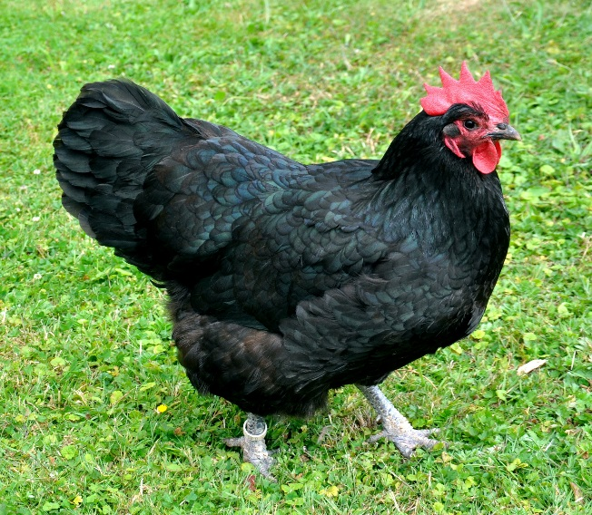
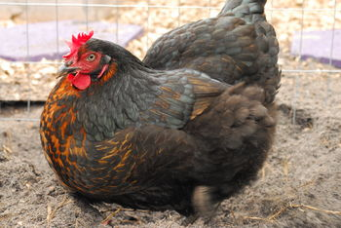
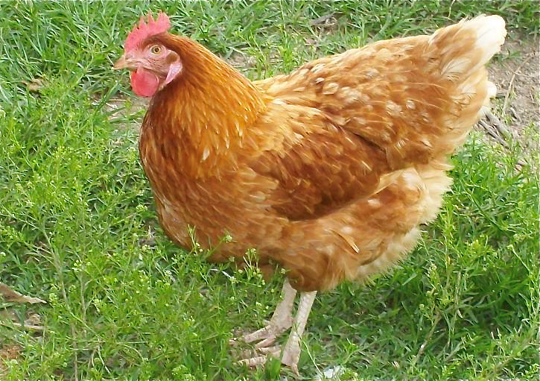
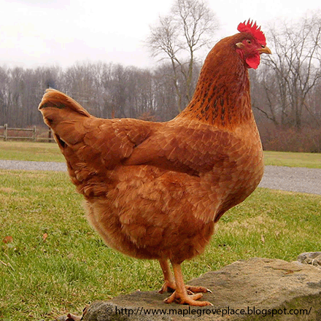
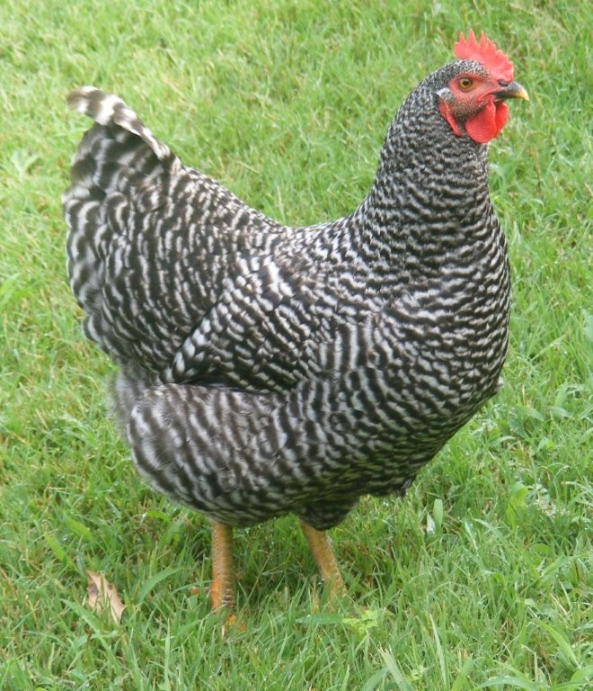
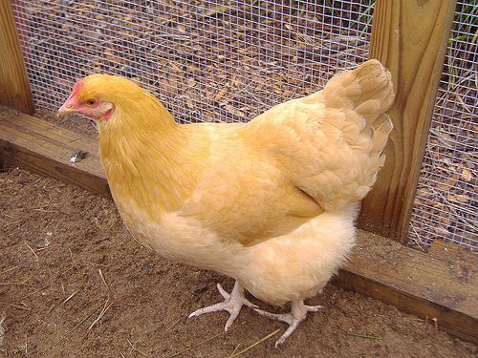
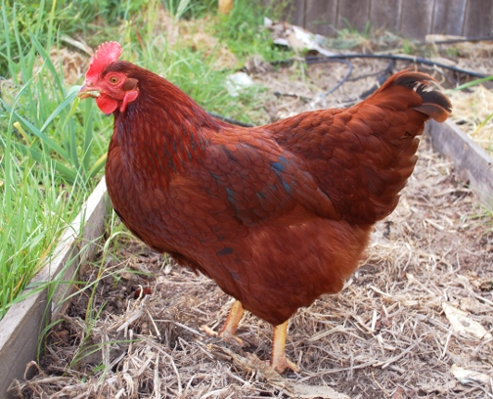
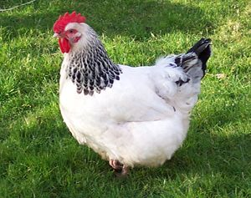
Bradshaw Feed and Pet Supply 7285 Bradshaw Rd, Sacramento Ca, 95829
If you are set up for chickens already, Here is what Bradshaw’s has:
Black Australorp = Annabelle
Black Sex Link
Golden Sex Link
New Hampshire Red
Barred Rock
Buff Orphington
Rhode Island Red
Light Brahma
This is what you need: Watering can $10 – 30, Feeder $10 – 30, Feed $18/ 50#, Enclosure, Nesting box $16.

Slide 17
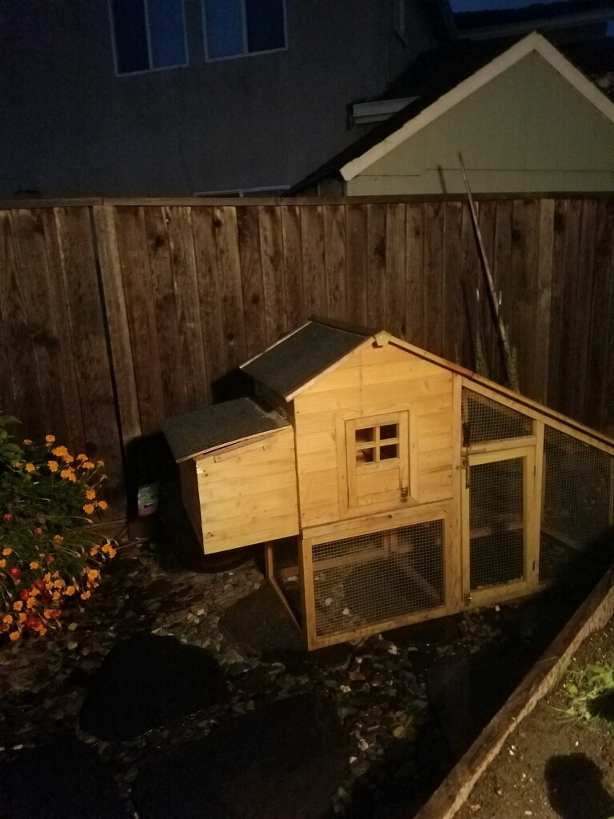

Slide 18
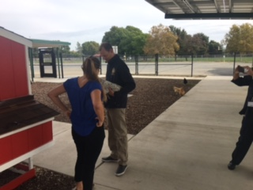

Slide 19
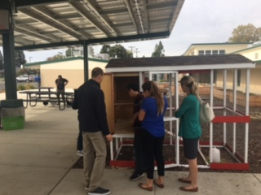

Slide 20
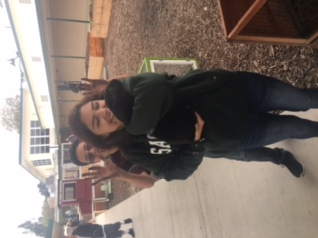

Slide 21
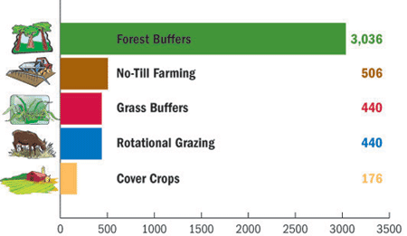
10/25 Our Carbon Footprint Obj. TSW learn about our impact as a population on our available resources. Page 10 NB
Monday you listed resources that needed to be managed: water, food, air, soil. What happens when they are not managed properly?
Name some “best practices” we use at the garden.
How will conservation techniques help us be more sustainable as a society?

Slide 22
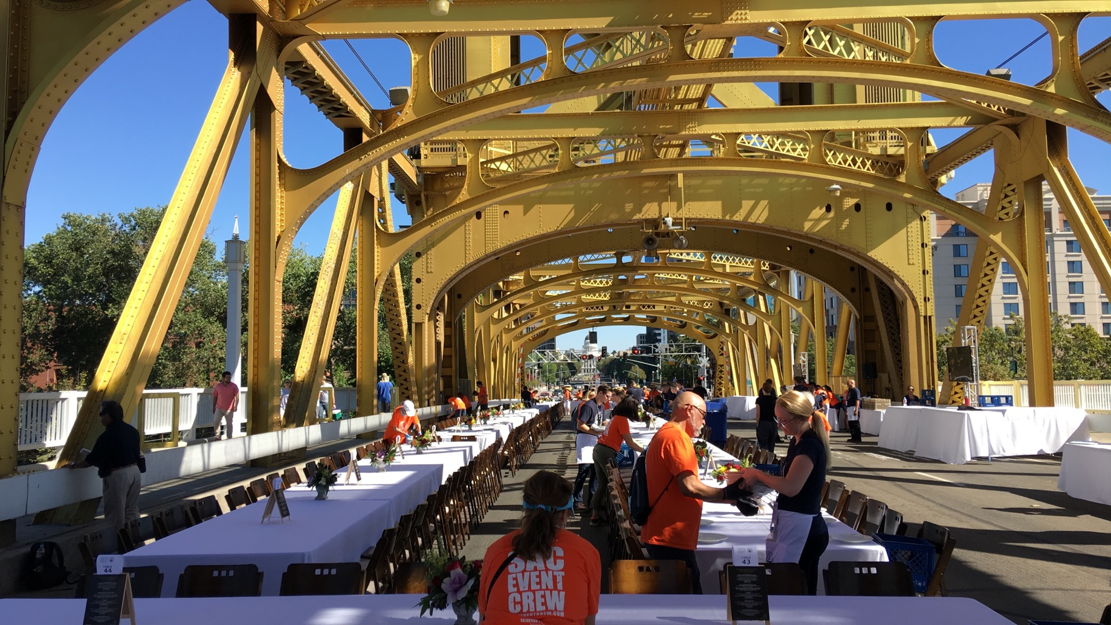

Slide 23
FFA Creed Practice P. 11 NB
Open the Official FFA Manual to page 35.
How does the FFA Creed support the “Transform” idea as a the National FFA Organization?
One Officer practice with a partner(s) to recite 2 paragraphs of your choosing. Students have the FFA Manual open, follow along and only correct if they pronounce the word wrong or pause or say the wrong word.

Slide 24
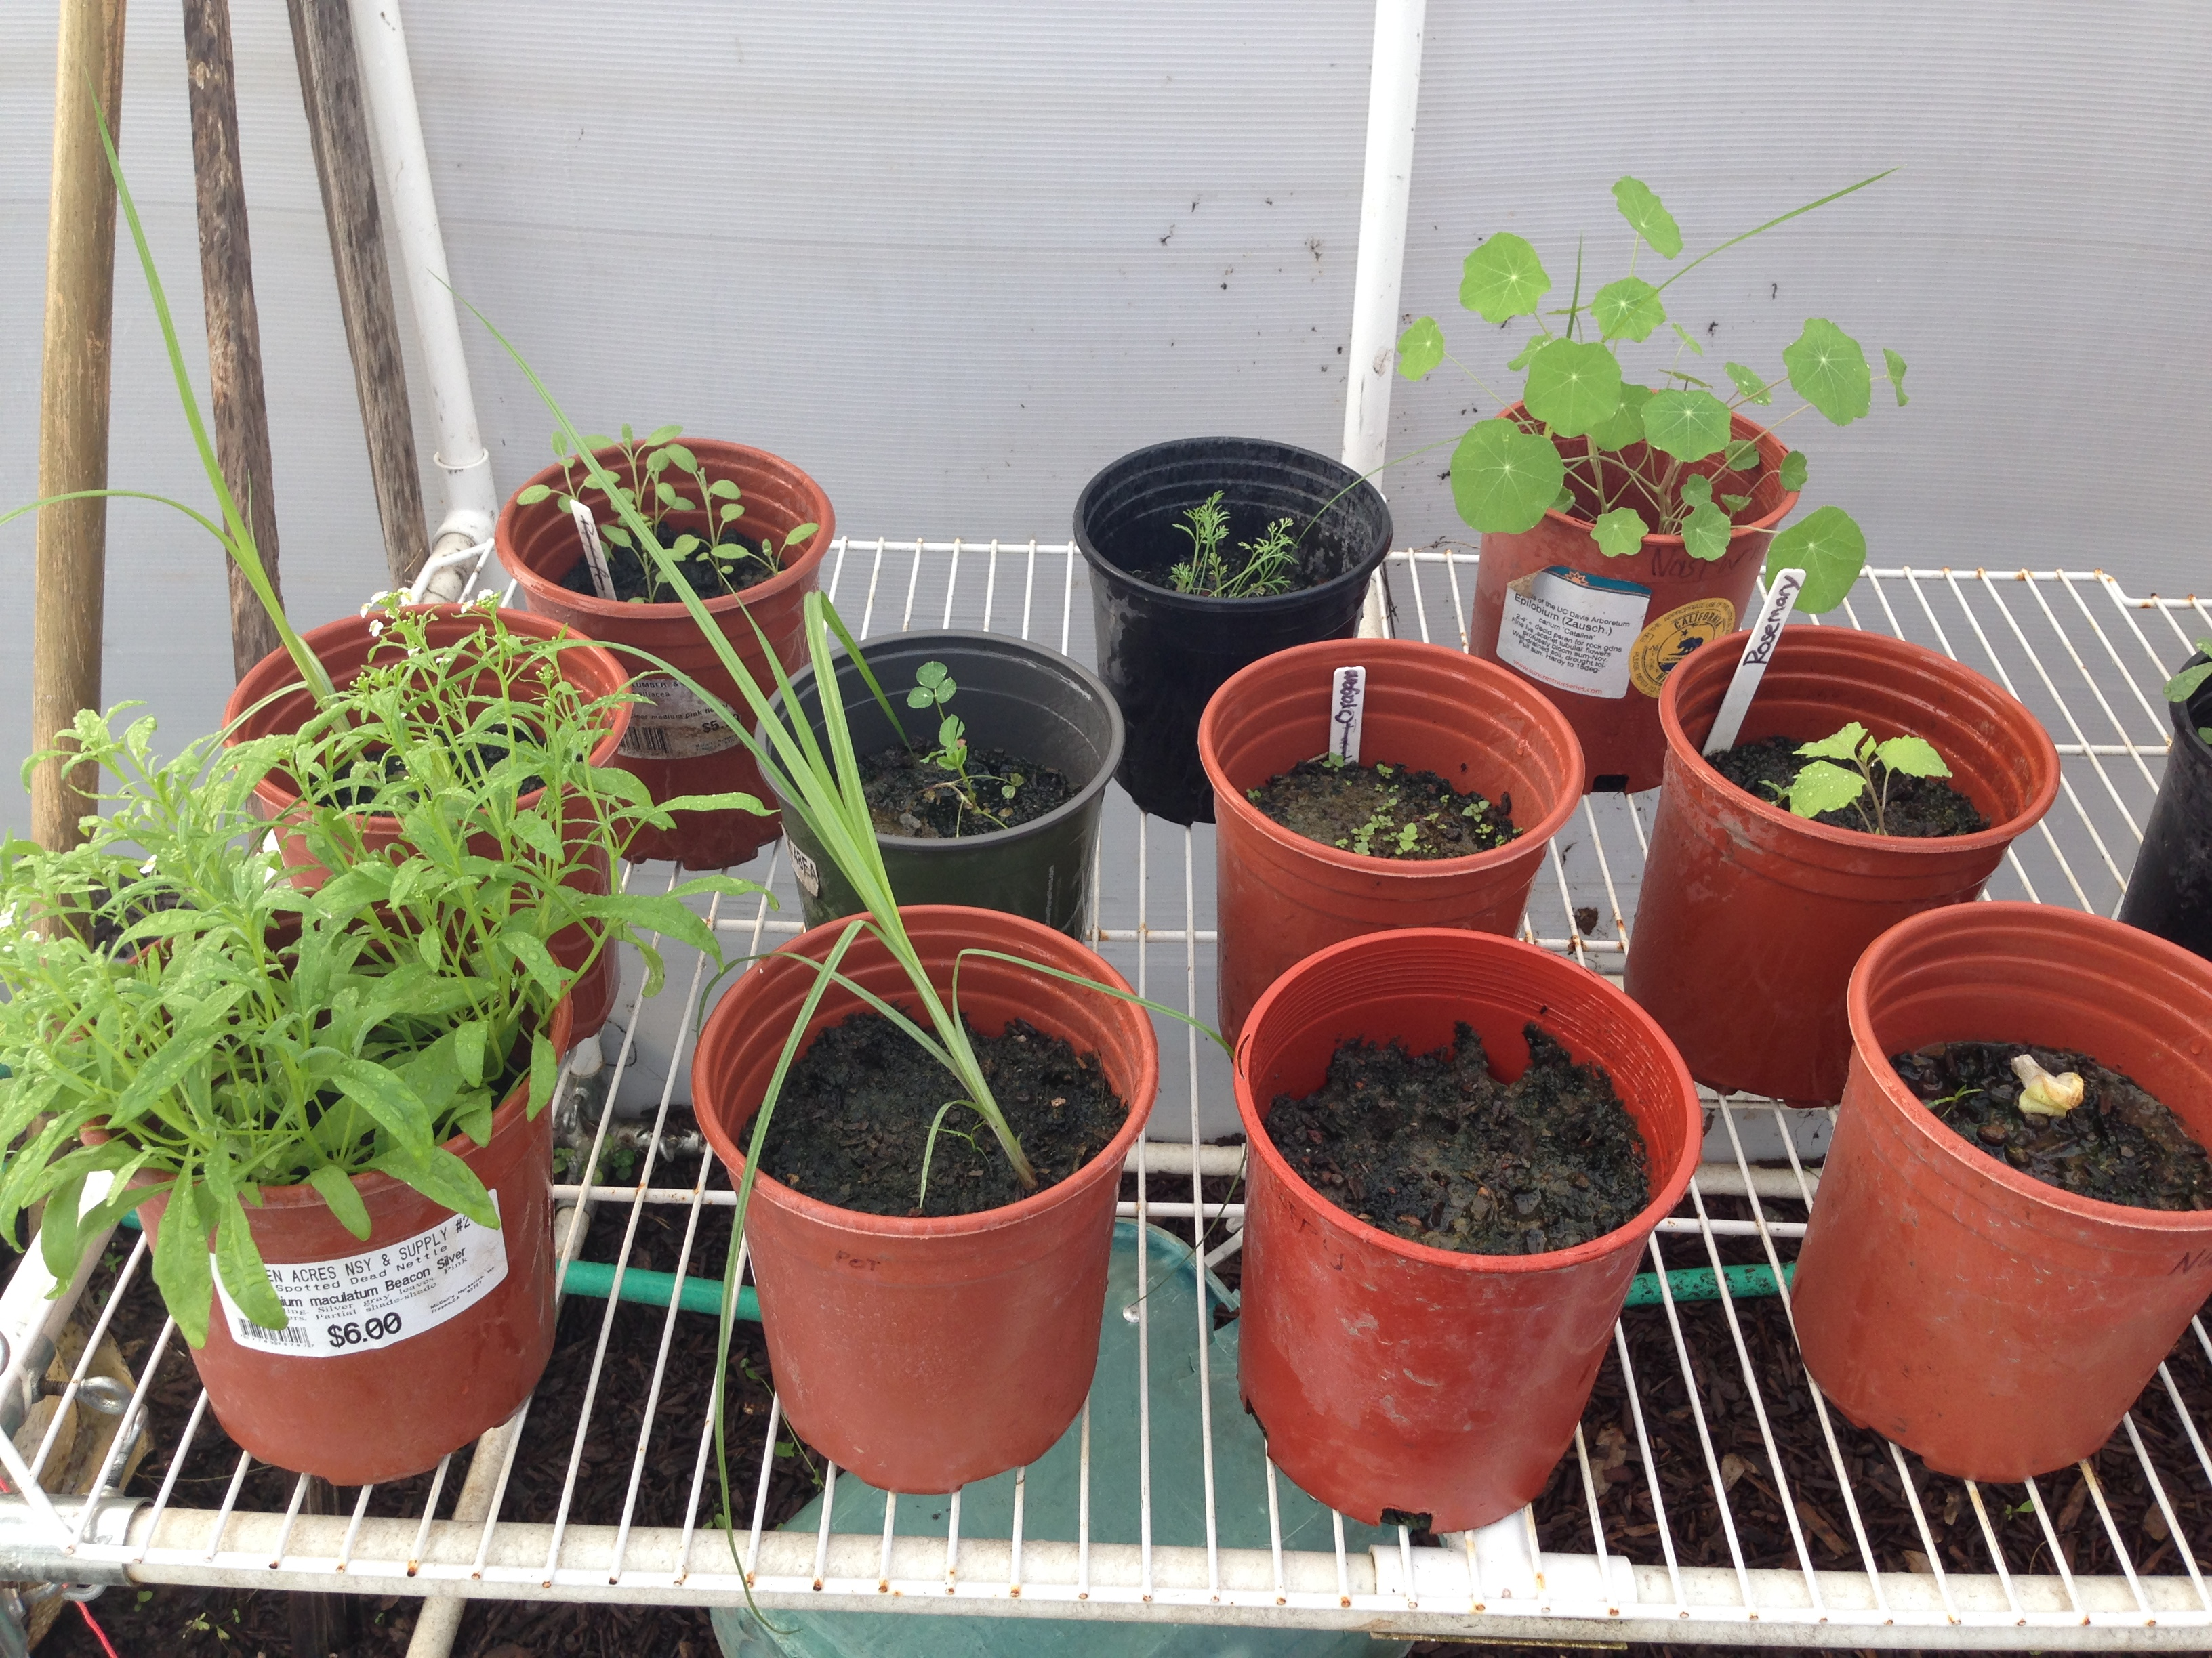

Slide 25
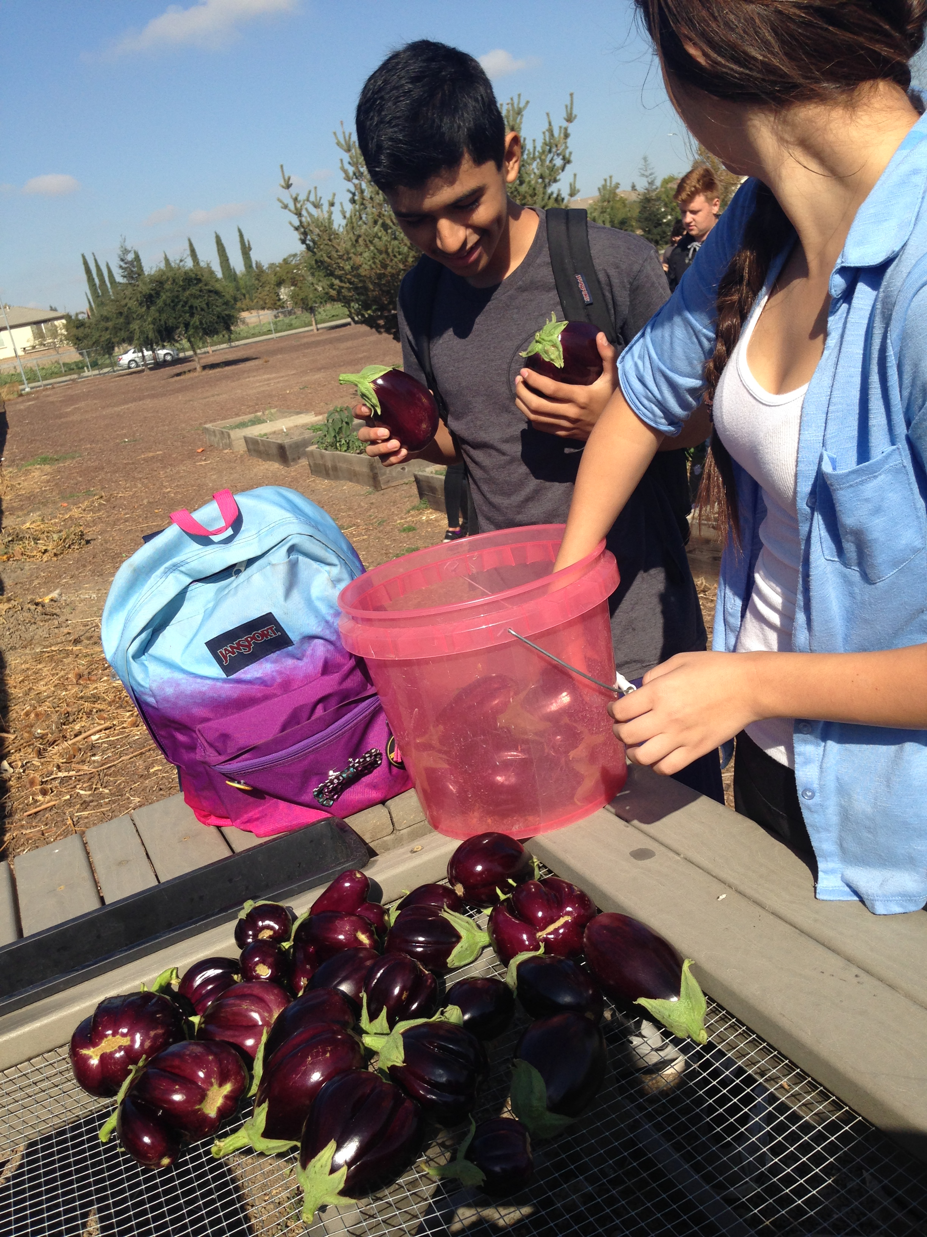
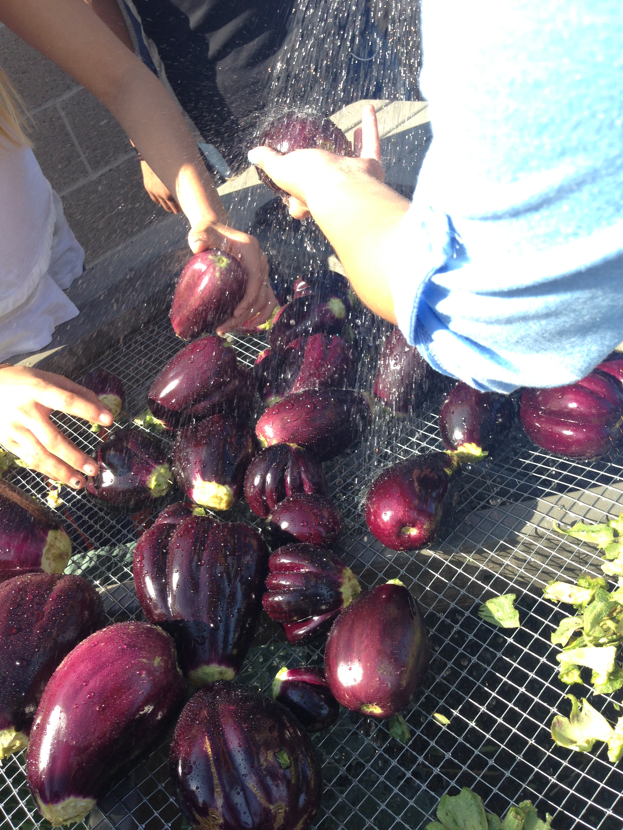

Slide 26
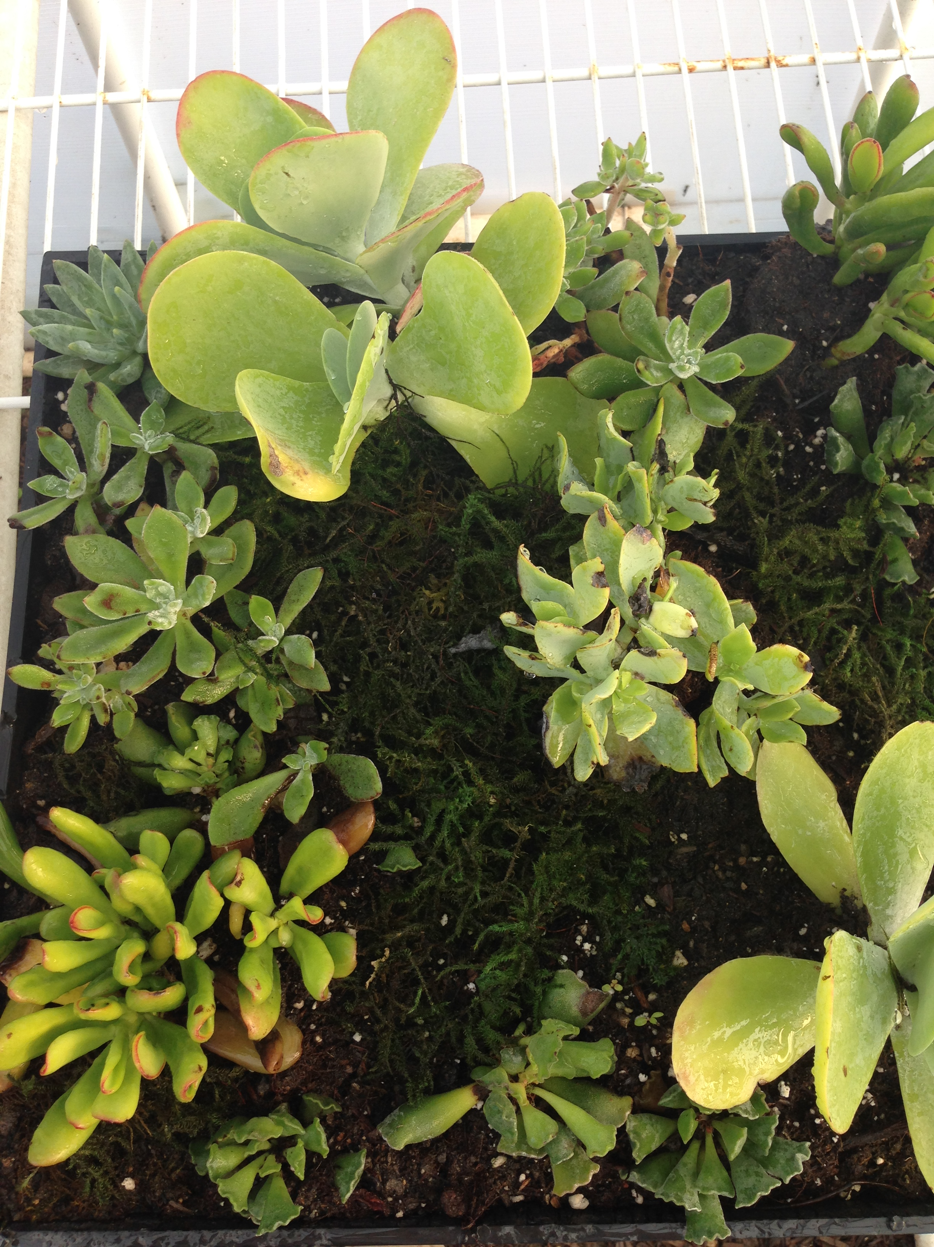
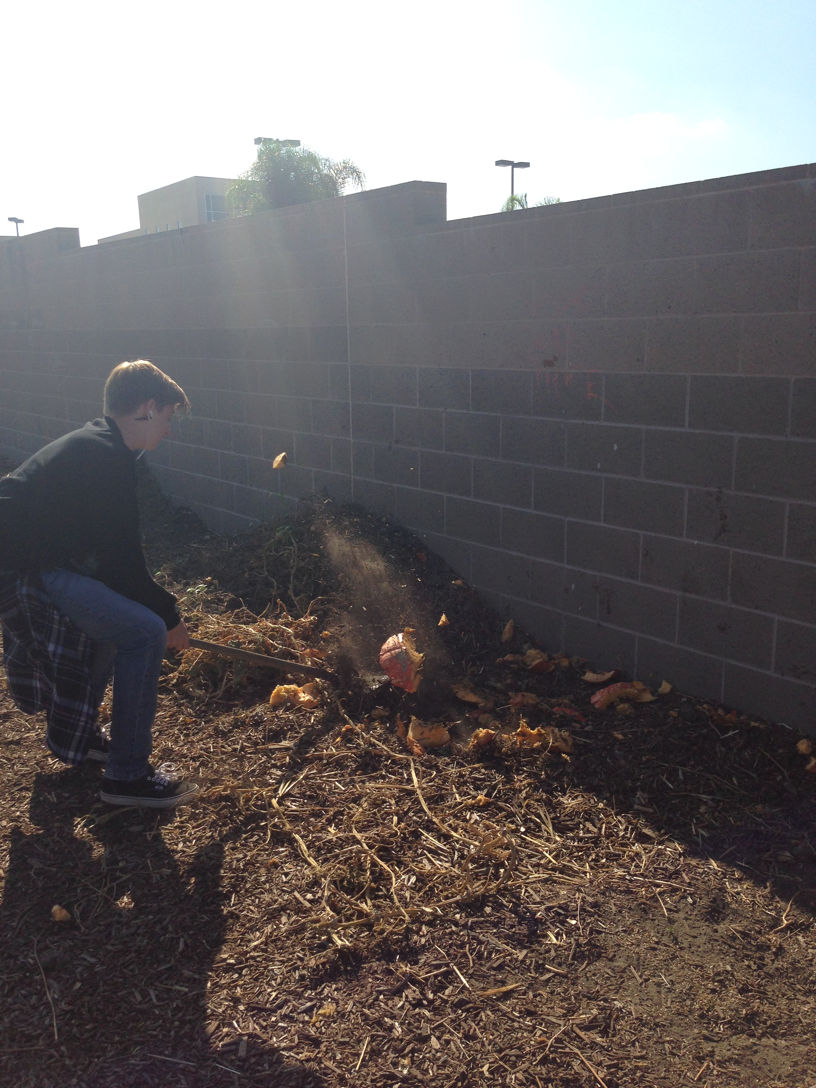

Slide 27
10/26 Our Carbon Footprint Obj. TSW learn how many Earth’s it takes to live their life style. P. 12 NB
What is a Carbon footprint?
What factors might contribute to your carbon footprint?
How many Earth’s does it take you to support your lifestyle, if everyone lived like you.

Slide 28
School buying local food to feed students

Slide 29
Vocabulary List UNIT 3 Due November 10th
Page 9 notebook
You can use it on your quizzes and tests.

Slide 30
Computer Lab Activity: Biocapacity of Countries p.13 NB
Use the Website: www.footprintnetwork.org
Research Biocapacity of 5 – 7 Countries. Record the trends and Biocapacity for each country.
Answer the following questions:
What trends do you see?
What are these trends related to?
What are the implications of these trends?
What needs to happen to increase our Biocapacity for the world?
Finally, write a paragraph to justify the need for sustainable management of resources and practices across countries.
What is the world Biocapacity, explain the trends using vocabulary words.

Slide 31
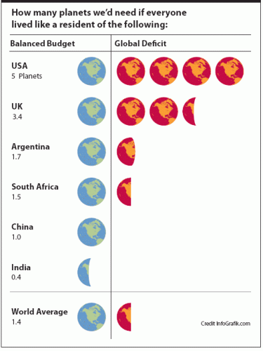
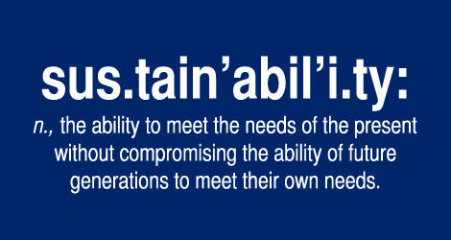
10/27 How many more Earths? Obj. TSW learn about how we need to conserve our resources now to have resources for future generations. P. 14 NB
How close was your prediction as to the number of Earth’s you thought you would use?
What ways can you be more conservative in your day to day life?
What are chapters 10 & 11 about in Omnivores Dilemma?

Slide 32
11/03 Fall Harvest Festival Obj. TSW create ideas for the Harvest Festival November 3rd at 5:30 at Bryte Campus.
Our Goal with F2F is to educate others about the benefits of eating locally, produce food for the RCHS cafeteria and the Bryte Campus. Create ideas for a vender booth- How can we make $?
Create ideas for an informational booth that is fun for all ages.

Slide 33
Page 13NB

Slide 34
Notebook Check Tuesday 10/27 P. 8 – 15 40 points
Date | Title/ Topic | Page #
10/19 | WU – Our Carbon Footprint: Resource Management | 8
10/23 | Vocabulary List – Our Carbon Footprint | 9
10/20 | WU – Our Carbon Footprint | 10
10/20 | Video - GATTACA | 11
10/22 | WU – Our Carbon Footprint | 12
10/22 | Activity: # of Earth’s | 13
10/23 | WU – How many more Earth’s? | 14
10/26 | Brainstorm – Major Pollution Situation World Wide | 15 Notebook Check p. 8 – 15 40 points

Slide 35
Activity: As a Class Brainstorm Major Pollution Situations in the World p. 11 NB
List Examples Below:
Pacific Garbage Patch
China’s Air Quality

Slide 36
Pollution in the World: P. 11 NB
Individual Research on a Pollution Situation in the World:
Where, What, How does it impact our available resources?
How does it impact our growing food to feed families?
Don’t forget to do your vocabulary!!!

Slide 37
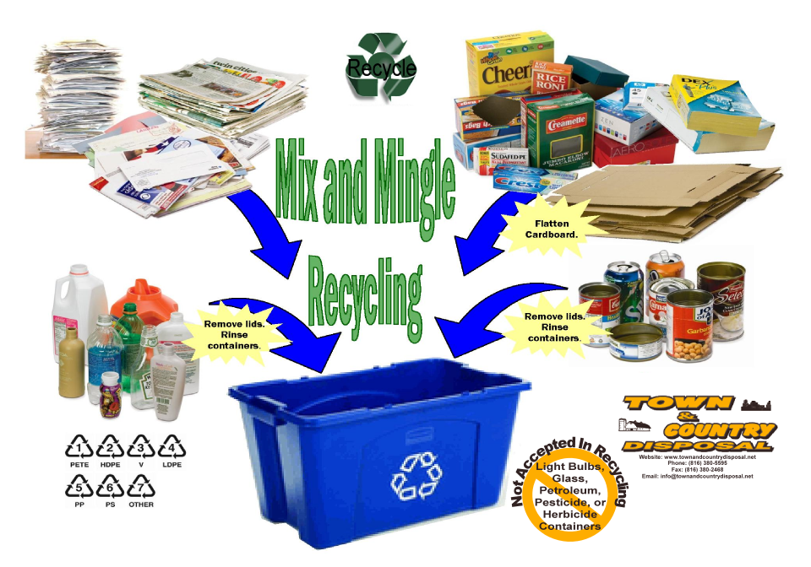
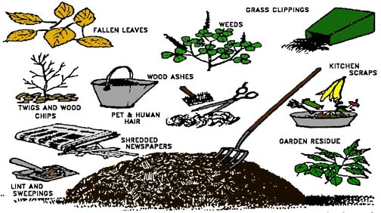
What if… 10/28 Obj. TSW think about ways we produce products and how they become obsolete. P. 16 NB
What is planned obsolescence?
How can we reduce, reuse & recycle products?
What if everything we produced could be biodigested, composted or recycled at the end of it’s life?

Slide 38
Contact local Farmers to show us their fields and their conservation practices. Fieldtrip November 15th UC Davis
Ideas of Names of local farmers & conservation practices

Slide 39
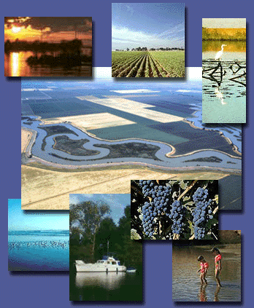
10/31 Land as a Resource Obj. TSW learn about organizations that protect our land. P. 18 NB
What benefits does land (Parks, Nature Reserves) provide for us?
What organizations manage our land?
What would you do differently?

Slide 40
Rangelands Trust
http://www.rangelandtrust.org/
Watch Video on Rangeland Trust
Randy Gustuvus - Director

Slide 41
Computer Lab Activity: Land is a Resource How is it managed? P. 13 NB
Research Bureau of Land Management
National Park Service
Fish and Game
National Forest Service
Choose one of these 4 Organizations and explain it’s history. Why was it created, what is its’ purpose, how do they educate the public about their purpose? Name 3 interesting facts.
Be prepared to share out.

Slide 42
Land is a Resource How is it managed? P.21 NB
Research Bureau of Land Management
National Park Service
Fish and Game
National Forest Service
Choose one of these 4 Organizations and explain it’s history. Why it was created, its purpose, how they educate the public about their purpose? Name 3 interesting facts.
Be prepared to share out.

Slide 43
Rangelands Trust
http://www.rangelandtrust.org/
Watch Video on Rangeland Trust
Write a short summary about why it is important that we have organizations that help protect our Natural Resources such as open land, or open water on the ocean, forests, etc.

Slide 44
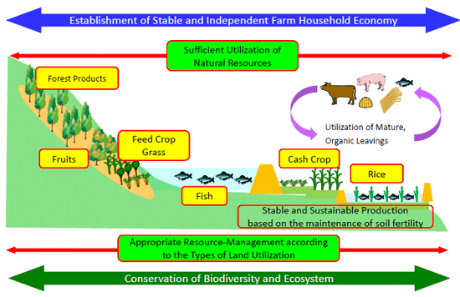

Slide 45
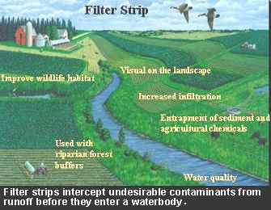
11/01 Conservation Practices Obj. TSW understand and explain conservation practices such as water conservation and pest management. P. 20 NB
Companion planting is a conservation practice, how does it work?
We used mulch in each of our garden beds over the summer, why?
What practice do we have for soil conservation?

Slide 46
Activity: List Our Best Practices Brainstorm conservation techniques we have in the garden that make it sustainable. P. 19 NB
Write class responses here:

Slide 47
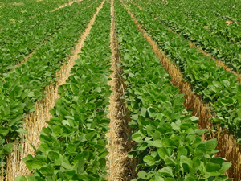
11/2 Conservation Practices Obj. TSW learn about conservation practices. P. 22 NB
How do these practices (to the left) improve soil productivity or water retention?
Why do we want to conserve soil/ water?
What are some of the threats to soil water?
No till farming

Slide 48
Conservation Practices we use in the garden.
Suggest ways to improve our effectiveness in the garden and describe some conservation techniques to include.
Crop Rotation – Make a map of each season, so we don’t plant in the same beds with the same crops. This helps keep pest #’s down.

Slide 49
11/3 Conservation Practices Obj. TSW understand how cover crop, intercropping and integrated pest management help conserve our soil. P.24 NB
What is a Cover Crop?
What is Intercropping?
Name some integrated pest management practices.

Slide 50
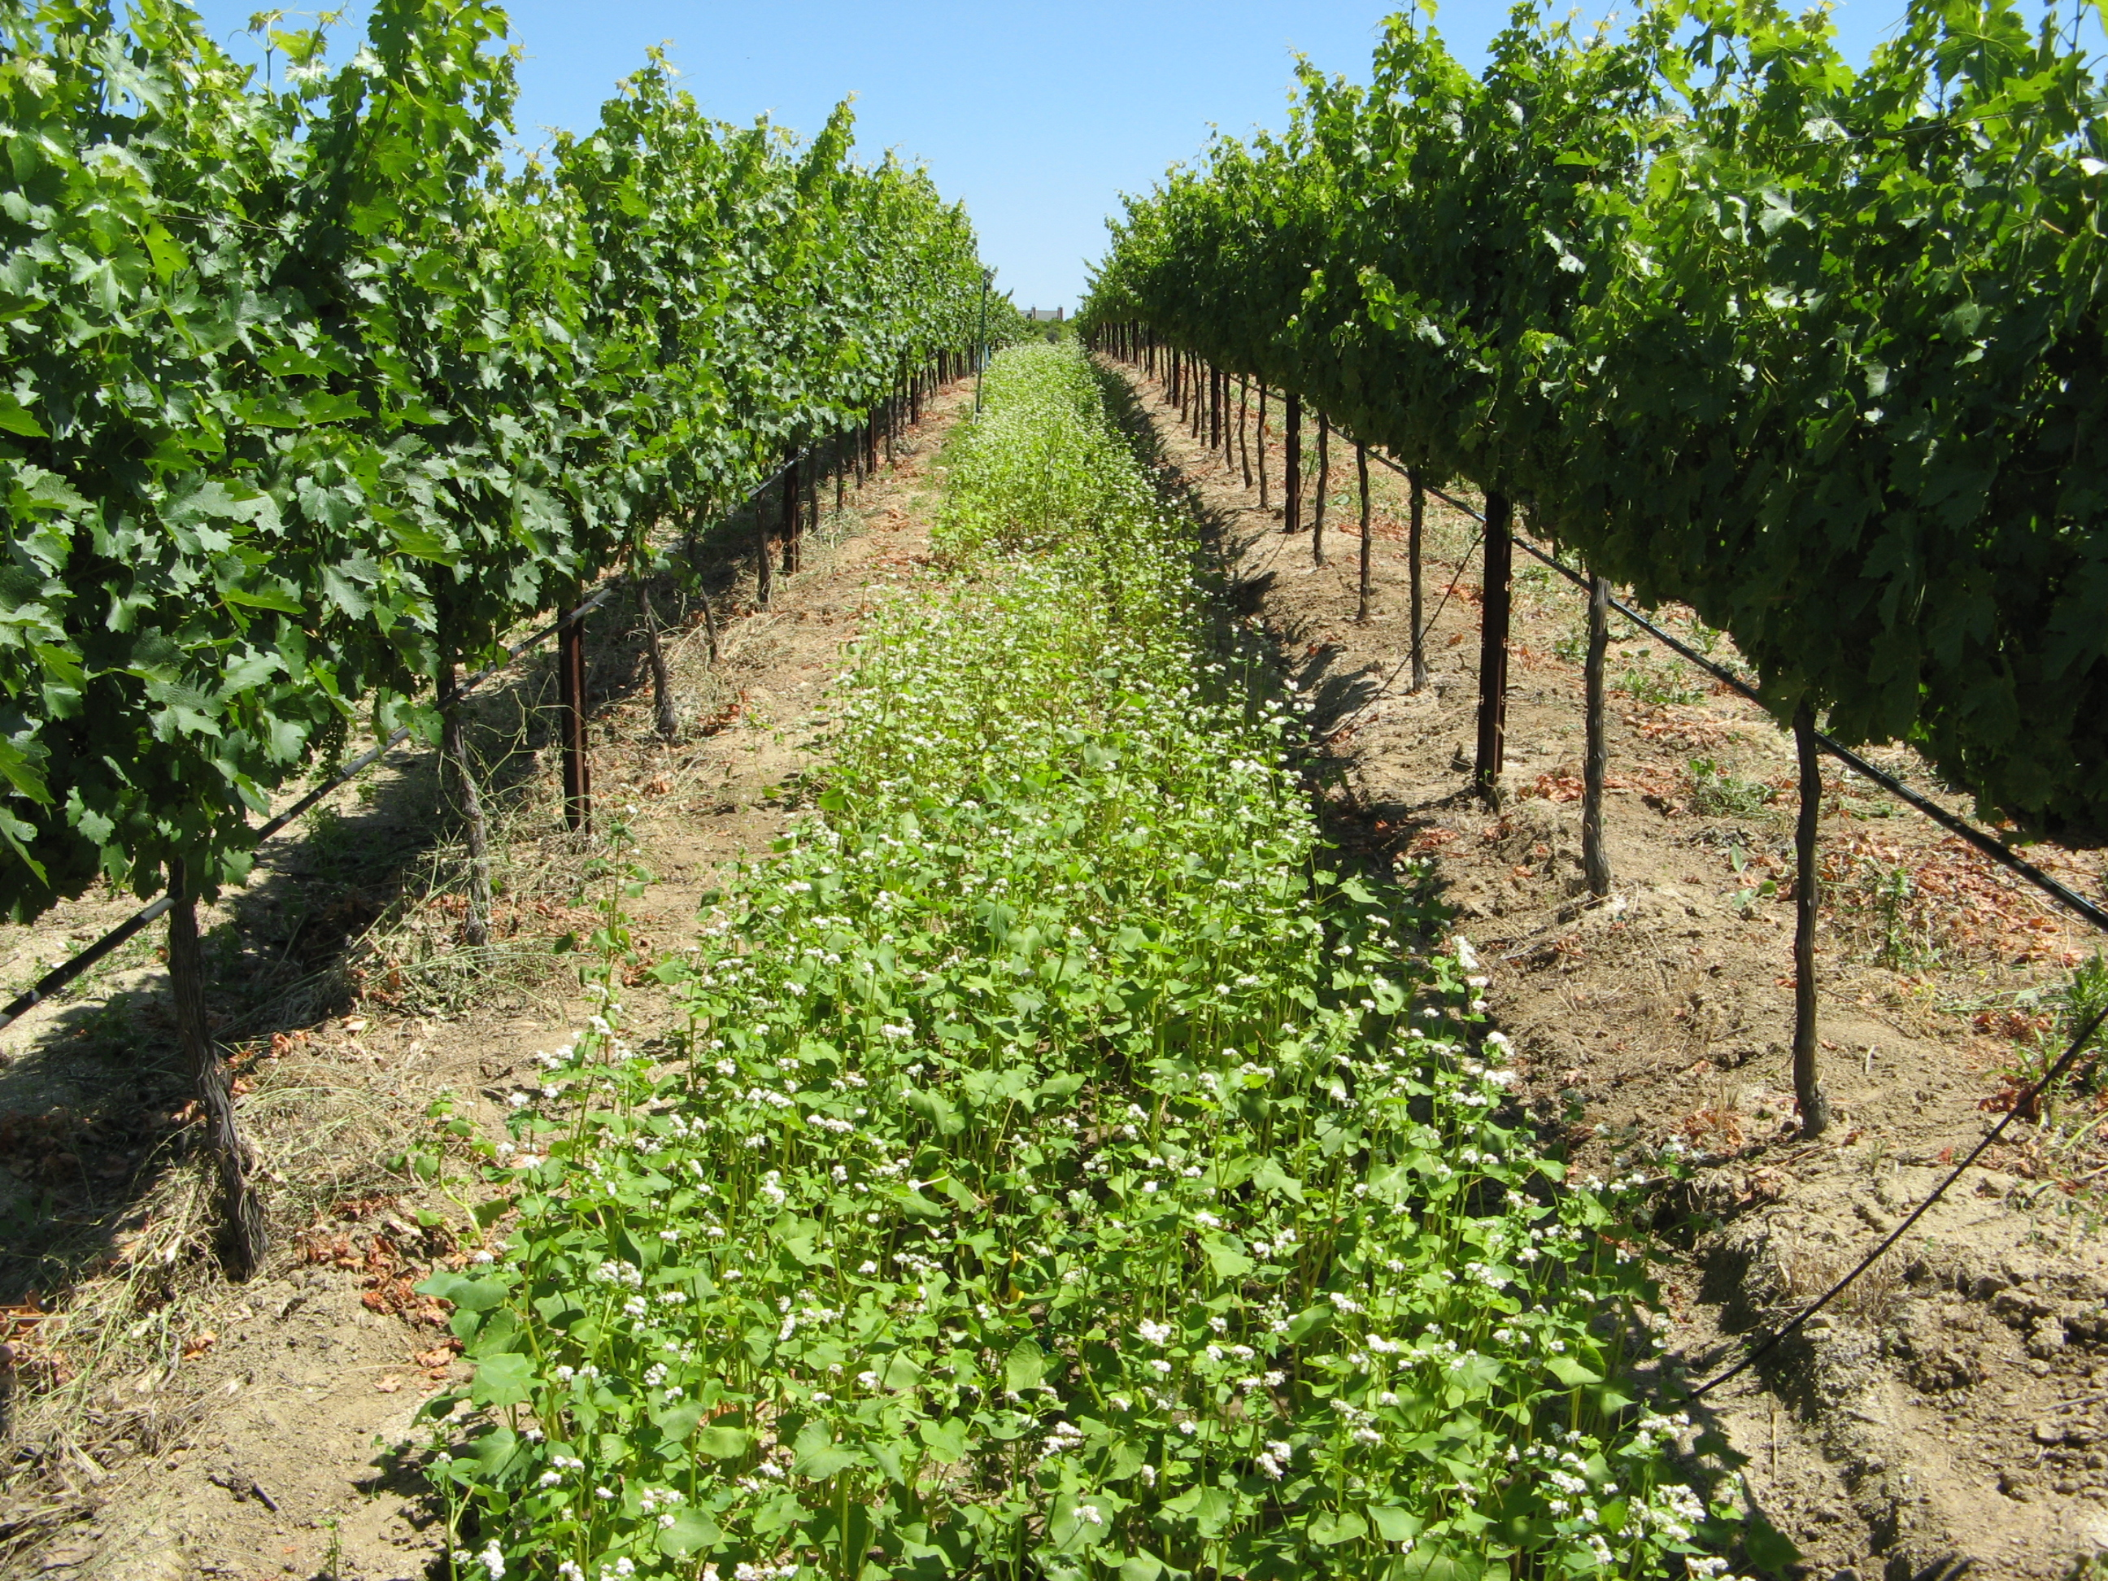
Cover Crop: growing a second crop in the same season of another that will improve soil health.
Suppressing weeds
Protecting soil from rain or runoff
Improving soil aggregate stability
Reducing surface crusting
Adding active organic matter to soil
Breaking hardpan
Fixing nitrogen –clover, fava beans
Scavenging soil nitrogen
Suppressing soil diseases and pests
http://covercrops.cals.cornell.edu/

Slide 51
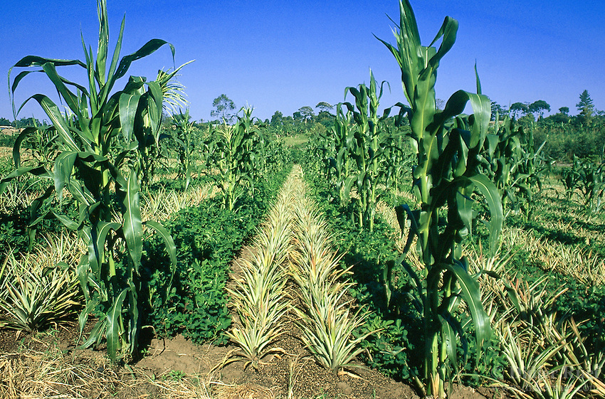
Innercropping – growing two or more crops at the same time in the same field.
Reduces insect/ pest infestations
Reduces plant diseases
Reduces erosion & Protects topsoil
Attracts beneficial insects
Minimize labor to control weeds
Increase in production of land
2 crops harvested instead of one
http://www.oisat.org/control_methods/cultural__practices/intercropping.html

Slide 52
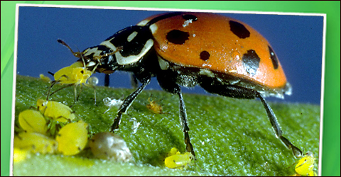
Integrated Pest management
Lady bugs
Preying Mantis’
Butterfly's
Less pesticides
Increased biodiversity

Slide 53
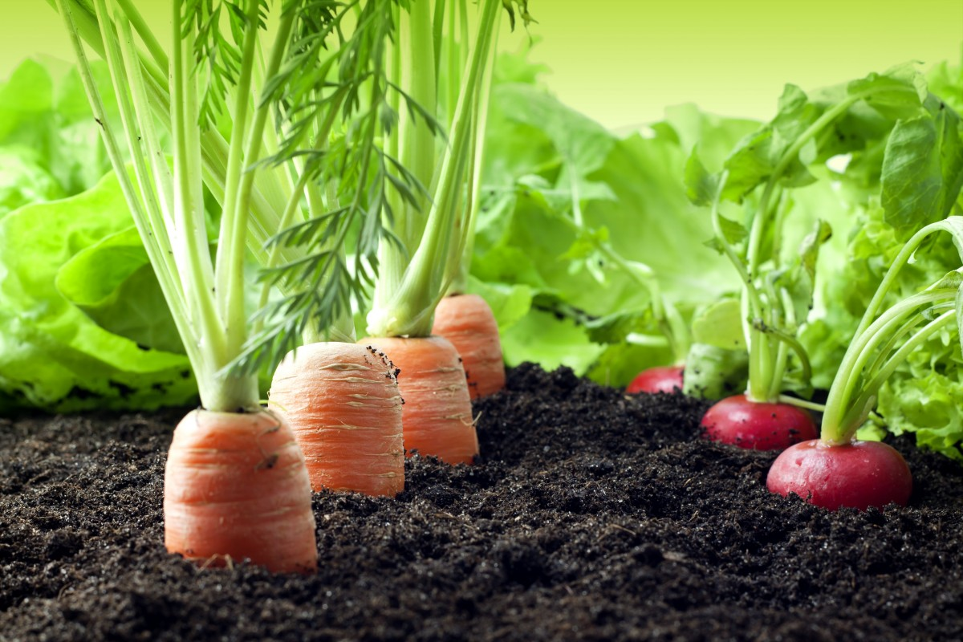
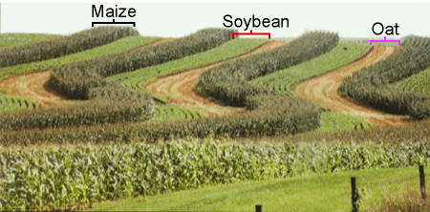
11/7 Biodiverisity Obj. TSW learn about what biodiversity is and why it is important. P.26 NB
What picture shows the highest number of different species (greatest biodiversity)?
What is Biodiverisity? How can it be measured?
Why is Biodiversity important?

Slide 54
Computer Lab Activity – Examine your Carbon Footprint for Foods http://www.eatlowcarbon.org/ p. 21 NB
What is your food carbon footprint?
How do your food choices affect your carbon footprint?
What are 5 easy tips to reduce your food carbon footprint?
List the food selection with the highest and lowest carbon footprint for: breakfast, soup, side order, entrée, dessert
What do the Carbon footprint scores actually mean?
How were they calculated?

Slide 55
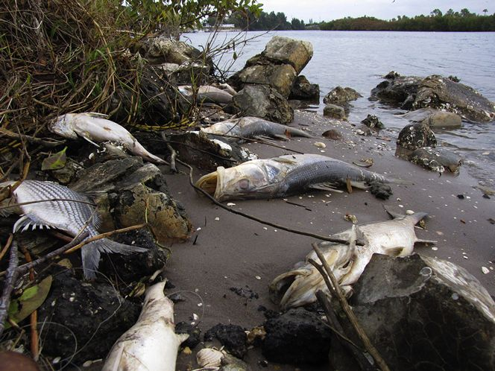
11/8 Threats to Biodiversity Obj. TSW realize that unlike any other mass extinction event, the current mass extinction now is directly related to human activities. P.26 NB
What is mass extinction?
What are some threats to Biodiversity?
What human activities are related to the our decline in biodiversity and mass extinction of species on the planet?

Slide 56
11/9 Applying Biodiversity to our Garden Obj. TSW learn how our garden is biodiverse, and areas of improvement. P.28 NB
How would you describe the biodiversity of our garden?
Why is biodiversity beneficial in natural environments?
How can we increase the biodiversity in our garden?

Slide 57
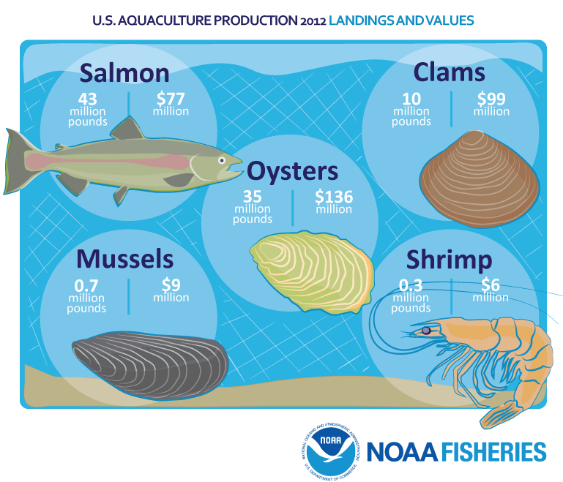
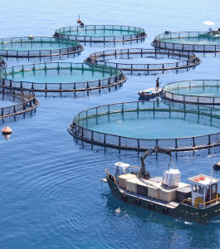
11/10 Aquaculture and Hydroponics Obj. TSW learn about exciting occupations in growing sustainable food. P.30 NB
What is Aquaculture about?
What is Hydroponics about?
Have you heard of Permaculture?

Slide 58
Computer Lab Activity: Choose one: Research Aquaculture, Hydroponics or Permaculture.
What is the history behind the science?
How is the product cared for/ produced?
What is the demand for the industry? Is it growing?
Describe some challenges to having one of these programs in our school district.
What would be some benefits?

Slide 59
Permaculture AXES Paragraph
What is Permaculture in your own words?
What are some examples of Permaculture?
What examples of permaculture do we have in our garden?
Why is Permaculture important?
Do you see it catching on in agriculture? Why or Why not?

Slide 60
http://www.openthefuture.com/cheeseburger_CF.html
Go to the website and read the article.
Discuss what you have read with 2 other students around you.
Class discussion on the energy needed to make a hamburger.
AXES Paragraph about the article in your notebook.
Cheeseburger Video

Slide 61
11/14 Eating a Cheeseburger Obj. TSW learn about the carbon footprint of eating a cheeseburger. P. 30 NB
What is a carbon footprint?
What kind of energy goes into making a cheeseburger?
Rank the carbon footprint of eating a cheeseburger: High, Medium or Low.

Slide 62
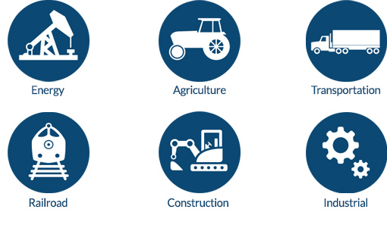
11/15 Along the Way… there are Jobs Obj. TSW learn about potential jobs in the Agriculture & transportation industry. P.32 NB
What are some potential jobs in Agriculture?
How many people work in an area related to Agriculture?
Why is this significant?

Slide 63
Agriculture Careers
Agricultural careers may be divided into various categories. These include: Agribusiness Management, Agricultural and Natural Resources Communications, Building Construction Management, Agriscience, Resource Development and Management, Parks, Recreations, and Tourism Resources, Packaging, Horticulture, Forestry, Food Science, and Fisheries/Wildlife
http://www.agday.org/education/careers.php

Slide 64
http://www.agday.org/education/careers.php
Go to the following link and research potential jobs in Agriculture.
Write a list of 5 potential jobs that are interesting to you and why.

Slide 65
11/16 Andy Warhal Hamburger Obj. TSW understand the common denominator a fast food hamburger creates. P.34 NB
What do you expect from a fast food hamburger?
What is your favorite memory eating a fast food hamburger?
Why is eating a fast food hamburger a common denominator among all people?

Slide 66
11/17 The Farm to Fork Movement Obj. TSW compare and contrast the farm to fork movement to the traditional way of growing food in large farms far away. p.36 NB
How is the Farm to Fork movement more efficient than traditional food?
How is F2F more efficient in terms of energy?
Discuss as a class the: distance the food travels, location of the goods and services and transportation to those places, and nutrient value in fresh food.

