Slide 1
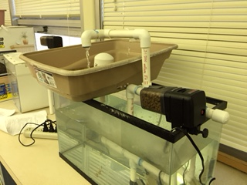
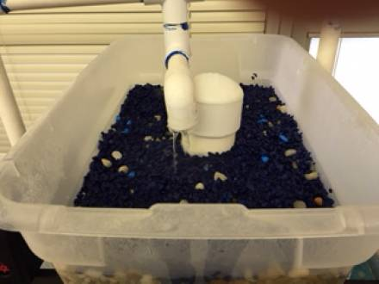
Lesson Aquaponics
UNIT 1 F2F

Slide 2
5/16 Aquaponics Obj. TSW construct ideas about how the mini aquaponics unit will be assembled and how it works. P. 76 NB
How does an aquaponics system work?
Read through the assembly instruction: Which step are you unclear about?
What is the Nitrification cycle?

Slide 3
Prefabricated Mini Aquaponics Unit

Slide 4
Food Matters Notes Page 77NB

Slide 5
5/18 Mini Aquaponics Unit Obj. TSW develop a plan to assemble an mini aquaponics unit. P. 78 NB
What are the benefits of an aquaponics system?
How does it “fit”, into our sustainable model?
What concerns do you have about assembling one?

Slide 6
Aquaponics Benefits
Efficient use of space
Reuse matter and Nutrients
Recycling Waste (nutrients)
Experience Symbiotic Relationships between organisms
Grow your own food

Slide 7
Aquaponics Unit Assigning Tasks – Nelson / Pade Mini Aquaponics System Read through the directions as a team. Decide who will have what roles. Write down questions (RFI – Request For Information) that you have or highlight parts of the directions you need clarification on. P. 79 NB
(1) Foreman: Read ALL directions and assigns tasks to construction crew and Gopher and makes sure ALL tasks are carried out appropriately.
(3) Construction: Responsible for cutting supplies to appropriate length and assembling the aquaponics unit.
(1) Gopher: person responsible for set up, clean up and getting the appropriate supplies.

Slide 8
5/19 Getting started with the Mini Aquaponics Unit Obj. TSW learn first hand skills assembling a mini aquaponics unit. P.80 NB
What was the construction of the mini aquaponics unit like yesterday?
Draw a sketch of what your mini aquaponics unit will look like.
What safety measures were taken to make sure McAllister did not lose her mind or have heart complications?

Slide 9
5/20 Mini Aquaponics Reflection Obj. TSW reflect on their experience building and assembling the aquaponics unit. P. 82 NB
How can Aquaponics benefit people throughout the world?
What would you do differently with you mini aquaponics unit?
What was one of your successes?

Slide 10
Aquaponics Article p. 81 NB
Do you think the general tone of the article is optimistic or pessimistic?
Why did Morgan travel to Haiti after the 2010 earthquake?
What is the main reason the Haitian people face food shortages?
Who is George Powell?
How do the teenagers at Stonewall Jackson help?

Slide 11
Transcript P. 59 NB
Tape your transcript to page 59 NB.
Write three short term goals you want to accomplish before the end of the year.
Write three long term goals you want to accomplish before you graduate/ life goals.

Slide 12
Internships.com P. 71 NB
Where are you interested in working?
What type of work?

Slide 13
Top 10 most Common Interview questions p. 73 NB
http://money.usnews.com/money/careers/slideshows/the-10-most-common-interview-questions/11
Choose 3 of these 10 questions and write our you answer on page 73 NB.

Slide 14
5/11 Aquaponics Obj. TSW realize one of the solutions to feeding the world is aquaponics. P. 72 NB
What is aquaponics?
What skills might you need to build an aquaponics unit.
Describe some characteristics (steps) of building an aquaponics unit.

Slide 15
Final Project – Garden Plants
PART 2 DUE McAllister needs to review your progress of your project before May 27TH.
Introduction
Briefly review your project for us.
Data
Qualitative Data: Words, Descriptions, Pictures, Video
Quantitative Data: Tables, Charts, Graphs
Data Analysis
What does the data mean?
What were some things that you learned from mistakes you made?
What would you do differently next time?
Conclusion
Explain what your project meant to you and how the class Farm 2 Fork has helped you gain a better understanding of your project/ gardening caring for plants/& or soil . If you were in charge of feeding the world, or creating more sustainable practices worldwide how you would go about it?

Slide 16
Final Project - Aquaponics Unit
PART 2 DUE McAllister needs to review your progress of your project before May 27TH.
Introduction
Briefly review your project for us.
Materials: List them
Procedure: Step 1… Step 2… Explain how you put it together.
Data
Qualitative Data: Words, Descriptions, Pictures, Video
Quantitative Data: Tables, Charts, Graphs, Flow Rate
Data Analysis
What were some things that you learned from mistakes you made?
What would you do differently next time?
Conclusion
Explain what your project meant to you and how the class Farm 2 Fork has helped you gain a better understanding of your project/ gardening caring for plants/& or soil . If you were in charge of feeding the world, or creating more sustainable practices worldwide how you would go about it?

Slide 17
What would be good questions to ask during an interview? P. 73 NB
Read the article, “How to prepare for an Entry-Level interview”

Slide 18
If you can’t get enough…
There are yet more Service Learning Opportunities at the Farmer’s Market.
Thursday May 19th from 5 – 7 pm
Thursday May 26th from 4:30 – 6:30 pm (this is the last one… or not)
Just kidding…
June 4th & 5th Join the Relay for Life Team to fight Cancer
A member(s) of our RCHS Ag team will be walking the track continuously for 24 hours to raise awareness of cancer, education, prevention, treatment and in memory of those who have lost their battle.

Slide 19
What other local businesses support the Farm to Fork movement? P. 41 NB
Research 3 businesses with in 100 miles that raise, grow, sell, buy, and distribute local produce and meat, including dairy cattle?
Explain what they do and how they do it.
Some of this information can be included in your 1 – 2 page paper.

Slide 20
Omnivores Dilemma How Corn Took Over America & The Farm p. 47 NB
How is the supermarket like a field of corn? P.10
Name some products made from corn. P. 11
How much biodiversity was lost from 1920 – 2002? P. 26 NB
Discuss a result of growing so much corn. P. 26 - 27

Slide 21
1 – 2 page paper Due May 12th Where does your food come from?
Where does your food come from?
Discuss where your family buys food. Discuss what Farm to Fork is and it’s benefits.
Why is it important to know where your food comes from?
Include examples, explanations, and show the significance of where our food comes from.
Maybe include ingredients such as High Fructose Corn Syrup, salt, fat, sugar in our diet.
Discuss the video: Fed Up.
Include notes from Kari Pina’s Guest presentation about how she sources healthy fresh food for 7700 students.
Include the difference between processed and natural foods. Why is that important?
Include companies, businesses that are part of the solution to eat healthier, and companies that could improve to become part of the solution. How are companies trying to change their image?
APA Style: purdue.owl.edu

Slide 22
www.cacareerzone.org p.49
Begin the Career Assessment
Write an occupation you are interested in.
One sentence describing the job in your own words
Describe the preparation required for that occupation
What is the range of salary?
What is that occupations outlook? Expanding, stagnant, decreasing?
What are the common College Majors?

Slide 23
www.cacareerzone.org P. 51NB
Read: “Things they need to be able to do”
Write one - three skill(s) or job description that you are good at.

Slide 24
Entry Level Research P. 53 NB
Find 3 Entry – Level employment opportunities from the Skills Profiler of California Career Zone
State your skill that will be an asset to that type of work.

Slide 25
Omnivore’s Dilemma CH 3 From Farm to Factory Turning bombs into Fertilizer p. 57 NB
What is Agribusiness? P. 29 NB
What is the main ingredient in fertilizer?
How is recycling fertilizer in a natural loop different than applying ammonium nitrate?

Slide 26
California Department of Food & Agriculture p.75 NB
https://www.cdfa.ca.gov/
https://www.cdfa.ca.gov/employment/
View the above websites.
Write in your notebook a summary of what the website has to offer.
What are some available employment positions offered in the CDFA?

Slide 27
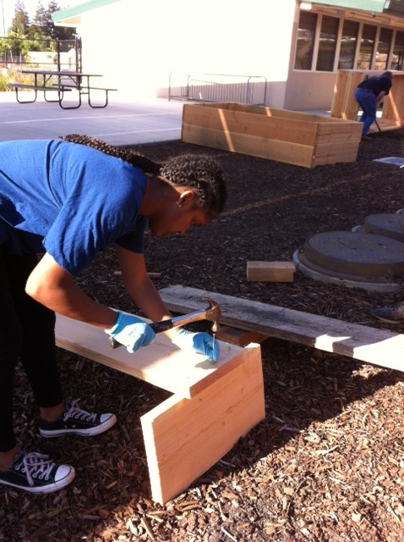
Assembling the Ramp for loading the garden beds with soil. May 15th, 2016

Slide 28
Still building the ramp… Finally we get to move soil, even the puppy dog gets to help.

Slide 29
I hope my future students appreciate all the hard work that went into building the garden beds and moving soil into them!

Slide 30
McAllister gets to play in the soil!!! ☺ Silly Goose…

Slide 31
Thank you!
West Sacramento Rotary, Centennial – Tony, Matt & Chris
Cheryle Sutton – Culinary Teacher
Jesus & Reshe- Student Volunteers

