Slide 1
Farm to Fork
Week 7

Slide 2
Last Week’s Work

Slide 3
Loading the Garden Beds

Slide 9
9/28 Fertilizer Obj. TSW understand and explain the importance of fertilizer for the growth of plants. P. 58NB
What elements are used in fertilizer?
What is the difference between organic and inorganic fertilizer?
What types of plants can add fertilizer to the soil just by being planted?

Slide 10
Farm to Fork Festival
Debrief for the class
Harvest Festival November 10th at Bryte Campus with Culinary.

Slide 11
9/29 Healthy Soil Obj. TSW learn how to create healthy soil to grow nutritious plants. P. 60NB
What does it take to create healthy soil?
What helps it drain well?
What soil texture helps hold onto nutrients?

Slide 12
Collaboration Day Tuesday Sept. 29th
We will be in the Computer lab in the library.
You will have an assignment about Fertilizer Research

Slide 13
Farm to Fork Festival 2015

Slide 15
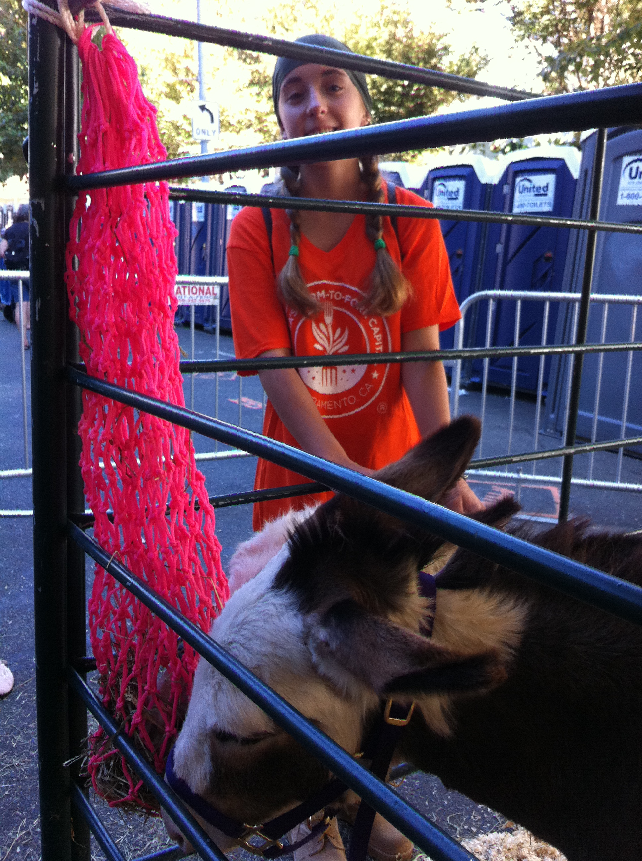
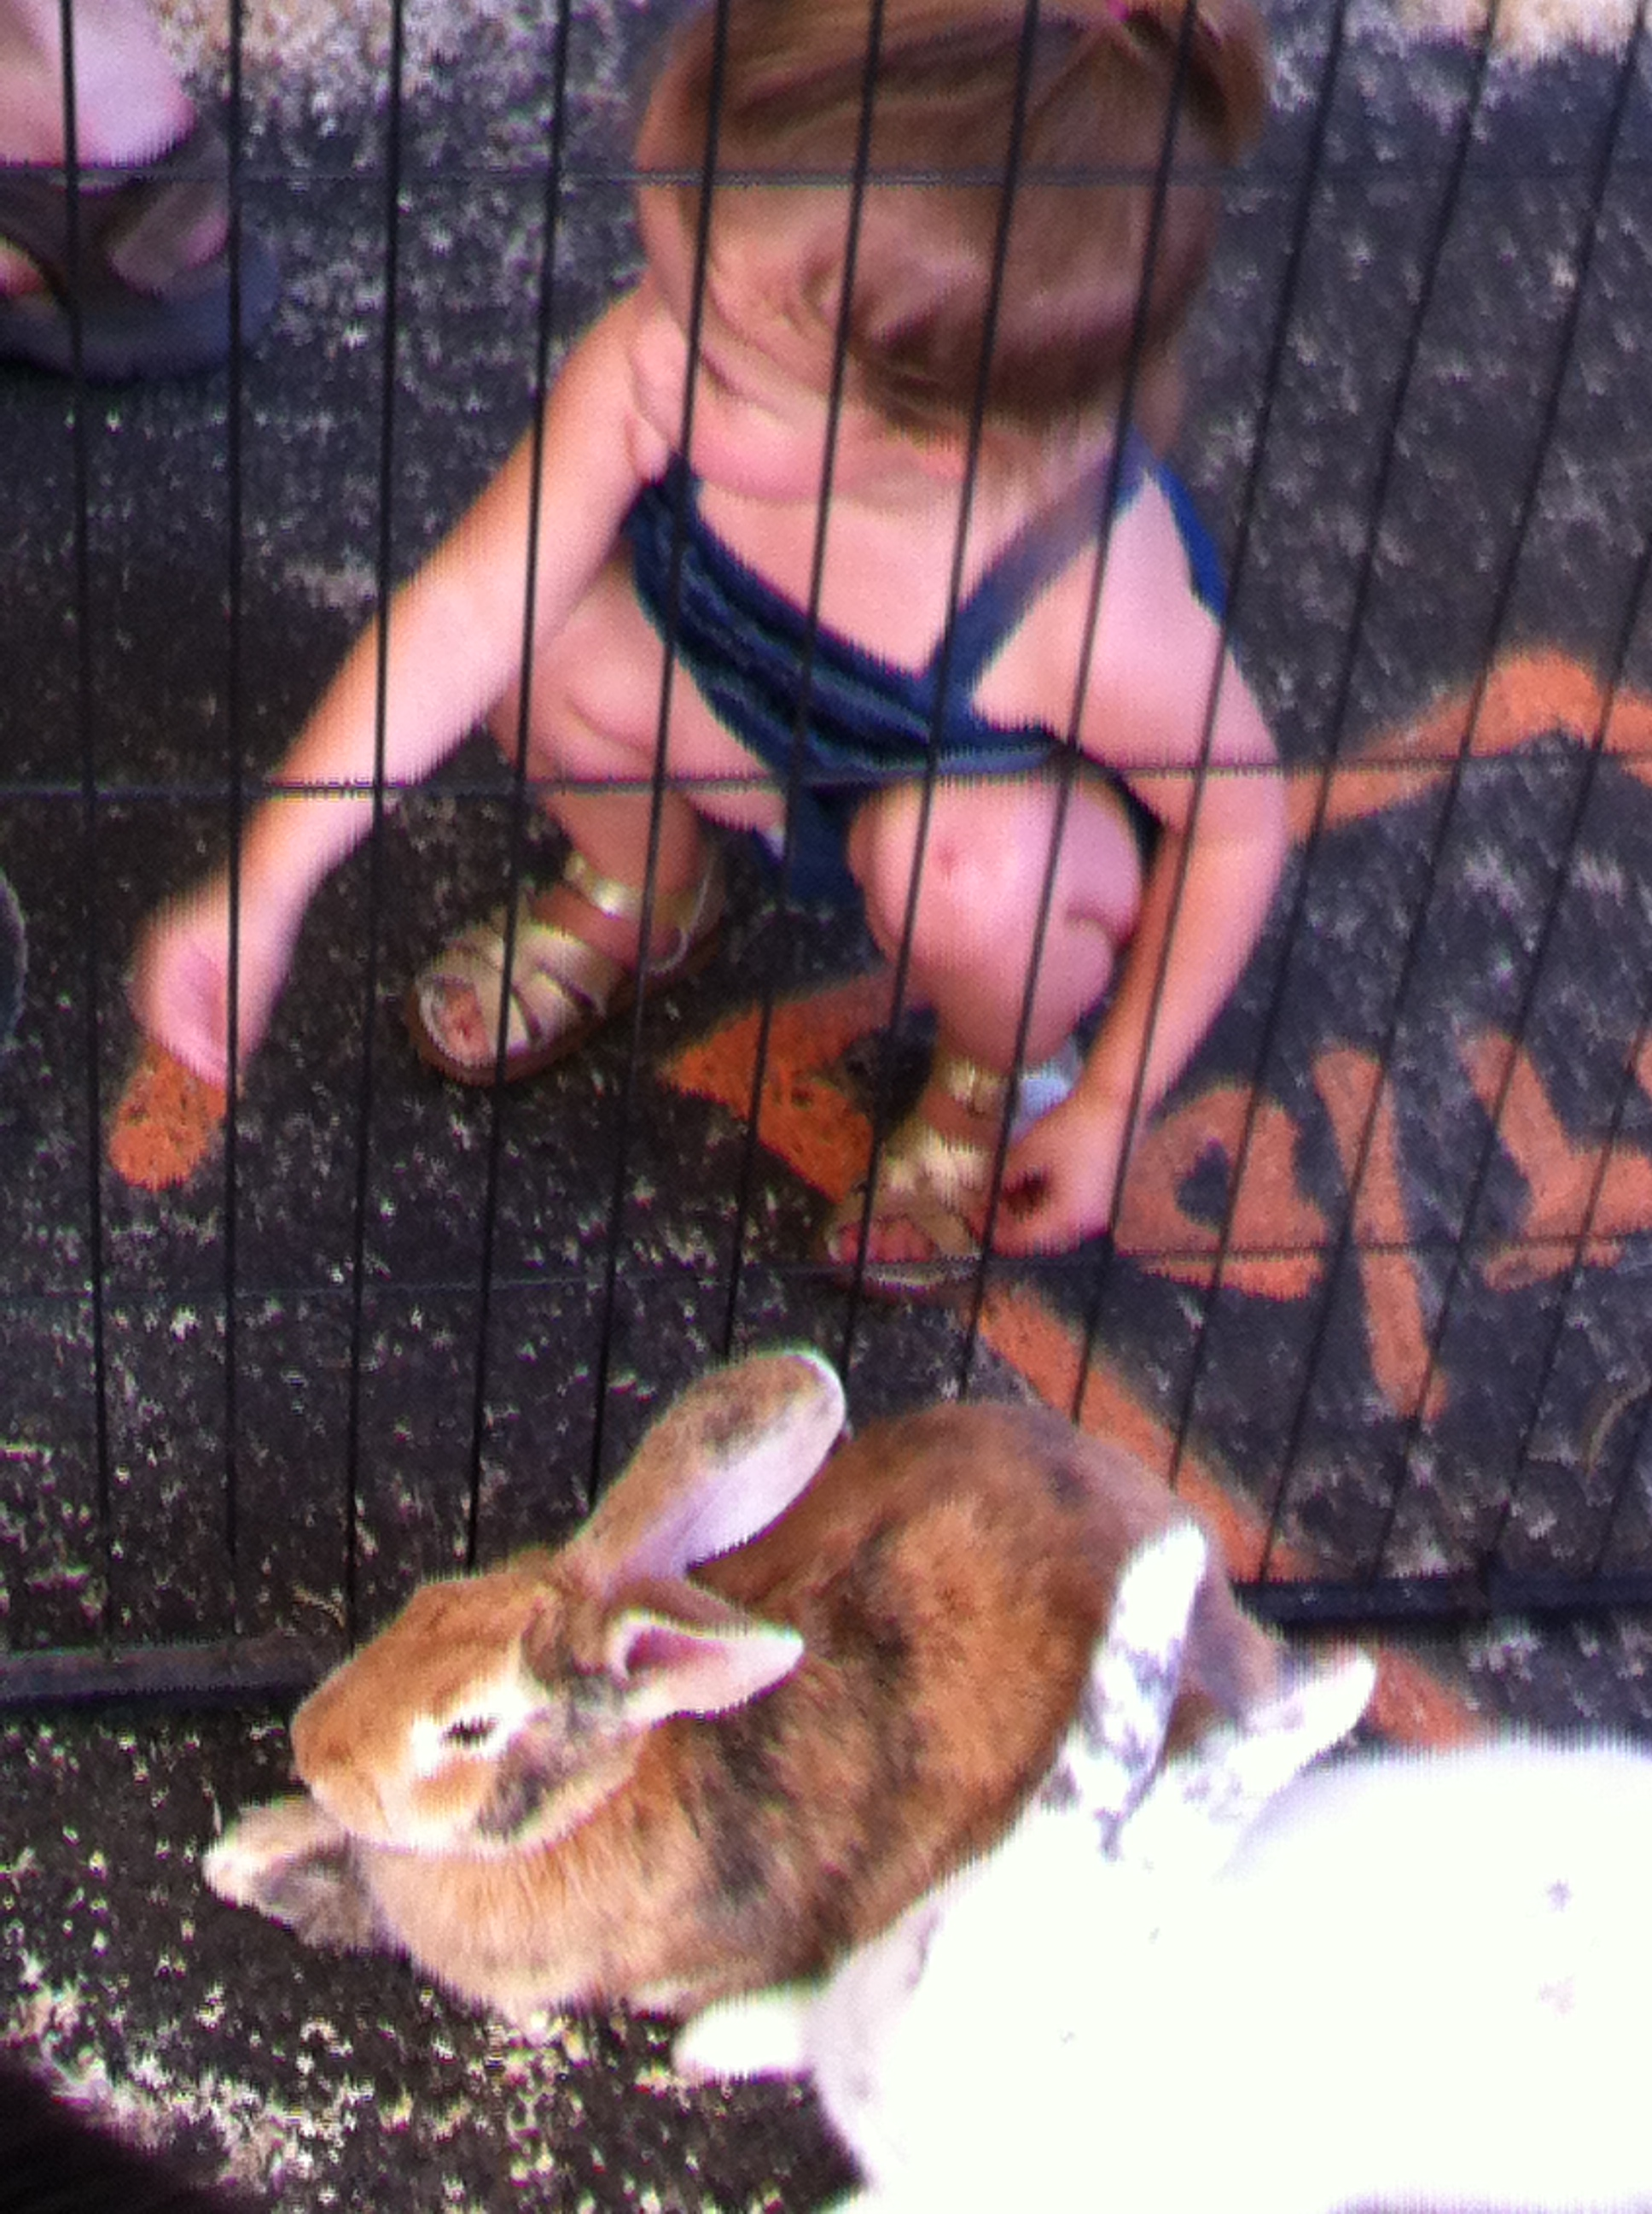
The Petting Zoo

Slide 16
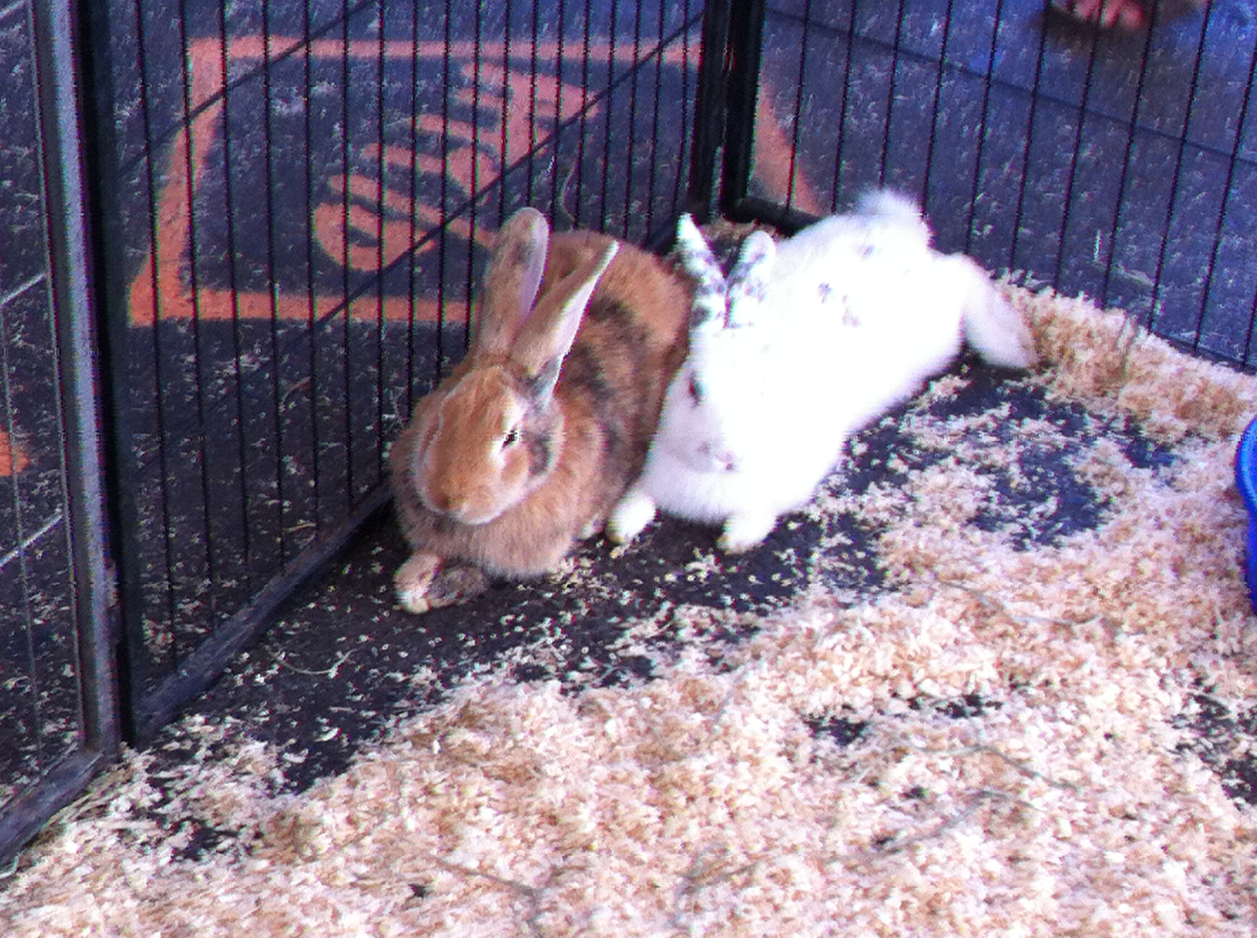
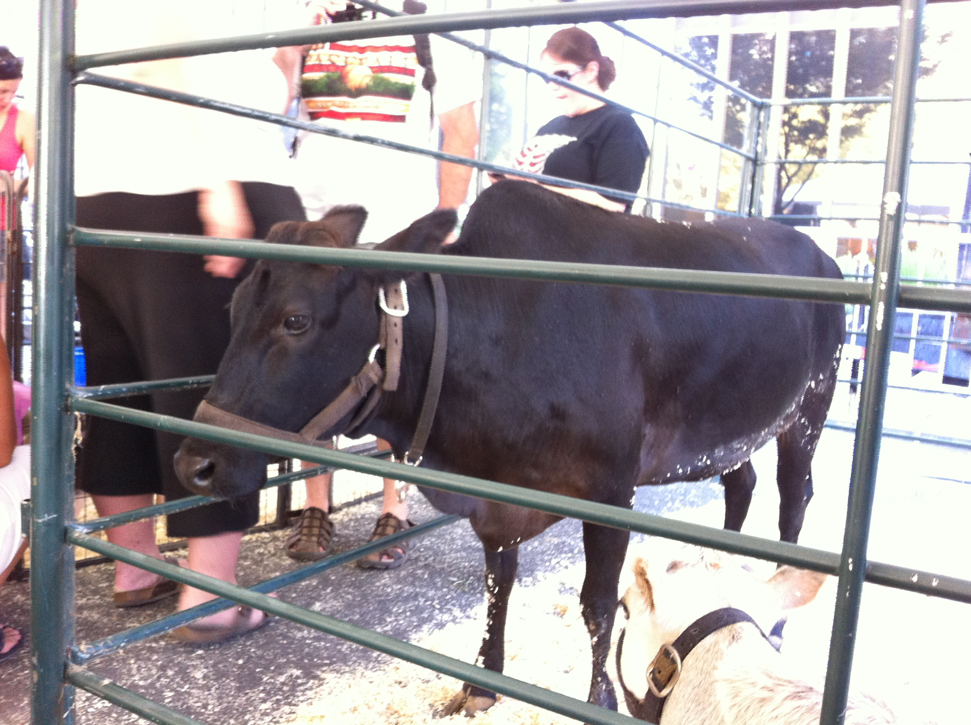

Slide 17
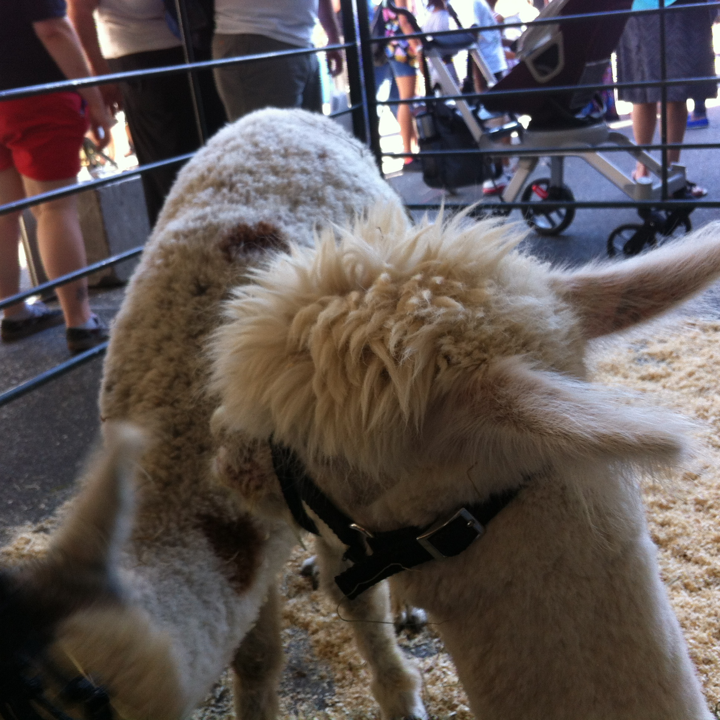
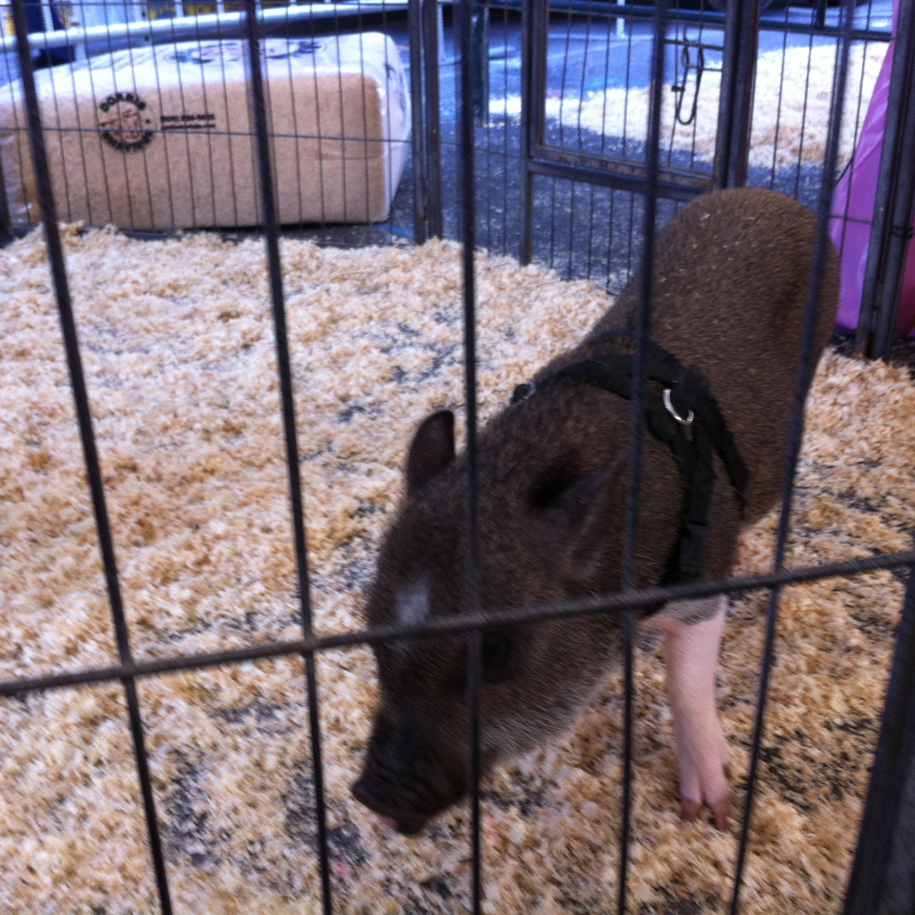

Slide 18
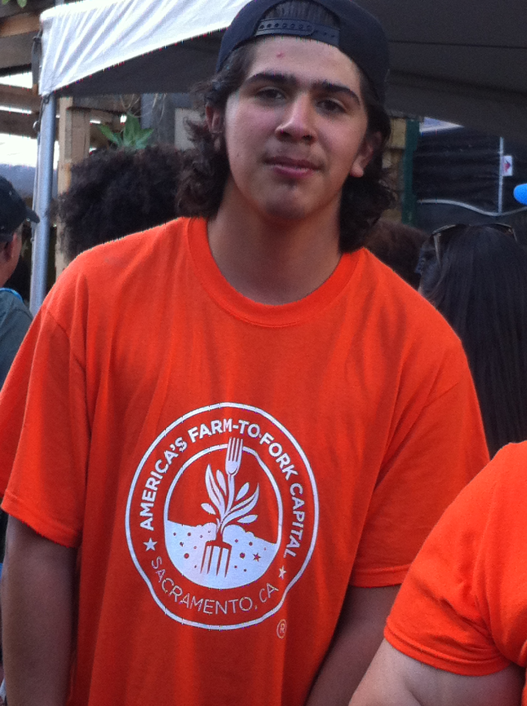

Slide 20
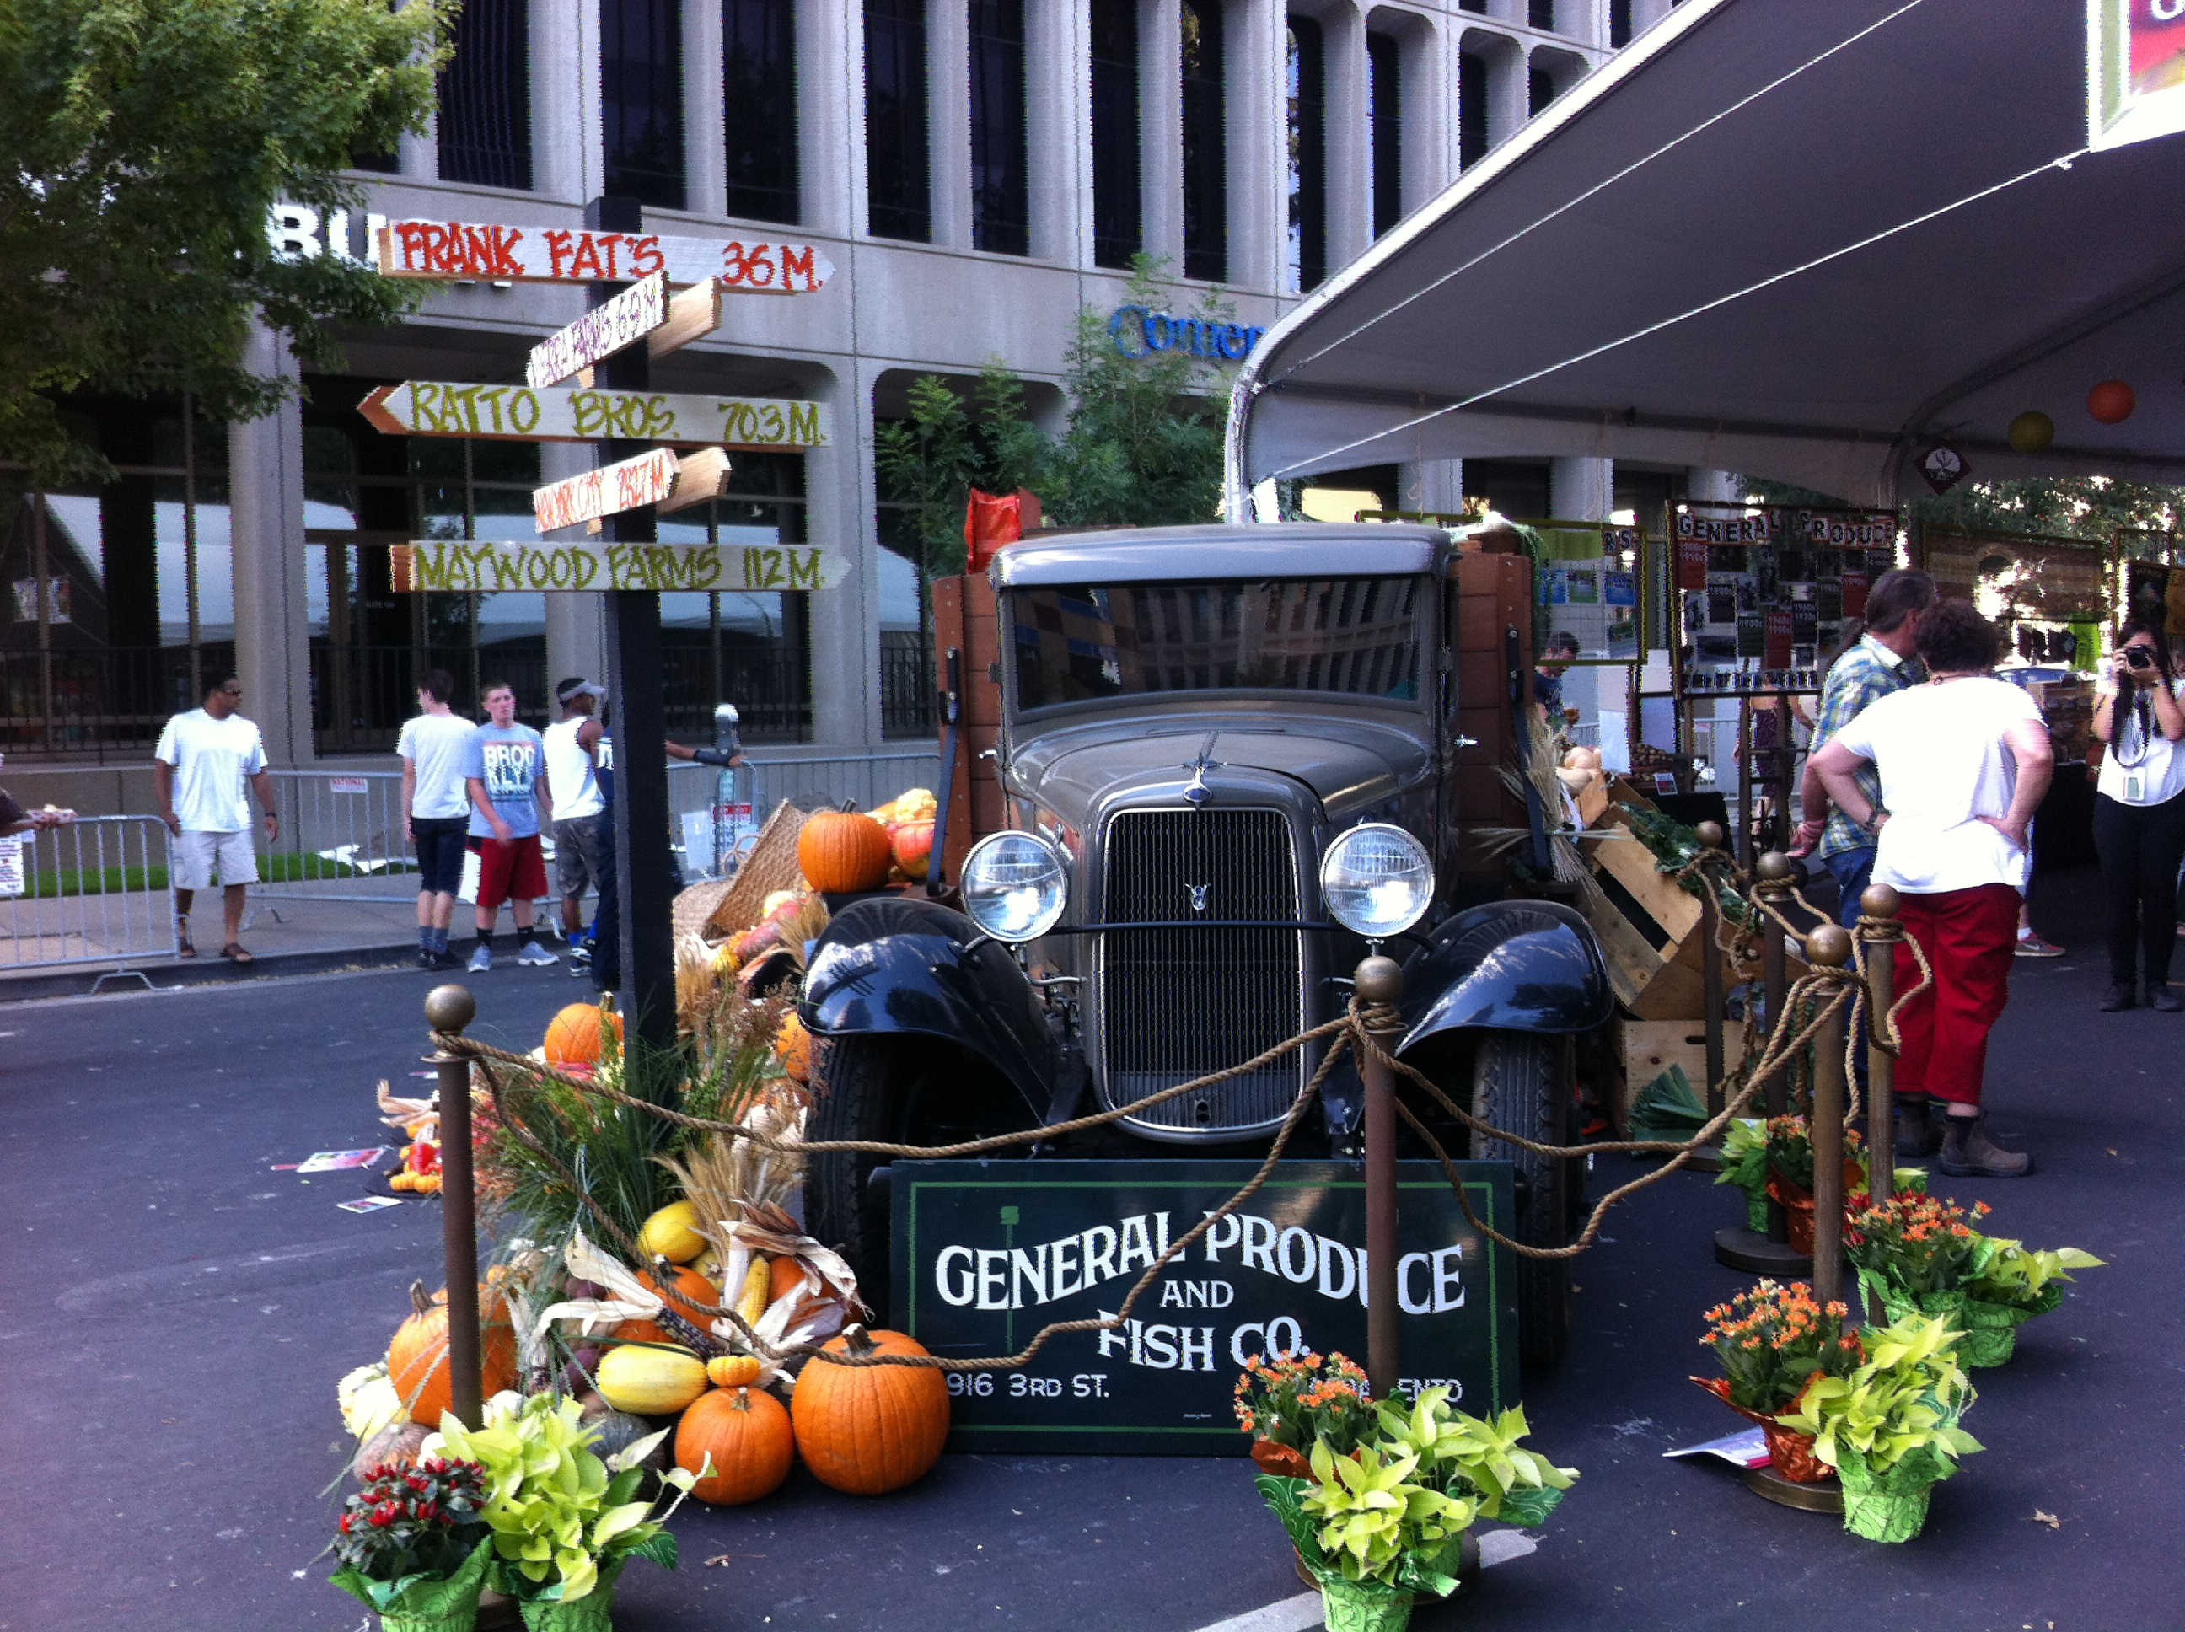

Slide 21
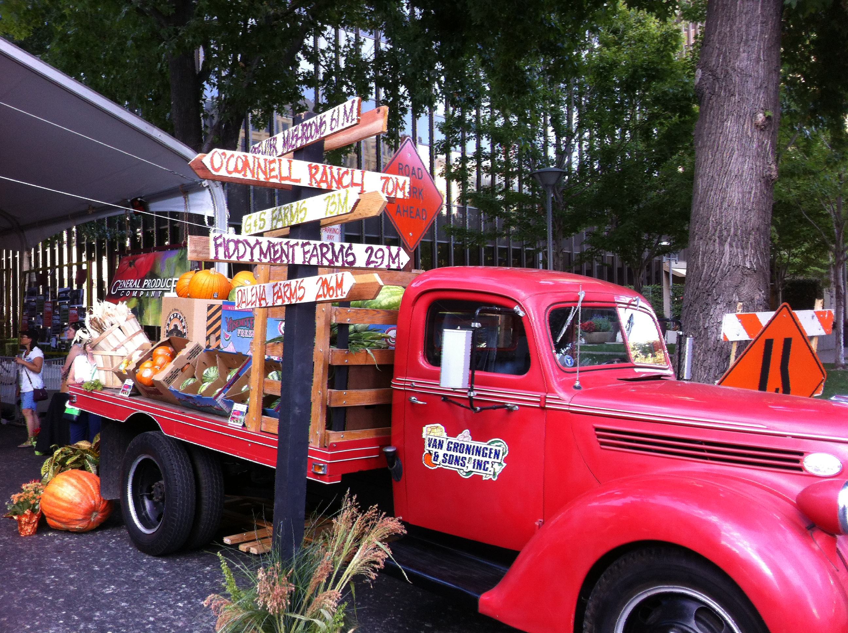

Slide 22
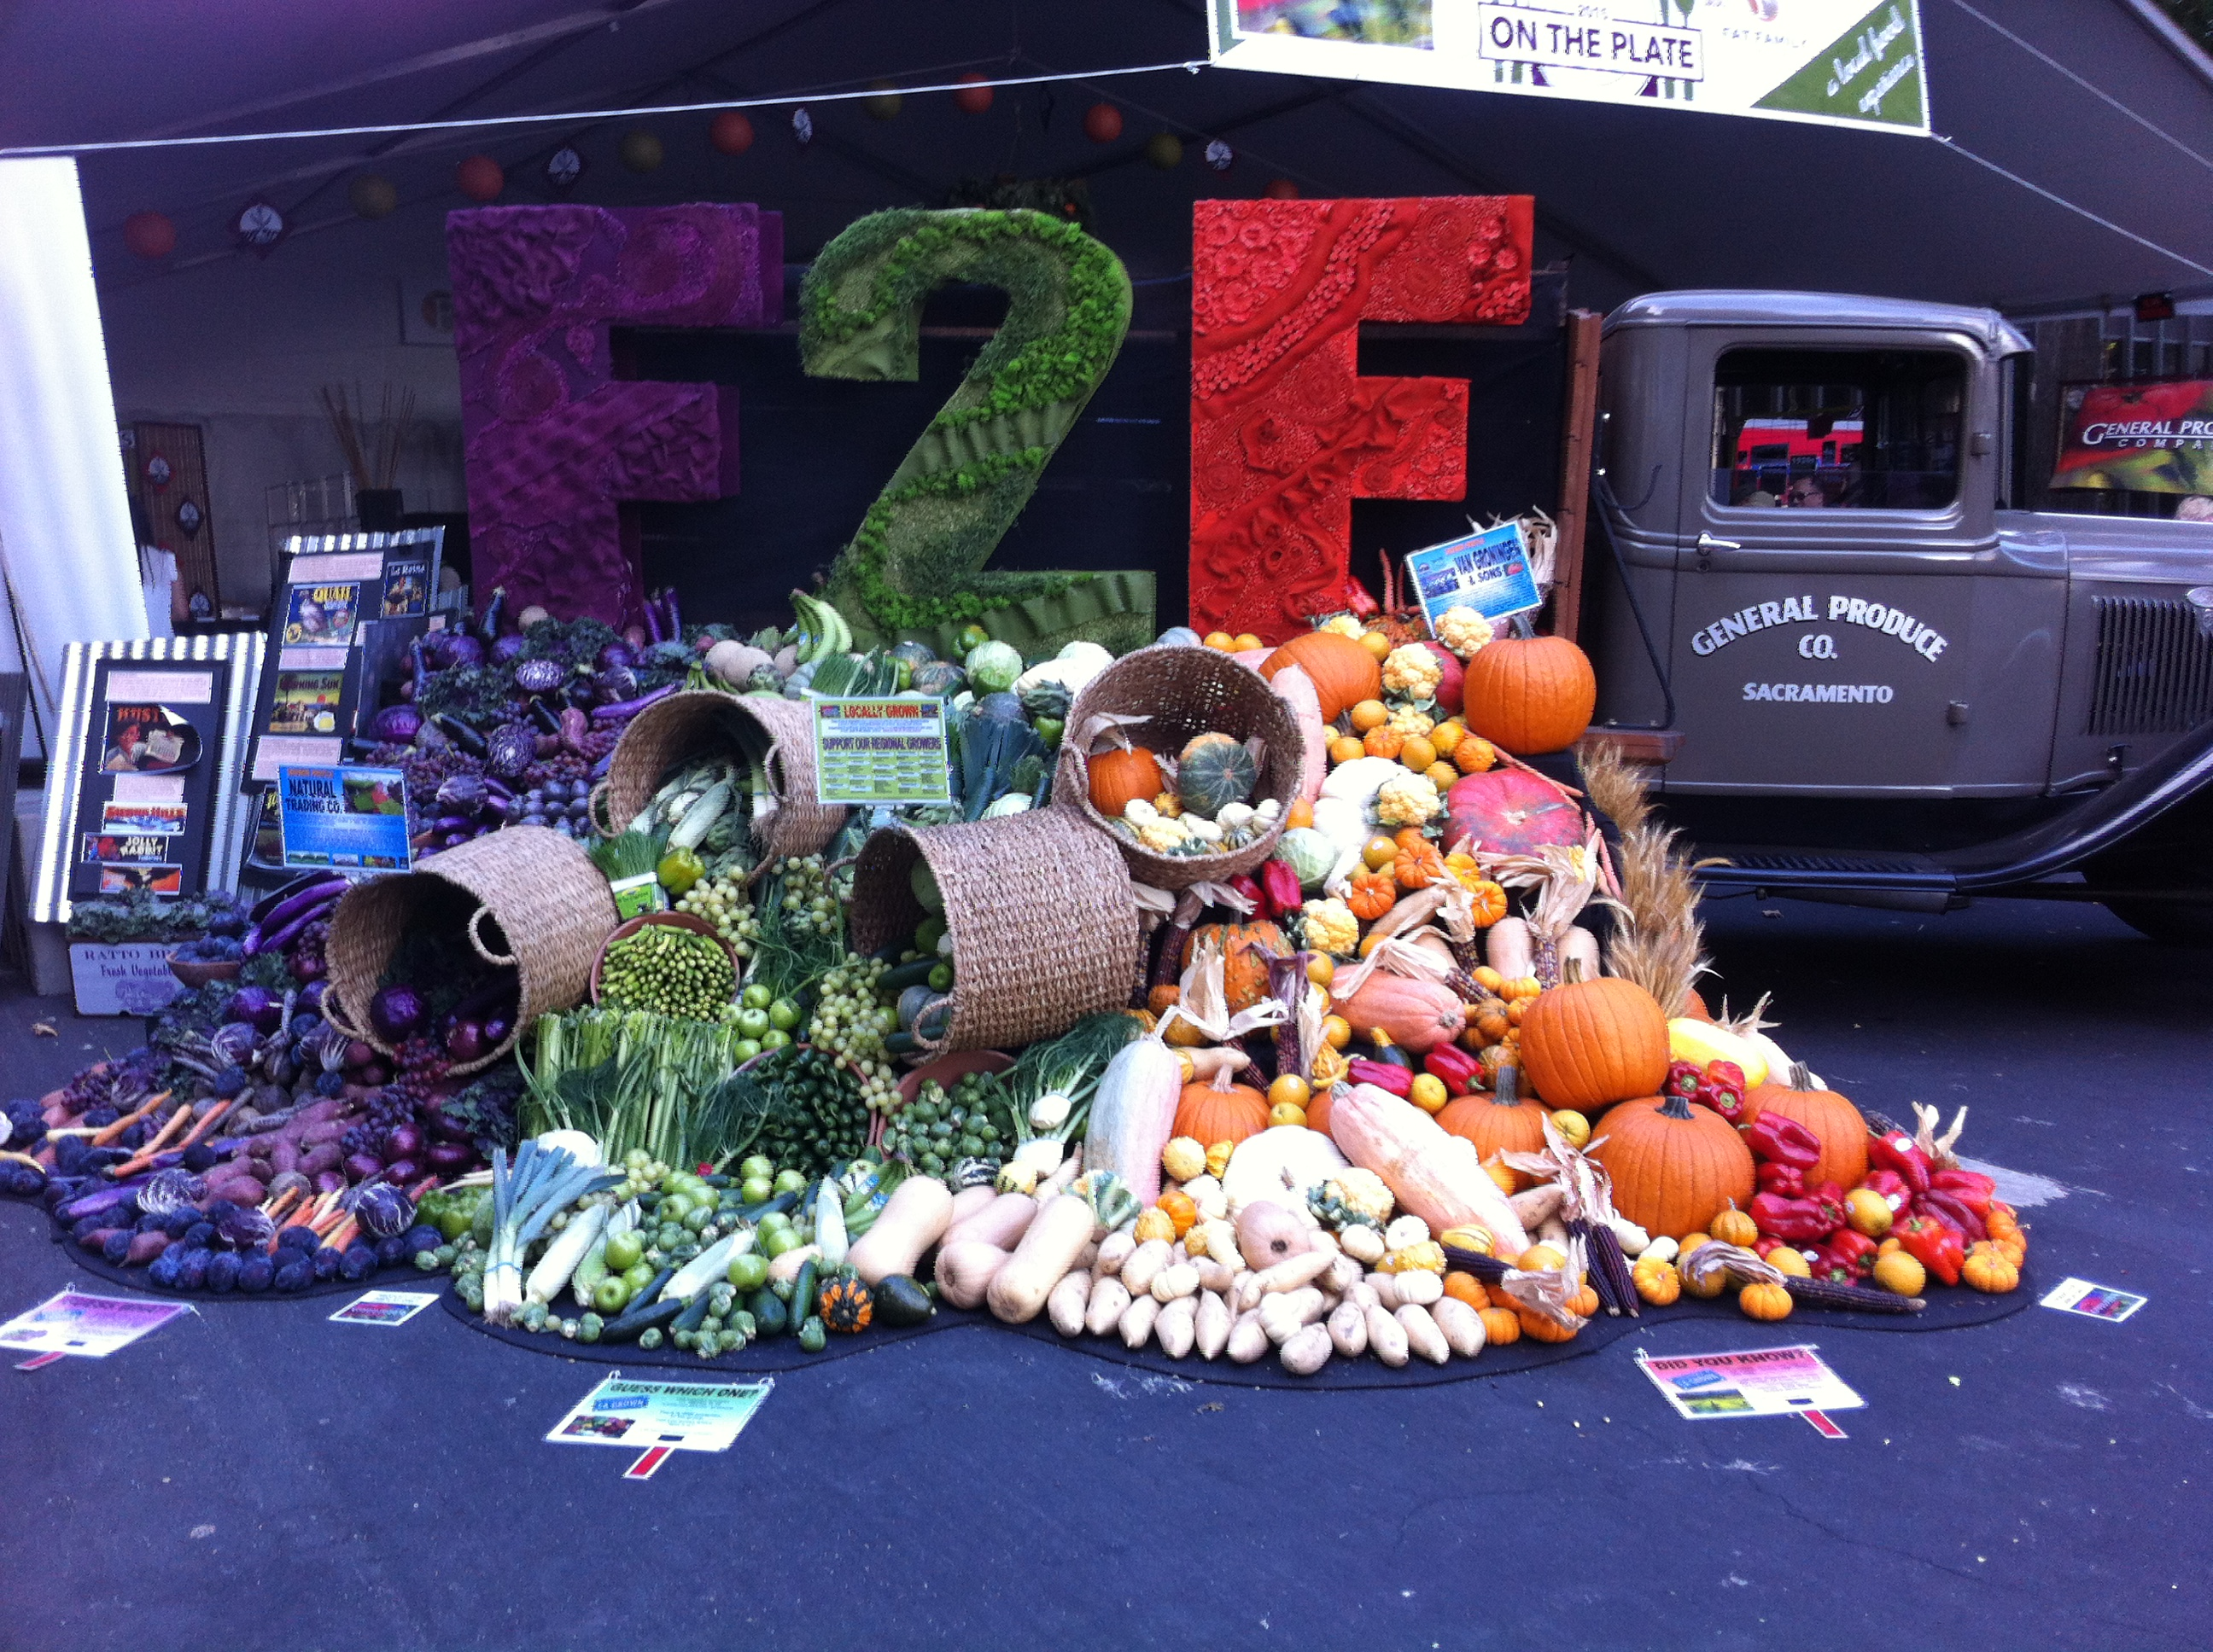

Slide 23
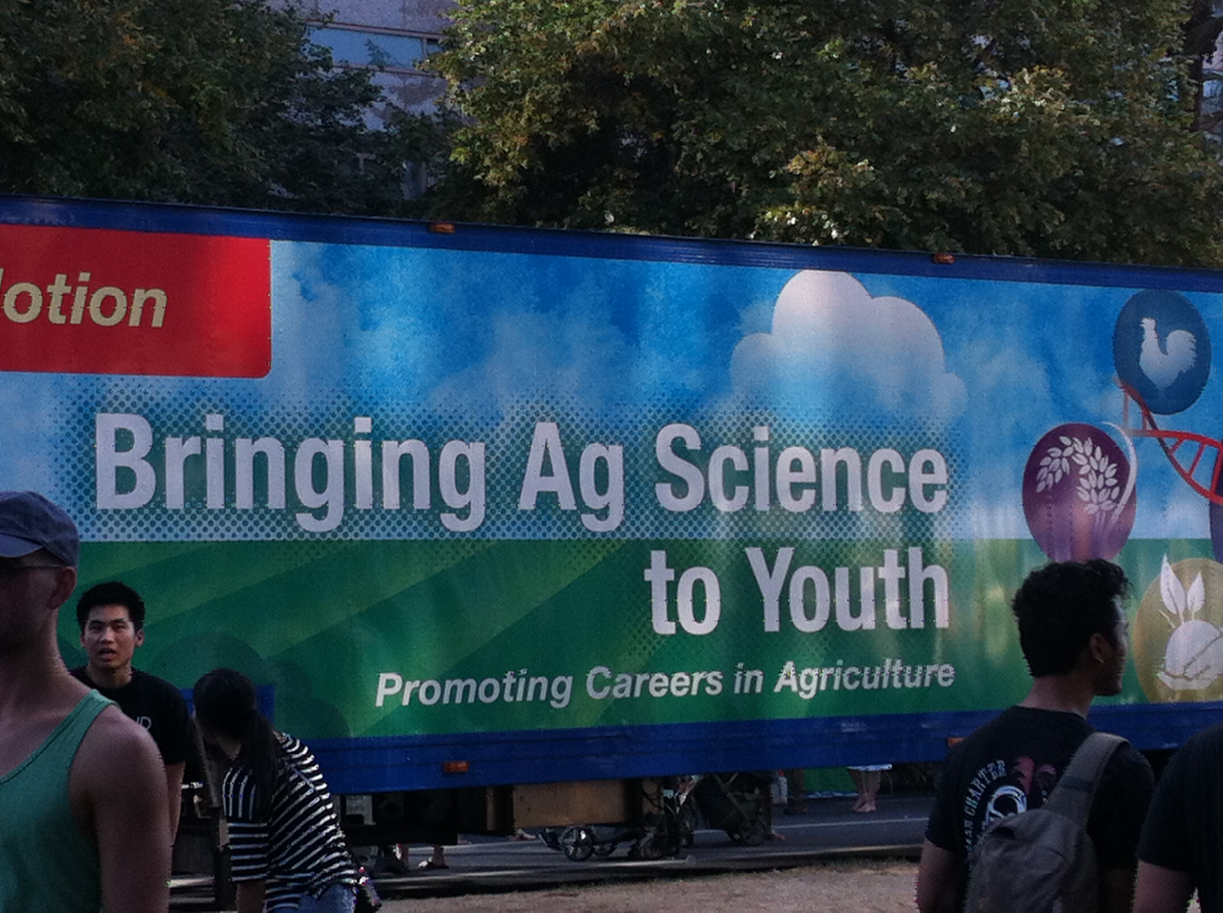

Slide 24
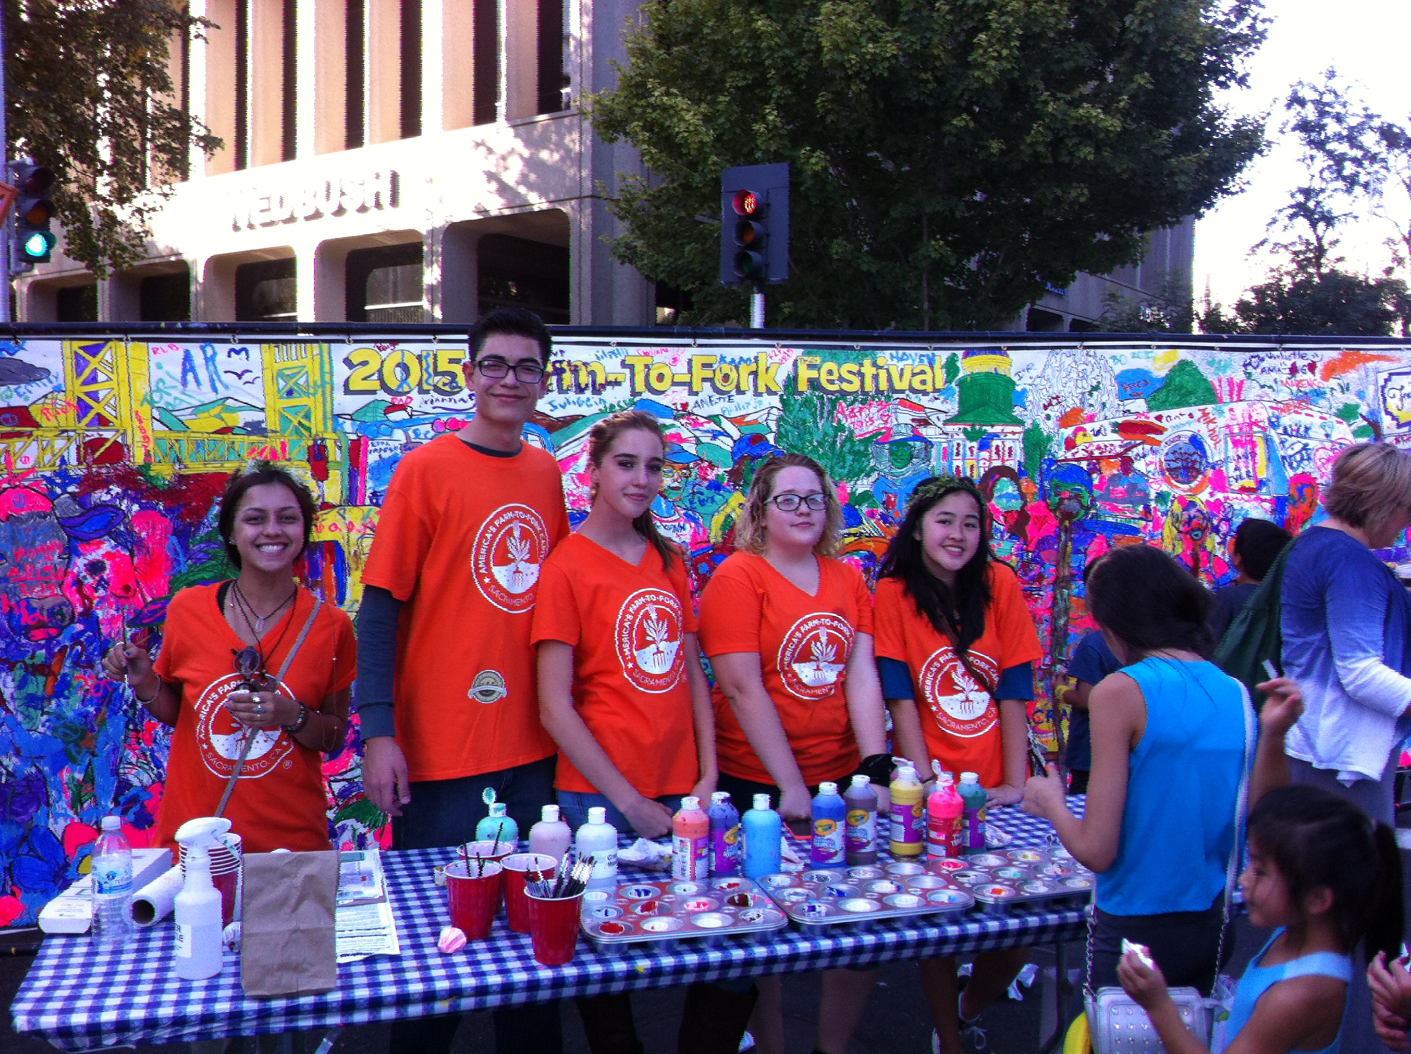

Slide 25
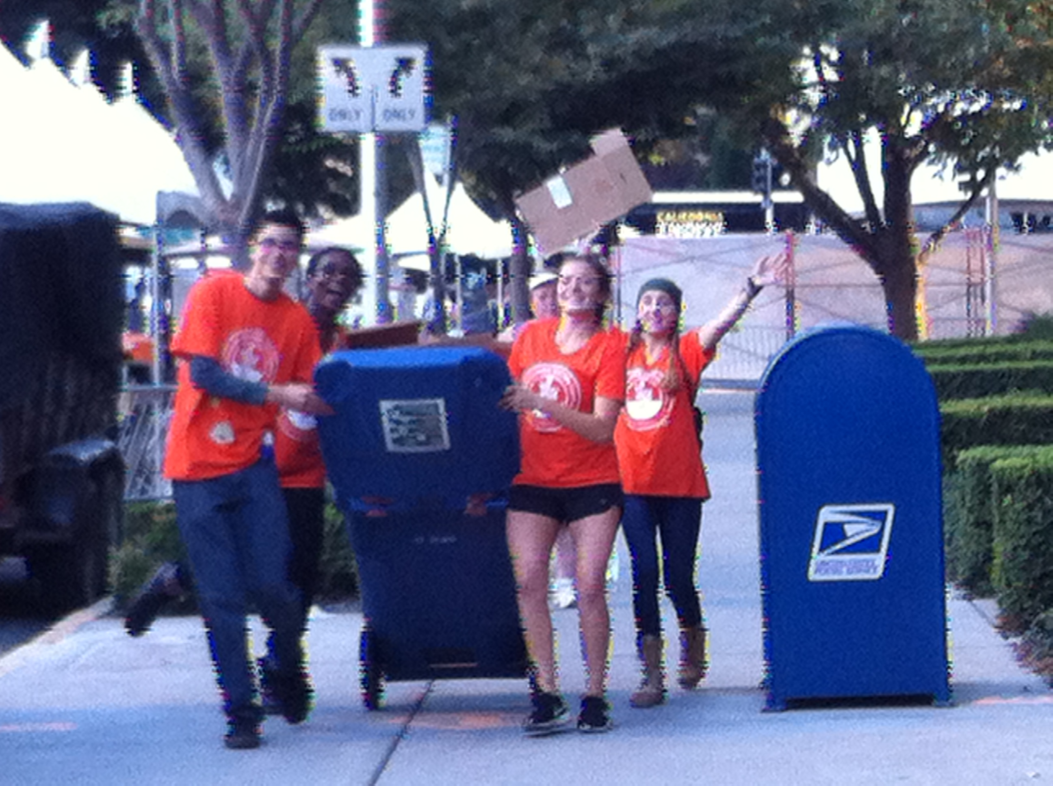

Slide 26
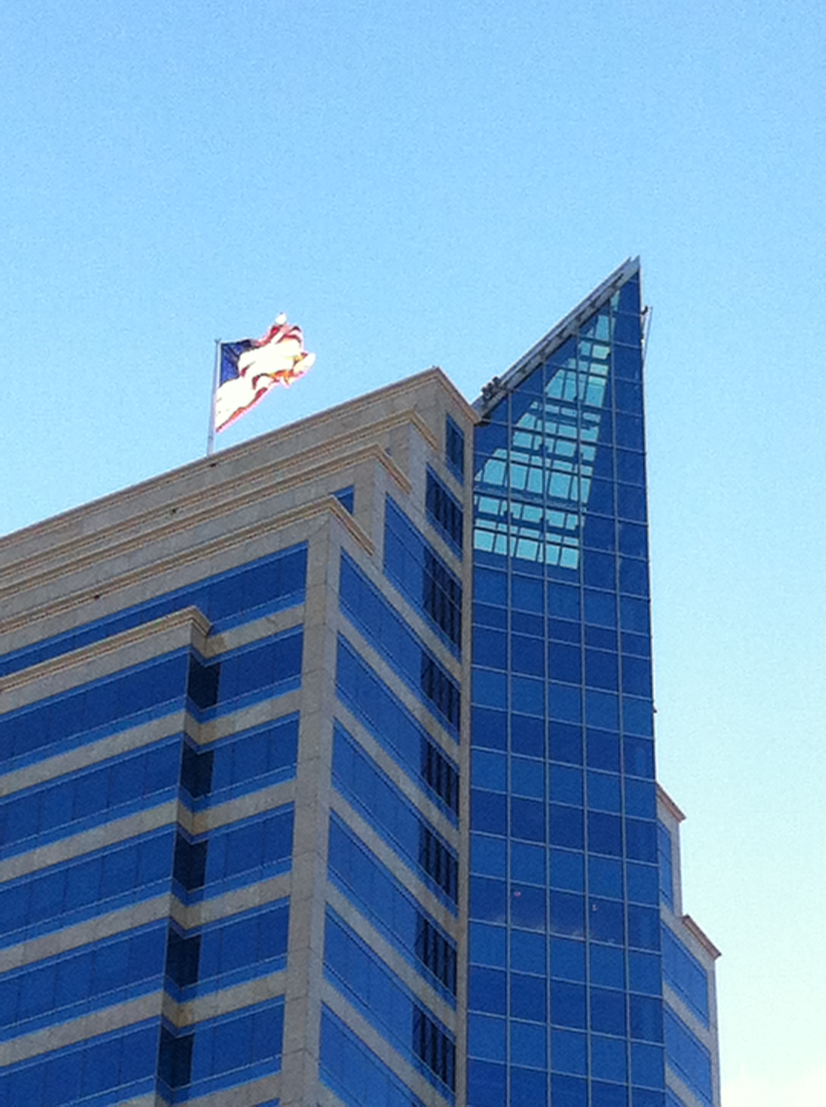
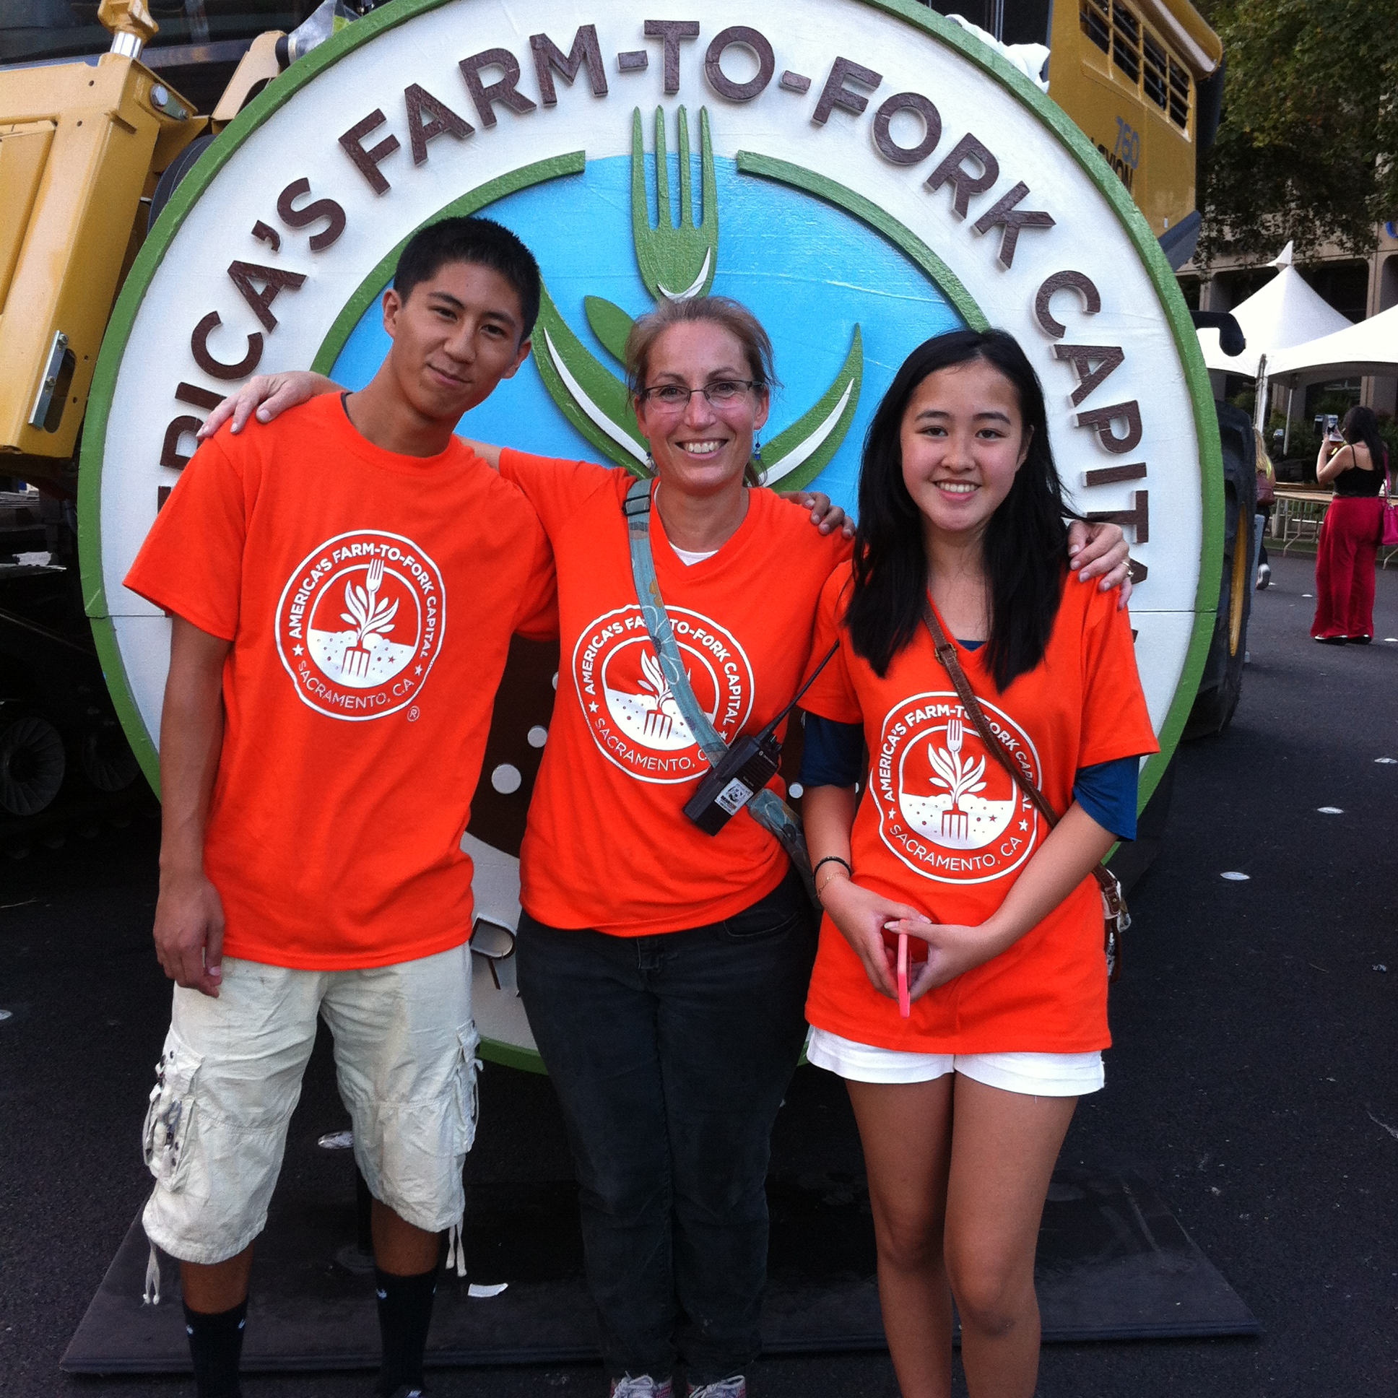

Slide 27
9/30 Compassion/ Inclusion Obj. TSW learn how to work with individuals who are different, yet have gifts. p.62NB
Our garden at RCHS is for everyone, how can we include others in the gardening experience?
What do you have to offer today when helping the SDC in the garden.
Our Pumpkins are impressive, what sort of plants can we help the SDC plant in the 2 beds by the entrance?

Slide 28
10/1 Erosion Obj. TSW learn how erosion by wind and water can carry away valuable nutrients. P. 64NB
What is erosion?
How can erosion degrade the land?
What are some solutions to prevent erosion?
Soil Erosion document

Slide 29
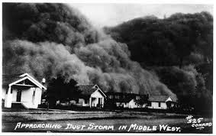
10/2 The Dust Bowl Obj. TSW understand how soil must be maintained to continue being productive. P. 66NB
Humans have made mistakes in farming, especially if they don’t understand how the natural world works. What was the Dust Bowl in October 1929?
What caused the Dust Bowl?
How was it fixed?

Slide 30
Thank you from Mrs. A!

