Slide 1
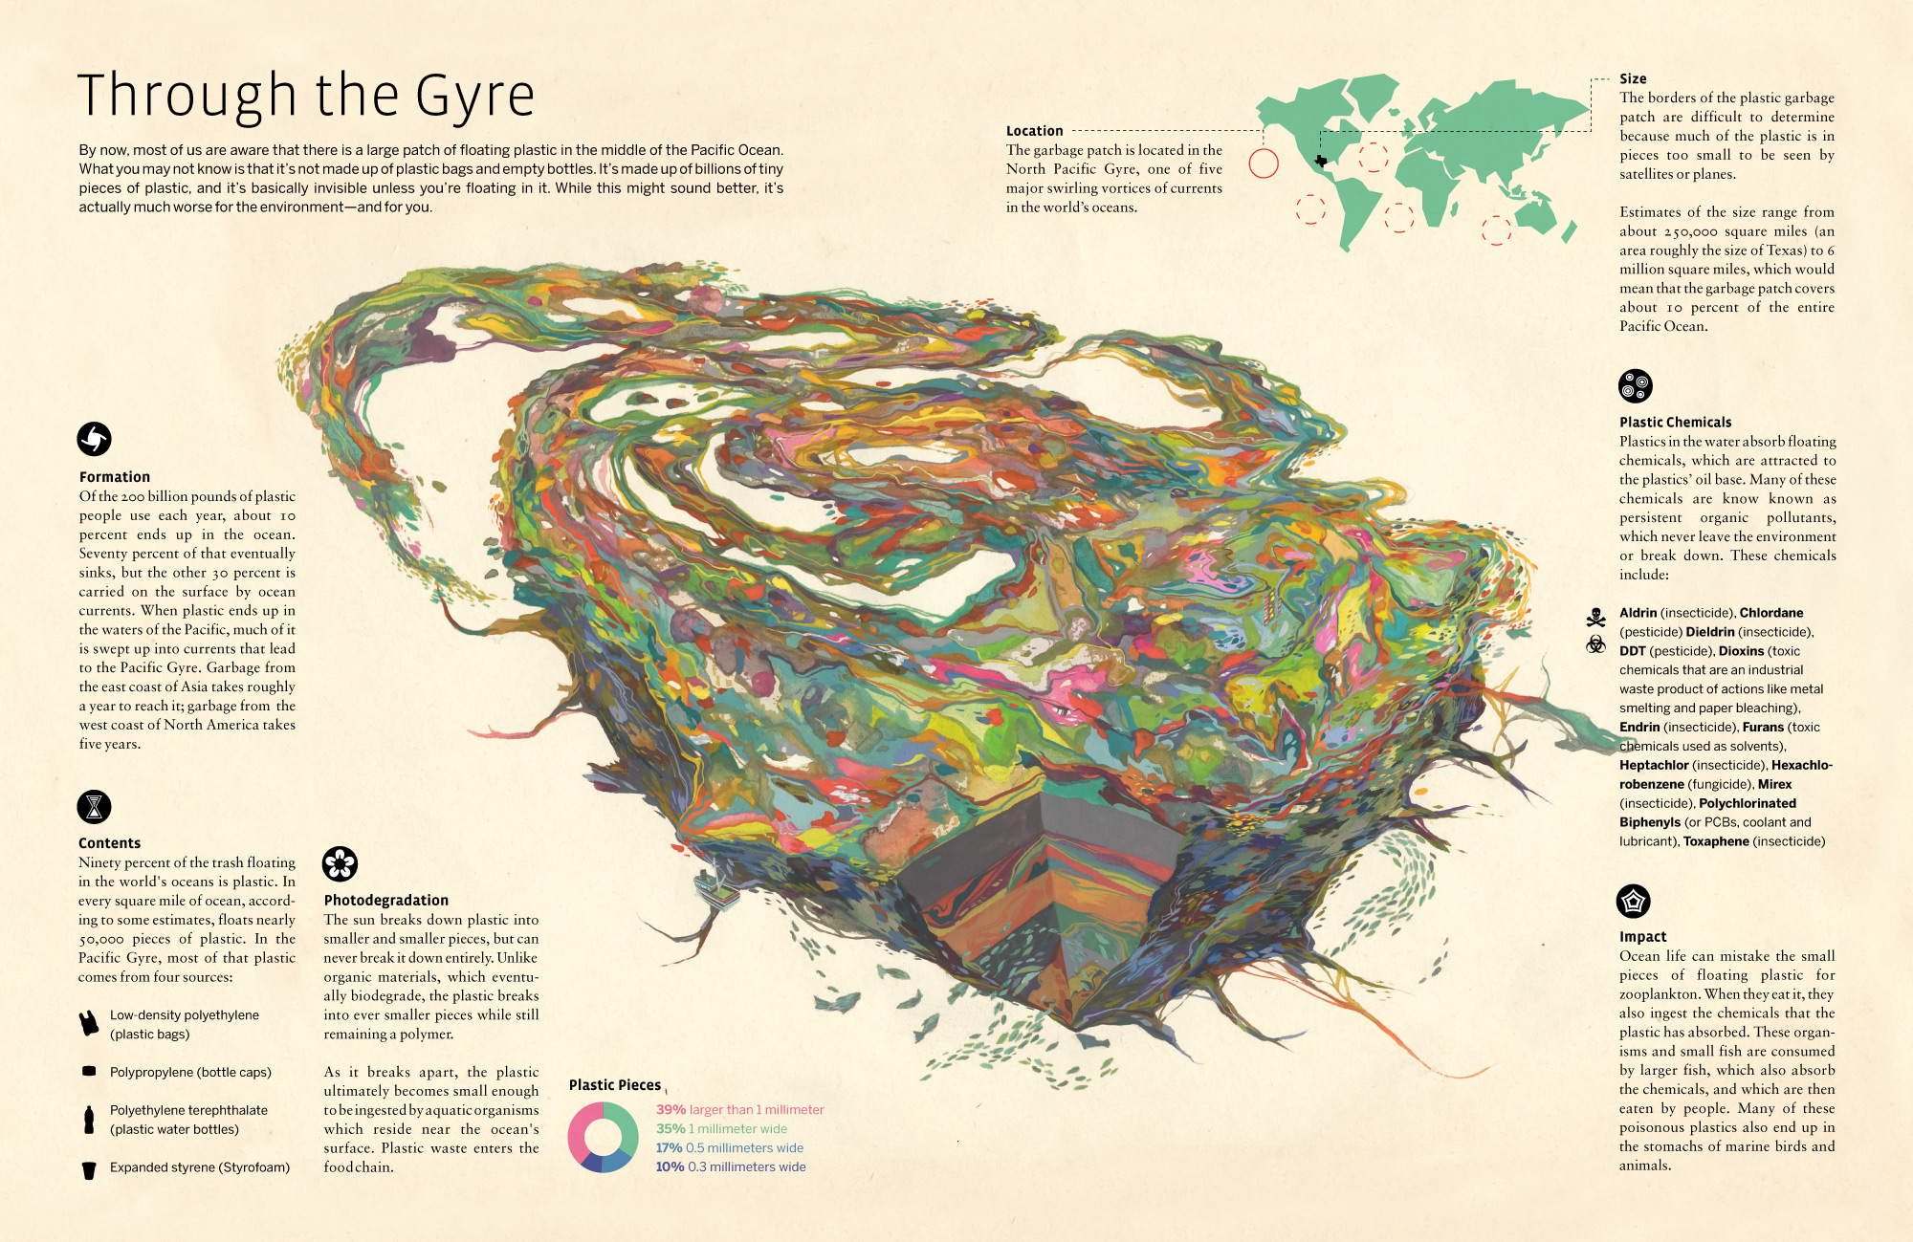

Slide 2
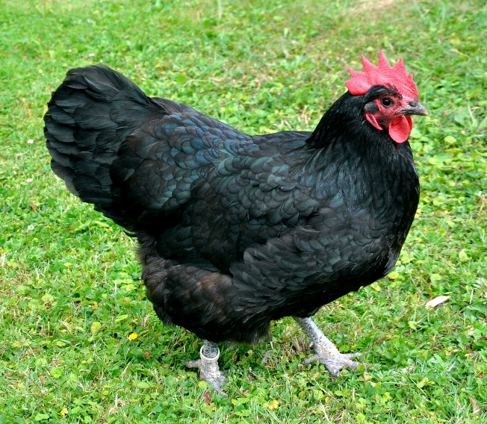
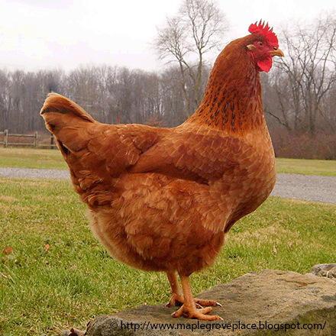
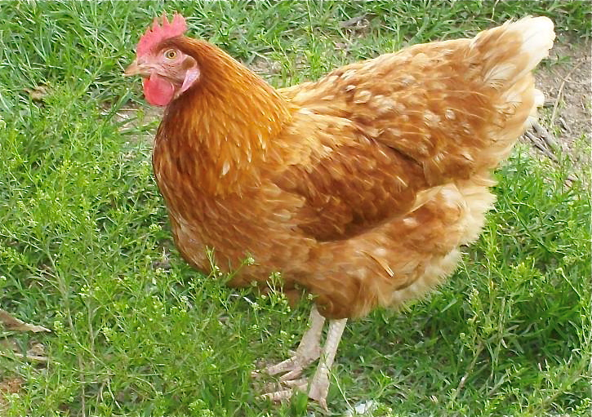
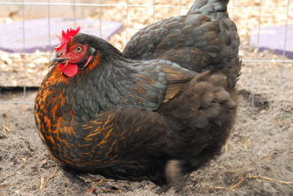
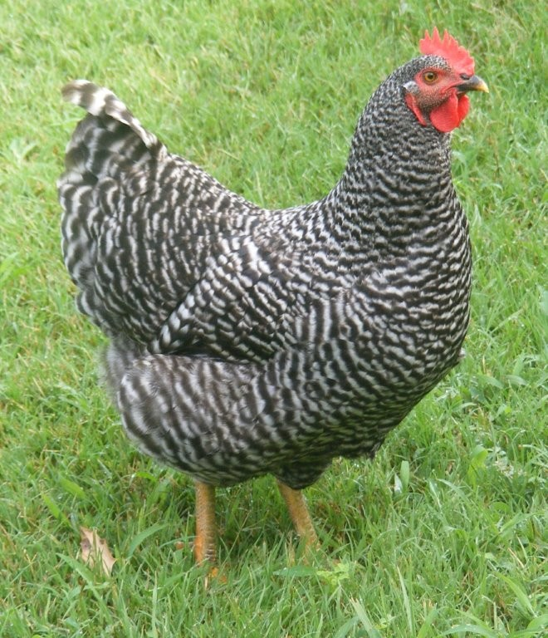
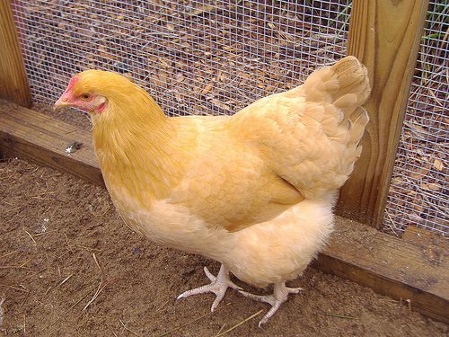
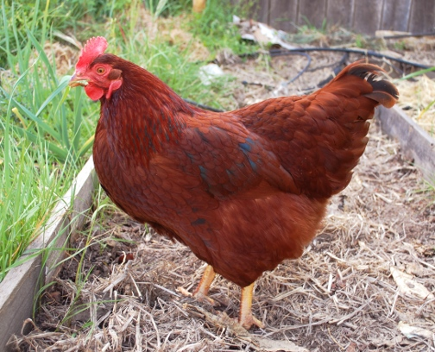
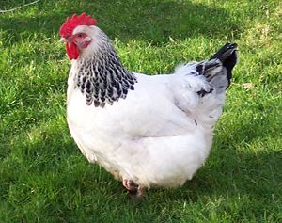
Bradshaw Feed and Pet Supply (916) 369-8225
7285 Bradshaw Rd, Sacramento Ca, 95829
If you are set up for chickens already, Here is what Bradshaw’s has:
Black Australorp = Annabelle
Black Sex Link
Golden Sex Link
New Hampshire Red
Barred Rock
Buff Orphington
Rhode Island Red
Light Brahma
This is what you need: Watering can $12 – 30, Feeder $12 – 30, Feed $17/ 50#, Enclosure, Nesting box $16.

Slide 3
Farm to Fork 1 Notebook
Semester 2: UNIT 3 Our Carbon Footprint and
UNIT 4 Feeding the World
Open your Notebook to the Center where the book is sewn.
Number the Right side of the page 1
Turn the page, number the left side of the page 2
Odd’s on the right, Evens on the left
Number to page 8

Slide 4
Farm to Fork
UNIT 3: Our Carbon Footprint
Lesson 1: Resource Management/Conservation Resources Week 12

Slide 5
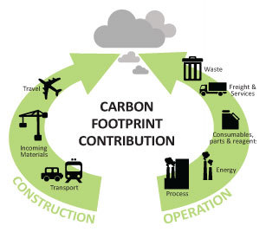
10/24 Our Carbon Footprint: Resources Management
Obj. TSW understand and explain how our resources can be limited and our actions have negative impacts on the planet. P. 8 NB
What resources do we need to live our lives?
How are these resources managed?
How is pollution created as a result?
At the Garden:
Finish Irrigation, water, weed, fertilize.

Slide 6
Omnivore’s Dilemma
October 24 – October 28
Read Chapters 10 & 11 by Friday. Part II Industrial Organic Meal
We will discuss the chapters.

Slide 7
Processed Corn Products
10% of US corn p. 68 – 69 Omnivore’s Dilemma
Sweetener for soft drinks
Starch for hamburger bun
Corn oil, used for cooking or salad oil
Margarine – hydrogenated trans fats
Mill starch make animal feed
Cornstarch is made
High Fructose Corn Syrup discovered by Japanese chemists
Maltodextrin – used to make pudding & gravy
Fermented starch can be used to make plastic

Slide 8
Wet Mill – industrial digestive system
Corn is broken down into different parts.
25 major wet mills in the US
Cargill and Archer Daniel Midland own the majority of them
At the mills the corn is grinded , soaked in acid & reduced to sugars

Slide 9
$ Breakfast Cereal & Fast Food $
General Mills – a box od cereal contains 4 cents worth of corn, but sells for $4.
McDonalds make $ by selling a “Chicken Nugget” not a recognizable piece of chicken because it is processed.
“ There’s money to be made in food, unless you’re trying to grow it.” George Naylor
  For every $1 the consumer spends on eggs, the farmer earns 40 cents.
  For every $1 the consumer spends on HFCS in Soft drinks, or cereal, the farmer only earns 4 cents.

Slide 10
Footprintnetwork.org p. 9 NB
# of Earth’s Activity
Calculate your own ecological footprint in the USA by taking this lifestyle survey regarding: food consumption, energy usage and transportations choices.
Write # of Earth’s it takes to live your lifestyle in your Notebook.
What steps could be taken to realistically decrease your footprint.
Then do the Activity again but, with a different country.
Why is your Ecological Footprint different is different countries? Who is one of the largest contributors to pollution?

Slide 11
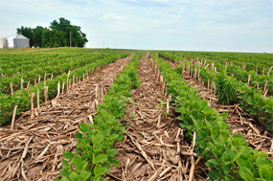
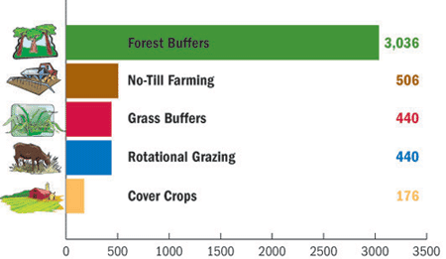
10/25 Our Carbon Footprint
Obj. TSW learn about our impact as a population on our available resources.
Page 10 NB
Monday you listed resources that needed to be managed: water, food, air, soil. What happens when they are not managed properly?
Name some “best practices” we use at the garden.
How will conservation techniques help us be more sustainable as a society?

Slide 12
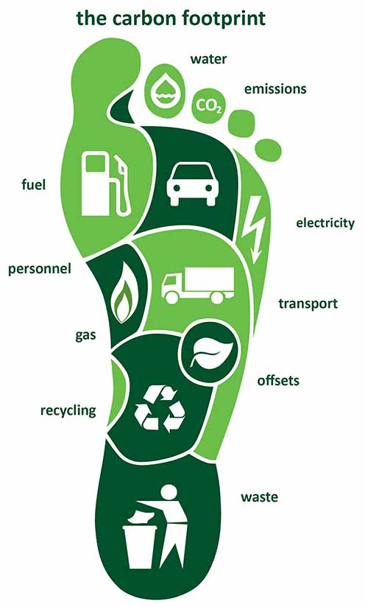
10/26 Our Carbon Footprint
Obj. TSW learn how many Earth’s it takes to live their life style. P. 12 NB
What is a Carbon footprint?
What factors might contribute to your carbon footprint?
Predict how many Earth’s does it take you to support your lifestyle, if everyone lived like you.

Slide 13
School buying local food to feed students

Slide 14
Vocabulary List
UNIT 3 Due November 10th
Page 9 notebook
You can use it on your quizzes and tests.
READ Omnivore’s Dilemma CH 9 & 10

Slide 15
Computer Lab Activity: Biocapacity of Countries . 9 NB
Use the Website: www.footprintnetwork.org
Research Biocapacity of 5 – 7 Countries. Record the trends and Biocapacity for each country.
Answer the following questions:
What trends do you see?
What are these trends related to?
What are the implications of these trends?
What needs to happen to increase our Biocapacity for the world?
Finally, write a paragraph to justify the need for sustainable management of resources and practices across countries.

Slide 16
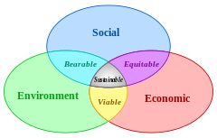
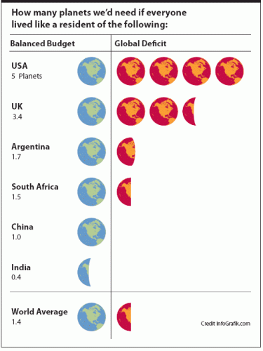
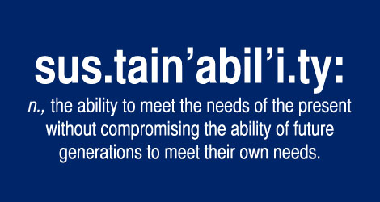
10/27 How many more Earths?
Obj. TSW learn about how we need to conserve our resources now to have resources for future generations. P. 14 NB
How close was your prediction as to the number of Earth’s you thought you would use?
What ways can you be more conservative in your day to day life?
What does it mean to have a world average of 1.4 Earths?
READ chapters 10 & 11 in Omnivores Dilemma.

Slide 17
Personal Carbon Footprint
Copy the pie chart, the global acres, and # of Earths
Why is there such a huge difference between the USA and other countries?
P.9 NB
Student | Earths - USA | Earths – Other Country
Manit | 3.8 | India = .6
Danniella | 4.5 | Italy = 2.5
Jeevan | 6.2 | Canada = 5.7
McAllister | 4.2
Ben | 5.2 | Austria = 2.9
Miguel | 4.5 | Canada = 5.6
Jacob | 3.4 | Australia = 2
Julian | 5.6 | Argentina = 2.0
Mary Carmen | 4.3 | Canada = 1.9
Johanna | 3.9 | Switzerland = 1.3
Reyna | 4.1 | England = 2.4
Pavel | 4.1 | Switzerland = 2.0
Gerardo | 4.0 | Africa = 2.0
Quincy | 4.8
Justin
Emiliano
Hailey

Slide 18
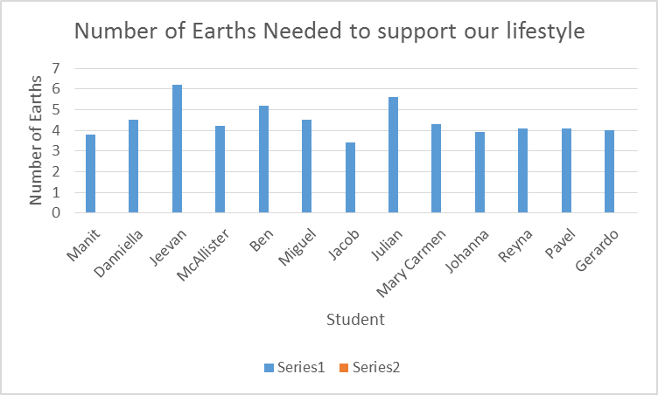

Slide 19
FFA Creed Practice P. 15 NB
Open the Official FFA Manual to page 35.
How does the FFA Creed support the FFA Mission in making a positive difference in lives of students?
One Officer practice with a partner(s) to recite 2 paragraphs of your choosing. Students have the FFA Manual open, follow along and only correct if they pronounce the word wrong or pause or say the wrong word.

Slide 20
Notebook Check
Tuesday 10/27 P. 8 – 15 40 points
Date | Title/ Topic | Page #
10/19 | WU – Our Carbon Footprint: Resource Management | 8
10/23 | Vocabulary List – Our Carbon Footprint | 9
10/20 | WU – Our Carbon Footprint | 10
10/20 | Video - GATTACA | 11
10/22 | WU – Our Carbon Footprint | 12
10/22 | Activity: # of Earth’s | 13
10/23 | WU – How many more Earth’s? | 14
10/26 | Brainstorm – Major Pollution Situation World Wide | 15 Notebook Check p. 8 – 15 40 points

Slide 21
Activity: As a Class Brainstorm Major Pollution Situations in the World p. 11 NB
List Examples Below:
Pacific Garbage Patch
China’s Air Quality

Slide 22
Pollution in the World: P. 11 NB
Individual Research on a Pollution Situation in the World:
  Where, What, How does it impact our available resources?
  How does it impact our growing food to feed families?
  Don’t forget to do your vocabulary!!!

Slide 23
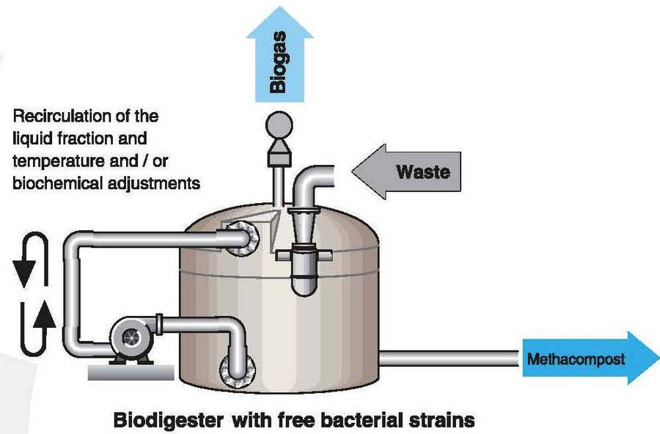
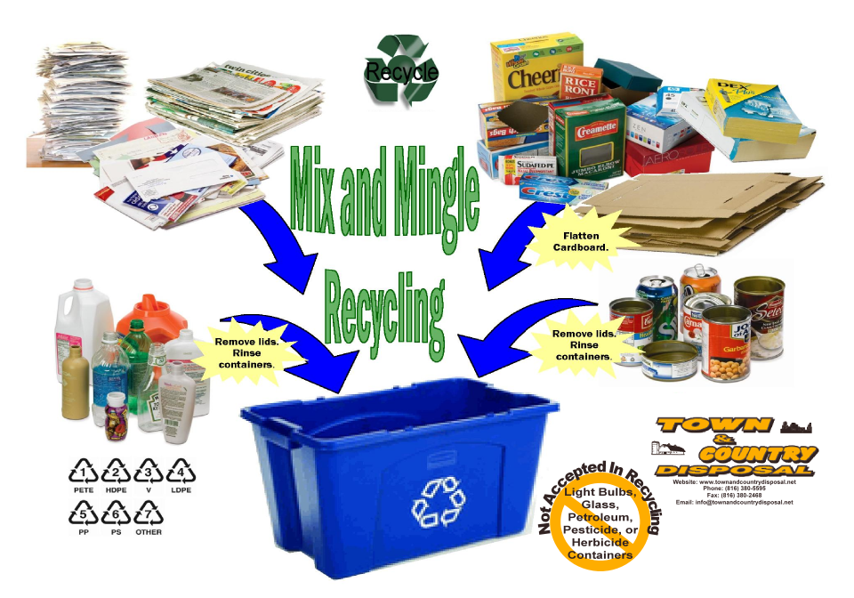
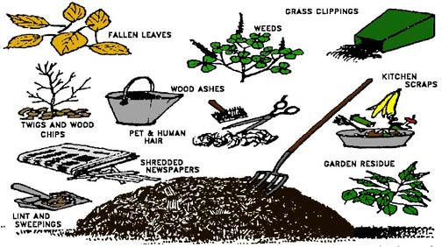
What if…
10/28 Obj. TSW think about ways we produce products and how they become obsolete. P. 16 NB
What is planned obsolescence?
How can we reduce, reuse & recycle products?
What if everything we produced could be biodigested, composted or recycled at the end of it’s life?

Slide 24
Contact local Farmers to show us their fields and their conservation practices.
Fieldtrip November 15th UC Davis
Ideas of Names of local farmers & conservation practices

Slide 25
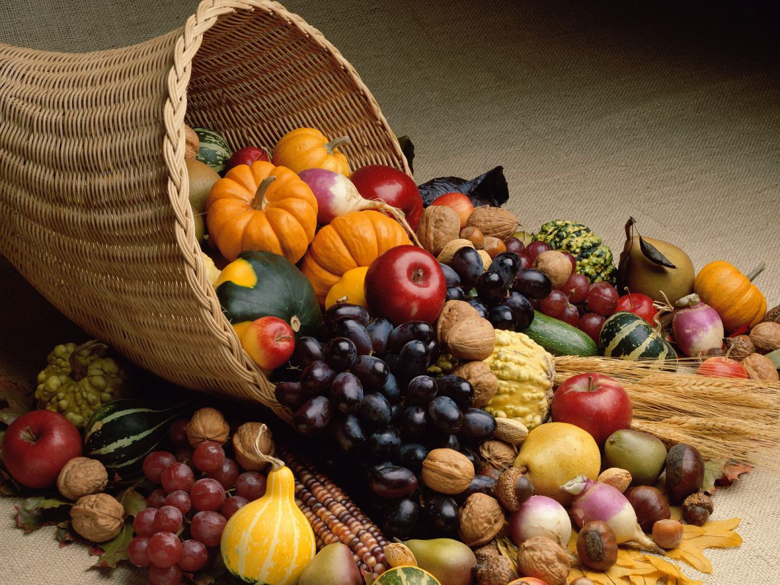
11/03 Fall Harvest Festival
Obj. TSW create ideas for the Harvest Festival November 3rd at 5:30 at Bryte Campus.
Our Goal with F2F is to educate others about the benefits of eating locally, produce food for the Caffe.
Create ideas for a vender booth- How can we make $?
Create ideas for an informational booth that is fun for all ages.

Slide 26
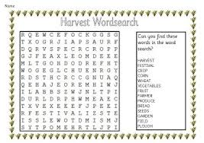
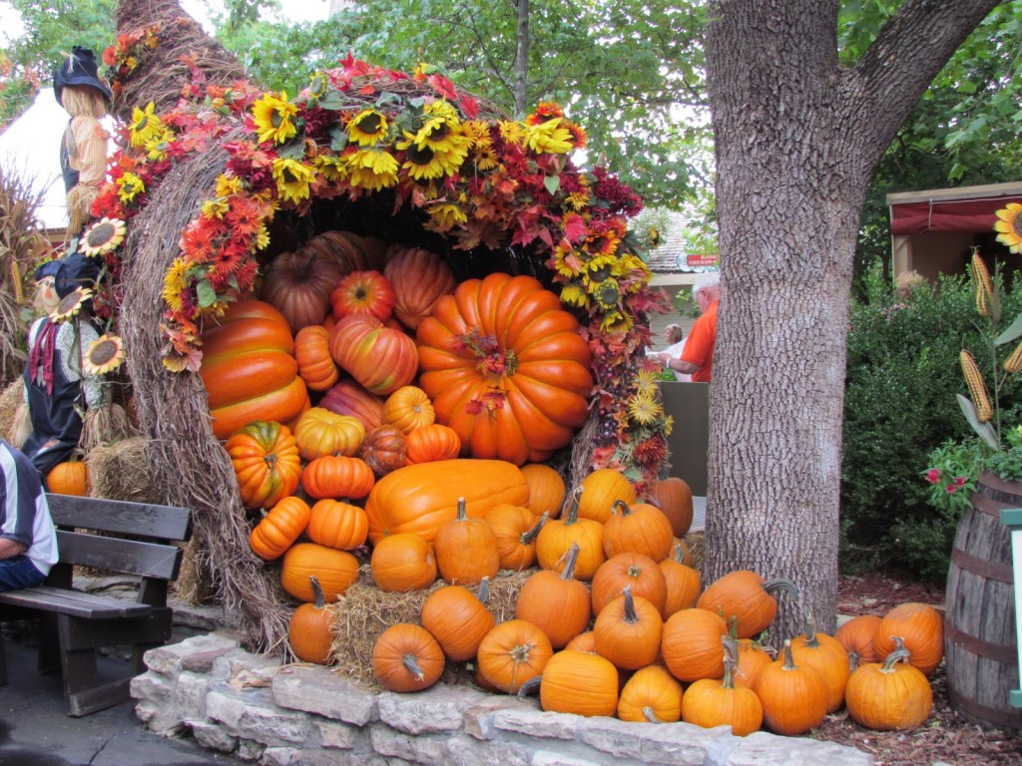
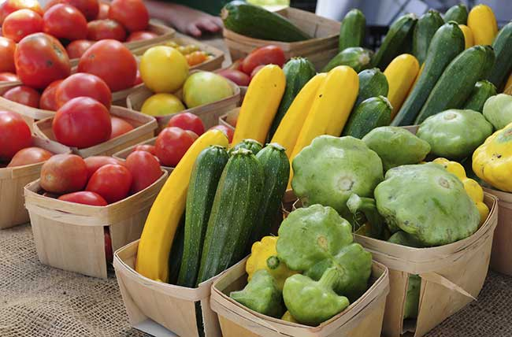
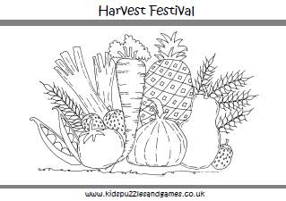
Ideas for Harvest Festival
Discuss ideas for the Harvest Festival to educate the community about what we do, what Farm to Fork is and sustainable agriculture, promote FFA.
What activities/ games can we do/ make to help educate others at the Harvest Festival about Farm to Fork & FFA?
What sort of fundraising ideas do you have?
What materials do we need for the Harvest Festival?

Slide 27
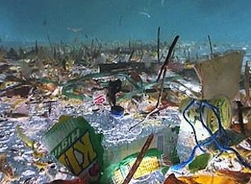
Pacific Garbage patch

Slide 28
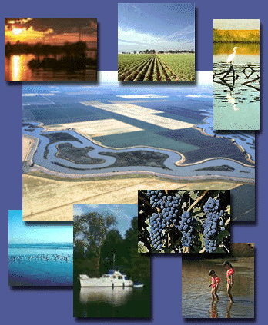
10/31 Land as a Resource
Obj. TSW learn about organizations that protect our land. P. 18 NB
What benefits does land (Parks, Nature Reserves) provide for us?
What organizations manage our land?
From your experience, how would you manage land differently?

Slide 29
Land is a Resource
How is it managed? P.21 NB
Research Bureau of Land Management
National Park Service
National Fish and Wildlife
National Forest Service
Choose one of these 4 Organizations and explain it’s history. Why it was created, its purpose now, how they educate the public about their purpose? Name 3 interesting facts.
Be prepared to share out in groups.

Slide 30
National Resource Organizations p. 21NB
Choose one of these 4 Organizations and explain it’s history. Why it was created, its purpose now, how they educate the public about their purpose? Name 3 interesting facts.
What website did you use? ___________________________________________.
NPS = Carah, Reyna, Julien
  Created 1916, conserving ecological habitats
  Theodore Roosevelt founder
  HQ – Washington DC
NFS = Johanna, Pavel, Emiliano, Mary, Cristal, Daniella, Ben Justin
  Began in 1905
  Sustain healthy, productive forests
  People share and enjoy forests
  Conserving the environment for future generations
  Natural, cultural, social, management of resources
NFW – Sydney, Omar, Jacob, Miguel, Jeevan
  Created to prevent overhunting
  Protect Biodiversity
  Supports conservation efforts in all states & territories
  Prevent extinction of animals/ plants
  Created Closed seasons to prevent overhunting
BLM – Hailey, Manit
  Round up horses
  Some are sold
  Allow cattle to feed on open range

Slide 31
Rangelands Trust
http://www.rangelandtrust.org/
Watch Video on Rangeland Trust
Write a short summary about why it is important that we have organizations that help protect our Natural Resources such as open land, or open water on the ocean, forests, etc.

Slide 32
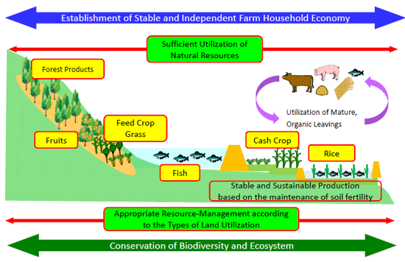

Slide 33
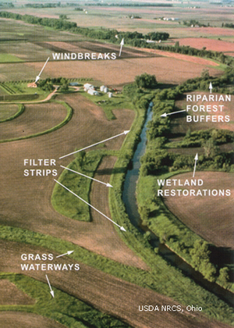
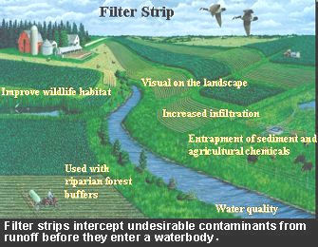
11/01 Conservation Practices
Obj. TSW understand and explain conservation practices such as water conservation and pest management. P. 20 NB
Companion planting is a conservation practice, how does it work?
Why might using mulch in each of our garden beds over the summer be a good idea?
What practices do we have for soil conservation?

Slide 34
Fall Harvest Festival Thursday Nov. 3rd 5:30
Decorations/ Materials
  Lights
  Hog Fencing & Zip ties
Education
  Plant a seed Station
  Color the Rainbow – Color Fruits & Vegetables
  Basket of Chicken Food
Food
  Capresse Salad – use basil leaves
  Pico De Gallo – use all peppers
Fun
  Bean Bag Game
Fundraising
  Sell Eggs $5/dozen, $7/ 18 eggs, $9/2 Dozen
  Chicken Races Donate $ to watch – NO betting
  Sell Basil in bunches $1/sprig
  Chicken Squat – pay $ to see if the hen poops on your Number in the pen
    Winner – gift card to Starbucks/ Target

Slide 35
Opening /Closing Ceremony Practice
Officers & Greenhand participants practice your lines with other students to memorize your parts/knowledge.
We will play FFA Kahoots on Thursday.
Everyone can take home a FFA Official Manual to practice.
There will eventually be a test for your Greenhand Degree. The degree will be Awarded Dec. 15th at the FFA Banquet.

Slide 36

Activity: List Our Best Practices
Brainstorm conservation techniques we have in the garden that make it sustainable. P. 23 NB
Write class responses here:

Slide 37
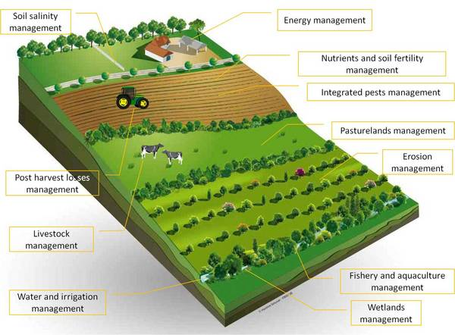
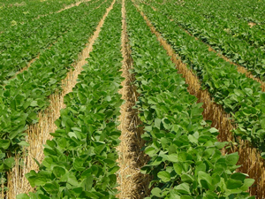
11/2 Conservation Practices
Obj. TSW learn about conservation practices used in agriculture. P. 22 NB
How do these practices (to the left) improve soil productivity or water retention?
Why do we want to conserve soil/ water?
What are some of the threats to soil, water?
No till farming

Slide 38
Next FFA Meeting Thursday November 10th
Cristal = Need Previous Meeting Minute written up.
Emiliano = Update on Twitter, FB & pictures reviewing our activities as a chapter in a PPT
Syed= Update on $ in chapter account, summary of fundraising for Fall Festival
FFA Awards Banquet = Students earning Greenhand degree will be awarded their Greenhand pins, STAR Greenhand degree, and others

Slide 39
Conservation Practices we use in the garden.
P.23 NB
Suggest ways to improve our effectiveness in the garden and describe some conservation techniques to include.
  Crop Rotation – Make a map of each season, so we don’t plant in the same beds with the same crops. This helps keep pest #’s down.

Slide 40
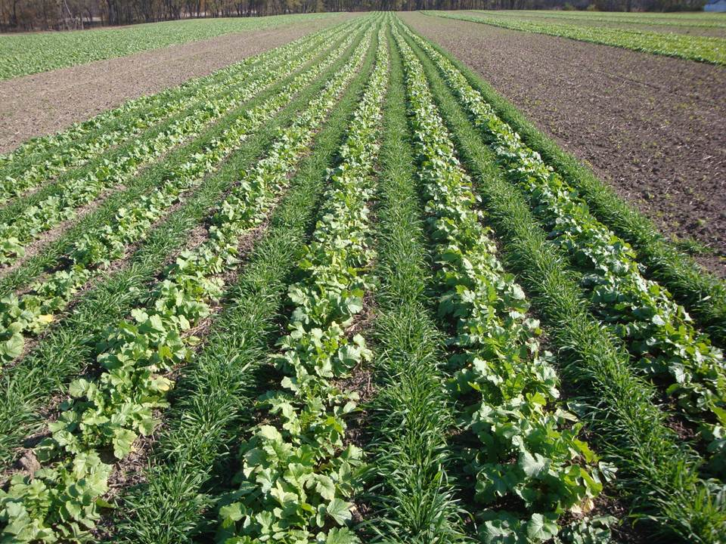
11/3 Conservation Practices
Obj. TSW understand how cover crop, intercropping and integrated pest management help conserve our soil. P.24 NB
What is a Cover Crop?
What is Intercropping?
Name some integrated pest management practices.

Slide 41
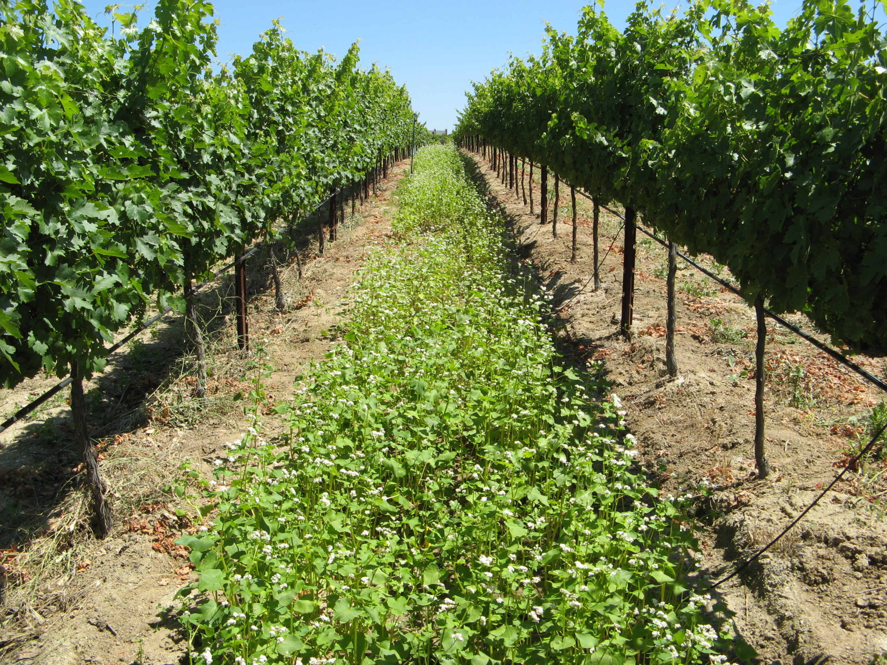
Cover Crop: growing a second crop in the same season of another that will improve soil health.
Suppressing weeds
Protecting soil from rain or runoff
Improving soil aggregate stability
Reducing surface crusting
Adding active organic matter to soil
Breaking hardpan
Fixing nitrogen –clover, fava beans
Scavenging soil nitrogen
Suppressing soil diseases and pests
http://covercrops.cals.cornell.edu/

Slide 42
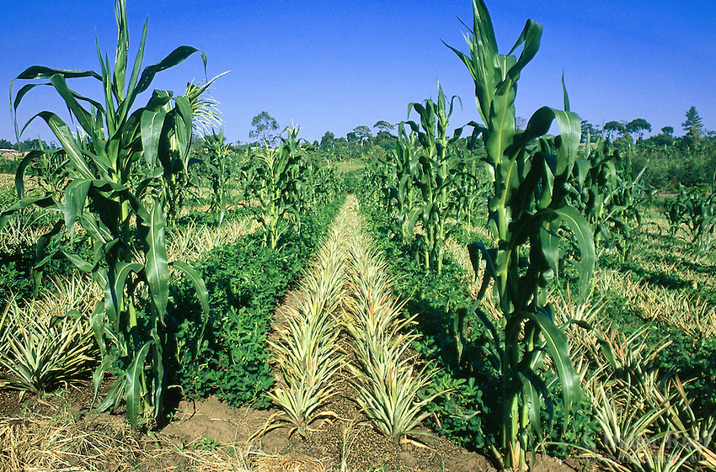
Innercropping – growing two or more crops at the same time in the same field.
Reduces insect/ pest infestations
Reduces plant diseases
Reduces erosion & Protects topsoil
Attracts beneficial insects
Minimize labor to control weeds
Increase in production of land
2 crops harvested instead of one
http://www.oisat.org/control_methods/cultural__practices/intercropping.html

Slide 43
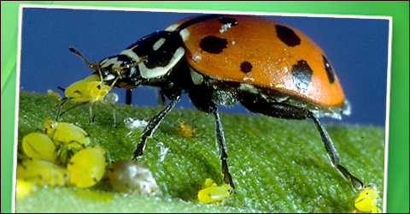
Integrated Pest Management (IPM)
Examples: Use natural predators in your garden. Lady bugs, Preying Mantis’, Butterfly's
Use Less pesticides, to decrease the resistance of pests to toxic chemcials.
Increase Biodiversity
Decrease the resources needed by the bad pests: water, food, shelter.
Seal all cracks in buildings.
Watch IPM video from YCOE.

Slide 44
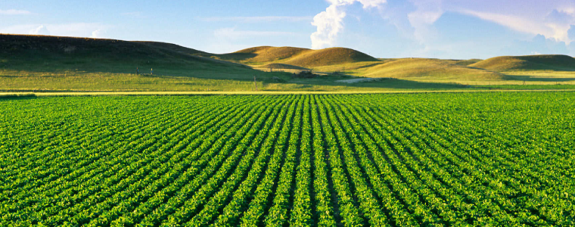
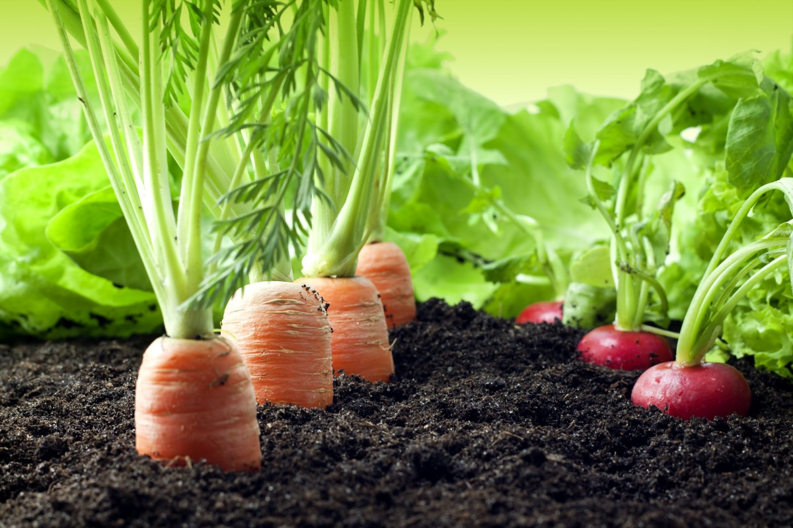
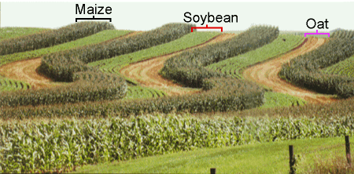
11/7 Biodiverisity
Obj. TSW learn about what biodiversity is and why it is important. P.26 NB
What picture shows the highest number of different species (greatest biodiversity)?
What is Biodiverisity? How can it be measured?
Why is Biodiversity important?

Slide 45
Computer Lab Activity –
Examine your Carbon Footprint for Foods http://www.eatlowcarbon.org/ p. 25 NB
What is your food carbon footprint?
How do your food choices affect your carbon footprint?
What are 5 easy tips to reduce your food carbon footprint?
List the food selection with the highest and lowest carbon footprint for: breakfast, soup, side order, entrée, dessert
What do the Carbon footprint scores actually mean?
How were they calculated?

Slide 46
Fertilized Chicken Eggs
Possibly Lavender Orphington
Possibly Lavender Orphington or Lemon Cuckoo Orphington
“Mystery” Brown Egg – Probably Half Orphington
“Mystery” Brown Egg – Probably Half Orphington
Ameraucana
Ameraucana
Rooster is Cream Legbar; Hen is French Blue Copper Maran x Black Cochin Bantam

Slide 47
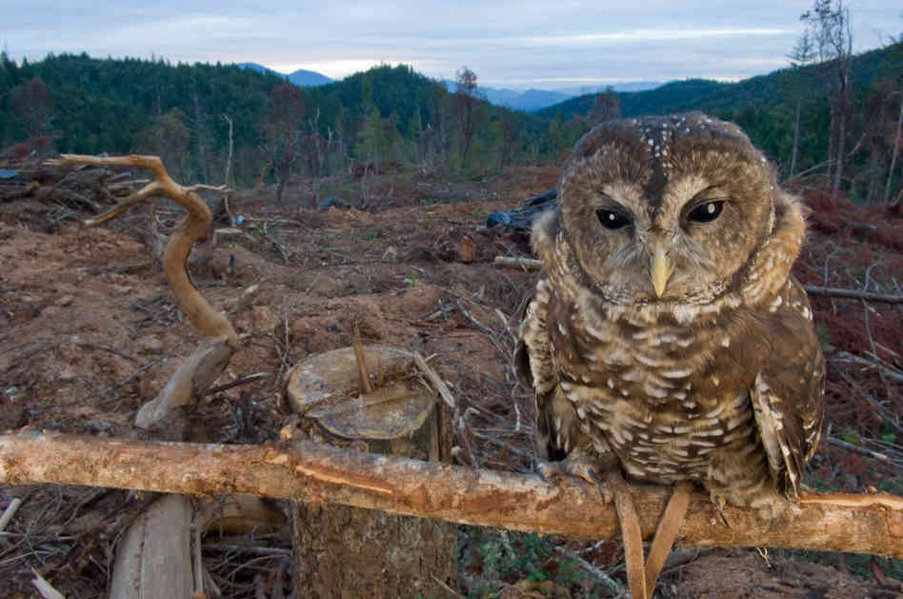
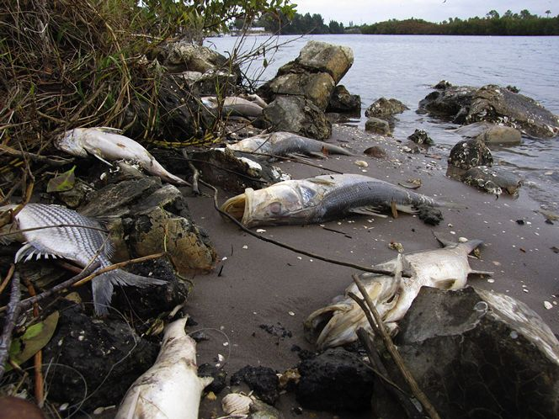
11/8 Threats to Biodiversity
Obj. TSW realize that unlike any other mass extinction event, the current mass extinction now is directly related to human activities. P.28 NB
What is mass extinction?
What are some threats to Biodiversity?
What human activities are related to the our decline in biodiversity and mass extinction of species on the planet?

Slide 48
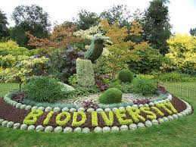
11/9 Applying Biodiversity to our Garden
Obj. TSW learn how our garden is biodiverse, and areas of improvement. P.30 NB
How would you describe the biodiversity of our garden?
Why is biodiversity beneficial in natural environments?
How can we increase the biodiversity in our garden?

Slide 49
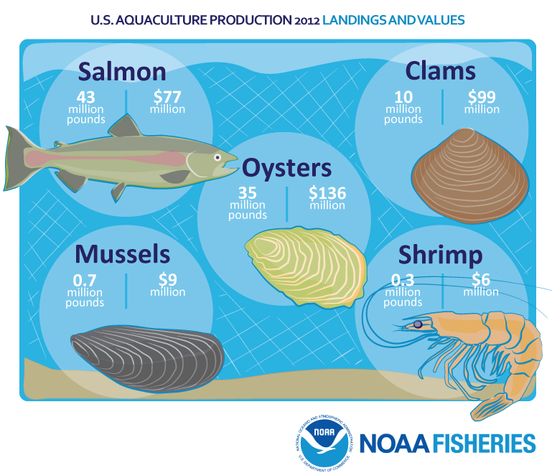
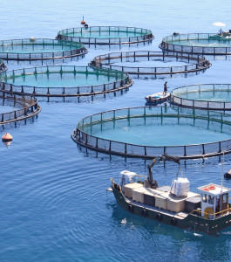
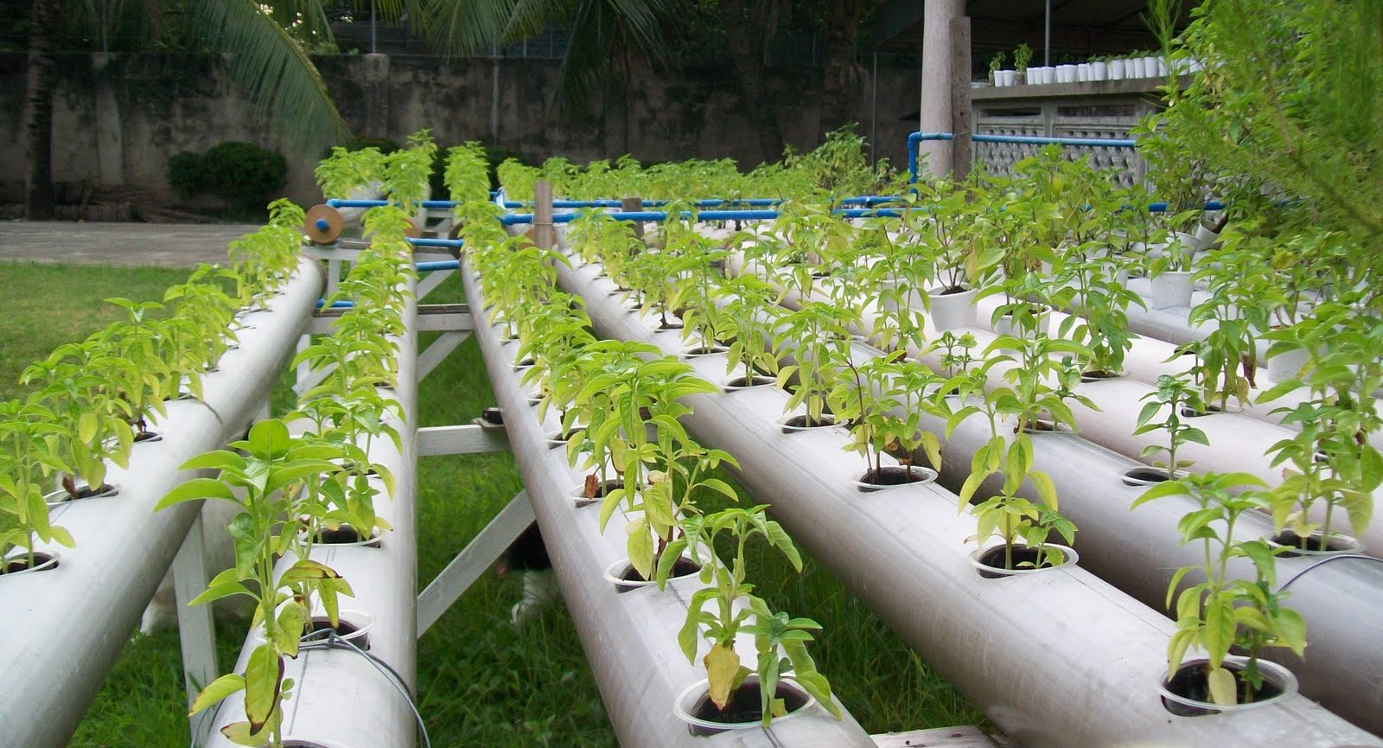
11/10 Aquaculture and Hydroponics
Obj. TSW learn about exciting occupations in growing sustainable food. P.32 NB
What is Aquaculture about?
What is Hydroponics about?
Have you heard of Permaculture?

Slide 50
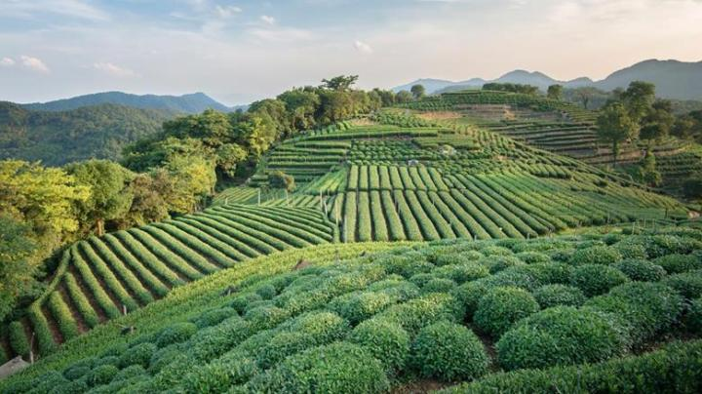
11/14 Green Revolution
Obj. TSW watch a video about synthetic pesticides and fertilizers. P. 34 NB
What is the Green Revolution?
What is the difference between synthetic and organic?
What suggestions do you have for our garden?

Slide 51
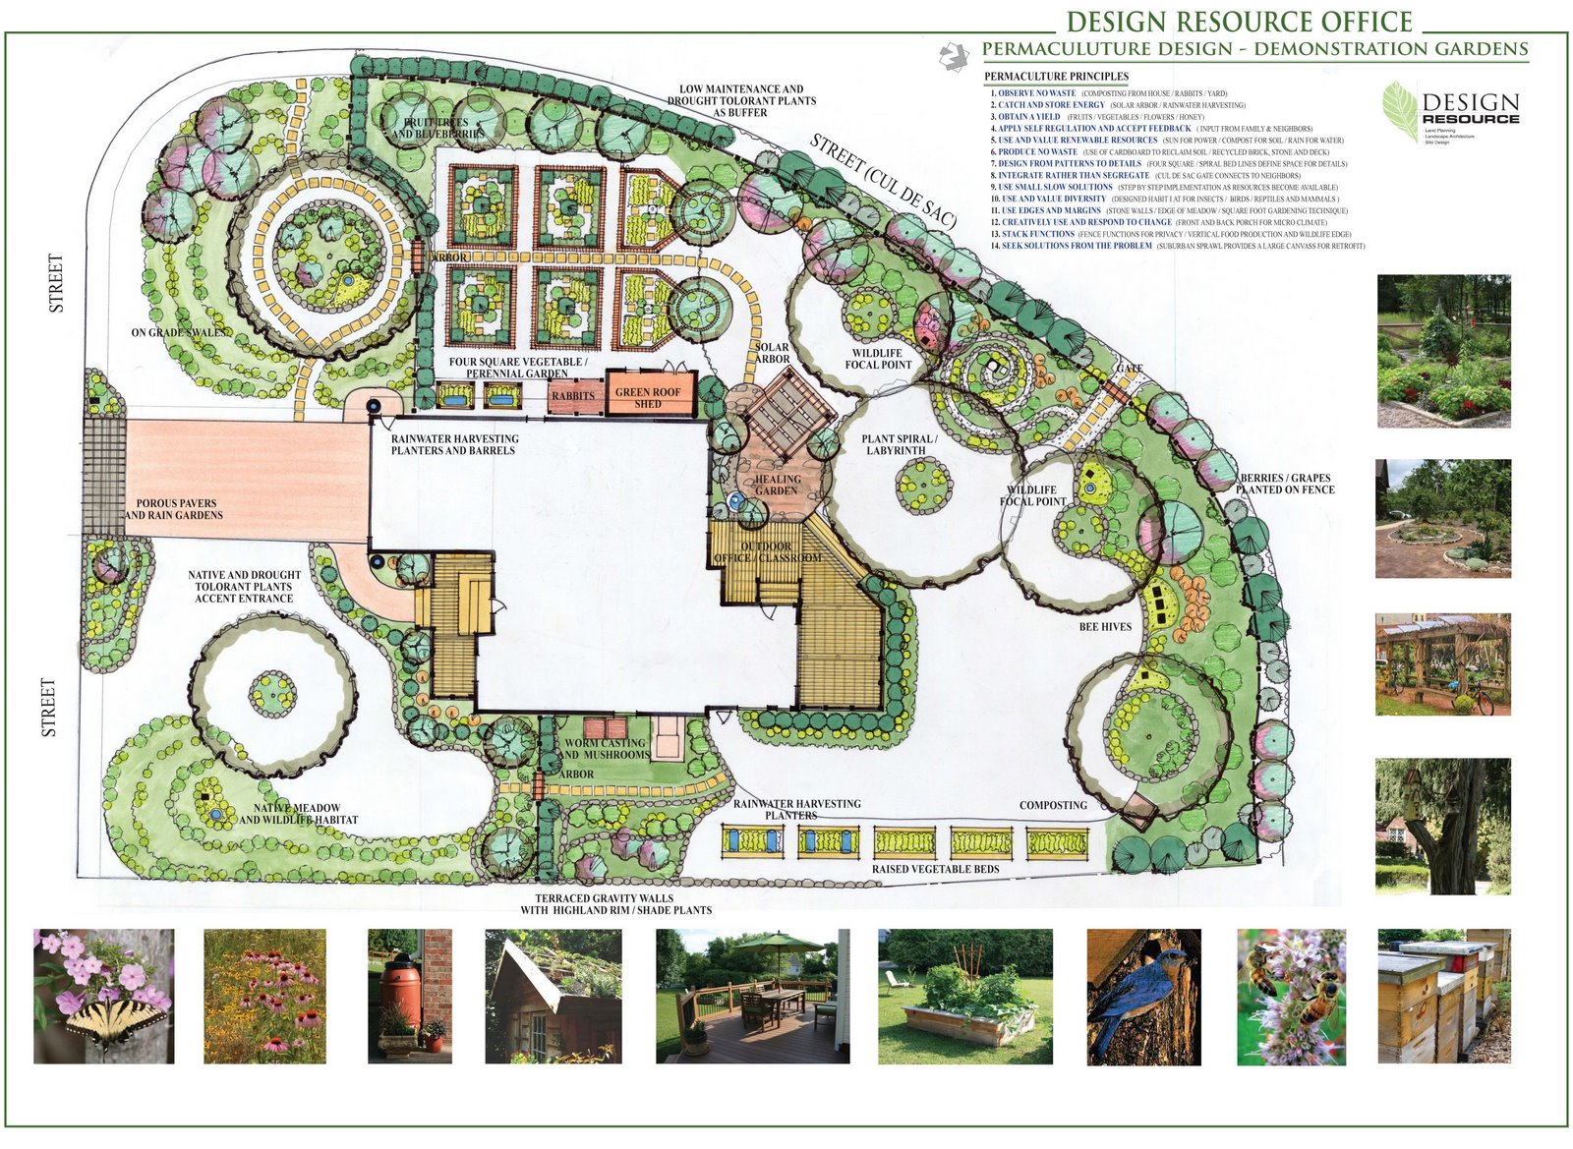
Computer Lab Activity:
Choose one: Research Aquaculture, Hydroponics or Permaculture.
What is the history behind the science?
How is the product cared for/ produced?
What is the demand for the industry? Is it growing?
Describe some challenges to having one of these programs in our school district.
What would be some benefits?

Slide 52
Permaculture AXES Paragraph
What is Permaculture in your own words?
What are some examples of Permaculture?
What examples of permaculture do we have in our garden?
Why is Permaculture important?
Do you see it catching on in agriculture? Why or Why not?

Slide 53
http://www.openthefuture.com/cheeseburger_CF.html
Go to the website and read the article.
Discuss what you have read with 2 other students around you.
Class discussion on the energy needed to make a hamburger.
AXES Paragraph about the article in your notebook.
Cheeseburger Video

Slide 54
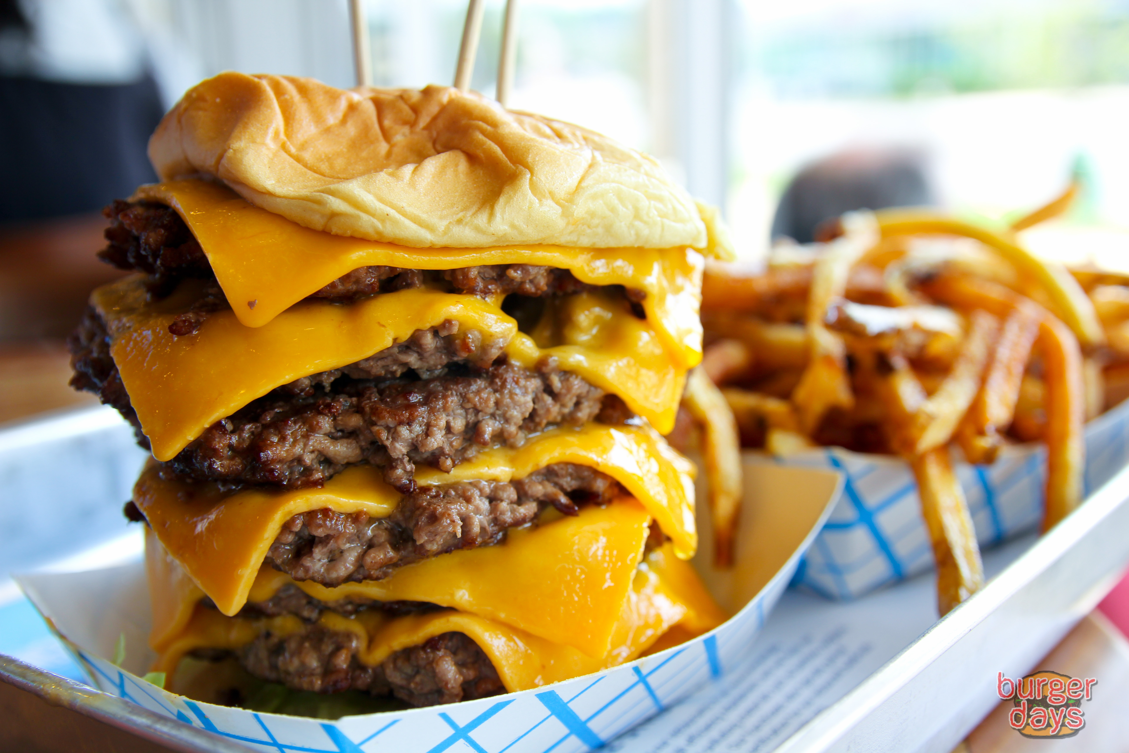
11/15 Eating a Cheeseburger
Obj. TSW learn about the carbon footprint of eating a cheeseburger. P. 36 NB
What is a carbon footprint?
What kind of energy goes into making a cheeseburger?
Rank the carbon footprint of eating a cheeseburger: High, Medium or Low.

Slide 55
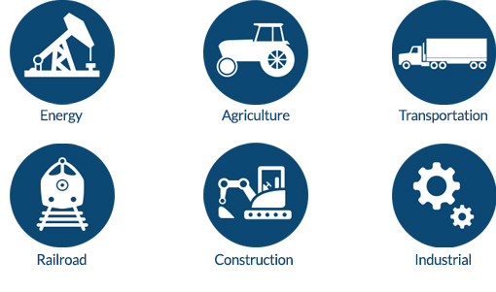
11/16 Along the Way… there are Jobs
Obj. TSW learn about potential jobs in the Agriculture & transportation industry. P.38 NB
What are some potential jobs in Agriculture?
How many people work in an area related to Agriculture?
Why is this significant?

Slide 56
Agriculture Careers
Agricultural careers may be divided into various categories. These include: Agribusiness Management, Agricultural and Natural Resources Communications, Building Construction Management, Agriscience, Resource Development and Management, Parks, Recreations, and Tourism Resources, Packaging, Horticulture, Forestry, Food Science, and Fisheries/Wildlife
http://www.agday.org/education/careers.php

Slide 57
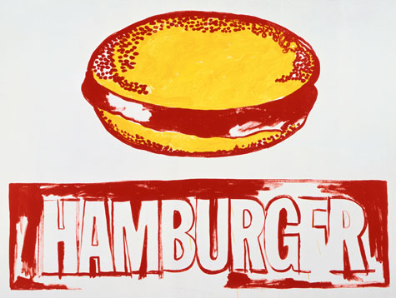
11/17 Andy Warhal Hamburger
Obj. TSW understand the common denominator a fast food hamburger creates. P.40 NB
What do you expect from a fast food hamburger?
What is your favorite memory eating a fast food hamburger?
Why is eating a fast food hamburger a common denominator among all people?

Slide 58
http://www.agday.org/education/careers.php
Go to the following link and research potential jobs in Agriculture.
Write a list of 5 potential jobs that are interesting to you and why.

Slide 59
Read Article on Organic vs. Synthetic Fertilizers and Pesticides
AXES Paragraph Page 33 NB

