Slide 1
Farm To Fork
Week 14
UNIT 3 KA 4

Slide 2
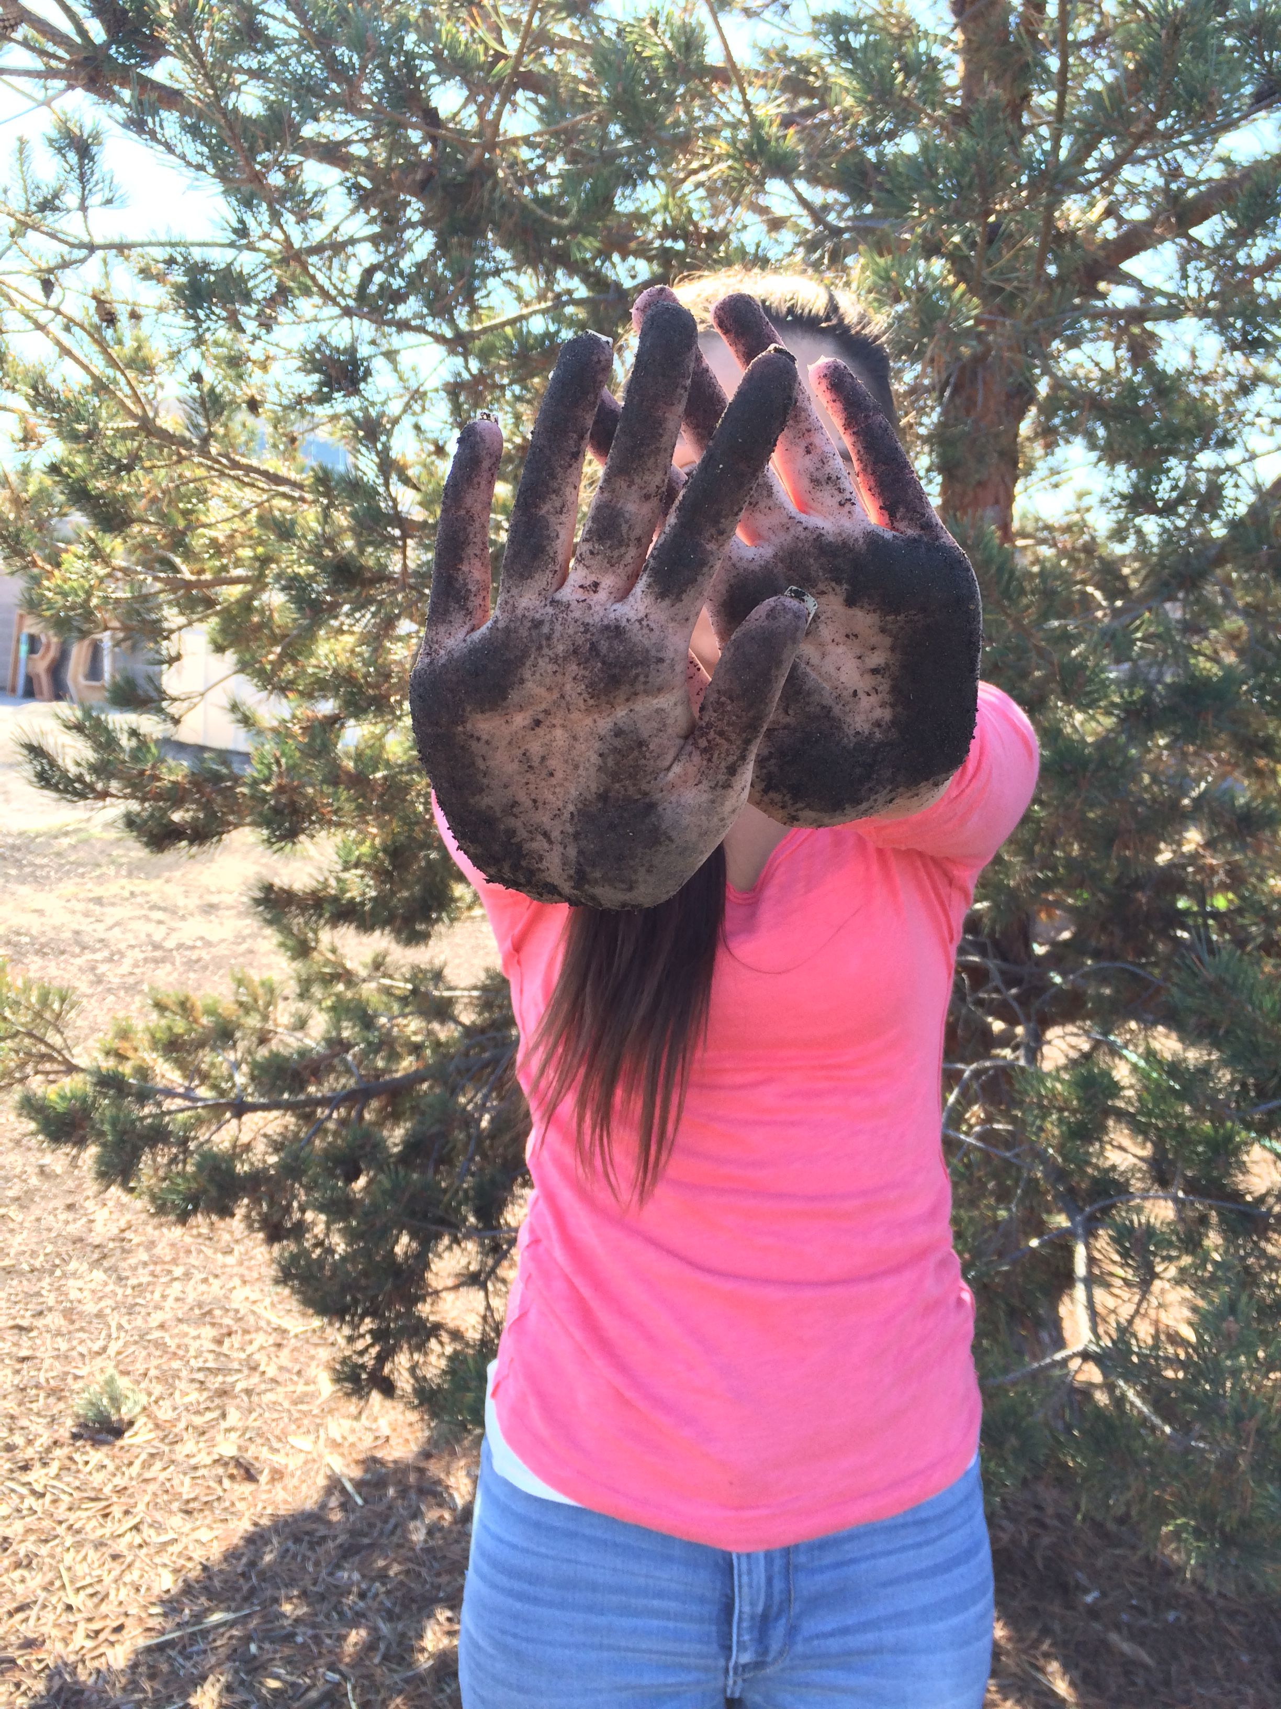
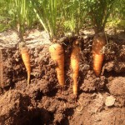

Slide 3
2015 Harvest Festival Bryte Campus

Slide 4
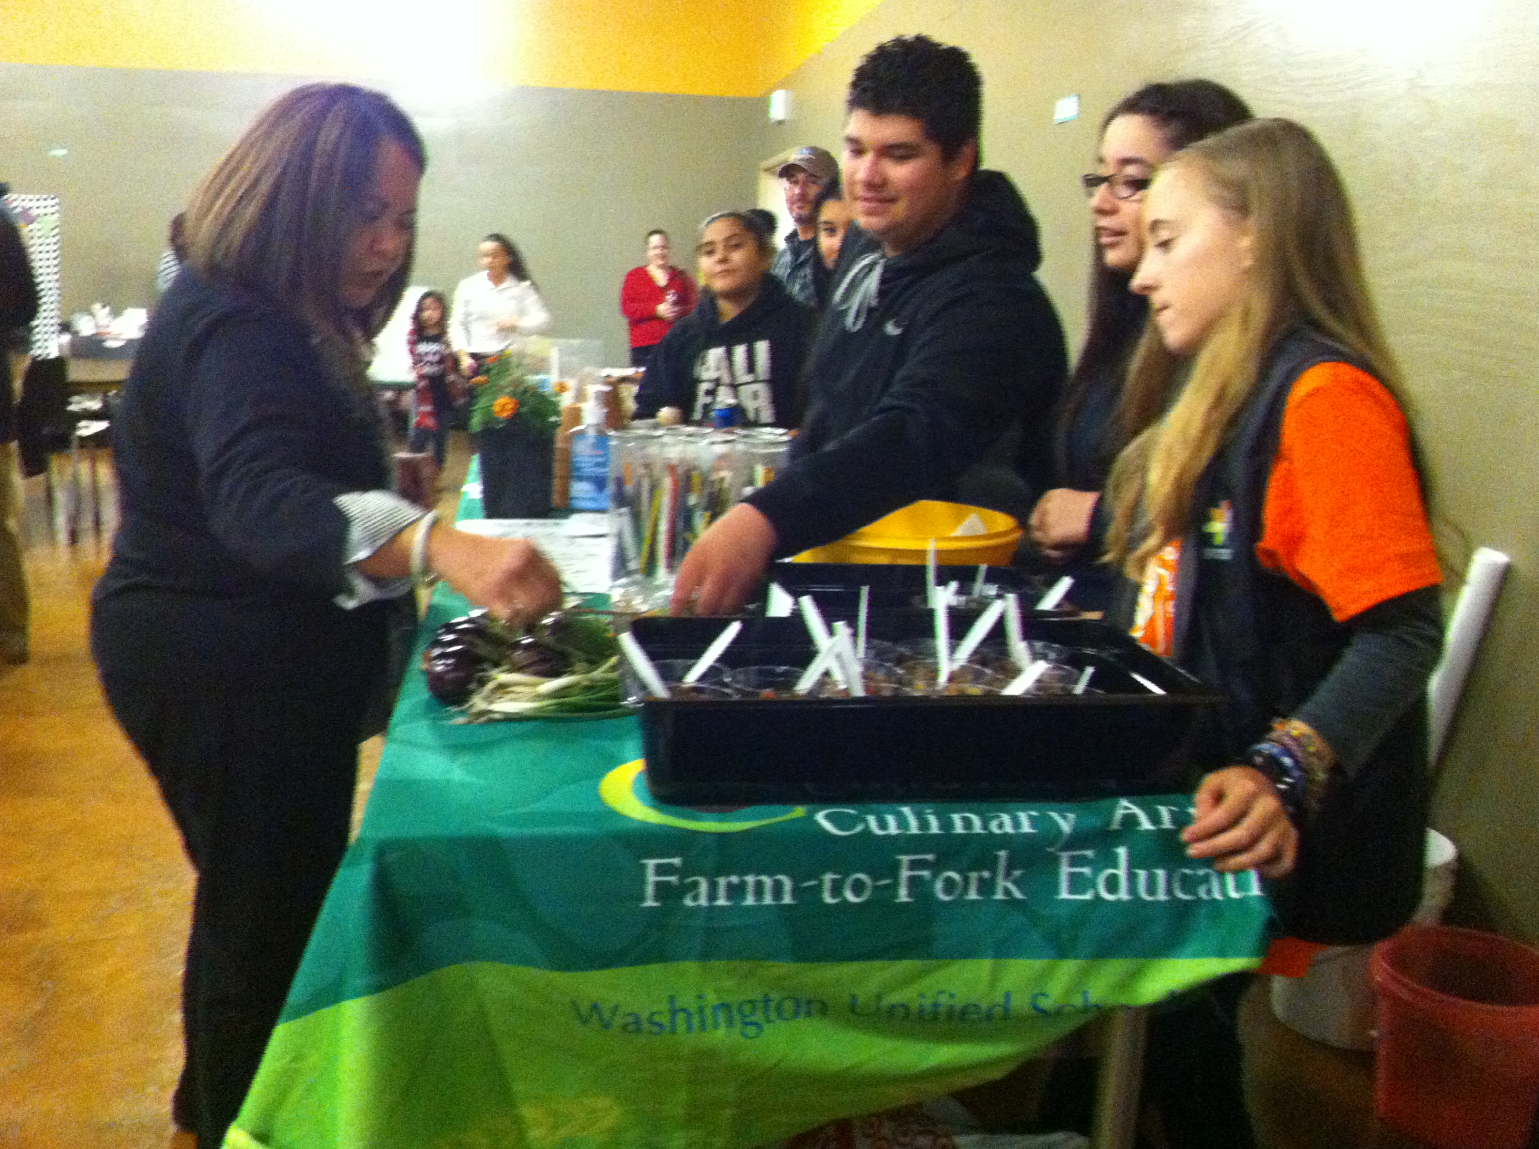

Slide 5
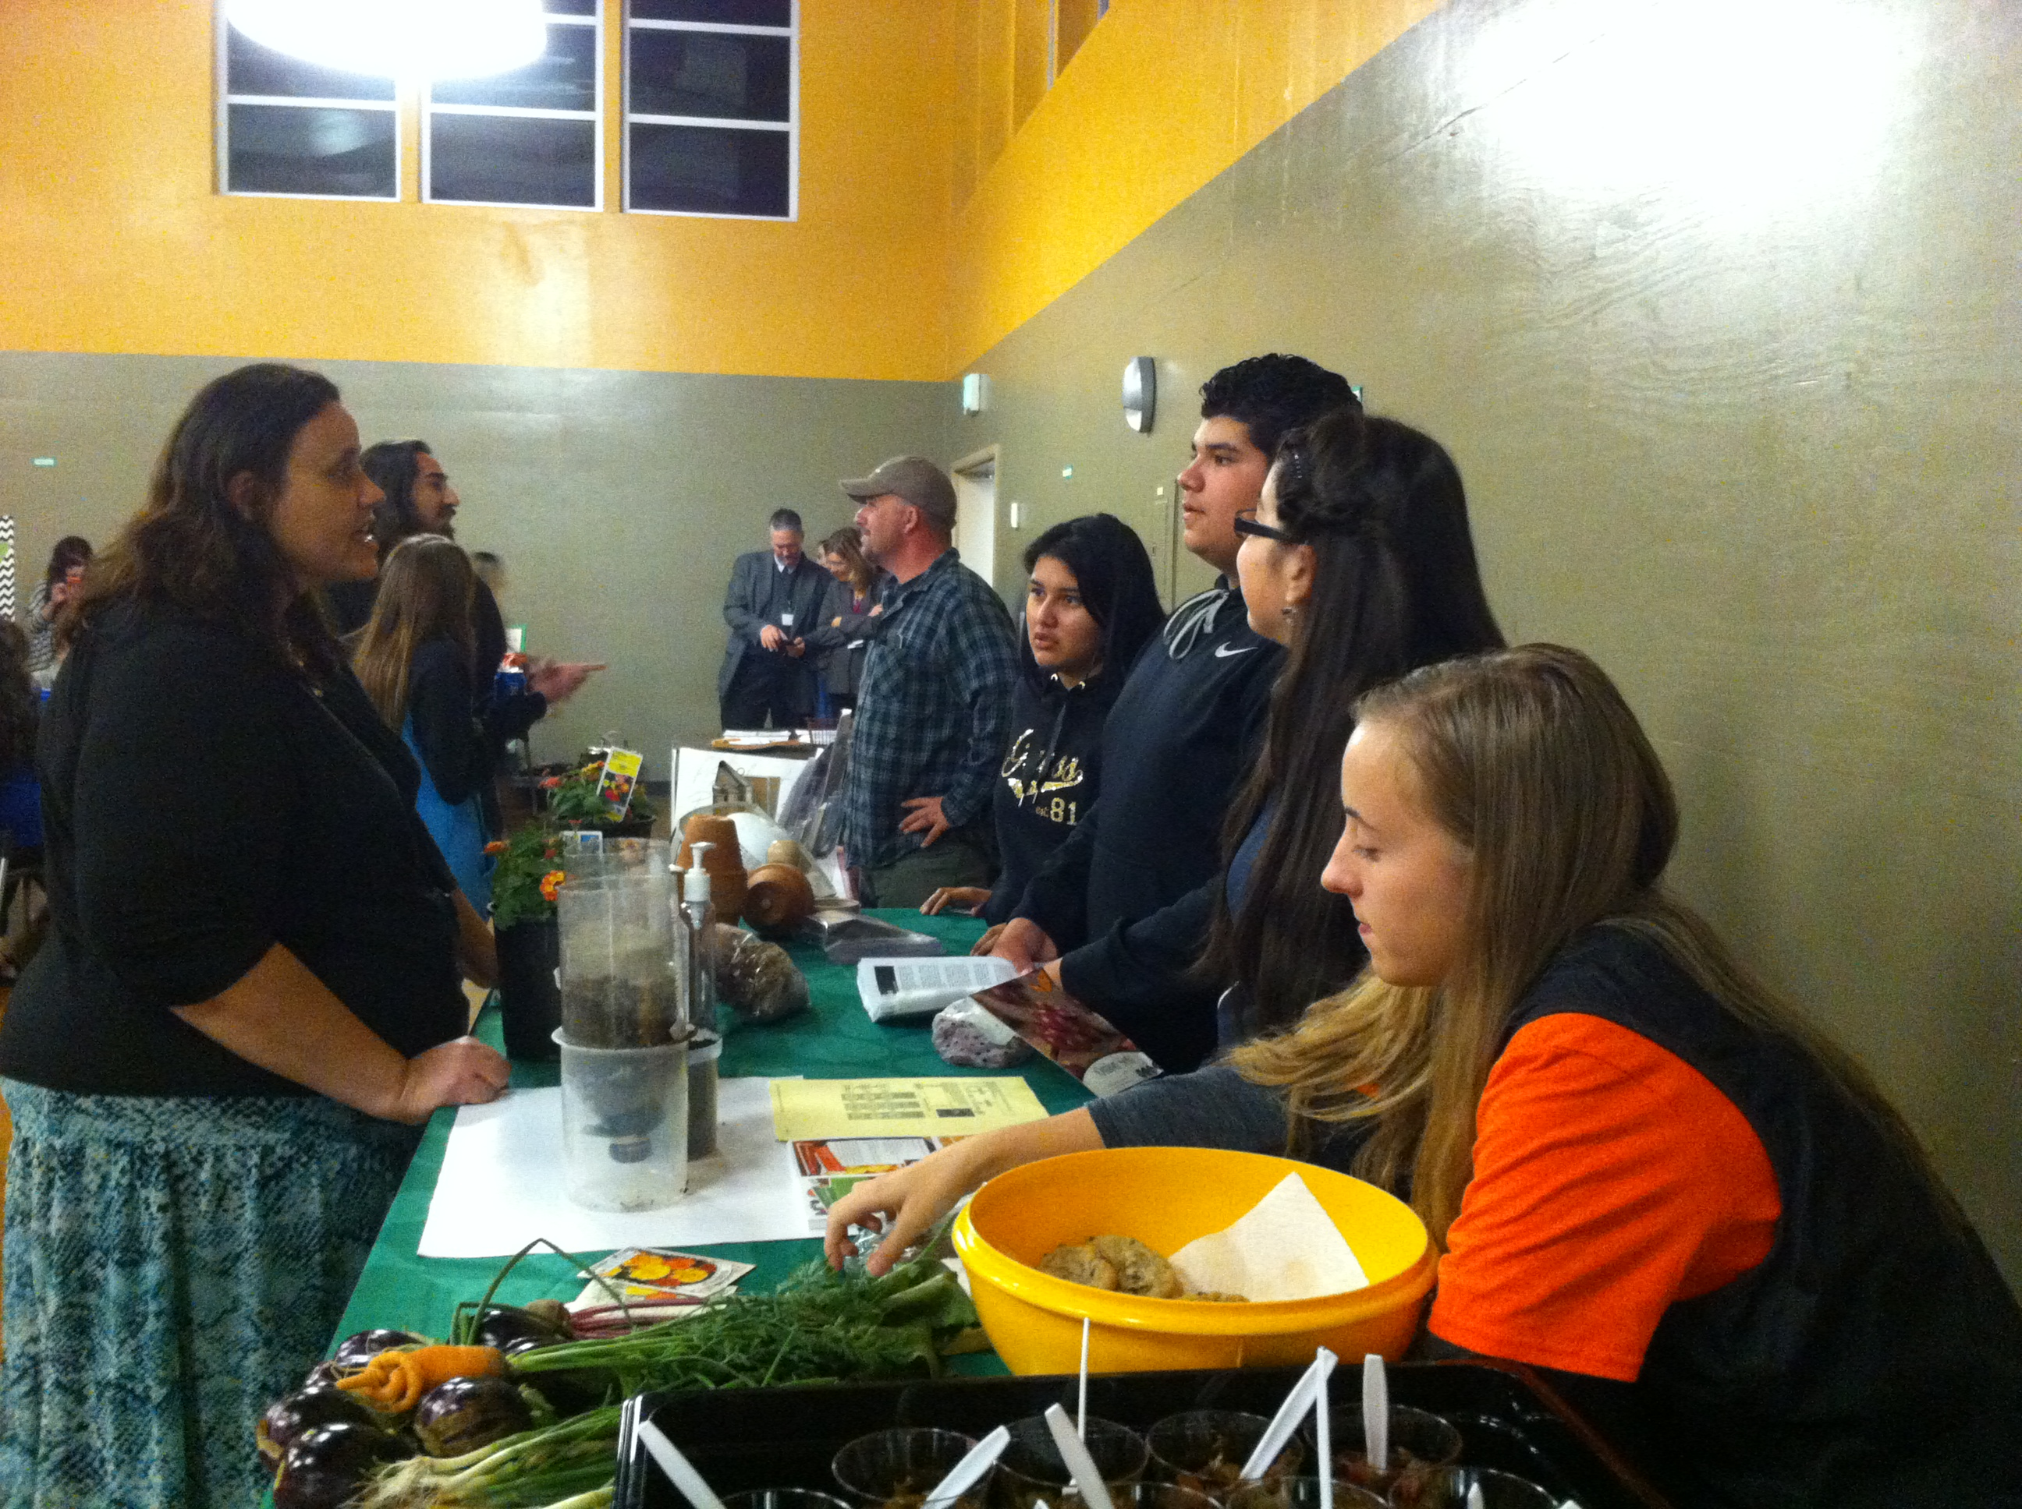

Slide 6
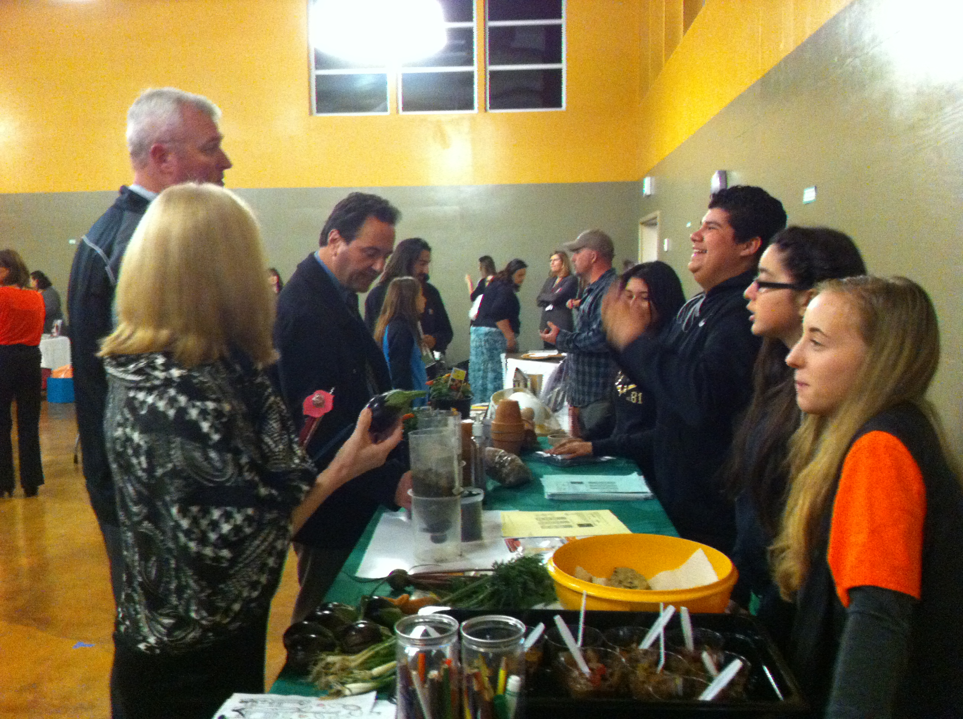

Slide 7
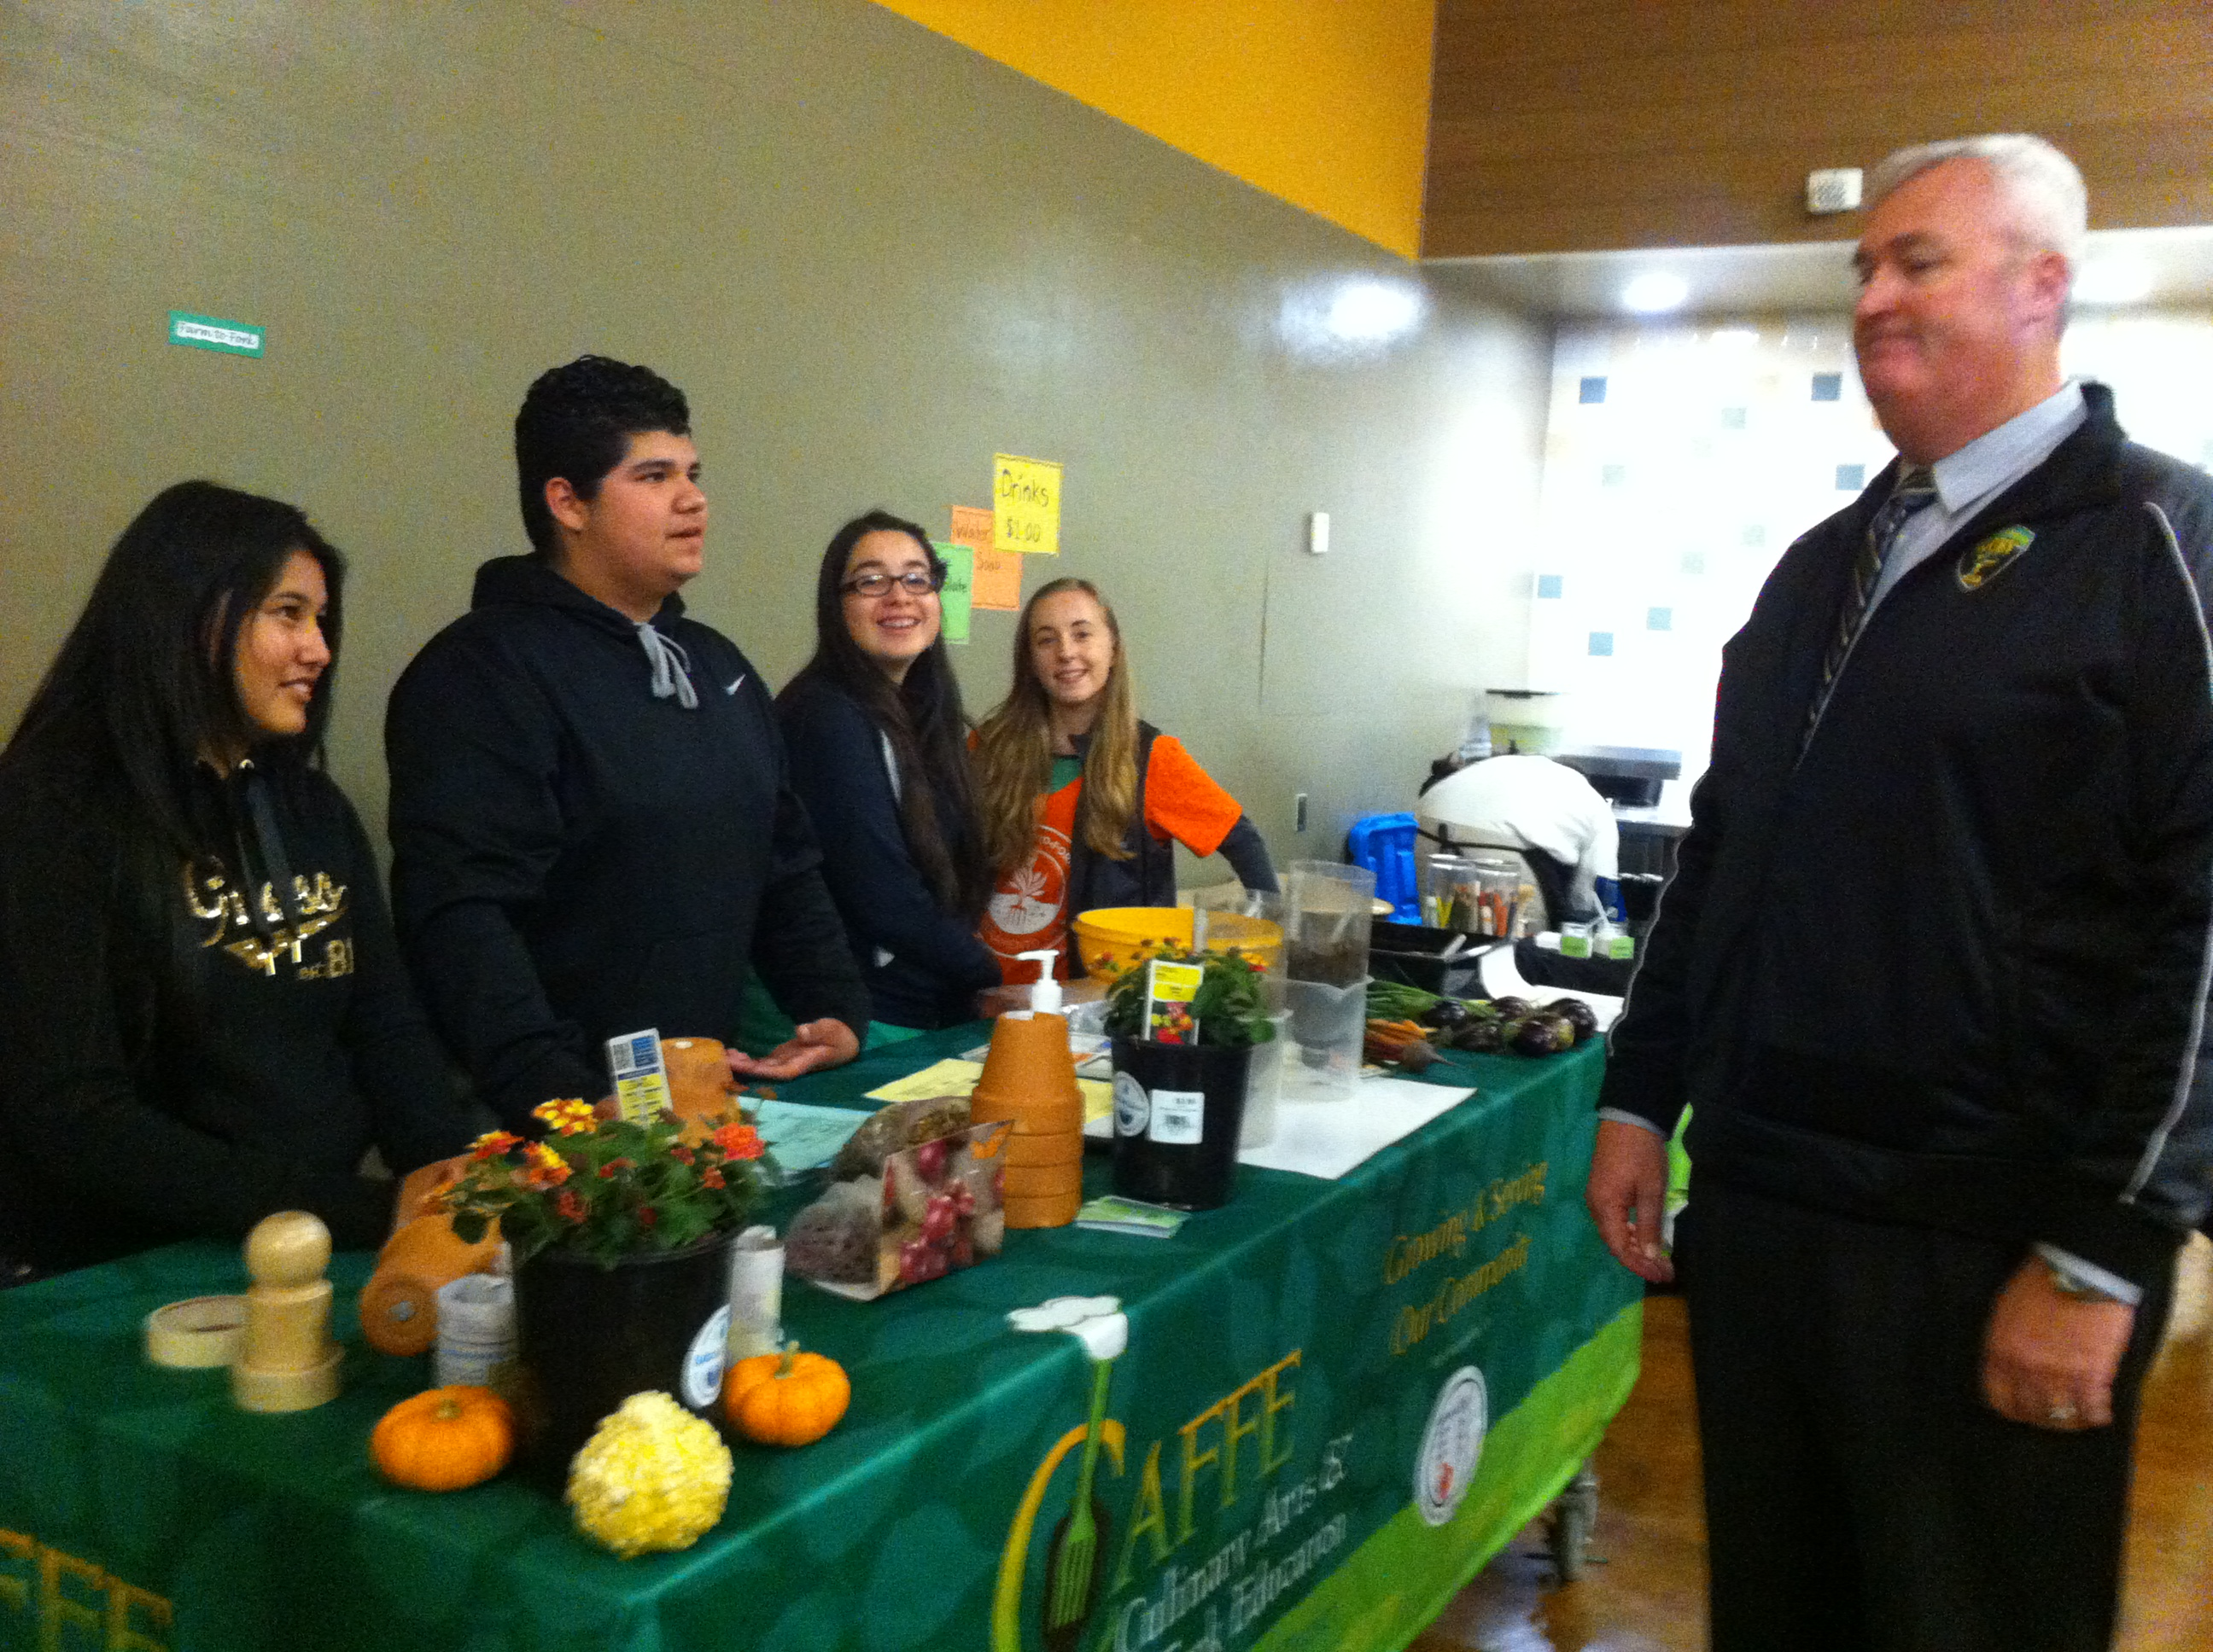

Slide 8
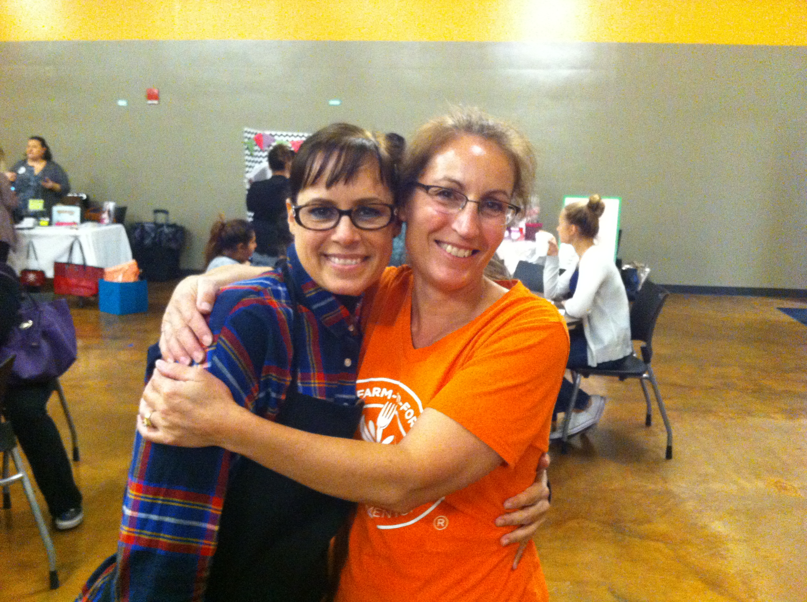

Slide 9
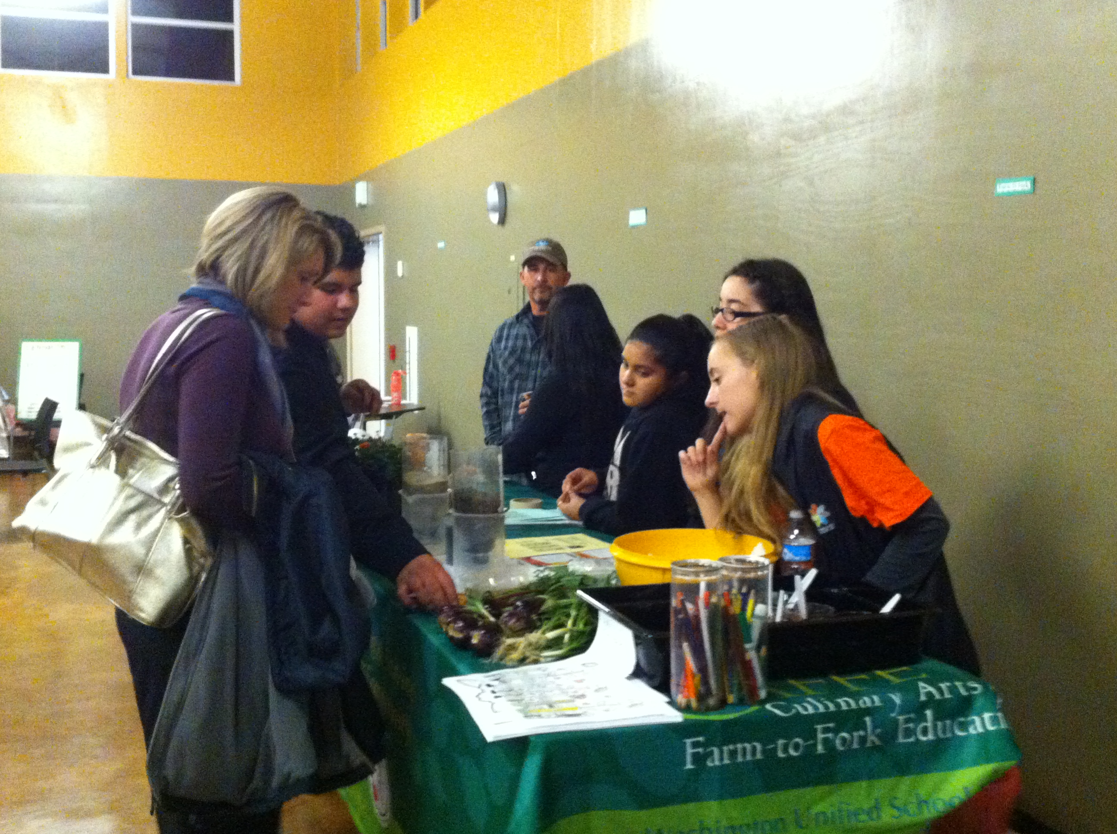

Slide 10
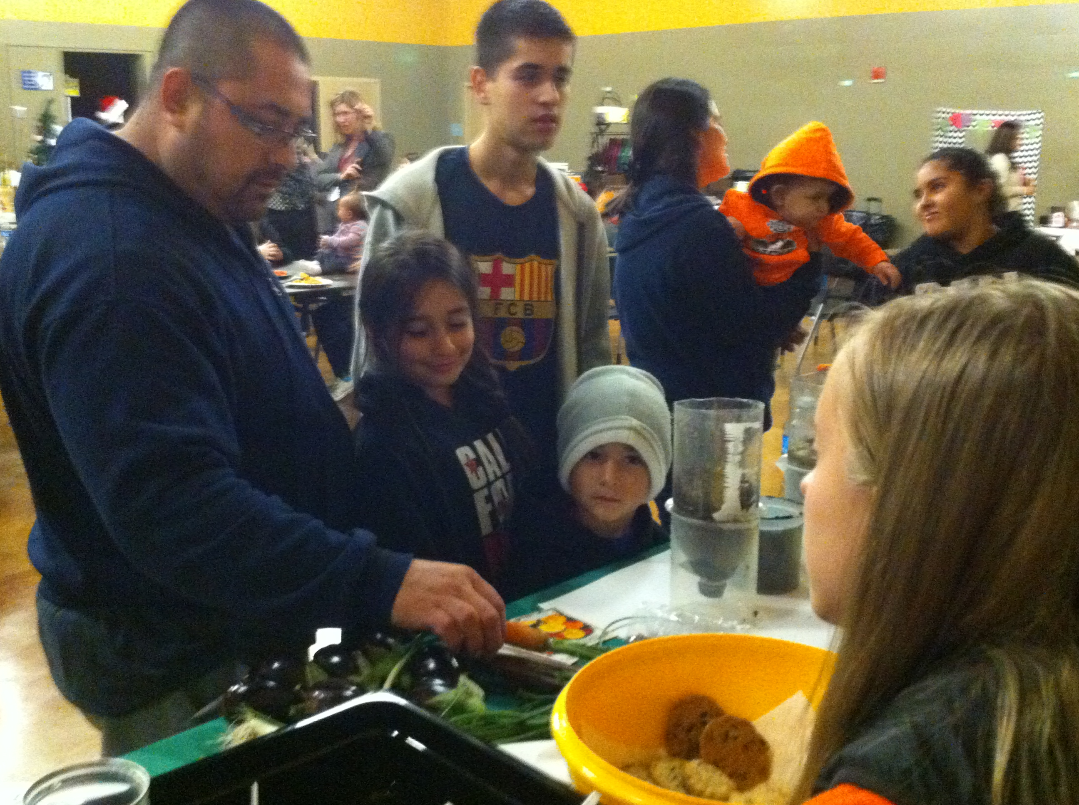

Slide 11
11/16 Transportation & Energy Obj. TSW learn about the energy it takes to produce a hamburger. P. 44 NB
What are the standard ingredients in a hamburger?
What is the Bun made of?
What do the cows eat?

Slide 12
Computer Lab Activity: Research Aquaculture, Hydroponics or Permaculture. P. 41& 43 NB
What is the history behind the science?
How is the product cared for/ produced?
What is the demand for the industry? Is it growing?
Describe some challenges to having one of these programs in our school district.
What would be some benefits?

Slide 13
Permaculture AXES Paragraph P. 43 NB
What is Permaculture in your own words?
What are some examples of Permaculture?
What examples of permaculture do we have in our garden?
Why is Permaculture important?
Do you see it catching on in agriculture? Why or Why not?

Slide 14
Vocabulary List P. 45 NB
Transportation & Energy

Slide 15
http://www.openthefuture.com/cheeseburger_CF.html
Go to the website and read the article.
Discuss what you have read with 2 other students around you.
Class discussion on the energy needed to make a hamburger.
AXES Paragraph about the article. P. 47 NB
Cheeseburger Video

Slide 16
11/17 Eating a Cheeseburger Obj. TSW learn about the carbon footprint of eating a cheeseburger. P. 46 NB
What is a carbon footprint?
What kind of energy goes into making a cheeseburger?
Rank the carbon footprint of eating a cheeseburger: High, Medium or Low.

Slide 17
11/18 Along the Way… there are Jobs Obj. TSW learn about potential jobs in the Agriculture & transportation industry. P. 48 NB
What are some potential jobs in Agriculture?
How many people work in an area related to Agriculture?
Why is this significant?

Slide 18
Agriculture Careers
Agricultural careers may be divided into various categories. These include: Agribusiness Management, Agricultural and Natural Resources Communications, Building Construction Management, Agriscience, Resource Development and Management, Parks, Recreations, and Tourism Resources, Packaging, Horticulture, Forestry, Food Science, and Fisheries/Wildlife
http://www.agday.org/education/careers.php

Slide 19
http://www.agday.org/education/careers.php
Go to the following link and research potential jobs in Agriculture.
Write a list of 5 potential jobs that are interesting to you and why on page 49 NB

Slide 20
11/19 Andy Warhal Hamburger Obj. TSW understand the common denominator a fast food hamburger creates. P. 50 NB
What do you expect from a fast food hamburger?
What is your favorite memory eating a fast food hamburger?
Why is eating a fast food hamburger a common denominator among all people?

Slide 21
Movie – Supersize me, Food Inc.
Notes Page 51NB = 1 page

Slide 22
11/20 Farm to Fork Movement Obj. TSW compare and contrast the farm to fork movement to the traditional way of growing food. P. 52 NB
How is the Farm to Fork movement more efficient than traditional food?
How is F2F more efficient in terms of energy?
Distance the food travels, location of the goods and services and transportation to those places

