Slide 1
Eutrophication Building Healthy Soil
Farm to Fork 2 Week 4

Slide 2
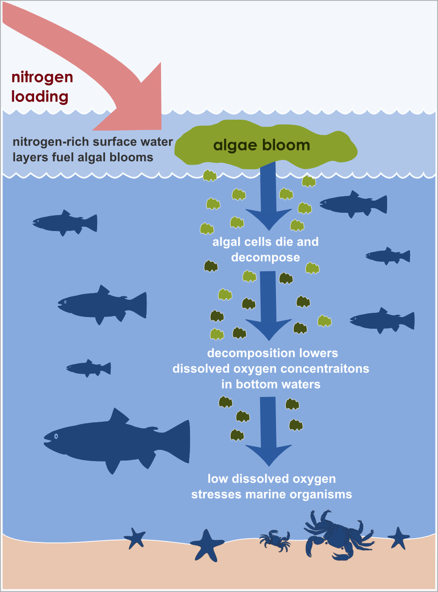
2/8 Eutrophication Obj. TSW learn about excess nutrients in the water P. 32NB
If nutrients in the soil are good, why would excess nutrient in the water be bad?
Describe what you think could happen.
How could Biodiversity be impacted by excess nutrients in the water?

Slide 3
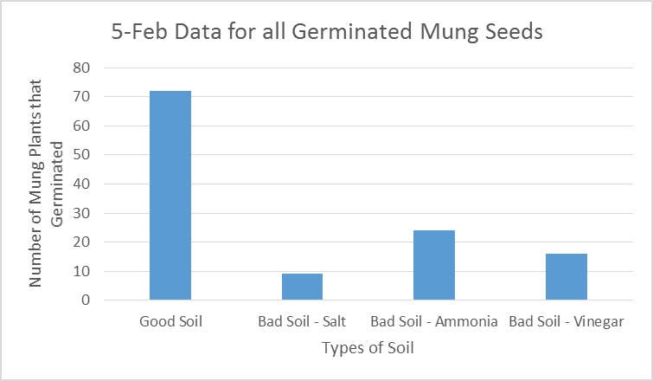
What is the impact of degraded soil on plant growth? Conclusion of Lab 2/5 P. 31 NB

Slide 4
Soil Degradation Lab
TSW learn how to enter data into excel to create a graph for a lab report.
Students will follow the Lab Report Template to create a lab about soil degradation, and use their data for evidence about how there are different qualities of soil for growing food.

Slide 5
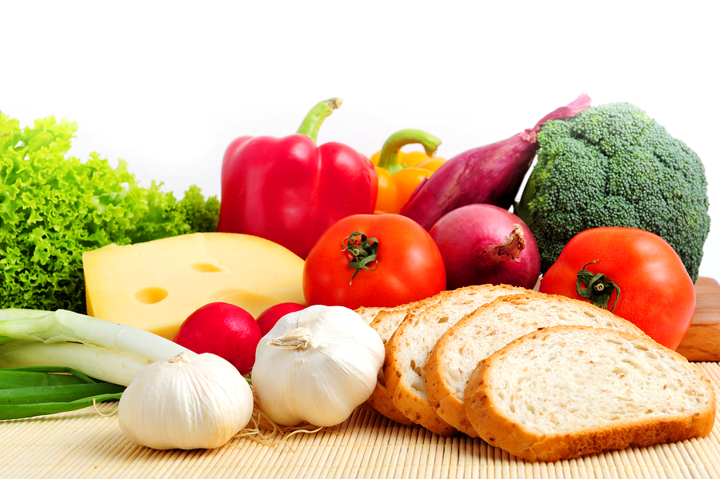
2/9 Where does your food come from? Obj. TSW reflect on what it takes to grow healthy food. P. 34 NB
Where does healthy food come from?
How is healthy food grown?
How can you be part of the solution to feed people healthy food?

Slide 6
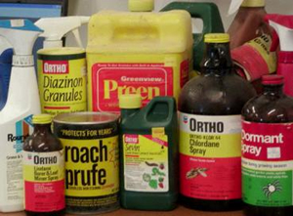
2/10 What chemical is it? Obj. TSW learn about chemicals that can be used in the growing of food. P. 36 NB
What is a pesticide?
What is a herbicide?
Why are some fertilizers synthetic, instead of organic?

Slide 7
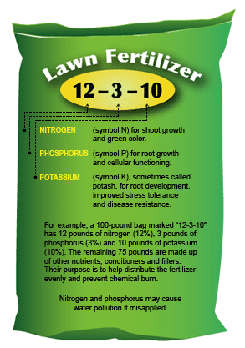
2/11 Fertilizers Obj. TSW learn about synthetic fertilizers and why we use them. P. 38 NB
What three nutrients have to be posted on the fertilizer bag?
What types of fertilizers are there?
Why do we make fertilizer if we have so much run off in bodies of water?

