Slide 1
Farm to Fork
Pumpkin Pie Making with Culinary Arts at the Bryte Campus
October 15th, 2015
Cheryle Sutton, Ellen Hoffmann, Robert Rossi, Jennifer McAllister, Chris Hanks, & RCHS students

Slide 2
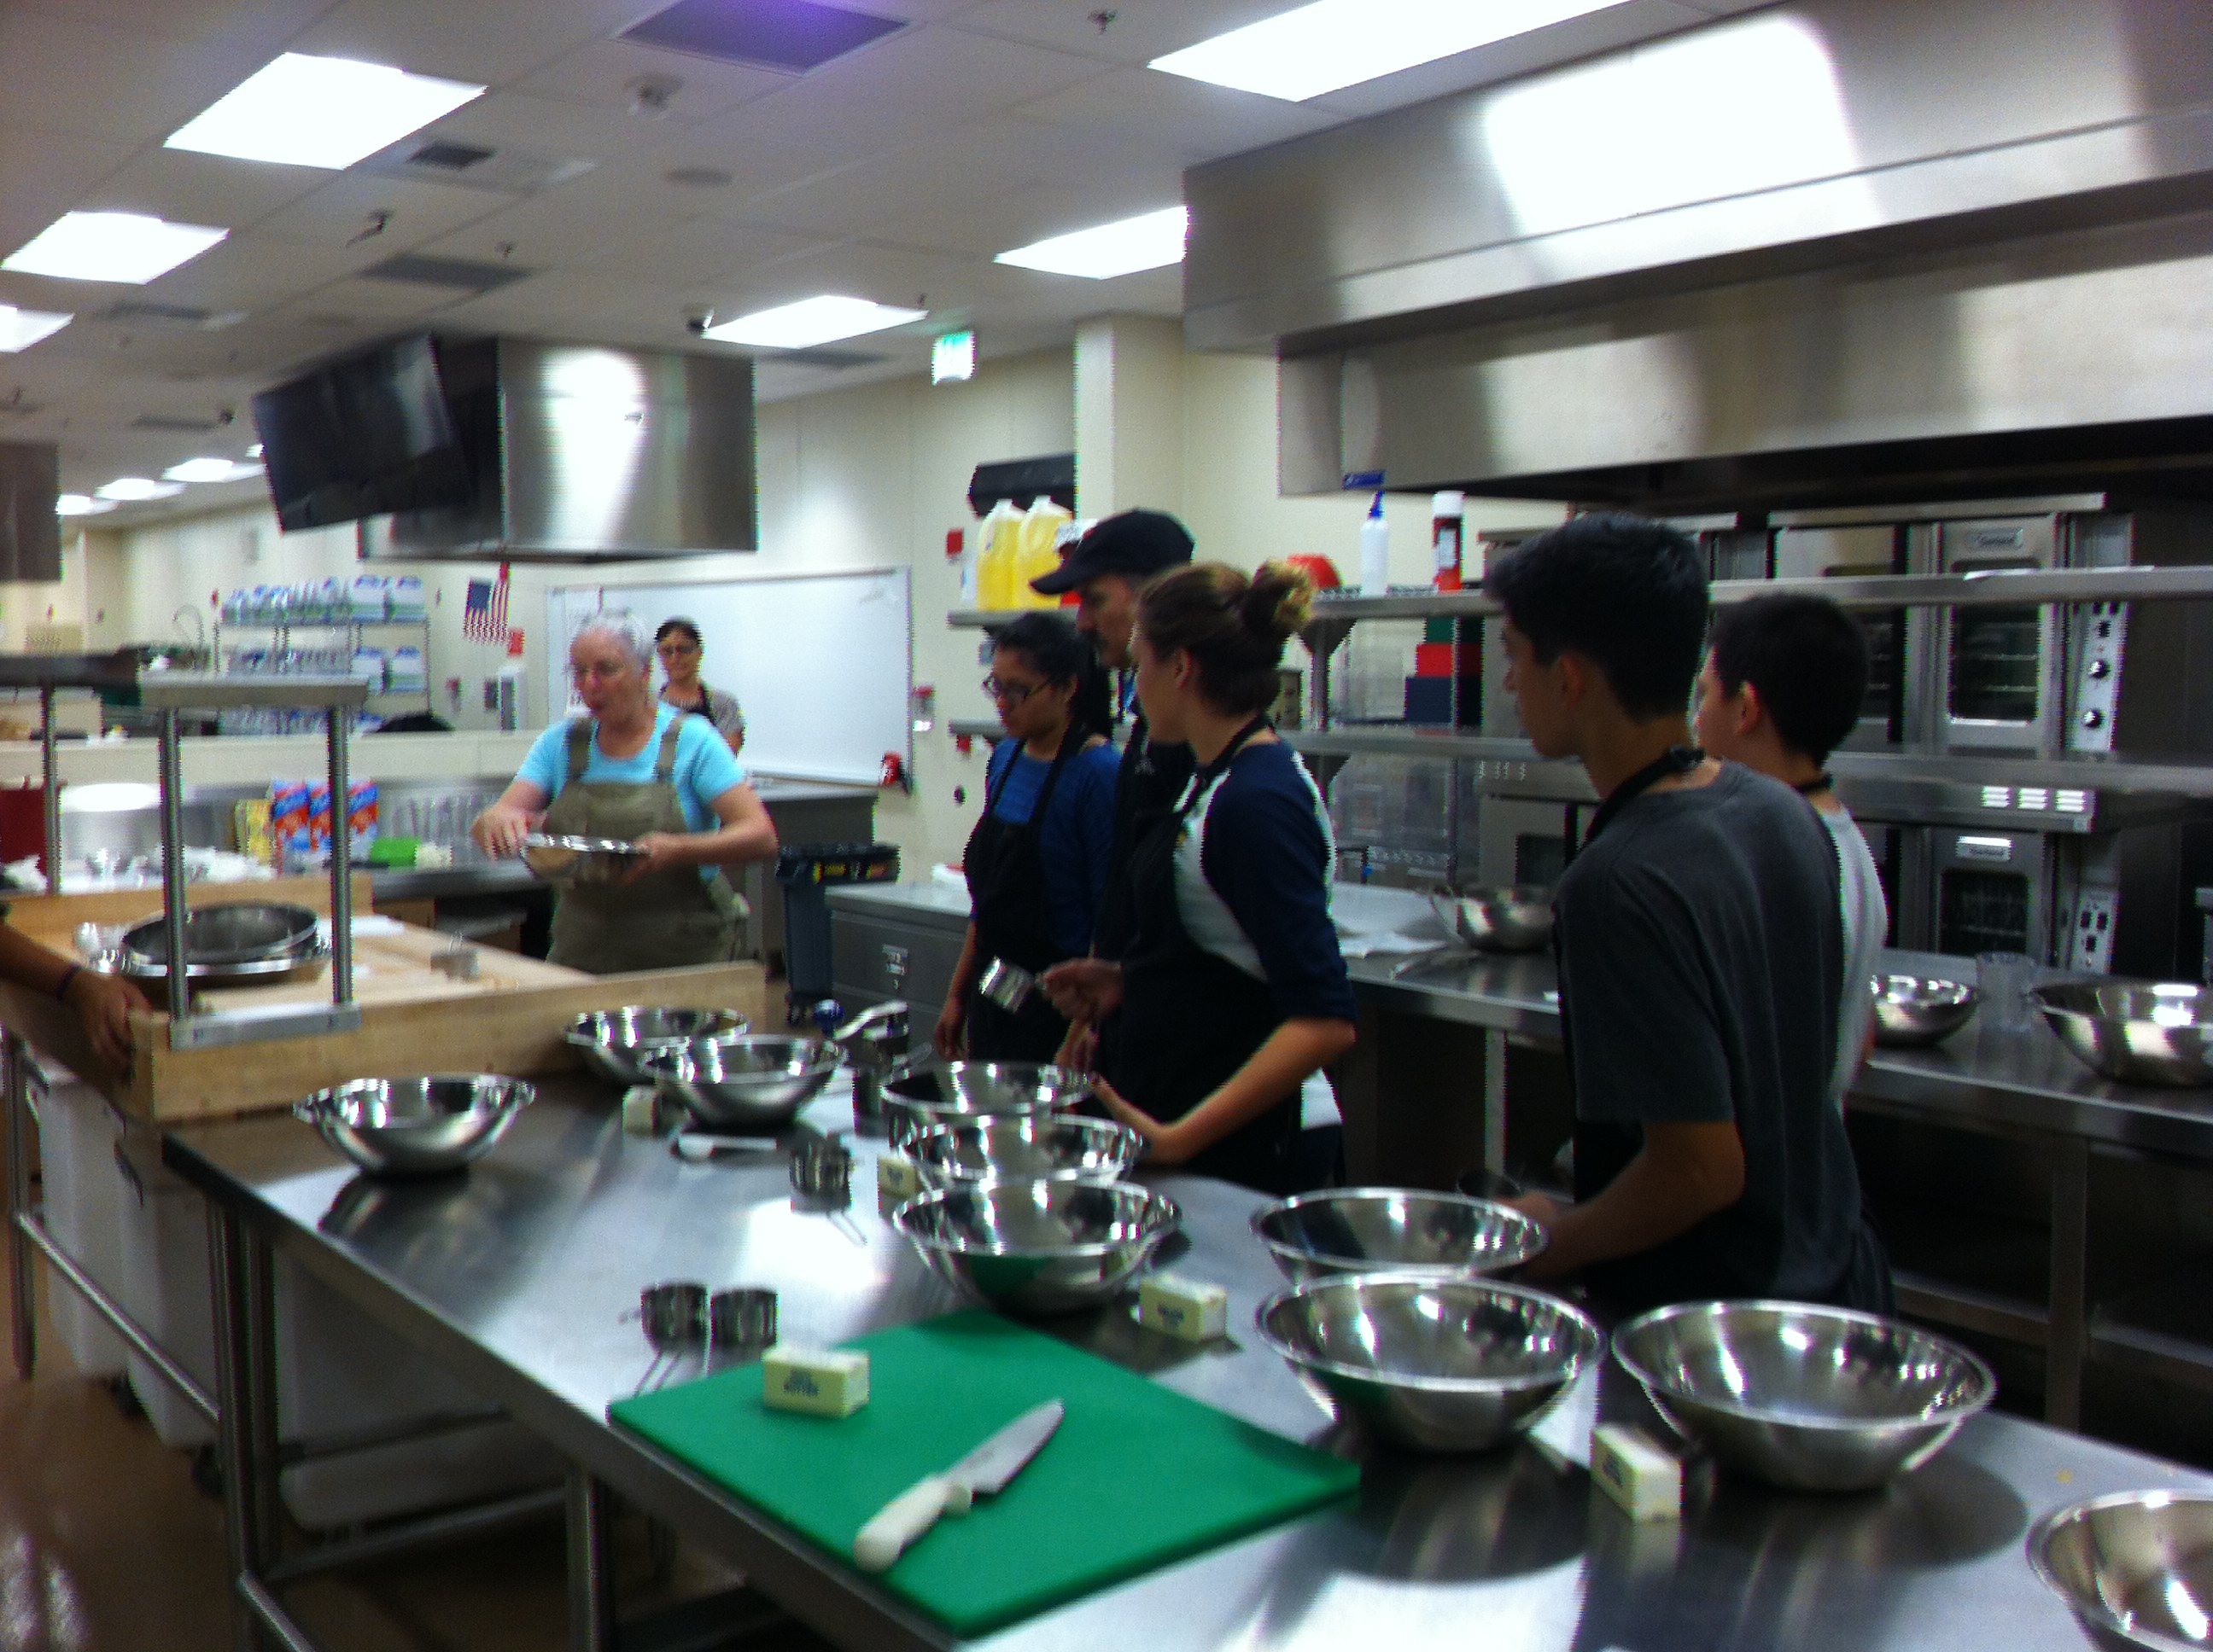
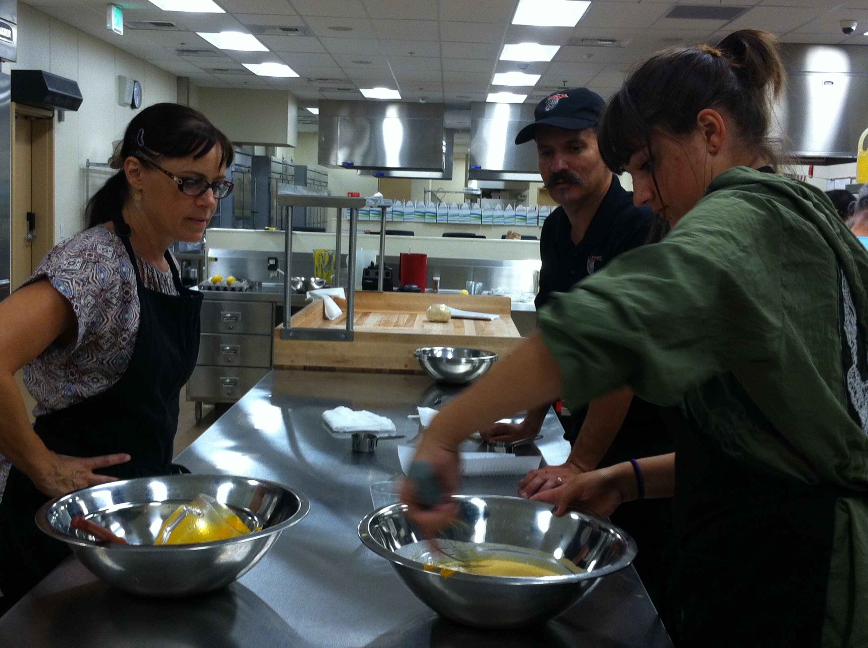
Pumpkin Pie Making Culinary Arts & Farm to Fork Education CAFFE

Slide 3
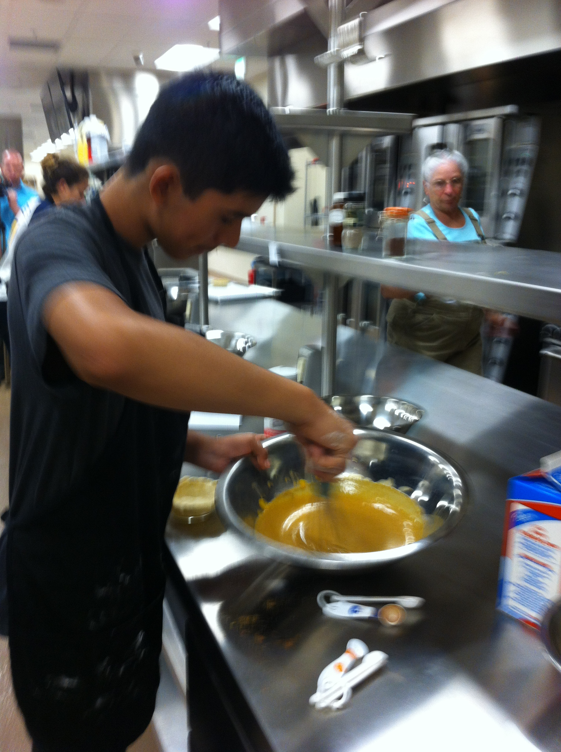
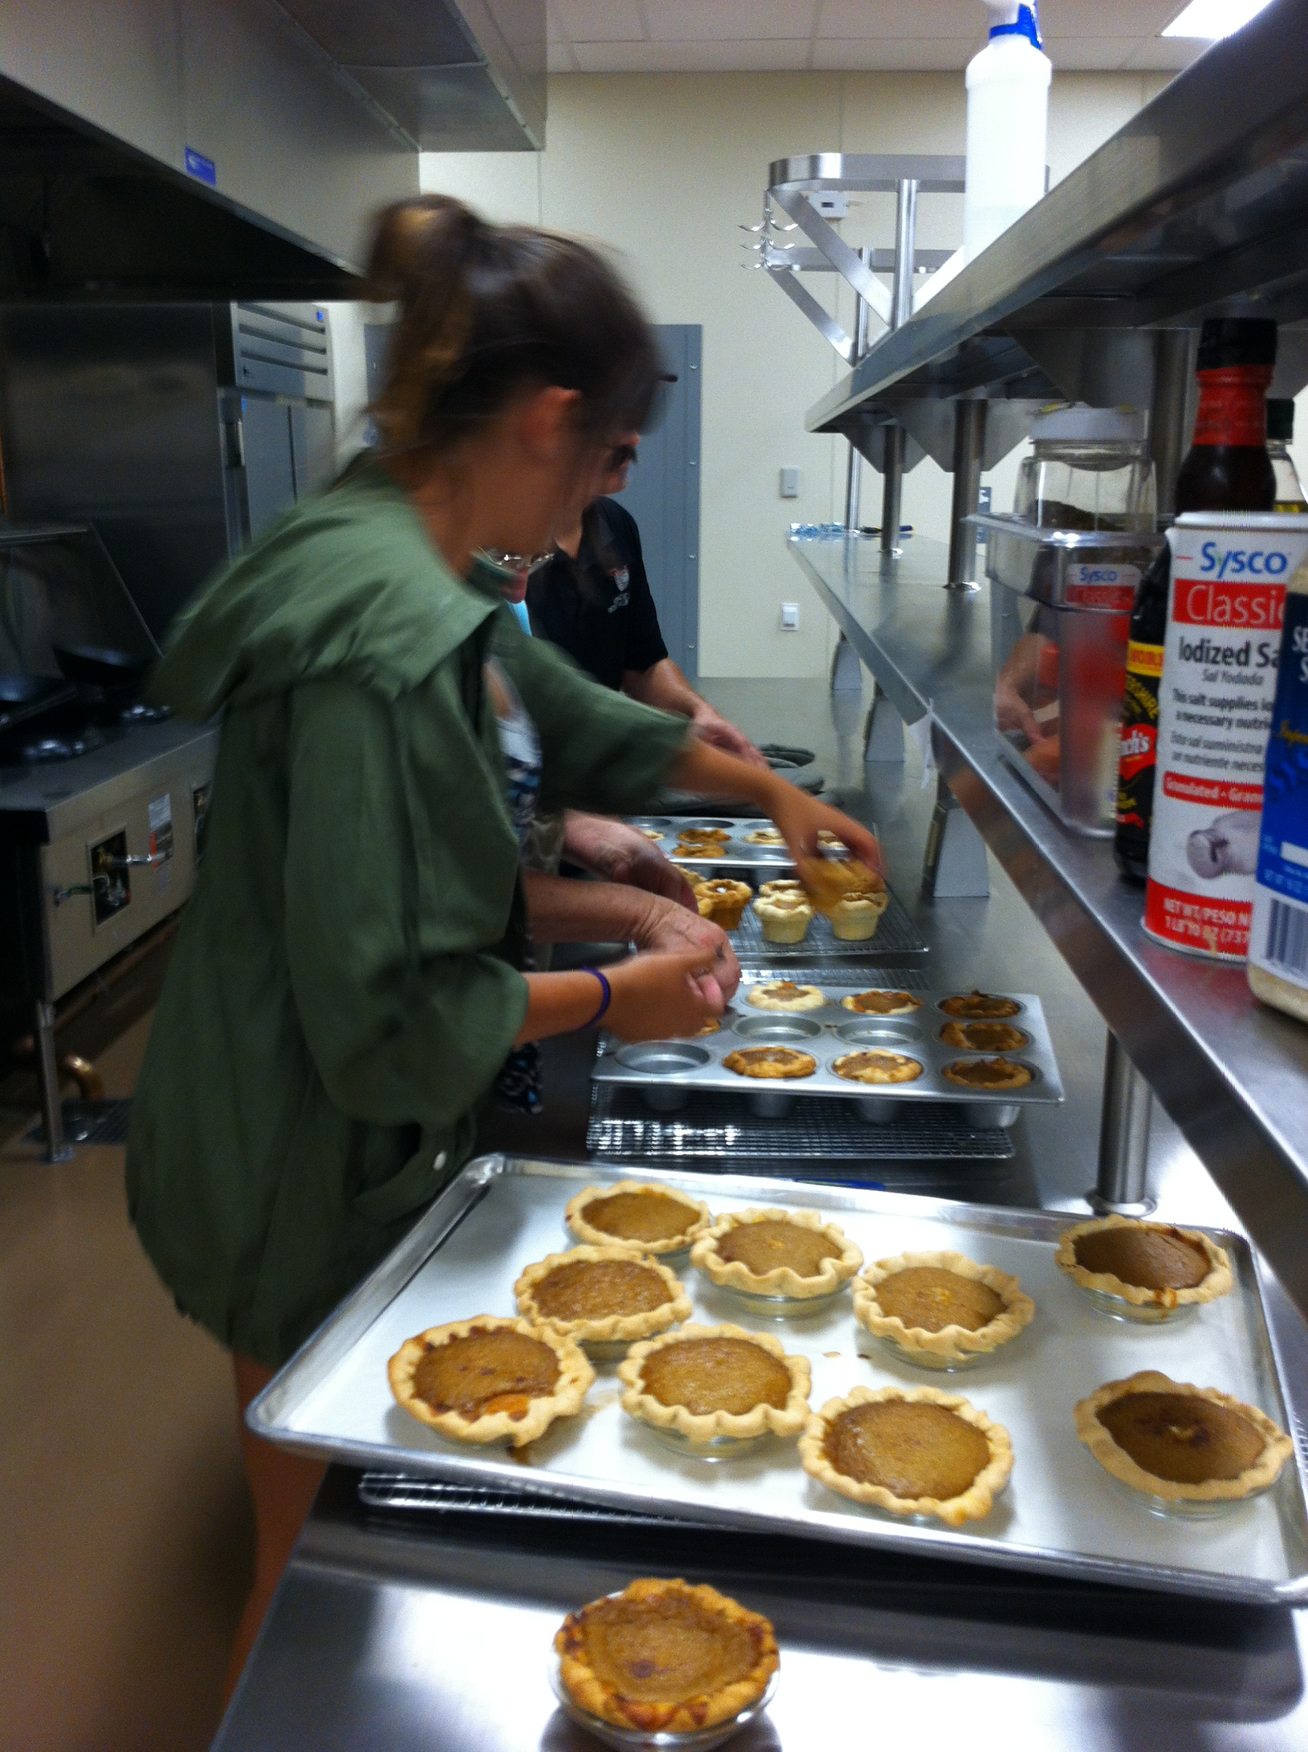
Pumpkin Pie Making Culinary Arts & Farm to Fork Education CAFFE

Slide 4
Pumpkin Pie Making Culinary Arts & Farm to Fork Education CAFFE

