Slide 1
Farm to Fork
Week 2
Seasonal Crops and Soil

Slide 2
8/24 Fall Season Crops vs. Spring Season Crops. P. 12 NB
Name the seeds that you would like to plant.
Look at one of the ordering catalogs, What was interesting to you?
Who wants to be the worm wranglers?
I only need 71☺
Morning Glory Flower

Slide 3
Fall Season Crops Warm Season Crops
Broccoli
Cauliflower
Garlic
Onions
Radishes
Carrots
Cilantro
Sweat Peas
Fava Beans
Watermelon
Strawberries
Peppers
Tomatoes
Squash
Pumpkins
Flowers
Beans
Copy this list on page 11 NB
What Fall Crops do we want to plant?
Nasturtium

Slide 4
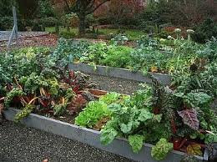
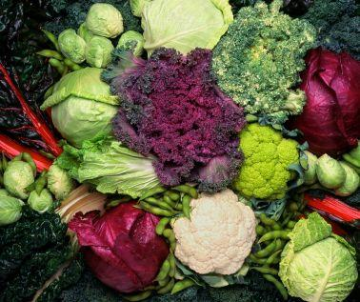
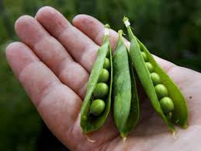
Vegetable Planting Guide
Tape to page 13 NB

Slide 5
Agenda 8/25
Roll
Seat count
Warm up
Omnivores Dilemma
Garden
Sign up on the list for your duty, put the date in the box for what you are doing.
Tomorrow – Tour Cafeteria
Thursday – Computer Lab – Farm to Fork Trifold
Friday - Garden

Slide 6
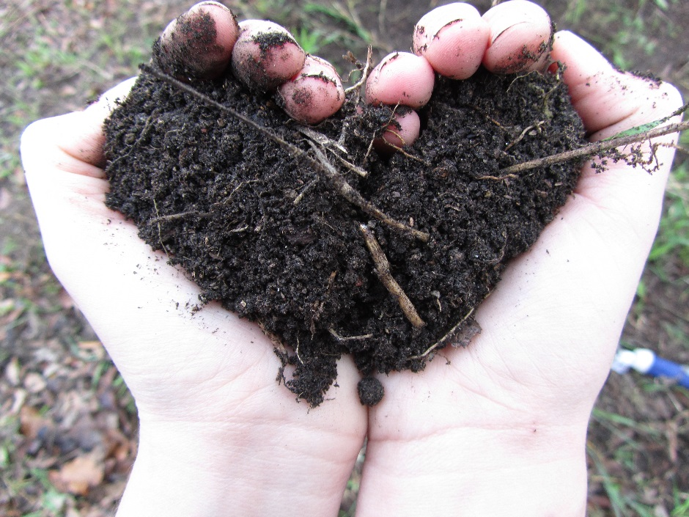
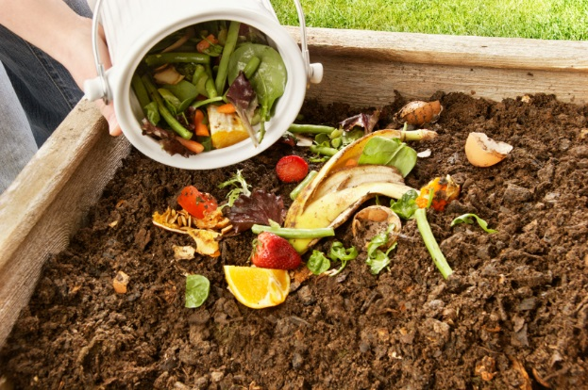
8/25 Compost Obj. TSW examine the process of decomposition by adding compost and soil to create more soil. P. 14 NB
What is the difference between dirt and soil?
What is compost?
Why is it good for the garden?

Slide 7
8/26 Agenda
Seat Count
Roll
Warm Up
Discuss Pictures – Use them for Farm2Fork Trifold tomorrow
Tour Cafeteria – Meet Rosie
Check out Omnivore’s Dilemma

Slide 8
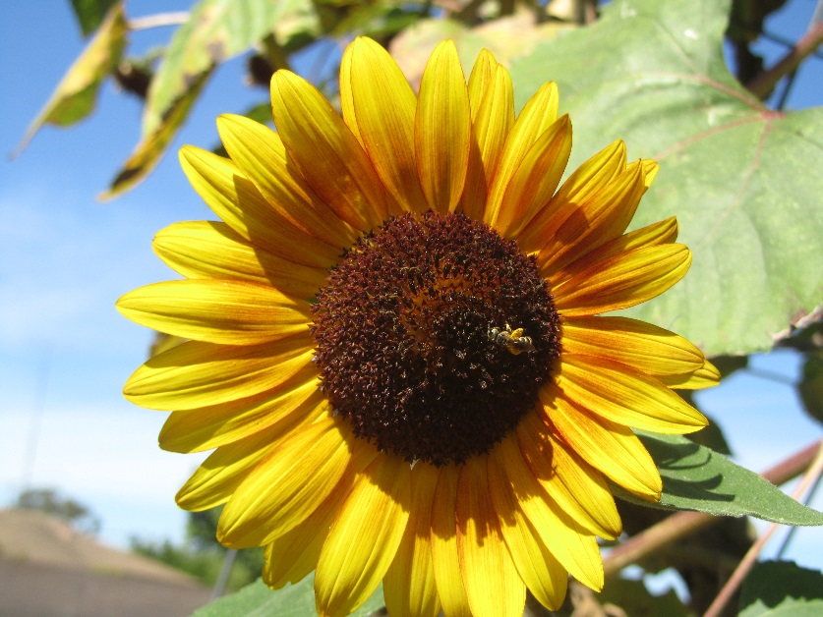
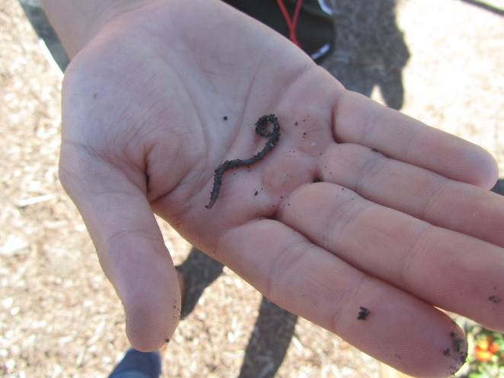
8/26 Biodigestion Obj. TSW learn about our Biodigestion program here at RCHS. P. 16 NB
What do you think Biodigestion is?
Why is it important?
How can you be part of the solution?

Slide 9
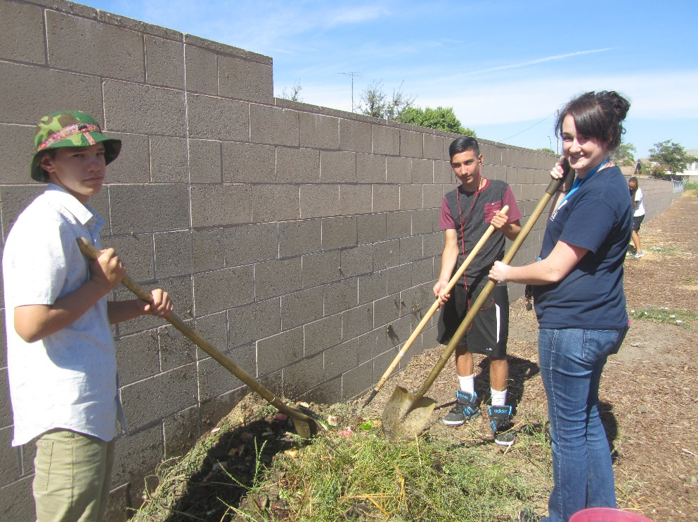
8/27 Creating a Farm-to-Fork Trifold Obj. TWS create a F2F trifold that advertises what F2F is and how it is beneficial. P. 18 NB
We have planted two new fall garden beds: Carrots & Radishes. What did we need to do to prepare the garden bed?
Before we added the seeds what needed to be added to the soil?
How do we know how deep to plant the seeds and how far apart they should be?

Slide 10
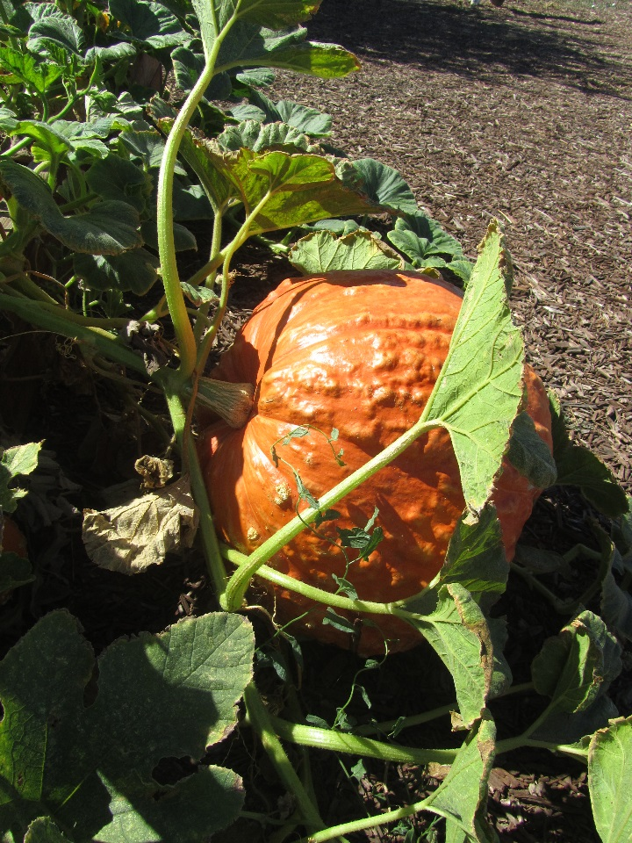
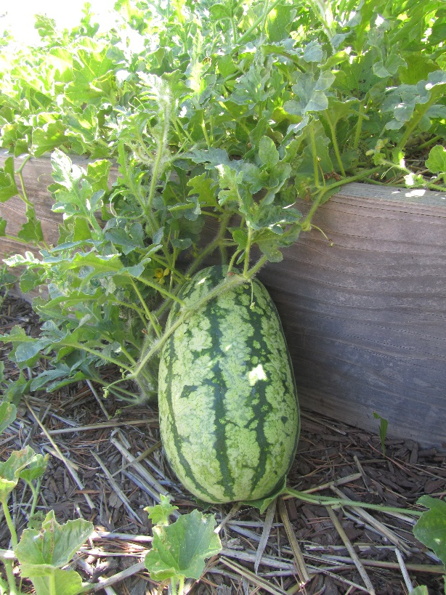
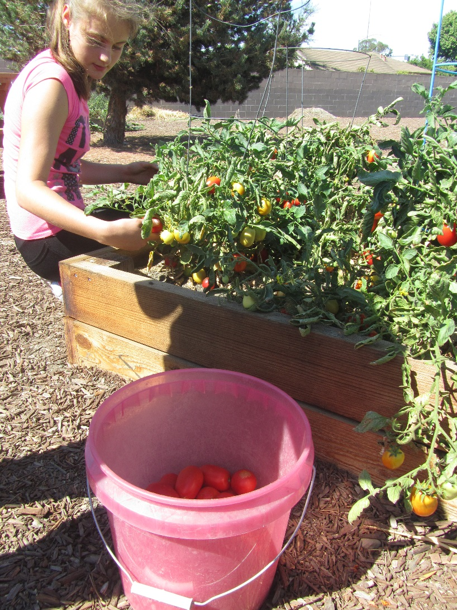
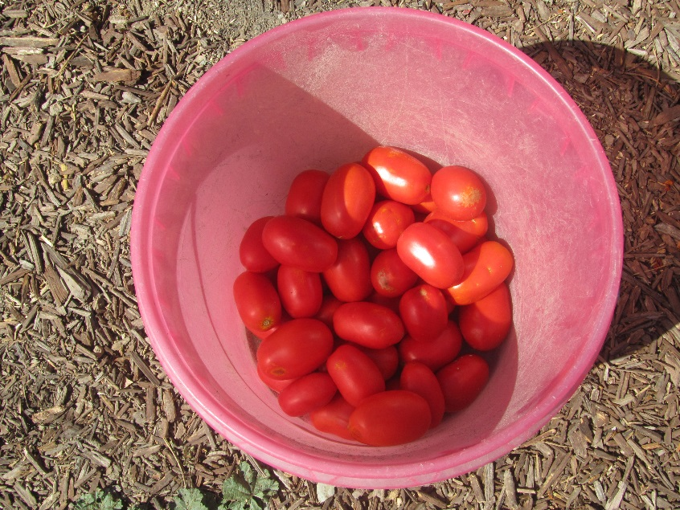

Slide 11
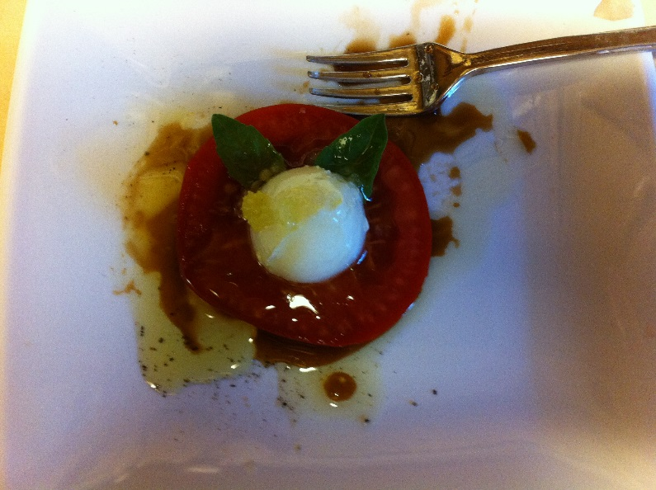
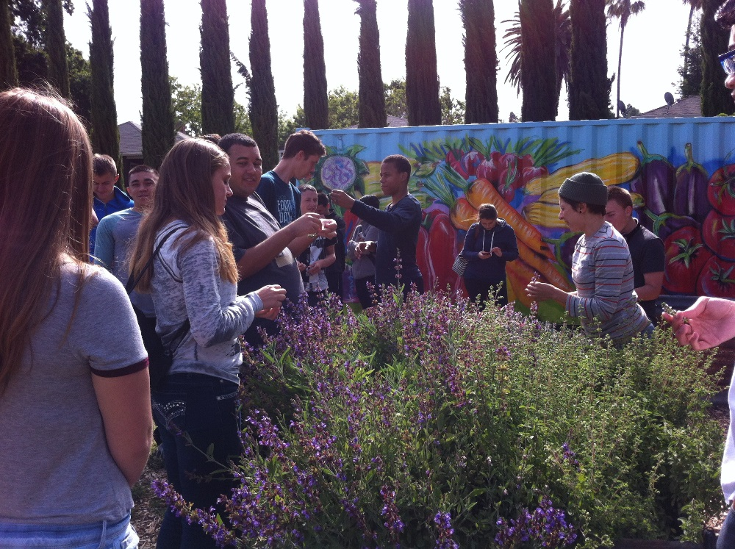
8/28 Omnivores Dilemma Obj. TSW develop a better perspective of where their food comes from. P. 20 NB
What is you impression of Omnivore’s Dilemma?
What are the four categories of how food is raised?
What was one thing you learned or did not realize before reading the first 6 pages of the book?

Slide 12
Dig It Dinner – Farm to Fork Celebration

