Slide 1
F2F
UNIT 1
Fertilizer – Organic vs. Synthetic, Omnivore’s Dilemma, Companion Planting

Slide 2
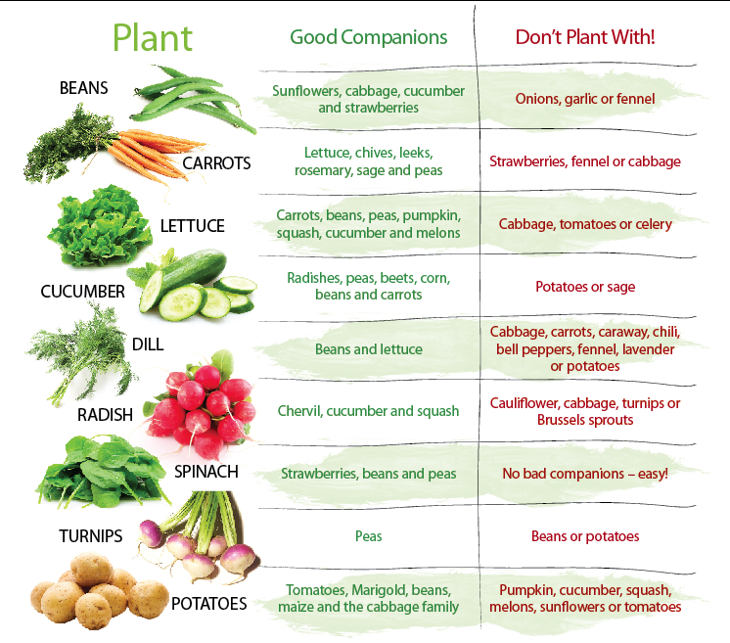
9/1 Vegetable Companion Planting Guide
Obj. TSW learn about companion planting and how certain plants grow well together and others inhibit growth. P. 26 NB
Look at your vegetable companion planting guide, what grows well with peas?
We will be growing Onions, Garlic and Potatoes this Fall, what should we not plant with them?
If we plant cauliflower, what should we not plant in that bed?

Slide 3
9/2 Characteristics of Soils
Obj. TSW learn how to create healthy productive soils. P. 28 NB
What did you observe yesterday during the porosity/ permeability demonstration?
The 2-liter bottle that had gravel with dirt allowed the water to flow faster than our beautiful healthy compost, why?
What else could we add to our compost that we are improving that might improve drainage/permeability?

Slide 4
Fertilizer Notes Page 27 NB
N-P-K
Nitrogen (N) – Promotes new green growth
      Component of Proteins, DNA, RNA, ATP, and Chlorophyll
Phosphorus (P) – Promotes production of blooms, flowers, seeds, and root development.
      Component of DNA, RNA, and ATP
      Transplanting
Potassium (K) – Promotes cell-wall thickening, protecting plants against cold temperatures, pests, and disease.
      Regulates water use and nutrient movement in cells
      Activates plant enzymes involved in processes such as photosynthesis and respiration

Slide 5
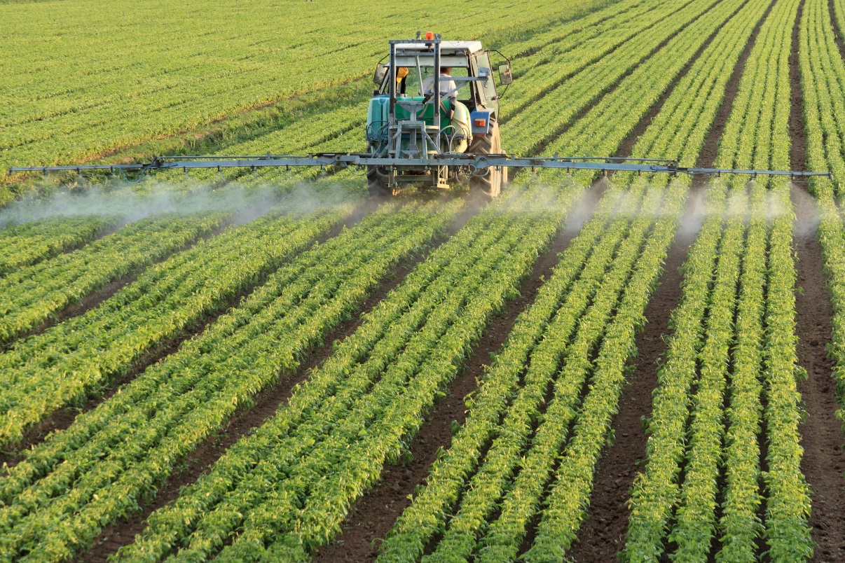
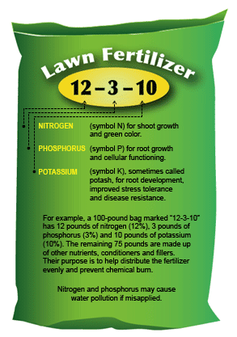
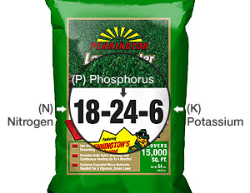
9/6 Types of Fertilizers
Obj. TSW learn about different types of fertilizers by taking notes and experimenting. P. 30 NB
What is fertilizer?
How can fertilizer help plants grow?
What are the three main elements in fertilizer?

Slide 6
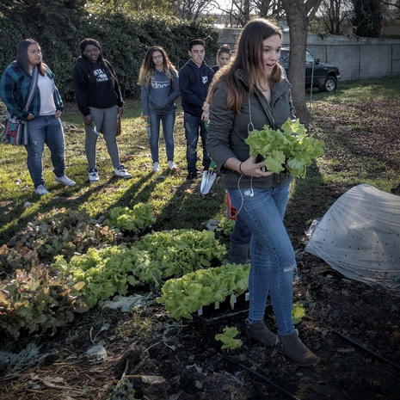
9/7 Omnivore’s Dilemma
Obj. TSW discuss a new perspective of food after reading Ch 2. P. 32 NB
Discuss Pollan’s second chapter in Omnivore’s Dilemma. How does what he says change the way you think about food?
What is a Hybrid?
How has “The Farm” changed since 1920?

Slide 7
Fert org vs inorg

Slide 8
Fritz houwer Fert.

