Slide 1
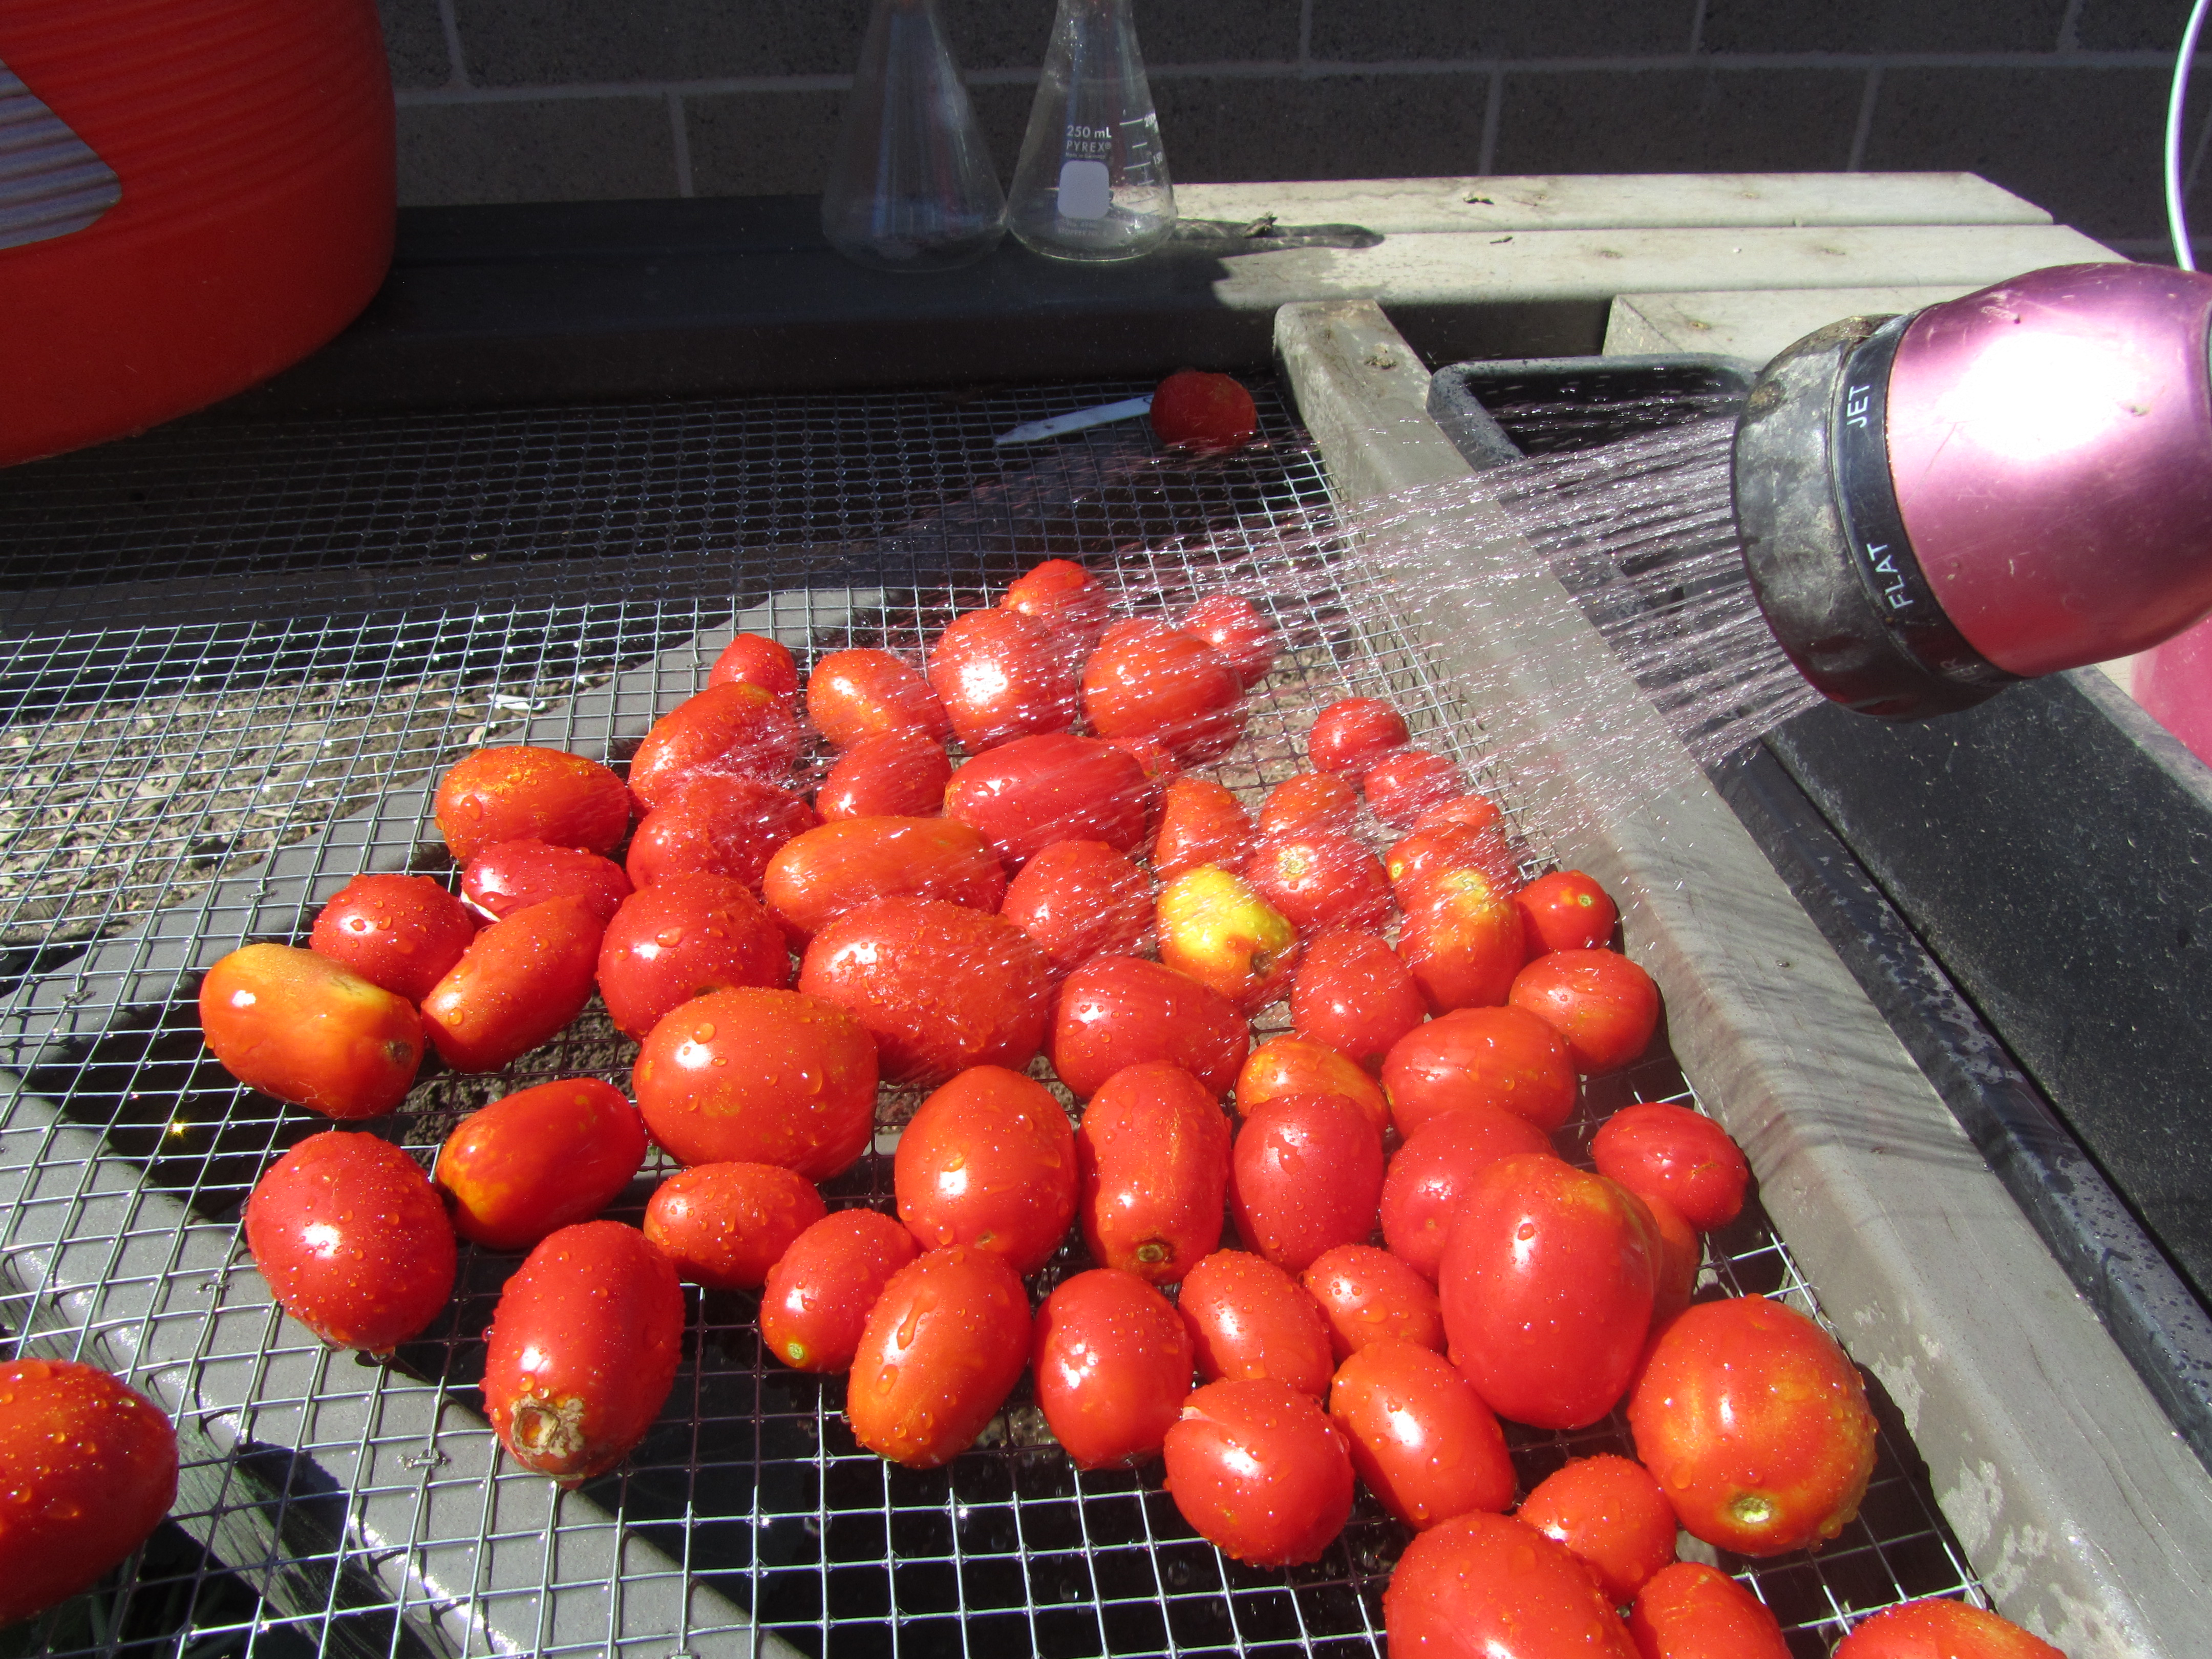
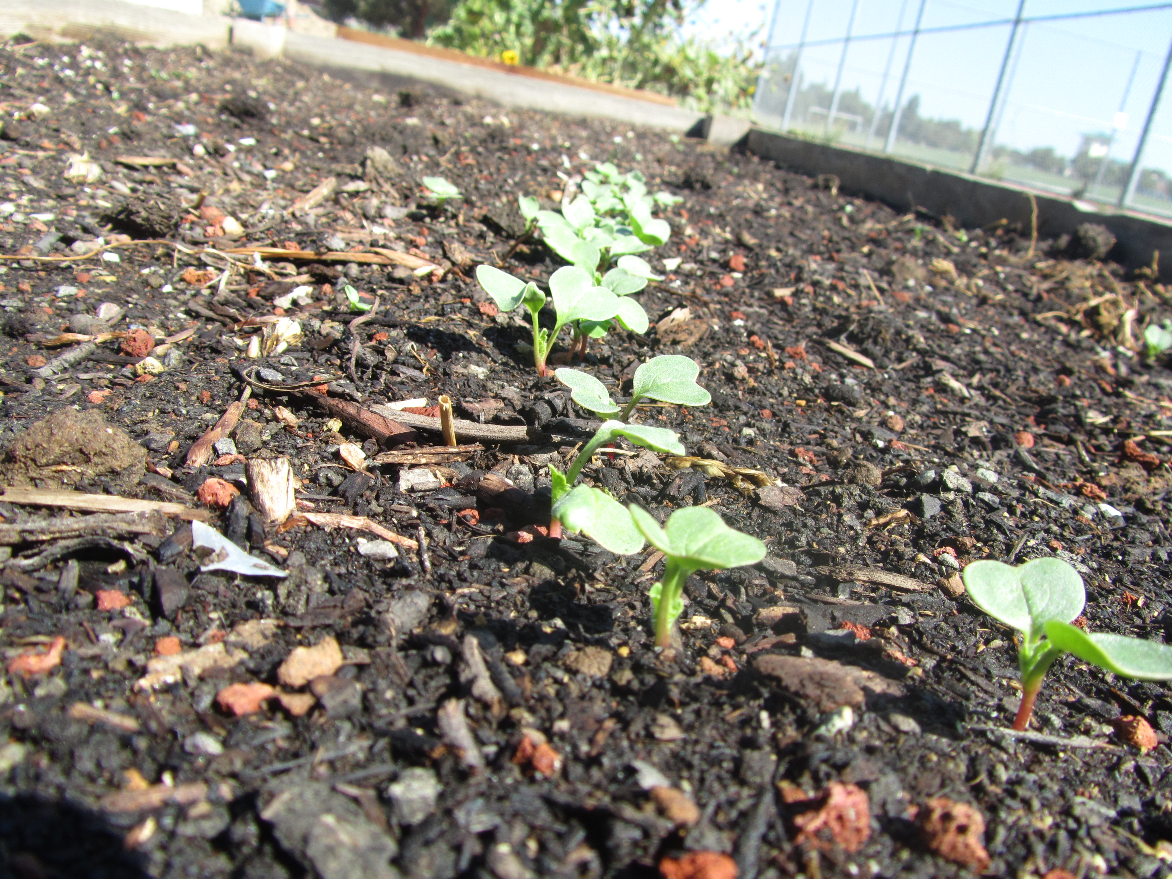
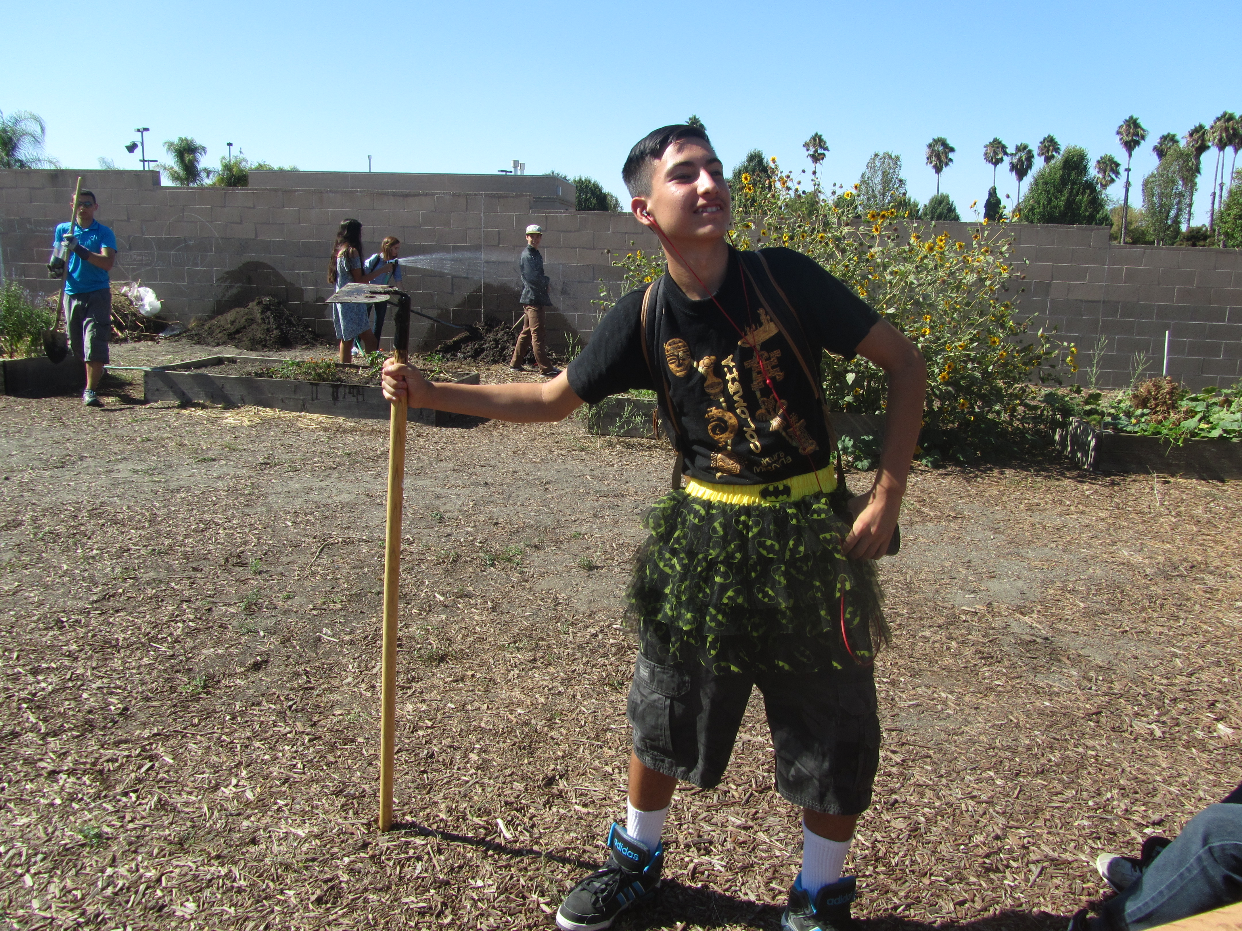
Farm to Fork
Week 5 – Plant Fall Garden,

Slide 2
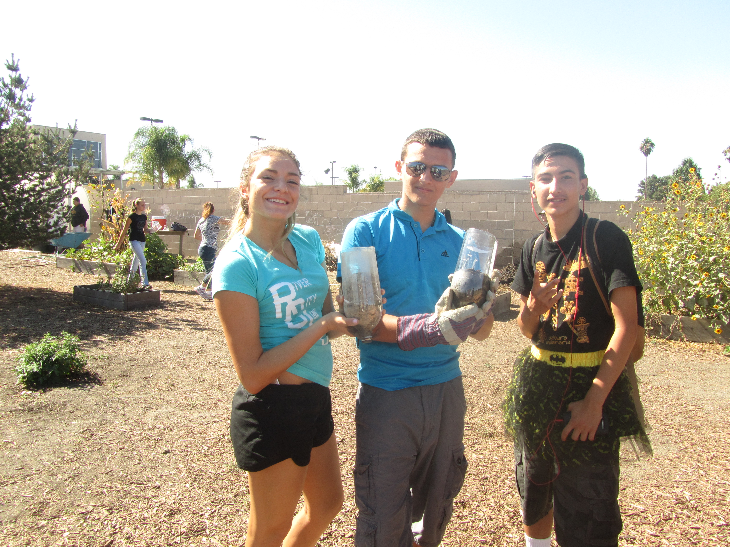

Slide 4
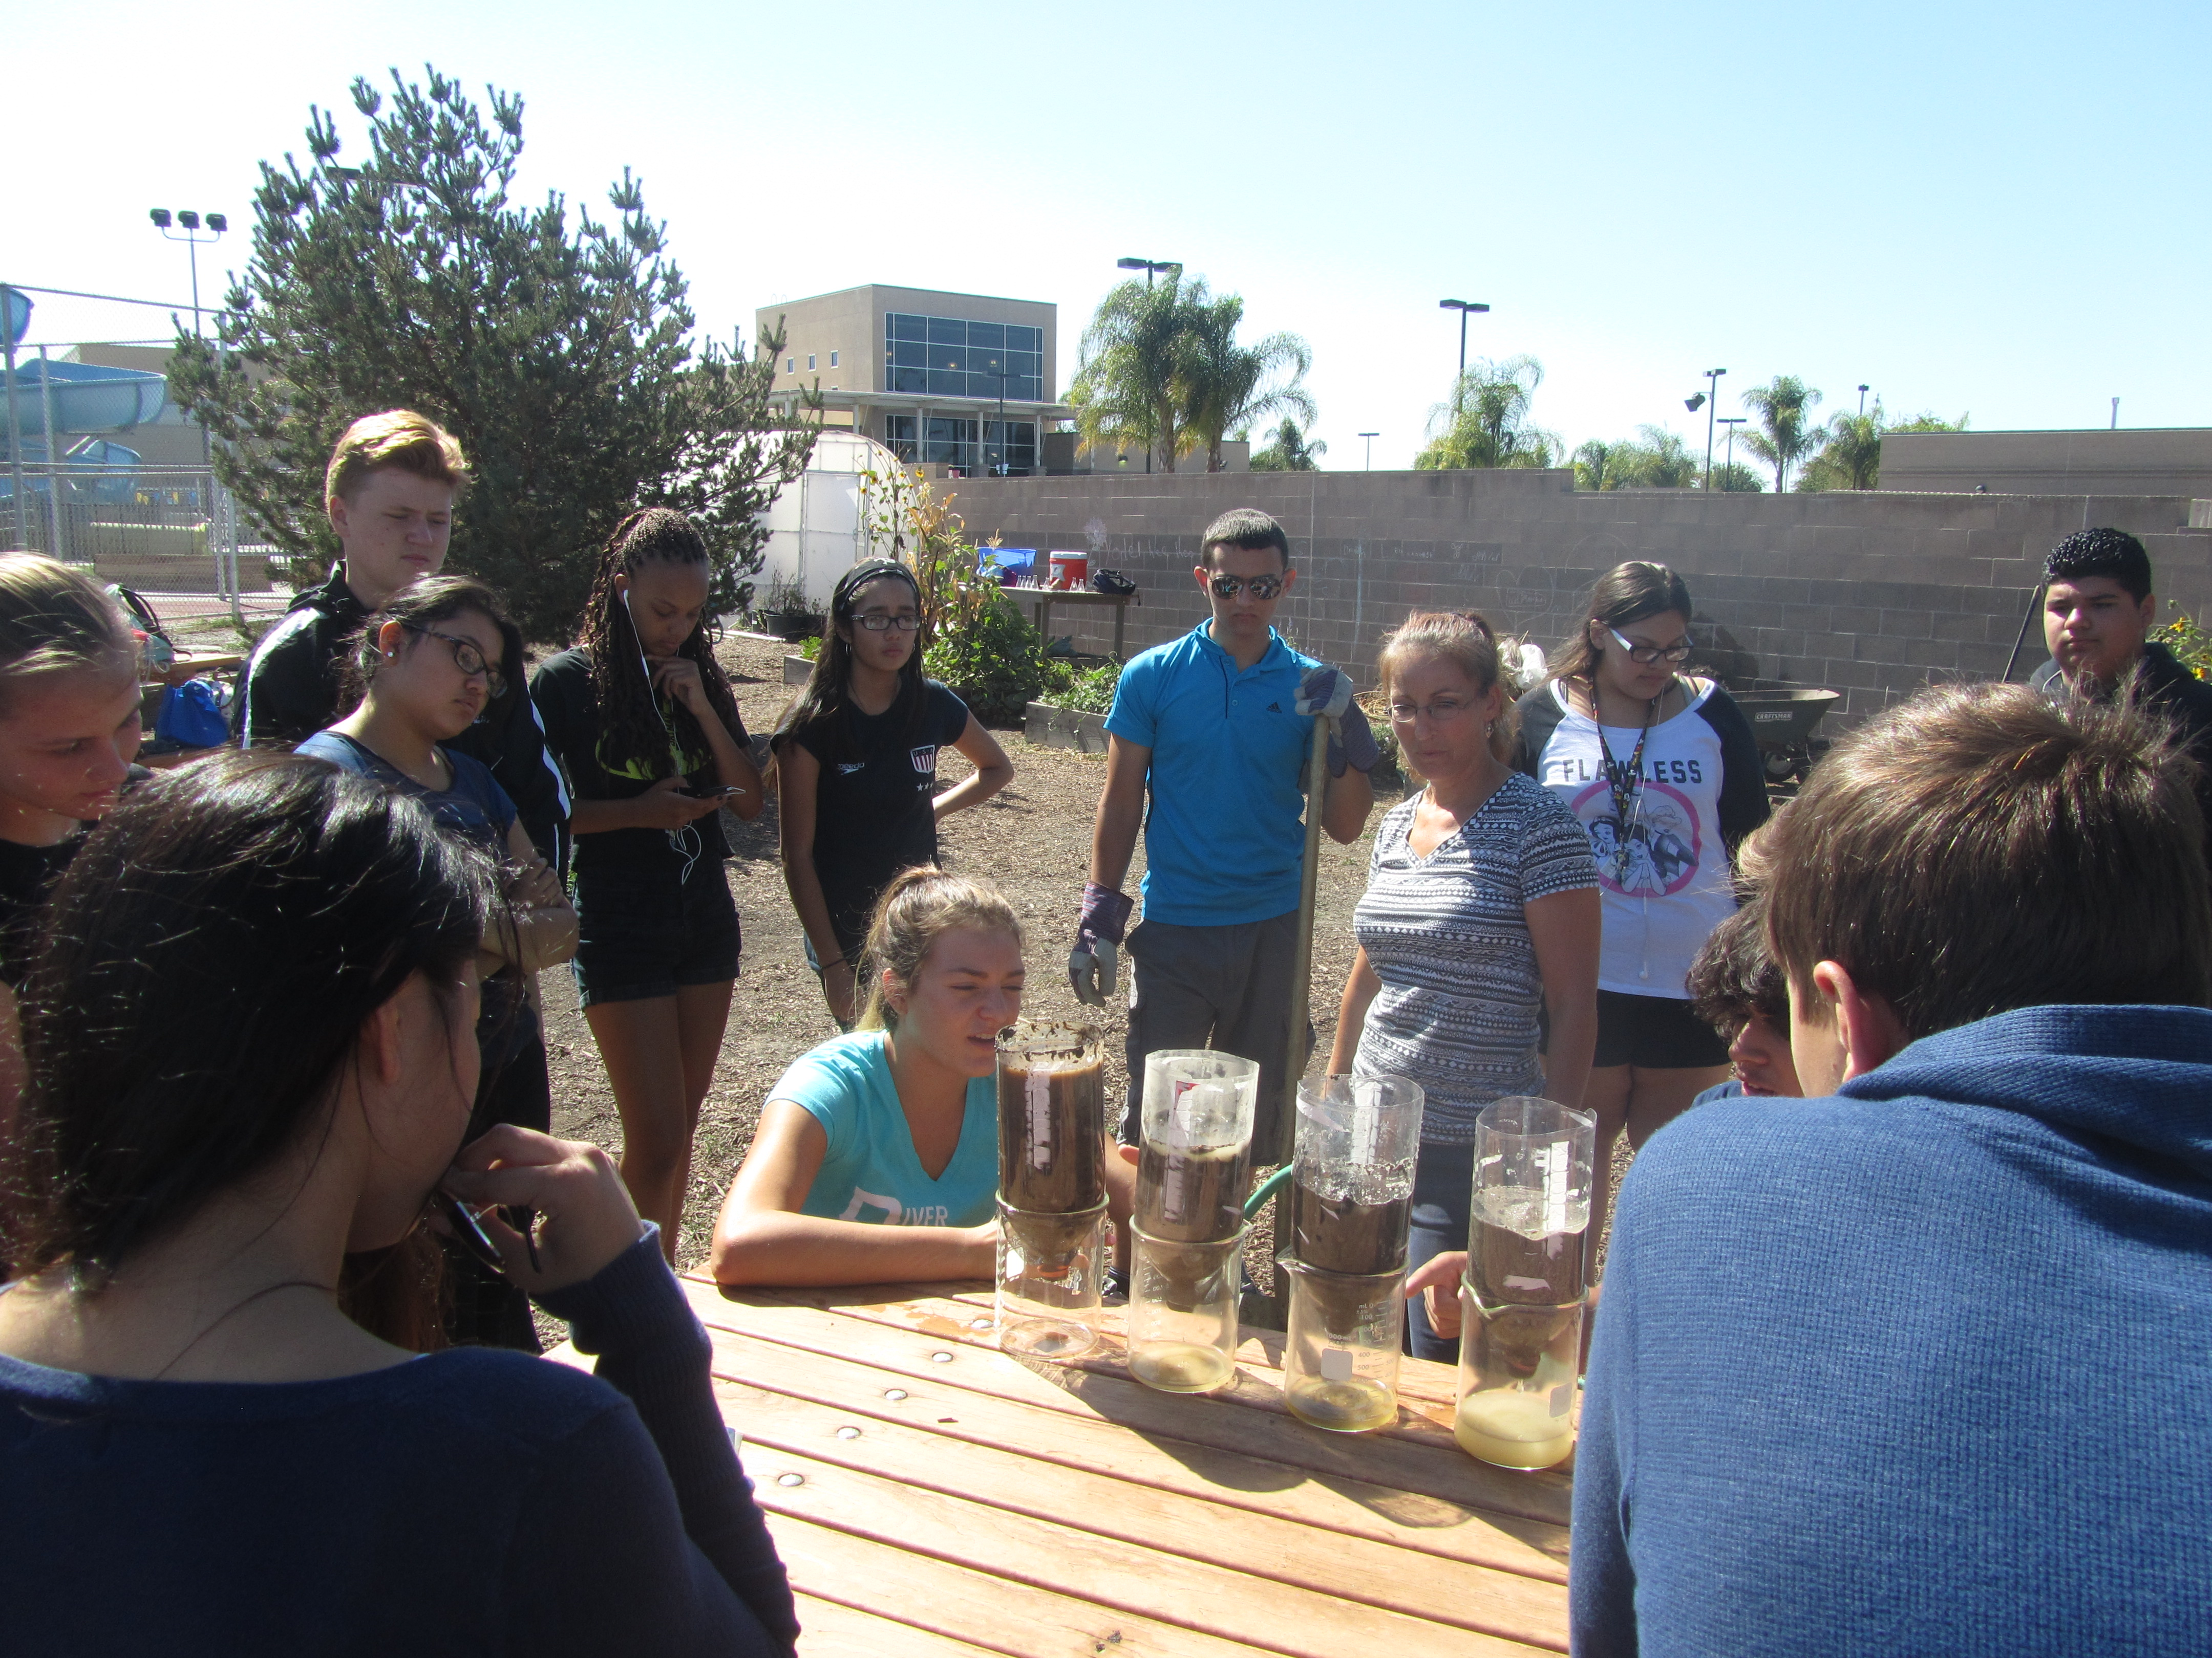

Slide 5
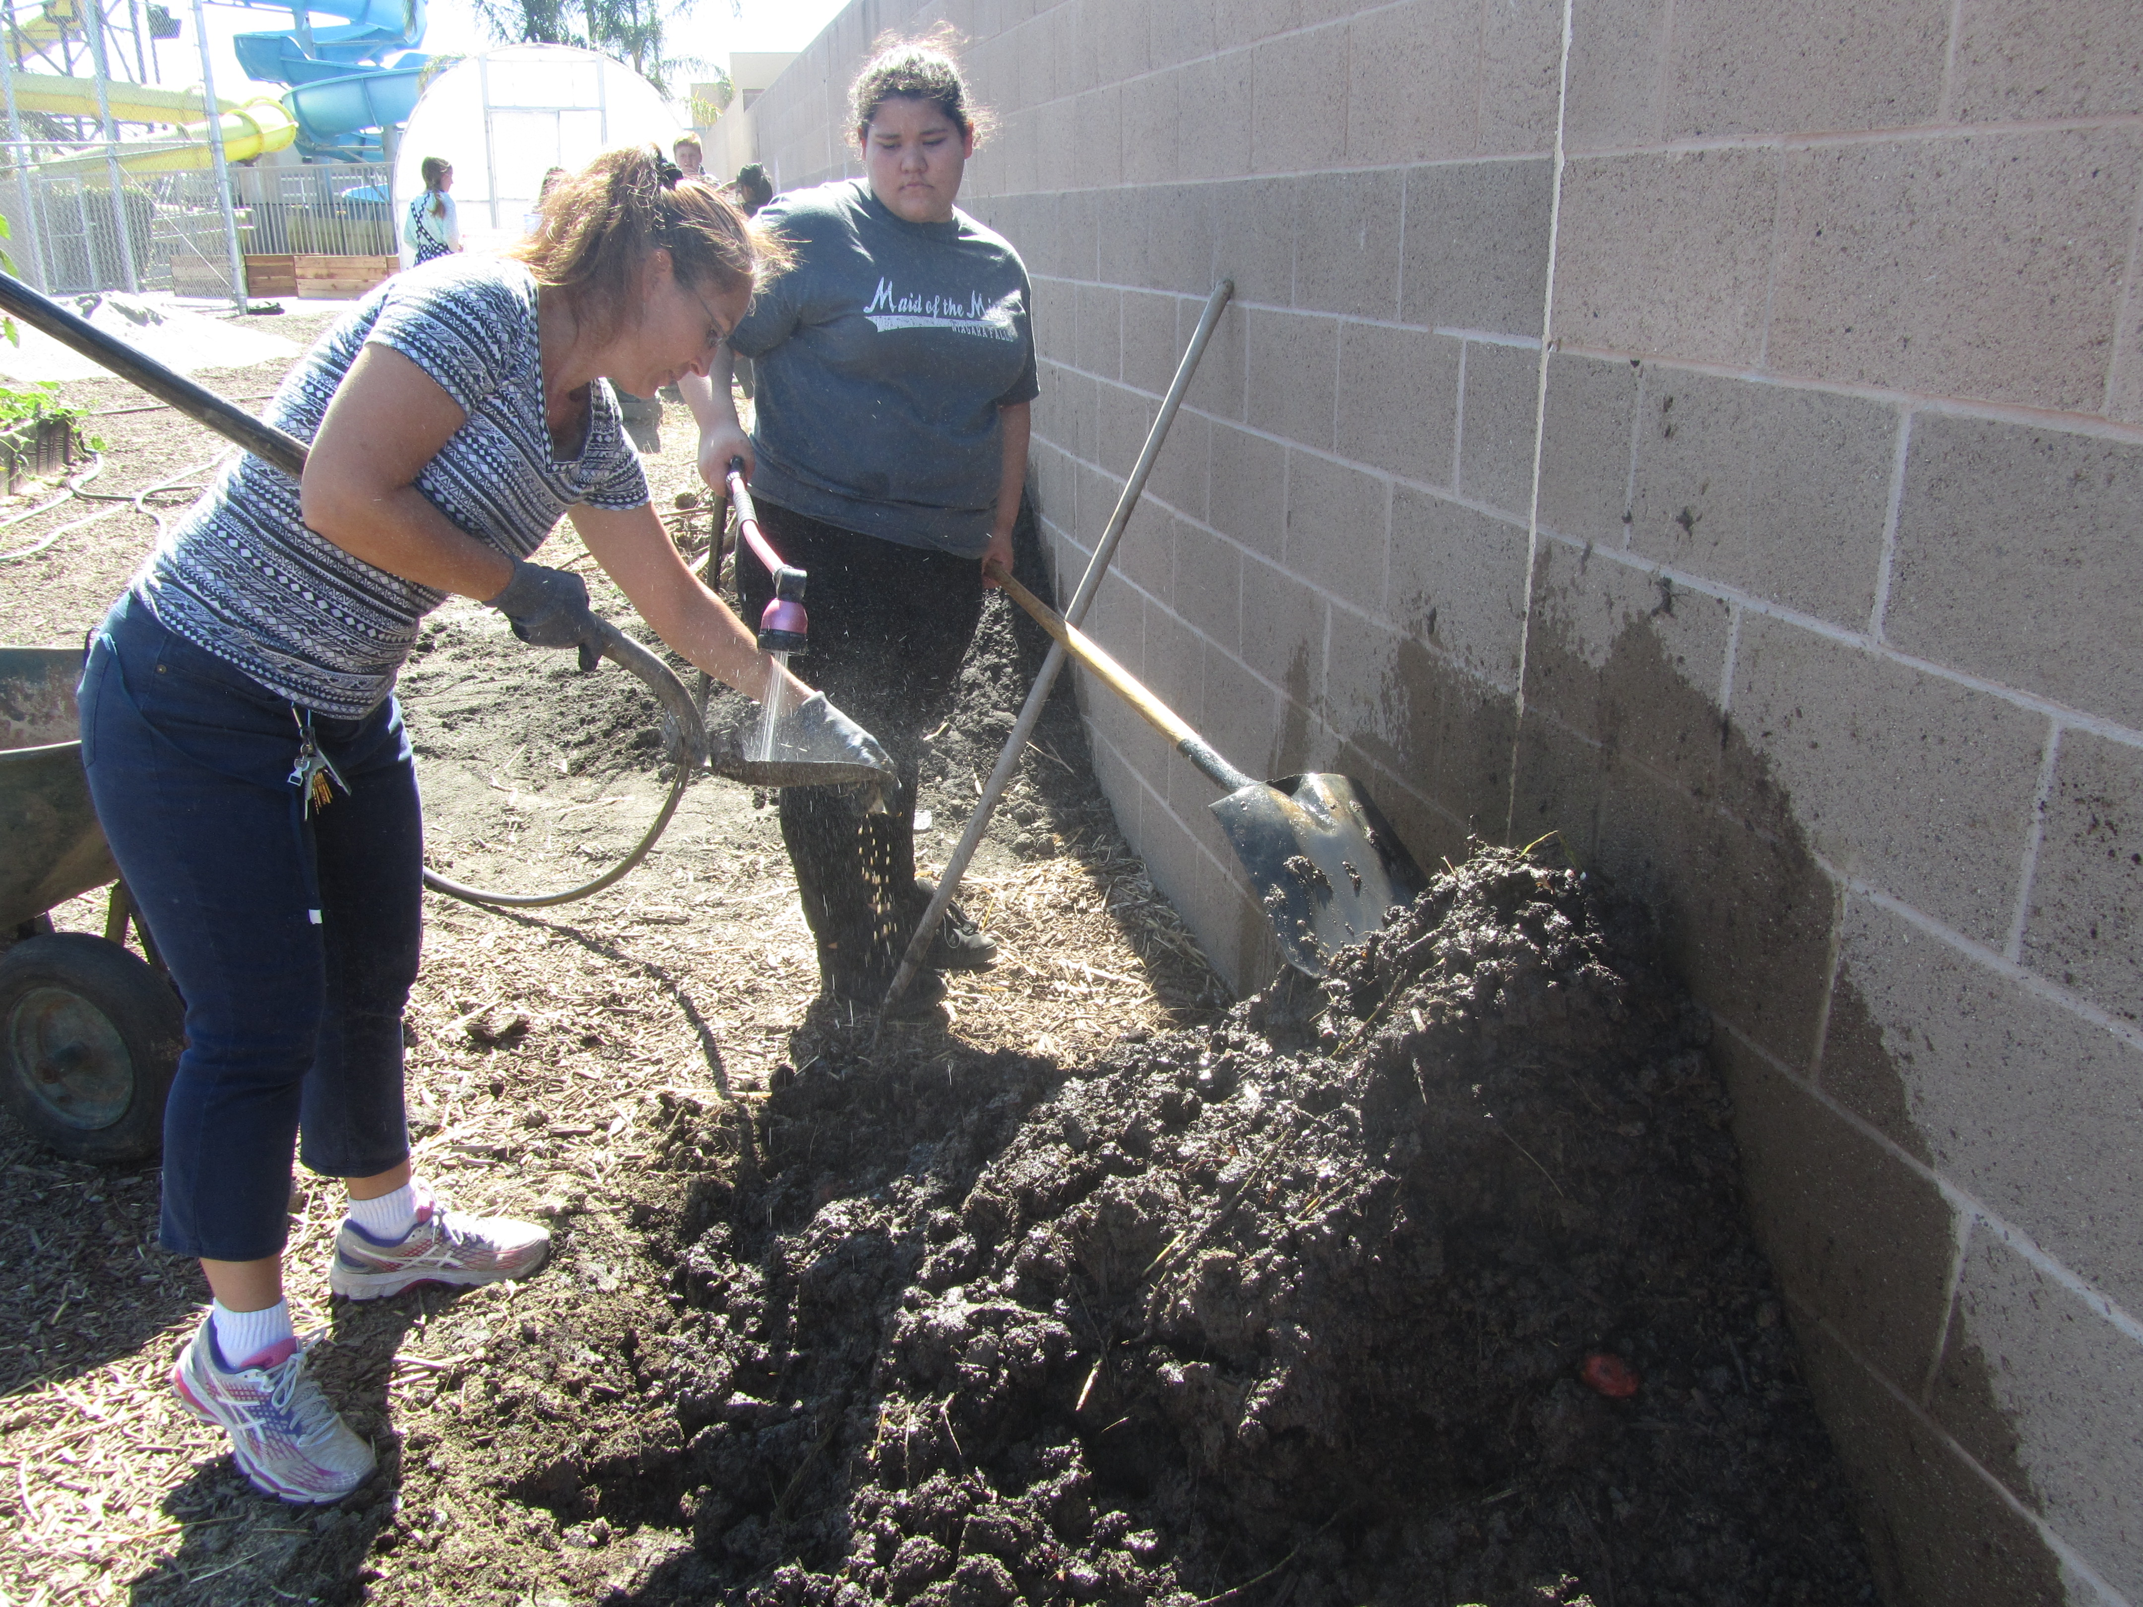

Slide 6
Moving gravel under the watering station

Slide 7
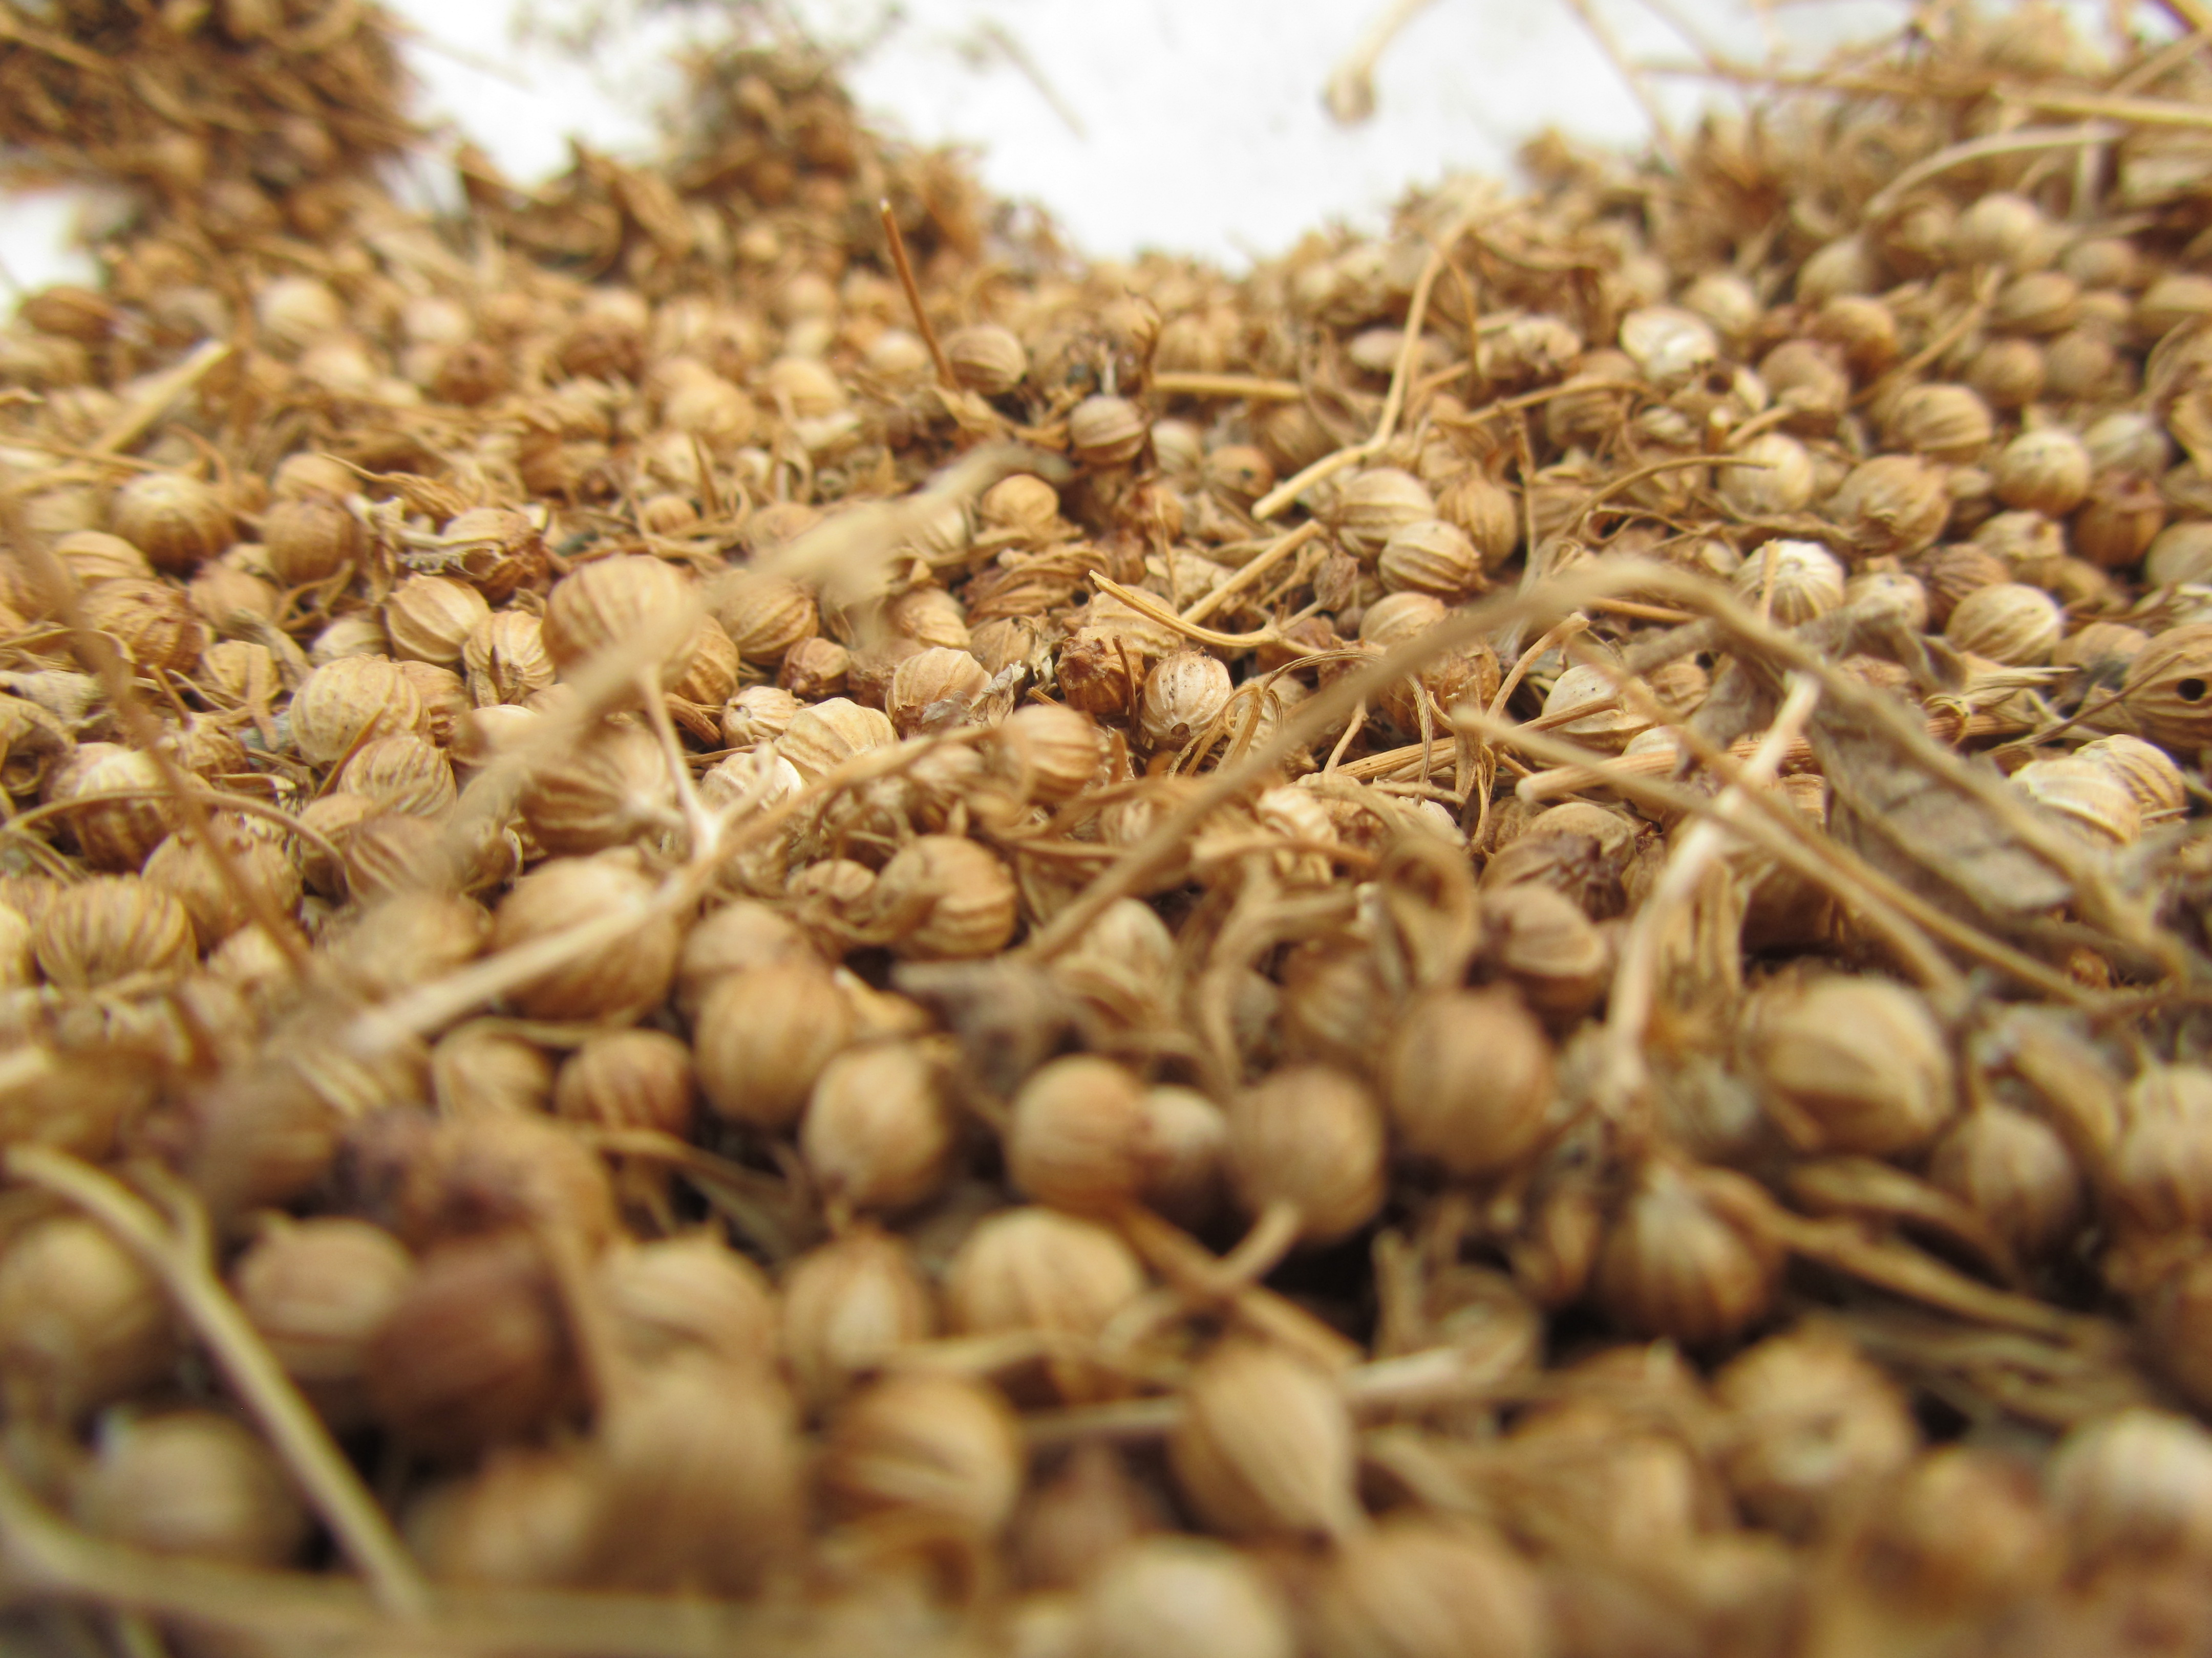

Slide 8
Watering the garden beds

Slide 9
Who’s prettier, the flowers or the girls?

Slide 10
William the Waterer☺

Slide 11
Have you shown McAllister your “ribbon test” yet?

Slide 12
Pretty Flowers – sunflowers need to come out this week:(

