Slide 1
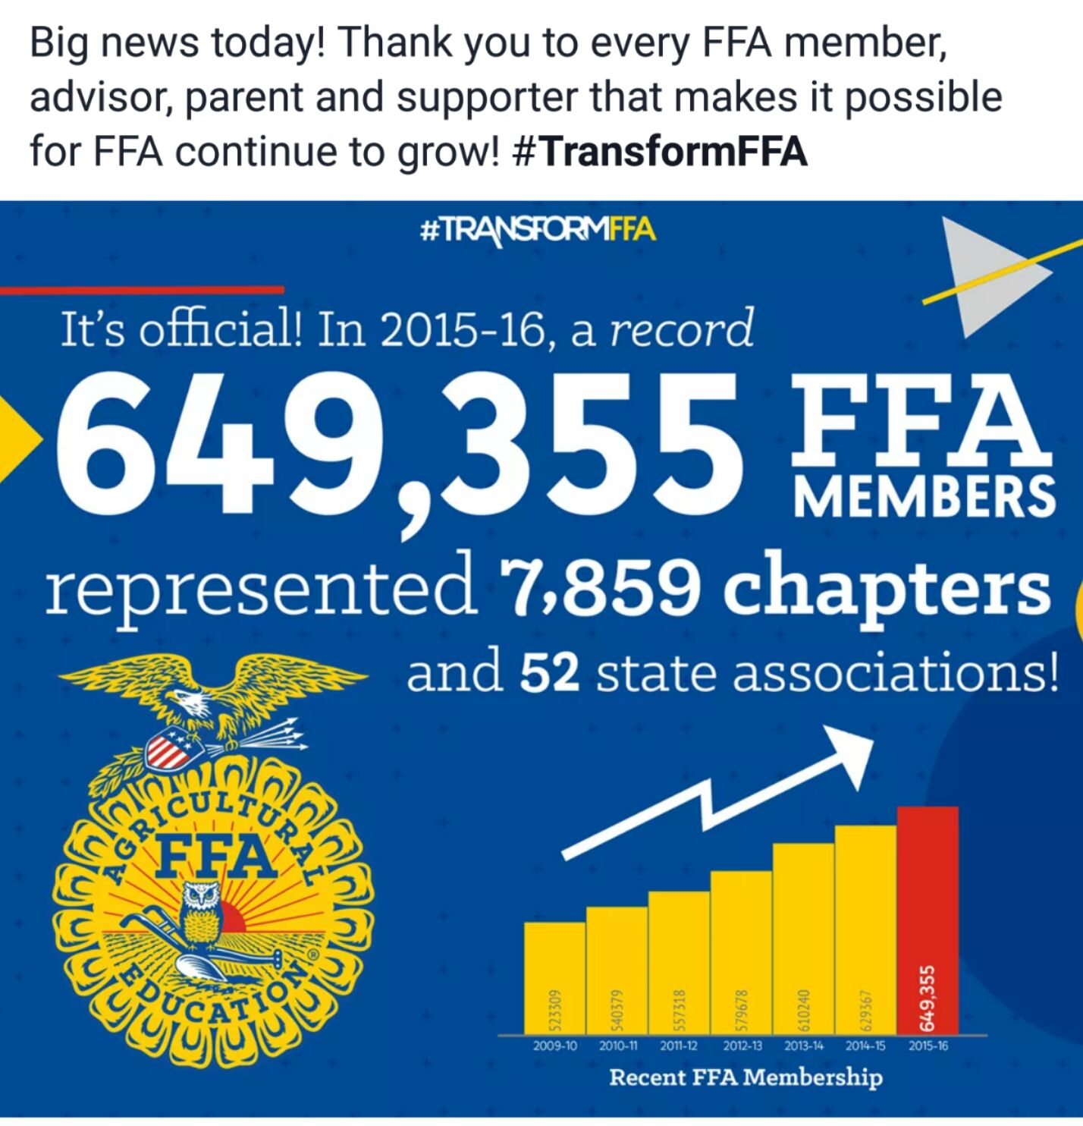

Slide 2
Opening Ceremonies: All Members in Unison:
“To practice brotherhood, honor agricultural opportunities and responsibilities and develop those qualities of leadership which an FFA member should possess.”
All Officers memorize your parts.
Greenhand FFA Degree: See FFA Manual page 26.

Slide 3
Structures & Practices for Sustainability
UNIT 2
Food Preservation: Canning & Curing
Vegetable Propagation & Hormones
Week 10

Slide 4
9/30 – 10/3 Greenhouse Structures Build your mini Greenhouse p. 63 NB
Students will begin work on a building a mini-greenhouse.
Working in a team of 3, students will develop a plan for their mini greenhouse. This plan must include the following:
1. An appropriate location. This greenhouse could be inside or outside a house or apartment.
2. An architectural design. Students must also present a justification for this design.
3. Necessary materials (type, quantity and cost). The cost may not exceed $25.
4. Timeline for construction. In this timeline, benchmarks should be listed.

Slide 5
10/14 Refection of Greenhouse Structure Typed 1 – 2 page paper
What plants did you start/ grow?
What was the experience like for the family?
Reflect on sharing your Greenhouse Structure at a Gardening Event/ Harvest Festival
Reflect on improvement for next time.
Share successes, and concepts used, learned in class.

Slide 6
Why we Can and Cure food…
Plant food is seasonal, and unless there is a greenhouse, it can not be grown.
Store food for later use.
Add to the variety of food we eat
Adds to our culture, and traditions.
Store food without refrigeration, no electricity

Slide 7
10/3 Chromebooks, Sparkvue & USB Bluetooth Adaptor Activity
Log into your appropriate Chromebook
Go to: https://goo.gl/K7sJHE This link will take you to the Chrome Web Store
Install the Spark Vue App by Add to Chrome
Get a USB Bluetooth Adaptor from McAllister

Slide 8
Critical Think Skills p. 65 NB
Claim – A statement of fact from the author. Usually in the first part of the article. Growing and preserving your own food is the most important aspects of sustainability.
Evidence – Proof of the claim. We are losing skills to preserve harvest.
Reasoning - Support for evidence, Why are we losing skills for preservation of food? In the Industrial Age people are more likely to just go to the store to buy our food.
Conclusion – AXES paragraph
Assertion, Example, Explanation, and Significance

Slide 9
Homework P. 71
Canned Foods Cured Foods
Bring a preserved food from home.

Slide 10
10/6 Sustainable Food Production
Measuring Productivity Lab
Students will create a lab to measure CO₂ levels, or O₂ levels during Photosynthesis and/ or Cellular Respiration. Using their results, students will create models to describe the interaction between these two processes. Their final lab report will detail these results and their models.
Students will make an argument in their conclusion for sustainable food production based on what they have learned from this unit.

Slide 11
10/10 Preserving Food Obj. TSW brainstorm a canned or cured food that could be grown here on site, processed and sold. p. 72 NB
What crops could we grow and can/ cure to sell?
Have other schools sold canned/ cured goods to raise money for their programs? If so, Which ones?
What resources do we need to try and see this process to fruition?

Slide 12
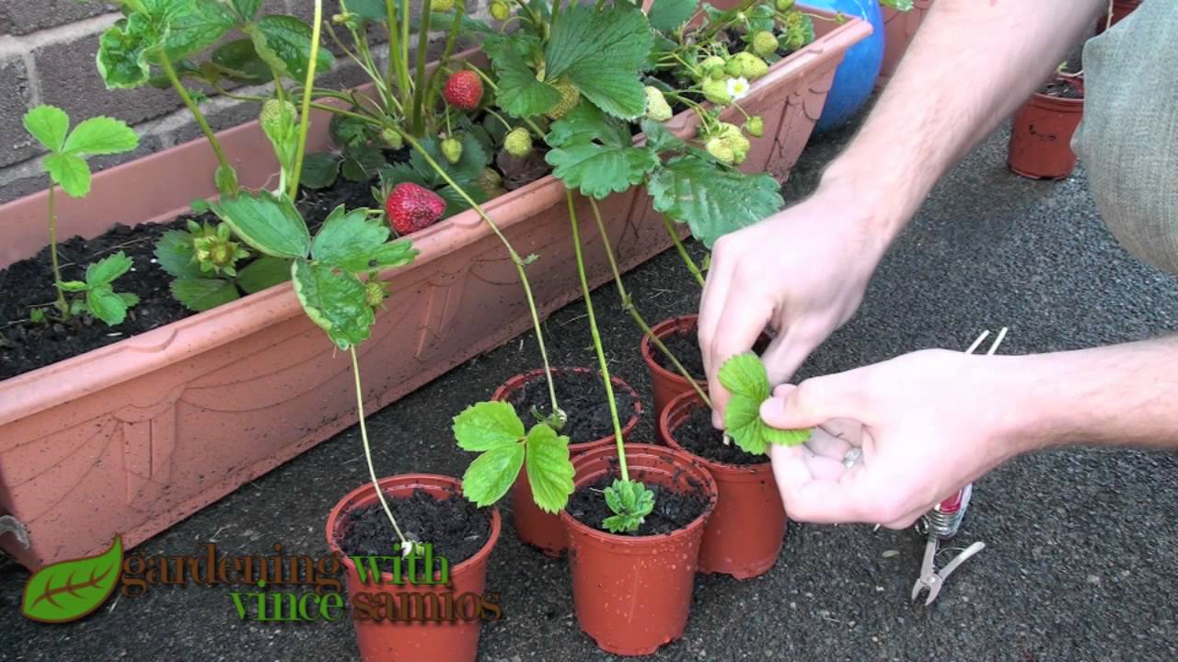
10/11 Vegetative Propagation Obj. TSW learn how plants make more plants, without producing typical seeds. P.74 NB
What is a flower bulb?
What is a strawberry runner?
What is a rhizome?

Slide 13
Help our Chaplain… Fill in the blank.
Chaplain: “Stationed by the ____________”.
VP: “Your duties there?”
Chaplain: “My duties as Chaplain are to promote personal growth among our members. I strive to uphold brotherhood and good morals in our lives.”

Slide 14
Laptops
Finish Trifold and email it to me as an attachment
Officers make your PPT slides in Microsoft Office and send to Emiliano.
Students can help Officers memorize your parts for the Meeting
Cristal – Create Last meetings Minutes & Agenda for this meeting
Finish Vocabulary for UNIT 2 - Due Friday
Everyone – FFA.org website and study FFA knowledge for Quiz/ Midterm

Slide 15
Greenhand Degree Requirements P. 75 NB Bold is done already
Enrolled in Ag Ed
Have satisfactory plans for a SAE
Learn and explain the FFA Creed, Motto, Salute, and FFA mission Statement
Describe and explain the meaning of the FFA emblem and colors
Demonstrate the knowledge of the FFA Code of Ethics; and proper use of the FFA jacket
Demonstrate knowledge of the history of the organization, the chapter Constitution and bylaws and the chapter Program of Activities.
Personally own or have access to the Official FFA Manual & the Official FFA Student handbook – online
Submit a written application for the Greenhand degree.

Slide 16
Entering your SAE Data for Awards

Slide 17
Factors that influence plant growth Copy on page 73 NB
Light
Amount of shade/ day
Water – Quantity and Quality (Yolo water has a lot of Boron in it)
Companion and Antagonist plants
Soil Quality – pH, Nitrogen, Phosphorus, Potassium, micronutrients
Hormones

Slide 18
Strawberry’s and Vegetative Propagation Notes p.75 NB
In the garden, find strawberries with runners attached.
Cut the runner.
Determine a good transplanting site for the daughter plant.
Water the daughter plant real good in it’s new home.
Other types of Vegetative propagation: Bulbs, Rhizomes, Tubers

Slide 19
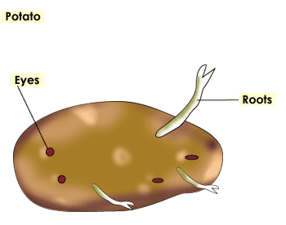
10/13 What’s in a Tuber? Lab Obj. TSW learn about the different parts of plants and how they can be propagated without seeds. p. 78 NB
What does the word propagate mean?
Why can some plants modify themselves to grow roots out of a modified stem and others can’t?
Besides the strawberry, what other vegetables can be propagated this way?

Slide 20
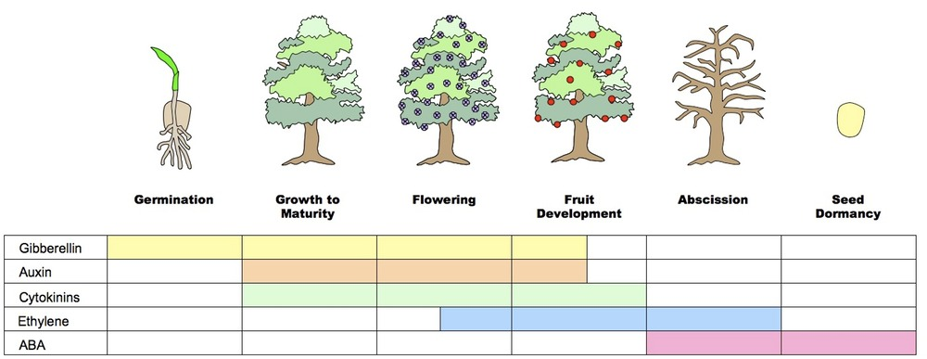
10/12 Hormones that control dormancy in plants Obj. TSW determine how specific hormones effect specific growth in plants by watching a video and taking notes. Watch the video to help understand how hormones can impact plants. P. 76 NB
What plant hormones are you familiar with, use the picture to help you?
What do you think hormones in plants do?
After watching the Video about Auxin, explain how it functions to promote stem growth.

Slide 21
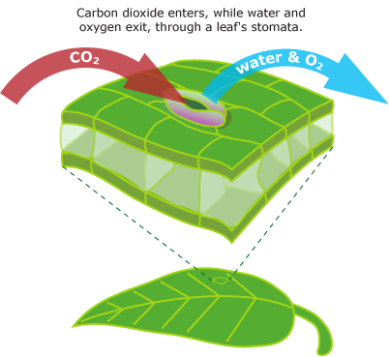
The Big 5 Understanding Plant Hormones
Auxin – stimulates plant growth
Gibberellin – makes stem’s longer
Cytokinin – stimulates plant cells to divide – G2 & Mitosis.
Ethylene – Ripening and rot of plants
It is a gas, not a chemical like the others.
Abscisic Acid- plant alters to decrease H2O availability due to drought
Shrivels up guard cells so that stomata are closed

Slide 22
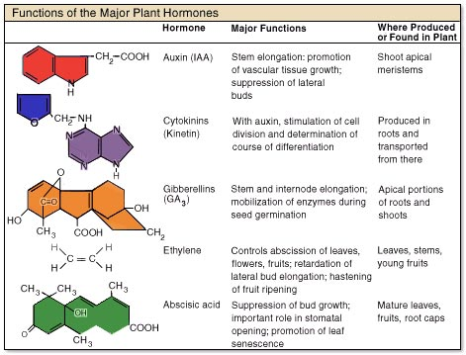
Copy the 5 hormones.
Write words that you are not sure about their meaning, then look them up, and write them in you notebook on page 77.

Slide 23
Why leaves change color..
Hormones are even involved in the leaves changing color.
Take notes, page 77 NB

Slide 24
Researching Plant Hormones p. 79NB

Slide 25
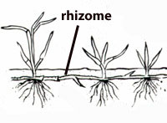
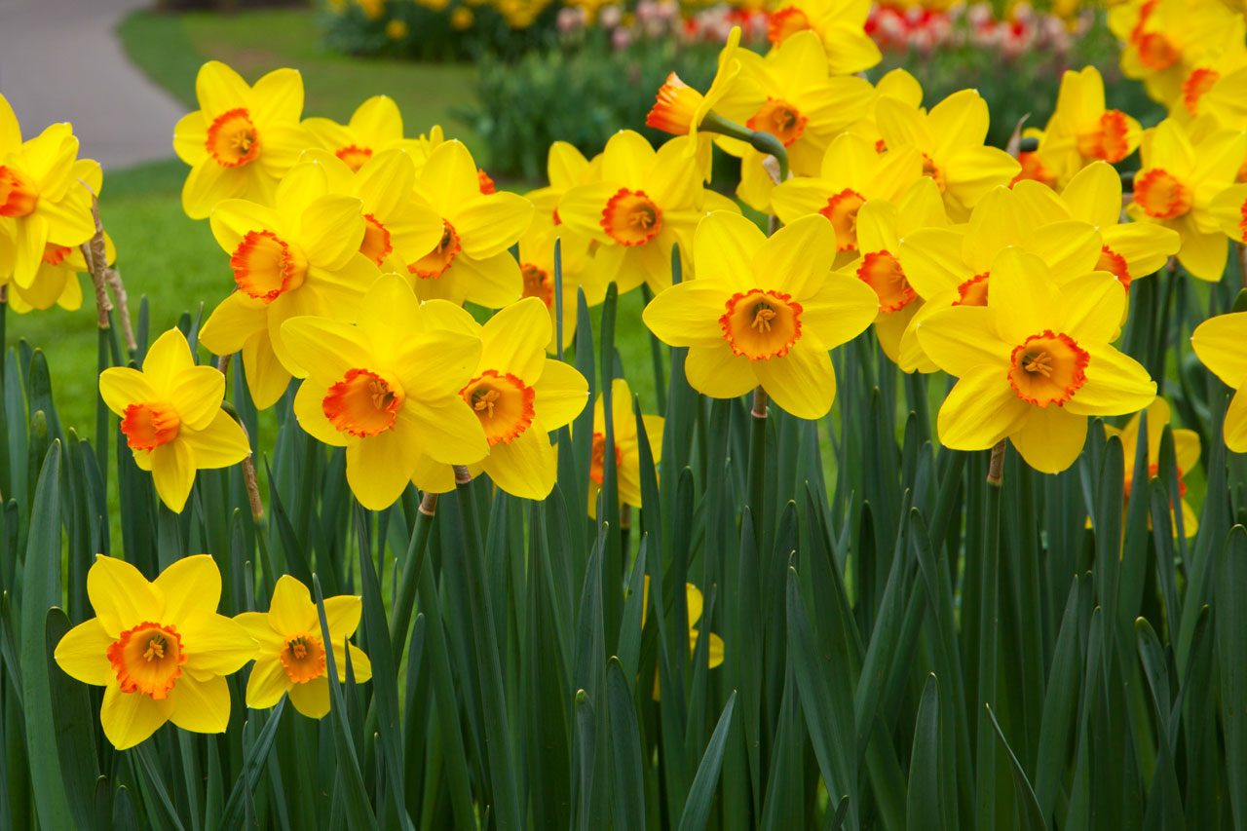
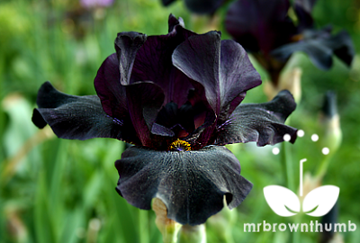
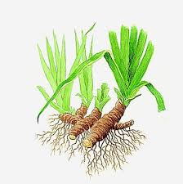
Don’t forget Flowers! Page 77 Find 5 more types of plants that can reproduce without seeds.
Daffodils
Iris
Bamboo

Slide 26
Make it grow! Bean/Peas & Auxin Lab p. 81 NB
Germinate Bean/ Pea plants
Plant in clean 2 liter bottles against the side of the bottle.
Apply “Clonex” to the seed, and plant in soil.
Observe and Measure how the hormone auxin affects the Root, Stem and Leaf.
Collect data for 2 weeks
Present findings to the class at the conclusion of the lab.

Slide 27
Planting Potatoes
Students will get potatoes from the local grocery store and seed potatoes form the local nursery.
With beakers and toothpicks students will grow the “eye of the Potato” to start in the ground.
After propagating tubers, and planting them in the soil, students will compare the texture of each during harvest.
Students will compare and contrast the grocery store potato to the nursery potato in a class discussion.

Slide 28
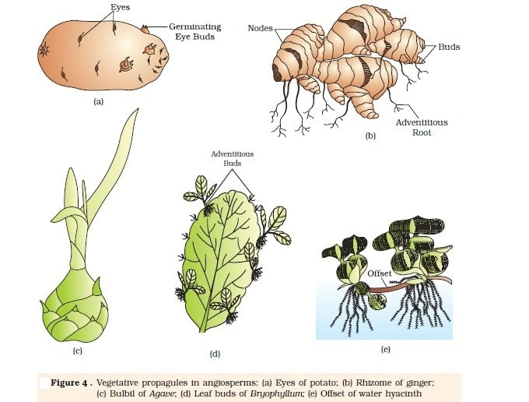
10/14 Reflection of Vegetative Propagation and the influence of Hormones on plants. P. 80 NB
What does it mean to propagate?
Explain how a plant can use vegetative propagation to reproduce more of itself.
Recommend a plant to grow in our gardens that can be propagated this way.

Slide 29
Reflection of Propagation p. 83 NB
Explain the plant(s) you worked with
Type of propagation
Success or failure of propagation or application of hormone
Use a page in your Notebook for your reflection

Slide 30
10/17 Review for Midterm Obj. TSW review FFA Leadership knowledge for the midterm. P. 82 NB
Using a Venn diagram, show the FFA Motto and Salute. Explain what they have in common.
Describe and explain the meaning of the FFA emblem and colors.
There are 11 code of ethics, try and name at least 3. Describe the proper use of the FFA jacket.

Slide 31
Jeopardy Game
Time to form teams.
Write all your members names on a piece of paper with your team number.

Slide 32
10/18 Review for Midterm Obj. TSW write a summary of their SAE projects. P. 84 NB
How much time have you invested in each of your projects?
How much money have you invested?
What learning objectives do you have for your SAE(s)?

Slide 33
Study Guide
Sustainability: Resources in the environment are used in a balanced way so that we have resources in the future. Triple Bottom Line is a good model. Using food scraps (Plant & manure) for compost. The tower gardens are part of our aquaponics program. Biodigestion (all food waste) is collected and converted to fuel. The chickens are sustainable. Recycling is sustainable.

Slide 34
10/19 Review for Final Obj. TSW finish the study guide today for tomorrows midterm. P. 86 NB
Explain Sustainability and practices we have at Bryte.
Explain the Triple Bottom Line, and why it is important.
Explain Photosynthesis and Cellular Respiration in the Carbon cycle.

Slide 35
The FFA Creed
How far have you memorized?
Officers – October 27th, You need to present the FFA Creed to the WUSD School Board.

Slide 36
Agriculture Education Term Quiz
Try and answer as many questions as you can by yourself.
Then work with a partner to help finish the paper of ID the terms.
We will go over all the terms together to make sure you know all the definitions and examples of the agricultural education terms.

Slide 37
Make 8 Teams Choose a Number from the bag.
You may work by yourself or with 1 or 2 other people.
Write the answer on the whiteboard of the question your picked.
Share out with the class after 10 – 15 minutes of writing a polished answer.
The class may add or help improve your answer.

