Slide 1
Cycles in Nature Unit 2
Week 6 Nitrogen Cycle

Slide 2
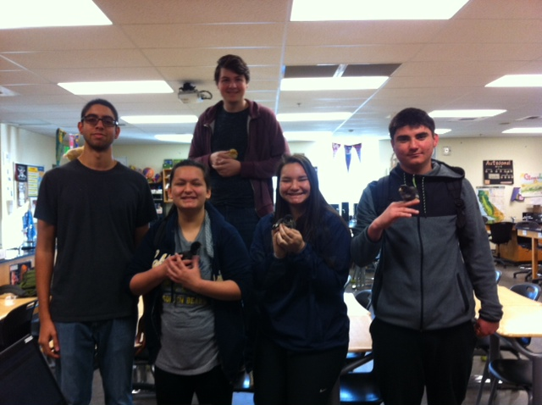

Slide 3
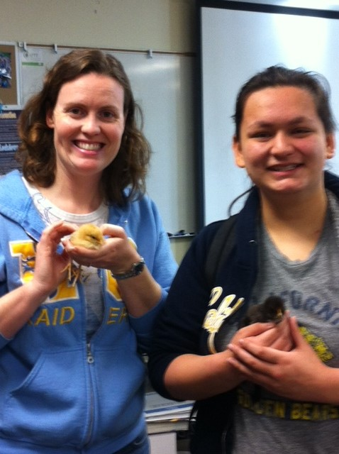

Slide 4
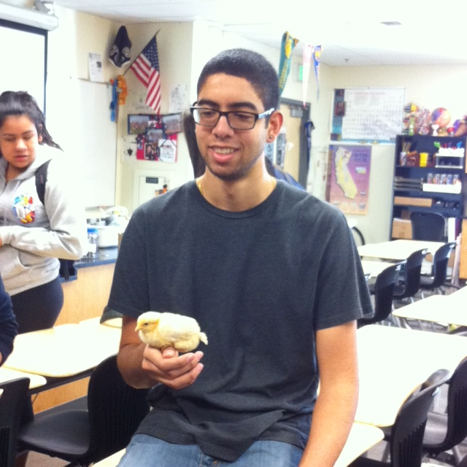

Slide 5
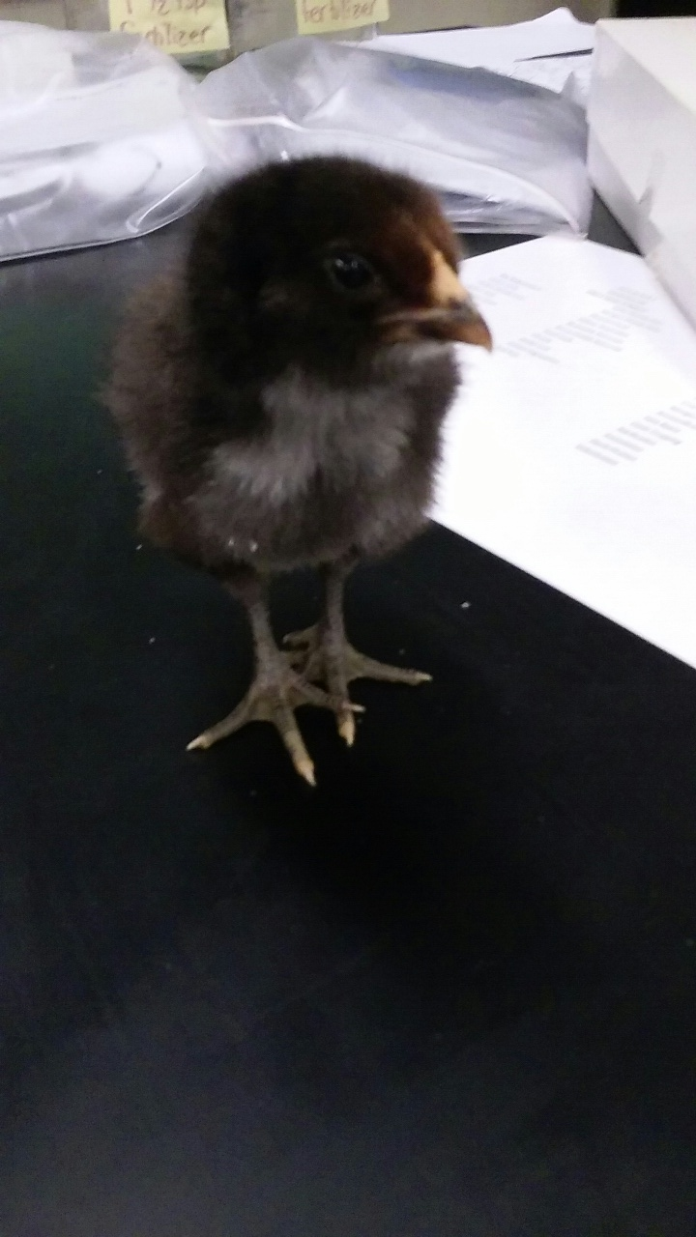
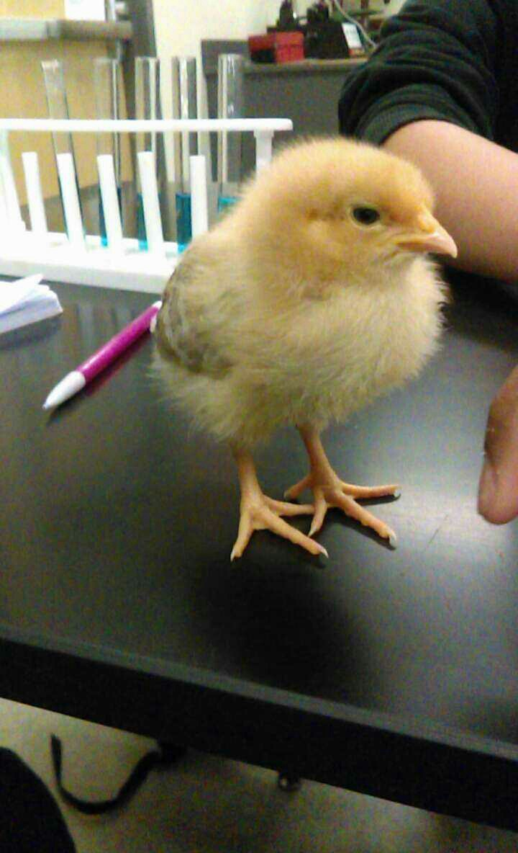

Slide 6
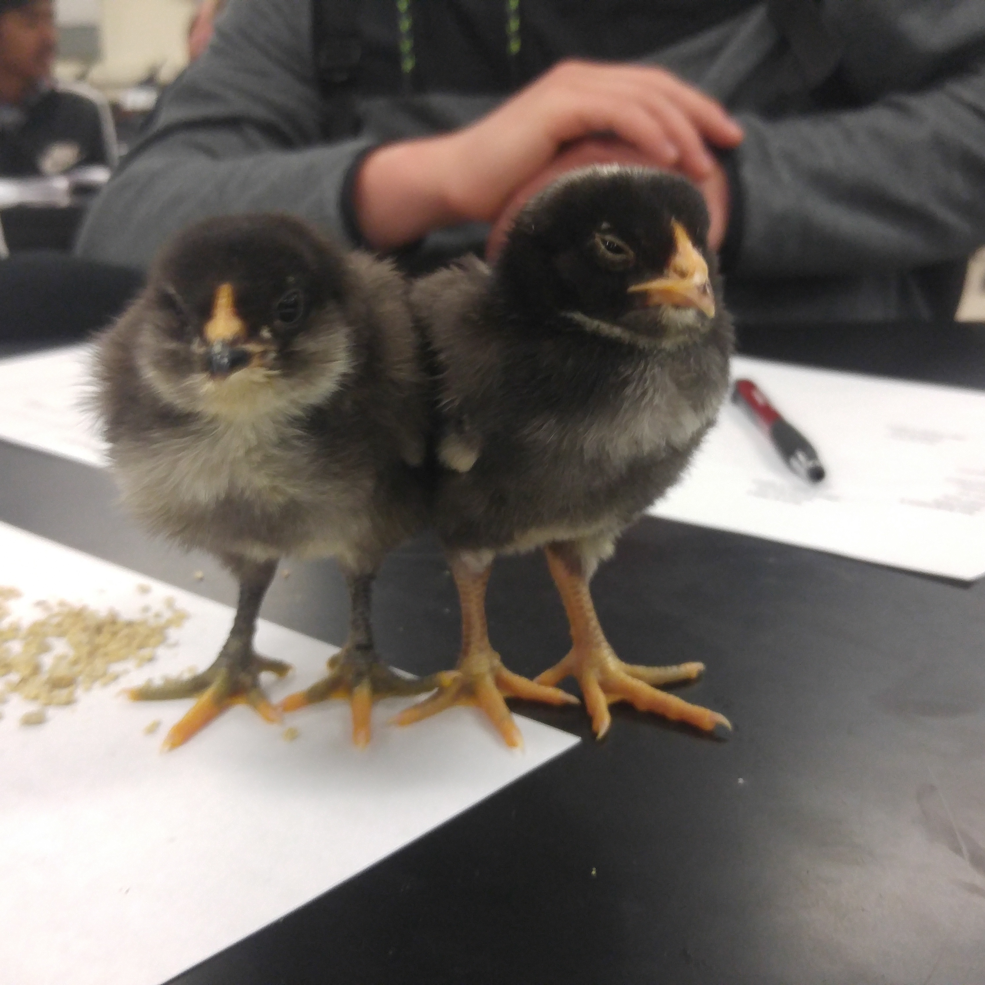

Slide 7
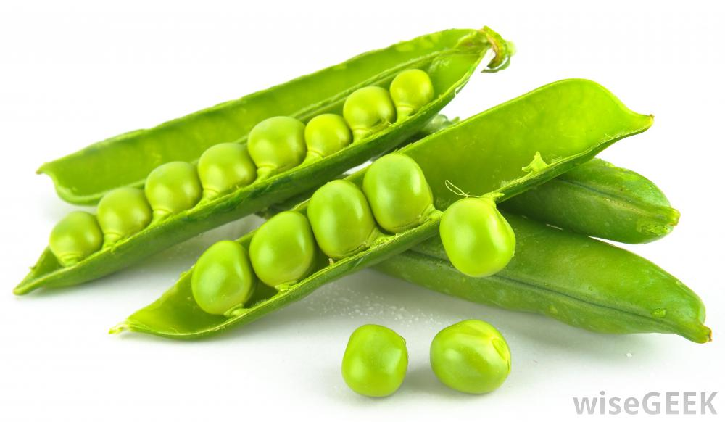
2/22 Nitrogen Cycle Obj. TSW learn how nitrogen flows through the environment. p. 48 NB
What do you know about the Nitrogen Cycle?
Do you think Bacteria is part of it? Why?
What type of plants help build Nitrogen in the soil?

Slide 8
Farm to Fork Leadership Offices
2016 SpringTerm
President- Organize Officers and communicate objectives, carry through with goals set by class.
Vice President – Support the president in organization of class meetings, communication throughout the class & school/board with overall goals, achievements.
Secretary – Written documentation of class meetings with goals, achievements. Communicate with all levels of officers, class members and McAllister.
Treasurer – Keep track of donations and expenditures, be present at all fundraisers. Return receipts to McAllister.
Videographer- Develop, create, & document our adventures in the garden and beyond, help maintain F2F Website
Publicist/ Journalist – Advertise F2F achievements, goals, communicate with community members about F2F. School Newspaper & News Ledger
Irrigation Specialist – Responsible for the proper amount, quality, and management of water in the garden.

Slide 9
Officer Nominations Select students who are willing to run for the office. Wednesday will be a computer lab day, nominees will type their speech for the election on Thursday.
President: Rocio A., John, Monica, Rocio Z, Nomi, Angel
Vice President: Patty, Adrian, John, Monica, Rocio Z.
Secretary: Sapana, Jakob, TJ, and John
Treasurer: Justin, John, Nomi, Adrian,
Videographer: Rocio A., John, Nomi,
Publicist/Journalist: Nomi, Patty, TJ, Justin
Irrigation Specialist: John, TJ, Patty, Nomi,

Slide 10
Read I Believe… Statements

Slide 11
Class Demonstration on Eutrophication Page 33 NB
What is Eutrophication?
What nutrients does it involve?
Explain the process of how it happens.
Why is it important? How does it impact other organisms?
Copy the Data Table:
Day | Control (No Fertilizer) Dissolved O2 | Variation 1 (1/2 tsp fertilizer) Dissolved O2 | Variation 2 (10- ½ tsp fertilizer) Dissolved O2
Day 1 | 10 mg/L | 8.5 mg/L | 7.6 mg/L
Day 2 | 20 mg/L | 1.3 mg/L | 1.3 mg/L
Day 3 | 7.7 mg/L | 4.3 mg/L | 3.6 mg/L

Slide 12
Local Food System vs. Industrial Food System Page 39 NB
What are some characteristics of each?
How are they similar?
How are they different?
What is your opinion on which on is better?

Slide 13
How does CO₂ Cycle between the Biotic and Abiotic Factors in the environment? Page 51NB
 | Bromthymol Blue | Before Blowing CO2 | After Blowing CO2 | After Adding Elodea Leaf
Color | Deep Blue
pH | 7.2 | 6.3 | 6.5
Analysis:
What processes exist that allow CO2 to cycle between the living and nonliving part of the environment?
Why was there a color change?
What will happen to the color, if we put a plant in it?

Slide 14
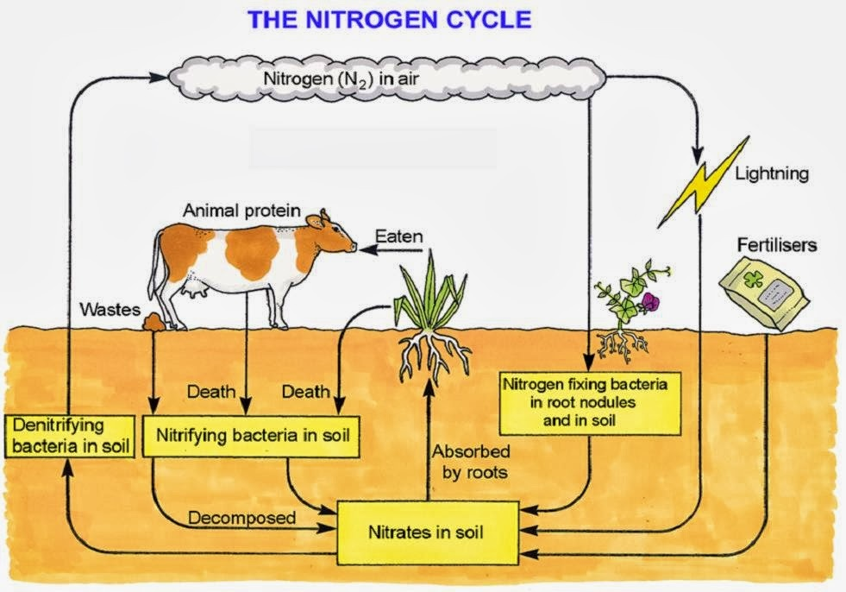
2/23 Plant Nutrients – Nitrogen Obj. TSW learn about nitrogen as a fertilizer and as a cycle in nature. P. 50 NB
Highlight things that you find interesting or could talk about with an adult.
What are the two basic chemical formula that show the forms in which plants can absorb nitrogen through their roots?
Look at the Nitrogen cycle on the back of the paper, What organism is responsible for converting N₂ to NO₃⁻ or NH₄^{+?}

Slide 15
Learn about Ag – Nitrogen Cycle WS P. 49NB
Read the article about Nitrogen: 5 – 10 minutes
What facts could you memorize?
Underline vocabulary words to learn.

Slide 16
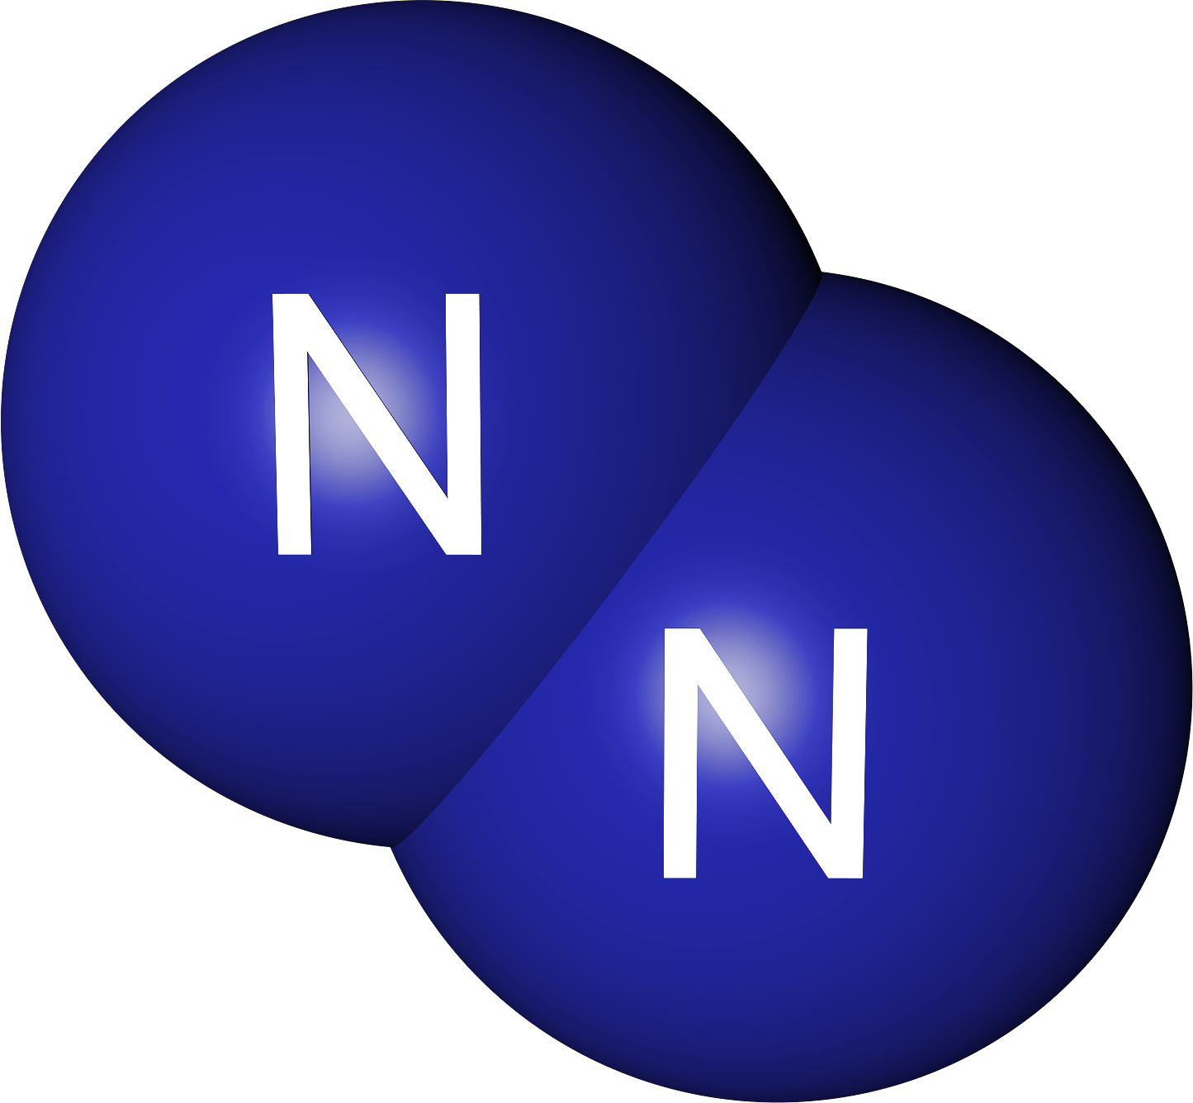
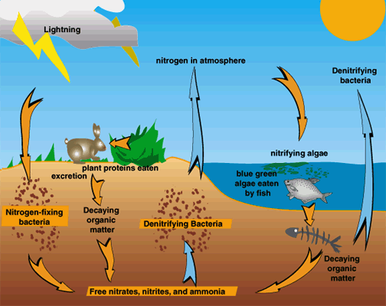
2/24 Know your Nitrogen Obj. TSW develop a deeper understanding of Nitrogen and it’s importance in the environment. P. 52 NB
A farmer goes to the feedstore to get some fertilizer for his legumes. He buys a 5 – 15 – 5 fertilizer. What % Nitrogen is the fertilizer?
Did the farmer really need fertilizer for his legumes? Why? Or Why not?
Suggest a better fertilizer and a crop he could plant for next year in that field.

Slide 17
Matter of Fact Notes Obj. TSW learn about molecules and compounds that cycle in the environment. P. 54 NB
Matter, mass, space.
Atom -Ex: H, Hydrogen; N, Nitrogen; Na, Sodium
Molecule, Substance- Ex. N₂ Nitrogen Gas; H₂ Hydrogen gas; O₂ Oxygen Gas
Compound, at least two different, millions.
H₂O water, NH₄⁺ Ammonium, NO₃⁻ Nitrate
5. Oxygen gas, O₂ & Nitrogen Gas N₂ are not considered compounds because they are each composed of the same element. Water, H₂O, is a compound because it is composed of more than one element.
6. Chemical formula, elements, subscripts. Ex: C₆H₁₂O₆ - Glucose

Slide 18
Gathering Data, Global Warming – Too much CO2 p. 47 NB Research the Greenhouse Effect of Carbon Dioxide
What is the role of CO2 and the impact on the Carbon Cycle?
Go to the following websites:
www.climate.gov
www.climate.nasa.gov
www3.epa.gov/climatechange

Slide 19
Obj. TSW distinguish between the 5 processes in the Nitrogen Cycle, what they produce & how they happen. p. 56 NB
What are the 5 processes in the Nitrogen Cycle?
Name the molecule or compounds in the Nitrogen Cycle.
What organism is responsible for most of the process in the cycle?

Slide 20
Nitrogen Cycle Game P. 55 NB What comes around goes around
Write a summary of the 5 Nitrogen cycle processes.
In your summary: Did you go through all 5 processes?
If not why?
Do you think this happens in the real world?
How does that change your idea of a cycle?
Write one thing that you learned.
What would you change for next time?

Slide 21
Computer Lab P. 57 NB Legume Harvesting
Research garden crops that are legumes that help “Fix” nitrogen in the soil.
Research garden crops that require a high nitrogen content in the soil to grow for the spring/ summer crop.
Write 5 Notes on this page.
Design on this page a drawing of a 4’ x 8’ garden bed of your spring crop.
Write an explanation for growing the legumes and tell why they will benefit other crops. Include “Nitrogen Fixer” and how it converts N2 to a form of fertilizer for the plants.

