Slide 1
Farm to Fork
Week 9

Slide 2
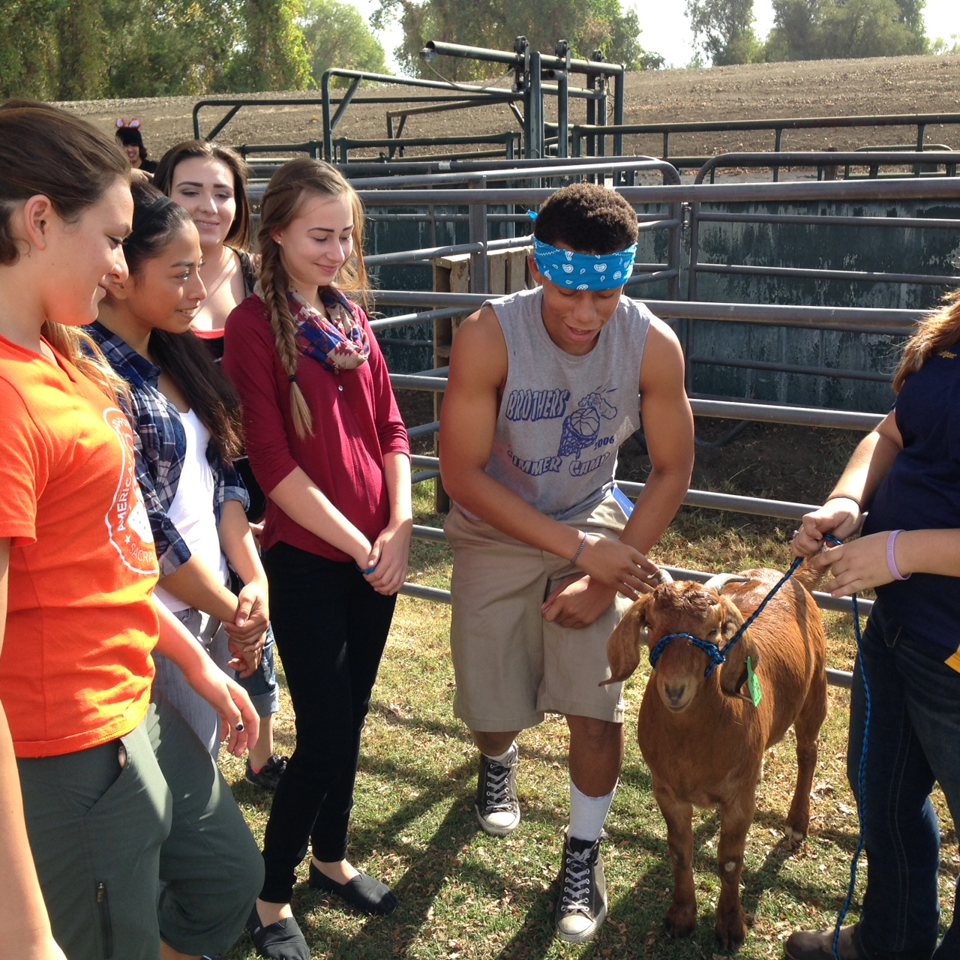
O’Connell Ranch

Slide 3
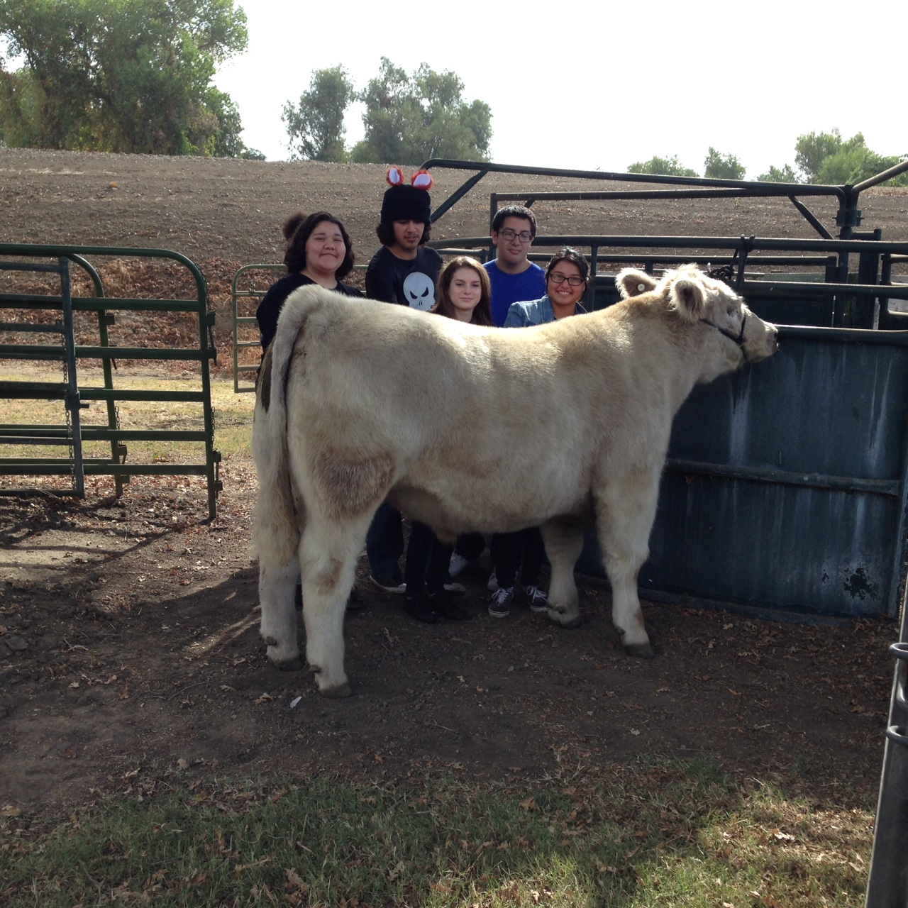

Slide 4
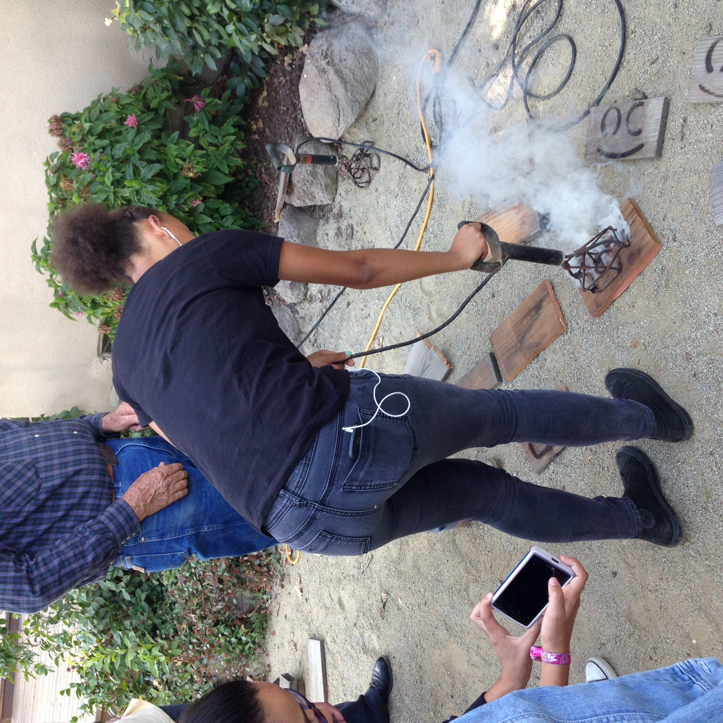

Slide 5
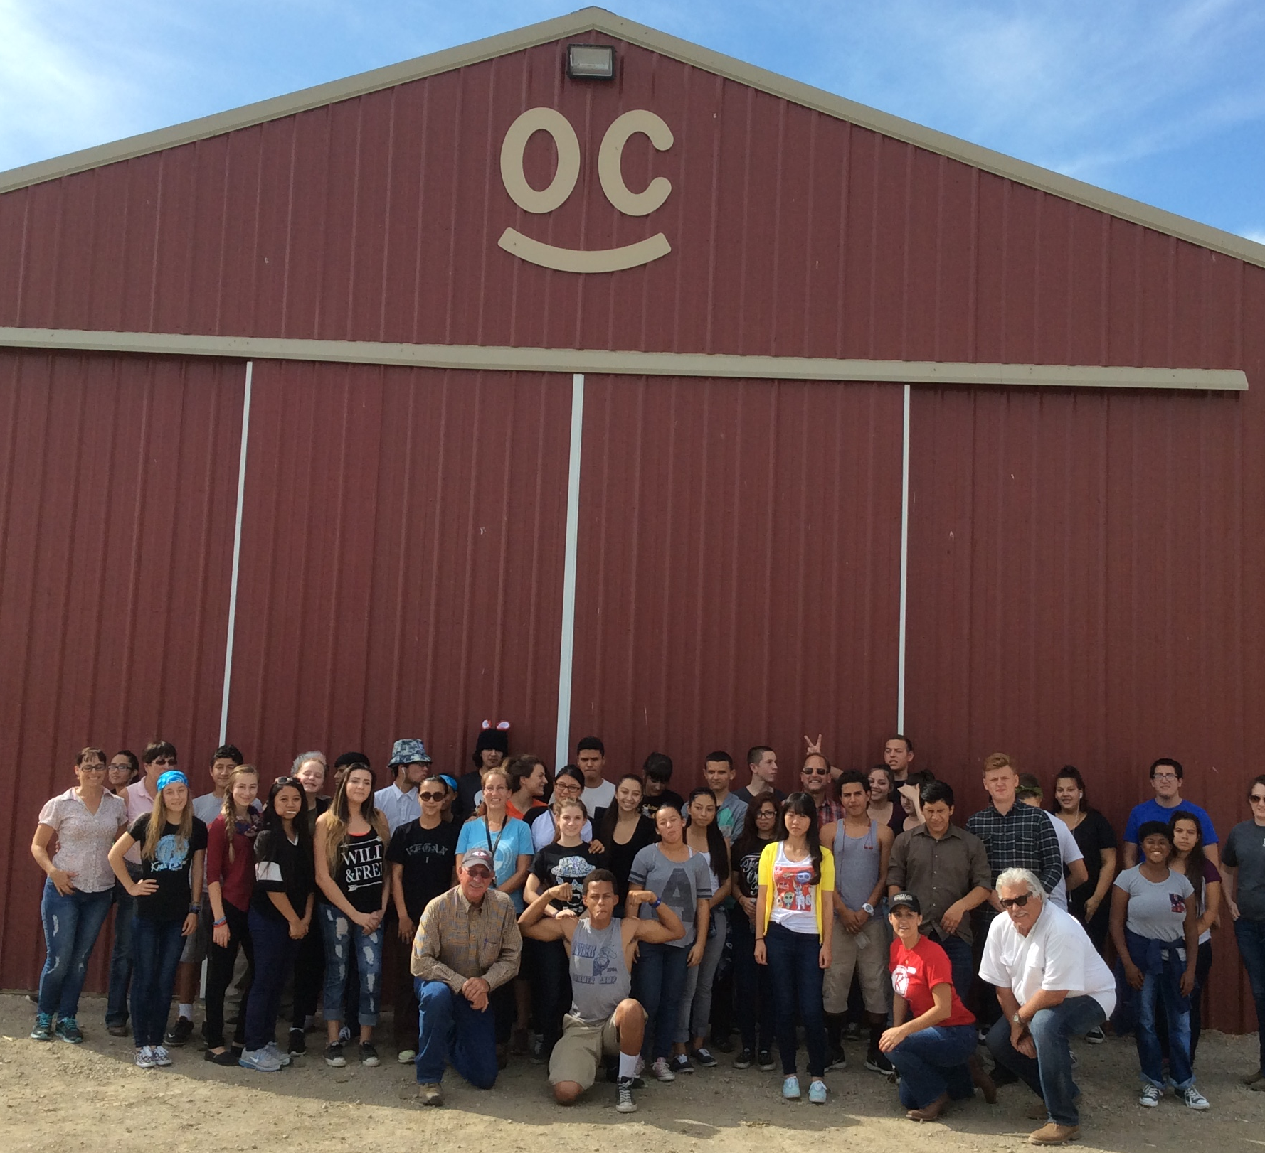

Slide 6
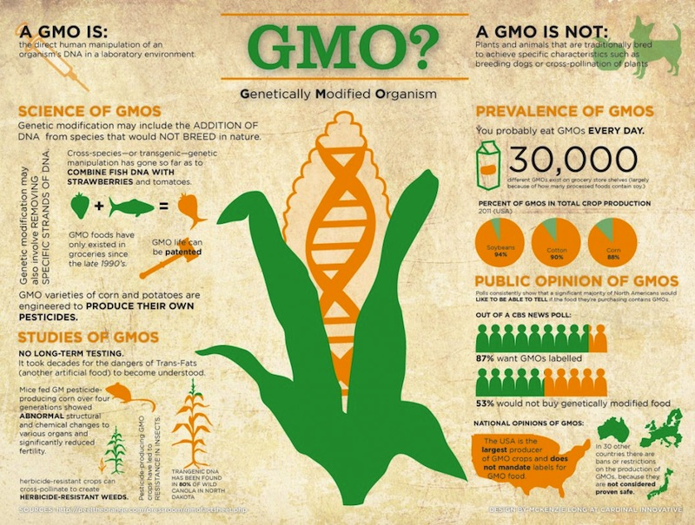
10/12 Genetically Modified Organisms Obj. TSW learn the pro’s and con’s of producing/ growing GMO’s. P. 76 NB
What was your article about?
What are some concerns about GMO’s after reading this article?
What are some benefits about producing GMO?

Slide 7
Pumpkin Pie!!!!
Thursday October 15
1 pm
Bryte Campus
You have to have your own transportation☺
Sign Up with McAllister

Slide 8
Biodigestion
Move the 7 Yellow Food Waste bins around the Quad where it makes sense for students to throw away their food
Place 2 plastic bags into each yellow bin.
Poke 1 hole into the outermost bag so it does not balloon up.
Place a 3rd plastic bag on one of the handles.

Slide 10
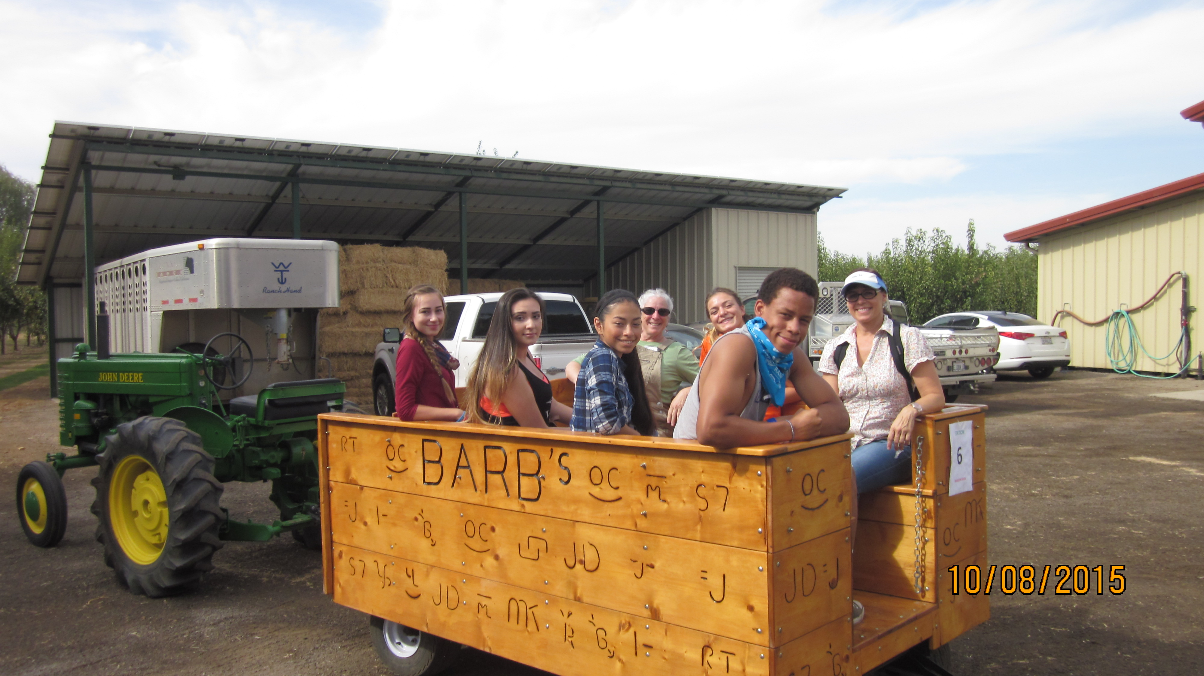

Slide 11
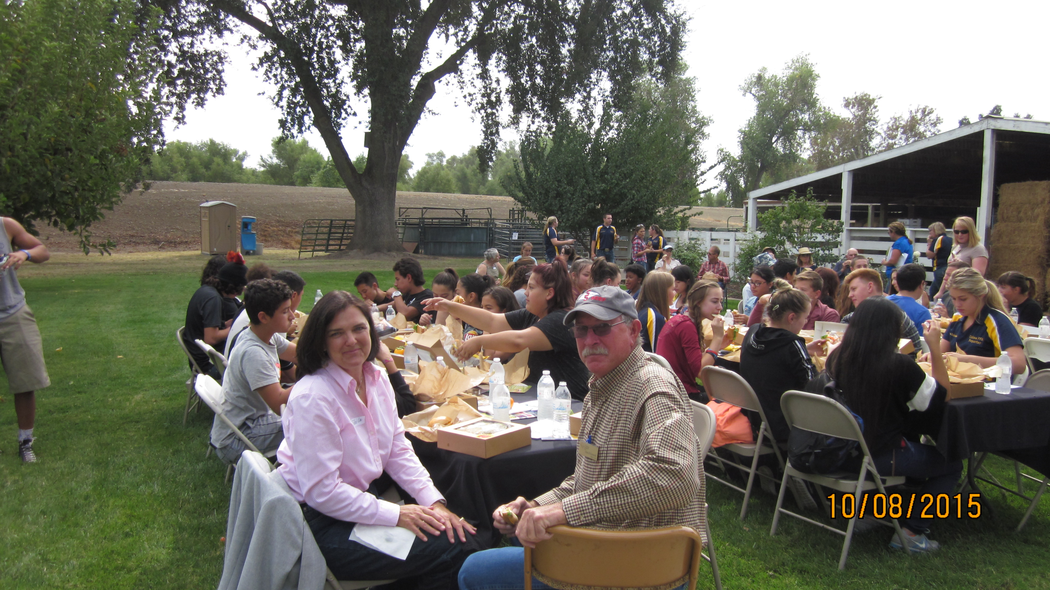

Slide 12
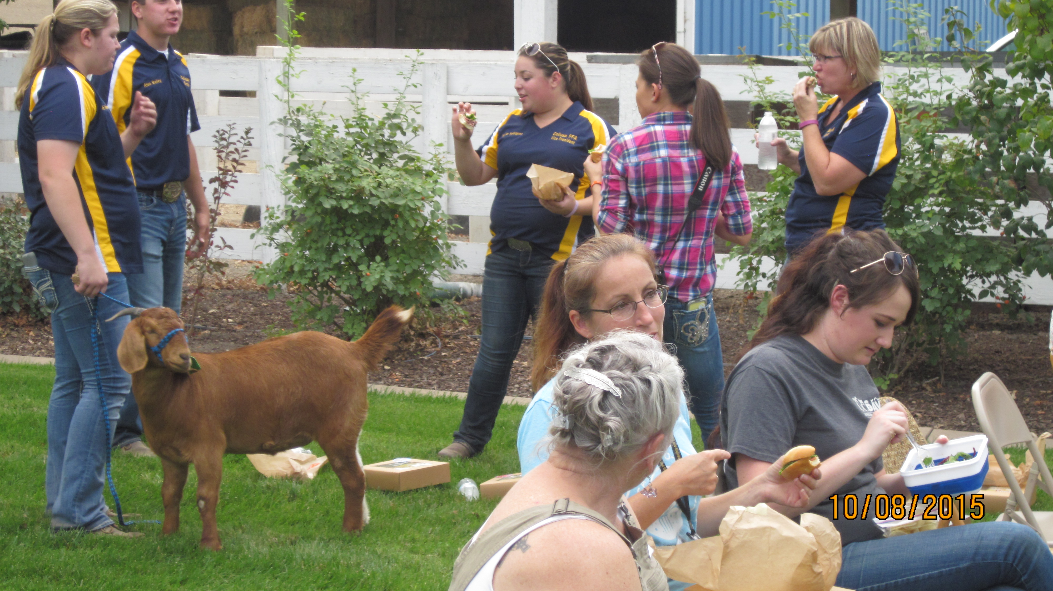

Slide 13
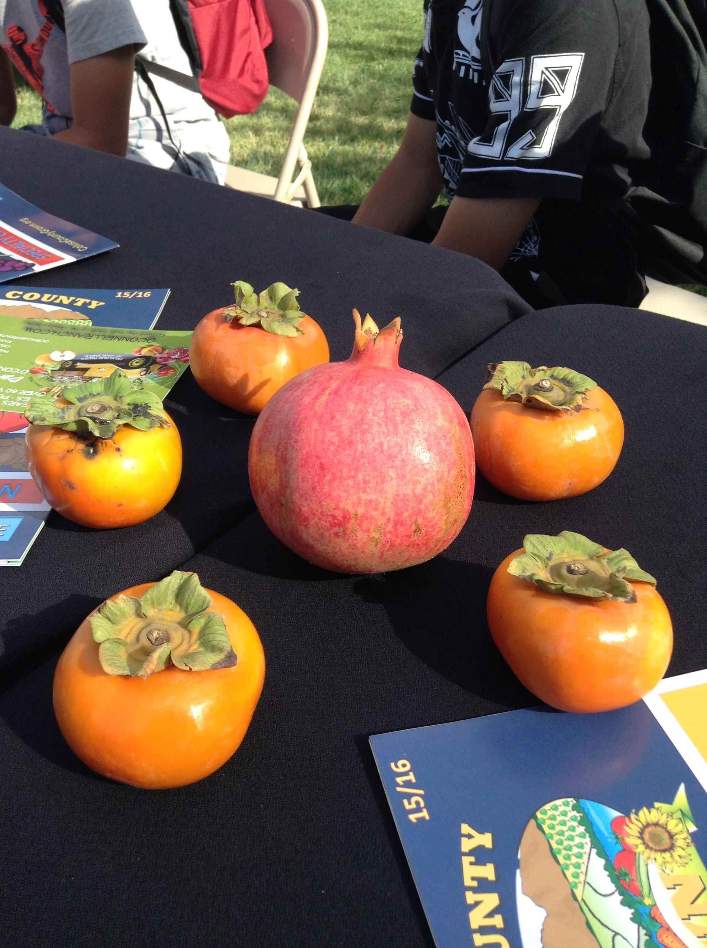
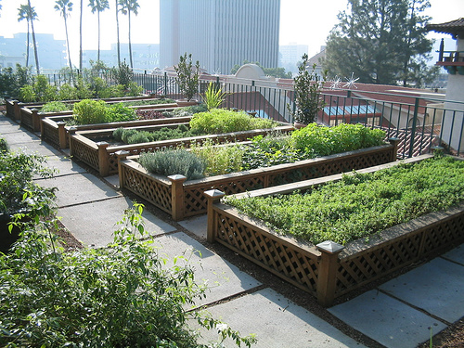
10/13 Urban and Rural Food Practices Obj. TSW learn about the different types of growing food to meet market demands. P. 78 NB
How did the O’Connell’s/ rural farmers grow their food?
How is the Urban Farm beneficial?
Rooftop gardening is happening in densely urban cities, how is it beneficial?

Slide 14
10/14 Your Garden Project Obj. TSW reflect on their garden project to gain a valuable understanding as to why caring for something other than one’s self is important. P. 80 NB
What steps have you taken to start your garden project?
What concerns do to need to address before you present your project tomorrow?
What have you learned from your experience in the garden?

