Slide 1
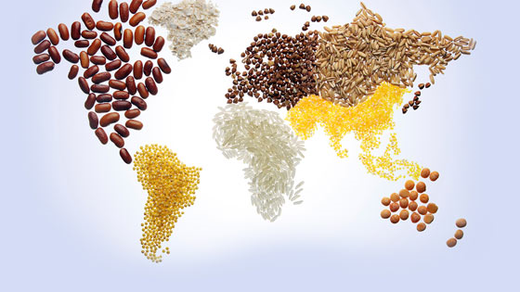
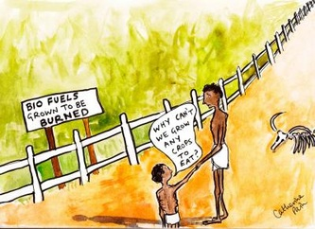
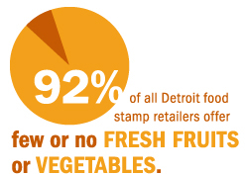
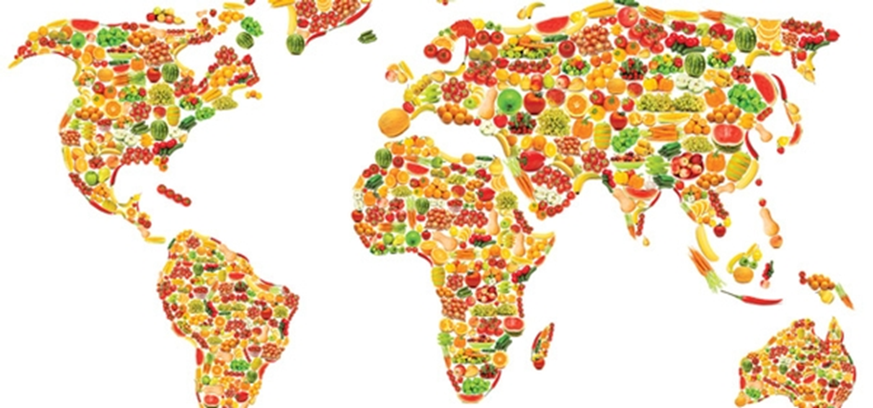
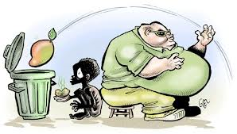
UNIT 3 Global Food Food Equity
Food & History Change over time
Journey 2050

Slide 2
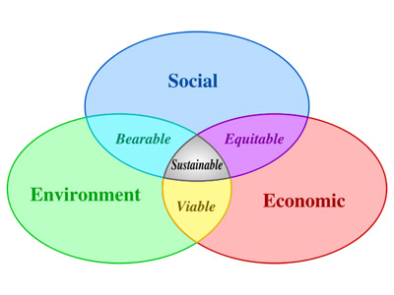
3/28 Food & History Change over time Obj. TSW develop a better understanding of global trends in the food industry. P. 8 NB
Journey 2050
Describe the word sustainability and give an example.
After watching the sustainability video, what are the three parts of the sustainability barrel?
What are our weakest links in the sustainability barrel? How do some of the parts of the sustainability barrel apply to our Farm to Fork program?

Slide 3
Journey 2050 Video
What are the three parts of the Sustainability Barrel?
What is a Limiting Factor? Give an example.
How can limiting factors keep us from feeding 9 billion people?
Be prepared to discuss how a balance of economic, social, and environmental issues can make it possible to feed more people.

Slide 4
Why do we care? What is the connection between Climate Change & Food Security?
Some countries/ regions of the world are going to be impacted to a greater extent due to climate change, which will intern impact how much food they can grow and feed their people?

Slide 5
Personal Goals for your project and garden p. 9 NB Garden tomorrow – Wednesday This must be filled out and get signed off in order to plant your transplants.
What steps need to be taken for your garden to be productive?
Have you measured the temperature, at three depths? Moisture?
What is your nitrogen, phosphate, and potassium amount?
What is your pH?
How do you intend to amend your garden?, if you need to add N-P-K?
How do you intend to amend your garden if the pH is not ideal?
In order to transplant, you must have at least 5 true leaves/ plant & water & make sure your phosphorus level is acceptable.
Can you direct seed?

Slide 6
3/29 Feeding Nine Billion Obj. TSW construct a plan and discuss possible solutions to feed 9 Billion by 2050. P. 10 NB
How would you propose to feed 9 Billion people on the planet? Try and list 4 steps only.
How will society be different? What limiting factors will exist?
What new industries might start?

Slide 7
Video: Feeding Nine Billion p. 11 NB Write the 4 possible solutions to the left. Write some good things about how the solutions can work. What are some challenges in those 4 possible solutions?
4 Solutions
Science & Technology
Distribution
Local Food Systems
Regulation of Food
Pro’s (Good) Con’s (Bad)

Slide 8
3/30 Yolo County Top Commodities Obj. TSW will estimate what the 3 top agricultural products are in our county. P. 12 NB
What is your estimate of the top 3 crops for Yolo County?
Agriculture in the Classroom, Summarize the video. Do you agree that agriculture is important in the classroom? Why or why not?
How do you predict Agriculture will change in our county in the future? Why?

Slide 9
Measuring Abiotic Factors in your Garden Bed
Garden Bed # | pH of Soil 4 - 8 | Soil Moisture Dry, Moist, Wet | Temp. Surface Celcius | Temp 5 cm | Temp 10 cm | Nitrogen (N) | Phosphorus (P) | Potassium (K)
1
2
3
4
5
6
7
8
9
10

Slide 10
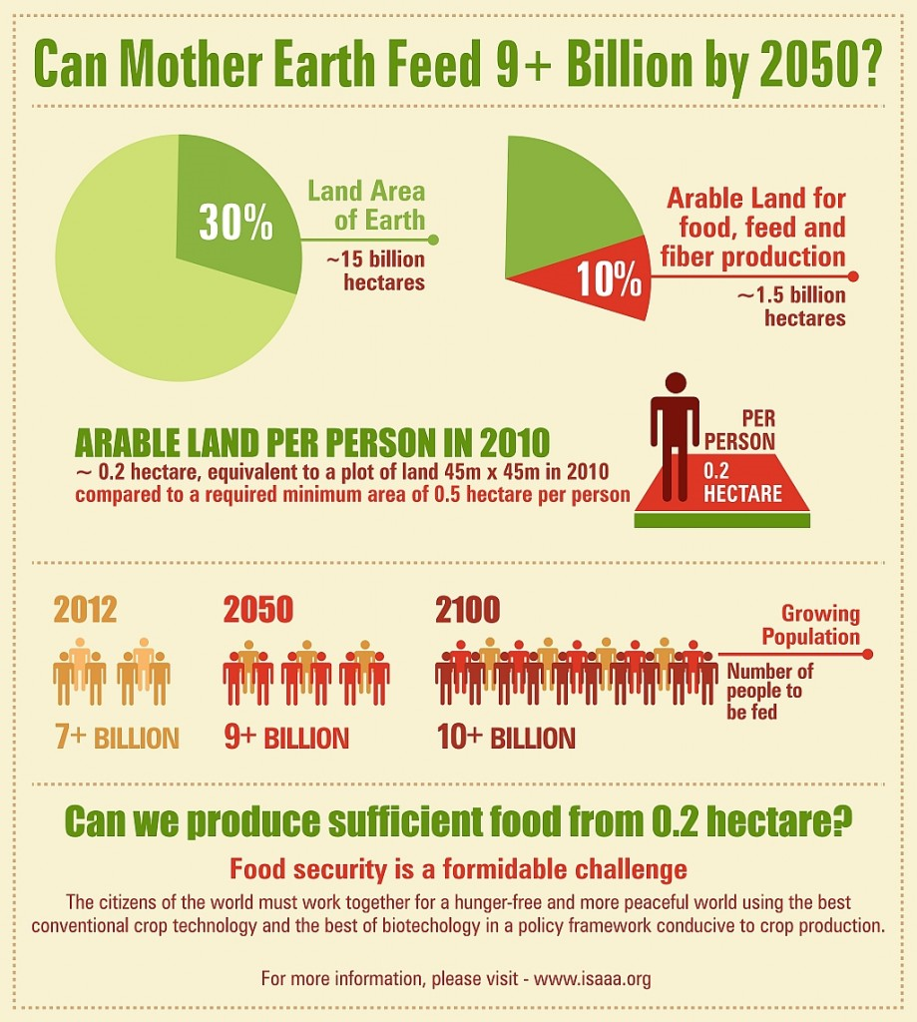
http://schoolgrown.org/
Aquaculture Project

Slide 11
Local Food Systems Obj. TSW connect our Farm to Fork Movement to other Local Food Systems. P. 14 NB
What is a local food system?
Give an example.
What is a closed- loop system? Write an example

Slide 12
4/1Aquaponics Obj. TSW learn how aquaponics will be part of the solution to feed the world. P. 16 NB
What is Aquaponics? How is it different from aquaculture?
After watching the video, what suggestions do you have for our program?
How can Aquaponics help “feed the need” for making all food more equitable?

Slide 13
Activity: Research Historical Agricultural Practices P. 13 NB
Food & History – Change over Time
Omnivore’s Dilemma – How has the history of food changed in the last 50 years? 100 years? 200 years?
How has it changed the American Diet?
Where did people eat?, How did they eat? Where did their food come from?
How is food changing in the future?

Slide 14
Activity: How do other countries feed their people? P.15 NB
Choose a country. Research the top 5 food commodities produced.
How does this country feed their people? Do they have local food systems in place?
If they do have local food systems in place describe them and how they work.

