Slide 1
Farm to Fork
UNIT 4 Feed the World
Economics, Poverty, Population and Carrying Capacity, Genetically Modified Organisms

Slide 2
Lesson 4: Populations-People & Carrying Capacity
F2F1 UNIT 4
Global Food

Slide 3
AET Website
Log in using your username and password.
Complete your profile.
Enter your SAE specifics.
Include all volunteer hours and POA’s for FFA.

Slide 4
Greenhand Test
Jacob, Miguel, Quincy look at the test and figure out which questions you got wrong and why.
Students get into one of the 3 groups of Jacob, Miguel and Quincy.
Get a Official FFA Manual
Page 47 Notebook – Write down the questions you got wrong, find the answer in the FFA Manual, Write the answer in the Notebook. Discuss the correct answer with your team leader.
Then students can retake the test again.
Must earn a 20 or > to be Proficient to earn your Greenhand degree.

Slide 5
SAE Qualification Questionnaire
Your SAE must be agriculturally related, created by you, invested time of 8 hours, supervised by your Ag Teacher and be part of your grade.
How does it provide real work situations?
What careers is it related to?
How is it part of your career goal?
List the skills, knowledge and attitudes you need for this career that your SAE might apply to.
How can you grow, and become more competent each year in the Ag program with this SAE?
How does your SAE allow for expansion, and/or change?
Have you kept records of your money, and time?

Slide 6
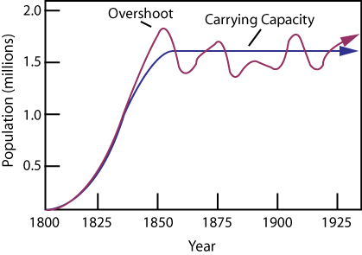
12/13 Earth’s Carrying Capacity
Obj. TSW learn how the increase in world population will have an impact on them. P.62 NB
Approximately how many people live in CA?
Approximately how many people live in the US?
Approximately how many people live on the Planet?

Slide 7
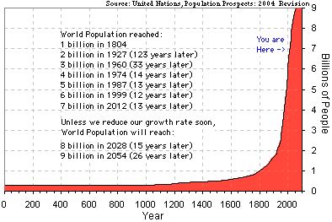
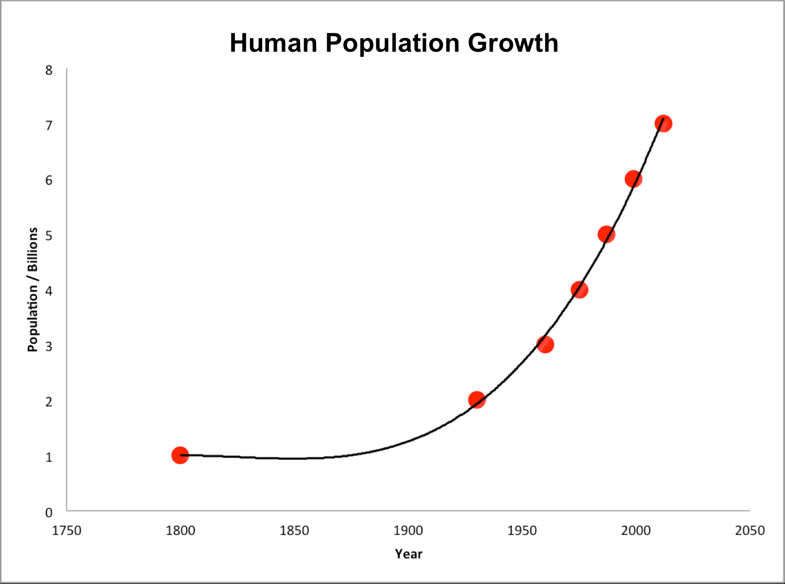
Earth’s Human Population Growth

Slide 8
Activity: Population Growth Analysis p.61NB
Introduction of Reindeer to St. Matthews Island in Alaska.
Analyze the graph of the growth of Reindeer from the original 29 that were introduced to St. Matthew’s Island.
Answer the 5 Preview questions.
Answer the analysis questions in complete sentences.
Finally, is there any relevance between this example of overpopulation and the human population on the Planet? 2 – 3 sentence answer.

Slide 9
United Nations p. 63 NB
Integrating Population Issues into Sustainable Development
Students research the website:
  Who are the United Nations?
  What do they do?
  How are they part of the solution for sustainable development?

Slide 10
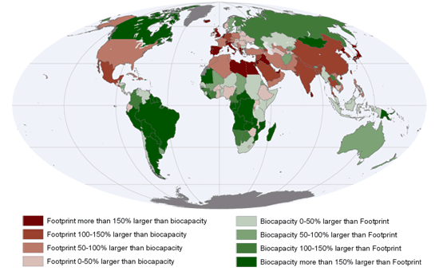
12/14 Earth’s Carrying Capacity
Obj. TSW understand that Biocapacity of countries and the carrying capacity of the planet are interlinked. P.64 NB
What are limiting factors in a Carrying Capacity graph?
What are some Density Dependent Factors?
What are some Density Independent Factors?

Slide 11

12/15 Sustainability Worldwide
Obj. TSW apply and discuss why it is important for sustainable practices to be enforced worldwide.p.66 NB
Describe sustainability.
Describe 3 sustainable practices you have learned in this class.
What are the implications of increased population growth if sustainable practices are not enforced?

Slide 12
How to end poverty in 15 years video
I have no TV.com
Take notes on page 67 NB

Slide 13
Online Article: Has Earth reached its Carrying Capacity? P. 69 NB

Slide 14
Maxine Abrulo – Coit Tower P. 69 NB
Answer questions from the WS.

Slide 15
Summative Assessment
Students should answer the following questions after they have gathered all their research:
Which of your five foods did you find for sale in other circulars? Why do you think they were for sale in more than one place?
Which of your 5 foods were more expensive or less expensive? Why do you think that is?
Notice and write about any trends that developed at certain grocery stores. For example, was the Dollar Store always the cheapest? Why?
Finally, the class will have a discussion about the supply and demand of food in our grocery markets.
What drives the economy of food?
Students will write a reflective 1 page paper summarizing all the activities from this key assignment, tying in the biocapacity of countries, the imports of food from other countries, and changes they may make in their lifestyle as a result.

Slide 16
Sustainability

Slide 17
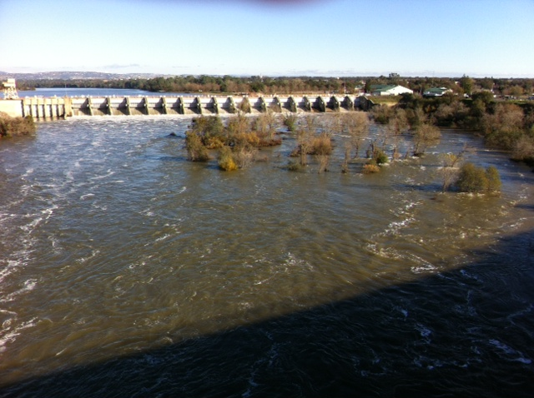
American River at Nimbus Dam
December 17, 2016

Slide 18
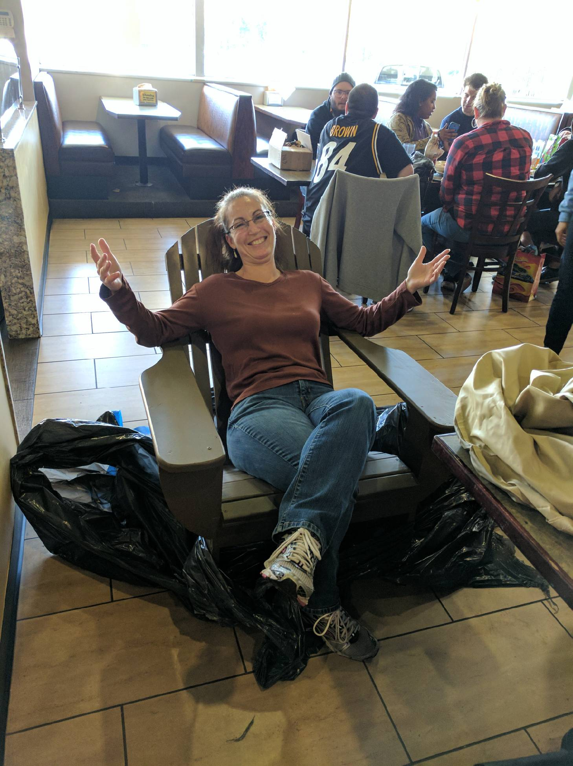
RCHS Construction Students make McAllister an Anderondike Chair for Christmas!

Slide 19
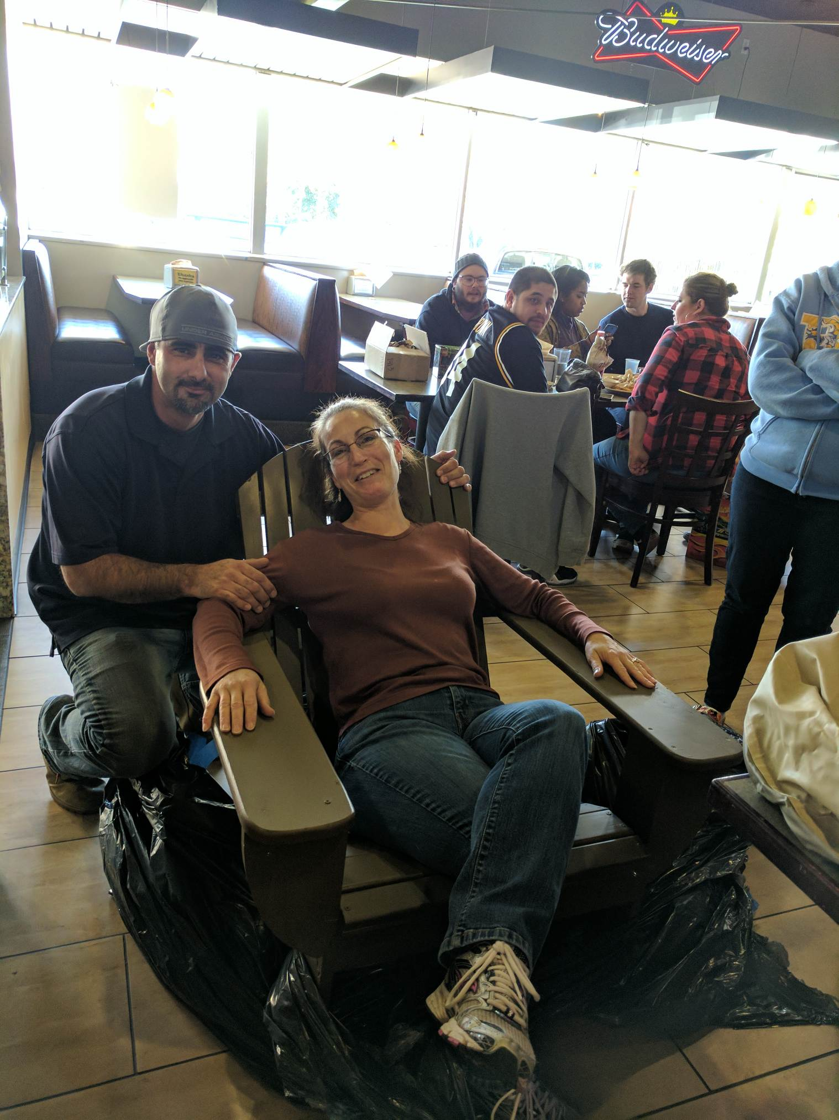
Thank you Mr. Billington for teaching your students how to make Adderondike chairs!

Slide 20
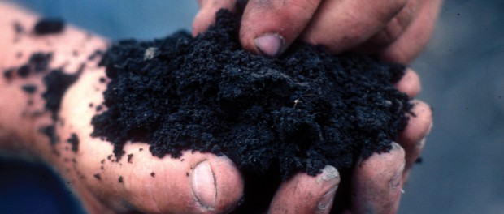
January 3rd From the Soil
Obj. TSW gain a better perspective of the importance of healthy soil. P. 66 NB
What are the components of healthy soil?
Why is Farm to Fork important?
Explain what you have learned about growing healthy food for RCHS students and Culinary?

Slide 21
Second Barcode
Take 3 – 4 Notes in the 2 minute video.
After watching the short video clip, what are your thoughts?
How realistic is a second barcode? P.71NB

Slide 22
Activity: The Story of Food nourish.org
Objective: Students examine food labels and conduct research to trace food paths from the original plant or animal source. They then make posters describing the story of a particular food.
Question: How does the way food is raised, processed, transported, and eaten impact both people and the environment?
Read the background information.

Slide 23
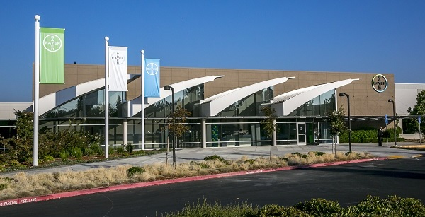
1/4 Bayer Crop Science
Obj. TSW learn about local companies that play a role in our Agricultural success. p.68 NB
What association do you have with Bayer?
Why would a Pharmaceutical company get involved with Crops and growing Food?
How does what you have learned about Bayer Crop Science under score the importance to growing healthy food worldwide?

Slide 24
Final Presentation –PPT
Farm to Fork Project PART 2 DUE McAllister needs to review your progress of your project before January 8TH.
PPT Individual: 10 – 15 Slides PPT Two students: 15 – 20 Slides
Introduction: Briefly review your project for us.
Data
Qualitative Data: Words, Descriptions, Pictures, Video
Quantitative Data: Tables, Charts, Graphs
Data Analysis
What does the data mean?
What were some things that you learned from mistakes you made?
What would you do differently next time?
Conclusion
Explain what your project meant to you and how the class Farm 2 Fork has helped you gain a better understanding of your project/ gardening caring for plants/& or soil . If you were in charge of feeding the world, or creating more sustainable practices worldwide how you would go about it?
Works Cited Title. Author. Website link.
Yolo Farm to Fork. By Dorthy Peterson. Dir. Dominic Machi. Perf. Beth Harrison. Yolo Farm To Fork. Yolo Farm to Fork.org, n.d. Web.

Slide 25
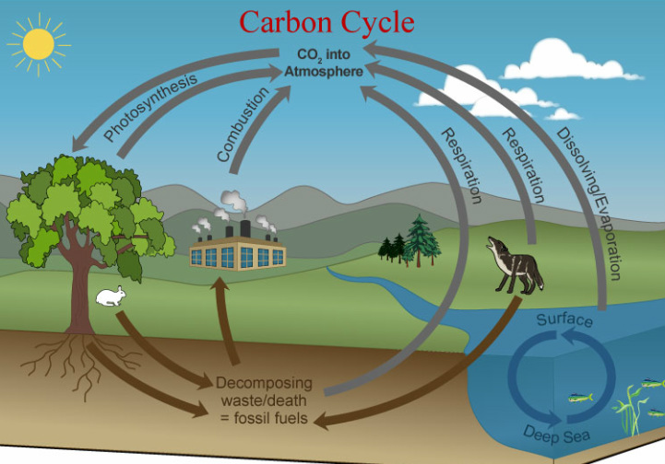
Carbon Cycle Review P. 84 NB
Obj TSW review how important the carbon cycle is to us.
What is the Carbon Cycle?
How does CO2 cycle through the Biotic and abiotic factors?
List 6 processes of the Carbon cycle.

Slide 26
Greenhouses & Carbon Cycle Activity. p. 85NB
"What happens to the carbon dioxide you breathe out or the carbon dioxide released from a burning paper?”
How does the carbon cycle influence the greenhouse effect?
How do greenhouses utilize the greenhouse effect to promote plant growth?
How is greenhouse plant cultivation a sustainable practice?

Slide 27
Students will draw the carbon cycle. Labeling the 6 processes that take place: Photosynthesis, Cellular Respiration, Exchange, Sedimentation & Burial, Extraction and Combustion. Students will gain a better understanding of how carbon cycles between the atmosphere, geosphere, hydrosphere, and biosphere form their graphical simulation of the carbon cycle.

Slide 28
Bayer Crop Science P. 85 NB
Where is Bayer Crop Science in West Sac?
What does Bayer Crop Science do concerning agriculture?
Give 3 examples of how they are involved in agriculture.
How does it relate to Farm to Fork?

Slide 29
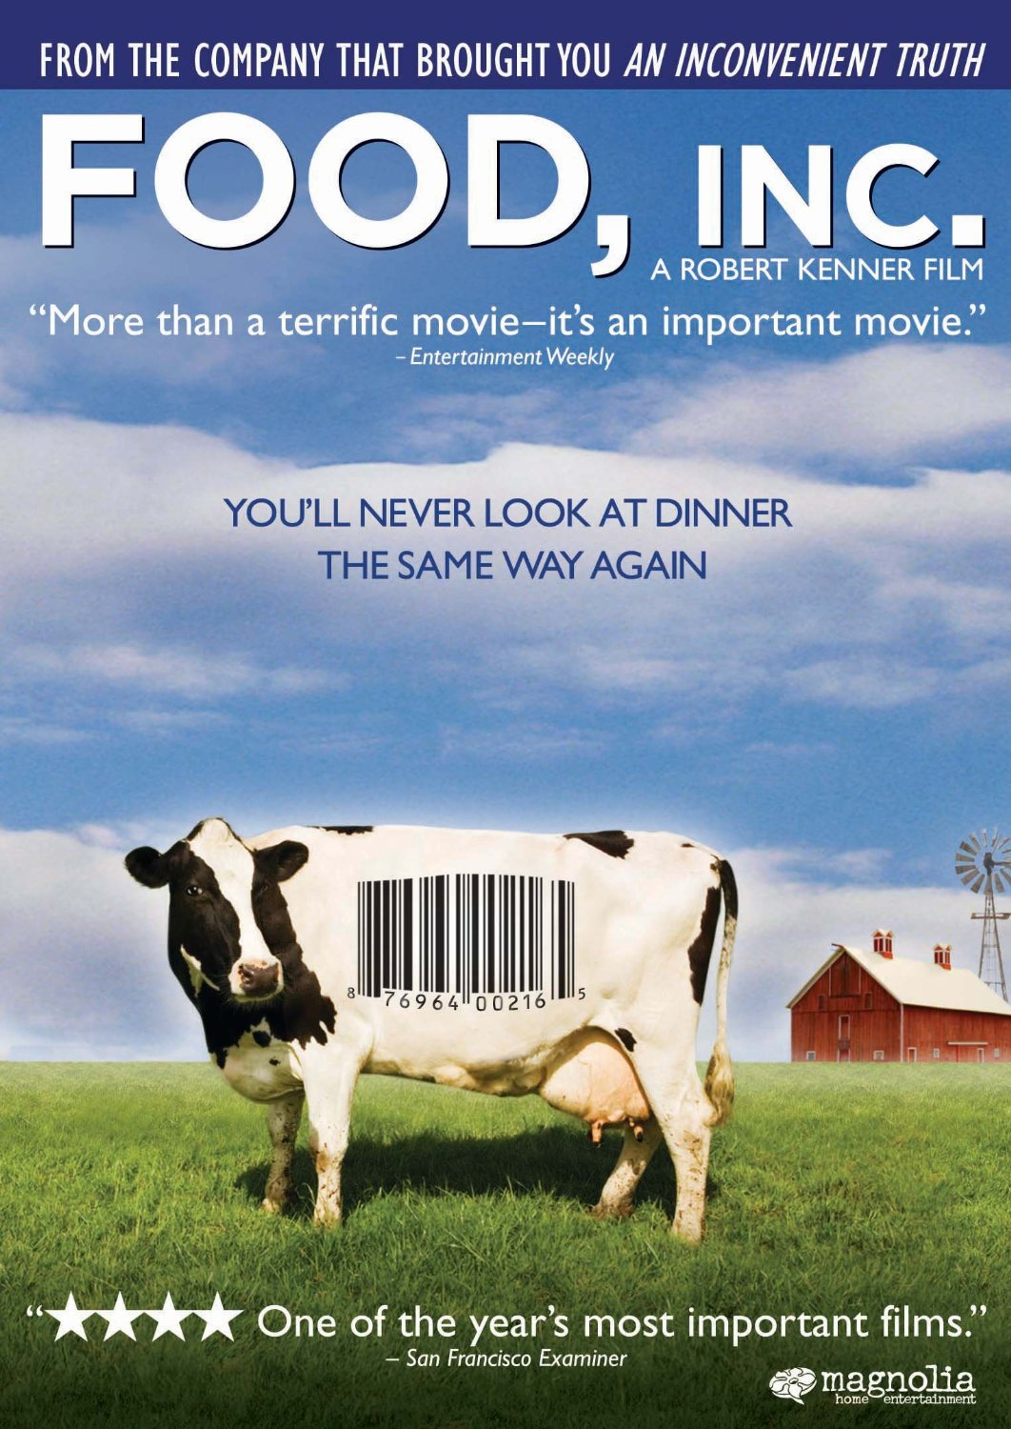
1/5 Food Inc.
Obj. TSW make connections between how food is produced and why Farm to Fork is so important. 86 NB
What impression was left on you by the movie Food Inc.?
What did you learn from Food Inc. that changes how you think about food?
If you got to meet Micheal Pollan in person, what would you like to ask him?

Slide 30
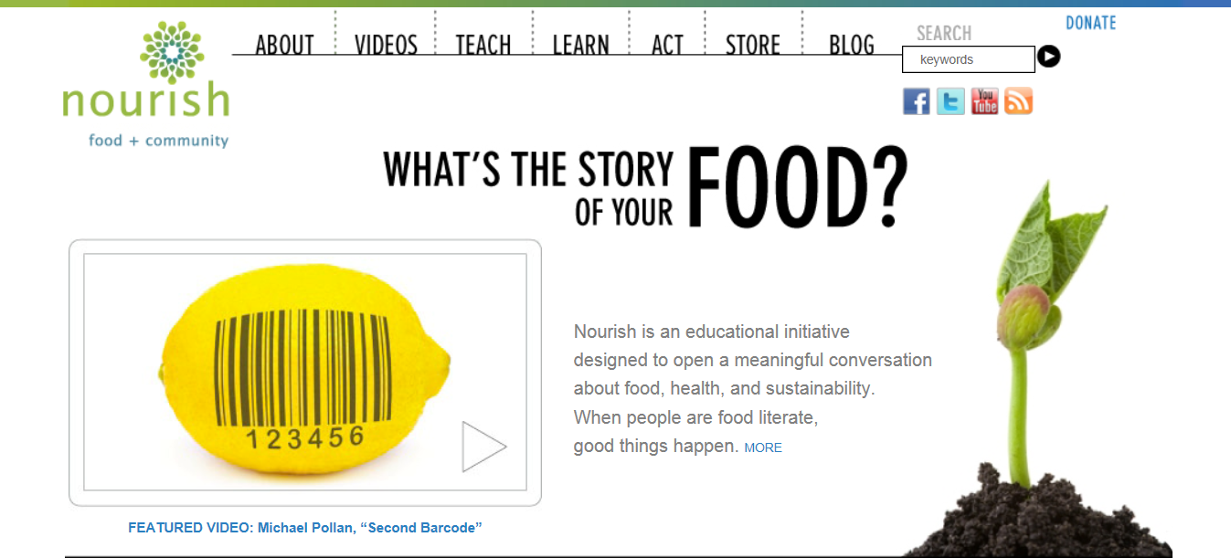
1/9 Nourish.org
Obj. TSW learn p. 88 NB
Name three things about the video that you learned.
How does Nourish relate to Food Inc. and to Farm to Fork?
How has Nourish changed your thinking about food? And what is healthy.

Slide 31


1/10 Understanding where our food comes from
Obj. TSW explain three aspects of how this class has impacted themselves, or the school or the community.
P. 90 NB
If someone were to ask you, “What was the Farm to Fork” class like? How would you describe what was taught in the class?

Slide 32
1/03 Aquaponics

Slide 33
Aquaponics Unit
Assigning Tasks – Nelson / Pade Mini Aquaponics System
Read through the directions as a team. Decide who will have what roles.
Write down questions (RFI – Request For Information) that you have or highlight parts of the directions you need clarification on. P. 79 NB
(1) Foreman: Read ALL directions and assigns tasks to construction crew and Gopher and makes sure ALL tasks are carried out appropriately.
(3) Construction: Responsible for cutting supplies to appropriate length and assembling the aquaponics unit.
(1) Gopher: person responsible for set up, clean up and getting the appropriate supplies.

Slide 34
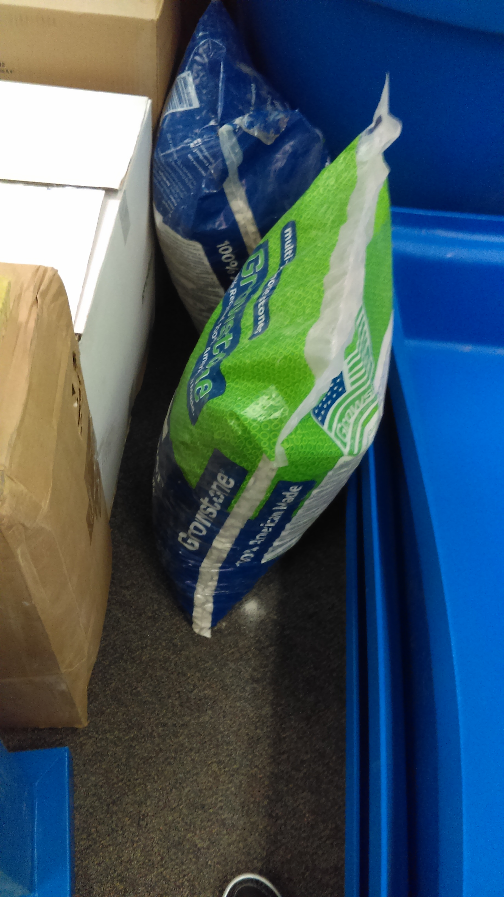
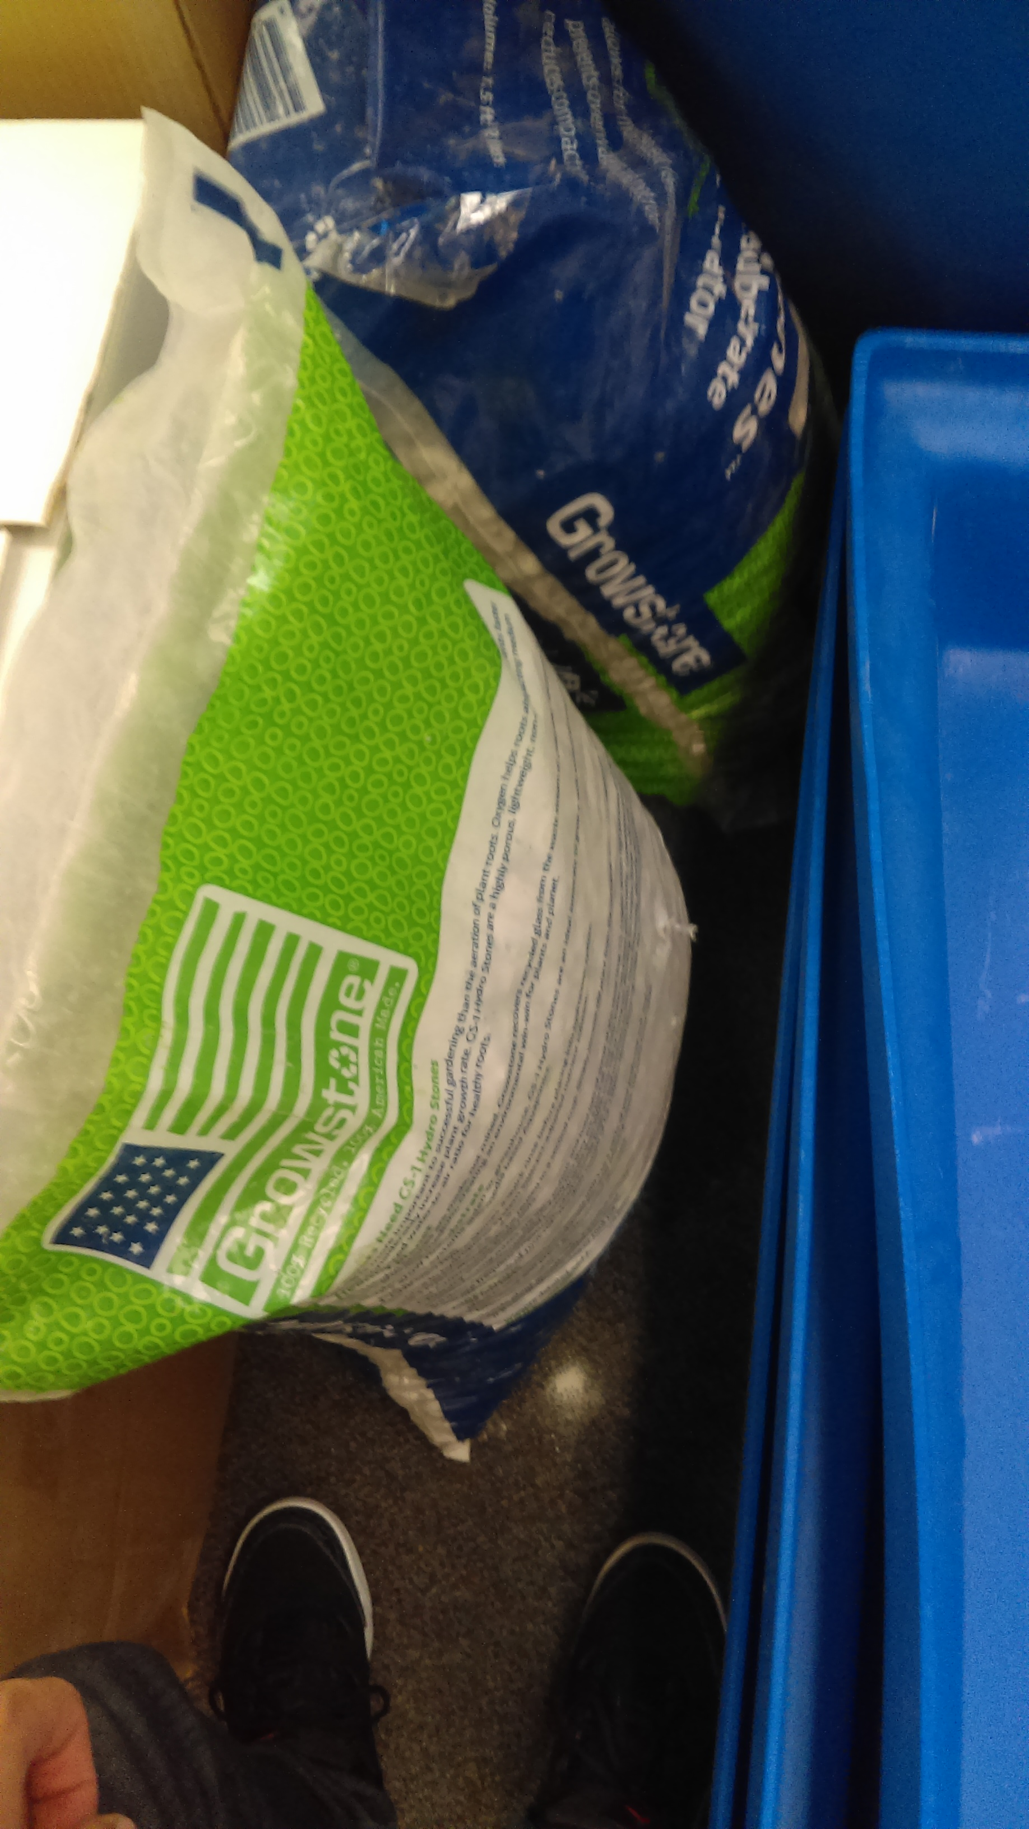
Grow stone – Plant medium for growing plants in an aquaponics system.
Promotes Nitrifying bacteria.

Slide 35
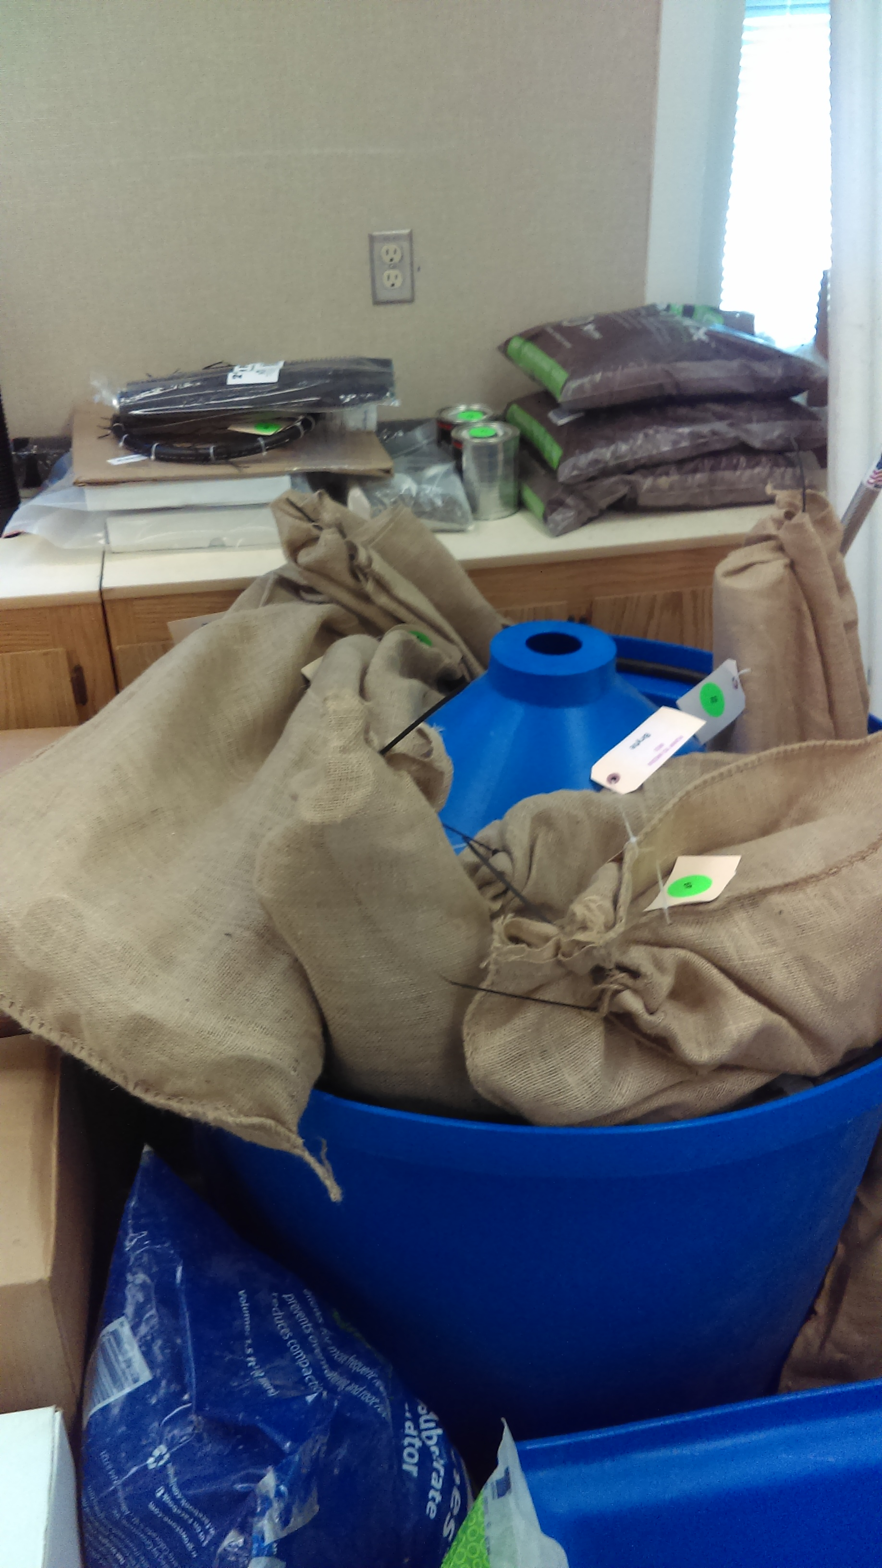
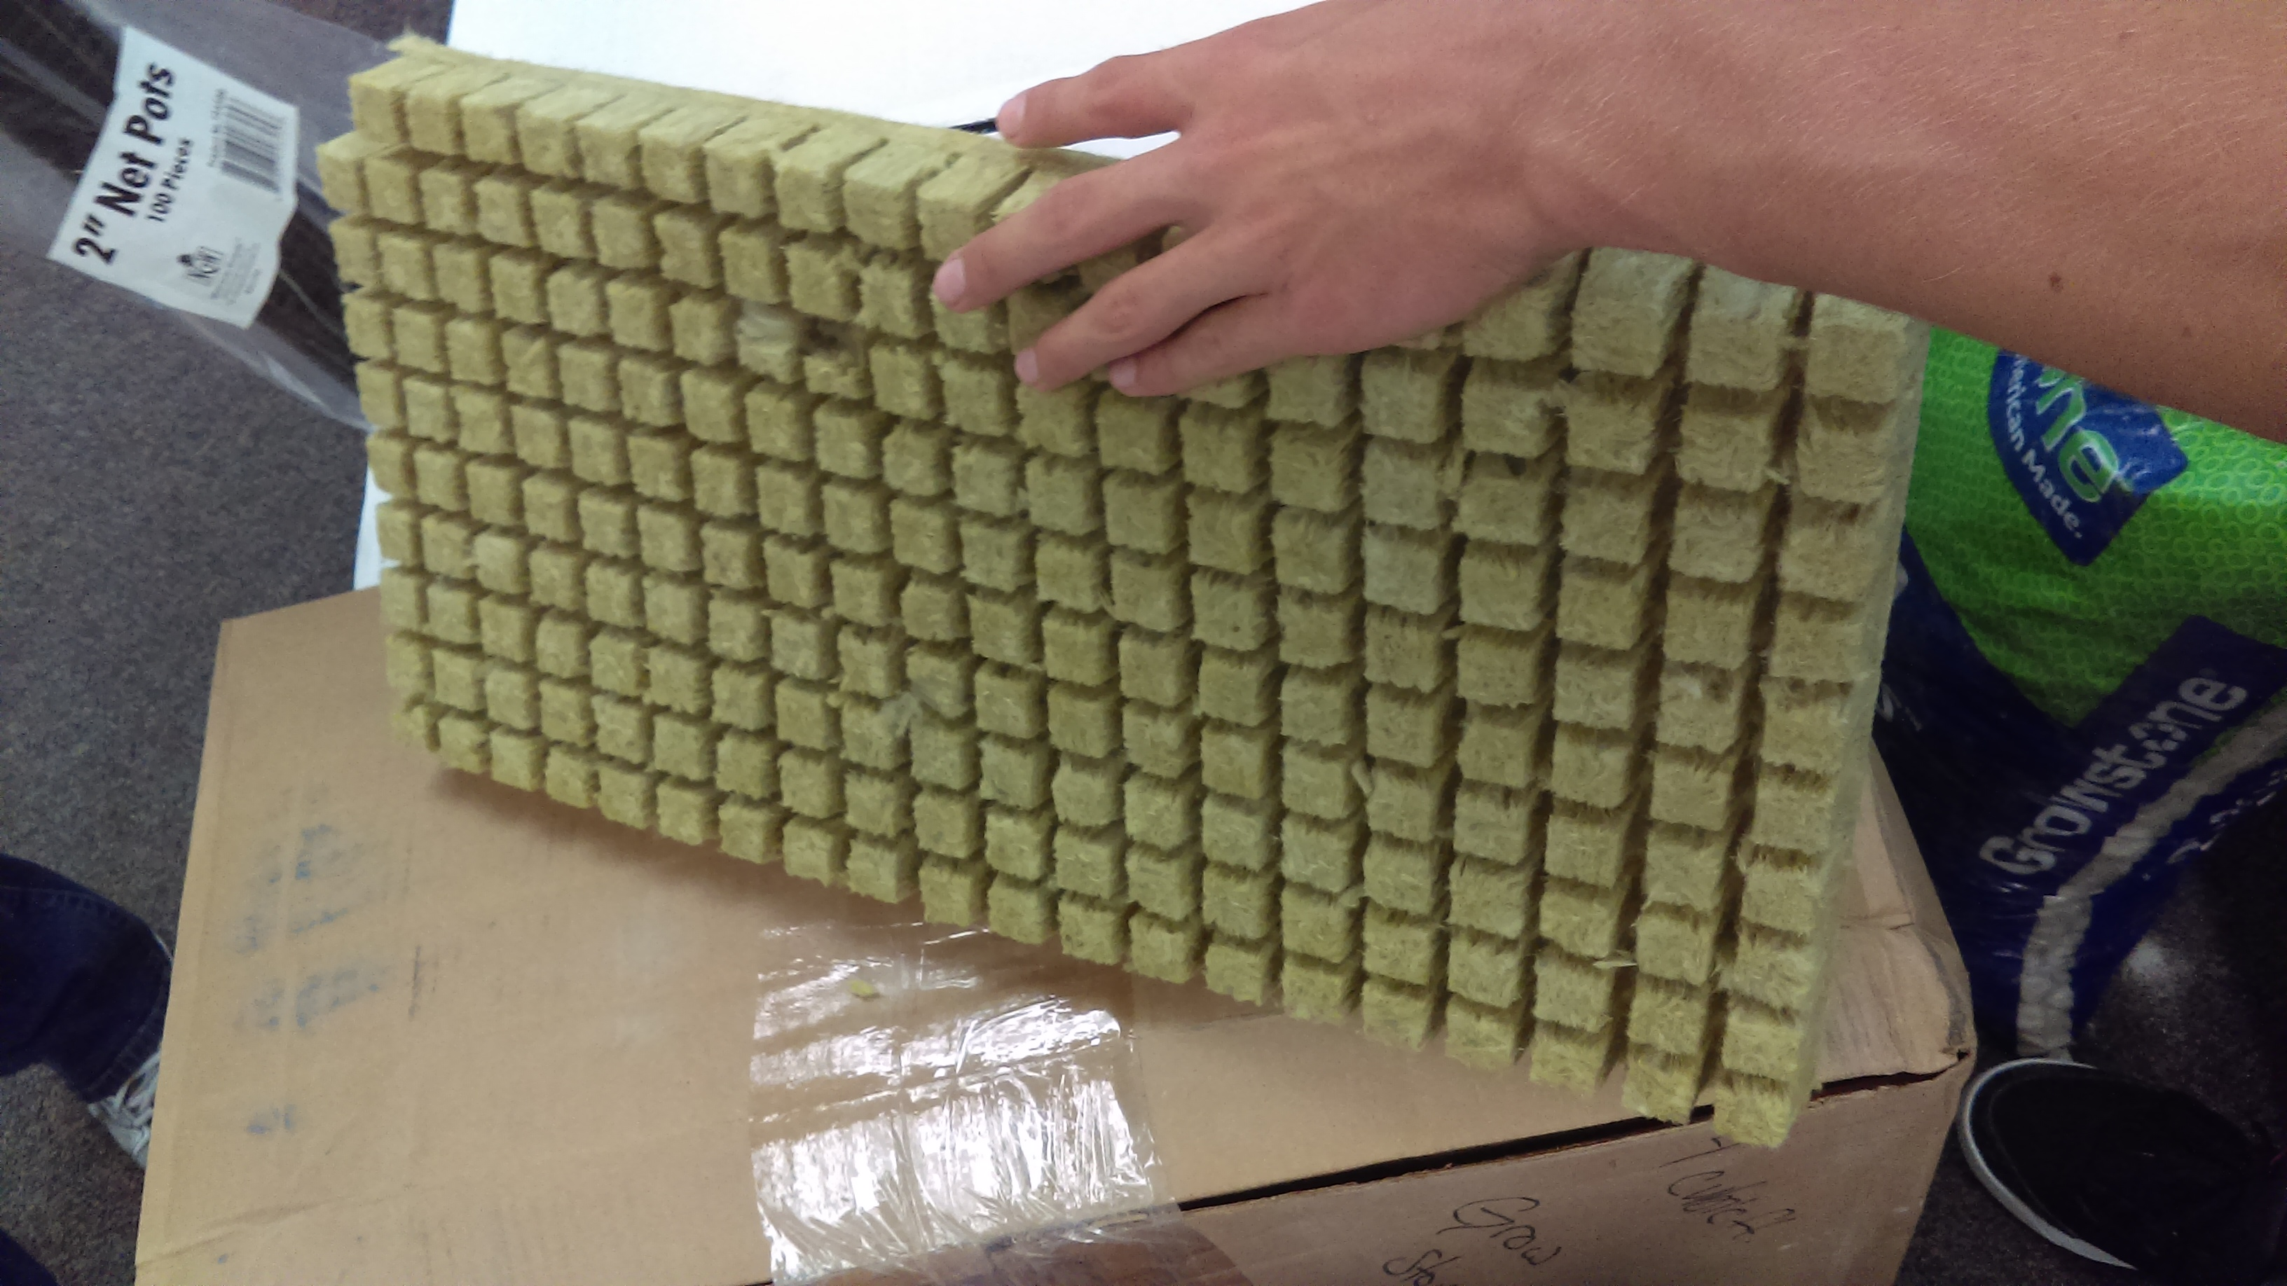
The tank and PVC in Burlap
& Rock Wool to start seeds.

Slide 36
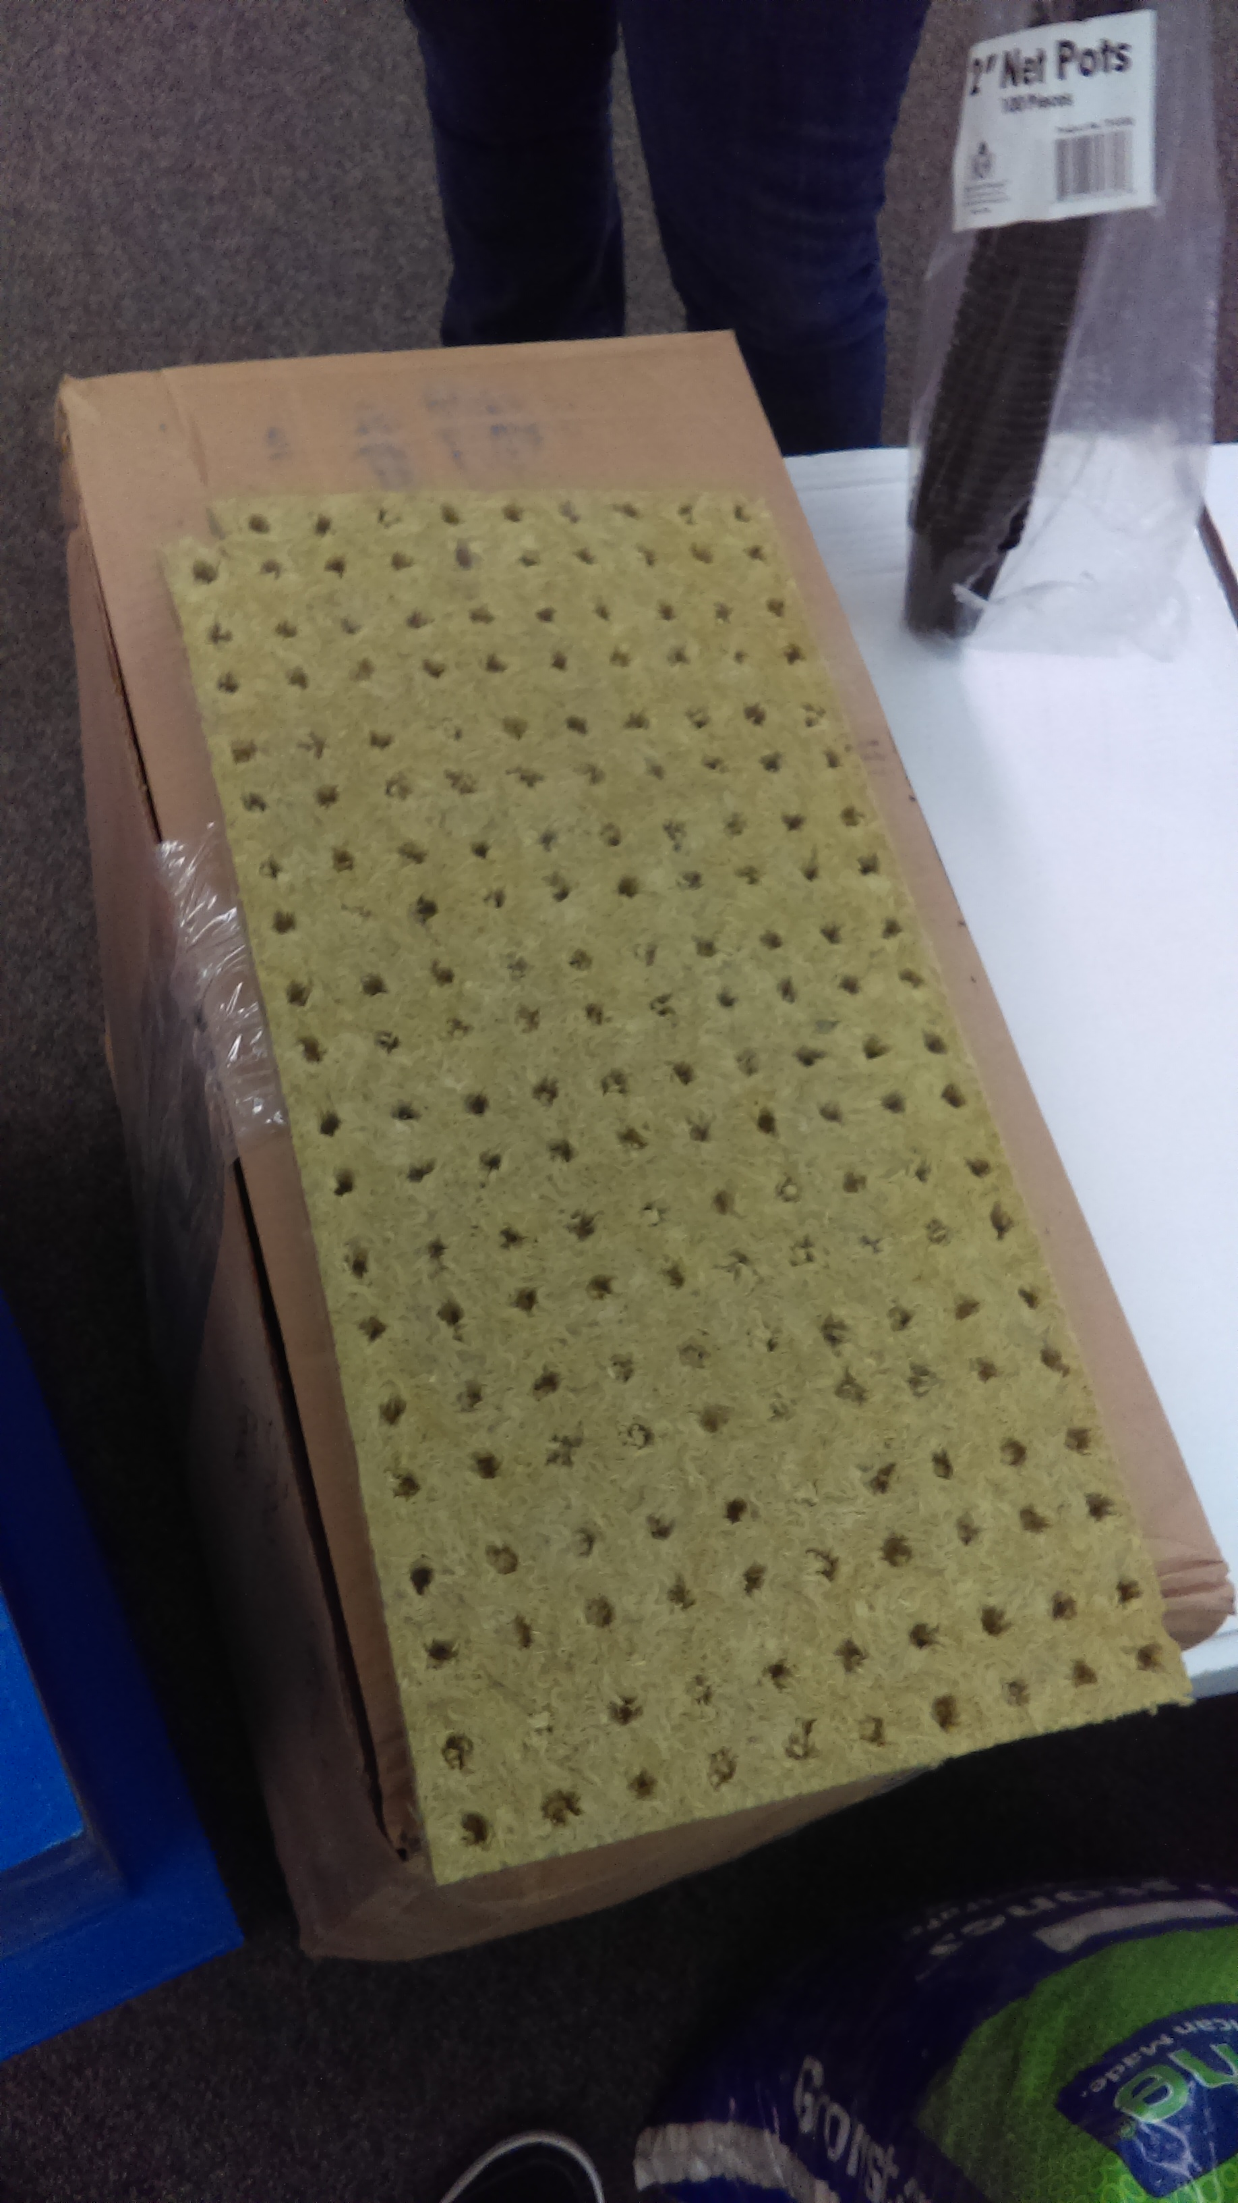
Rock Wool

Slide 37
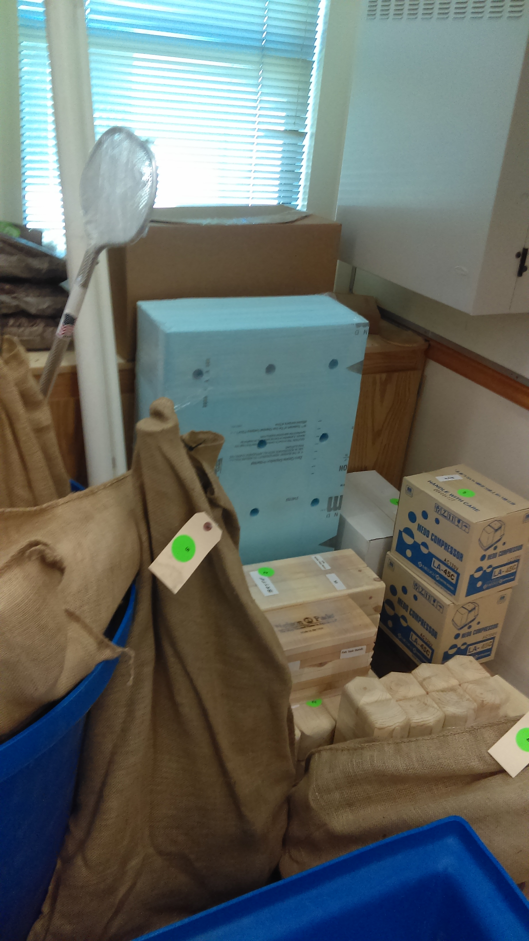
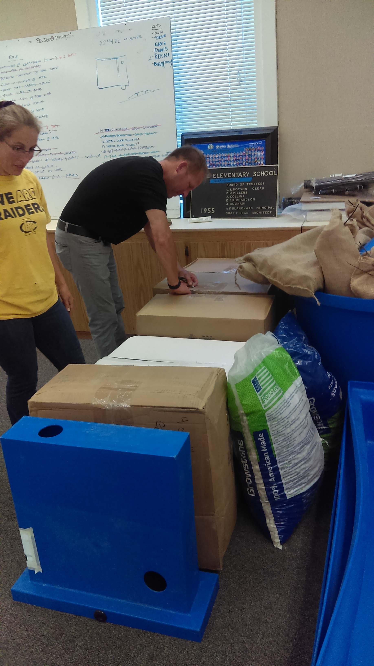
What? I get to assemble this? Yah!!!!

Slide 38
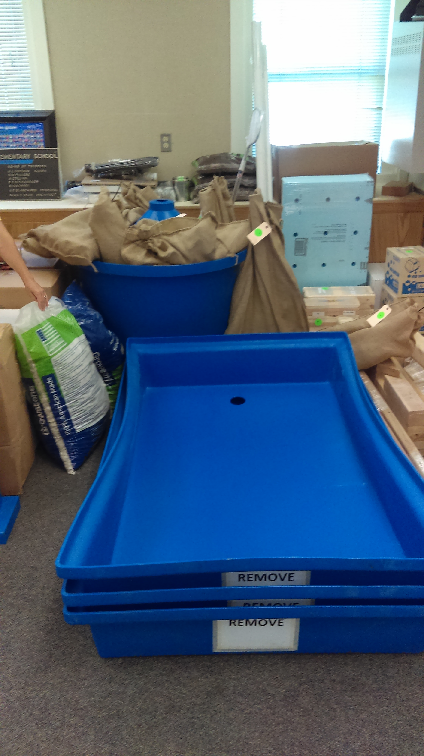
The plant beds where we grow food.

Slide 39
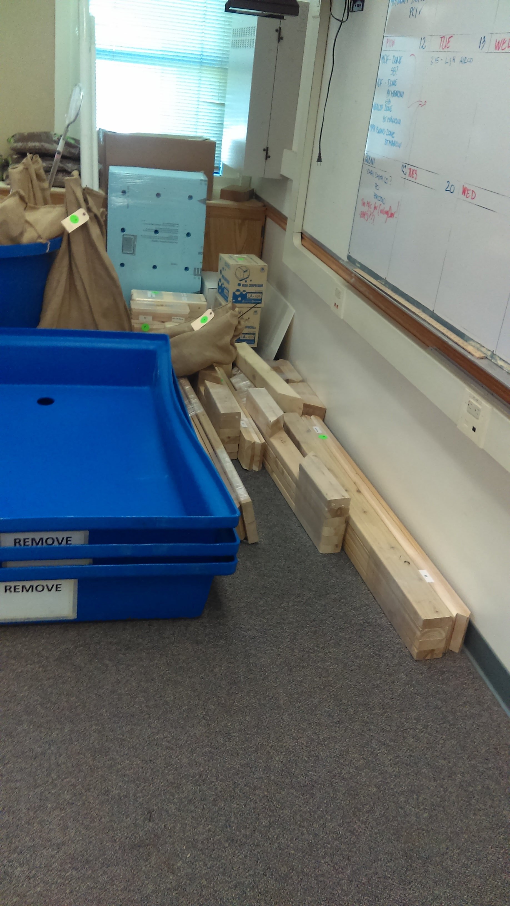
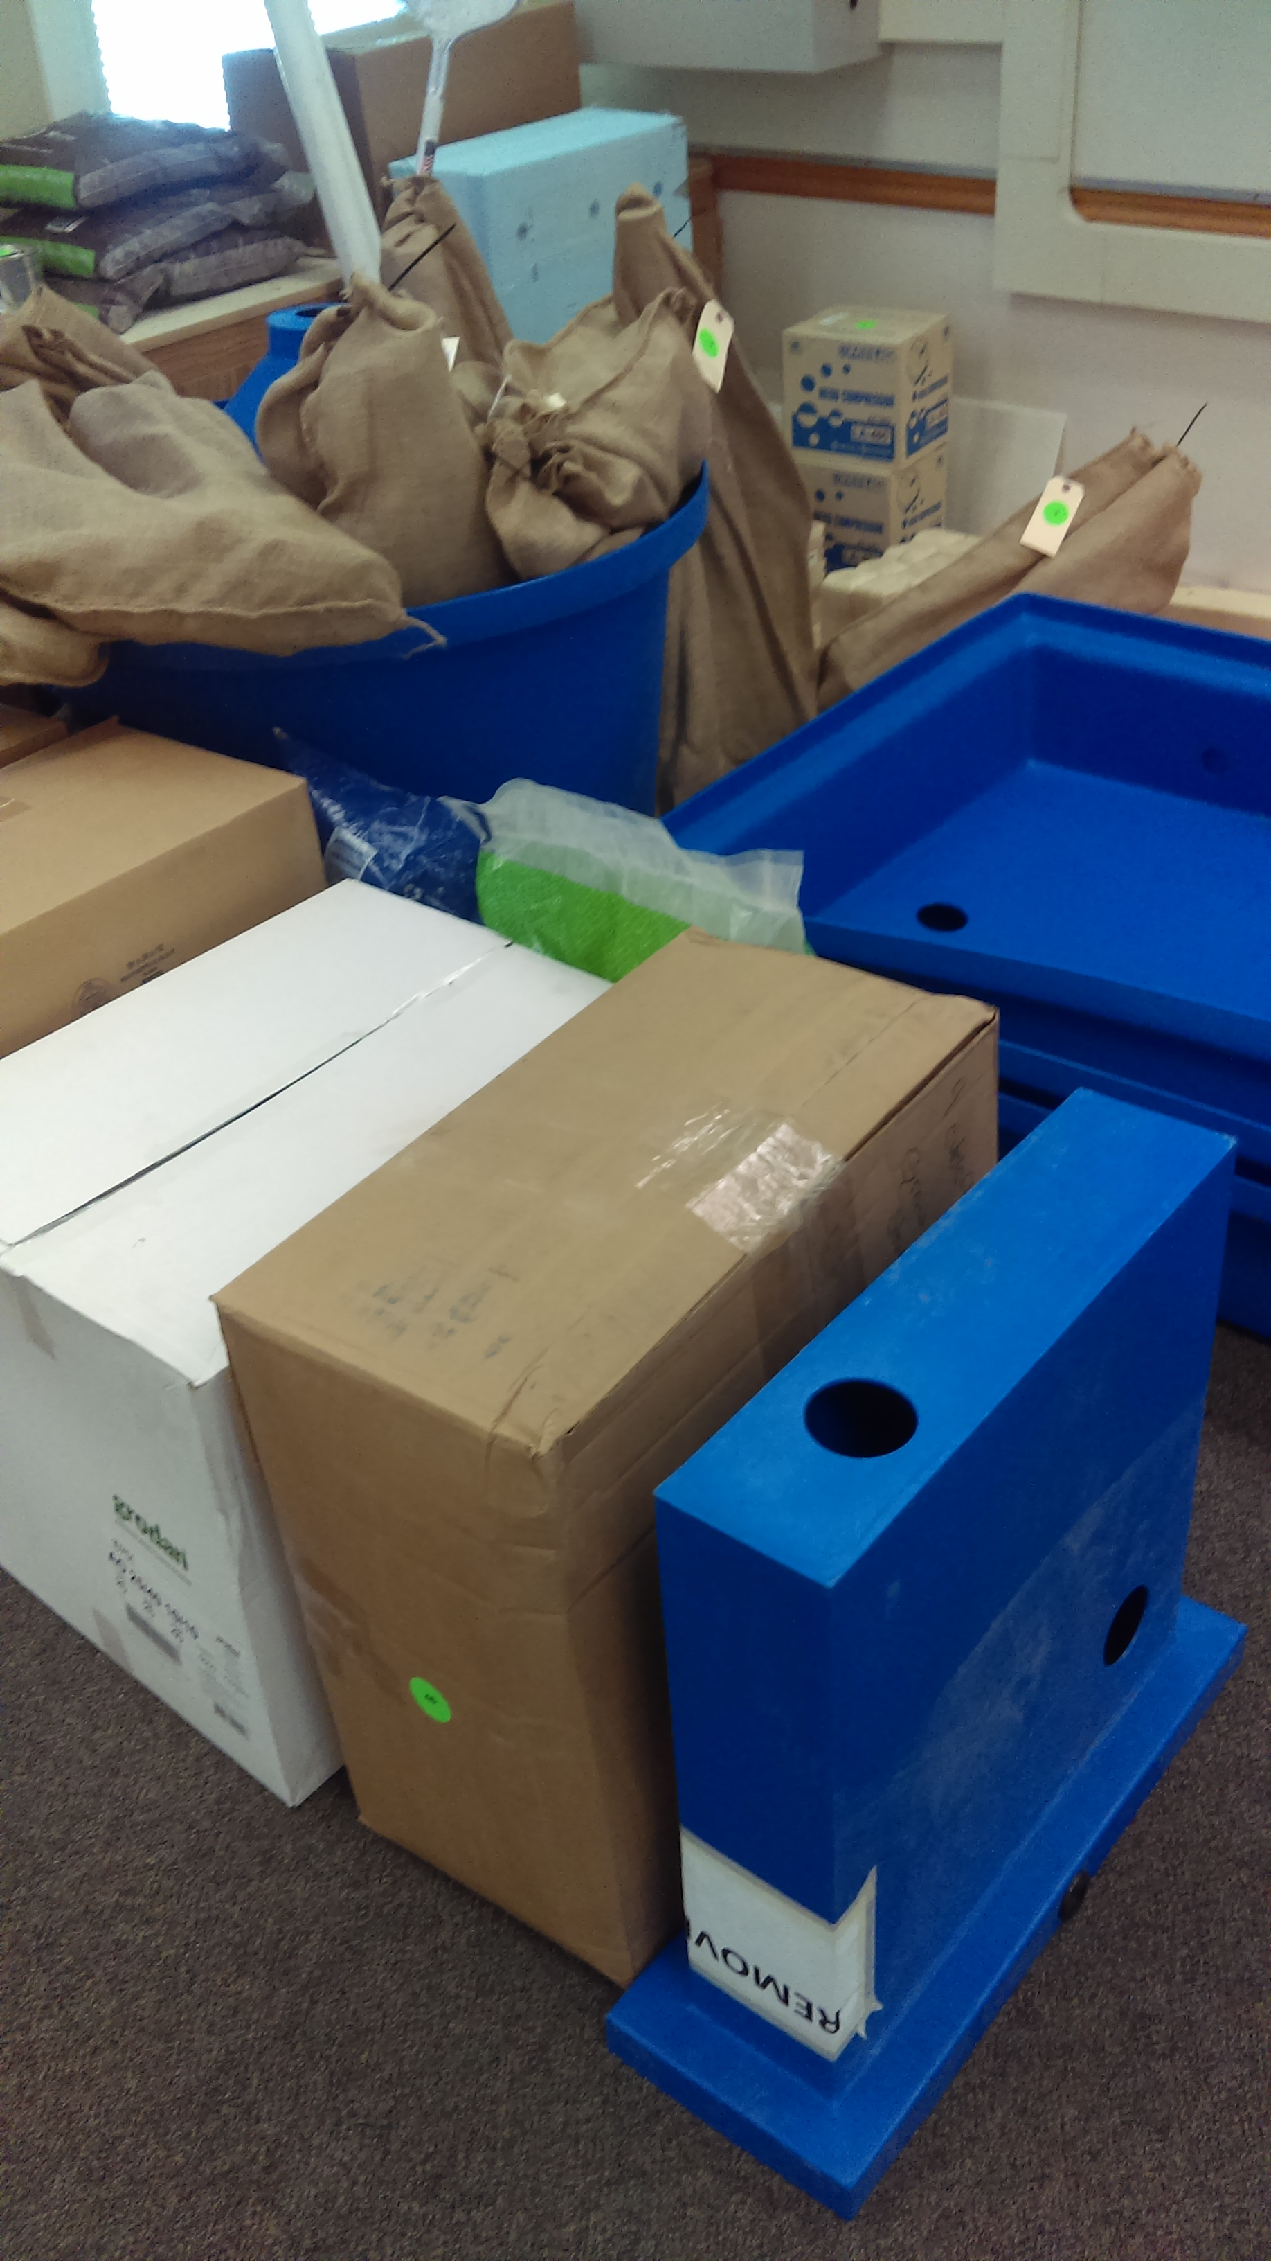
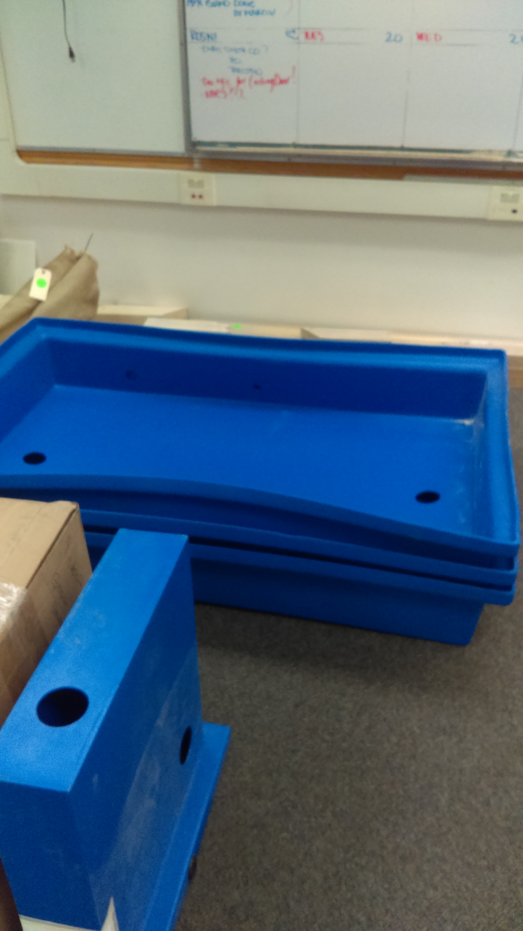
What? I have wood to assemble too?

Slide 40
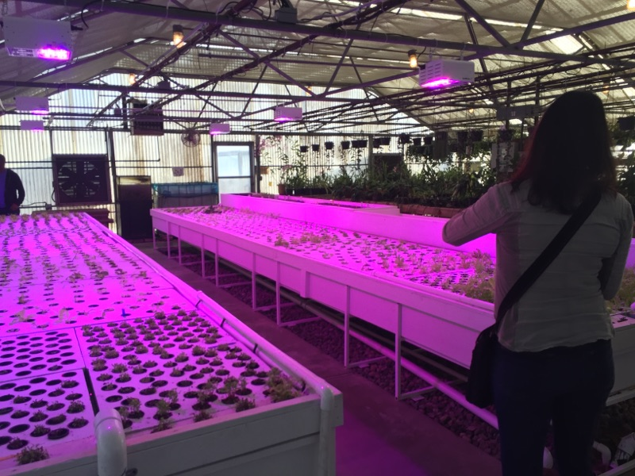
You can use different spectrums of light to stimulate different growth patterns.
Plants absorb Red and green wavelengths, and reflect green.

Slide 41
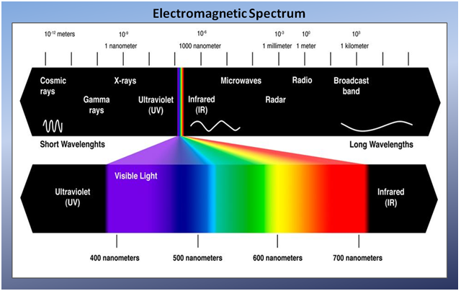

Slide 42
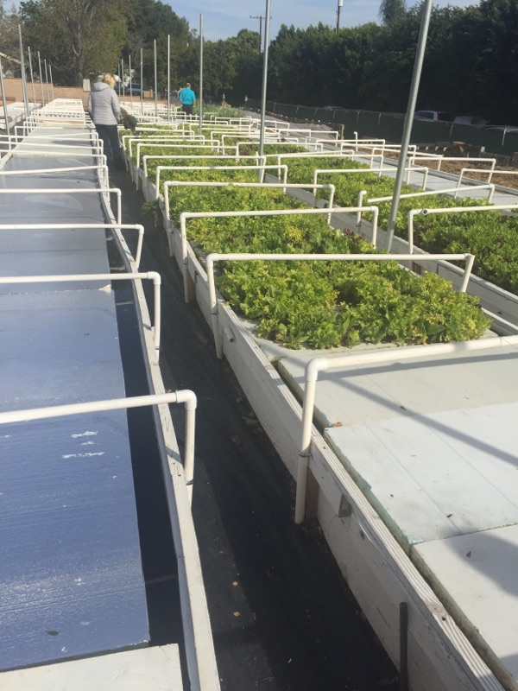

Slide 43
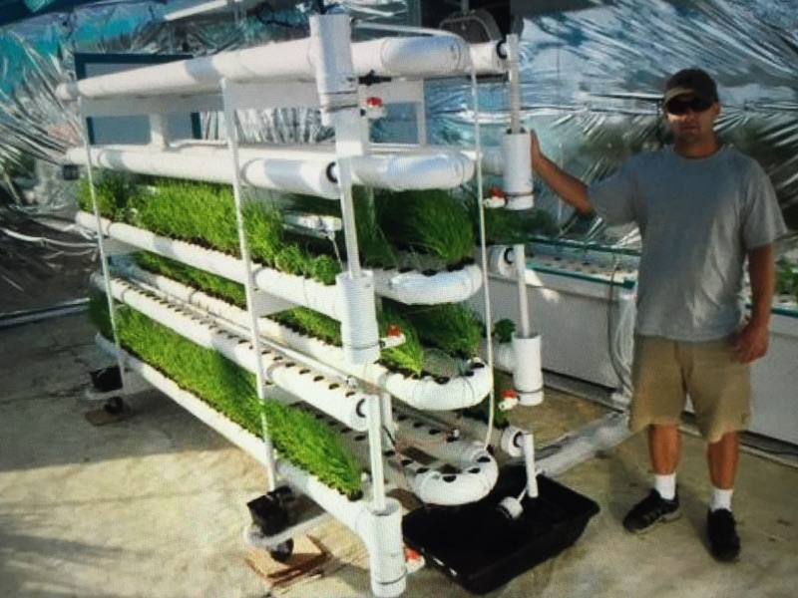

Slide 44
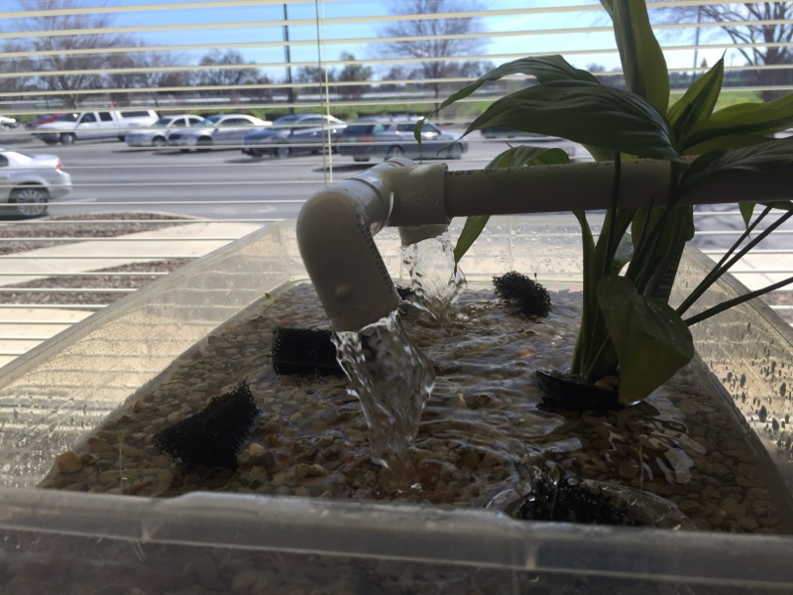

Slide 45
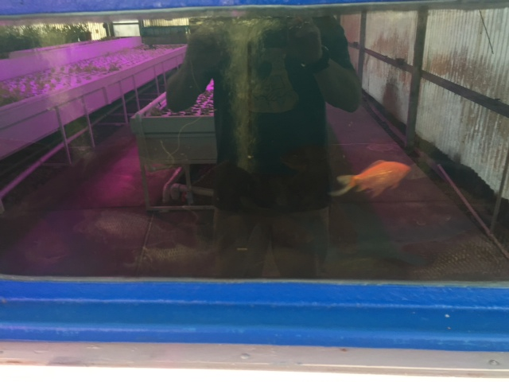

Slide 46
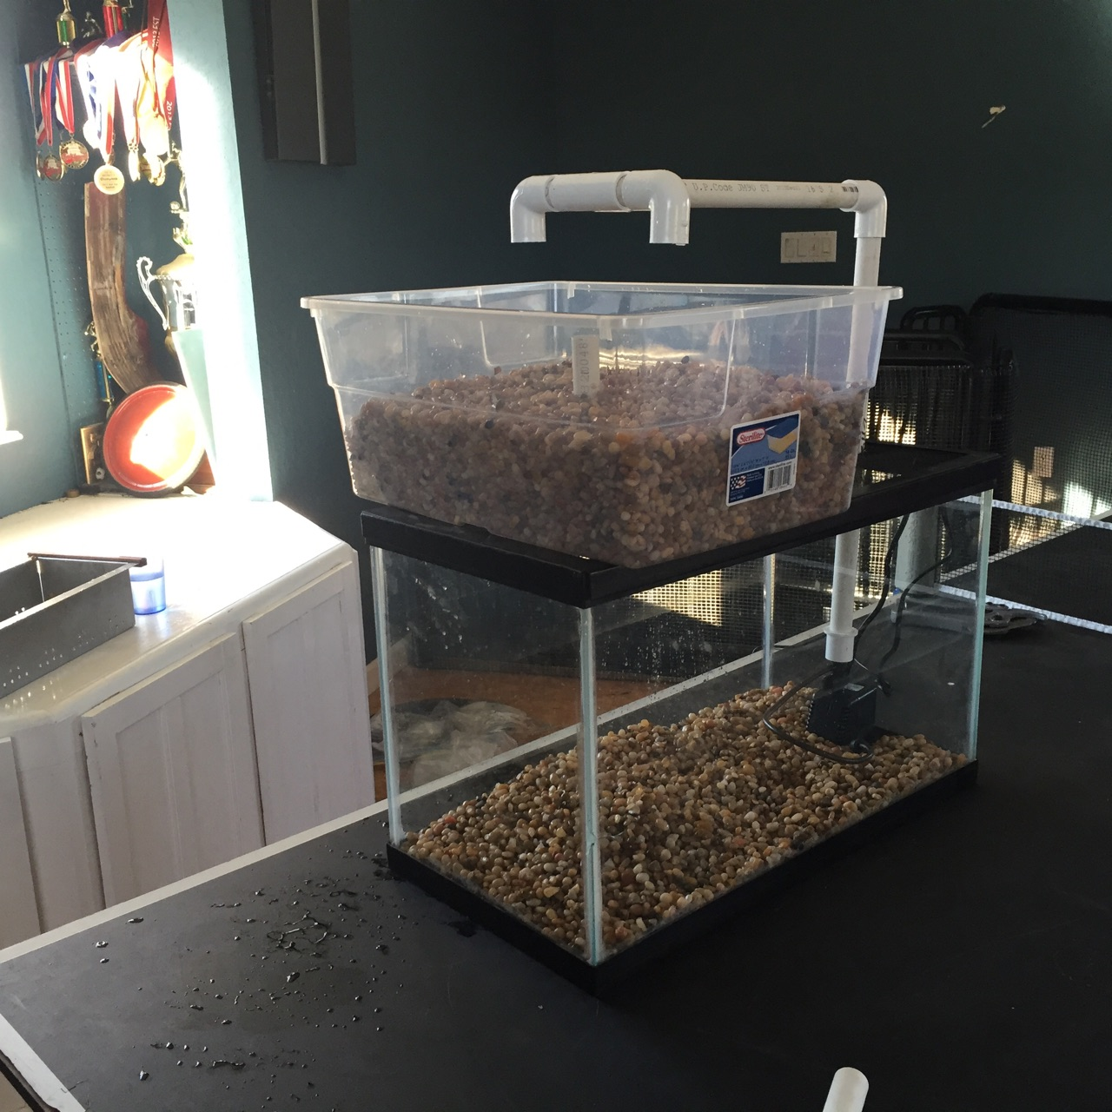
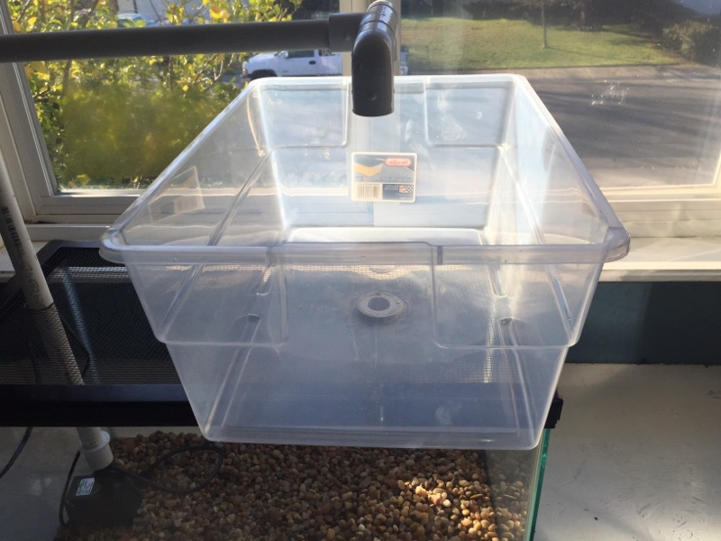

Slide 47
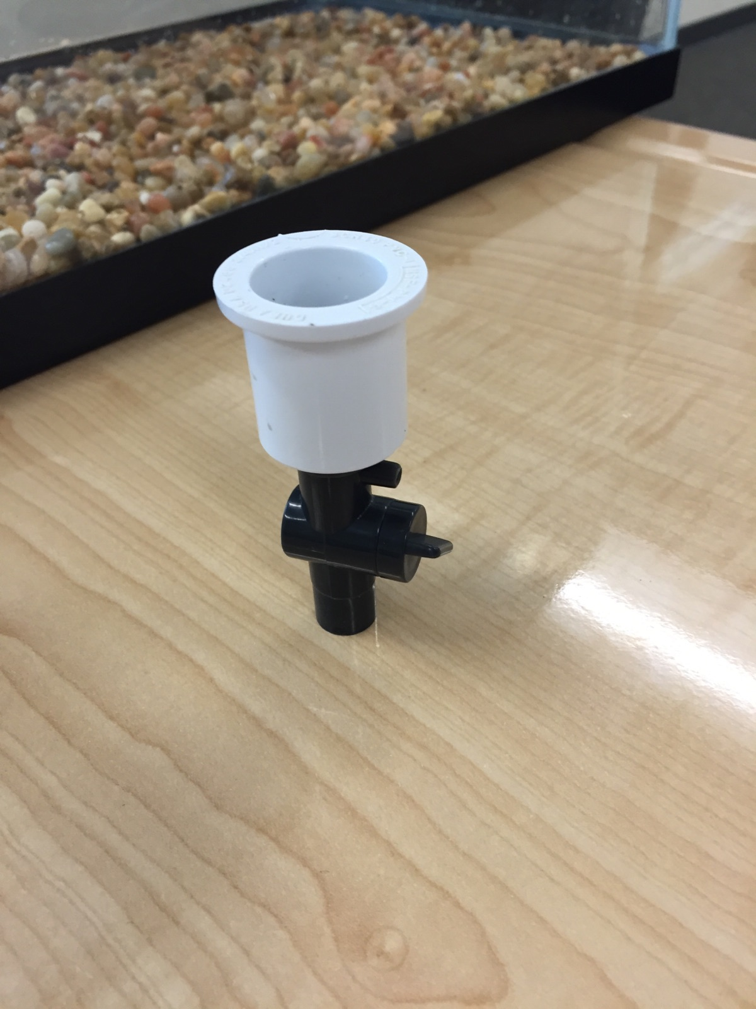

Slide 48
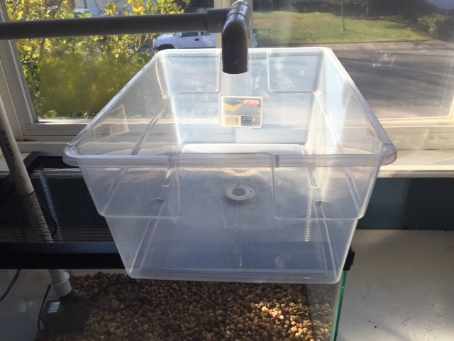

Slide 49
What do you want in your plant bed?
Foam board? Raft system.
Or Growing media?

Slide 50
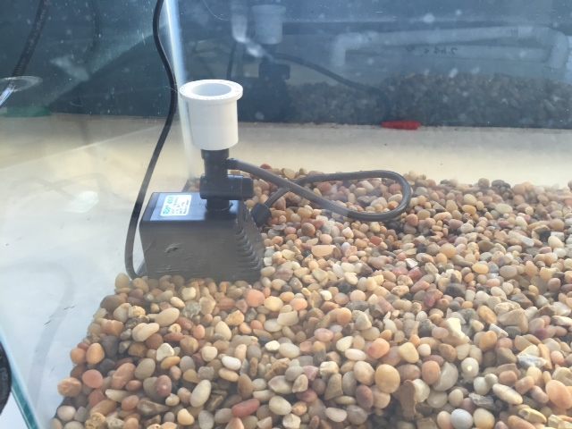
PVC attachment to pump

Slide 51
Aquaponics Article p. 81 NB
Do you think the general tone of the article is optimistic or pessimistic?
Why did Morgan travel to Haiti after the 2010 earthquake?
What is the main reason the Haitian people face food shortages?
Who is George Powell?
How do the teenagers at Stonewall Jackson help?

Slide 52
Final Project – Garden Plants
PART 2 DUE McAllister needs to review your progress of your project before May 27TH.
Introduction
Briefly review your project for us.
Data
Qualitative Data: Words, Descriptions, Pictures, Video
Quantitative Data: Tables, Charts, Graphs
Data Analysis
What does the data mean?
What were some things that you learned from mistakes you made?
What would you do differently next time?
Conclusion
Explain what your project meant to you and how the class Farm 2 Fork has helped you gain a better understanding of your project/ gardening caring for plants/& or soil . If you were in charge of feeding the world, or creating more sustainable practices worldwide how you would go about it?

Slide 53
Final Project - Aquaponics Unit
PART 2 DUE McAllister needs to review your progress of your project before May 27TH.
Introduction
Briefly review your project for us.
Materials: List them
Procedure: Step 1… Step 2… Explain how you put it together.
Data
Qualitative Data: Words, Descriptions, Pictures, Video
Quantitative Data: Tables, Charts, Graphs, Flow Rate
Data Analysis
What were some things that you learned from mistakes you made?
What would you do differently next time?
Conclusion
Explain what your project meant to you and how the class Farm 2 Fork has helped you gain a better understanding of your project/ gardening caring for plants/& or soil . If you were in charge of feeding the world, or creating more sustainable practices worldwide how you would go about it?

Slide 54
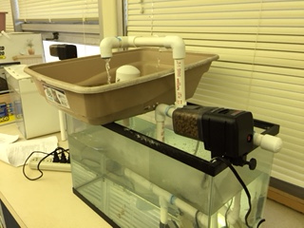
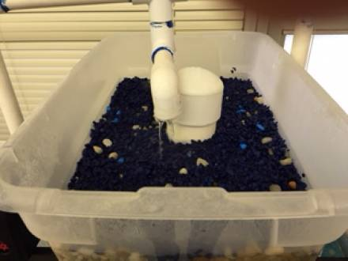
Lesson
Aquaponics
UNIT 1 F2F

Slide 55
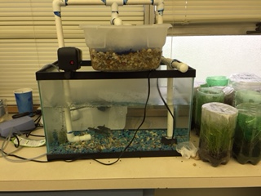
1/03 Aquaponics
Obj. TSW construct ideas about how the mini aquaponics unit will be assembled and how it works. P. 68 NB
How does an aquaponics system work?
Read through the assembly instruction: Which step are you unclear about?
What is the Nitrification cycle?

Slide 56
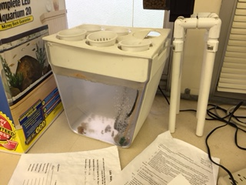
Prefabricated Mini Aquaponics Unit

Slide 57
Food Matters Notes Page 73NB

Slide 58
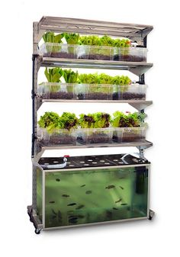
1/04 Mini Aquaponics Unit
Obj. TSW develop a plan to assemble an mini aquaponics unit. P. 70 NB
What are the benefits of an aquaponics system?
How does it “fit”, into our sustainable model?
What concerns do you have about assembling one?

Slide 59
Aquaponics Benefits
Efficient use of space
Reuse matter and Nutrients
Recycling Waste (nutrients)
Experience Symbiotic Relationships between organisms
Grow your own food

Slide 60
Aquaponics Unit
Assigning Tasks – Nelson / Pade Mini Aquaponics System
Read through the directions as a team. Decide who will have what roles.
Write down questions (RFI – Request For Information) that you have or highlight parts of the directions you need clarification on. P. 75 NB
(1) Foreman: Read ALL directions and assigns tasks to construction crew and Gopher and makes sure ALL tasks are carried out appropriately.
(3) Construction: Responsible for cutting supplies to appropriate length and assembling the aquaponics unit.
(1) Gopher: person responsible for set up, clean up and getting the appropriate supplies.

Slide 61
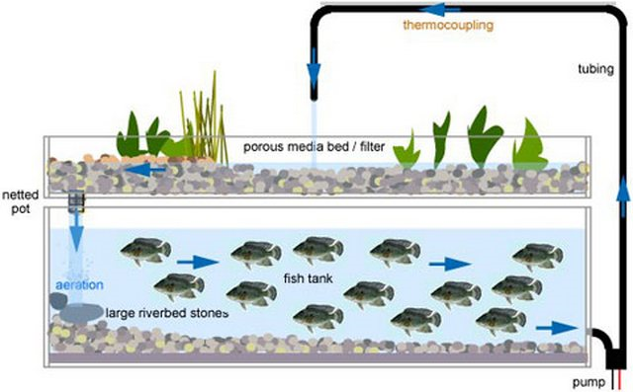
1/05 Getting started with the Mini Aquaponics Unit
Obj. TSW learn first hand skills assembling a mini aquaponics unit. P.72 NB
What was the construction of the mini aquaponics unit like yesterday?
Draw a sketch of what your mini aquaponics unit will look like.
What safety measures were taken to make sure McAllister did not lose her mind or have heart complications?

Slide 62
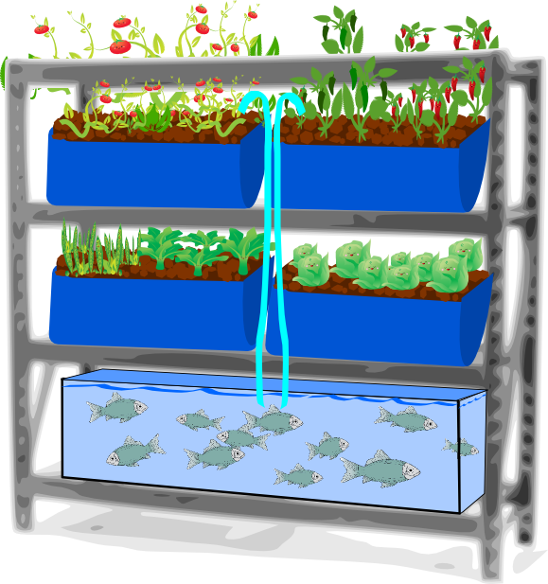
1/09 Mini Aquaponics Reflection
Obj. TSW reflect on their experience building and assembling the aquaponics unit. P. 74 NB
How can Aquaponics benefit people throughout the world?
What would you do differently with you mini aquaponics unit?
What was one of your successes?

Slide 63
Aquaponics Article p. 77 NB
Do you think the general tone of the article is optimistic or pessimistic?
Why did Morgan travel to Haiti after the 2010 earthquake?
What is the main reason the Haitian people face food shortages?
Who is George Powell?
How do the teenagers at Stonewall Jackson help?

Slide 64
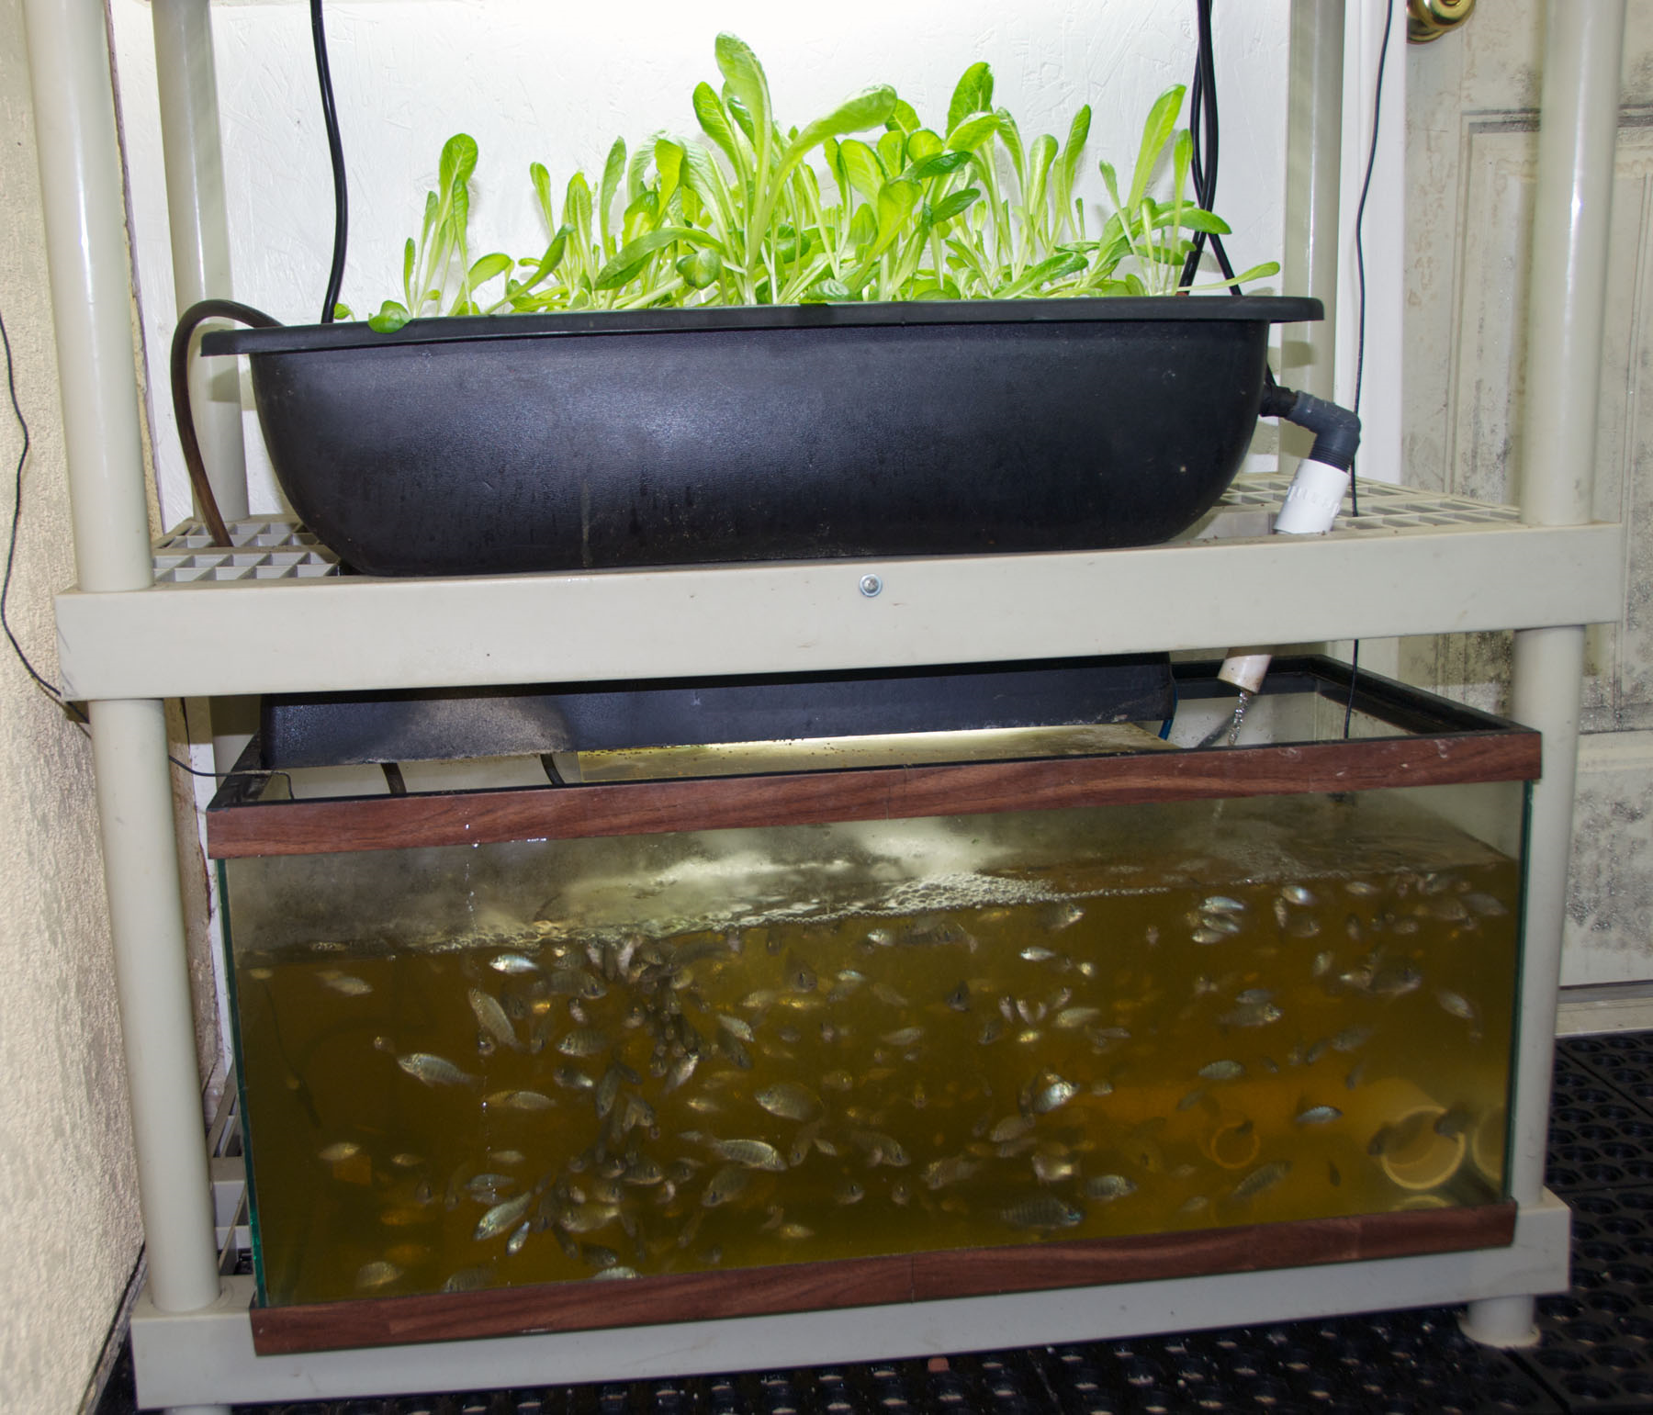
1/10 Aquaponics
Obj. TSW realize one of the solutions to feeding the world is aquaponics. P. 76 NB
What is aquaponics?
What skills might you need to build an aquaponics unit.
Describe some characteristics (steps) of building an aquaponics unit.

Slide 65
Final Project – Garden Plants
PART 2 DUE McAllister needs to review your progress of your project before May 27TH.
Introduction
Briefly review your project for us.
Data
Qualitative Data: Words, Descriptions, Pictures, Video
Quantitative Data: Tables, Charts, Graphs
Data Analysis
What does the data mean?
What were some things that you learned from mistakes you made?
What would you do differently next time?
Conclusion
Explain what your project meant to you and how the class Farm 2 Fork has helped you gain a better understanding of your project/ gardening caring for plants/& or soil . If you were in charge of feeding the world, or creating more sustainable practices worldwide how you would go about it?

Slide 66
Final Project - Aquaponics Unit
PART 2 DUE McAllister needs to review your progress of your project before May 27TH.
Introduction
Briefly review your project for us.
Materials: List them
Procedure: Step 1… Step 2… Explain how you put it together.
Data
Qualitative Data: Words, Descriptions, Pictures, Video
Quantitative Data: Tables, Charts, Graphs, Flow Rate
Data Analysis
What were some things that you learned from mistakes you made?
What would you do differently next time?
Conclusion
Explain what your project meant to you and how the class Farm 2 Fork has helped you gain a better understanding of your project/ gardening caring for plants/& or soil . If you were in charge of feeding the world, or creating more sustainable practices worldwide how you would go about it?

Slide 67
If you can’t get enough…
There are yet more FFA opportunities.
  Friday Jan. 6th & 27th all day in F commons to Recruit 10th graders into Ag Sci. Academy
  Friday Jan. 20th Yolo Sectional Public Speaking Contest at Woodland Community College
  8th Grade Parent Night Feb. 1st & 2nd RCHS Café. At 6 pm
  Riverbank 8th Grade tour/Visit Feb/ March
  Science is Awesome Night Feb. 21st RCHS Quad 5 – 8 pm
  End of Year Award Ceremony May 3rd RCHS Cafe
  June 3rd & 4th Join the Relay for Life Team to fight Cancer
    A member(s) of our RCHS Ag team will be walking the track continuously for 24 hours to raise awareness of cancer, education, prevention, treatment and in memory of those who have lost their battle.

Slide 68
1 – 2 page paper Due May 12th
Where does your food come from?
Where does your food come from?
  Discuss where your family buys food. Discuss what Farm to Fork is and it’s benefits.
Why is it important to know where your food comes from?
  Include examples, explanations, and show the significance of where our food comes from.
    Maybe include ingredients such as High Fructose Corn Syrup, salt, fat, sugar in our diet.
    Discuss the video: Fed Up.
    Include notes from Kari Pina’s Guest presentation about how she sources healthy fresh food for 7700 students.
  Include the difference between processed and natural foods. Why is that important?
  Include companies, businesses that are part of the solution to eat healthier, and companies that could improve to become part of the solution. How are companies trying to change their image?
APA Style: purdue.owl.edu

