Slide 1
Global Food
Economic of Food
Farm to Fork 1
November 30 – December 17th

Slide 2
Happy Thanksgiving
How was your Thanksgiving?
What do you have to be thankful for?
Success does not just happen. Successful people have the ability to reflect on events. They also acknowledge what they are grateful for.

Slide 3
Agenda Week 15 Nov. 30th – Dec. 4th In the Garden…
Walk around the tennis courts to get to Greenhouse
Transplant Mr. Duff’s plant
Move rocks into the greenhouse
Turn Compost
Plant Sweet potatoes?
Clean Greenhouse
Sweep Sidewalk
Organize & Sweep Shed
Pull Weeds
Water
Fertilize
Transplant Roses
Install Foot Brush/ Cleaner
Plant Carrots – again?
Place Mat & Boot Brush at entrance

Slide 4
Upcoming Events
Friday December 4th 3:30, Quad side – Clare Wiley’s – Wiley Hall Building Naming Ceremony
Then walk out to the Garden and Plant seeds in garden bed.
Saturday December 5th 10 am – 2 pm Help with Festival @ RCHS
Thursday December 10th 7 pm F2F Presentation to the WUSD School Board at City Hall on West Capital.

Slide 5
This Week…
Monday – Garden – Check list for work to do.
Tuesday – Classroom (Warm Up, Video, Discussion) Minimum Day
Wednesday - Computer Lab Room 801
Thursday - Computer Lab ??? Or Garden
Friday – Garden – Clean for the Event

Slide 6
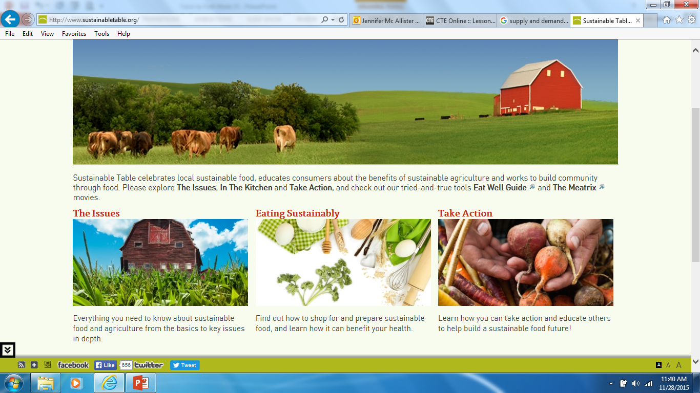
11/30 Eating Foods in Season Obj. TSW learn about the seasonality of food. P. 54 NB
http://www.sustainabletable.org/seasonalfoodguide/
What are five fresh food choices you love to eat?
What months are they in season?
In a typical grocery store, are those same foods available all year round? Why?

Slide 7
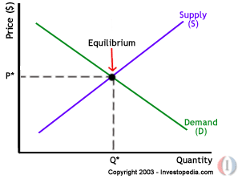
Supply & Demand Copy this Graph on P. 55 NB

Slide 8
How does an increase in supply impact the price of the product?

Slide 9
12/1 The Future of Farming Obj. TSW learn about Sustainable Agriculture on the East coast. P. 56
Describe farming in California.
Name 5 products we grow.
How might farming in California change in the next twenty years?
2012 Census of Agriculture

Slide 10
Out to Pasture –The Future of Farming
P. 57 NB Answers to Video: “Out to Pasture”
P. 55NB – Vocabulary List UNIT 4 Global Food
Economic of Food

Slide 11
Computer Lab Activity P. 59 NB
Research current videos about sustainable agriculture in the West, preferably California.
Take 5 Notes on West Coast Sustainable Agriculture.
Write a summary paragraph about the concepts from the video.
The best video will be viewed in class. ☺

Slide 12
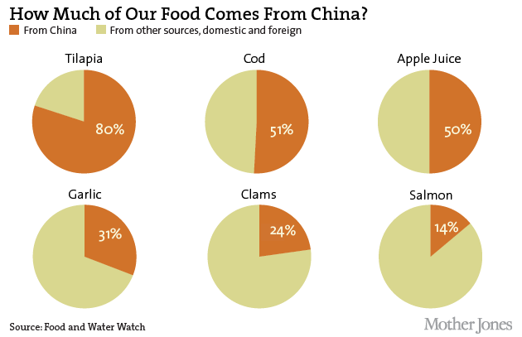
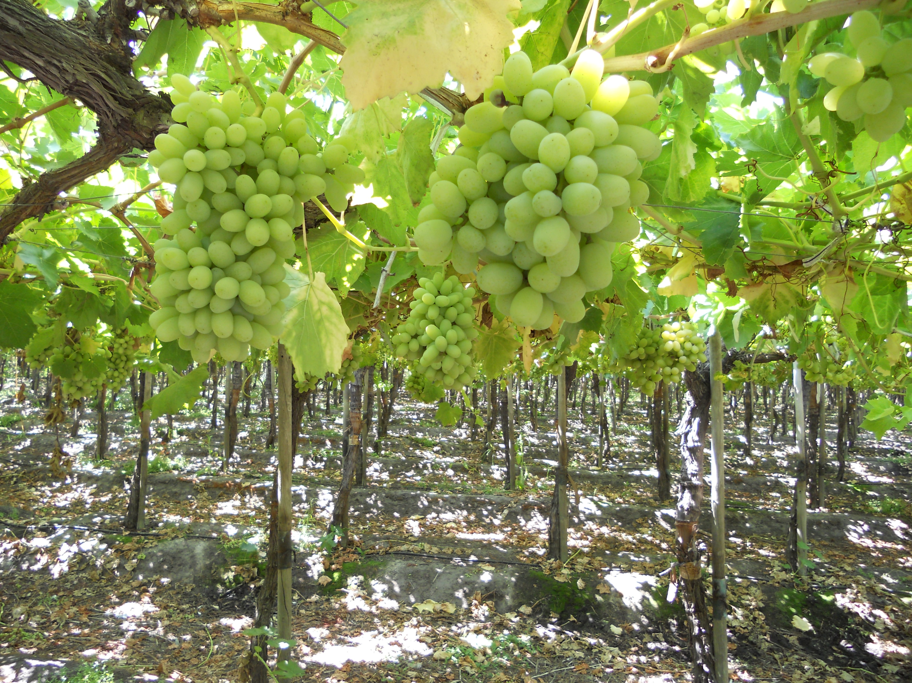
12/2 Economics of Food Obj. TSW understand why and how food is imported. P. 58 NB
Imported food
Name an imported food.
Where is it imported from?
How do agricultural imports impact our Biocapacity as a country?

Slide 13
Computer Lab Activity A grape from Chile p. 61NB
Where in Chile is the Grape grown?
How is it transported from the field? Where does it go?
How does the grape get through customs?
How is it stored along the way?
How long does it take from the time it is picked to the time it can arrive on your table?
How do agricultural imports impact our Biocapacity as a country?

Slide 14
12/3 How much would you pay? Obj. TSW apply the basics of supply and demand at a local grocery store. P. 60 NB
As a Class choose 5 total food/ drink items.
Come to a consensus as to the predicted cost and maximum price you would be willing to pay for each.
Do you always buy the cheapest product? Why?

Slide 15
Answer the following questions…p. 63NB
Was the product you wanted the cheapest? If it was not, how much more expensive was it? Were you surprised by this?
Was there any product that was more money than you originally said you would not spend on it?
Using your individual bottle of water as an example, if you were to buy a case of water containing a 24 pack for $4.99, how much money would you save?
Why does it pay to buy in bulk? Is there a downside?
How does this relate to Supply and Demand?

Slide 16
12/4 Omnivore’s Dilemma Obj. TSW learn about the four different types of how food can be grown. P. 62 NB
Reading Omnivores Dilemma, why does Micheal Pollan by a steer in Chapter 5?
In CH 7, Fat from Corn, discusses the “Supersize”, Why is this an issue?
Processed foods and cheap fat. “As creatures who can eat many different things, how do we know what is good to eat and what is not?” p. 84 Pollan

