Slide 1
UNIT 2 Structures and Practices for Sustainability
Greenhouses & Gardening Structures, Kitchen Gardening, Food Preservation Curing and Canning, Hormones and Propagation
Week 7 September 26th – 30th

Slide 2
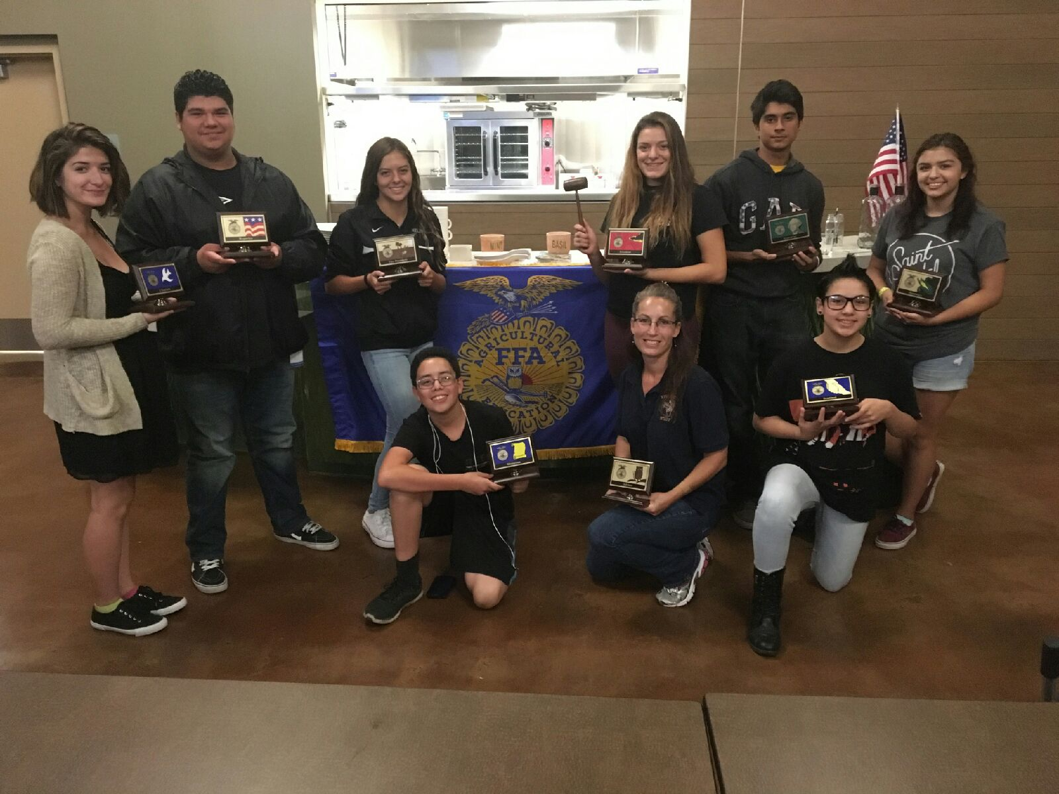
2016 West Sacramento FFA Chapter Officers
President:
Vice President:
Secretary:
Treasurer:
Reporter
Sentinel:
Historian:
Chaplain:
Parliamentarian:

Slide 3
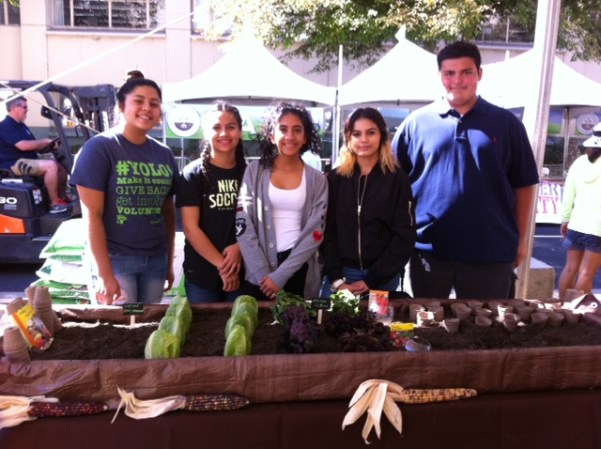
FARM to FORK FESTIVAL

Slide 4
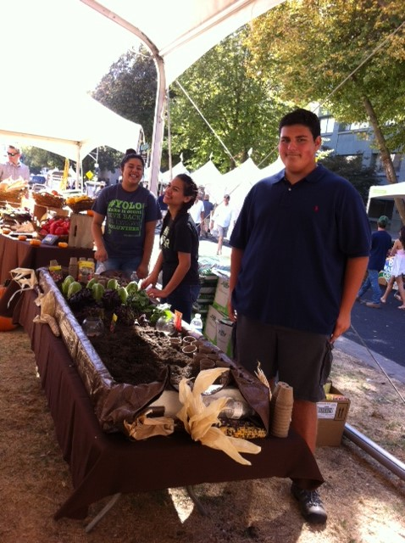

Slide 5
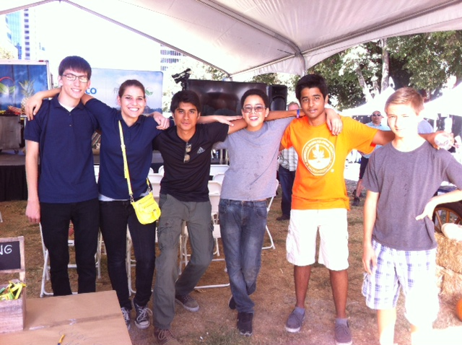
Fun times with FFA Students

Slide 6
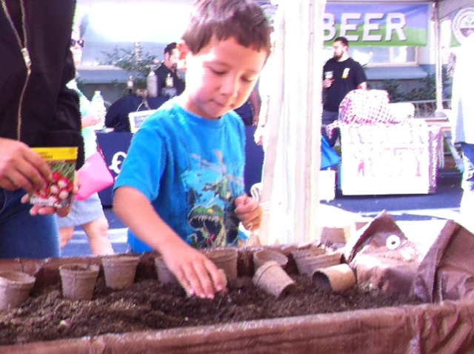
Planting the seeds for Agriculture 1 seed at a time.

Slide 7
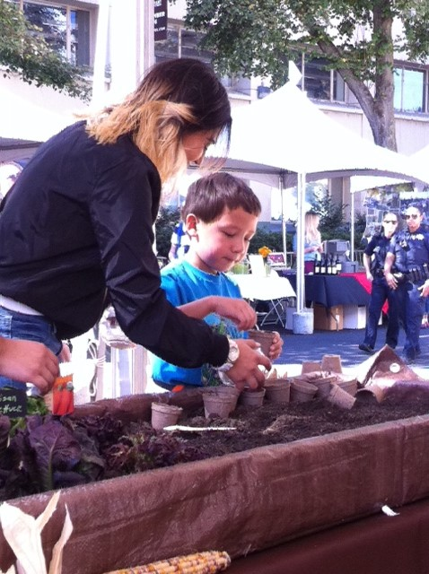
When students become teachers, personal growth happens.
A little bit of your future self begins to shine.

Slide 8
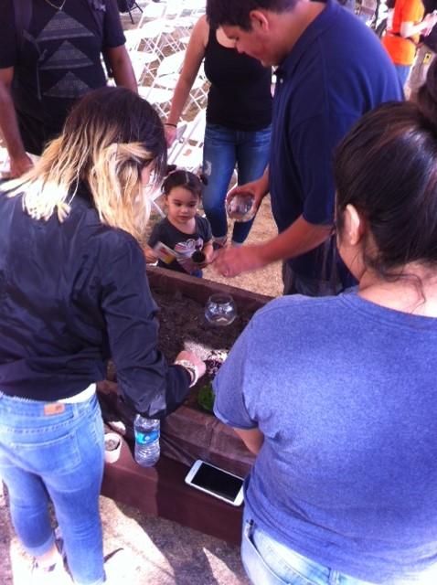
So Cute!

Slide 9
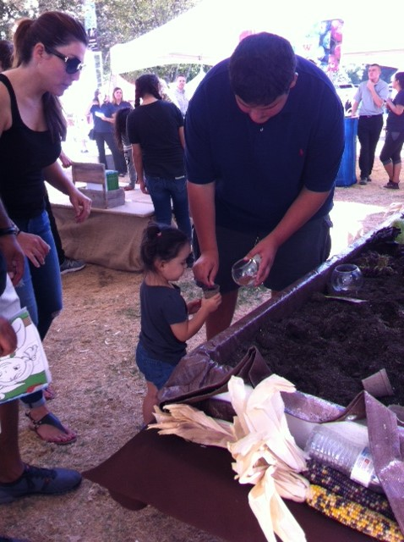
THIS is my Fav!
Planting the seed of learning.

Slide 10
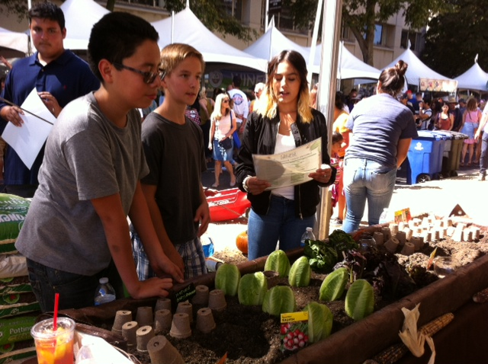
Daniella,
I don’t think the boys are listening…
Silly boys.

Slide 11
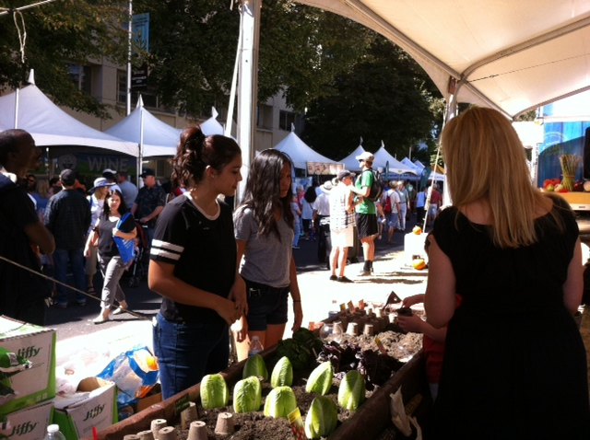
FUN TIMES

Slide 12
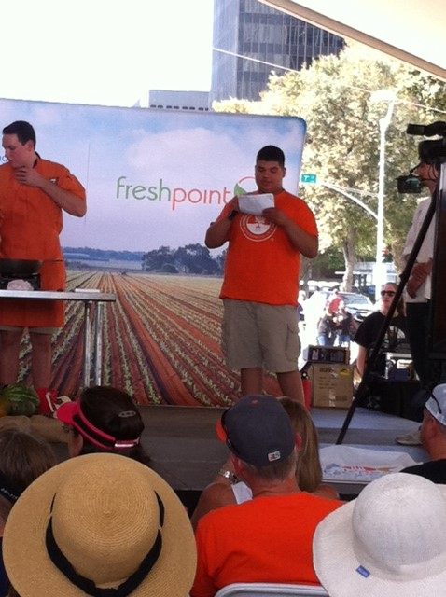
Practice Makes Perfect!
Keep up the good work Emiliano!

Slide 13
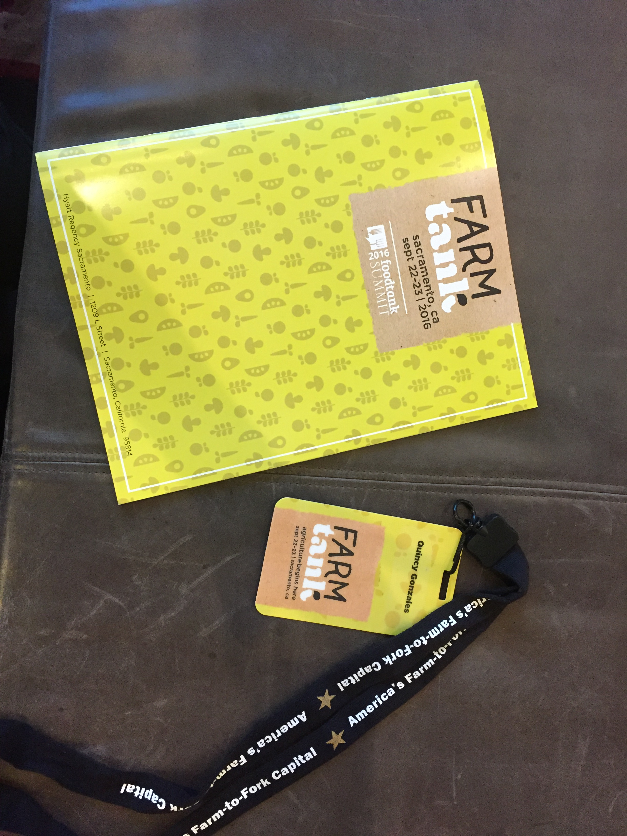
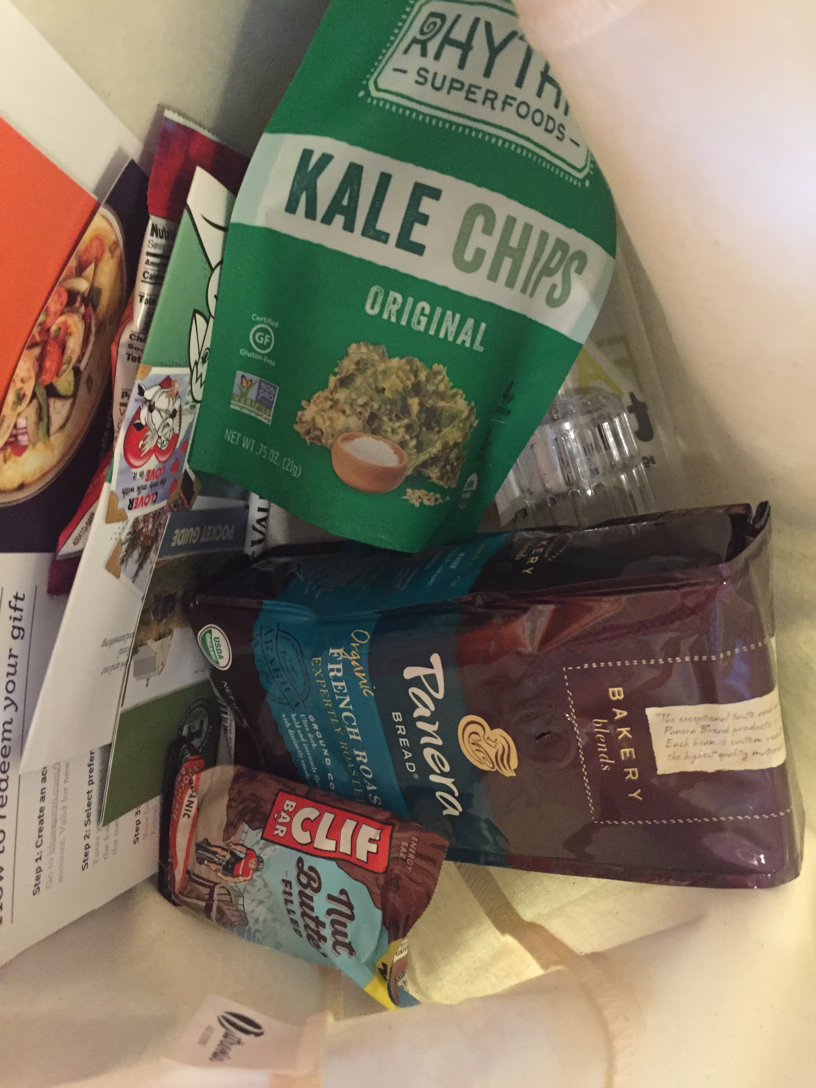
Quincy’s Experience at Farm Tank

Slide 14
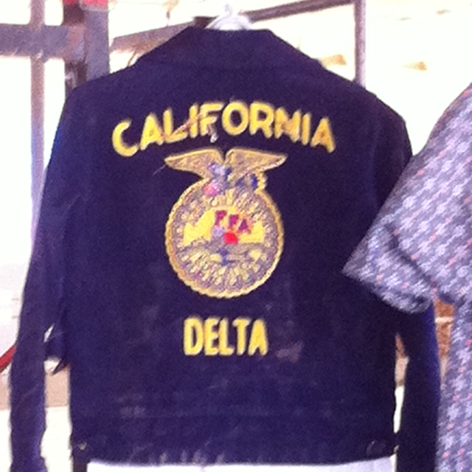
SAE – Supervised Agricultural Experience Hands On Agriculture
P. 55 NB
Title your SAE
Describe your goal(s) of your SAE(s).
Materials used/ needed for your SAE.
How do you plan to improve your SAE?
How has your SAE helped you learn about Agriculture?
How does the FFA Motto apply to your SAE?
“Learning to do,
Doing to learn,
Earning to live,
Living to serve.”

Slide 15
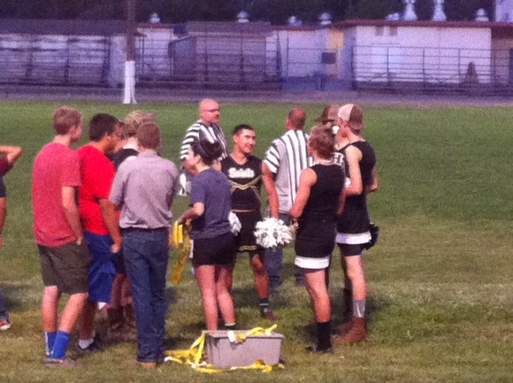
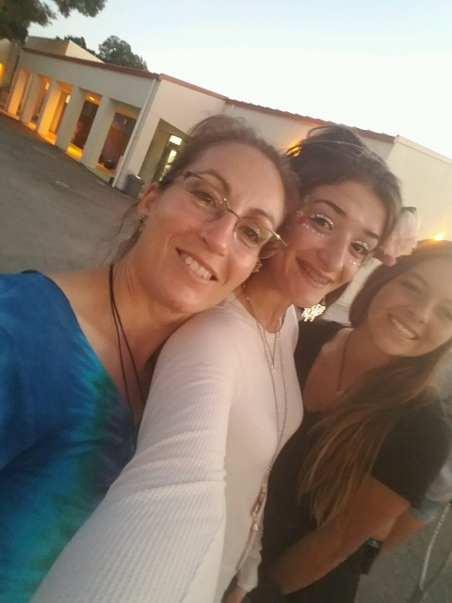
Biomolecules/ Macromolecules
Notes Page 65 NB

Slide 16
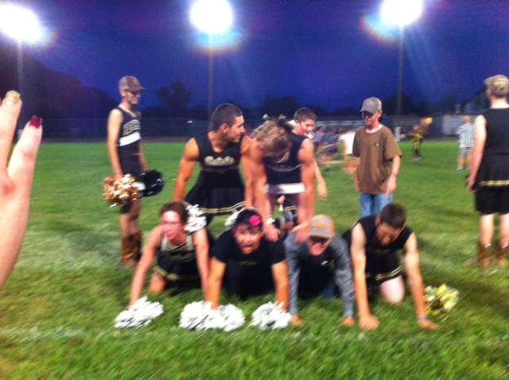

Slide 17
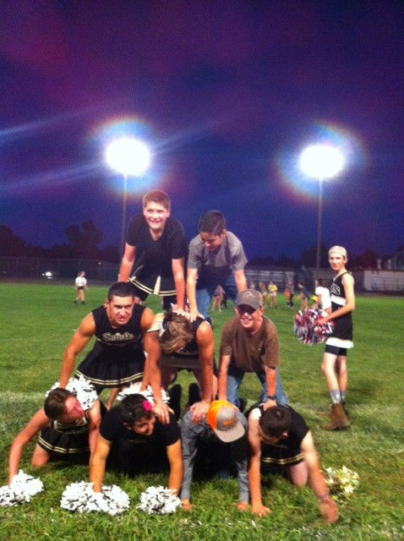

Slide 18
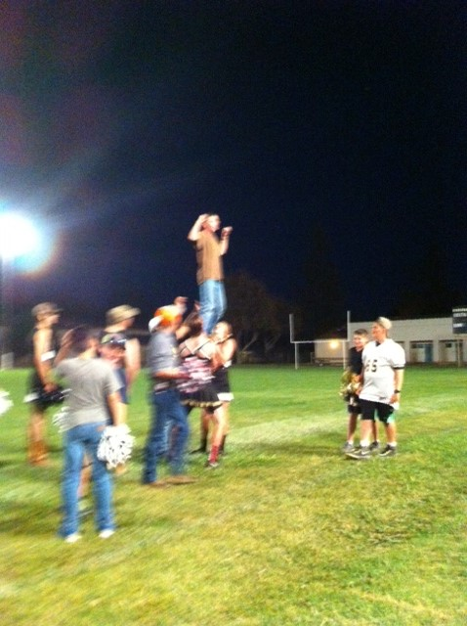

Slide 19
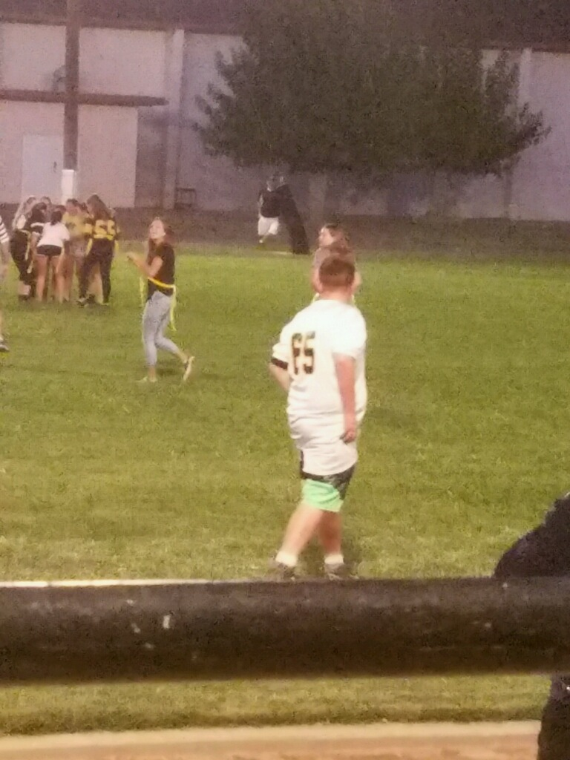
Melina playing flag football

Slide 20
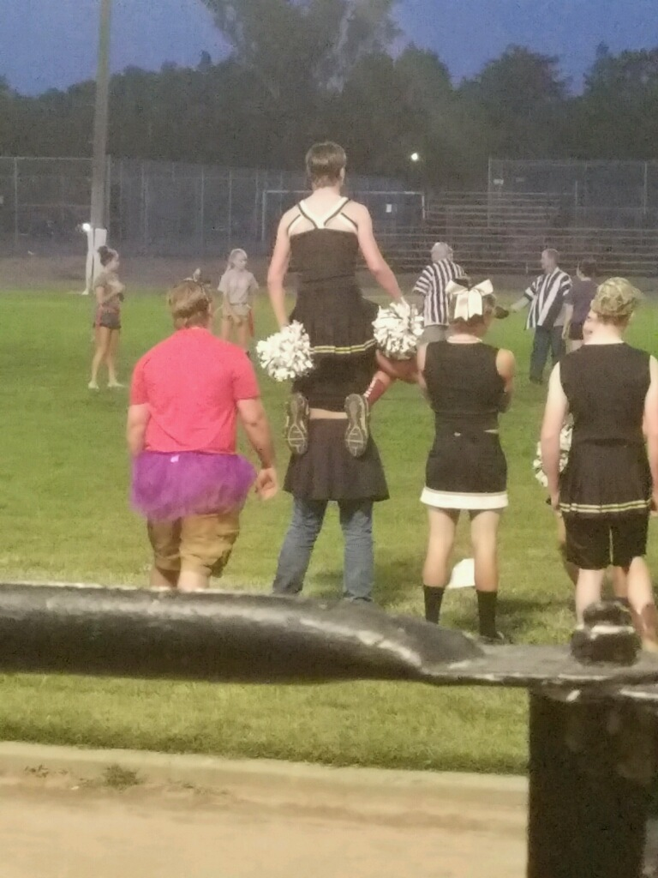

Slide 21
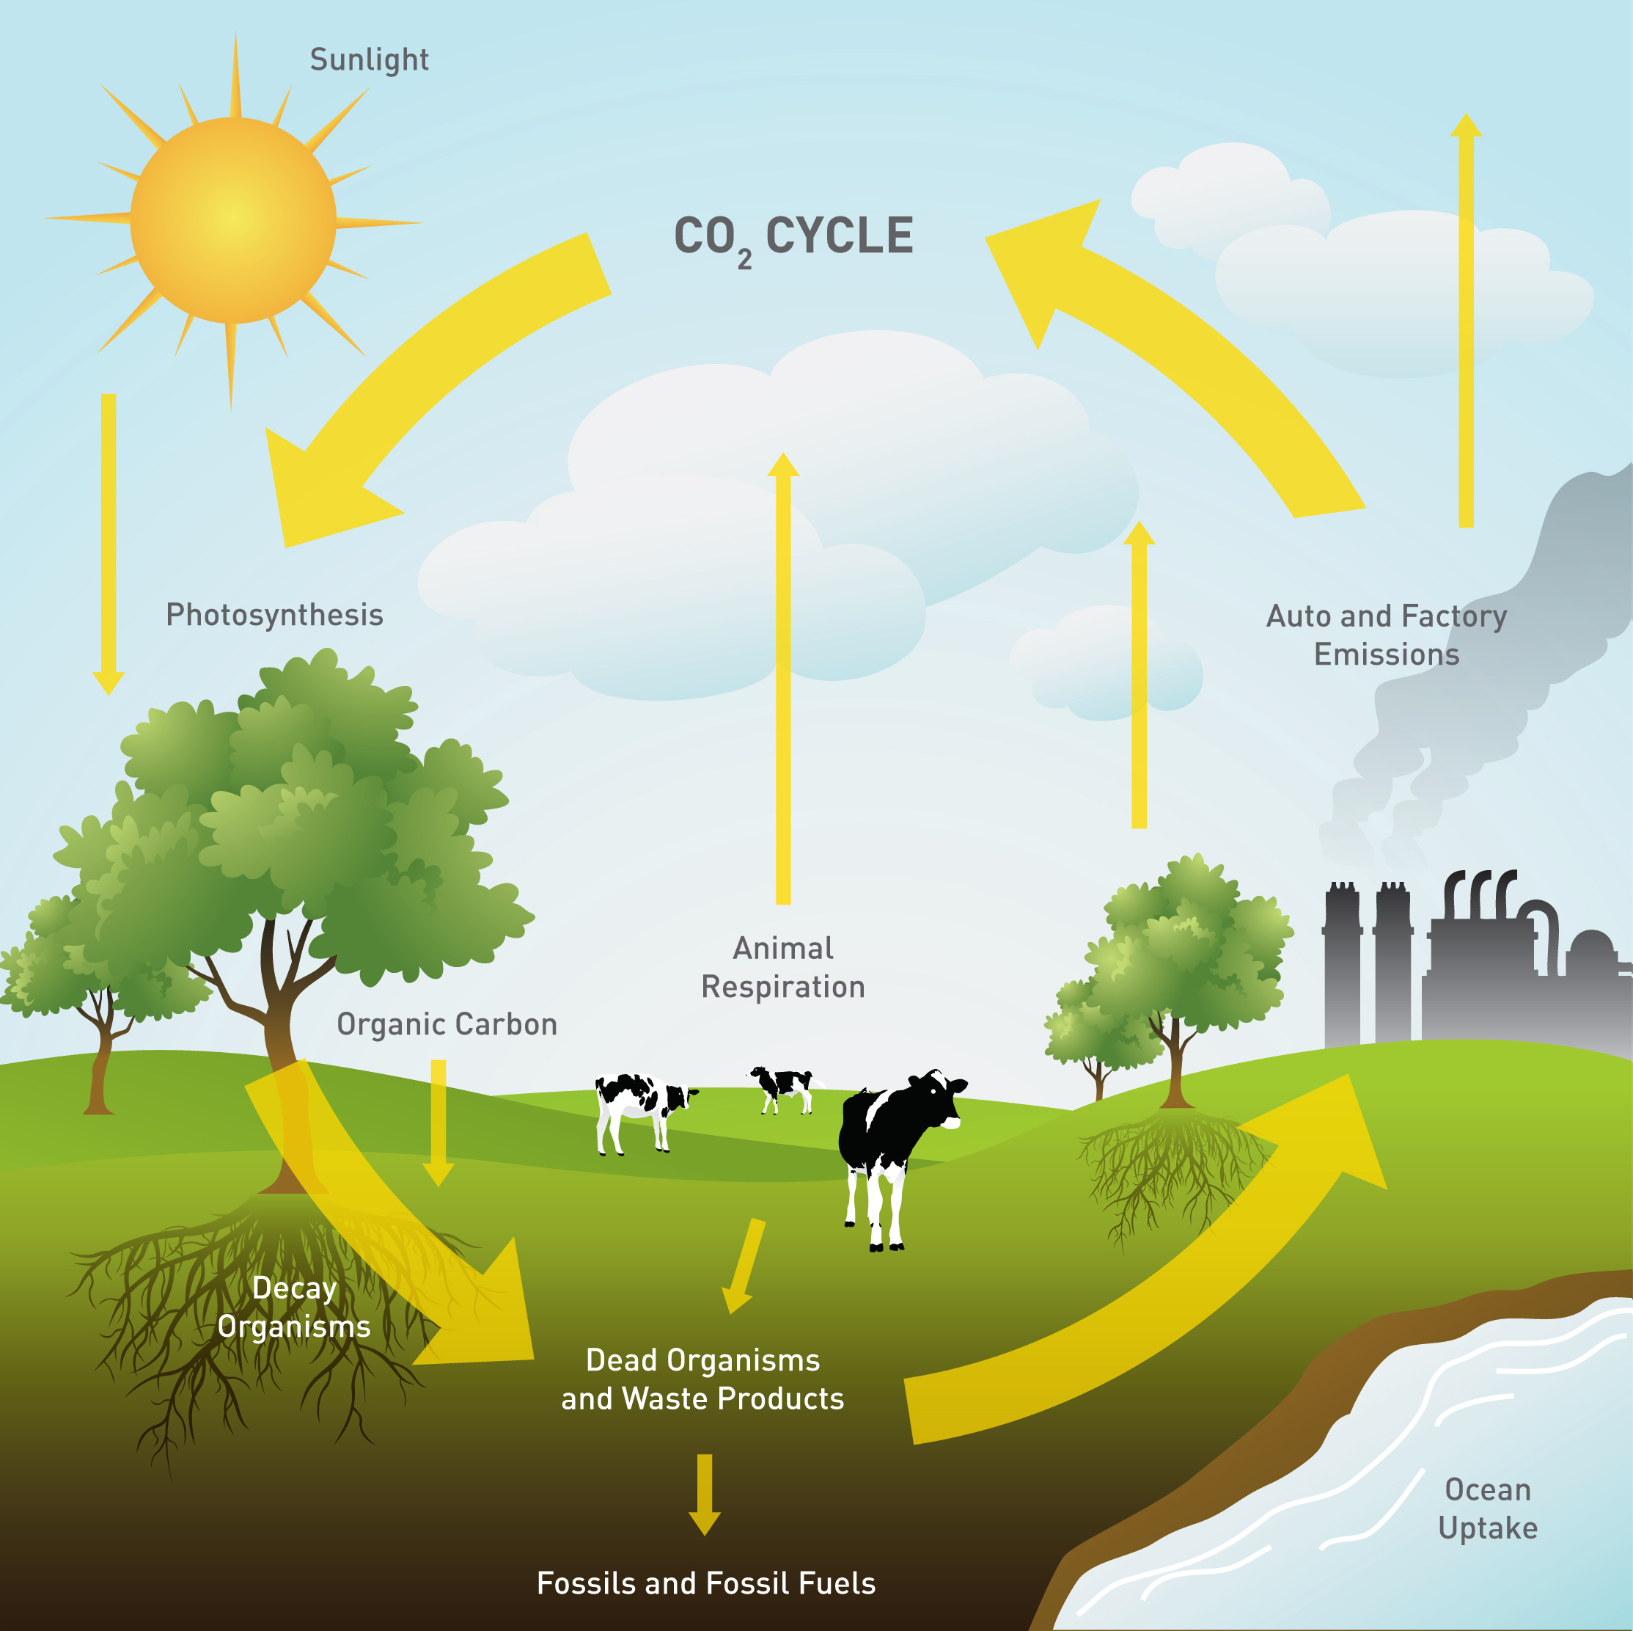
9/19 The Carbon Cycle Obj. TSW explain how the carbon cycle works and why it is important. P. 44 NB
What is the Carbon Cycle?
How are we part of it?
Name two processes that are part of the carbon cycle.

Slide 22
Greenhouse Effect
Watch the following Academic Carbon Cycle video:
How does Carbon influence the Greenhouse Effect?
How do greenhouses utilize the greenhouse effect to promote plant growth?
How is greenhouse plant cultivation a sustainable practice?

Slide 23
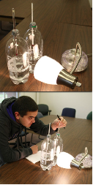
Demonstration! Why is it so Sticky in this Greenhouse?
What do you think will happen to the temperature of the two bottles?
What is Greenhouse Effect?
How is this an example of the Carbon Cycle?
Why is CO₂ a Greenhouse gas?
Image Source: http://mrcc.isws.illinois.edu/resources_links/downloads/HowTo_GreenhouseEffect.pdf

Slide 24
Carbon Cycle Activity P. 47 NB
PhET – Chemistry Greenhouse Gas
What is the difference between a sunlight photon and an infrared photon?
How does the simulation let you manipulate the environment to increase CO2 Production?
Suggest a possible solution to our global increase in CO2.

Slide 25
Carbon Cycle
Wednesday – Computer Lab PhET – Chemistry Greenhouse Gas
Study the other cycles in Nature
McAllister Will grade your Notebook P. 35 -44 50 points
Work on typing up your project
Do research on your project
Research http://hmclause.com/
http://calrice.org/
http://www.farmersrice.com/

Slide 26
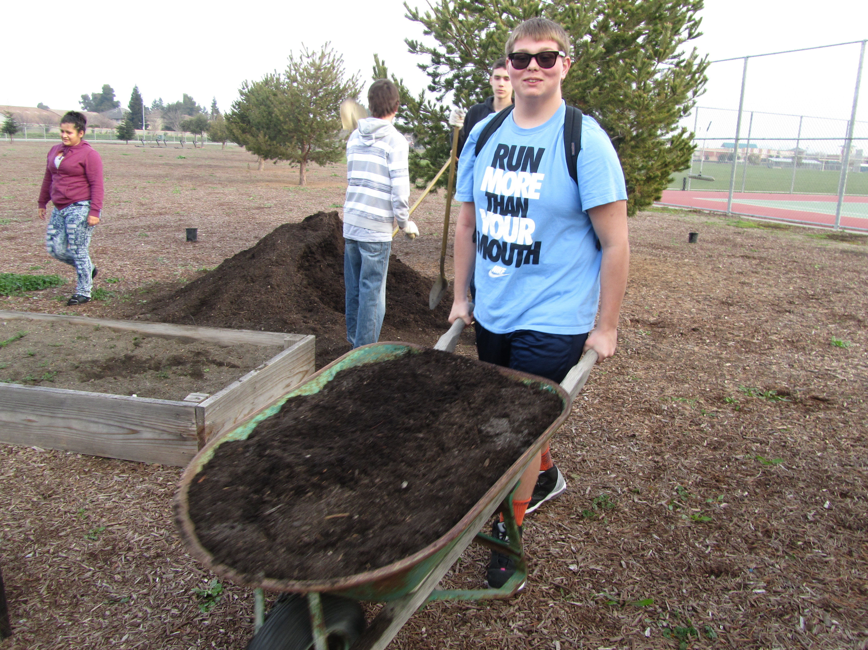
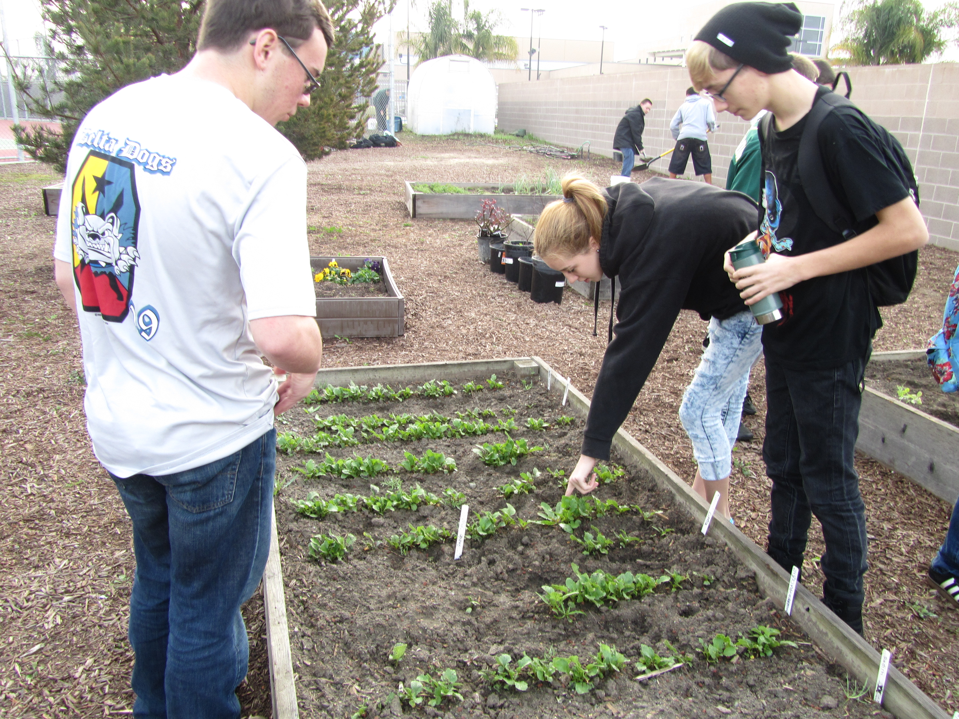
Projects p. 29 NB
What can you do to make a positive difference in our garden?
How can you be part of the solution to feed healthy food to our fellow students?
How can you help make our garden be more sustainable?
How can you help make our school more sustainable?
How can you help inspire a younger generation to grow healthy food?

Slide 27
Project Ideas – Need more Diversity
Explore the benefits and costs of Solar
Explore the benefits and costs of Biodigestion, Composting, Recycling
Explore and learn about what it takes to maintain the school property.
So Far we have: watermelon, milk, flowers, strawberries, Flower bed, Flowers for the Administration, growing rice, growing black berries, raspberries, three types of liquids to water with, pumpkins, carnations, carrots

Slide 28
Show Jesse’s Time lapse of Soil
Thank you!
You Rock Jesse ☺

Slide 29
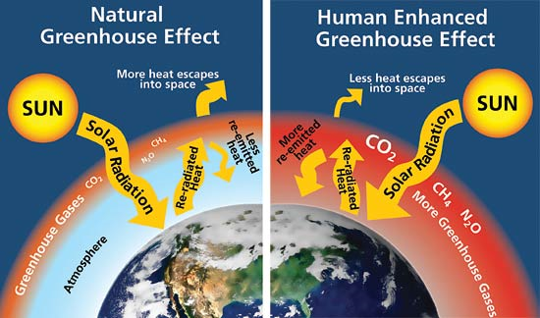
9/22 Greenhouse Effect Obj. TSW apply the greenhouse effect to real word situations and on going climate change. P. 50. NB
Watch the following Academic Carbon Cycle video:
How does Carbon influence the Greenhouse Effect?
How do greenhouses utilize the greenhouse effect to promote plant growth?
How is greenhouse plant cultivation a sustainable practice?

Slide 30
Scientific Method p. 49NB
“Why is it so sticky in this greenhouse?” Demonstration
Prediction: What do you think will happen to the temperature of each of the 2 bottles?
Introduction/ Background: Describe the Greenhouse Effect, how do we benefit, what are some consequences of increase CO₂ in the atmosphere?
Observations: Of the temperature difference in the bottles.
Materials: Used in the Demonstration.
Data: Recorded from the temperature difference between the two bottles.
Analysis: Students will explain why the temperature in one bottle was higher slightly than the other.
Conclusion: How can we as individuals and as a society decrease our carbon dioxide production.

Slide 31
The Carbon Cycle Obj. TSW explain how the carbon cycle works and why it is important. P. 46 NB
What is the Carbon Cycle?
How are we part of it?
Name two processes that are part of the carbon cycle.

Slide 32
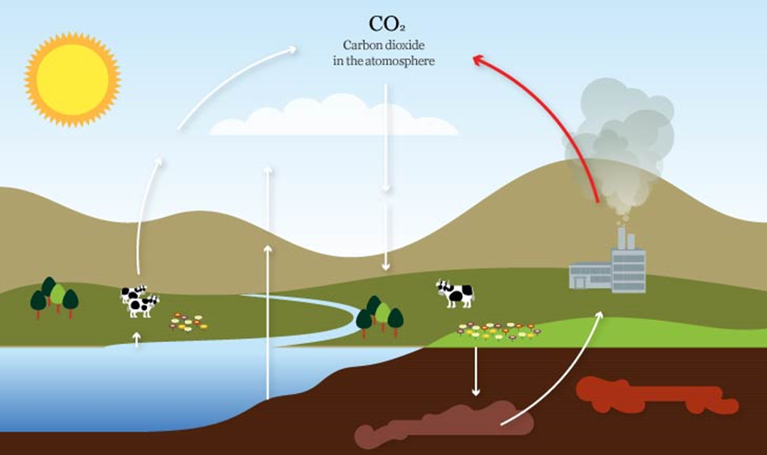
9/23 Carbon Cycle Processes Obj. TSW watch the following two videos discuss the relationship between both processes in the Carbon Cycle. P. 52 NB
Photosynthesis
Cellular Respiration
Make sure you can write an AXES Paragraph about each.
You may create a Venn diagram to begin with for Notes.

Slide 33
1. Draw the picture on the screen. Using the following processes: Photosynthesis, Cellular Respiration, Exchange, Sedimentation & Burial, Extraction, Combustion, place each process where it belongs in the picture. 2. How might the following: Biosphere, Geosphere, Hydrosphere, Atmosphere act as a carbon sink?
9/26 Understanding the processes in the Carbon Cycle
Obj. TSW explain how carbon is a dynamic part of our lives and our
existence on the planet. P. 54 NB

Slide 34
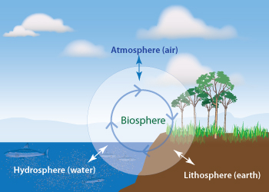
9/27 How Carbon moves between spheres Obj. TSW learn about the 4 spheres and how carbon is a part of each. P. 56 NB
How does CO2 cycle through the Biosphere, Geosphere, Hydrosphere and Atmosphere on the planet?

Slide 36
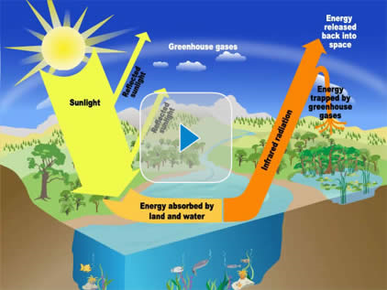
9/28 Greenhouse Effect & Carbon Cycle Obj. TSW demonstrate the relationship between the natural greenhouse effect and humans influence on it by explaining the carbon cycle. P. 58 NB
How is the Greenhouse effect good?
How does the carbon cycle impact the greenhouse effect?
In what ways do humans influence the carbon cycle?

Slide 37
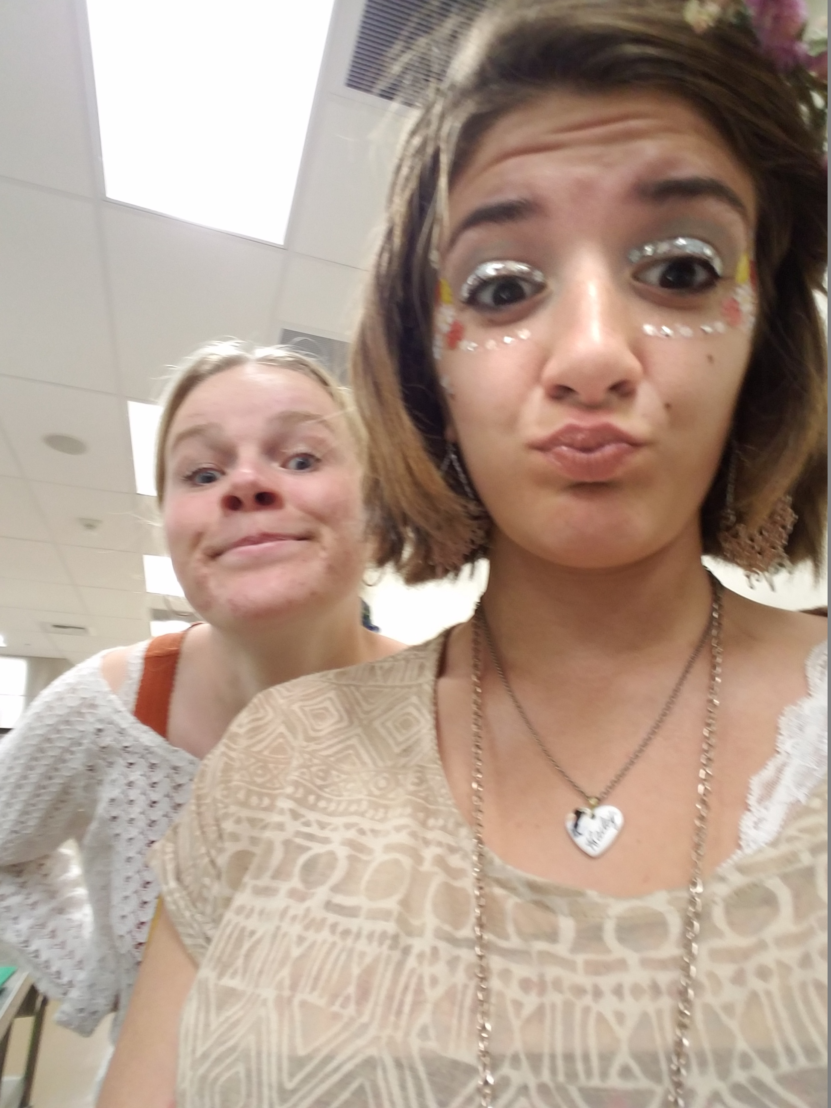
Happy Farm to Fork students

Slide 38
9/29 Carbon Cycle Quiz & NB Check
Write an AXES Paragraph on the Carbon Cycle.
Assertion, Example, Explanation, Significance
Make sure to include the two processes discussed friday and how CO₂ in impacted by each. Understanding “carbon sinks” can be part of the solution to our climate change concerns. Explain how carbon is stored in the various “spheres”.

Slide 39
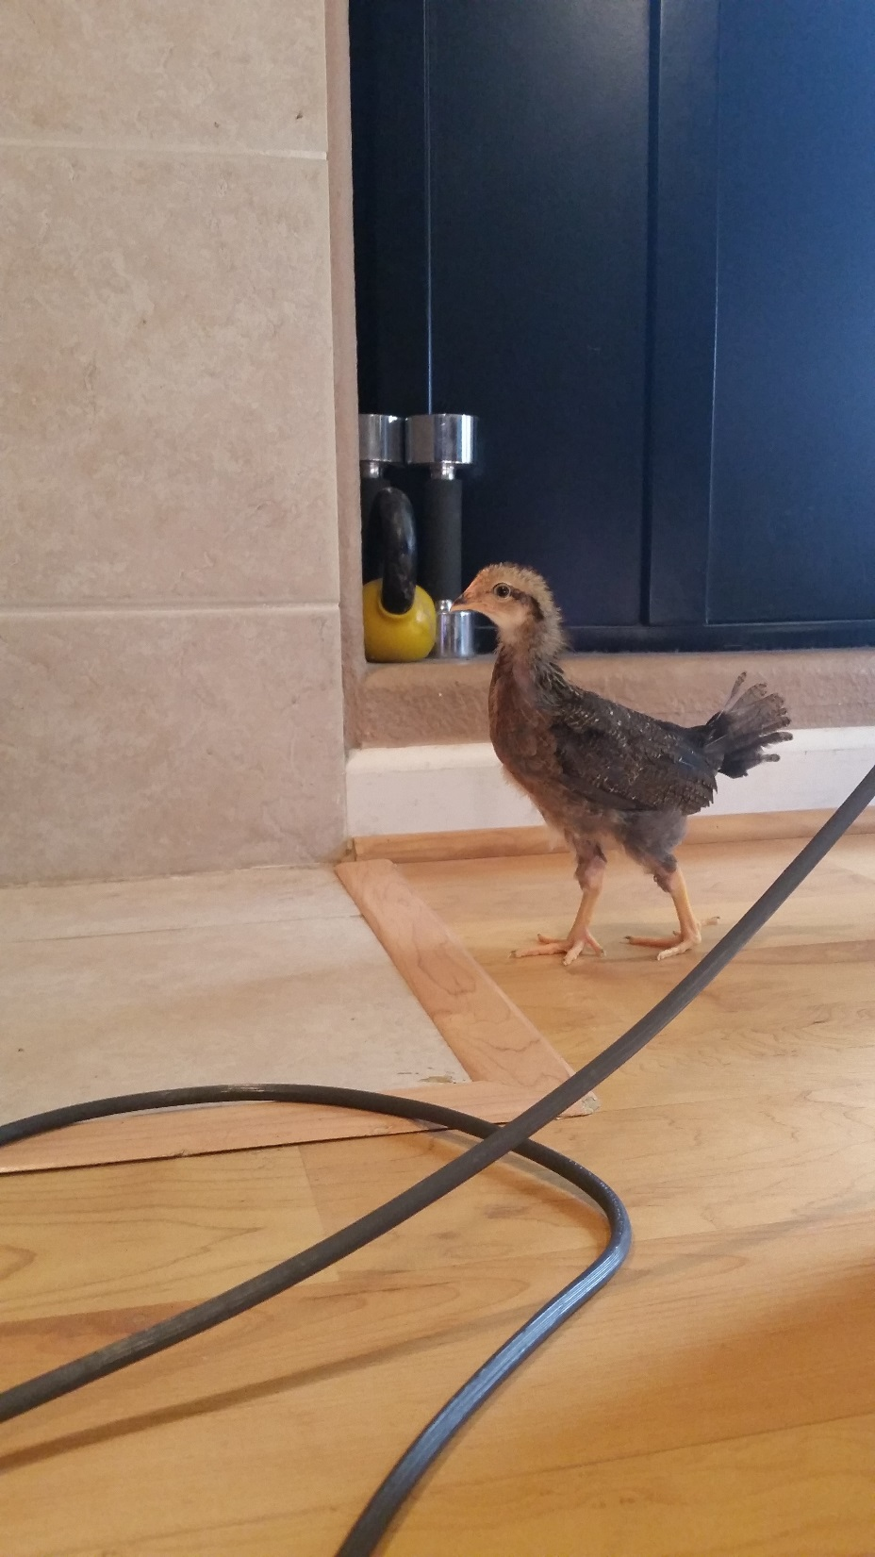
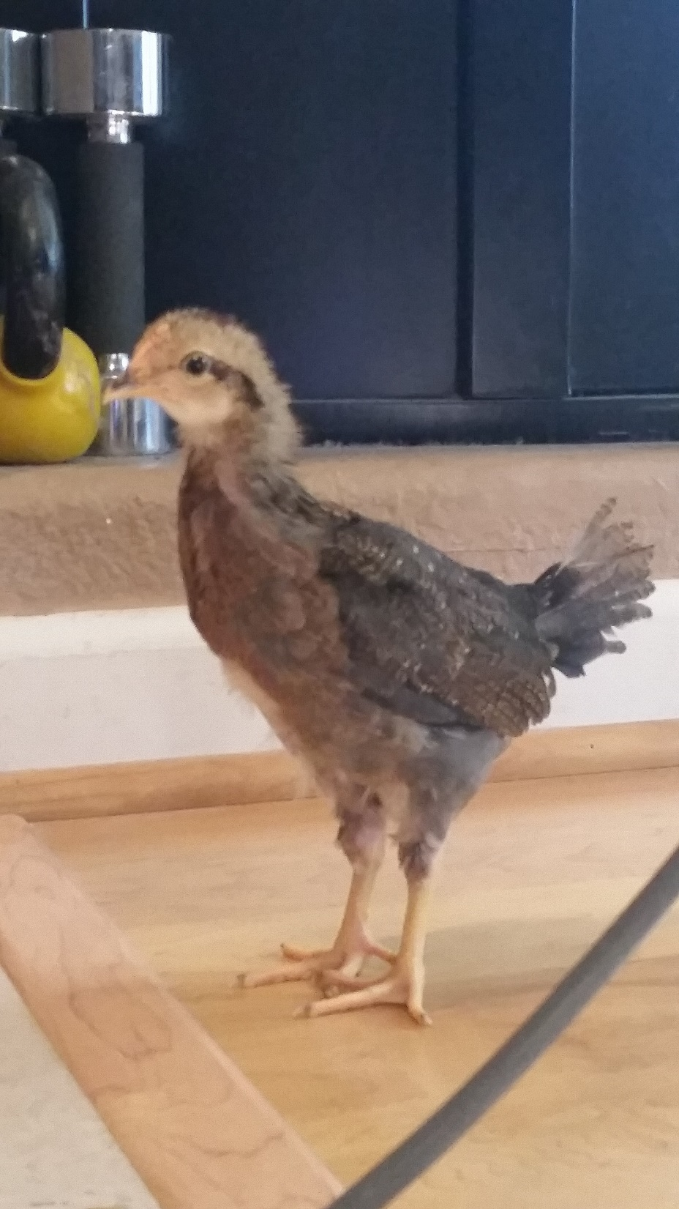
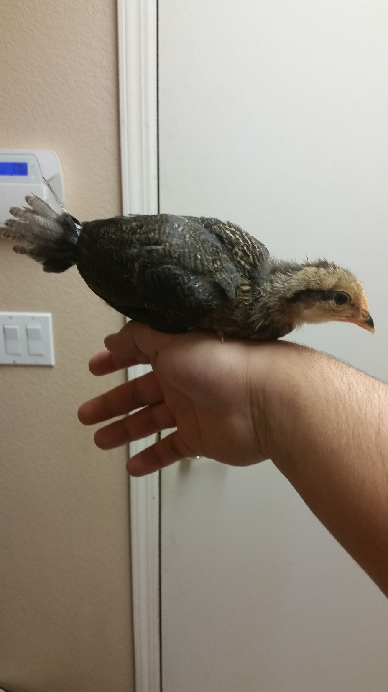

Slide 40
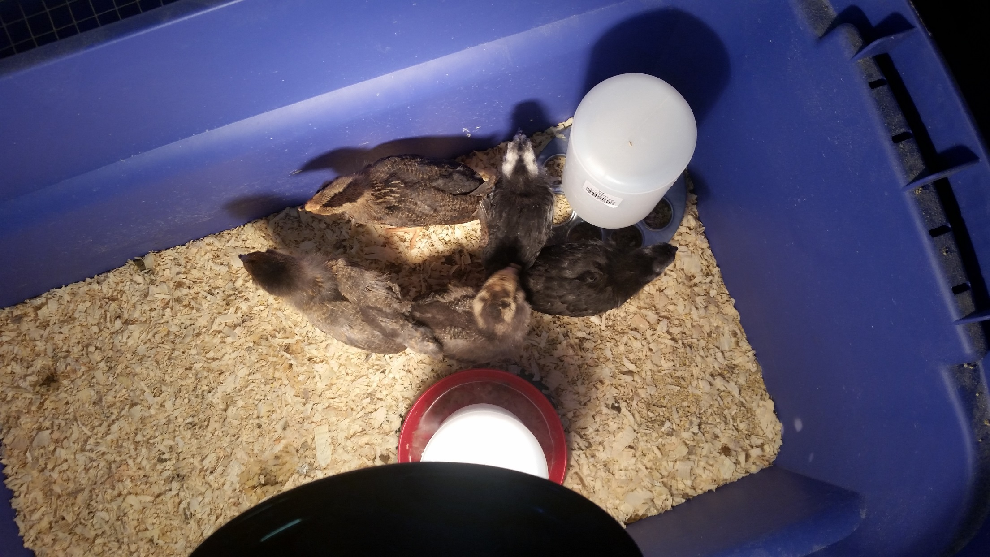

Slide 41
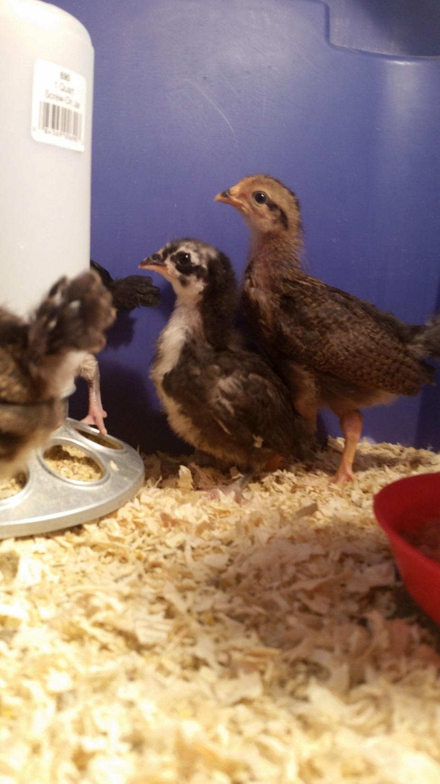

Slide 42
Carbon Cycle p. 53 NB
What happens to the carbon dioxide you breath out or carbon dioxide released from a burning paper?
Draw the Carbon Cycle in your Notebook, as the teacher draws it on the board. Make sure to label the following processes: Photosynthesis, Cellular Respiration, Exchange, Sedimentation and Burial, Extraction and Combustion
In addition, Point out how CO2 cycles through the Biosphere, Geosphere, Hydrosphere and Atmosphere, Labeling each on the white board as well.
Use the following slide to show the background, while writing the processes.

Slide 43
Installing the PVC
Omar, getting to work.
Why the PVC is needed.

Slide 44
Looking good – Fantastic Job you guys!

Slide 45
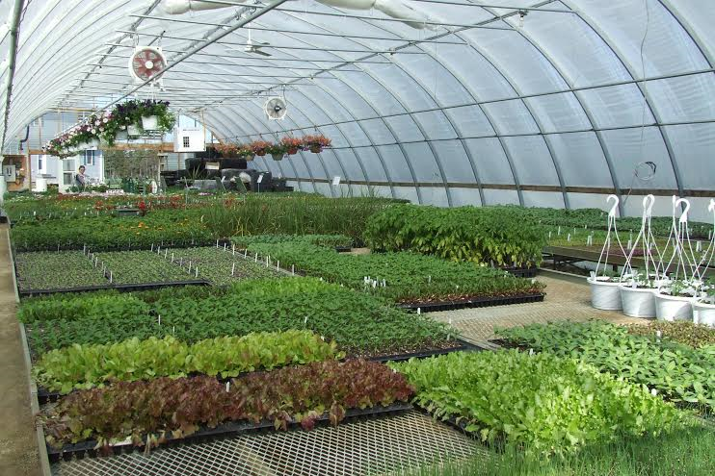
9/29 Analysis of a Greenhouse Obj. TSW determine the essential components to building a greenhouse. P. 60 NB
What types of energy does a greenhouse need to be productive?
What materials might you need to create a greenhouse?
What other factors, such as direction/ location should be considered when building a greenhouse?
Using the class greenhouse (or video) as an example make observations and explore aspects of our greenhouse that can be applied to the building of your greenhouse.

Slide 46
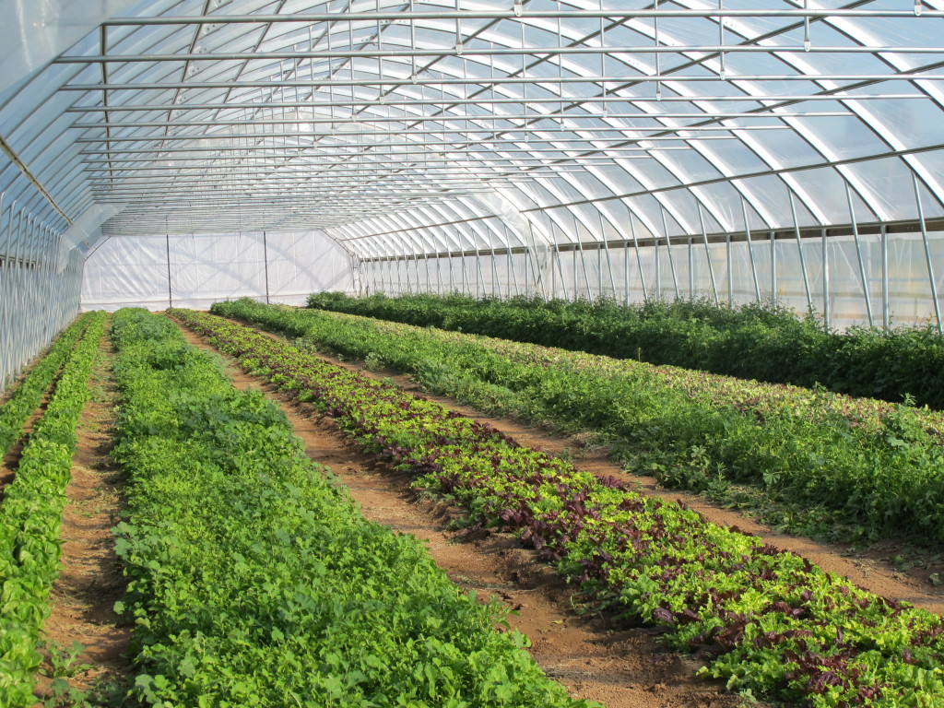
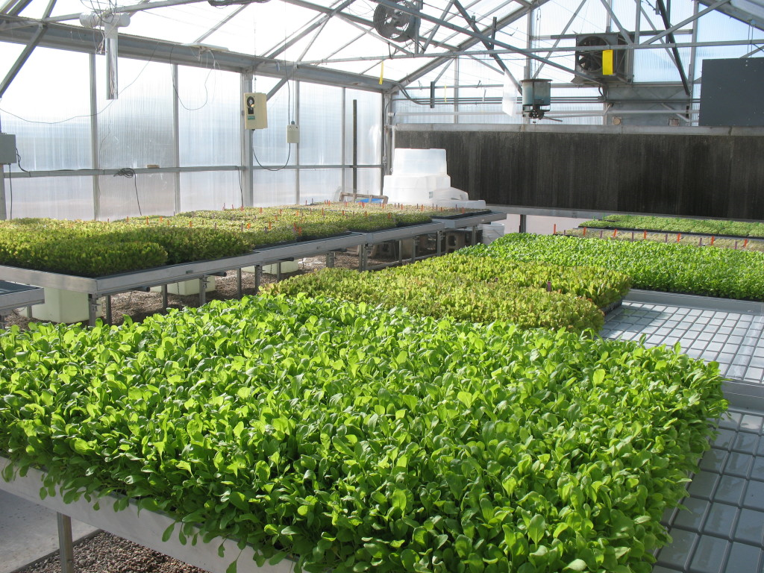
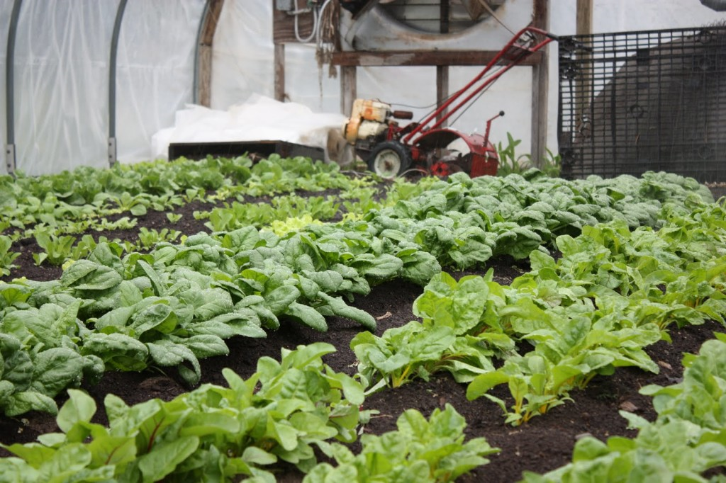
9/30 Application of the Greenhouse Effect Obj. TSW apply what they have learned about the carbon cycle and how it relates to the Greenhouse effect by designing in teams a greenhouse. P. 62 NB
Why might designing a greenhouse be important?
Relate what you have learned about the Carbon Cycle to how a greenhouse works to help grow food.
What would you like to grow in your greenhouse with your team?

Slide 47
9/30 Greenhouse Structures Build your mini Greenhouse
Students will begin work on a building a mini-greenhouse.
Working in a team of 3, students will develop a plan for their mini greenhouse. This plan must include the following:
1. An appropriate location. This greenhouse could be inside or outside a house or apartment.
2. An architectural design. Students must also present a justification for this design.
3. Necessary materials (type, quantity and cost). The cost may not exceed $25.
4. Timeline for construction. In this timeline, benchmarks should be listed.

Slide 48
10/14 Refection of Greenhouse Structure Typed 1 – 2 page paper
What plants did you start/ grow?
What was the experience like for the family?
Reflect on sharing your Greenhouse Structure at a Gardening Event/ Harvest Festival
Reflect on improvement for next time.
Share successes, and concepts used, learned in class.

Slide 49
10/3 Chromebooks, Spark Vue & USB Bluetooth Adaptor
Log into your appropriate Chromebook
Go to: https://goo.gl/K7sJHE This link will take you to the Chrome Web Store
Install the Spark Vue App by Add to Chrome
Get a USB Bluetooth Adaptor from McAllister

Slide 50
Omnivores Dilemma CH 5 - 8

Slide 51
10/6 Sustainable Food Production
Measuring Productivity Lab
Students will create a lab to measure CO₂ levels, or O₂ levels during Photosynthesis and/ or Cellular Respiration. Using their results, students will create models to describe the interaction between these two processes. Their final lab report will detail these results and their models.
Students will make an argument in their conclusion for sustainable food production based on what they have learned from this unit.

Slide 52
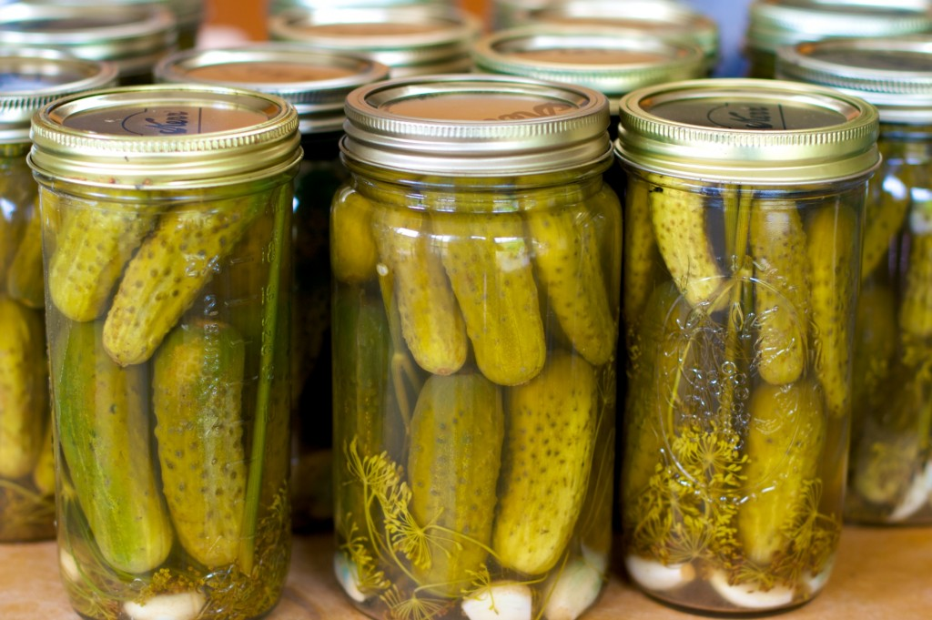
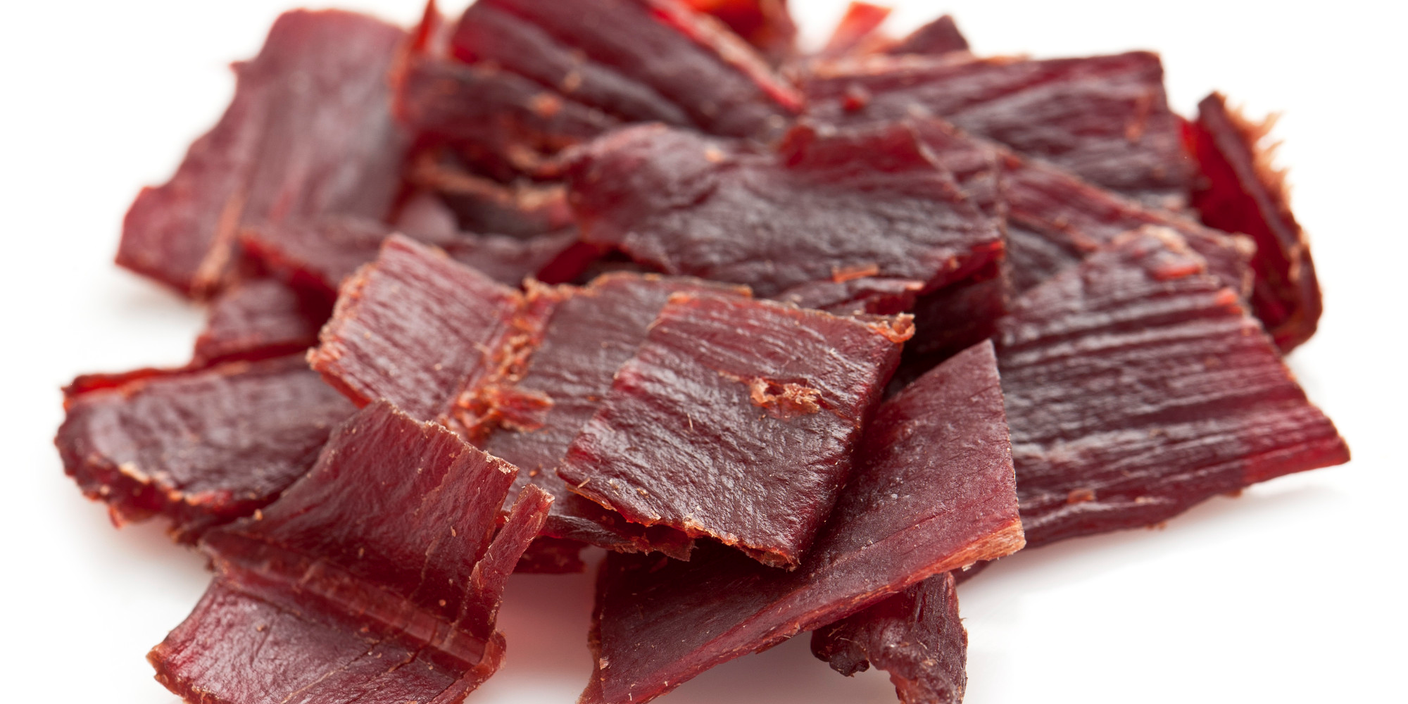
10/3Canned and Cured Foods Has anyone ever had Pickles or Beef Jerky? What is in each product? Make a list of as many canned and cured foods as you can.
Canned Foods
Cured Foods

Slide 53
10/3Canning and Curing Foods Watch the following videos for discussion later. Homework – inventory your kitchen/pantry for canned and cured foods. Make two lists: Fruits & Veggies, and Meat.
Curing Deer Meat Video
Salt
Sugar
Smoke
170 degree heat
Canning Dill Pickles Video
Dill
Garlic

Slide 54
Read the article: Native American Food Preservation: Keeping the Harvest By: Jessie Keith
Answer the 5 questions from the article.

Slide 55
Dispelling Myths about canned food/ Bring a can to class
Students will read: 5 Canned Food Myths Dispelled by Jennifer Christman
Paraphrase each of the myths in your Notebook
Each student will share their can or cured food with a recipe of how to use/ eat it.

Slide 56
Preserving Food Article Analysis
Students will research and article online about Food Preservation.
In their article:
Annotate the text
Discuss it with a partner
Write about new information they learned from the article or the guest speaker.
Write about their personal experience with canning or curing food.

Slide 57
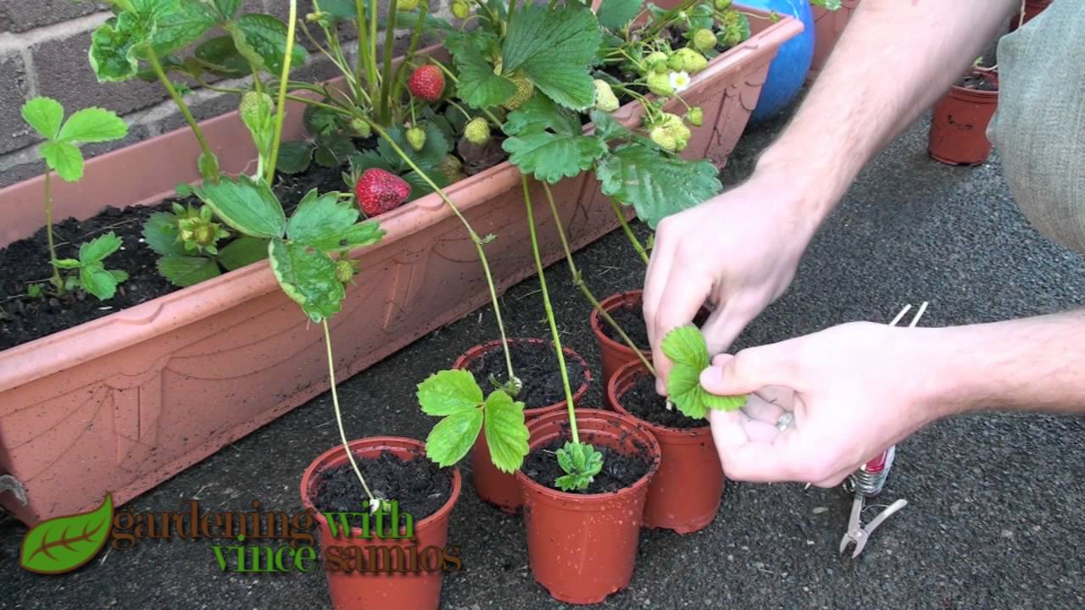
10/10 Vegetative Propagation Obj. TSW learn how plants make more plants, without producing typical seeds.
What is a flower bulb?
What is a strawberry runner?
What is a rhizome?

Slide 58
Strawberry’s and Vegetative Propagation
In the garden, find strawberries with runners attached.
Cut the runner.
Determine a good transplanting site for the daughter plant.
Water the daughter plant real good in it’s new home.

Slide 59
Hormones that control dormancy in plants Watch the video to help understand how hormones can impact plants.
Research 3 – 5 plant hormones:
How do they work, and how do we use them in plant production?
Auxin
Gibberillin
Ethylene
Cytokinins
Write a 1 – 2 page response answering these questions about these hormones in your notebook.

Slide 60
Make it grow! Bean/Peas & Auxin Lab
Germinate Bean/ Pea plants
Plant in clean 2 liter bottles against the side of the bottle.
Observe and Measure how the hormone auxin affects the Root, Stem and Leaf.
Collect data for 2 weeks
Present findings to the class at the conclusion of the lab.

Slide 61
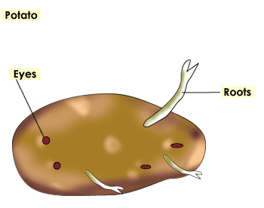
What’s in a Tuber? Lab
Students will get potatoes from the local grocery store and seed potatoes form the local nursery.
With beakers and toothpicks students will grow the “eye of the Potato” to start in the ground.
After propagating tubers, and planting them in the soil, students will compare the texture of each during harvest.
Students will compare and contrast the grocery store potato to the nursery potato in a class discussion.

Slide 62
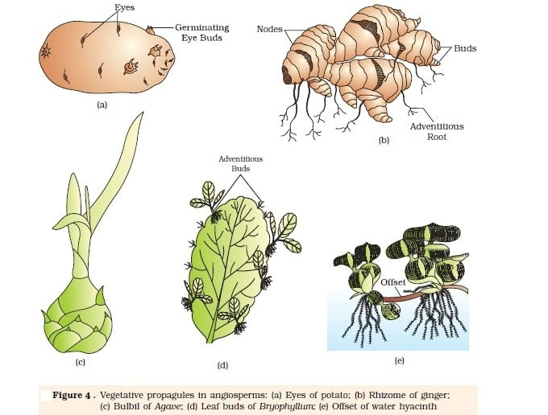
Reflection of Vegetative Propagation and the influence of Hormones on plants.
Explain the plant(s) you worked with
Type of propagation
Success or failure of propagation or application of hormone
Use a page in your Notebook for your reflection.

