Slide 1
Lesson 1: Resources in the Community
F2F2 UNIT 4
Career Exportation and Guidance

Slide 2
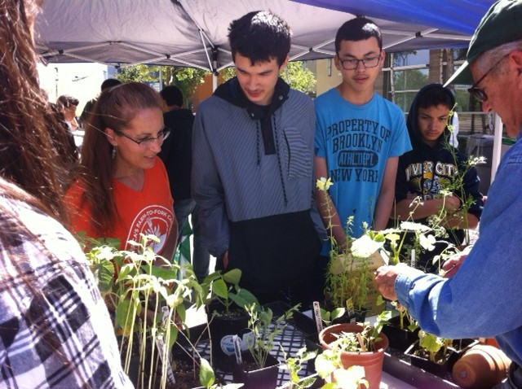
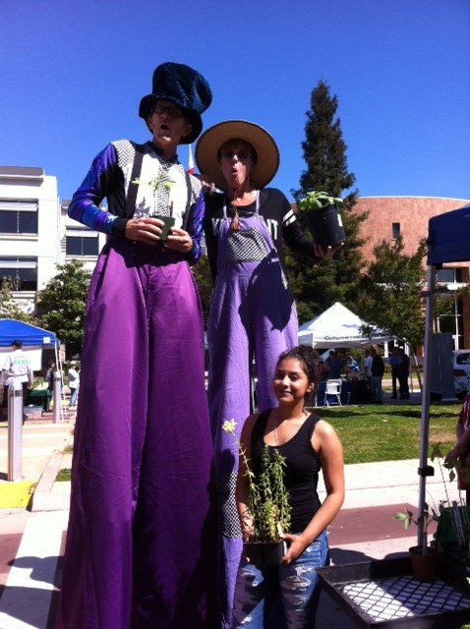
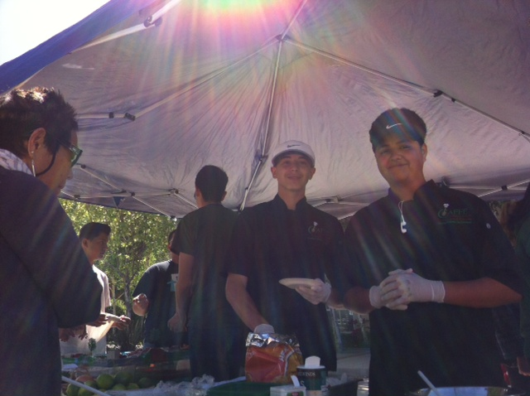
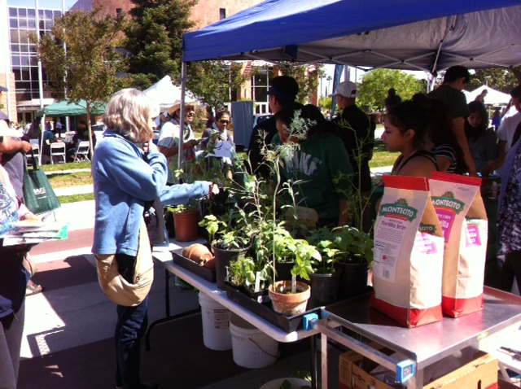
Resources in the Community
UNIT 4 Career Explorations & Guidance

Slide 3
Resources in the Community Obj. TSW remember all the people who have helped us throughout the year & develop networking skills that support your goals in agriculture.
Who has helped us in F2F this term?
What aspect of an Ag Career do you think you will go into?
What skill(s) will that career require?

Slide 4
www.cacareerzone.org
Begin the Career Assessment
Write an occupation you are interested in.
One sentence describing the job in your own words
Describe the preparation required for that occupation
What is the range of salary?
What is that occupations outlook? Expanding, stagnant, decreasing?
What are the common College Majors?

Slide 5
www.cacareerzone.org
Read: “Things they need to be able to do”
Write one - three skill(s) or job description that you are good at.

Slide 6
Entry Level Research
Find 3 Entry – Level employment opportunities from the Skills Profiler of California Career Zone
State your skill that will be an asset to that type of work.

Slide 7
Awards & Recognition Dining Event
Who needs to be recognized and to what extent for their help in our Program?

Slide 8
Lesson 2: Resources in the Region
F2F2 UNIT 4
Career Exportation and Guidance

Slide 9
Resources in the Region Obj. TSW realize all the resources that go into helping develop a successful program.
If West Sacramento is our Community, where and how big is the Sacramento Region?
What possible resources could be have in our Sacramento Region?
Future students are a resource. When would you like to do a Garden tour for 8th graders from Riverbank?

Slide 10
What other local businesses in the region support the Farm to Fork movement?
Research 3 businesses with in 100 miles that raise, grow, sell, buy, and distribute local produce and meat, including dairy cattle?
Explain what they do and how they do it.
Some of this information can be included in your 1 – 2 page paper.

Slide 11
Internships.com
Where are you interested in working?
What type of work?
What skills will you need for the internship you are interested in?
What skills/ networking do you hope to develop from the internship?
Yolo County Office of Education has an Internship Coordinator – Andrew Codd. Email him and ask about possible internship opportunities.

Slide 12
Lesson 3: Resources in the State
F2F2 UNIT 4
Career Guidance and Exploration

Slide 13
State Resources Obj. TSW realize educational resources in the state that help support a career choice.
What are transcripts?
What does the student rank mean?
Compare & contrast a weighted and unweighted gpa.

Slide 14
California Department of Food & Agriculture https://www.cdfa.ca.gov/
Who are they?
What do they do?
Explain some job descriptions?
What are some necessary skills/ education needed for specific jobs/career in Agriculture?
List three contacts that you could email, to ask for further information or possibly set up a guest speaker.

Slide 15
Researching Ag Colleges
UC Davis
Cal Poly San Luis Obispo
Colorado State University, Fort Collins
Pennsylvania State http://animalscience.psu.edu/
What Ag Majors are offered?
What interests you about them?

Slide 16
Colleges need your Transcripts Let’s do a Transcript Review
Tape your transcript to this page in your notebook
Write three short term goals you want to accomplish before the end of the year.
Write three long term goals you want to accomplish before you graduate/ life goals.

Slide 17
Financial Opportunities Obj. TSW develop a better understanding of financial and skill building opportunities to better their future.
What are scholarships & grants?
What are internships?
Why are scholarships and grants better than loans?

Slide 18
Top 10 most Common Interview questions
http://money.usnews.com/money/careers/slideshows/the-10-most-common-interview-questions/11
Choose 3 of these 10 questions and write our you answer on page NB.

Slide 19
Interviews Obj. TSW learn the nuances of interviewing to give yourself an edge.
What would you think are some positive things to do in an interview?
What things should be avoided during interview?
Is the interview only one way?

Slide 20
What would be good questions to ask during an interview?
Read the article, “How to prepare for an Entry-Level interview”

Slide 21
Lesson 4: Resources in the Country/ World
F2F2 UNIT 4
Career Guidance and Exploration

Slide 22
Resources in the Country/ World Obj. TSW critique employment opportunities with from the local level all the way through the global level.
Name a possible employment opportunity that is local in West Sacramento that relates to Farm to Fork.
Name a possible employment opportunity that is regional.
Name a possible employment opportunity that is with the state or federal government or world organization.

Slide 23
The day in a life of…
Watch a video from the following link: A day in the life: National Resource Conservation Service
https://www.nrcs.usda.gov/wps/portal/nrcs/detailfull/national/careers/join/?cid=stelprdb1083243
List things you like about that career, and things that would be a drawback for you personally.
Prepare questions for a guest speaker.
Ask at least one of your questions.
Take one page of notes about the presentation.

Slide 24
Employment Opportunities in Yolo County
Bayer Crop Science
Dave Vierra’s Farm
Raleys
SolaBee Farms
Urban Farms West Sacramento

Slide 25
Bureau of Labor Statistics https://www.bls.gov/home.htm
Open the web page at the link below and open the tab “Publications”.
Scroll down to “Occupational Outlook Handbook”. Under Occupational groups, click “Farming Fishing and Forestry.” Read about the life of agricultural workers.
Describe what agricultural workers do and the job outlook.

Slide 26
Agricultural Employment Obj. TSW realize how they need to develop skills that can not be automated.
What does the word automated mean?
What skills in agriculture could be or are automated?
What skills do you need that can not be automated?

Slide 27
Advantages & Disadvantages of a Global Career – Finding Balance
Use the computer to investigate careers in global organizations such as: United Nations, Unicef, Peace corps, Red Cross, Aide Worker, Salvation Army, Doctors without Boarders, World Seed Bank.
List at least 5 advantages and disadvantages of a career in these global organizations.

Slide 28
Preserving land and wildlife Obj. TSW realize federal government agencies effort to conserve land and wildlife.
What federal agencies are you familiar with that protect land, and/or wildlife for future generations.
Why is protecting our land and wildlife needed?
How does preserving land & wildlife fit into supporting the Farm to Fork idea?

Slide 29
California Department of Food & Agriculture
https://www.cdfa.ca.gov/
https://www.cdfa.ca.gov/employment/
View the above websites.
Write in your notebook a summary of what the website has to offer.
What are some available employment positions offered in the CDFA?

Slide 30
Sustainability -the ability to only use a resource to the extent that future generations will still have the same quality and quantity.
National Park Service
Bureau of Land Management
Fish & Wildlife Management
National Forest Service
Farm to Fork is a local effort to feed people healthy, nutritious food in a sustainable way using conservation and best management practices that does not degrade our soil over time.

Slide 31
National Organizations
Create a graphic organizer for four federal programs (National forestry Service, Fish & Wildlife, Bureau of Land Management, National Park Service).
In the graphic organizer, include descriptions and job opportunities of each program.

Slide 32
1 – 2 page paper Due _______ Where does your food come from?
Where does your food come from?
Discuss where your family buys food. Discuss what Farm to Fork is and it’s benefits.
Why is it important to know where your food comes from?
Include examples, explanations, and show the significance of where our food comes from.
Maybe include ingredients such as High Fructose Corn Syrup, salt, fat, sugar in our diet.
Discuss the video: Fed Up.
Include notes from a Food Service Director Guest presentation about how he/she sources healthy fresh food for students in the school district.
Include the difference between processed and natural foods. Explain organic and genetically modified foods. Why is that important?
Include companies, businesses that are part of the solution to eat healthier, and companies that could improve to become part of the solution. How are companies trying to change their image?
Cite your Sources APA Style: purdue.owl.edu

