Slide 1
2015 Fall Farm to Fork Officers
President: Quincy
Vice President: Paige
Secretary: Emiliano
Treasurer: Valeria
Photographer/ Videographer: Ariana
Publicist: Nathalie
Irrigation Specialist: Val

Slide 2
Carbon Cycle Activity
Friday – Computer Lab PhET – Chemistry Greenhouse Gas
Study the other cycles in Nature
Notes in the Notebook

Slide 3
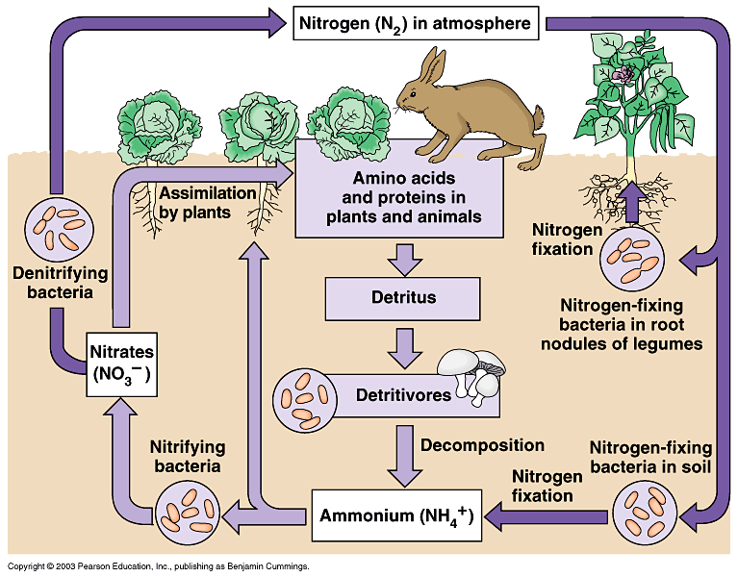
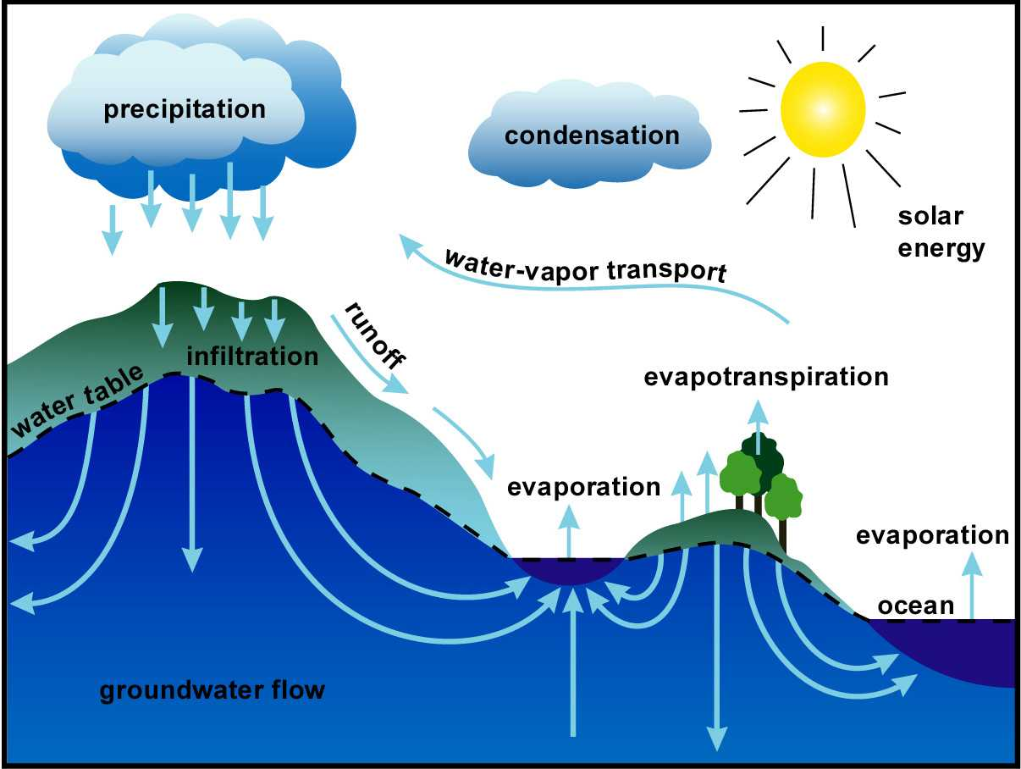
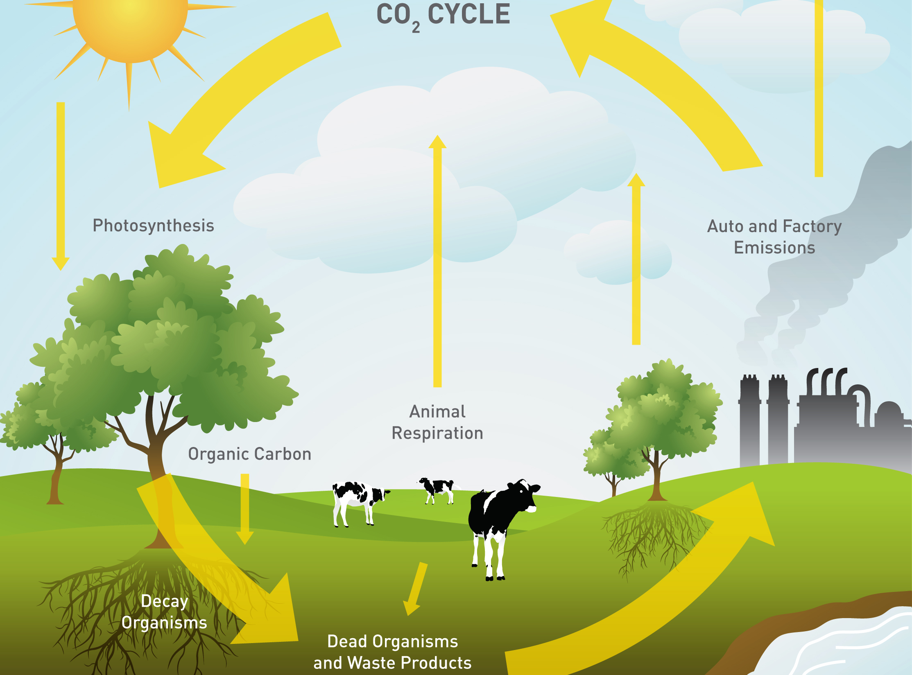
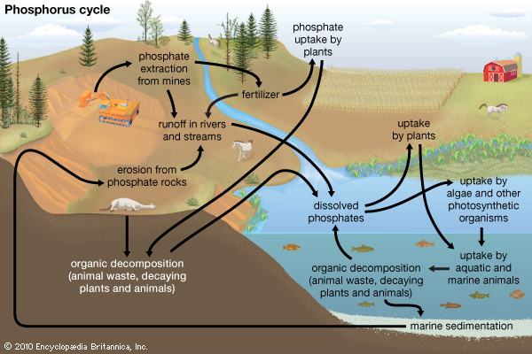
Cycles in Nature
Week 6

Slide 4
9/21 The Carbon Cycle Obj. TSW explain how the carbon cycle works and why it is important. P. 48 NB
What is the Carbon Cycle?
How are we part of it?
Name two processes that are part of the carbon cycle.

Slide 5
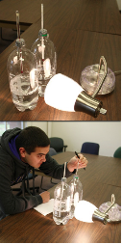
Demonstration!
What do you think will happen to the temperature of the two bottles?
What is Global Warming?
How is this an example of the Carbon cycle?
P. 21 PDF
Image Source: http://mrcc.isws.illinois.edu/resources_links/downloads/HowTo_GreenhouseEffect.pdf

Slide 6
Carbon Cycle
Wednesday – Computer Lab PhET – Chemistry Greenhouse Gas
Study the other cycles in Nature
McAllister Will grade your Notebook P. 35 -44 50 points
Work on typing up your project
Do research on your project
Research http://hmclause.com/
http://calrice.org/
http://www.farmersrice.com/

Slide 7
9/22 Nitrogen Cycle Obj. TSW explain the Nitrogen cycle and why it is important. P. 50 NB
What is the Nitrogen Cycle?
Why is the Nitrogen cycle important?
Name a process in the Nitrogen Cycle.

Slide 8
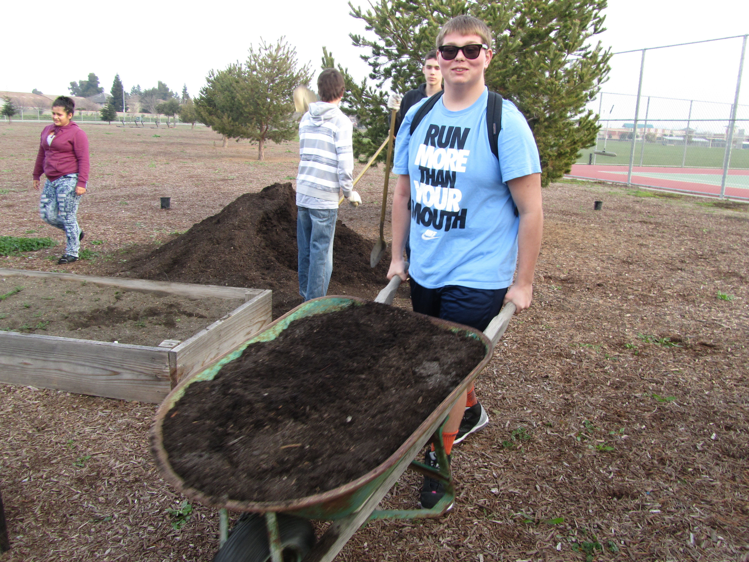
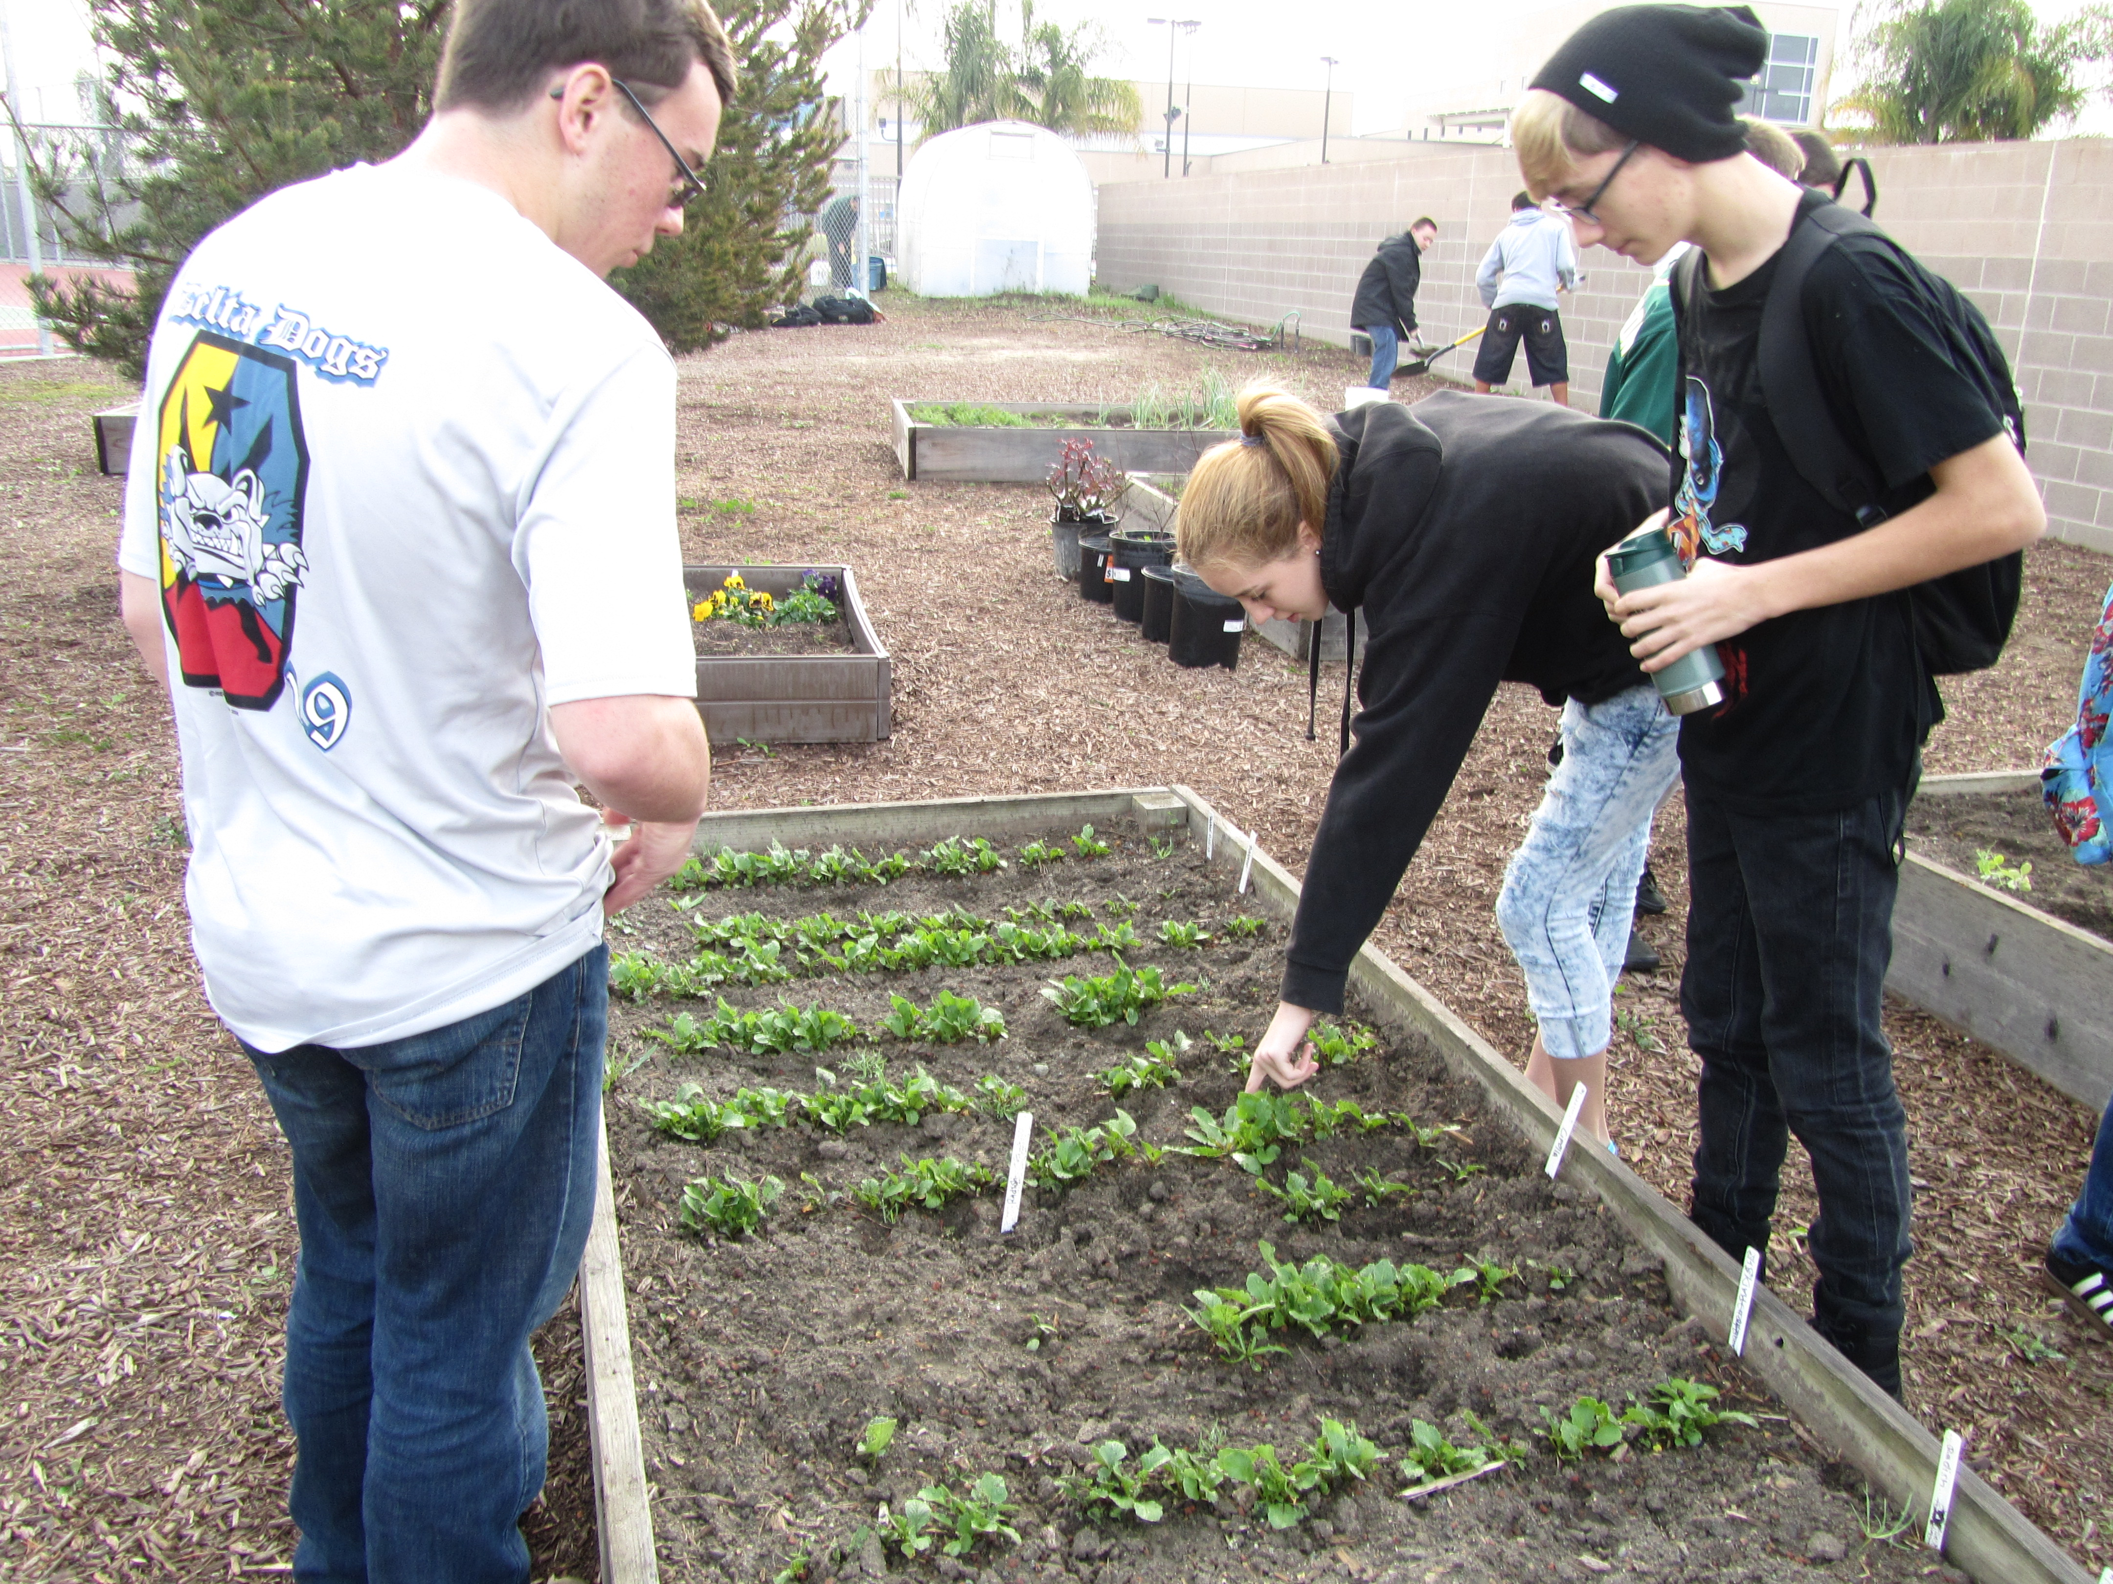
Projects p. 29 NB
What can you do to make a positive difference in our garden?
How can you be part of the solution to feed healthy food to our fellow students?
How can you help make our garden be more sustainable?
How can you help make our school more sustainable?
How can you help inspire a younger generation to grow healthy food?

Slide 9
Project Ideas – Need more Diversity
Explore the benefits and costs of Solar
Explore the benefits and costs of Biodigestion, Composting, Recycling
Explore and learn about what it takes to maintain the school property.
So Far we have: watermelon, milk, flowers, strawberries, Flower bed, Flowers for the Administration, growing rice, growing black berries, raspberries, three types of liquids to water with, pumpkins, carnations, carrots

Slide 10
9/23 The Water Cycle Obj. TSW explain the water cycle and why it is important. p. 52 NB
What is the Water Cycle?
Why is the Water Cycle important?
What are some processes in the Water Cycle?

Slide 11
9/24 Phosphorous Cycle Obj. TSW explain the phosphorus cycle and why it is important. p. 54NB
What is the Phosphorus Cycle?
Why is it important?
What are some of the processes in the Phosphorus cycle?

