Slide 1
Farm to Fork
UNIT 4 Feed the World
Economics, Poverty, Population and Carrying Capacity, Genetically Modified Organisms

Slide 2
Lesson 4: Populations-People & Carrying Capacity
F2F1 UNIT 4
Global Food

Slide 3
AET Website
Log in using your username and password.
Complete your profile.
Enter your SAE specifics.
Include all volunteer hours and POA’s for FFA.

Slide 4
Greenhand Test
Jacob, Miguel, Quincy look at the test and figure out which questions you got wrong and why.
Students get into one of the 3 groups of Jacob, Miguel and Quincy.
Get a Official FFA Manual
Page 47 Notebook – Write down the questions you got wrong, find the answer in the FFA Manual, Write the answer in the Notebook. Discuss the correct answer with your team leader.
Then students can retake the test again.
Must earn a 20 or > to be Proficient to earn your Greenhand degree.

Slide 5
SAE Qualification Questionnaire Your SAE must be agriculturally related, created by you, invested time of 8 hours, supervised by your Ag Teacher and be part of your grade.
How does it provide real work situations?
What careers is it related to?
How is it part of your career goal?
List the skills, knowledge and attitudes you need for this career that your SAE might apply to.
How can you grow, and become more competent each year in the Ag program with this SAE?
How does your SAE allow for expansion, and/or change?
Have you kept records of your money, and time?

Slide 6
Earth’s Carrying Capacity Obj. TSW learn how the increase in world population will have an impact on them. P.60 NB
Approximately how many people live in CA?
Approximately how many people live in the US?
Approximately how many people live on the Planet?

Slide 7
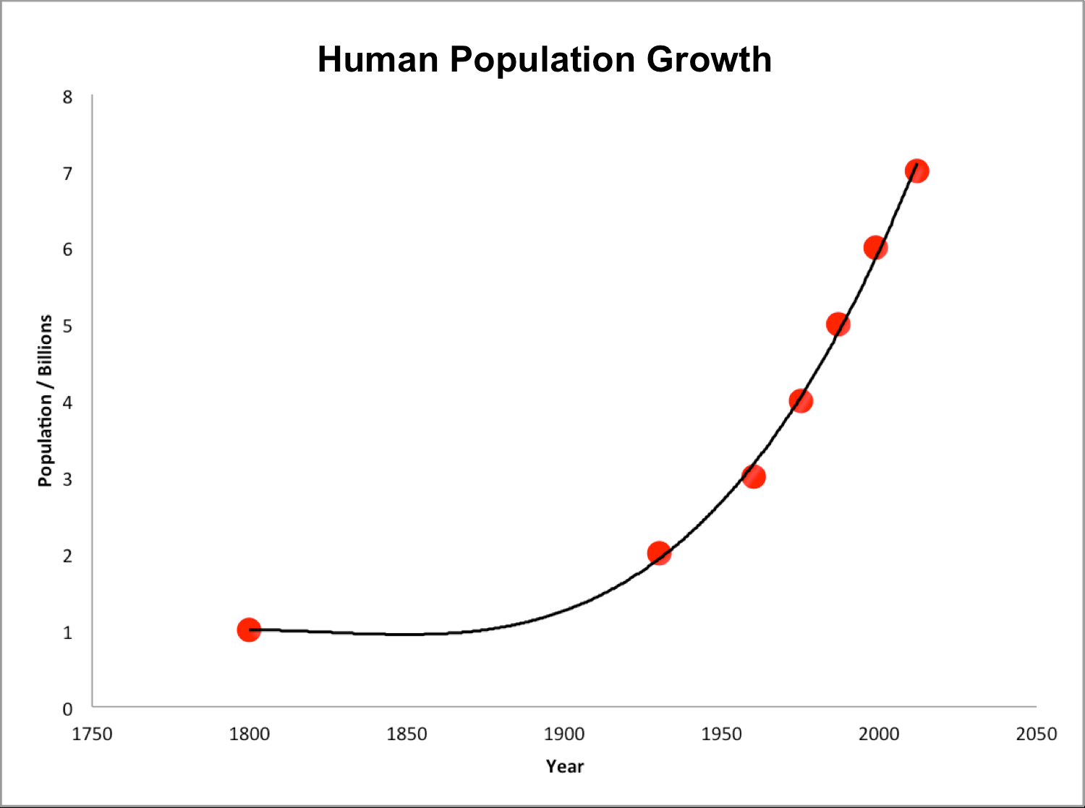
Earth’s Human Population Growth

Slide 8
Activity: Population Growth Analysis
Introduction of Reindeer to St. Matthews Island in Alaska.
Analyze the graph of the growth of Reindeer from the original 29 that were introduced to St. Matthew’s Island.
Answer the 5 Preview questions.
Answer the analysis questions in complete sentences.
Finally, is there any relevance between this example of overpopulation and the human population on the Planet? 2 – 3 sentence answer.

Slide 9
United Nations p. 63 NB Integrating Population Issues into Sustainable Development
Students research the website:
Who are the United Nations?
What do they do?
How are they part of the solution for sustainable development?

Slide 10
12/14 Earth’s Carrying Capacity Obj. TSW understand that Biocapacity of countries and the carrying capacity of the planet are interlinked. P.62 NB
What are limiting factors in a Carrying Capacity graph?
What are some Density Dependent Factors?
What are some Density Independent Factors?

Slide 11
12/15 Sustainability Worldwide Obj. TSW apply and discuss why it is important for sustainable practices to be enforced worldwide.p.64 NB
Describe sustainability.
Describe 3 sustainable practices you have learned in this class.
What are the implications of increased population growth if sustainable practices are not enforced?

Slide 12
How to end poverty in 15 years video
I have no TV.com
Take notes on page 67 NB

Slide 13
Online Article: Has Earth reached its Carrying Capacity? P. 65 NB

Slide 14
Maxine Abrulo – Coit Tower P. 69 NB
Answer questions from the WS.

Slide 15
Summative Assessment
Students should answer the following questions after they have gathered all their research:
Which of your five foods did you find for sale in other circulars? Why do you think they were for sale in more than one place?
Which of your 5 foods were more expensive or less expensive? Why do you think that is?
Notice and write about any trends that developed at certain grocery stores. For example, was the Dollar Store always the cheapest? Why?
Finally, the class will have a discussion about the supply and demand of food in our grocery markets.
What drives the economy of food?
Students will write a reflective 1 page paper summarizing all the activities from this key assignment, tying in the biocapacity of countries, the imports of food from other countries, and changes they may make in their lifestyle as a result.

Slide 16
Sustainability

Slide 17
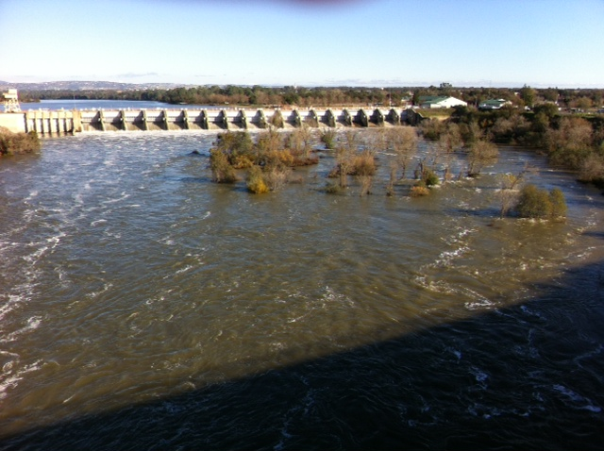
American River at Nimbus Dam
December 17, 2016

Slide 18
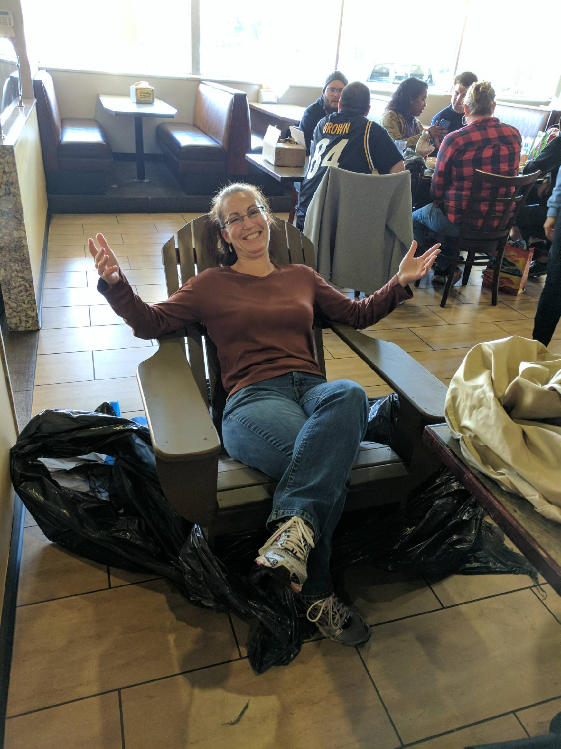
RCHS Construction Students make McAllister an Anderondike Chair for Christmas!

Slide 19
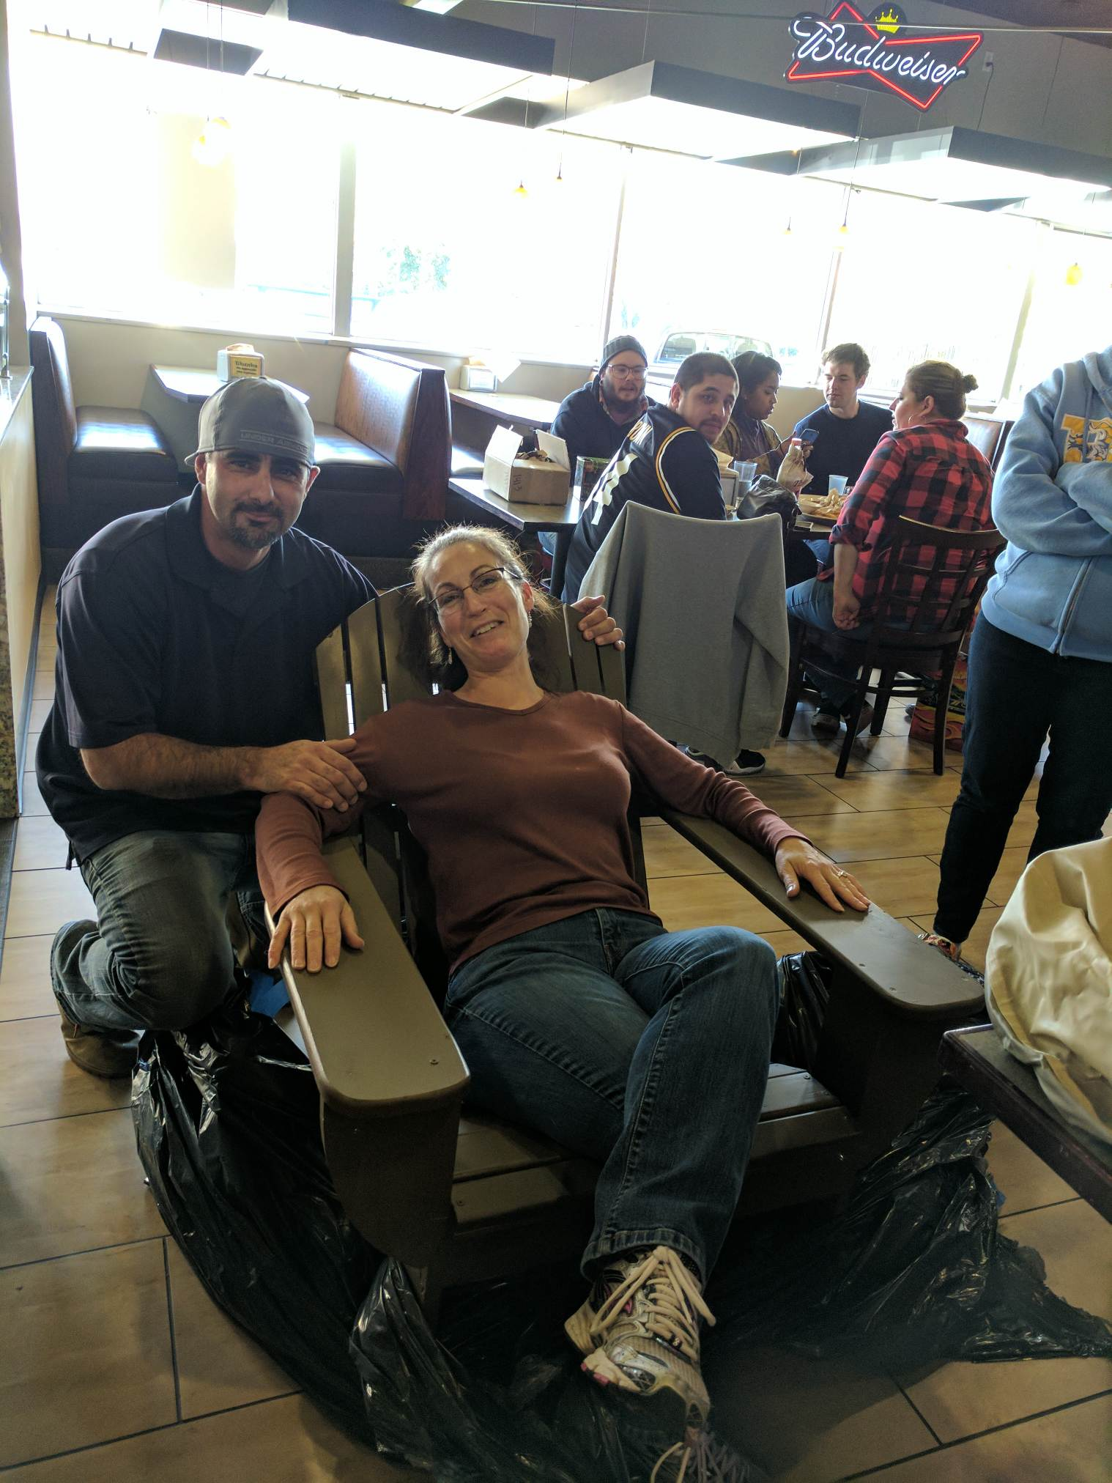
Thank you Mr. Billington for teaching your students how to make Adderondike chairs!

Slide 20
January 3rd From the Soil Obj. TSW gain a better perspective of the importance of healthy soil. P. 66 NB
What are the components of healthy soil?
Why is Farm to Fork important?
Explain what you have learned about growing healthy food for RCHS students and Culinary?

Slide 21
Second Barcode
Take 3 – 4 Notes in the 2 minute video.
After watching the short video clip, what are your thoughts?
How realistic is a second barcode?

Slide 22
Activity: The Story of Food nourish.org
Objective: Students examine food labels and conduct research to trace food paths from the original plant or animal source. They then make posters describing the story of a particular food.
Question: How does the way food is raised, processed, transported, and eaten impact both people and the environment?
Read the background information.

Slide 23
1/4 Bayer Crop Science Obj. TSW learn about local companies that play a role in our Agricultural success. p.68 NB
What association do you have with Bayer?
Why would a Pharmaceutical company get involved with Crops and growing Food?
How does what you have learned about Bayer Crop Science under score the importance to growing healthy food worldwide?

Slide 24
Final Presentation –PPT
Farm to Fork Project PART 2 DUE McAllister needs to review your progress of your project before January 8TH.
PPT Individual: 10 – 15 Slides PPT Two students: 15 – 20 Slides
Introduction: Briefly review your project for us.
Data
Qualitative Data: Words, Descriptions, Pictures, Video
Quantitative Data: Tables, Charts, Graphs
Data Analysis
What does the data mean?
What were some things that you learned from mistakes you made?
What would you do differently next time?
Conclusion
Explain what your project meant to you and how the class Farm 2 Fork has helped you gain a better understanding of your project/ gardening caring for plants/& or soil . If you were in charge of feeding the world, or creating more sustainable practices worldwide how you would go about it?
Works Cited Title. Author. Website link.
Yolo Farm to Fork. By Dorthy Peterson. Dir. Dominic Machi. Perf. Beth Harrison. Yolo Farm To Fork. Yolo Farm to Fork.org, n.d. Web.

Slide 25
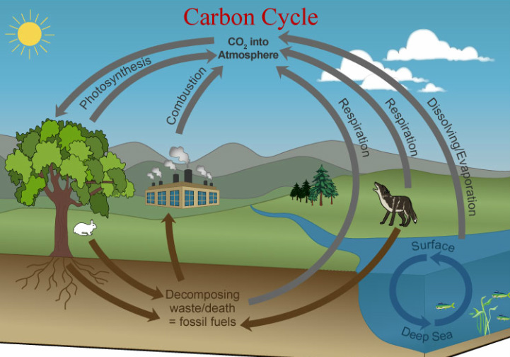
Carbon Cycle Review P. 84 NB Obj TSW review how important the carbon cycle is to us.
What is the Carbon Cycle?
How does CO2 cycle through the Biotic and abiotic factors?
List 6 processes of the Carbon cycle.

Slide 26
Greenhouses & Carbon Cycle Activity. p. 85NB
"What happens to the carbon dioxide you breathe out or the carbon dioxide released from a burning paper?”
How does the carbon cycle influence the greenhouse effect?
How do greenhouses utilize the greenhouse effect to promote plant growth?
How is greenhouse plant cultivation a sustainable practice?

Slide 27
Students will draw the carbon cycle. Labeling the 6 processes that take place: Photosynthesis, Cellular Respiration, Exchange, Sedimentation & Burial, Extraction and Combustion. Students will gain a better understanding of how carbon cycles between the atmosphere, geosphere, hydrosphere, and biosphere form their graphical simulation of the carbon cycle.

Slide 28
Bayer Crop Science P. 85 NB
Where is Bayer Crop Science in West Sac?
What does Bayer Crop Science do concerning agriculture?
Give 3 examples of how they are involved in agriculture.
How does it relate to Farm to Fork?

Slide 29
1/5 Food Inc. Obj. TSW make connections between how food is produced and why Farm to Fork is so important. 86 NB
What impression was left on you by the movie Food Inc.?
What did you learn from Food Inc. that changes how you think about food?
If you got to meet Micheal Pollan in person, what would you like to ask him?

Slide 30
1/9 Nourish.org Obj. TSW learn p. 88 NB
Name three things about the video that you learned.
How does Nourish relate to Food Inc. and to Farm to Fork?
How has Nourish changed your thinking about food? And what is healthy.

Slide 31
1/10 Understanding where our food comes from Obj. TSW explain three aspects of how this class has impacted themselves, or the school or the community. P. 90 NB
If someone were to ask you, “What was the Farm to Fork” class like? How would you describe what was taught in the class?

Slide 32
1/11

