Slide 1
Global Food
Week 16 Poverty, Not just a lack of money
Farm to Fork 1
Dec. 7th – December 11th

Slide 2
F2F Agenda Week 16 Dec. 7th – 11th
Monday – Classroom – WU, Practice Public Speaking ,WS #11 & 12 p. 57NB, Jeopardy p. 65NB
Tuesday (Minimum Day)– Room 801 – WU, Practice Public Speaking, Activity - Feed the Need p. 67NB & Voc. Poverty, Not just a lack of $ p. 69NB
Wednesday – Classroom – WU, Practice Public Speaking, Garden
Thursday – Room 801 - WU – Practice Public Speaking, Activity: Who controls the Food? Write Reflection. P.71 NB
Friday – Classroom – WU – Lecture – Notes P. 73NB, Video , Notes p. 75NB

Slide 3
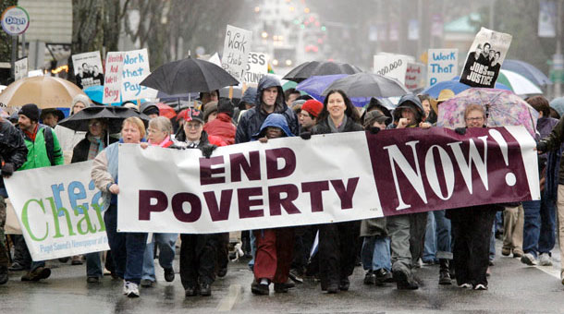
12/7 Poverty, Not Just a lack of $ Obj. TSW learn about poverty and why it still exists. P. 64 NB
What is poverty?
What does poverty look like?
How are food insecurity and poverty related?

Slide 4
12/8 Feed the Need Obj. TSW research local, state-wide, country-wide, and international programs that work to feed people. P. 66 NB
Off the top of your head, what are some organizations that feed people in poverty.
Would you volunteer at some of these organizations?
How can we be part of the feed the need?

Slide 5
Answer the following questions…p. 65NB
Was the product you wanted the cheapest? If it was not, how much more expensive was it? Were you surprised by this?
Was there any product that was more money than you originally said you would not spend on it?
Using your individual bottle of water as an example, if you were to buy a case of water containing a 24 pack for $4.99, how much money would you save?
Why does it pay to buy in bulk? Is there a downside?
How does this relate to Supply and Demand?

Slide 6
Computer Lab Room 801 December 8th & 10th
Tuesday –Minimum Day! 9:22 – 10:16
Thursday – Regular Day

Slide 7
12/9 Solutions to Feed the Need: GMO’s Obj. TSW research the pro’s and con’s of GMO’s as a solution to decrease poverty. P. 68 NB
Look at the picture to the left. Compare the two types of tomatoes. Which one is GMO?
What examples of GMO do you know about?
Explain Genetically Modified Organisms in your own words.

Slide 8
11/10 Who Controls the Food? Obj. TSW have a greater understanding of how countries can import and export food. P. 68 NB
What country has the most people?
What country has the least amount of food?
What country has the most food?

Slide 9
Who Controls the food? P. 67NB
You will be assigned a country.
Stand Next to your country.
Then the food will be handed out in proportion to the amount of food that country has.
How did you feel about the amount of food your received?
Is it fair that North America has the majority of the food but not the majority of the people?
Write a ½ page reflection describing your feelings about this experience. For example, how did it feel to have minimal food when others had more than they needed?

Slide 10
GMO Research Activity P. 69 NB
Pro GMO
Find 6 Arguments for GMO’s Con GMO Find 6 Arguments against using GMO’s

Slide 11
12/11 Pro’s & Con’s GMO’s Obj. TSW create an argument for or against GMO’s. P. 72NB
From your research yesterday, write three arguments for GMO’s.
From your research yesterday, write three arguments against GMO’s.
What is your opinion about GMO’s.

Slide 12
P. 71 NB
Write a reflection about the GMO debate. State your claim and include evidence for support.
Evaluate what could have been improved for individuals, or group performance?

