Slide 1
Farm-to-Fork
Week 3
Compost, Fertilizer, F2F Brochure, “I believe” statement, Elections

Slide 2
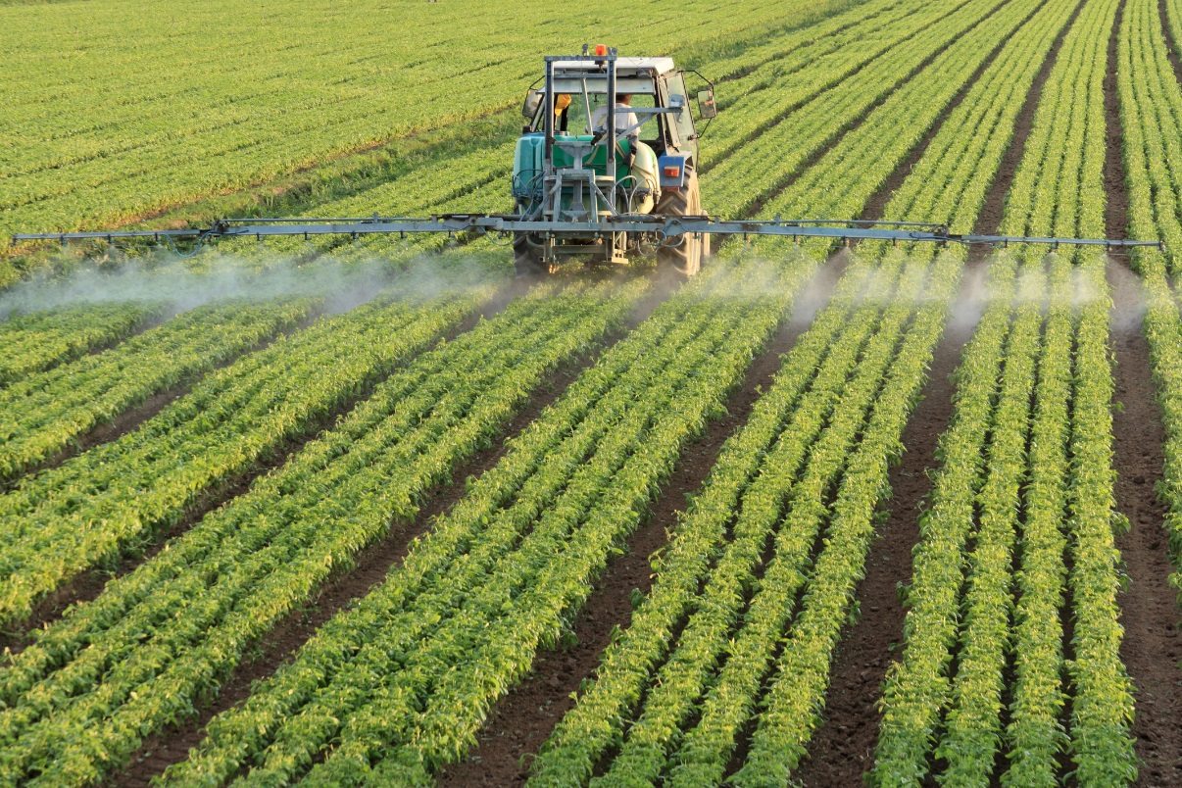
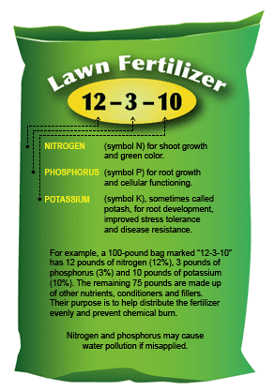
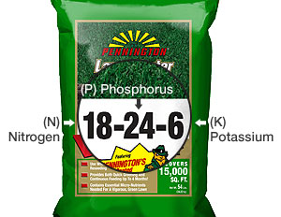
8/31 Types of Fertilizers Obj. TSW learn about different types of fertilizers by taking notes and experimenting. P. 22 NB
What is fertilizer?
How can fertilizer help plants grow?
What are the three main elements in fertilizer?

Slide 3
Fertilizer Notes Page 17 NB N-P-K
Nitrogen (N) – Promotes new green growth
Component of Proteins, DNA, RNA, ATP, and Chlorophyll
Phosphorus (P) – Promotes production of blooms, flowers, seeds, and root development.
Component of DNA, RNA, and ATP
Transplanting
Potassium (K) – Promotes cell-wall thickening, protecting plants against cold temperatures, pests, and disease.
Regulates water use and nutrient movement in cells
Activates plant enzymes involved in processes such as photosynthesis and respiration

Slide 4
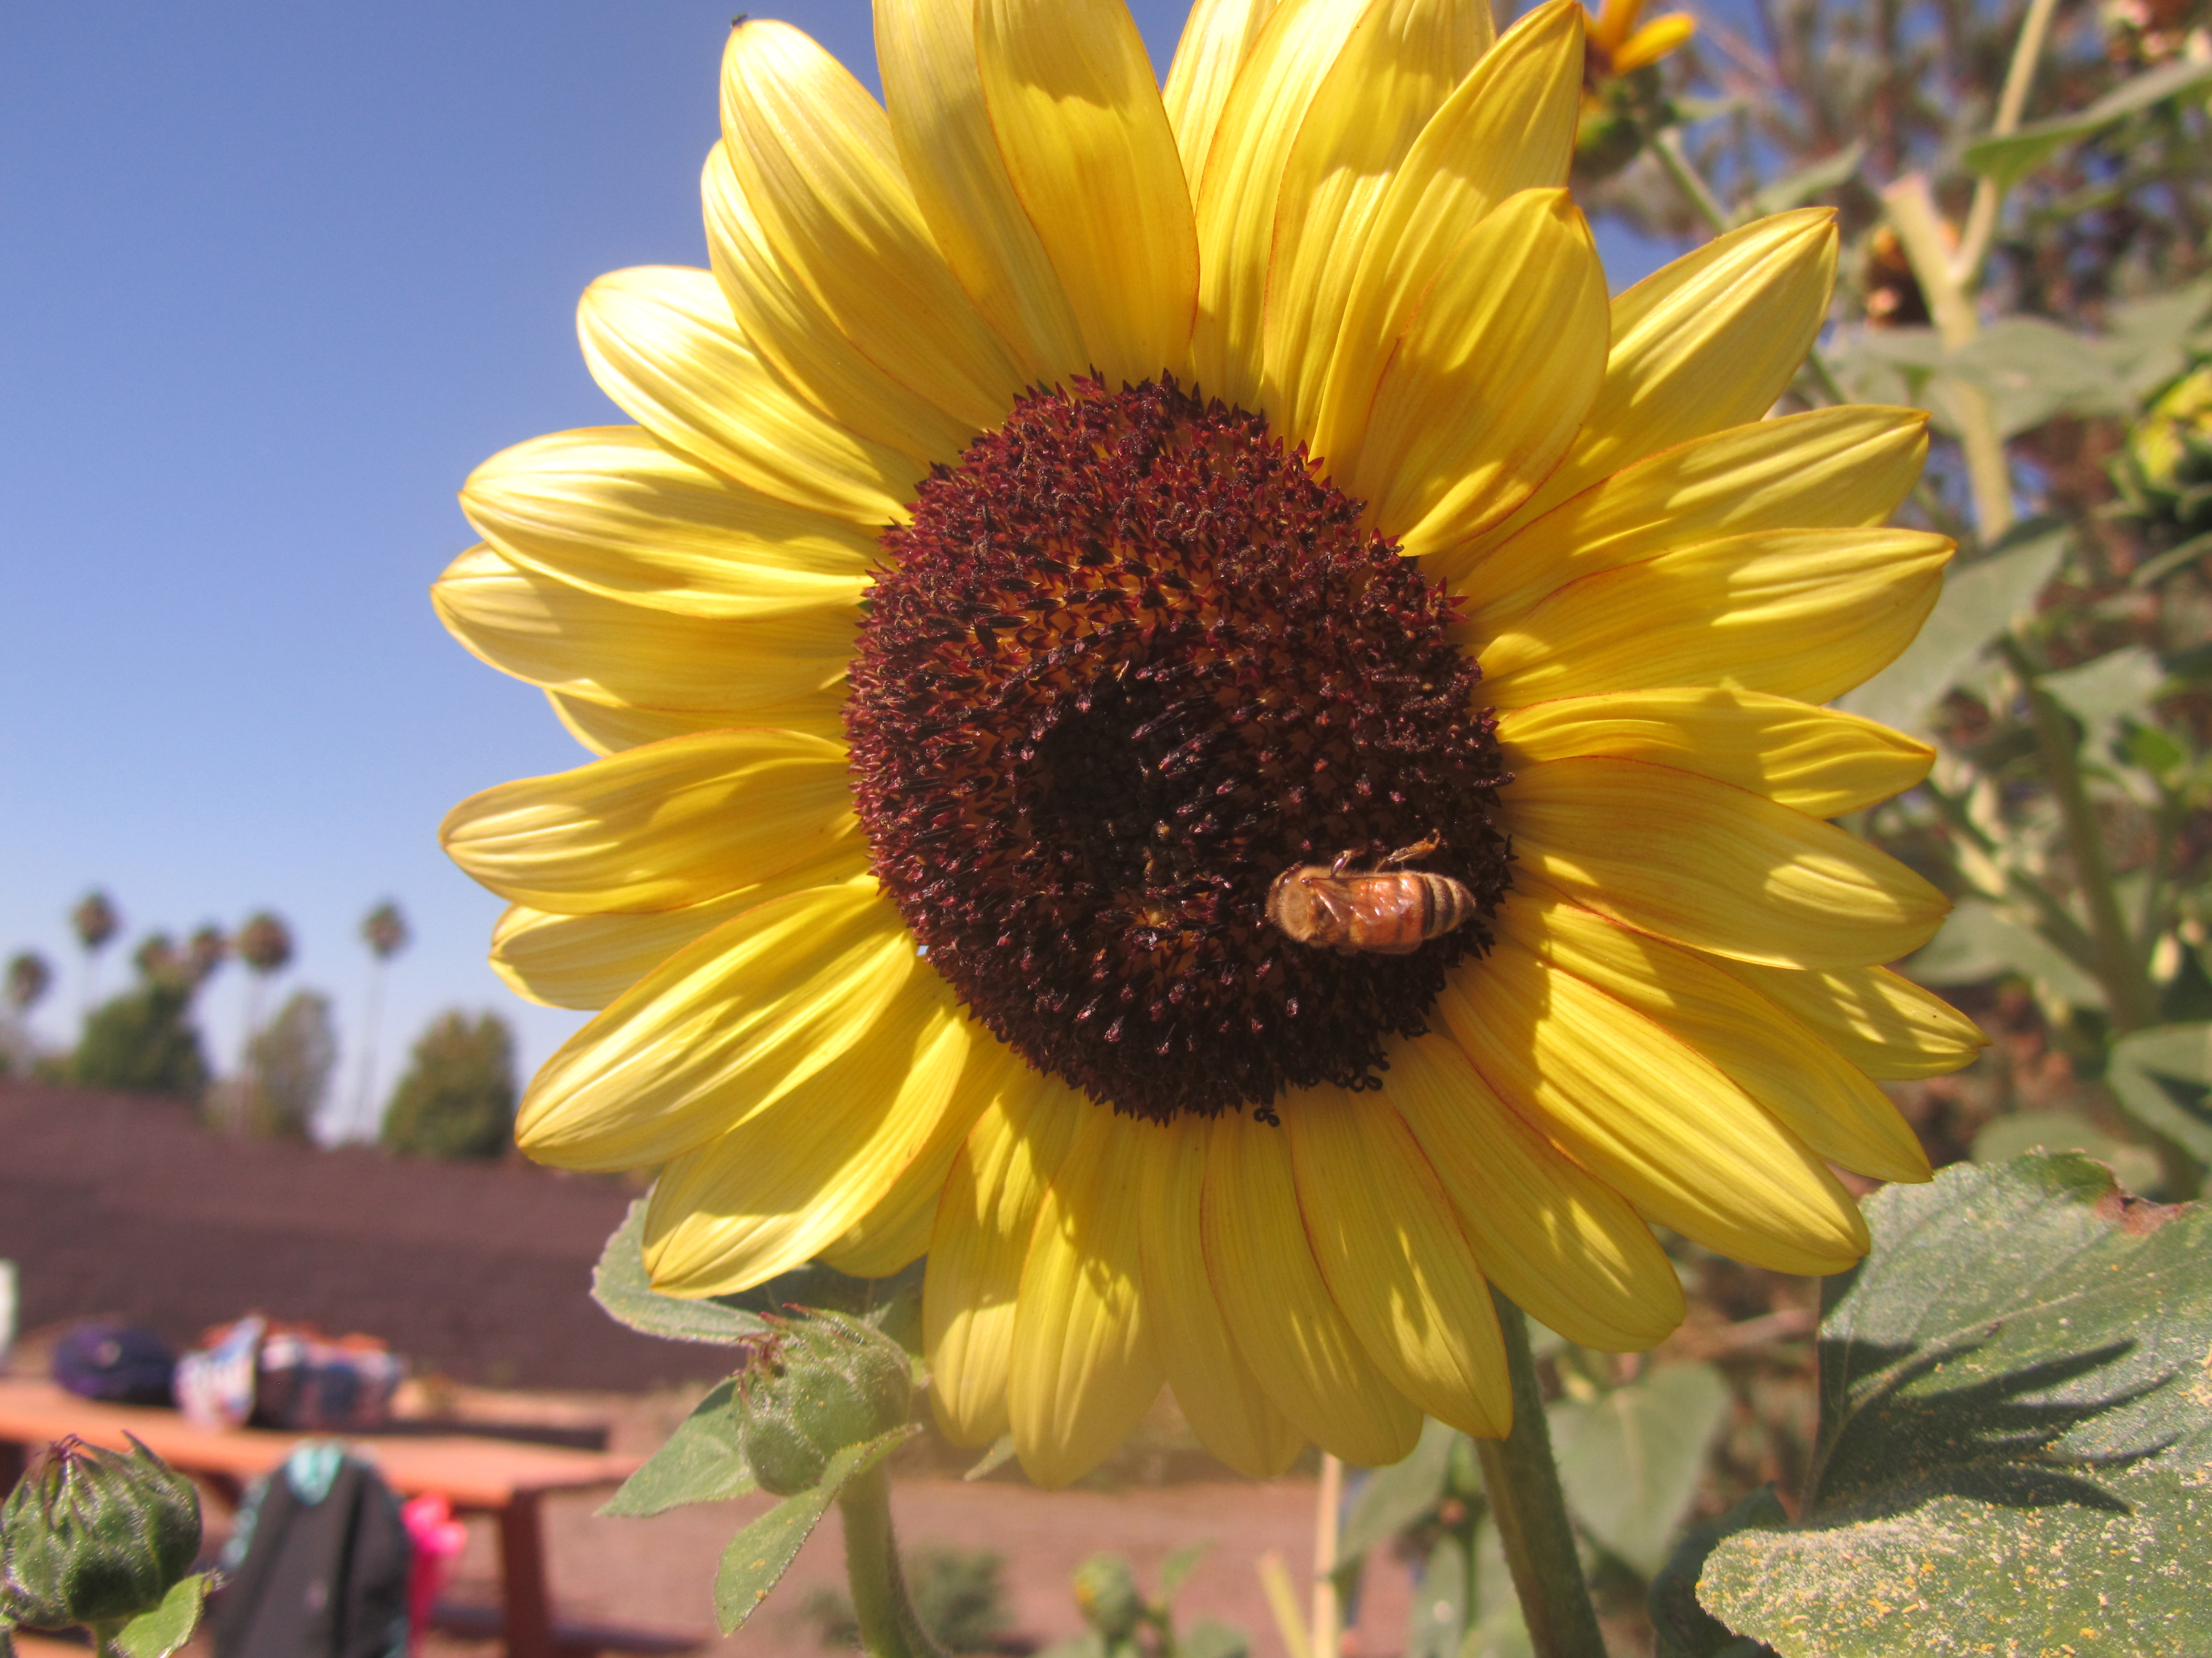
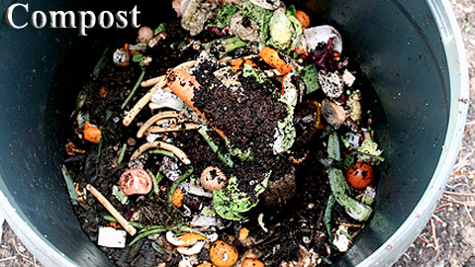
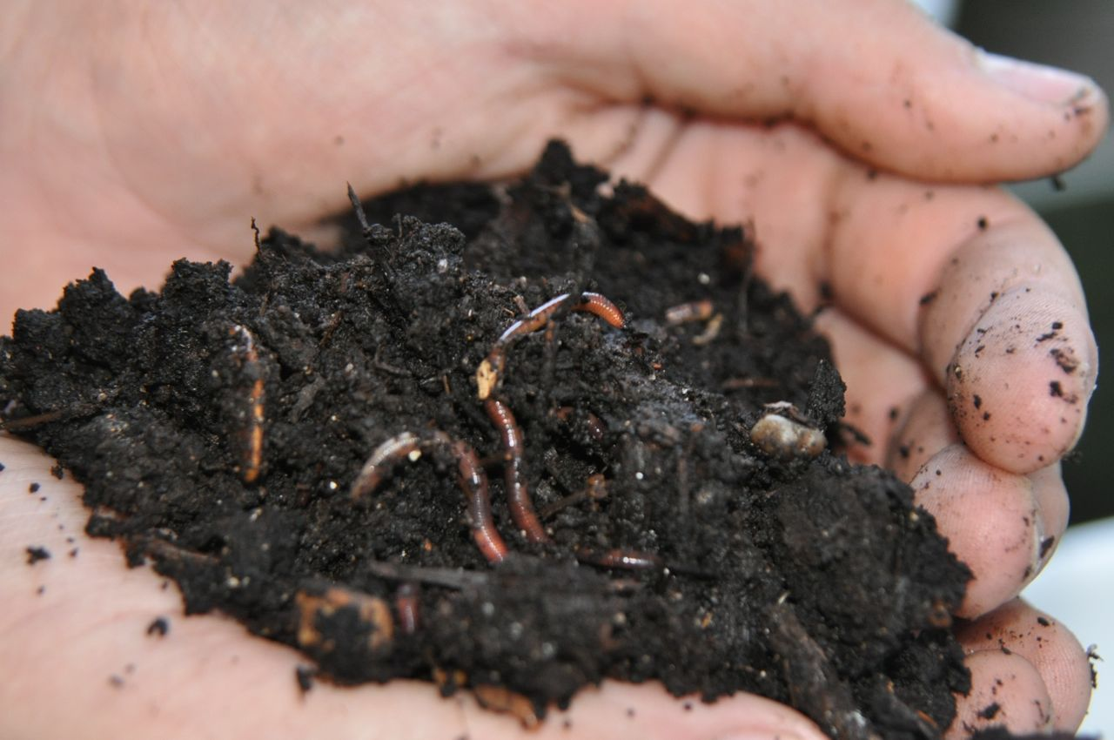
9/1 Compost Obj. TSW finish their Farm-to-Fork Brochures in the career center and email them to me as an attachment. P. 24NB
What is compost?
What can go into compost?
Write three benefits of composting for garden use.

Slide 5
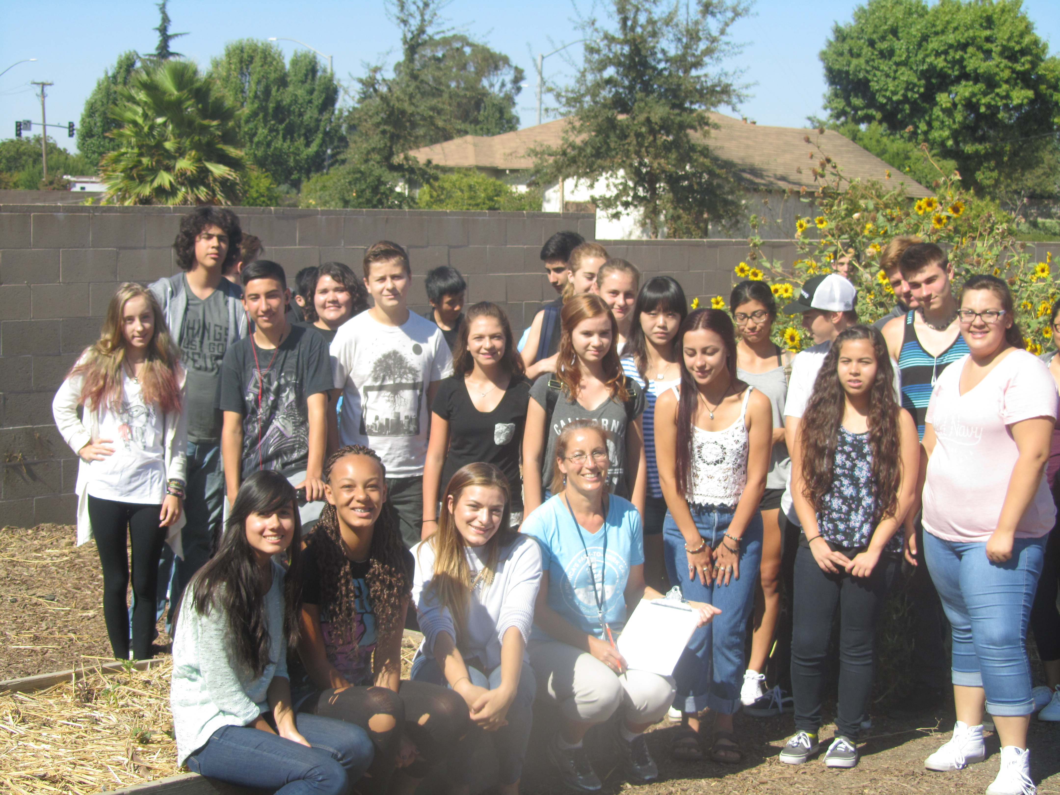
Farm-to-Fork Fall 2015

Slide 6
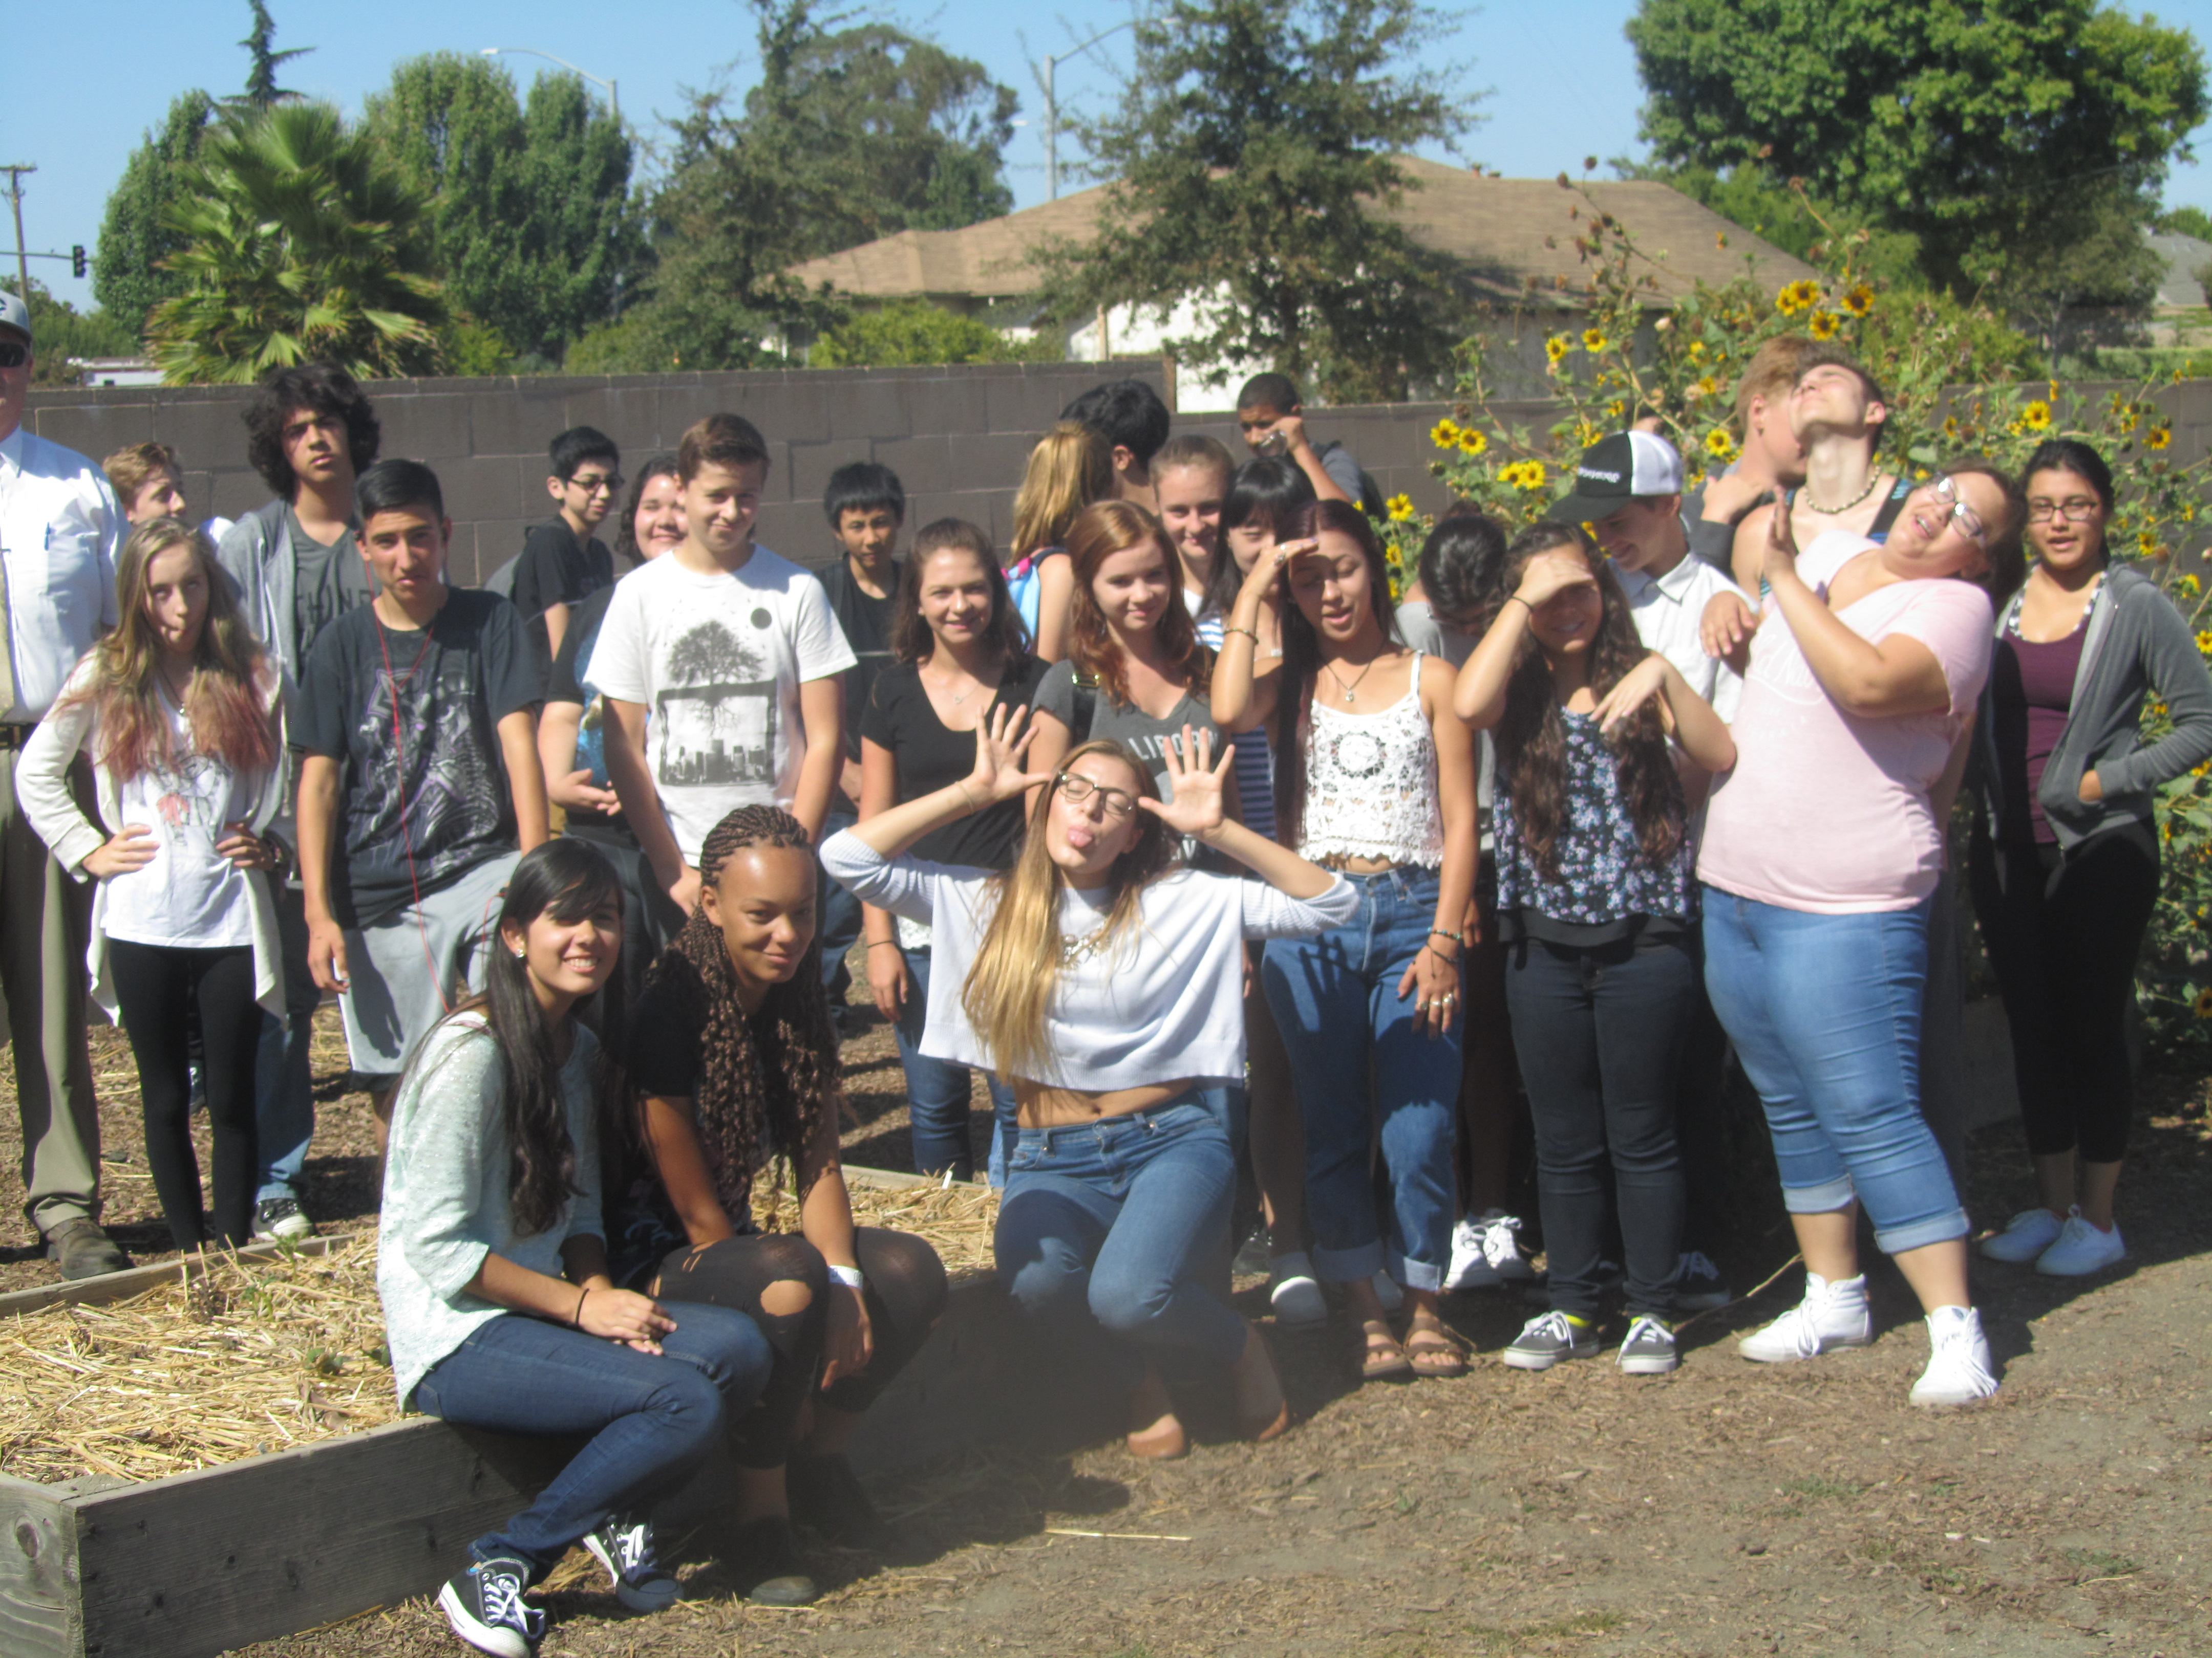

Slide 7
Mr. Hauptmann
Vice Principal

Slide 8
Compost Notes p. 15NB
Compost – any plant material that can be broken down by microbes, insects, and worms.
Adds moisture, nutrients, and biodiversity to garden bed.
30% Green Nitrogen containing Compost
70% Brown Carbon containing Compost
Keep moist, turn regularly
Add red wiggler worms, worm castings are good for the soil
More productive
Aerate the soil
Help breakdown organic matter into usable nutrients for plants

Slide 9
8/31 Agenda
Work in the Garden
Plant flower seeds for the greenhouse
Weed
Add compost & turn
Add Worms to compost
Add worms to each garden bed
Dead head flowers
Cut flowers for delivery
Plant Cilantro – New garden bed
Water
Clean area by greenhouse
Clean inside of greenhouse
Move rocks to under water station.- less weeds, or mud
Sign up on list

Slide 10
jmcallister@wusd.k12.ca.us

Slide 11
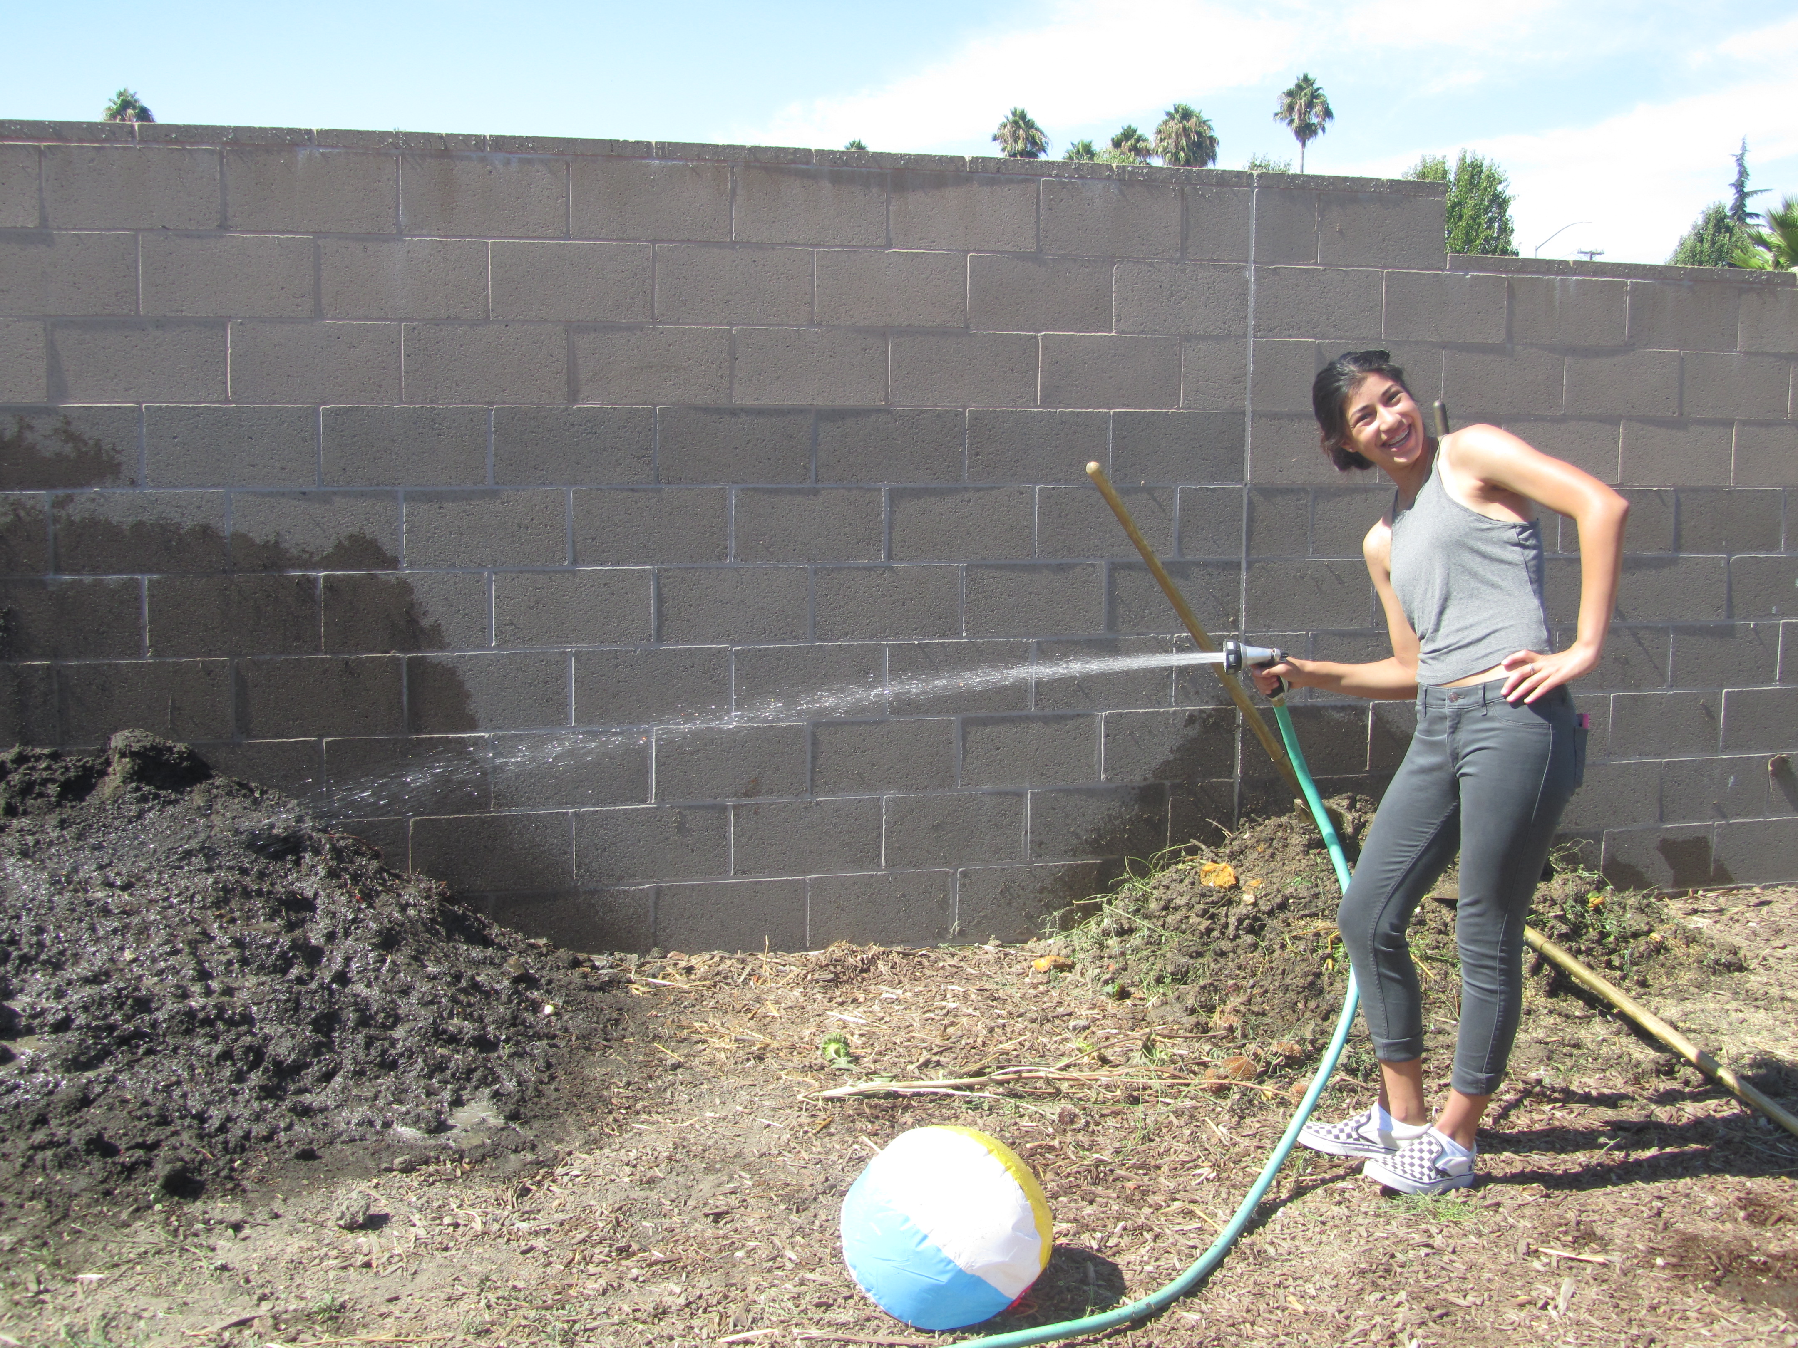
9/2 Three Types of Soil Obj. TSW learn about sand, silt and clay to understand how nutrients are held. P. 26 NB
What are the three textures of soil?
How properties might the three soil textures differ in? What would sand be good for?
How could you determine your type of soil?

Slide 12
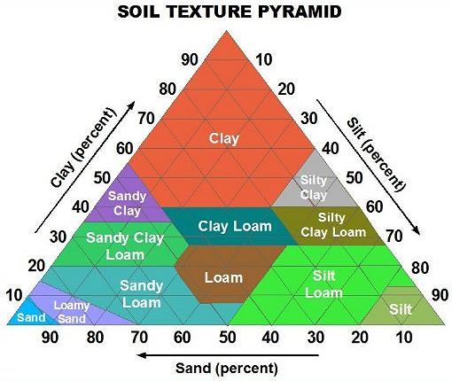
Ribbon Test
Types of soil:
Sand, Silt, Clay

Slide 13
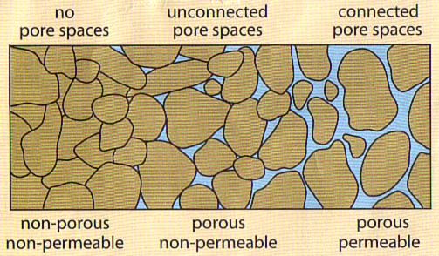
9/3 Porosity & Permeability Obj. TSW Learn about Porosity and Permeability of soils and how to create healthier soils. P. 28NB
What do you think porosity is?
What do you think permeability is?
How might they be important to soils?

Slide 14
Farm-to-Fork Festival
Saturday September 26th
^{Counts as Service Learning}
Two Shifts AM 11:30 – 3:30
PM 3:30 – 7:30
Please sign the sign up sheet, with your contact information.

Slide 15
9/4 Characteristics of Soils Obj. TSW learn how to create healthy productive soils. P. 30 NB
What did you observe yesterday during the porosity/ permeability demonstration? Emiliano, Where are my pictures? ☺
The 2-liter bottle that had gravel with dirt allowed the water to flow faster than our beautiful healthy compost, why?
What else could we add to our compost that we are improving that might improve drainage/permeability? Phillip – what did you do yesterday?

Slide 16
Nutrient availability
What pH is the most beneficial?

