Slide 1
Understanding Water
UNIT 1 KA 3
Week 3

Slide 2
This water is making me thirsty!
Why is the man dying even though he is surrounded by water?
What is dehydration?
How does it impact the body?
What % of the body is water?

Slide 3
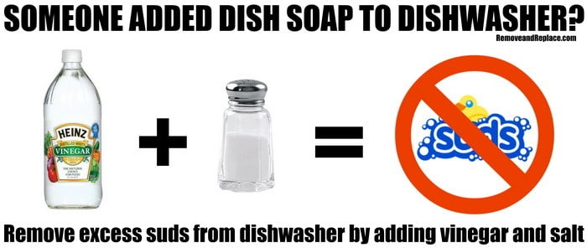
3/16 To Suds or not to suds? Obj. TSW learn how salts effect the suddiziness of soap. P. 82 NB
Write some experiences you have with soap and water.
What could limit the amount of suds you have with water?
Compare & contrast the words of dilution and saturation.

Slide 4
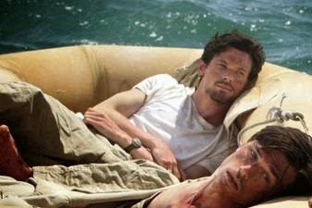
3/15 Water, Water Everywhere, not a drop to drink Obj. TSW learn about characteristics of water. P. 80 NB
Is the water we drink Pure? H₂O?
What other minerals could be in it?
What could happen if cells from a freshwater organism were placed in a saltwater solution?

Slide 5
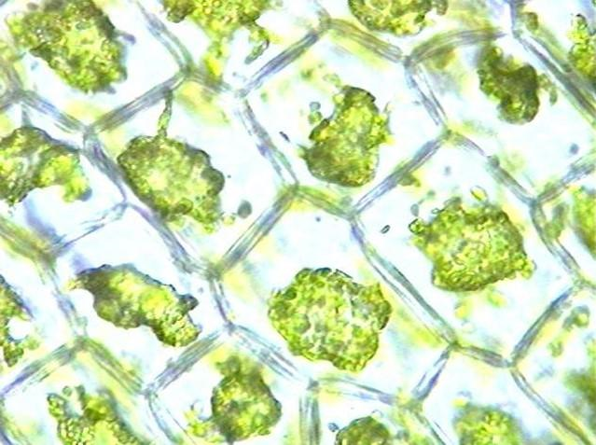
Cells in a Sugar Solution & Distilled Water & Salt Water What happens to the cells in sugar solution and salt solution?

Slide 6
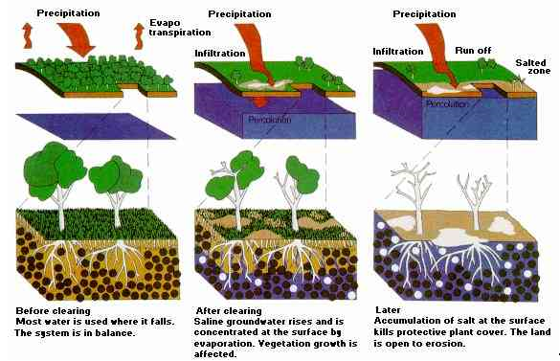
Salinization
Salinization Article
Central Valley Salinity

Slide 7
Activity/ Project Construct an Aquaponics Model
From the pictures, How does an Aquaponics Model work?
What are some benefits of this system?
Draw sketches of what you think your model should look like in your notebook.
Write a detailed description of your model as you are building it.
When you are done designing and building your model, write a reflection of what went well and what you would improve on.

Slide 8
Aquaponics in North Carolina & Haiti
How can Aquaponics benefits people though out the world?
Read the article, & answer the following questions:
1. Do you think the general tone of the article is optimistic or pessimistic? Why?
2. Why did Morgan travel to Haiti after the 2010 earthquake?
3. What is the main reason the Haitian people face food shortages?
4. Who was George Powell?
5. How do the teenagers at Stonewall Jackson help?

