Slide 1
Propagation
Week 8

Slide 2
10/5 Vegetative Propagation Obj. TSW learn how plants make more plants, without producing typical seeds. P. 68NB
What is a flower bulb?
What is a strawberry runner?
What is a rhizome?

Slide 3
10/6 Farm-2-Fork Movement Obj. TSW understand that gardening can happen in several different ways. P. 70 NB
Why did the F2F movement take hold here in Sacramento?
What is the difference between a rural and urban farm?
What is Roof Top Gardening?

Slide 4
Computer Lab
Library today –
Career Center – tuesday
Assignments: Finish Paragraph for Fertilizer P. 59 Fritz Haber
Work on Nitrogen Worksheet P. 61 NB
Work on F2F Project to present on Thursday October 15th.
Present to class or turn in a paper to McAllister

Slide 5
10/7 Sustainability Obj. TSW apply the concept of sustainability to real world examples on a ranch and in our garden. P. 72 NB
What does sustainability mean?
What sustainable practices do we have in our garden? On Campus?
For the Fieldtrip, look at sustainable practices on the ranch.

Slide 6
10/8 OMG GMO Video Obj. TSW watch the video quietly and take notes about Genetically Modified Organisms. P. 74 NB
What does GMO stand for?
Before you watch the video, is it a good thing or a bad thing?
What do you already know about GMO’s?

Slide 7
10/9 O’Connell Ranch Fieldtrip Obj. TSW share sustainability practices and any information about GMO’s learned on the Fieldtrip. P. 74 NB
What sustainable practices did the O’Connell Ranch use?
Did they use any Genetically Modified Organisms on their ranch? If so why?
Share three things about the GMO video or the fieldtrip to O’Connell Ranch.

Slide 8
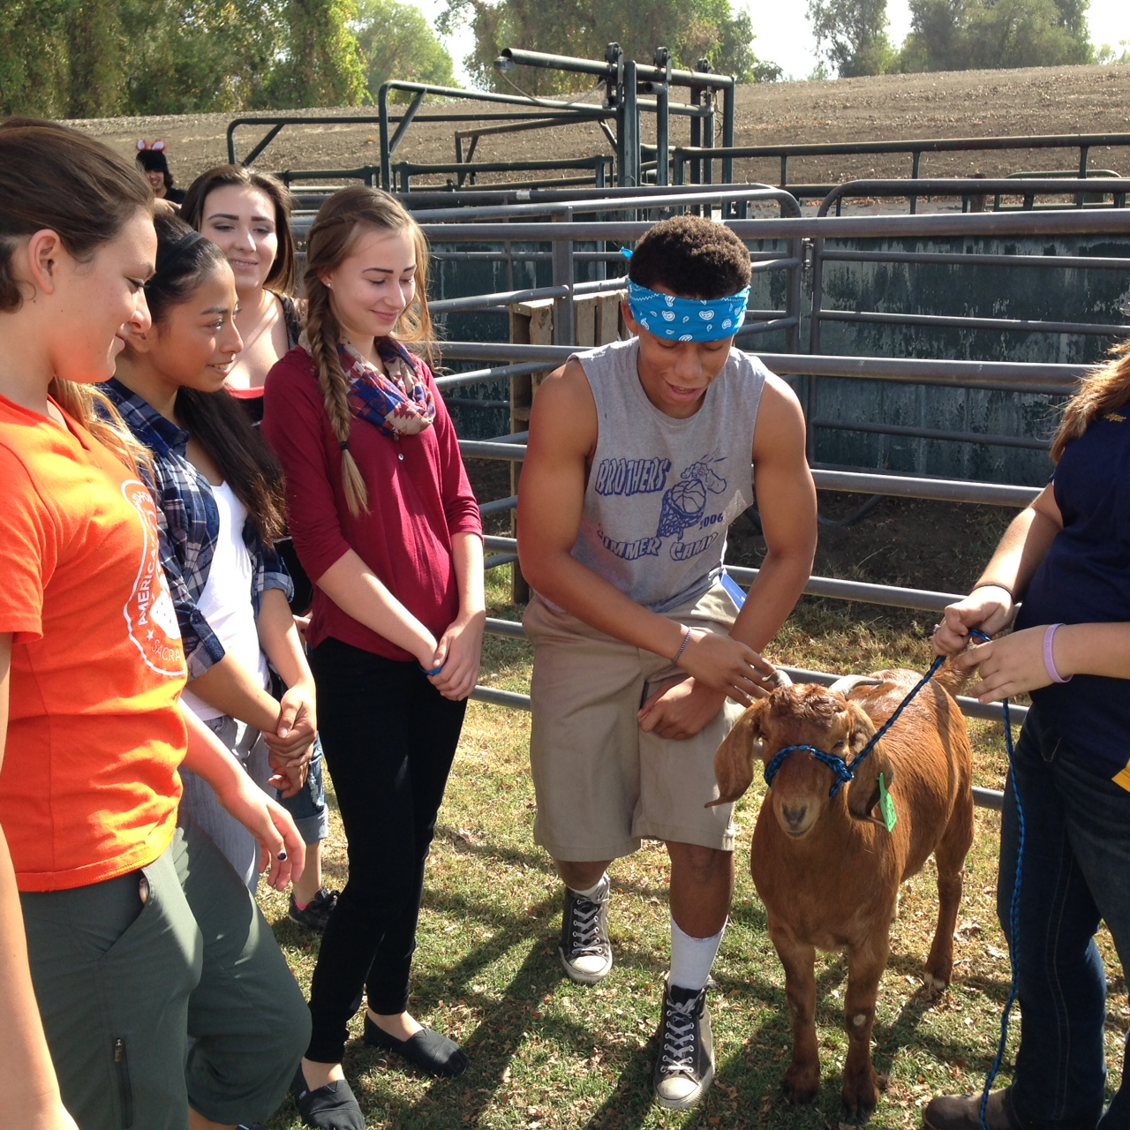
O’Connell Ranch

Slide 9
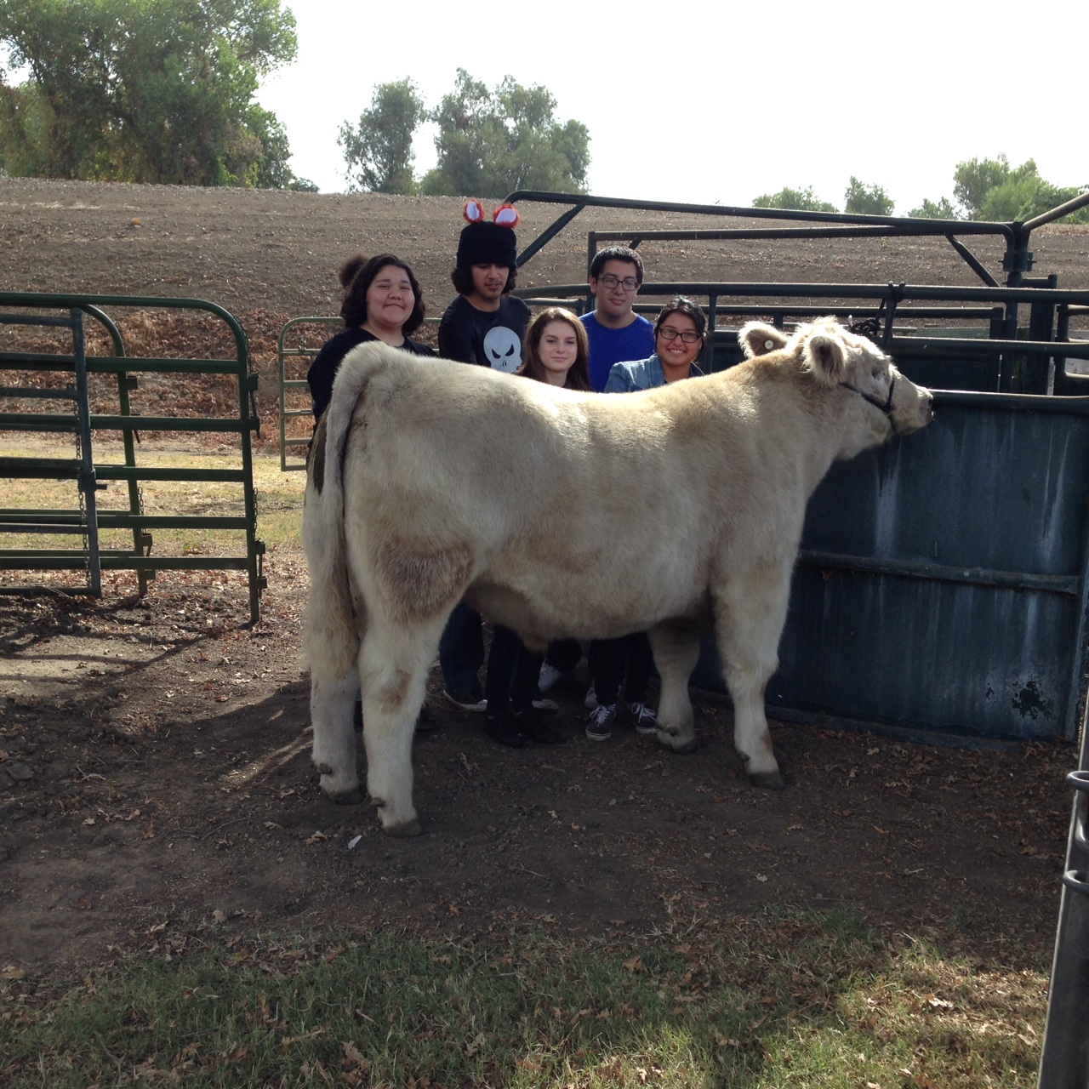

Slide 10
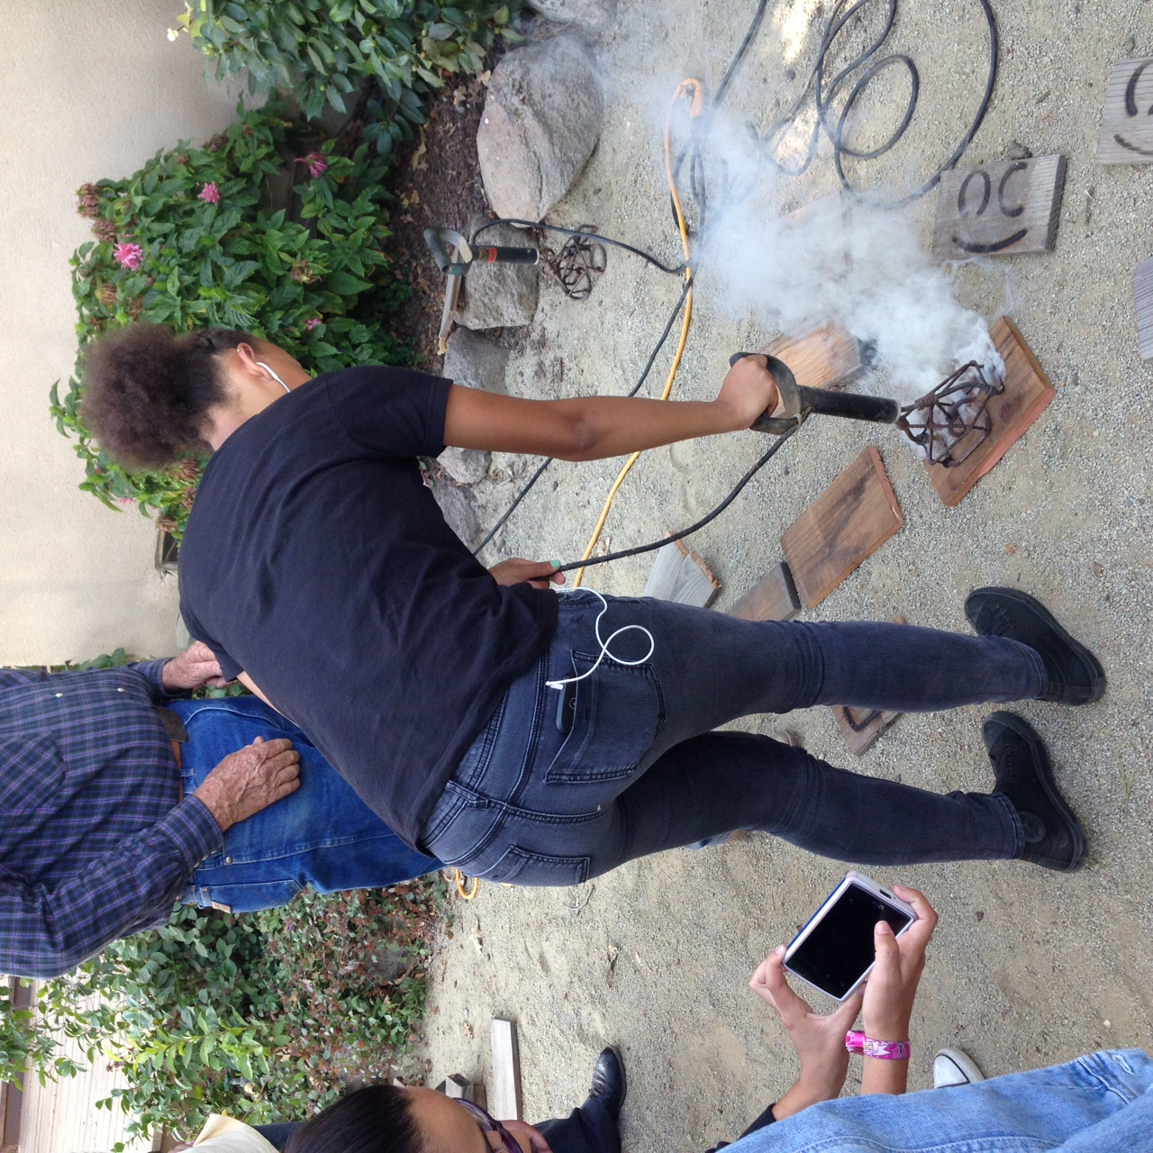

Slide 11
