Slide 1
Soil Degradation
F2F2 Week 2

Slide 2
1/25 Soil Degradation Obj. TSW learn about how healthy soil supports life and itself needs to be properly cared for. P. 14 NB
What is soil degradation?
Monocropping, Soil compaction, Salinization, Amount of Organic matter, Too Basic, Too Acidic are some examples of how soil can be degraded. Choose one and explain what you think it is.
How could you test to see if the soil is bad?

Slide 3
Soil Degradation World Wide

Slide 4
World Map

Slide 5
1/25 Agenda – Computer Lab
Finish vocabulary Page 11
Continue to build your Trifold
Show the F2F website
Todays Activity: Research any of the Soil Degradation conditions: Depletion of nutrient by monocropping, acid soil, alkaline soil, soil compaction, lack of organic matter, salinization. What is it? How does it happen? How can it be corrected? Page 17 NB

Slide 6
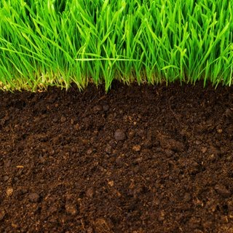
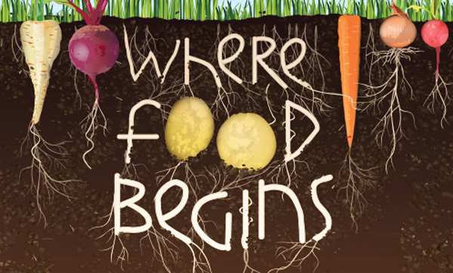
1/26 It can’t be all that bad. Obj. TSW learn about healthy characteristics of soil to help grow healthy food. P. 16 NB
What is soil?
What does soil have that plants need to grow?
What does it mean when a seed germinates?
Get Books from the Library

Slide 7
Best Management Practices P. 19 NB
Tape your WS to page 19 NB
Answer the questions from watching the video.
We will discuss the answers after the video.

Slide 8
1/26 Activity: It can’t be that bad.
Choose to work by yourself or a partner or in a group of three.
Get one planting container.
Fill the 1st row with healthy compost/ soil from the garden about ¾ full. (Control)
Fill the 2nd row with Clay soil, or add salt to it or compact the soil really tight when planting the seeds, or add lemon juice, or ammonia. Take note of the quantity that you use. Fill the pot ¾ full. When making the soil degraded, only add 1 -2 pipettes of solution.
Plant 4 Mung seeds in each pot. Read the directions on the packet to plant them at the proper depth.
Record data daily for germination, and growth rate of your seeds/ plant.

Slide 9
Activity: It can’t be all that bad. Data Table Page 19 NB
Days/ Dates | Germination/ Growth in the Control group | Germination / Growth in the Experimental Group
Day 1 1/26 | 0 | 0
Day 2 1/27
Day 3 1/28
Day 4 1/29
Day 5 2/1
Day 6 2/2
Day 7 2/3
Day 8 2/4
Day 9 2/5

Slide 10
What is the impact of degraded soil on plant growth? Conclusion of Lab 2/5

Slide 11
1/27 At a Loss? Let’s find Nutrients? Obj. TSW watch some best management practices from a Journey 2050 video. P. 18 NB
What is the difference between biotic and abiotic factors in an environment?
What are the three main nutrients plants need to grow?
Name 3 -5 abiotic factors plants need to grow.

Slide 12
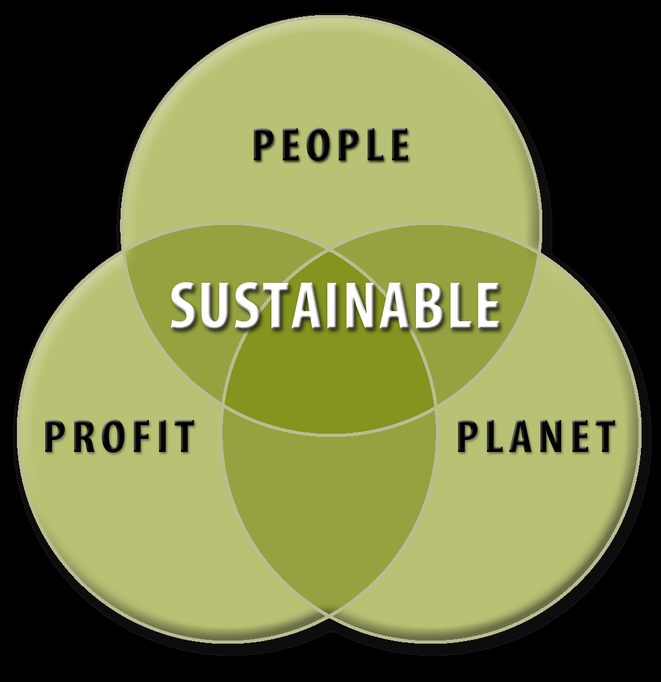
1/28 Sustainability Obj. TSW apply sustainability practices with experience out in the garden. P. 20 NB
What does sustainability mean?
What three factors are considered in a sustainable system?
What is a limiting factor?

Slide 13
Abiotic factors in the Garden
pH
Temperature of soil
Soil Moisture
Rocks
Sand
Compost

Slide 14
1/28 Measuring Abiotic factors in the garden P. 21 NB
Garden Bed # | pH of Soil 0-14 | Soil Moisture (mV) | Surface Temperature | 5 cm deep Temperature | 10 cm deep Temperature
1
2
3
4
5
6
7
8
9
10
11
12
13
14
15

Slide 15
Ground Rules for the Garden
Walk out together (so I can see everyone).
GO to the bathroom before we walk out to the garden
NO Cell phones on in garden.
Everyone takes part in cleaning up.
NO one leaves the garden area until McAllister says it’s clean and everyone can go.
Everyone waits at the gate with PE.
Safety! No unsafe behavior.

Slide 16
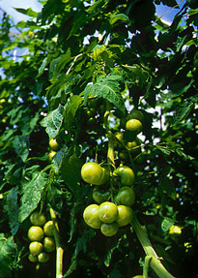
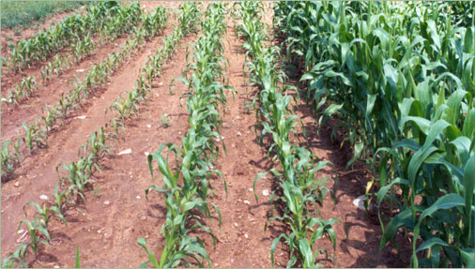
1/29 Test those nutrients! Obj. TSW learn how to test the Nitrate, Phosphate, and Potassium of the soil in the garden. P. 22 NB
How does Nitrogen help plants?
How does Phosphate help plants?
How does Potassium help plants?

Slide 17
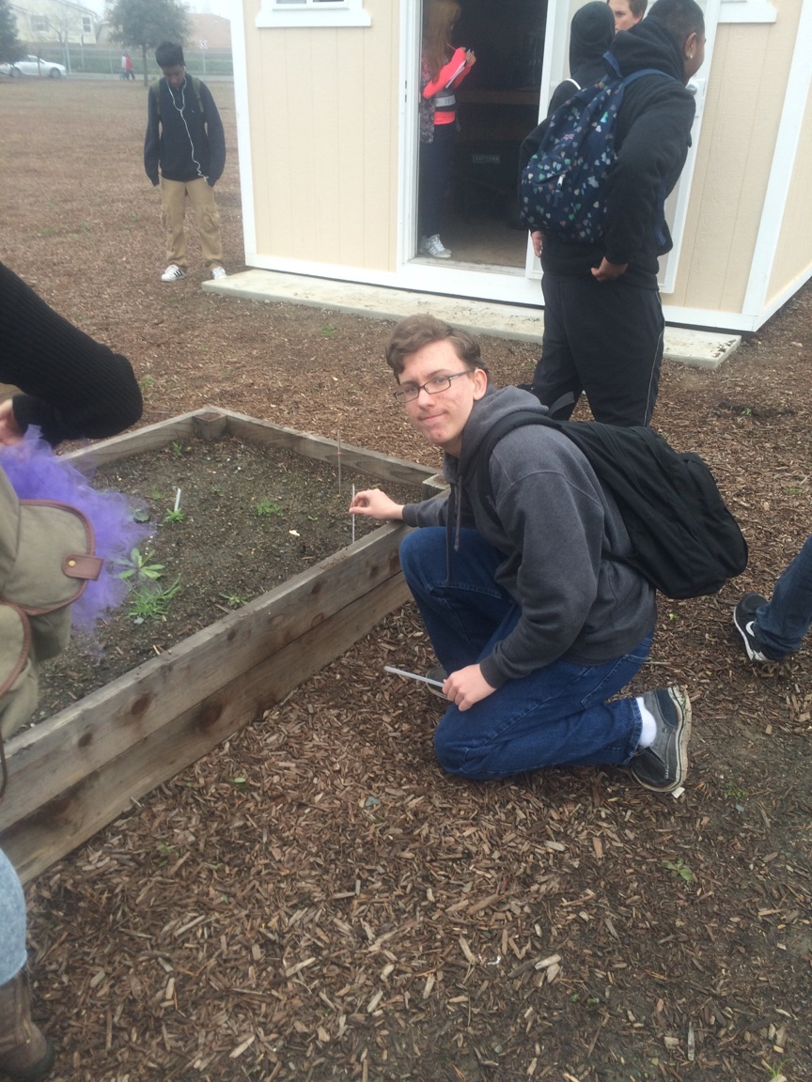

Slide 18
Monday – Garden Testing Nutrients
1/29 Computer lab
UNIT 1 Lesson 2 Vocabulary
Grade Notebooks
Work on Trifold for Farm to Fork

Slide 19
Farm to Fork Tri Fold
Show pictures of you in the garden working.
Show pictures of what Farm to Fork is.
Explain What Farm to Fork is About
Explain what we plan to do
Explain what we had been accomplished in the Garden.
Why is Farm to Fork Important? List 3 – 4 reasons

