Slide 1
Lesson 1: Food & History- Change over time
F2F2 UNIT 3
Global Food/ Food Equity

Slide 2
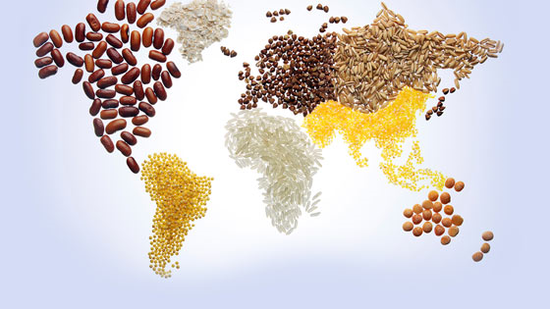
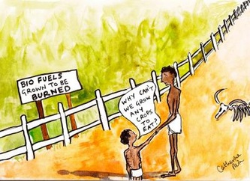
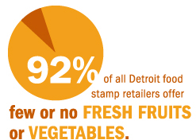
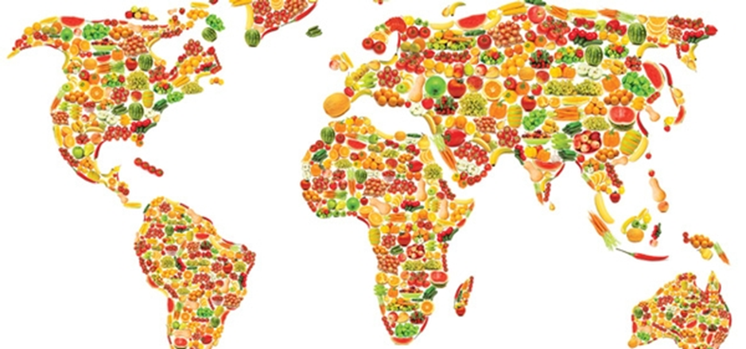
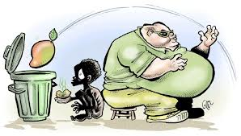
UNIT 3 Global Food Food Equity
Food & History Change over time

Slide 3
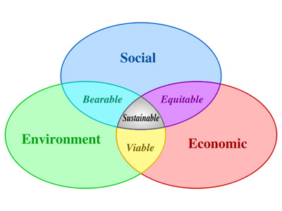
Food & History Change over time Obj. TSW develop a better understanding of global trends in the food industry.
Journey 2050
Describe the word sustainability and give an example.
After watching the sustainability video, what are the three parts of the sustainability barrel?
What are our weakest links in the sustainability barrel? How do some of the parts of the sustainability barrel apply to our Farm to Fork program?

Slide 4
Journey 2050 Video
What are the three parts of the Sustainability Barrel?
What is a Limiting Factor? Give an example.
How can limiting factors keep us from feeding 9 billion people?
Be prepared to discuss how a balance of economic, social, and environmental issues can make it possible to feed more people. Write your thoughts about the video and concerns for the future in your notebook.

Slide 5
Why do we care? What is the connection between Climate Change & Food Security?
Some countries/ regions of the world are going to be impacted to a greater extent due to climate change than others, which will in turn impact how much food they can grow and how many people they can feed.

Slide 6
Personal Goals for your project and garden This must be filled out and get signed off in order to plant your transplants.
What steps need to be taken for your garden to be productive?
Have you measured the temperature, at three different depths, 0”, 5” & 10”? Moisture?
What is your nitrogen, phosphate, and potassium amount?
What is your pH?
How do you intend to amend your garden?, if you need to add N-P-K?
How do you intend to amend your garden if the pH is not ideal?
In order to transplant, you must have at least 5 true leaves/ plant & water & make sure your phosphorus level is acceptable.
Can you direct seed?

Slide 7
Measuring Abiotic Factors in your Garden Bed
Garden Bed # | pH of Soil 4 - 8 | Soil Moisture Dry, Moist, Wet | Temp. Surface Celsius | Temp 5 cm | Temp 10 cm | Nitrogen (N) | Phosphorus (P) | Potassium (K)
1
2
3
4
5
6
7
8
9
10

Slide 8
Feeding Nine Billion Obj. TSW construct a plan and discuss possible solutions to feed 9 Billion by 2050.
How would you propose to feed 9 Billion people on the planet? Try and list 4 steps only.
How will society be different? What limiting factors will exist?
What new industries might start?

Slide 9
Video: Feeding Nine Billion Write the 4 possible solutions to the left. Write some good things about how the solutions can work. What are some challenges in those 4 possible solutions?
4 Solutions
Science & Technology
Distribution
Local Food Systems
Regulation of Food
Pro’s (Good) Con’s (Bad)

Slide 10
Your Counties Top Commodities Obj. TSW will estimate what the 3 top agricultural products are in our county.
What is your estimate of the top 3 crops for Yolo County?
Agriculture in the Classroom, Summarize the video. Do you agree that agriculture is important in the classroom? Why or why not?
How do you predict Agriculture will change in our county in the future? Why?

Slide 11
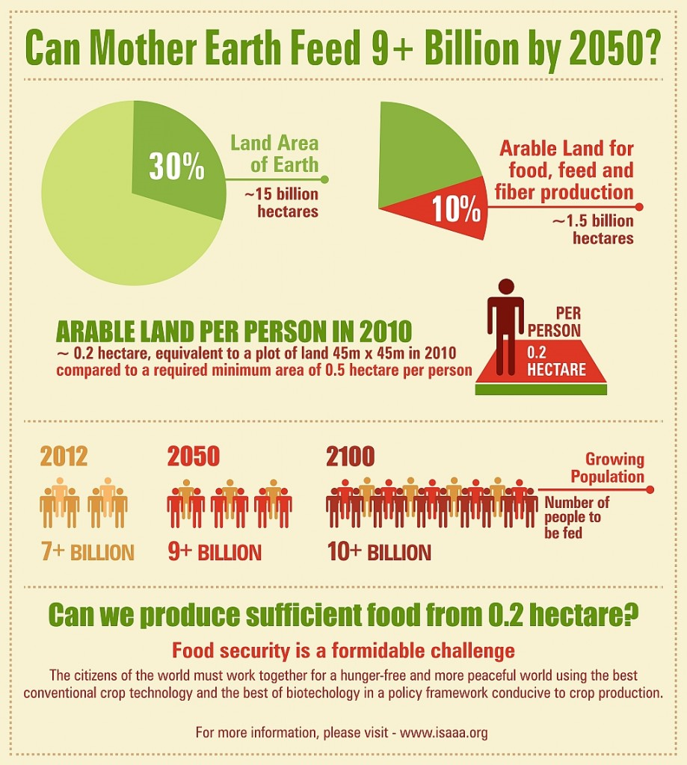
http://schoolgrown.org/
Aquaculture Project
Can Aquaculture be part of the solution for the future?

Slide 12
Local Food Systems Obj. TSW connect our Farm to Fork Movement to other Local Food Systems.
What is a local food system?
Give an example.
Looking at the picture to the left, Describe/ explain a closed- loop system? Write an example of a closed-loop system from your experience in this class.

Slide 13
Activity: Research Historical Agricultural Practices
Food & History – Change over Time
Omnivore’s Dilemma – How has the history of food changed in the last 50 years? 100 years? 200 years?
How has it changed the American Diet?
Where did people eat?, How did they eat? Where did their food come from?
How is food changing in the future?

Slide 14
ERS (Economic Research Service) Report Summary US Department of Agriculture
May 2010 article: www.ers.usda.gov
Local Food Systems: Concepts, Impacts and Issues Read the article and write an AXES (Assertion, eXample, Explanation, Significance) paragraph about Local Food Systems.
At the above website, click on Data.
Food Security – What does the data show about food security in our state, country?
USDA Ag Census Maps: https://www.agcensus.usda.gov/index.php
Research where three crops/ commodities/ products. What are their trends? Where are they growth/ produced?
Research Spotlight
What research is being done and where? Why should we care?

Slide 15
Activity: How do other countries feed their people?
Choose a country. Research the top 5 food commodities produced.
How does this country feed their people? Do they have local food systems in place? What do they import and from what country? What do they export and to whom?
If they do have local food systems in place describe them and how they work.

Slide 16
Aquaponics Obj. TSW learn how aquaponics will be part of the solution to feed the world.
What is Aquaponics? How is it different from aquaculture?
After watching the video, what suggestions do you have for our program?
How can Aquaponics help “feed the need” for making all food more equitable?

Slide 17
Lesson 2: Poverty, The need for GMO’s?
F2F2 UNIT 3
Global Food/ Food Equity

Slide 18
The Faces of Poverty Obj. TSW will have a better understanding of what Poverty is and is not.
What is poverty in your own words? Write a complete sentence.
Write 5 observations about the picture.
This Picture was taken in Kathmandu Valley in Napal, North East of India. What does poverty look like?

Slide 19
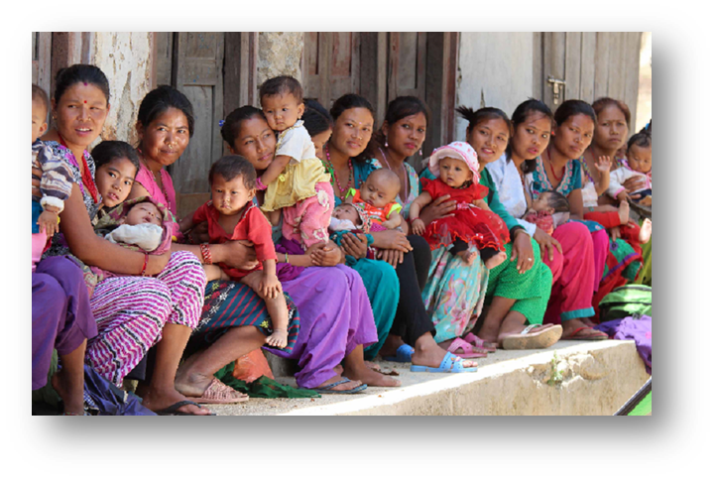
Class Discussion about your 5 observations of the UNICEF Photo of women & children.
Share out your observations of the picture with people at your table.
After 3 minutes of discussing what you see and think, each table should share with the class at least two observations.
Once an observation is said, that one can not longer be said to the class. So be ready to share out another of your observations/ thoughts about the picture.

Slide 20
8 Millennium Development Goals: 2015 Progress Chart Obj. TSW understand factors that contribute to poverty around the world and domestically.
GOAL 1: Eradicate extreme poverty & hunger
GOAL 2: Achieve universal primary education
GOAL 3: Promote gender equality and empower women
GOAL 4: Reduce child mortality
GOAL 5: Improve maternal health
GOAL 6: Combat HIV/ AIDS, malaria & other diseases
GOAL 7: Ensure Environmental Sustainability
GOAL 8: Develop a Global Partnership for Development
Choose 3 of the United Nations Goals that interest you about measuring poverty.
Is it enough to just give people food to eat? Why?
Choose two countries, Compare & Contrast one of your 3 Goals for those countries. How are they different? How are they the same?

Slide 21
Africa

Slide 22
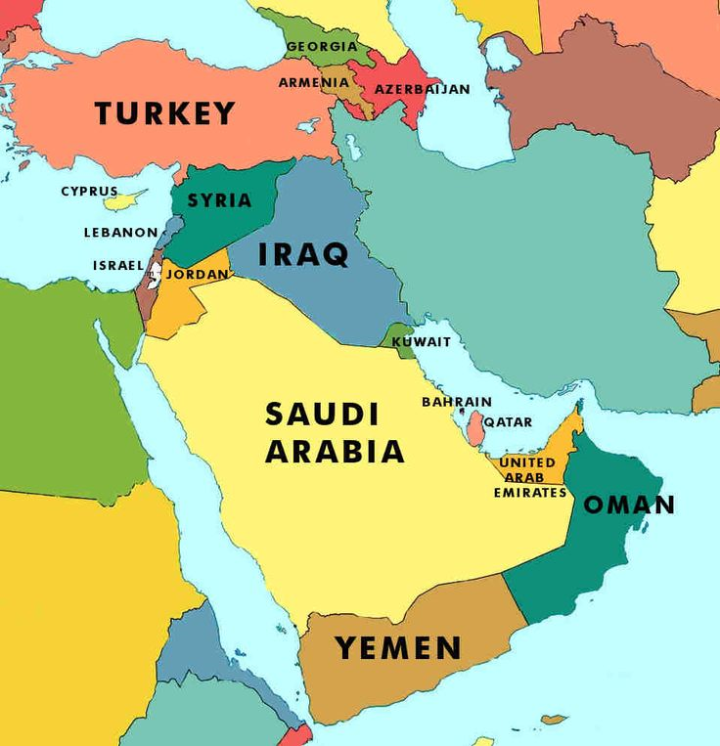
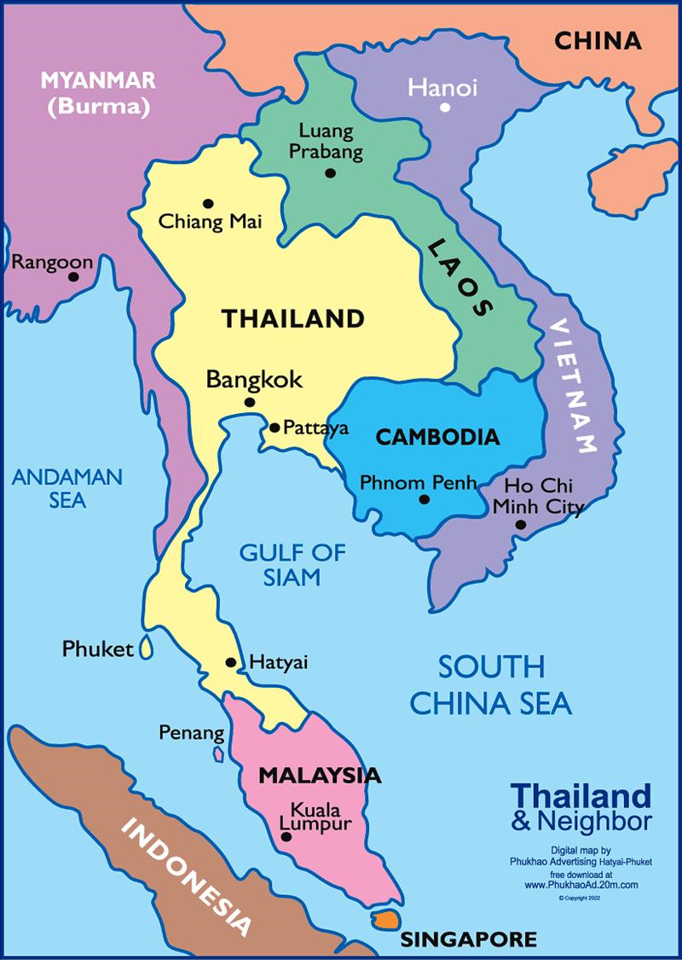
Asia

Slide 23
Oceania

Slide 24
Latin America and Caribbean

Slide 25
Caucasus & Central Asia

Slide 26
Computer Lab Activity http://www.worldhunger.org/articles/Learn/world%20hunger%20facts%202002.htm
Working in teams, students select an impoverished geographical location and research the various nutritional or dietary deficiencies in their native population. One vitamin or nutrient deficiency and the health issues associated with the particular dietary shortcoming. In addition, students will suggest food groups that would alleviate the deficiency. For example, one group might choose to look at a group suffering from a lack of vitamin C, and its association with rickets. Summative assessment includes a Power Point presentation outlining geographic locale, dietary deficiency, physical maladies resulting from vitamin or nutrient deficiency, and suggest foods as remedies.

Slide 27
DNA – Deoxyribonucleic Acid Obj. TSW learn about the molecular genetic material that can be manipulated to help solve food insecurity.
What is a gene? How is it part of DNA?
What is a transgenic organism?
What is a Genetically Modified Organism? Give an example.

Slide 28
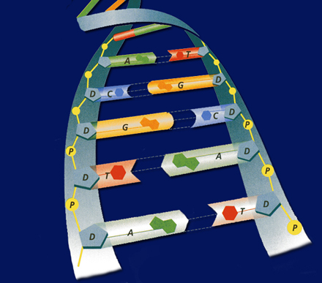
Deoxyribonucleic Acid
Take Notes on page NB
Shape
Double Helix
Backbone
Sugar & Phosphate
Nitrogen bases
Guanine
Thymine
Adenine
Cytosine
Base pairing
A=T
C=G

Slide 29
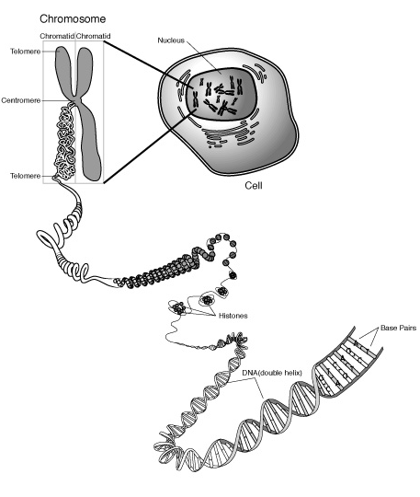
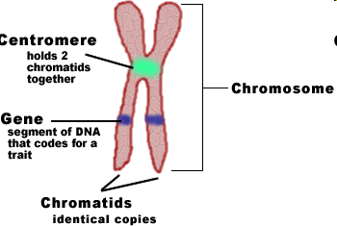
What is a gene?
A segment of DNA that codes for a trait.
Disease resistance
bacteria
fungi
Vitamin A

Slide 30
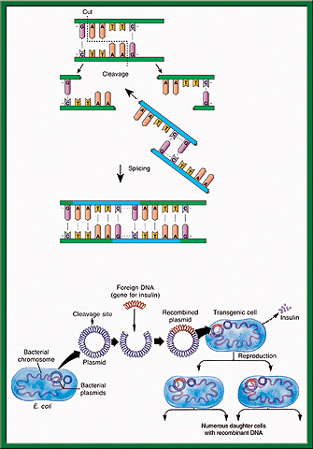
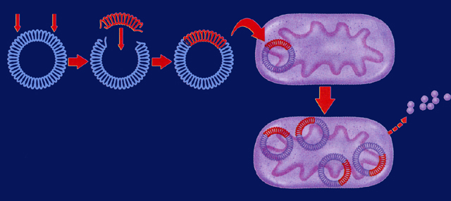
Gene splicing
Bacterial plasmids are used with restriction enzymes to cut sections of DNA out of one organism to be inserted into another organism.
Transgenic Organisms – organisms (plants, animals, fungi, bacteria, protists) that have foreign DNA from another organism in them.

Slide 31
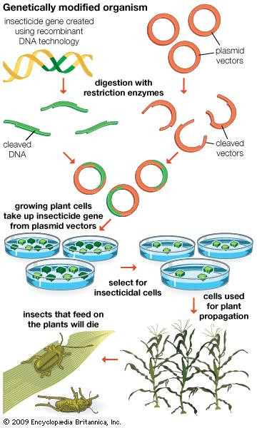
GMO’s – Genetically Modified Organisms
Golden Rice – Vitamin A inserted to prevent deficiencies.
Vaccines in food – to prevent diarrhea diseases.
Bt Corn – to kill the larval stage of the corn borer beetle
Insect resistance

Slide 32
GMO Guest Speaker Notes P. NB
Please take ½ page of notes about GMO’s from our guest speakers presentation.
After the guest speaker is finished, write three questions students ask or that you have about the topic/ GMO’s/ guest speaker.
Continue writing for the rest of the page: Include what GMO’s are, give an example of GMO’s that are in our Grocery Stores.
Explain how GMO’s are created.
In addition, explain why GMO’s are controversial.
Include your opinion if Companies should own the genetic rights to organisms.
Lastly, Why do you or don’t you agree with GMO’s?

Slide 33
Genetically Modified Organisms Obj. TSW learn to construct and critique facts from opinions about GMO’s P. NB
How can genetic engineering and/or Genetically Modified Organisms be part of the solution to poverty and feeding 9 billion people by 2050?
Why or how can we own genes?
Write a 3 sentence opinion about GMO’s

Slide 34
Create a survey & Interview people. You have learned that feeding 9 Billion people by 2050 will be challenging, that part of that solution are local farms and possibly the use of GMO’s.
Working with a partner or by yourself:
Create a 5 question survey asking people about GMO’s and/ or poverty/ or how to grow food/ Urban Farms- Farm to Fork.
Ask only 10 random people of various ages, socioeconomic and ethnic backgrounds.
Your teacher must approve your questions first, before you conduct your survey.
Present a chart of responses in a PPT slide to show the class. Due: __________.
Write a 1 page reflection on this activity: What went as expected, what did not go as expected? Why? What did you learn about Poverty?, GMO’s?, Food? Page ____NB

Slide 35
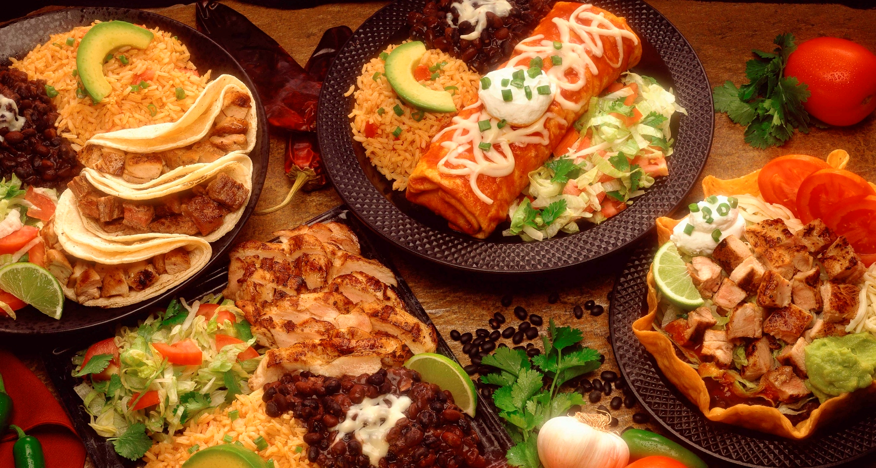
The science of food Obj. TSW construct a logical argument for or against GMO’s using scientific language.
How is DNA important in GMO’s?
How has technological advances played a role in developing food?
If you could change one food source to be different in some way, what would it be and why?

Slide 36
Lesson 3: Old School Remedies
F2F2 UNIT 3
Global Food/ Food Equity

Slide 37
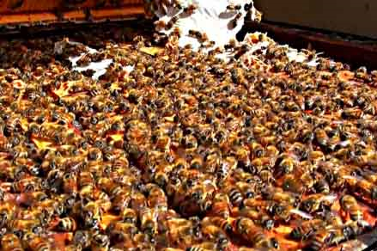
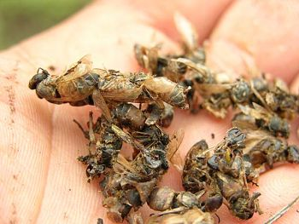
Honey, Can it help with Allergies? Obj. TSW learn about the possible benefits of eating local honey.
What do you know about honey?
What do you know about bees?
What do you know about Colony Collapse Disorder?

Slide 38
Online Honey Bee Research Activity p. NB
What are the benefits to eating locally grown honey?
What are different types of Bees?
What breed of bees are in our local area?
What is Colony Collapse Disorder, What are the possible causes? How does it impact us?

Slide 39
Guest Speaker - Bees
Write a page of notes about Honey bees p. NB
What are honey bees?
Give examples of what they do using words such as: Pollination, symbiosis, food chain.
Explain how their social structure with the Queen, worker and drones are organized.
Why is it important to learn about Colony Collapse Disorder?

Slide 40
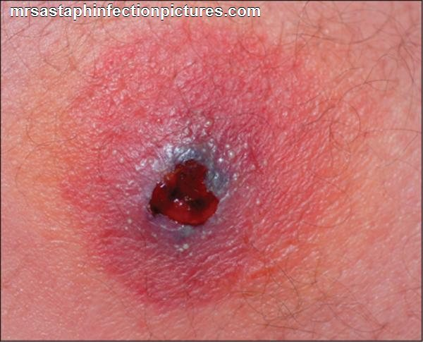
Antibiotic Resistance – MRSA Obj. TSW learn why antibiotic resistant bacteria can be so threatening.
What does it mean to be resistant?
MRSA stands for: Multiple – Resistant Staphylococcus Aureus. Why is this type of bacteria so concerning?
What happens when we run out of effective antibiotics to treat bacterial diseases?

Slide 41
Antibiotic Resistance – Cattle/ Livestock Obj. TSW understand why large CAFO’s medicate their animals even though they are not sick. P. NB
The picture to the left is a bacteria with three ways it develops a resistance to antibiotics. Describe one of them.
What is a plasmid in a bacteria?
What is an enzyme?
Discussion: How have Bacteria developed three ways to resist antibiotics?

Slide 42
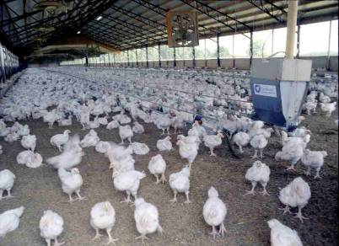
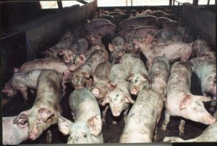
CAFO Concentrated Animal Feedlot Organizations

Slide 43
Cattle Feedlot

Slide 44
Activity: Choose any of the following domesticated Farm animals and research antibiotic resistance p. NB
Cattle, Sheep, Pigs, Chickens, Goats
How are the animals given the medication?
What bacterial infections are they being protected against? What are the most common types of diseases your particular farm animal gets?
Why do we care about antibiotic resistant strains of bacteria in our livestock?
Cite your Online Resources in your NB. You will need at least three resources.
https://owl.english.purdue.edu/owl/section/2/10/

Slide 45
Old School Remedies Obj. TSW think of things they have heard family members say that work to get healthy.
What old school remedies does your family have?
What plants, herbs, can help fight some illnesses?
Why is it important that we not forget our ancestors and their solutions to staying healthy?

Slide 46
Read the Online article: Anglo-Saxon remedy kills hospital superbug MRSA
Daily News 30 March 2015
https://www.newscientist.com/article/dn27263-anglo-saxon-remedy-kills-hospital-superbug-mrsa/
What is the Claim of the article?
Write the Evidence for the Claim.
What is the reasoning for the Evidence?
Summarize the article by writing an AXES paragraph.
Print out the Article Worksheet of questions from CTE Online: F2F2 UNIT 3 Lesson 3
Students will answer questions in complete sentences.

Slide 47
Family Old School Remedies p. NB
Describe one of your family’s Old school remedies.

Slide 48
How is your garden growing? Obj. TSW analyze how their garden is growing and what they could do better. p. NB
How are your plants growing?
What would you do differently? List your next steps.
What materials do you need?

Slide 49
Lesson 4: Food Cultures/ Leadership Food Awareness
F2F2 UNIT 3
Global Food/ Food Equity

Slide 50
Leadership for a healthy food culture Obj. TSW learn how companies can be part of the solution for a healthy food culture.
Give some examples of how our food culture is changing in (Your City) or (Your State)?
How can a healthy food culture support a healthy lifestyle?
How can partnerships between large companies and schools help strengthen and promote food awareness?

Slide 51
Food Culture: Urban Farms & Grocery Stores teaming together Obj. TSW understand food culture and give examples of how it is changing in our city.
Write some examples of how local food is accessible in (Your City).
This partnership provides other benefits besides healthy food awareness, list some.
If you could visit a local farm or ranch, what would you like to see? Why?

Slide 52
America’s Diet Obj. TSW recognize unhealthy aspects of our diet and be able to exchange them for healthier choices.
What aspects of our diet do we know are unhealthy for us?
List some examples of health related diseases due to an unhealthy diet.
Describe 3 healthier choices we could all make, what benefits could result?

Slide 53
Draw this on p. NB

Slide 54
Chemistry in Agriculture
Find 3 interesting factoids about animals that can be included in your notebook and included in your 1 -2 assessment paper. P. NB

Slide 55
What other local businesses support the Farm to Fork movement? P. NB
Research 3 businesses with in 100 miles that raise, grow, sell, buy, and distribute local produce and meat, including dairy cattle?
Explain what they do and how they do it.
Some of this information can be included in your 1 – 2 page paper.

Slide 56
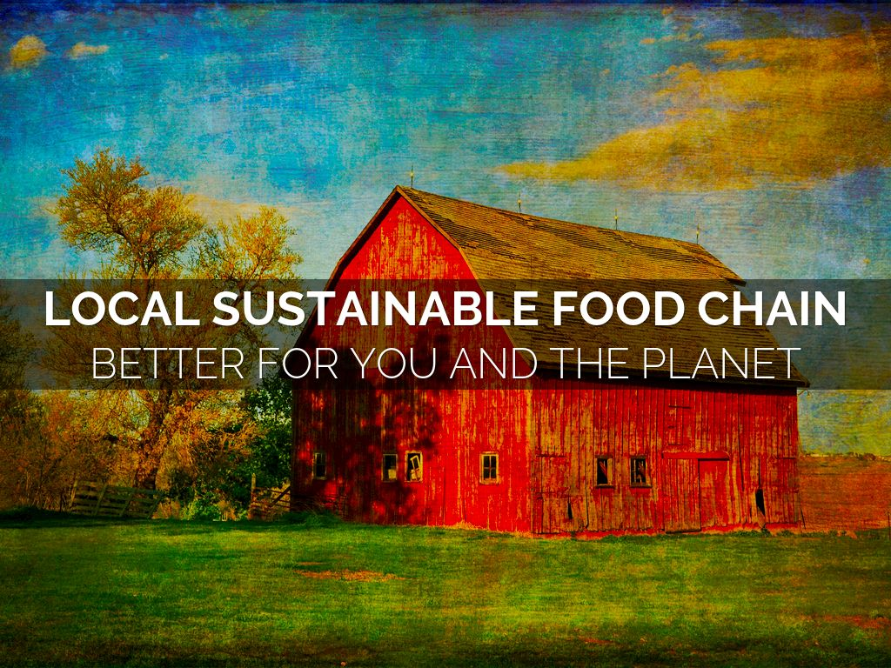
Local Sustainable Food Obj. TSW learn about sustainable food and how it is competitively priced. P. NB
A friend asks you, “ What is local sustainable food?” How do you explain what it is?
How can the local food be competitively priced?
How much would your pay for a gallon of milk?

Slide 57
Guest Speaker – Food Services Director for our School District p. NB
Sourcing Local Farms to feed the students in our School district
Take notes in your Notebook, page
This will be included in your 1 – 2 page paper.

Slide 58
Where does your food come from? Obj. TSW assert their understanding of what healthy food is and how it is grown.
What does it take to eat healthy in America?
Where does your family buy most of your food?
If you were in charge of feeding America, how would your knowledge and understanding of growing food make us healthier?

Slide 59
1 – 2 page paper Where does your food come from?
Where does your food come from?
Discuss where your family buys food. Discuss what Farm to Fork is and it’s benefits.
Why is it important to know where your food comes from?
Include examples, explanations, and the significance of where our food comes from/ grown.
Maybe include ingredients such as High Fructose Corn Syrup, salt, fat, sugar in our diet.
Include the difference between processed and natural foods. Why is that important?
Include companies, businesses that are part of the solution to eat healthier, and companies that are part of the problem. Or companies that are trying to change their image and how.
APA Style: purdue.owl.edu

