Slide 1
Lesson 3
Resources in the State
UNIT 4 Career Guidance and Exploration

Slide 2

5/9 State Resources
Obj. TSW realize educational resources in the state that help support a career choice. P. 68 NB
What are transcripts?
What does the student rank mean?
Compare & contrast a weighted and unweighted gpa.

Slide 3
Transcript P. 59 NB
Tape your transcript to page 59 NB.
Write three short term goals you want to accomplish before the end of the year.
Write three long term goals you want to accomplish before you graduate/ life goals.

Slide 4

5/10 Financial Opportunities
Obj. TSW develop a better understanding of financial and skill building opportunities to better their future. P. 70 NB
What are scholarships & grants?
What are internships?
Why are scholarships and grants better than loans?

Slide 5
Internships.com
P. 71 NB
Where are you interested in working?
What type of work?

Slide 6
Top 10 most Common Interview questions p. 73 NB
http://money.usnews.com/money/careers/slideshows/the-10-most-common-interview-questions/11
Choose 3 of these 10 questions and write our you answer on page 73 NB.

Slide 7
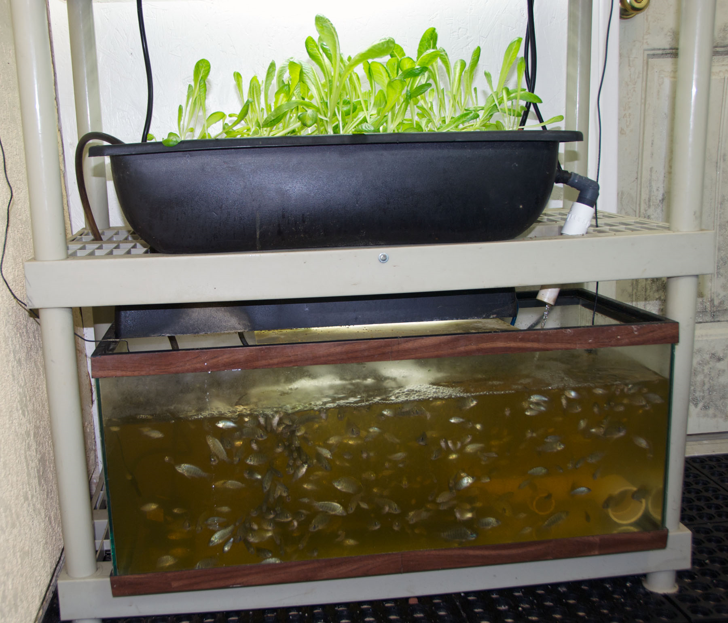
5/11 Aquaponics
Obj. TSW realize one of the solutions to feeding the world is aquaponics. P. 72 NB
What is aquaponics?
What skills might you need to build an aquaponics unit.
Describe some characteristics of an aquaponics unit.

Slide 8
5/12 Interviews
Obj. TSW learn the nuances of interviewing to give them an edge. P. 74 NB
What would you think are some positive things to do in an interview?
What things should be avoided during interview?
Is the interview only one way?

Slide 9
What would be good questions to ask during an interview? P. 73 NB
Read the article, “How to prepare for an Entry-Level interview”

Slide 10
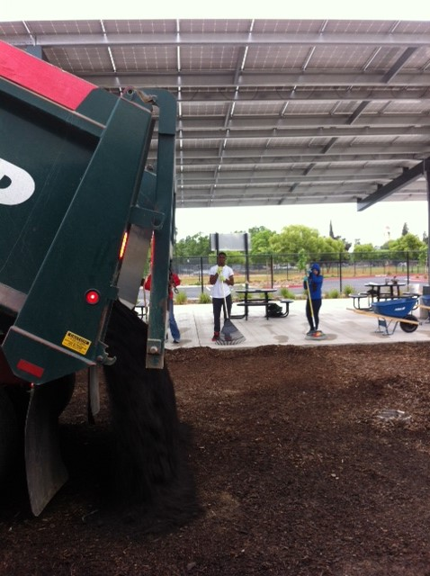
Saturday May 7th 8:30 am, The soil arrives

Slide 11
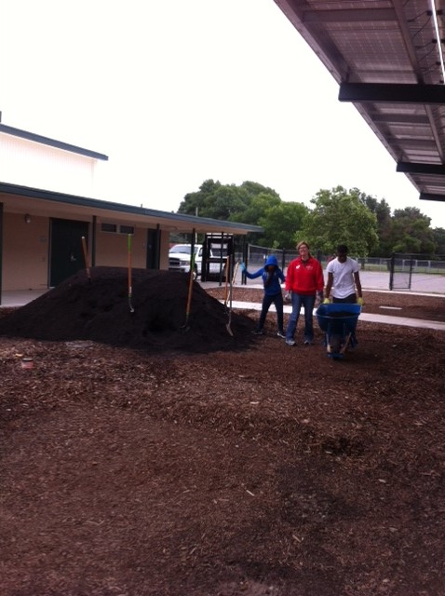
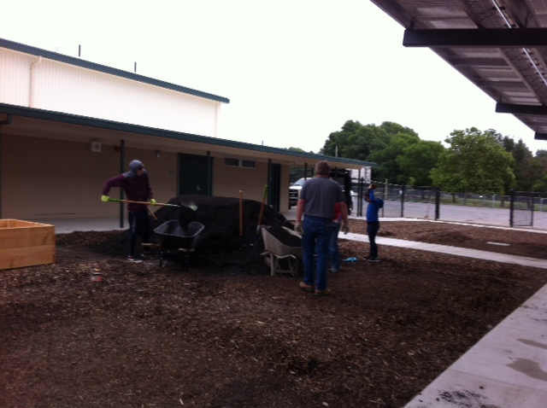
Let’s Wheel…

Slide 12
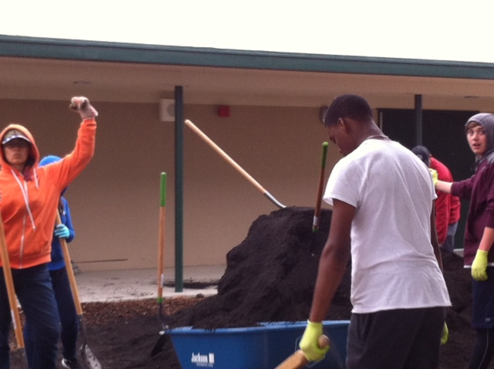
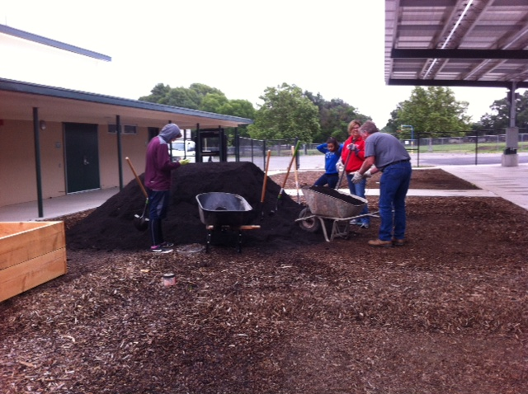
Moving soil into the garden beds at Bryte

Slide 13
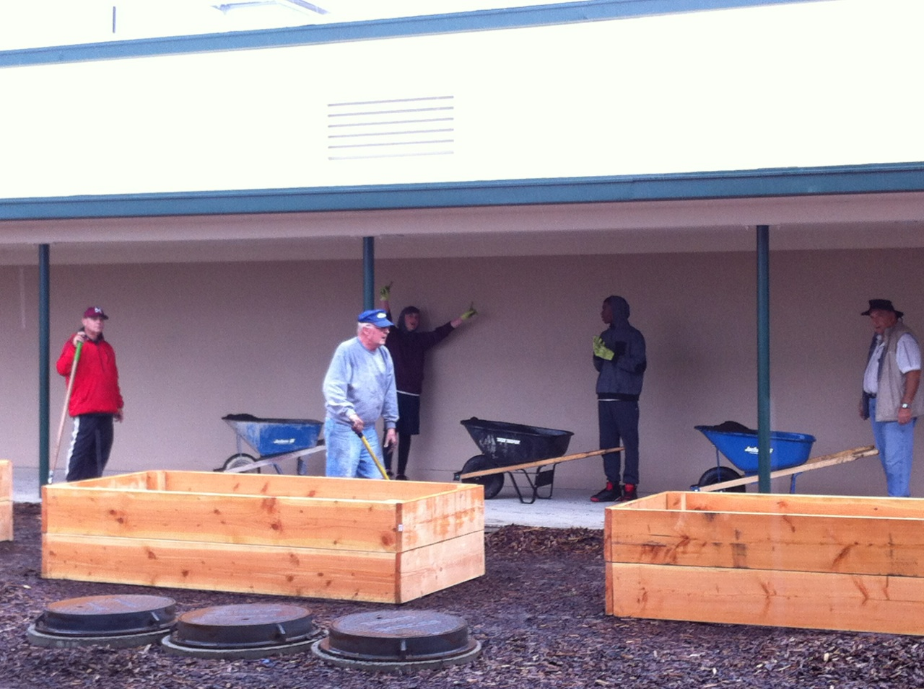
Yes, it’s raining…
Notice the caravan of wheel barrows waiting in line to dump soil into the beds.

Slide 14
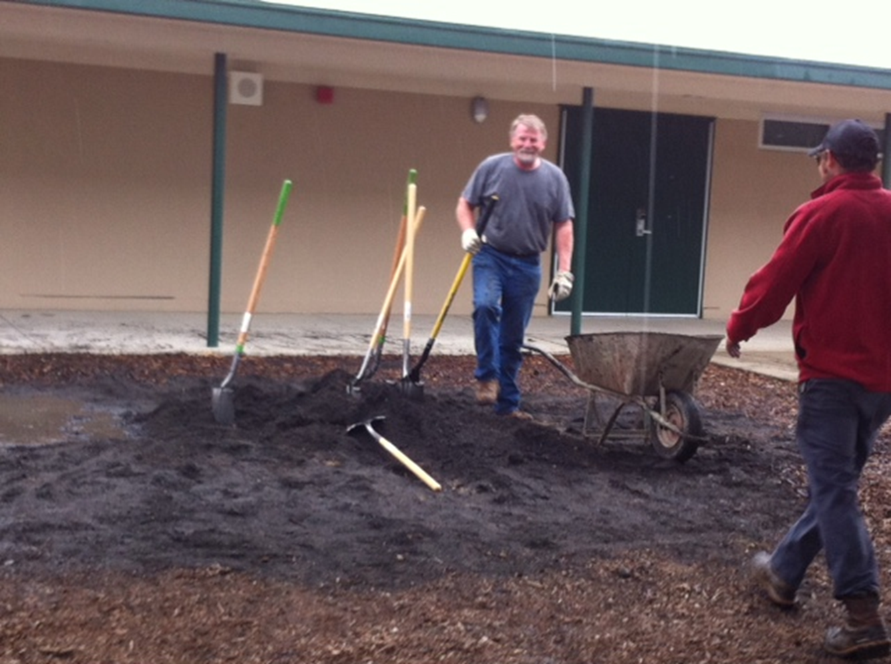
Almost to the End…

Slide 15
But wait, There’s more…
Yes! you too can be part of the building of the First Every Ag Program at RCHS! Bryte Campus.
Please come join us at Bryte on 637 Todhunter at 8 am on Sunday am May 15th, To move the final 12 yards of soil into the garden beds.
Free donuts.

Slide 16
If you can’t get enough…
There are yet more Service Learning Opportunities at the Farmer’s Market.
  Thursday May 19th from 5 – 7 pm
  Thursday May 26th from 4:30 – 6:30 pm (this is the last one… or not)
  Just kidding…
  June 4th & 5th Join the Relay for Life Team to fight Cancer
    A member(s) of our RCHS Ag team will be walking the track continuously for 24 hours to raise awareness of cancer, education, prevention, treatment and in memory of those who have lost their battle.

Slide 17
What other local businesses support the Farm to Fork movement? P. 41 NB
Research 3 businesses with in 100 miles that raise, grow, sell, buy, and distribute local produce and meat, including dairy cattle?
Explain what they do and how they do it.
Some of this information can be included in your 1 – 2 page paper.

Slide 18
Omnivores Dilemma
How Corn Took Over America & The Farm p. 47 NB
How is the supermarket like a field of corn? P.10
Name some products made from corn. P. 11
How much biodiversity was lost from 1920 – 2002? P. 26 NB
Discuss a result of growing so much corn. P. 26 - 27

Slide 19
1 – 2 page paper Due May 12th
Where does your food come from?
Where does your food come from?
  Discuss where your family buys food. Discuss what Farm to Fork is and it’s benefits.
Why is it important to know where your food comes from?
  Include examples, explanations, and show the significance of where our food comes from.
    Maybe include ingredients such as High Fructose Corn Syrup, salt, fat, sugar in our diet.
    Discuss the video: Fed Up.
    Include notes from Kari Pina’s Guest presentation about how she sources healthy fresh food for 7700 students.
  Include the difference between processed and natural foods. Why is that important?
  Include companies, businesses that are part of the solution to eat healthier, and companies that could improve to become part of the solution. How are companies trying to change their image?
APA Style: purdue.owl.edu

Slide 20
www.cacareerzone.org p.49
Begin the Career Assessment
Write an occupation you are interested in.
One sentence describing the job in your own words
Describe the preparation required for that occupation
What is the range of salary?
What is that occupations outlook? Expanding, stagnant, decreasing?
What are the common College Majors?

Slide 21
www.cacareerzone.org
P. 51NB
Read: “Things they need to be able to do”
Write one - three skill(s) or job description that you are good at.

Slide 22
Entry Level Research P. 53 NB
Find 3 Entry – Level employment opportunities from the Skills Profiler of California Career Zone
State your skill that will be an asset to that type of work.

Slide 23
Omnivore’s Dilemma
CH 3 From Farm to Factory
Turning bombs into Fertilizer p. 57 NB
What is Agribusiness? P. 29 NB
What is the main ingredient in fertilizer?
How is recycling fertilizer in a natural loop different than applying ammonium nitrate?

Slide 24
California Department of Food & Agriculture p.75 NB
https://www.cdfa.ca.gov/
https://www.cdfa.ca.gov/employment/
View the above websites.
Write in your notebook a summary of what the website has to offer.
What are some available employment positions offered in the CDFA?

