Slide 1
Farm to Fork
UNIT 4 Feed the World
Economics, Poverty, Population and Carrying Capacity, Genetically Modified Organisms

Slide 2
Lesson 2: Poverty, not just a lack of Money
F2F1
UNIT 4
Global Food – Week 16

Slide 3
Greenhand Test
Jacob, Miguel, Quincy look at the test and figure out which questions you got wrong and why.
Students get into one of the 3 groups of Jacob, Miguel and Quincy.
Get a Official FFA Manual
Page 47 Notebook – Write down the questions you got wrong, find the answer in the FFA Manual, Write the answer in the Notebook. Discuss the correct answer with your team leader.
Then students can retake the test again.
Must earn a 20 or > to be Proficient to earn your Greenhand degree.

Slide 4
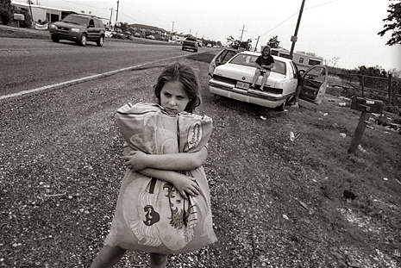
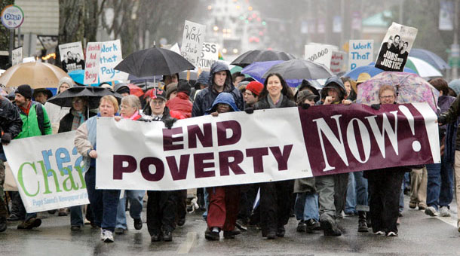
Poverty, Not Just a lack of $
Obj. TSW learn about poverty and why it still exists. P. 52 NB
What is poverty?
What does poverty look like?
How are food insecurity and poverty related?

Slide 5
Greenhand Test Review
Get in your groups to study your greenhand test. Page 47 NB

Slide 6

Feed the Need
Obj. TSW research local, state-wide, country-wide, and international programs that work to feed people. P. 54 NB
Off the top of your head, what are some organizations that feed people in poverty.
Would you volunteer at some of these organizations?
How can we be part of the feed the need?

Slide 7
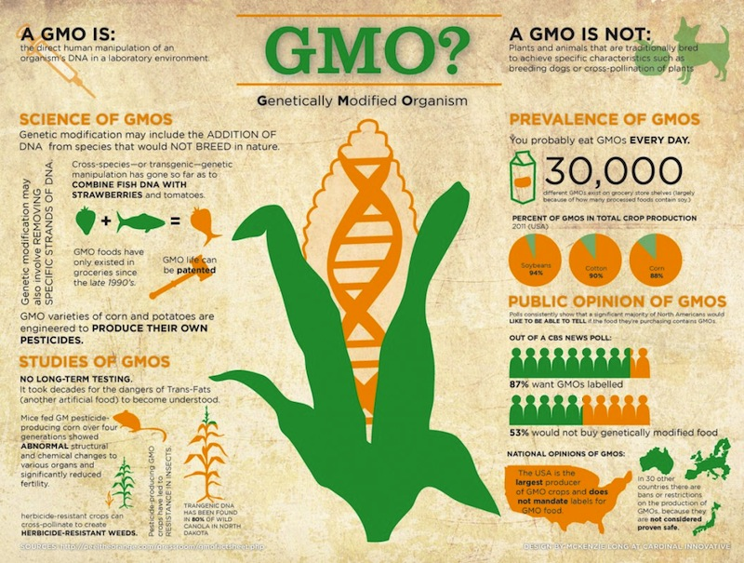
Genetically Modified Organisms
Obj. TSW learn the pro’s and con’s of producing/ growing GMO’s by reading a articles about GMO’s. p. 56 NB
What was your article about?
What are some concerns about GMO’s after reading this article?
What are some benefits about producing GMO?

Slide 8
SAE Qualification Questionnaire
Your SAE must be agriculturally related, created by you, invested time of 8 hours, supervised by your Ag Teacher and be part of your grade.
How does it provide real work situations?
What careers is it related to?
How is it part of your career goal?
List the skills, knowledge and attitudes you need for this career that your SAE might apply to.
How can you grow, and become more competent each year in the Ag program with this SAE?
How does your SAE allow for expansion, and/or change?
Have you kept records of your money, and time?

Slide 9
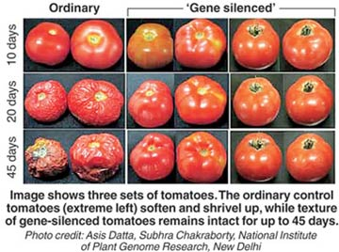
Solutions to Feed the Need: GMO’s
Obj. TSW research the pro’s and con’s of GMO’s as a solution to decrease poverty. P. 58 NB
Look at the picture to the left. Compare the two types of tomatoes. Which one is GMO?
What examples of GMO do you know about?
Explain Genetically Modified Organisms in your own words.

Slide 10
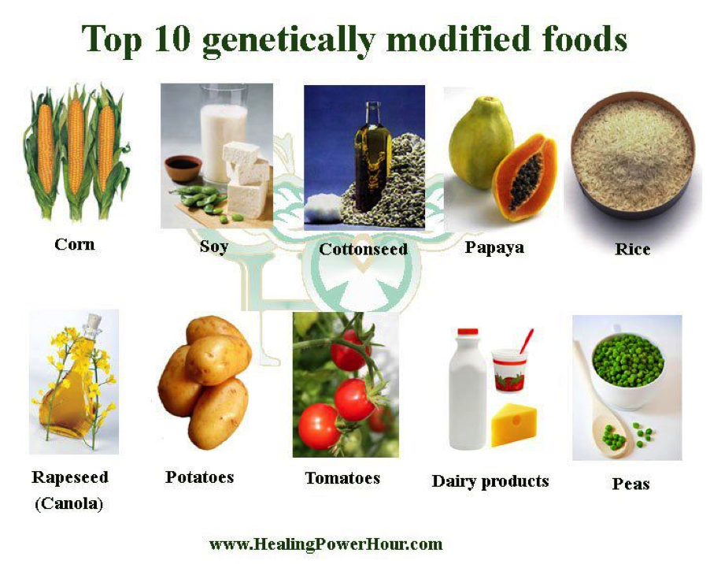
GMO Video
Obj. TSW watch a video about GMO’s and take notes about some benefits and concerns about Genetically Modified Organisms. P. 60 NB
What does GMO stand for?
Before you watch the video, what do you think you know about GMO’s
What do you want to learn about GMO’s?

Slide 11
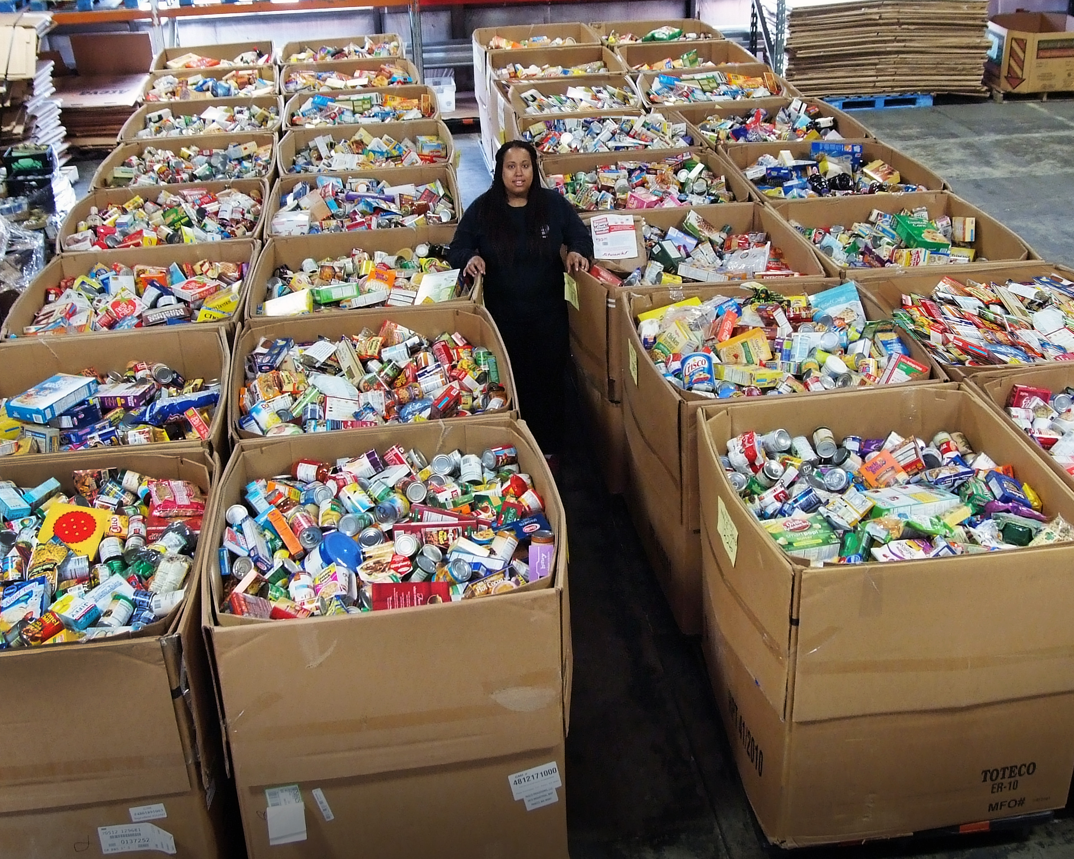
Who Controls the Food?
Obj. TSW have a greater understanding of why countries import and export food.
What country has the most people?
What country has the least amount of food?
What country has the most food?

Slide 12
Activity: Who Controls the food? P. 57NB
You will be assigned a country/continent: Africa, Europe, America, South America, Asia,
Stand Next to your country.
Then the food (Small Carrots, Grapes) will be handed out in proportion to the amount of food that country has.
How did you feel about the amount of food your received?
Is it fair that North America has the majority of the food but not the majority of the people?
Write a ½ page reflection describing your feelings about this experience. For example, how did it feel to have minimal food when others had more than they needed?
What can be done to Feed the Need?

Slide 13
Lesson 3: Genetically Modified Organisms
F2F1 UNIT 4
Global Food

Slide 14
GMO Research Activity
Pro GMO
Find 6 Arguments for GMO’s Con GMO Find 6 Arguments against using GMO’s

Slide 15
Guest Speakers = GMO

Slide 16
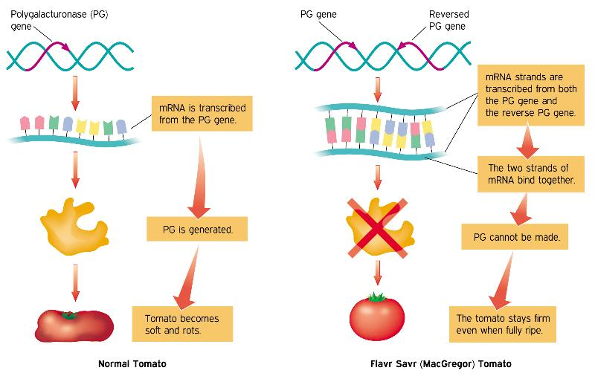
Pro’s & Con’s GMO’s
Obj. TSW create an argument for or against GMO’s.
From your research yesterday, write three arguments for GMO’s.
From your research yesterday, write three arguments against GMO’s.
What is your opinion about GMO’s. Support your opinion.

Slide 17
The Great GMO Debate
Split the class in ½, facing each other. Present opening arguments, opinions and rebuttals.
Write a reflection about the GMO debate. State your claim and include evidence for support.
Evaluate what could have been improved for individuals, or group performance?

Slide 18
Lesson 4: Populations-People & Carrying Capacity
F2F1 UNIT 4
Global Food

Slide 19
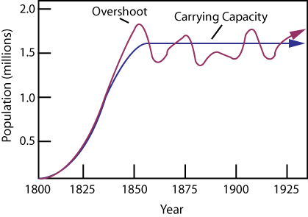
Earth’s Carrying Capacity
Obj. TSW learn how the increase in world population will have an impact on them.
Approximately how many people live in CA?
Approximately how many people live in the US?
Approximately how many people live on the Planet?

Slide 20
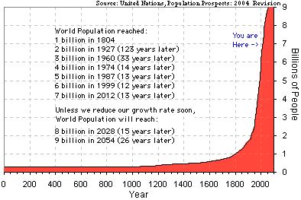
Earth’s Human Population Growth

Slide 21
Activity: Population Growth Analysis
Introduction of Reindeer to St. Matthews Island in Alaska.
Analyze the graph of the growth of Reindeer from the original 29 that were introduced to St. Matthew’s Island.
Answer the 5 Preview questions.
Answer the analysis questions in complete sentences.
Finally, is there any relevance between this example of overpopulation and the human population on the Planet? 2 – 3 sentence answer.

Slide 22
United Nations
Integrating Population Issues into Sustainable Development
Students research the website:
  Who are the United Nations?
  What do they do?
  How are they part of the solution for sustainable development?

Slide 23
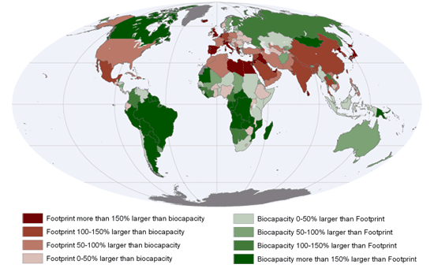
Earth’s Carrying Capacity
Obj. TSW understand that Biocapacity of countries and the carrying capacity of the planet are interlinked.
What are limiting factors in a Carrying Capacity graph?
What are some Density Dependent Factors?
What are some Density Independent Factors?

Slide 24

Sustainability Worldwide
Obj. TSW apply and discuss why it is important for sustainable practices to be enforced worldwide.
Describe sustainability.
Describe 3 sustainable practices you have learned in this class.
What are the implications of increased population growth if sustainable practices are not enforced?

Slide 25
Online Article: Has Earth reached its Carrying Capacity?

Slide 26
Maxine Abrulo – Coit Tower
Answer questions from the WS.

Slide 27
Summative Assessment
Students should answer the following questions after they have gathered all their research:
Which of your five foods did you find for sale in other circulars? Why do you think they were for sale in more than one place?
Which of your 5 foods were more expensive or less expensive? Why do you think that is?
Notice and write about any trends that developed at certain grocery stores. For example, was the Dollar Store always the cheapest? Why?
Finally, the class will have a discussion about the supply and demand of food in our grocery markets.
What drives the economy of food?
Students will write a reflective 1 page paper summarizing all the activities from this key assignment, tying in the biocapacity of countries, the imports of food from other countries, and changes they may make in their lifestyle as a result.

Slide 28
Sustainability

Slide 29
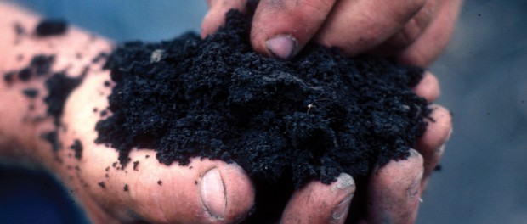
January 4th From the Soil
Obj. TSW gain a better perspective of the importance of healthy soil. P. 80 NB
What are the components of healthy soil?
Why is Farm to Fork important?
Explain what you have learned about growing healthy food for RCHS students and Culinary?

Slide 30
Second Barcode
Take 3 – 4 Notes in the 2 minute video.
After watching the short video clip, what are your thoughts?
How realistic is a second barcode?

Slide 31
Activity: The Story of Food nourish.org
Objective: Students examine food labels and conduct research to trace food paths from the original plant or animal source. They then make posters describing the story of a particular food.
Question: How does the way food is raised, processed, transported, and eaten impact both people and the environment?
Read the background information.

Slide 32
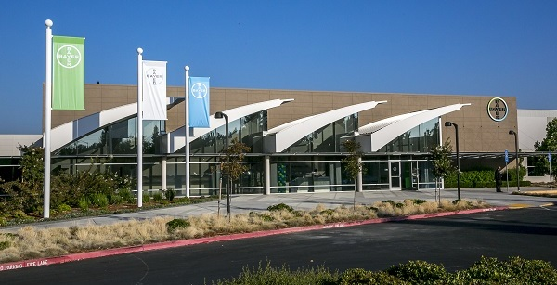
11/5 Bayer Crop Science
Obj. TSW learn about local companies that play a role in our Agricultural success. p.82 NB
What association do you have with Bayer?
Why would a Pharmaceutical company get involved with Crops and growing Food?
How does what you have learned about Bayer Crop Science under score the importance to growing healthy food worldwide?

Slide 33
Final Presentation –PPT
Farm to Fork Project PART 2 DUE McAllister needs to review your progress of your project before January 8TH.
PPT Individual: 10 – 15 Slides PPT Two students: 15 – 20 Slides
Introduction: Briefly review your project for us.
Data
Qualitative Data: Words, Descriptions, Pictures, Video
Quantitative Data: Tables, Charts, Graphs
Data Analysis
What does the data mean?
What were some things that you learned from mistakes you made?
What would you do differently next time?
Conclusion
Explain what your project meant to you and how the class Farm 2 Fork has helped you gain a better understanding of your project/ gardening caring for plants/& or soil . If you were in charge of feeding the world, or creating more sustainable practices worldwide how you would go about it?
Works Cited Title. Author. Website link.
Yolo Farm to Fork. By Dorthy Peterson. Dir. Dominic Machi. Perf. Beth Harrison. Yolo Farm To Fork. Yolo Farm to Fork.org, n.d. Web.

Slide 34
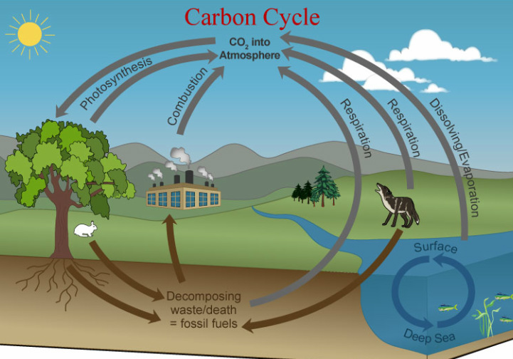
Carbon Cycle Review P. 84 NB
Obj TSW review how important the carbon cycle is to us.
What is the Carbon Cycle?
How does CO2 cycle through the Biotic and abiotic factors?
List 6 processes of the Carbon cycle.

Slide 35
Greenhouses & Carbon Cycle Activity. p. 85NB
"What happens to the carbon dioxide you breathe out or the carbon dioxide released from a burning paper?”
How does the carbon cycle influence the greenhouse effect?
How do greenhouses utilize the greenhouse effect to promote plant growth?
How is greenhouse plant cultivation a sustainable practice?

Slide 36
Students will draw the carbon cycle. Labeling the 6 processes that take place: Photosynthesis, Cellular Respiration, Exchange, Sedimentation & Burial, Extraction and Combustion. Students will gain a better understanding of how carbon cycles between the atmosphere, geosphere, hydrosphere, and biosphere form their graphical simulation of the carbon cycle.

Slide 37
Bayer Crop Science P. 85 NB
Where is Bayer Crop Science in West Sac?
What does Bayer Crop Science do concerning agriculture?
Give 3 examples of how they are involved in agriculture.
How does it relate to Farm to Fork?

Slide 38
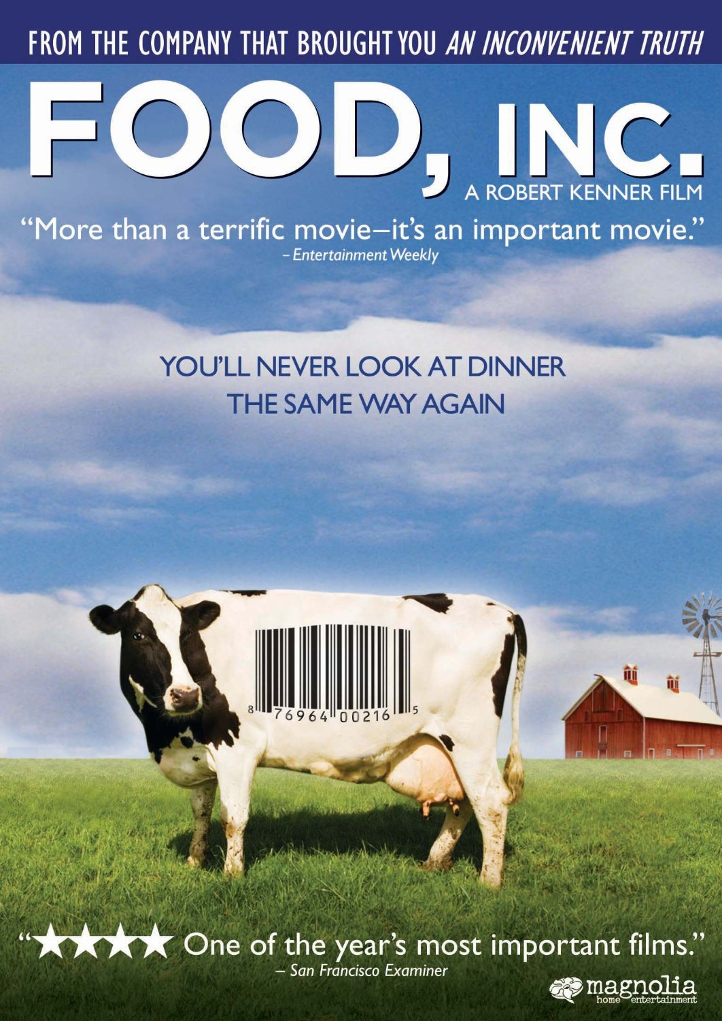
11/8 Food Inc.
Obj. TSW make connections between how food is produced and why Farm to Fork is so important. 86 NB
What impression was left on you by the movie Food Inc.?
What did you learn from Food Inc. that changes how you think about food?
If you got to meet Micheal Pollan in person, what would you like to ask him?

Slide 39
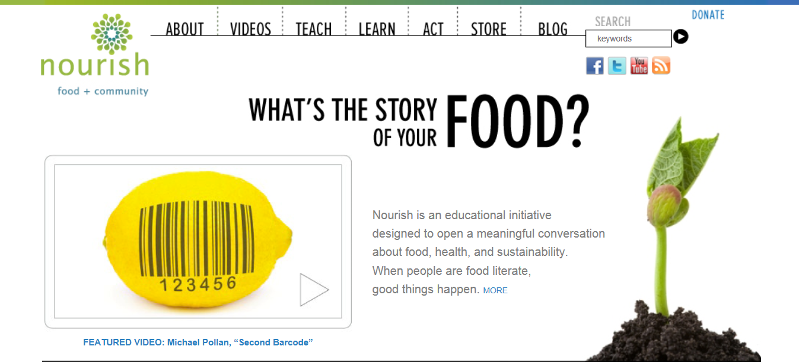
11/12 Nourish.org
Obj. TSW learn p. 88 NB
Name three things about the video that you learned.
How does Nourish relate to Food Inc. and to Farm to Fork?
How has Nourish changed your thinking about food? And what is healthy.

Slide 40


11/13 Understanding where our food comes from
Obj. TSW explain three aspects of how this class has impacted themselves, or the school or the community.
P. 90 NB
If someone were to ask you, “What was the Farm to Fork” class like? How would you describe what was taught in the class?

