Slide 1
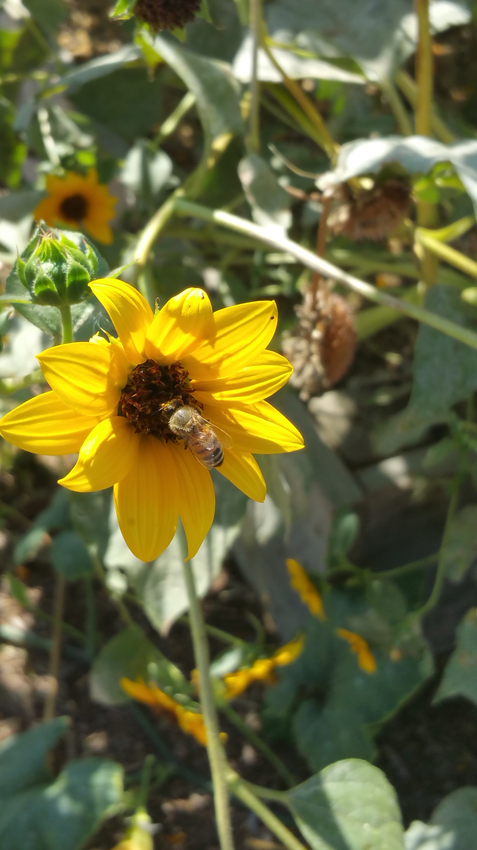
Farm-to-Fork
Week 4
Soil Texture, Plant Bulbs, Plant Flowers (Greenhouse) Fall Crops, Allelopathy Lab, Officer Elections, Individual Projects

Slide 2
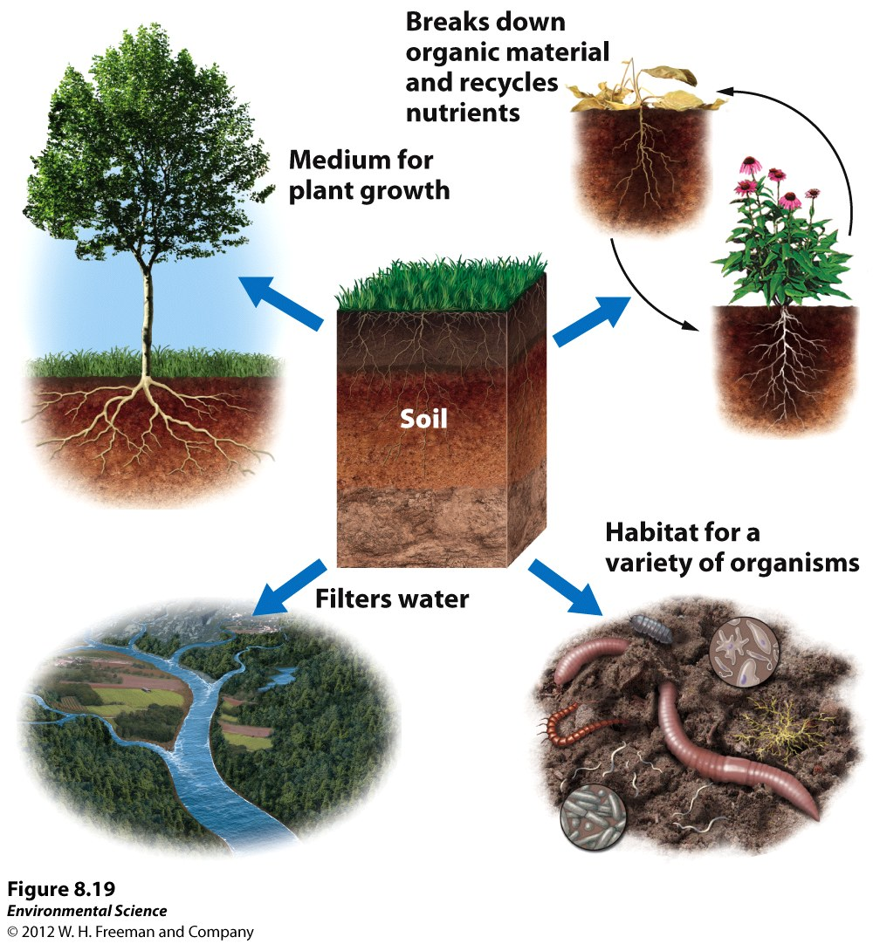
Purposes of Soil
Page 31 NB

Slide 3
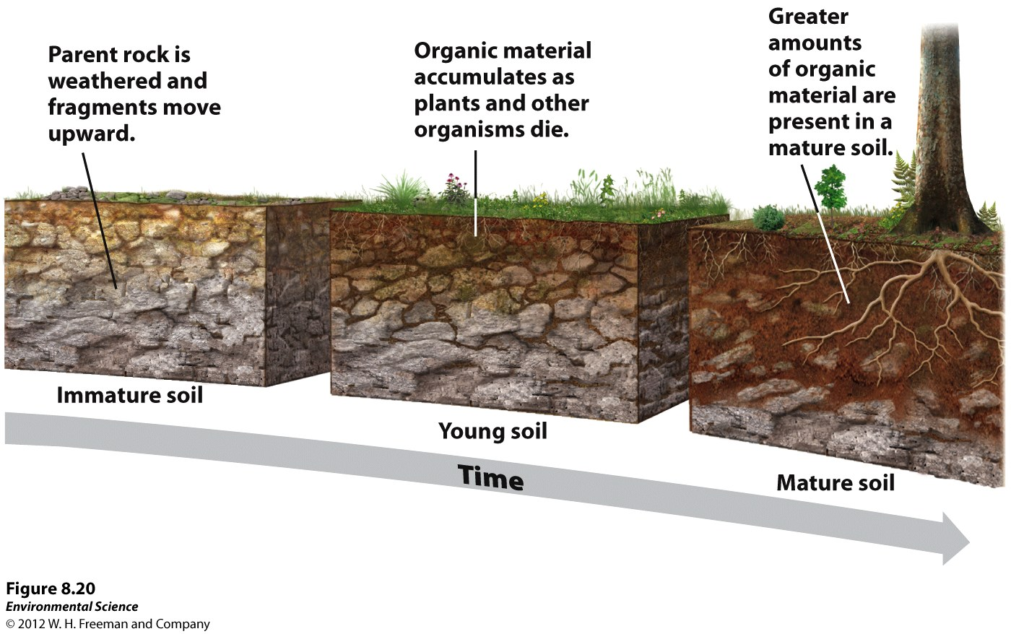
How Soil is Made…

Slide 4
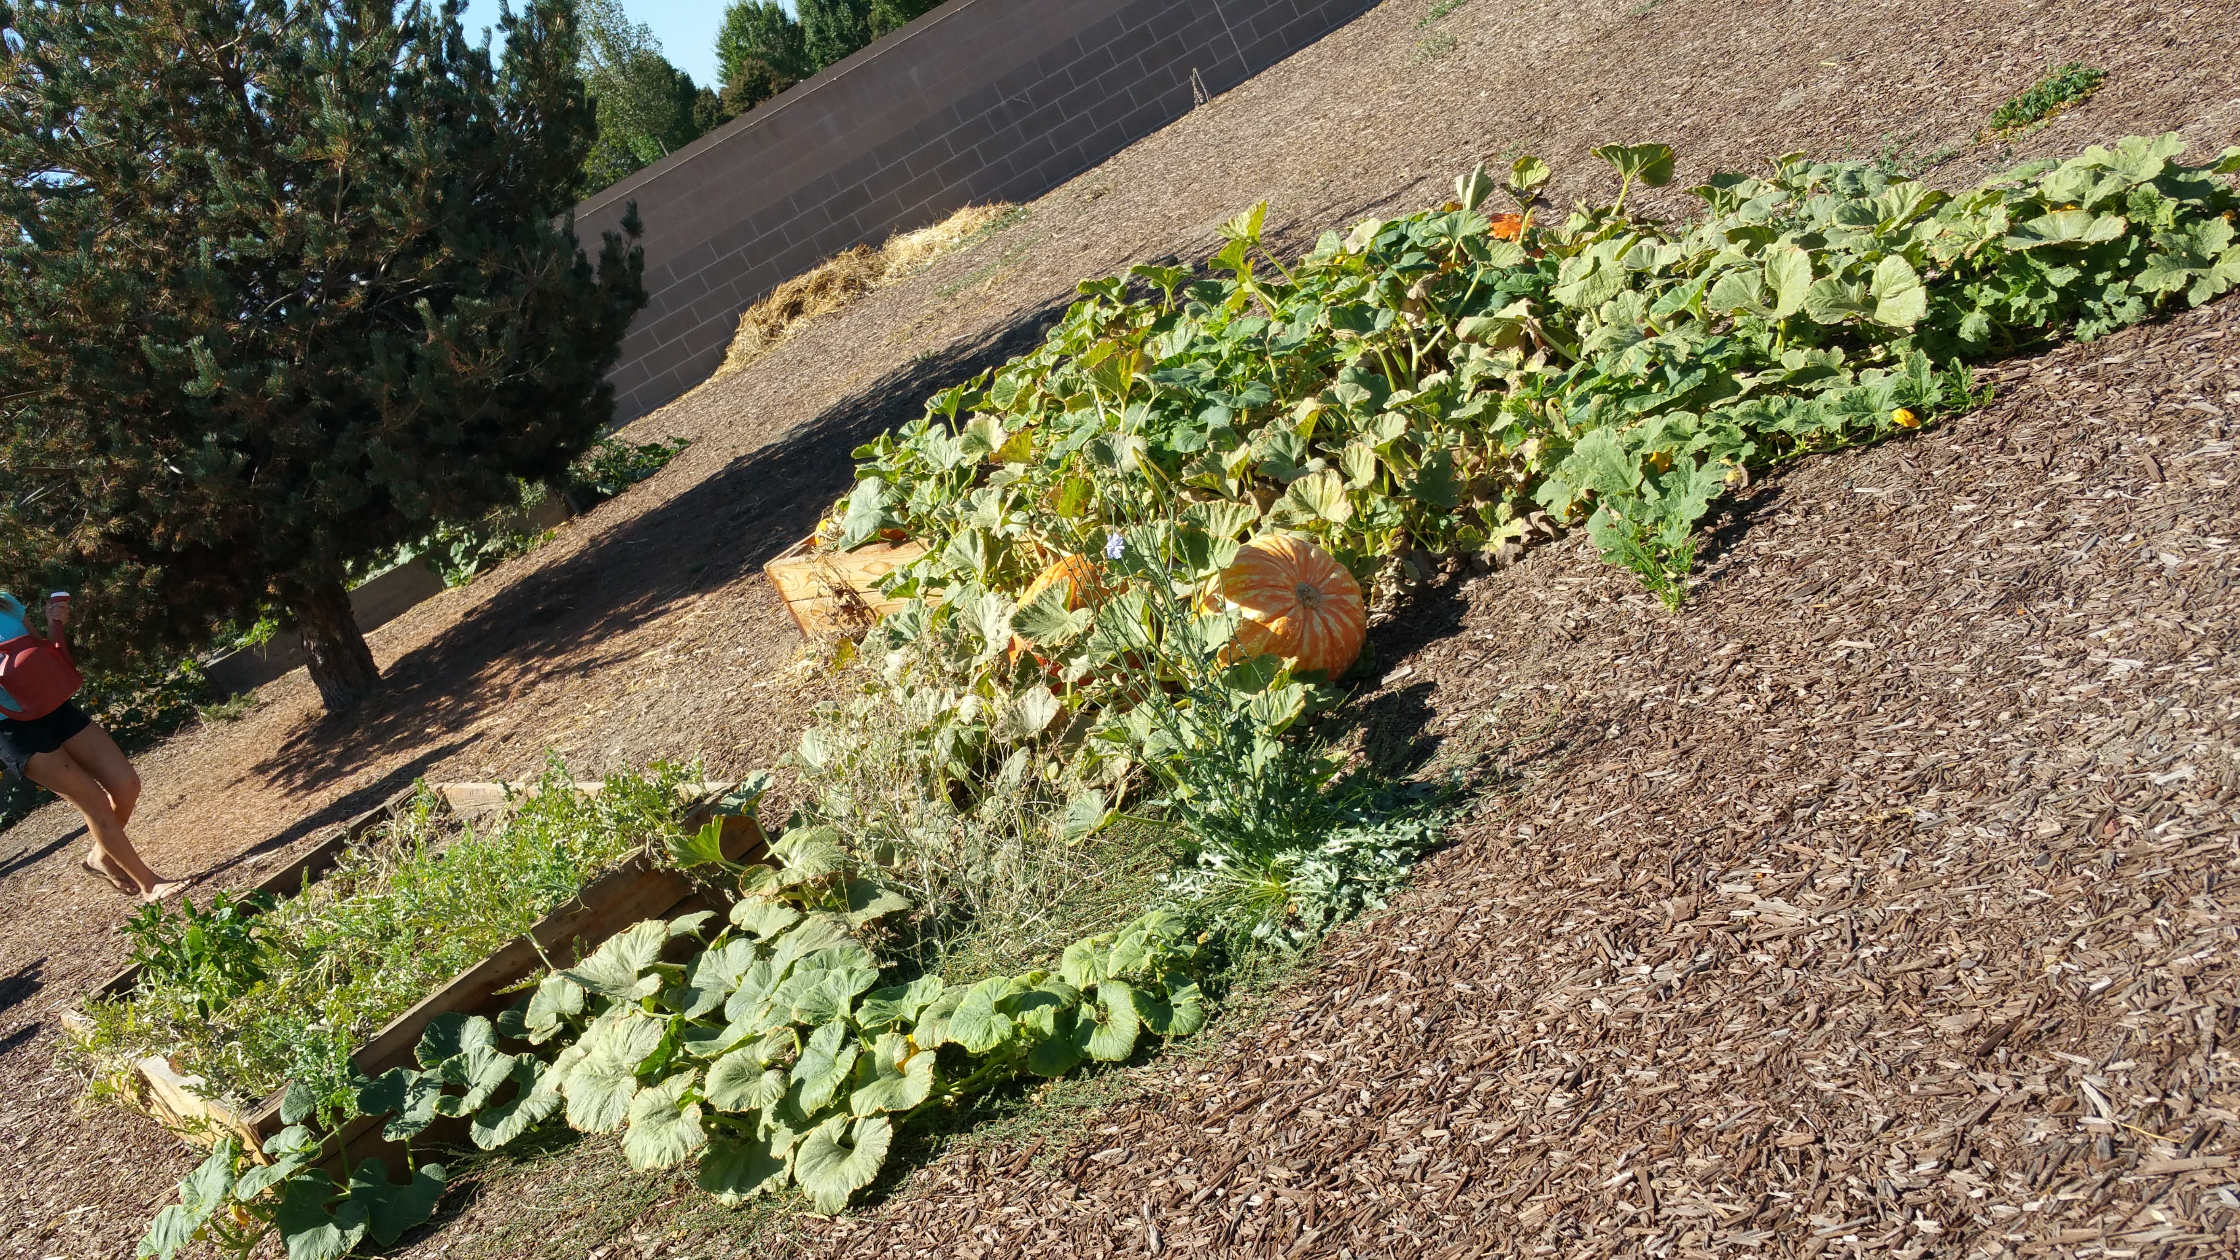
9/8 – 9/11 Garden Agenda
Work in the Garden
Plant flower seeds for the greenhouse
Weed
Add compost & turn
Add Worms to compost
Add worms to each garden bed
Dead head flowers
Cut Sunflowers for delivery (Thursday) (20)
Plant Sweet Peas – New garden bed
Water – Test with Hydrometer
Clean area by greenhouse
Clean inside of greenhouse
Sign up on list (you are graded on your work in the garden-Participation)

Slide 5
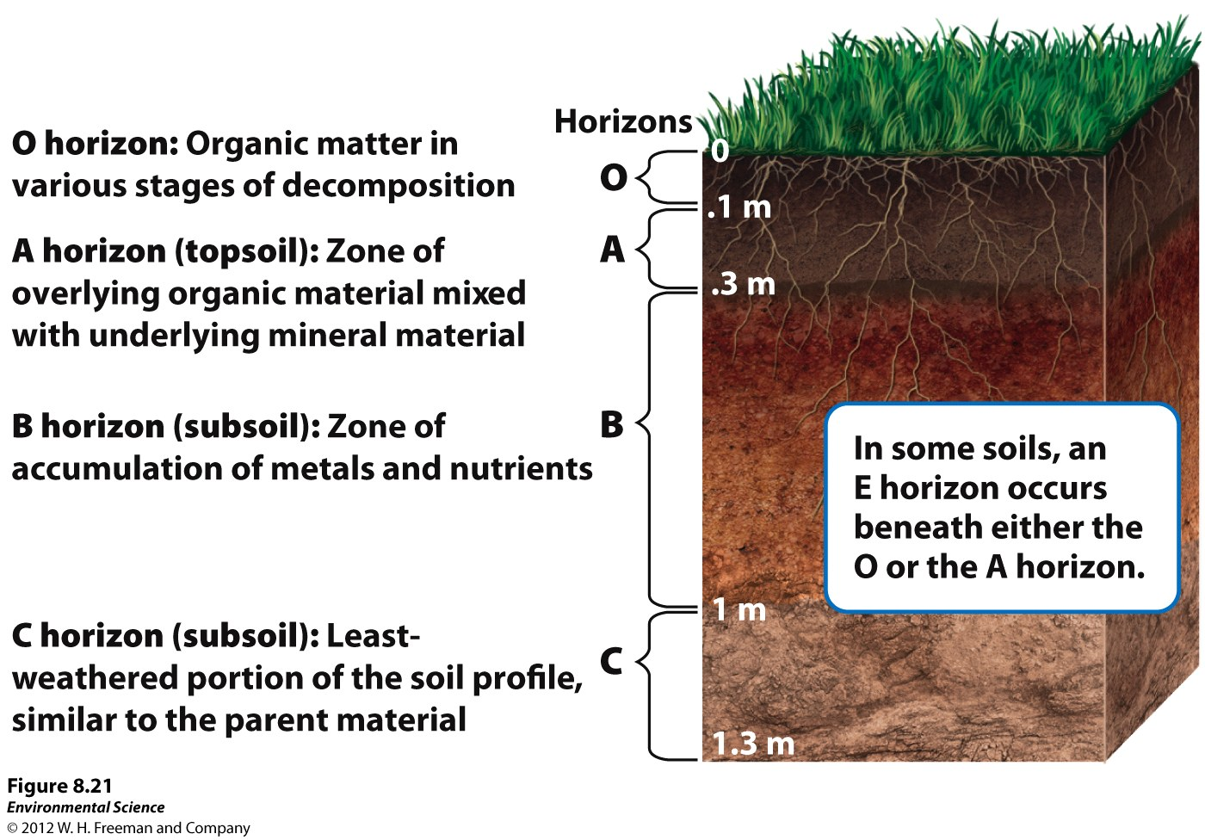
Soil Horizons

Slide 6
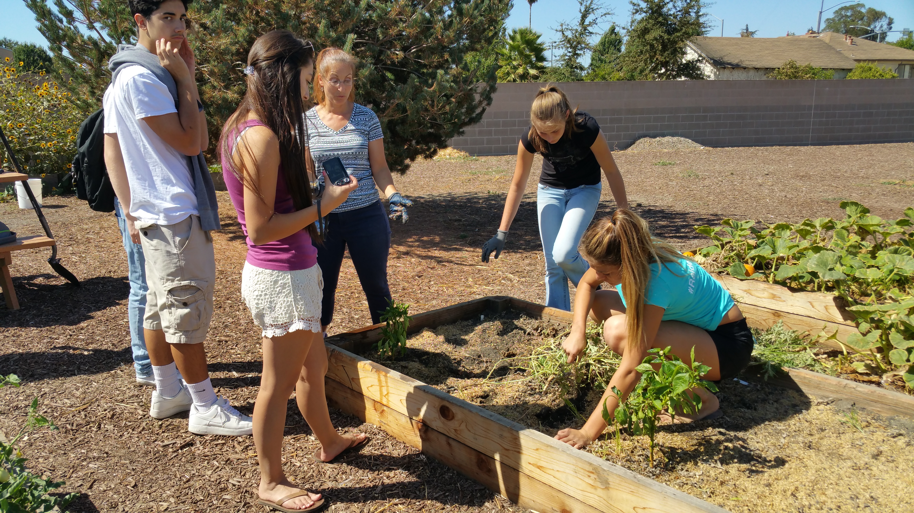
Farm-to-Fork Fieldtrip
California Rangeland Trust/ Raley’s
Coach Bus – Not a school bus, They are paying (Thank you Card)
Colusa, CA O’Connell Ranch Producers of Fruit & Nuts, Cattle
They will cover lunch.
8:45 – 4:45 pm
1.5 hours each way
Need two more Chaparones

Slide 7
Porosity & Permeability Demonstration

Slide 8
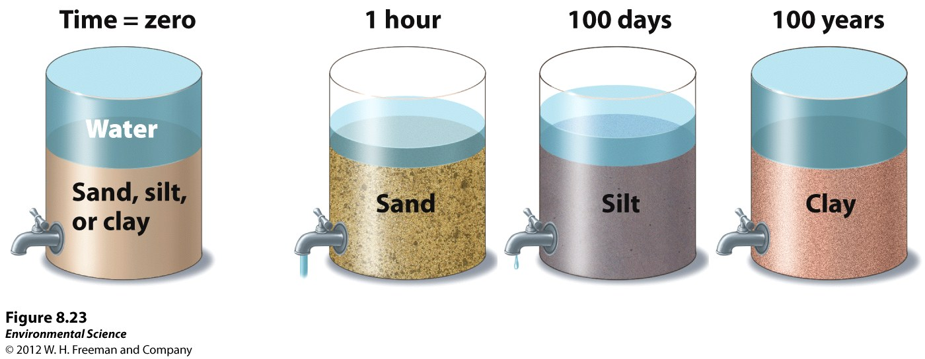
Porosity & Permeability

Slide 9
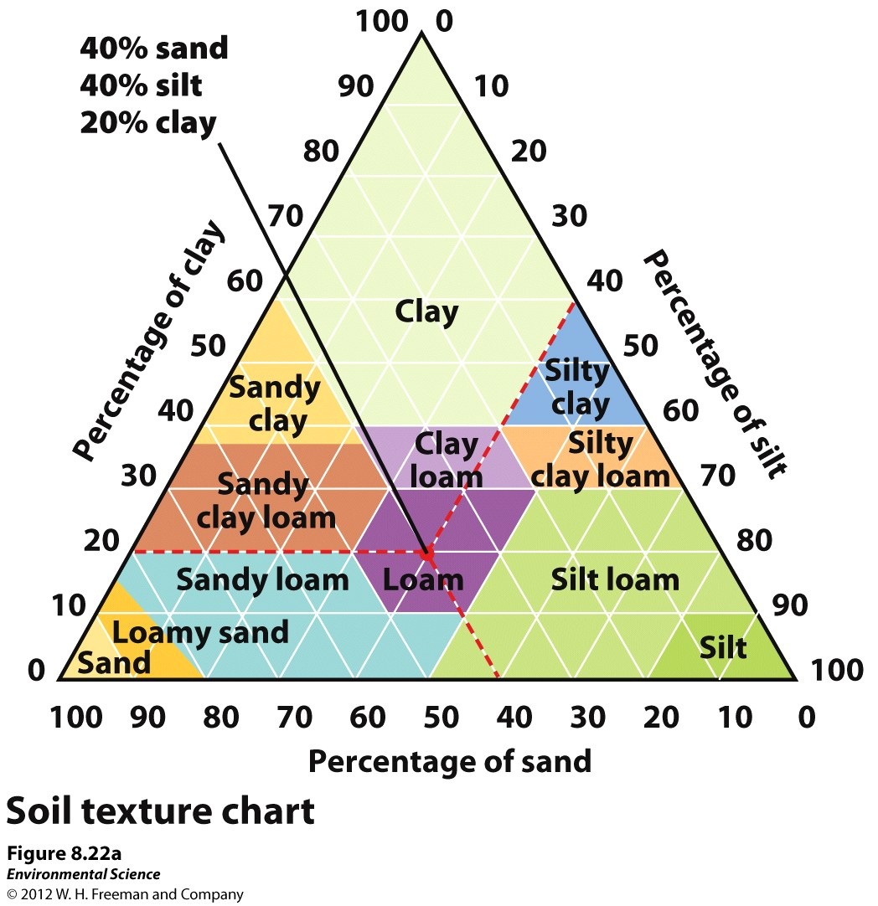
How to read a Soil Texture Chart

Slide 10
9/8 – 9/11 Agenda
Computer Lab – Finish Brochure, “I Believe” statement, grade Notebooks Wednesday P. 19 - 36
Students read “I Believe” statement, to class.
Officer Elections? Wednesday, Thursday

Slide 11
Farm-to-Fork Leadership Offices
2015 Fall Term
President- Organize Officers and communicate objectives, carry through with goals set by class.
Vice President – Support the president in organization of class meetings, communication throughout the class & school/ board with overall goals, achievements.
Secretary – Written documentation of class meetings with goals, achievements. Communicate with all levels of officers and class members.
Treasurer – Keep track of donations and expenditures, be present at all fundraisers.
Videographer- Develop, create, & document our adventures.
Publicist – Advertise F2F achievements, goals.

Slide 12
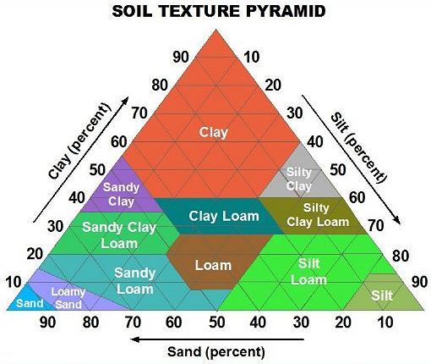
9/8 Ribbon Test Obj. TSW identify different types of soils. P. 32 NB
Types of soil Video
Name the three soil textures.
2. Name three soil types.
3. What soil is 20% Clay
30% Silt, 50% Sand?

Slide 13
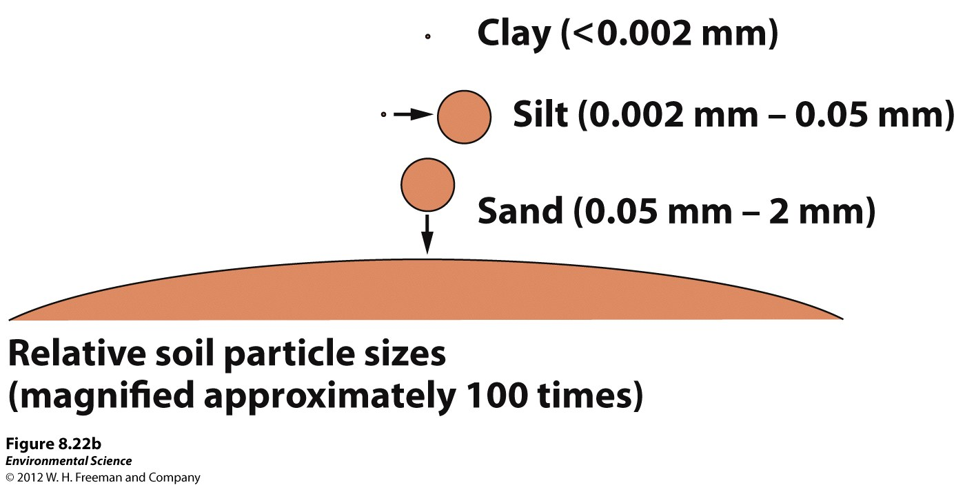

Slide 14
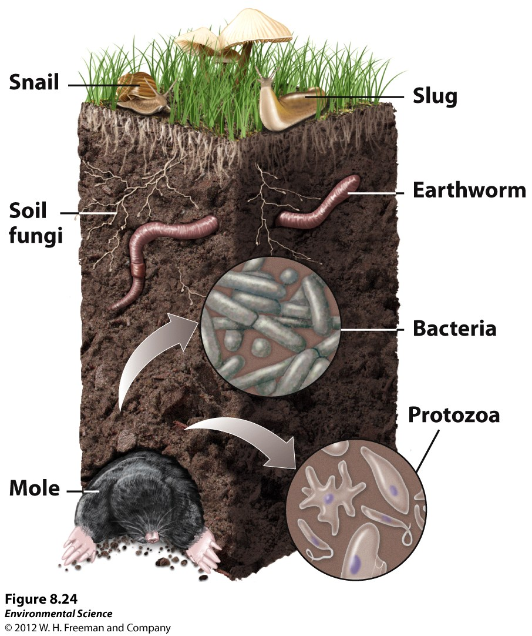
Soil is an Ecosystem
Soil is alive. When we get our awesome soil from Hasties, why do we have to add our compost to it?

Slide 15
“I believe” Statements
Who will read their “I Believe” statements today?

Slide 16
Page 27 NB Notes from Video - Soils
Activity in the Garden:
Name your soil. How do you know what it is? Use your Flow Texture Chart to help identify your soil.
What type of soil do garden plants grow well in?

Slide 17
9/9 Name that Soil Obj. TSW name the type of soil from the % texture & visa versa. P. 34 NB
What type of soil is 30% Clay, 30% Silt,
And 40% Sand?
If you were to make a Silt Loam, What %
of each of the soil textures would your need?
3. If you were to make a Sandy Clay Loam,
What % of each soil texture would you need?

Slide 18
9/10 Nutrient Availability Obj. TSW learn the relationship between pH and nutrient availability of soils. P. 36 NB
1. What is pH?
2. What pH is the most beneficial nutrient availability?
3. How do you know?

