Slide 1
Lesson 2: Poverty, The need for GMO’s?
UNIT 3 Global Food/ Food Equity

Slide 2
4/4 The Faces of Poverty Obj. TSW will have a better understanding of what Poverty is and is not. P. 18 NB
What is poverty in your own words? Write a complete sentence.
Write 5 observations about the picture.
This Picture was taken in Kathmandu Valley in Napal, North East of India. What does poverty look like.

Slide 3
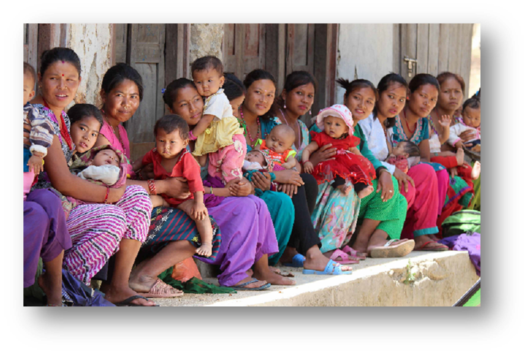
Class Discussion about your 5 observations of the UNICEF Photo of women & children.
Share out your observations of the picture with people at your table.
After 3 minutes of discussing what you see and think about it, each table should share with the class at least two observations.
Once an observation is said, that one can not longer be said to the class. So be ready to share out another of your observations/ thoughts about the picture.

Slide 4
4/5 8 Millennium Development Goals: 2015 Progress Chart Obj. TSW understand factors that contribute to poverty around the world and domestically. P. 20 NB
GOAL 1: Eradicate extreme poverty & hunger
GOAL 2: Achieve universal primary education
GOAL 3: Promote gender equality and empower women
GOAL 4: Reduce child mortality
GOAL 5: Improve maternal health
GOAL 6: Combat HIV/ AIDS, malaria & other diseases
GOAL 7: Develop a global partnership for development
Choose 3 of the United Nations Goals that interest you about measuring poverty.
Is it enough to just give people food to eat? Why?
Choose two countries, Compare & Contrast one of your 3 Goals for those countries. How are they different? How are they the same?

Slide 5
Africa

Slide 6
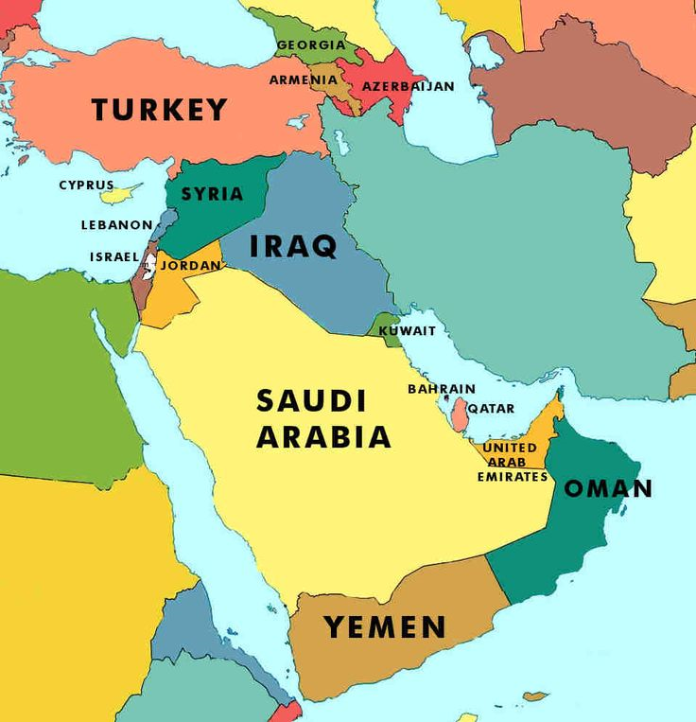
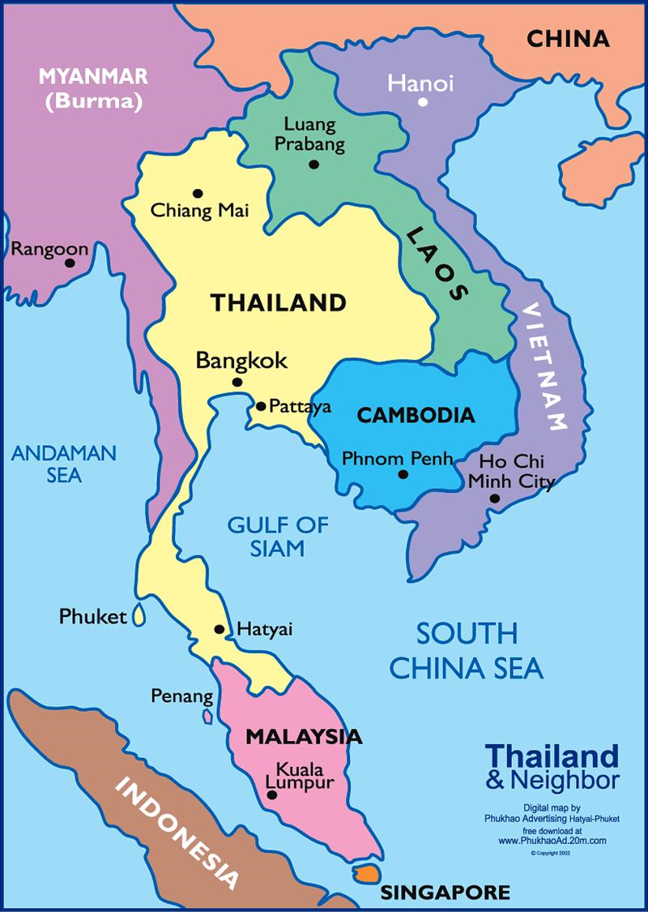
Asia

Slide 7
Oceania

Slide 8
Latin America and Caribbean

Slide 9
Caucasus & Central Asia

Slide 10
Computer Lab Activity p. 19 NB http://www.worldhunger.org/articles/Learn/world%20hunger%20facts%202002.htm
Working in teams, students select an impoverished geographical location and research the various nutritional or dietary deficiencies in their native population. One vitamin or nutrient deficiency and the health issues associated with the particular dietary shortcoming. In addition, students will suggest food groups that would alleviate the deficiency. For example, one group might choose to look at a group suffering from a lack of vitamin C, and its association with rickets. Summative assessment includes a Power Point presentation outlining geographic locale, dietary deficiency, physical maladies resulting from vitamin or nutrient deficiency, and suggest foods as remedies.

Slide 11
4/6 DNA – Deoxyribonucleic Acid Obj. TSW learn about the molecular genetic material that can be manipulated to create food that adds vitamins to it p. 22 NB
What is a gene? How is it part of DNA?
What is a transgenic organism?
What is a Genetically Modified Organism? Give an example.

Slide 12
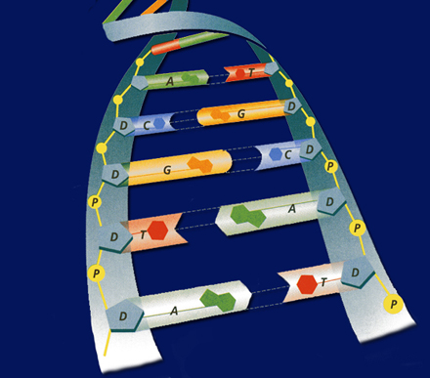
Deoxyribonucleic Acid
Take Notes on page 21 NB
Shape
Double Helix
Backbone
Sugar & Phosphate
Nitrogen bases
Guanine
Thymine
Adenine
Cytosine
Base pairing
A=T
C=G

Slide 13
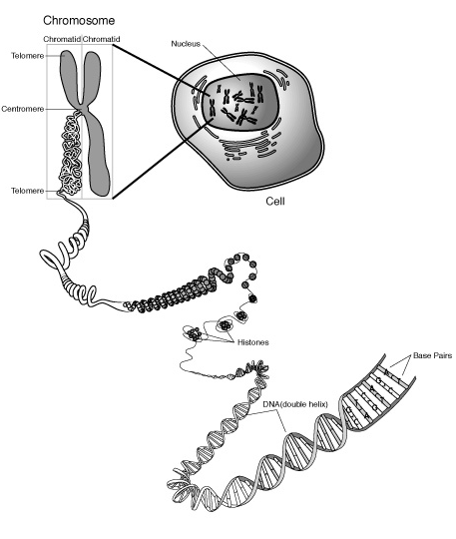
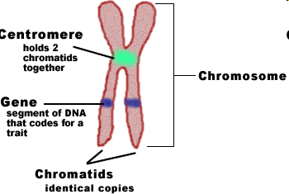
What is a gene?
A segment of DNA that codes for a trait.
Disease resistance
bacteria
fungi
Vitamin A

Slide 14
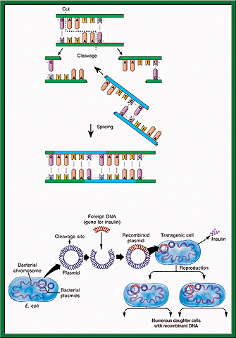
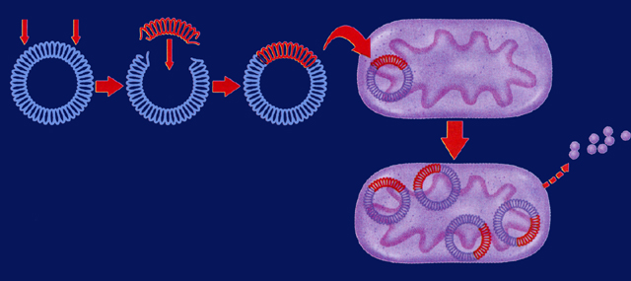
Gene splicing
Bacterial plasmids are used with restriction enzymes to cut sections of DNA out of one organism to be inserted into another organism.
Transgenic Organisms – organisms (plants, animals, fungi, bacteria, protists) that have foreign DNA from another organism in them.

Slide 15
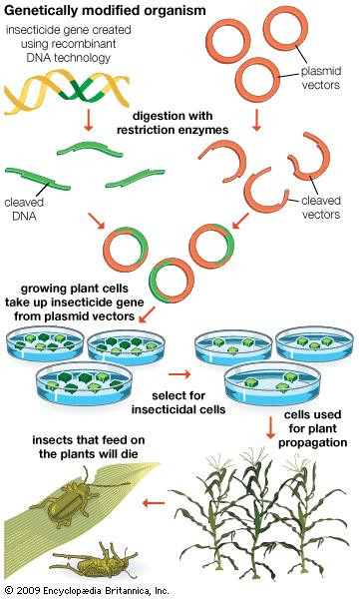
GMO’s – Genetically Modified Organisms
Golden Rice – Vitamin A inserted to prevent deficiencies.
Vaccines in food – to prevent diarrhea diseases.
Bt Corn – to kill the larval stage of the corn borer beetle
Insect resistance

Slide 16
4/7 Genetically Modified Organisms Obj. TSW learn to construct and critique facts from opinions about GMO’s P. 24 NB
How can genetic engineering and/or Genetically Modified Organisms be part of the solution to poverty and feeding 9 billion people by 2050?
Why or how can we own genes?
Write a 3 sentence opinion about GMO’s

Slide 17
Guest Speaker Notes P. 23 NB
Please take ½ page to 1 page of notes about GMO’s.
Include what they are, give an example of GMO’s that are in our Grocery Stores.
Explain how GMO’s are created.
In addition explain why GMO’s are controversial.
Include your opinion if Companies should own the genetic rights to organisms.
Lastly, Why do you or don’t you agree with GMO’s?

Slide 18
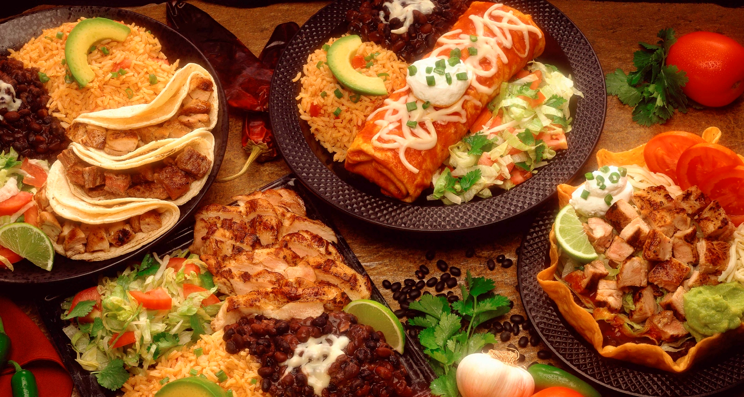
4/8 The science of food Obj. TSW construct a logical argument for or against GMO’s using scientific language. P. 26 NB
How is DNA important in GMO’s?
How has technological advances played a role in developing food?
If you could change one food source to be different in some way, what would it be and why?

Slide 19
Create a survey & Interview people. P. 25 NB You have learned that feeding 9 Billion people by 2050 will be challenging, that part of that solution are local farms and possibly the use of GMO’s.
Working with a partner or by yourself:
Create a 5 question survey asking people about GMO’s and/ or poverty/ or how to grow food/ Urban Farms- Farm to Fork.
Ask only 10 random people of various ages, socioeconomic and ethnic backgrounds.
McAllister must approve your questions first.
Present a chart of responses in a PPT slide to show the class. Due April 15th.
Write a 1 page reflection on this activity: What went as expected, what did not go as expected? Why? What did you learn about Poverty?, GMO’s?, Food? Page 23NB

