Slide 1
Food Cultures/ Leadership Food Awareness
UNIT 3 Global Food/ Food Equity

Slide 2
Create a survey & Interview people. P. 25 NB You have learned that feeding 9 Billion people by 2050 will be challenging, that part of that solution are local farms and possibly the use of GMO’s.
Working with a partner or by yourself:
Create a 5 question survey asking people about GMO’s and/ or poverty/ or how to grow food/ Urban Farms- Farm to Fork.
Ask only 10 random people of various ages, socioeconomic and ethnic backgrounds.
McAllister must approve your questions first.
Present a chart of responses in a PPT slide to show the class. Due April 15th.
Write a 1 page reflection on this activity: What went as expected, what did not go as expected? Why? What did you learn about Poverty?, GMO’s?, Food? Page 23NB

Slide 3
Online Honey Bee Research Activity p. 27 NB
What are the benefits to eating locally grown honey?
What are different types of Bees?
What breed of bees are in our local area?
What is Colony Collapse Disorder, What are the possible causes? How does it impact us?

Slide 4
Activity: Choose any of the following domesticated Farm animals and research antibiotic resistance p. 31 NB
Cattle, Sheep, Pigs, Chickens, Goats
How are the animals given the medication?
What bacterial infections are they being protected against? What are the most common types of diseases your particular farm animal gets?
Why do we care about antibiotic resistant strains of bacteria in our livestock?
Cite your Online Resources in your NB. You will need at least three resources.
https://owl.english.purdue.edu/owl/section/2/10/

Slide 5
Family Old School Remedies p. 35NB
Describe one of your family’s Old school remedies.

Slide 6
4/18 Leadership for a healthy food culture Obj. TSW learn how companies can be part of the solution for a healthy food culture. P. 38 NB
Give some examples of how our food culture is changing in West Sacramento or California?
How can a healthy food culture support a healthy lifestyle?
How can partnerships between large companies and schools help strengthen and promote food awareness?

Slide 7
4/19 Food Culture: Urban Farms & Raley’s teaming together Obj. TSW understand food culture and give examples of how it is changing in West Sacramento. P. 40 NB
Write some examples of how local food is accessible in West Sacramento.
This partnership provides other benefits besides healthy food awareness, list some.
If you could visit a local farm or ranch, what would you like to see? Why?

Slide 8
4/20 America’s Diet Obj. TSW recognize unhealthy aspects of our diet and be able to exchange them for healthier choices. P. 42 NB
What aspects of our diet do we know are unhealthy for us?
List some examples of health related diseases due to an unhealthy diet.
Describe 3 healthier choices we could all make, what benefits could result?

Slide 9
Draw this on p.37NB

Slide 10
Chemistry in Agriculture
Find 3 interesting factoids about animals that can be included in your 1 -2 page paper. P. 39 NB

Slide 11
What other local businesses support the Farm to Fork movement? P. 41 NB
Research 3 businesses with in 100 miles that raise, grow, sell, buy, and distribute local produce and meat, including dairy cattle?
Explain what they do and how they do it.
Some of this information can be included in your 1 – 2 page paper.

Slide 12
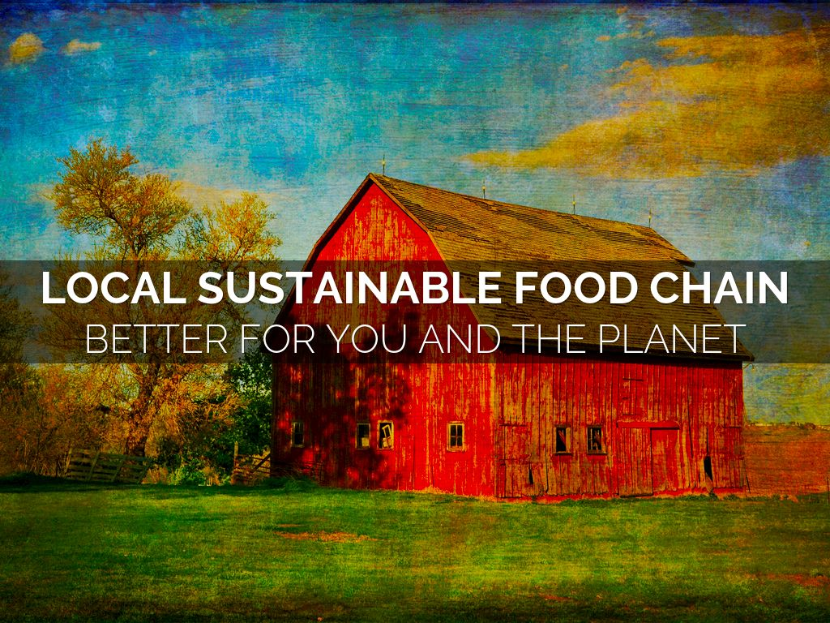
4/21 Local Sustainable Food Obj. TSW learn about sustainable food and how it is competitively priced. P. 44 NB
A friend asks you, “ What is local sustainable food?” How do you explain what it is?
How can the local food be competitively priced?
How much would your pay for a gallon of milk?

Slide 13
Guest Speaker – Karri Pina p. 43 NB
Sourcing Local Farms to feed RCHS students
Take notes in your Notebook, page
This will be included in your 1 – 2 page paper.

Slide 14
4/22 Where does your food come from? Obj. TSW assert their understanding of what healthy food is and how it is grown. P. 46NB
What does it take to eat healthy in America?
Where does your family buy most of your food?
If you were in charge of feeding America, how would your knowledge and understanding of growing food make us healthier?

Slide 15
1 – 2 page paper Where does your food come from?
Where does your food come from?
Discuss where your family buys food. Discuss what Farm to Fork is and it’s benefits.
Why is it important to know where your food comes from?
Include examples, explanations, and the significance of where our food comes from.
Maybe include ingredients such as High Fructose Corn Syrup, salt, fat, sugar in our diet.
Include the difference between processed and natural foods. Why is that important?
Include companies, businesses that are part of the solution to eat healthier, and companies that are part of the problem. Or companies that are trying to change their image and how.
APA Style: purdue.owl.edu

