Slide 1
Farm to Fork Week 12
Unit 3: Our Carbon Footprint
Resource Management and Conservation Practices

Slide 2
This week…
Prepare for Next week Harvest Festival: Fundraiser & Information Booth
Prepare for School Board Members visits: Sarah Kirby Gonzalez & Katie Villegas & Renee Collins
Officers meet in the front Office for welcoming our guest. Ariana: Tuesday
Escort out to the garden at 10:30.
I sent all Thank you Cards.
Master Gardener visit??? Talk out at the Garden?
Grade Notebooks Monday and Thursday – Computer Lab Library Monday, Room 801 Thursday

Slide 3
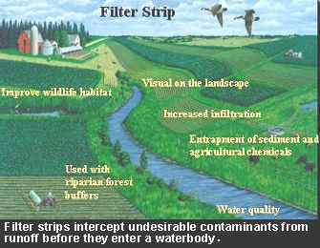
11/2 Conservation Practices Obj. TSW understand and explain conservation practices such as water conservation and pest management to members of the school board this week. P. 26 NB
Companion planting is a conservation practice, how does it work?
We used mulch in each of our garden beds over the summer, why?
What practice do we have for soil conservation?

Slide 4
Activity: List Our Best Practices Brainstorm conservation techniques we have in the garden that make it sustainable. P. 27 NB
Remember to show Board Members how we are being efficient with water.

Slide 5
Contact local Farmers to show us their fields and their conservation practices.
Would you like to walk along the Clarksburg Trail and meet a farmer in their field?

Slide 6
Computer Lab Activity: Biocapacity of Countries P. 29 NB
Use the Website: www.footprintnetwork.org
Research Biocapacity of 5 – 7 Countries. Record the trends and Biocapacity for each country.
Answer the following questions:
What trends do you see?
What are these trends related to?
What are the implications of these trends?
What needs to happen to increase our Biocapacity for the world?
Finally, write a paragraph to justify the need for sustainable management of resources and practices across countries.

Slide 7
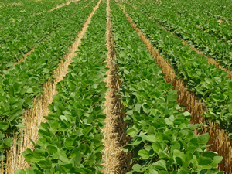
11/3 Conservation Practices Obj. TSW learn about conservation practices. P. 28 NB
How do these practices (to the left) improve soil productivity or water retention?
Why do we want to conserve soil/ water?
What are some of the threats to soil water?
No till farming

Slide 8
Conservation Practices we use in the garden. P. 23 NB
Suggest ways to improve our effectiveness in the garden and describe some conservation techniques to include.
Crop Rotation – Make a map of each season, so we don’t plant in the same beds with the same crops. This helps keep pest #’s down.

Slide 9
Projects to work on in the garden
Be productive
Pull weeds, in the garden beds, in the garden area
Plant Onion bulb sets in center planter, remember the name tag
Turn compost
Stop by G Building and get donations from Mrs. Hoffmann
Move sand for Zen garden
Move soil to compost pile
Rake ground flat
Trim Roses
Organize the Greenhouse

Slide 10
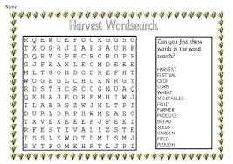
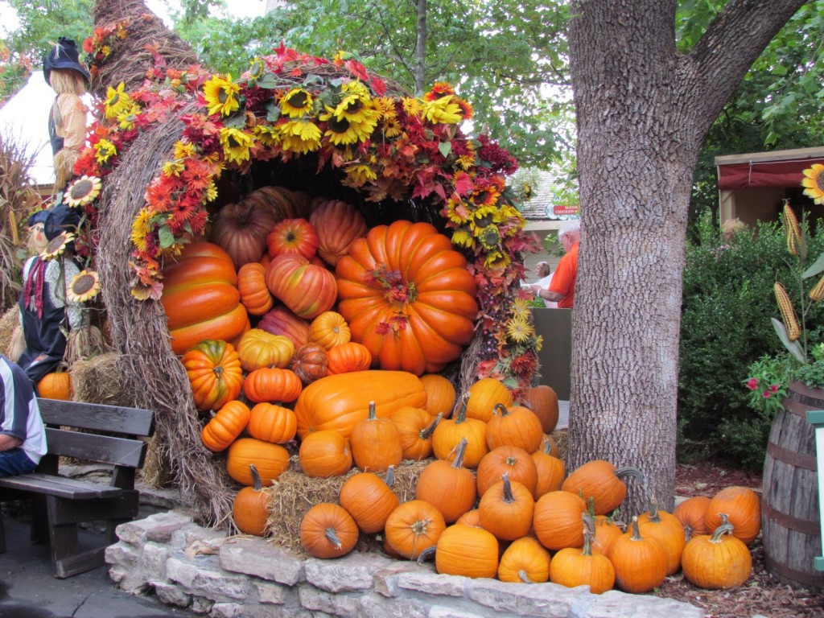
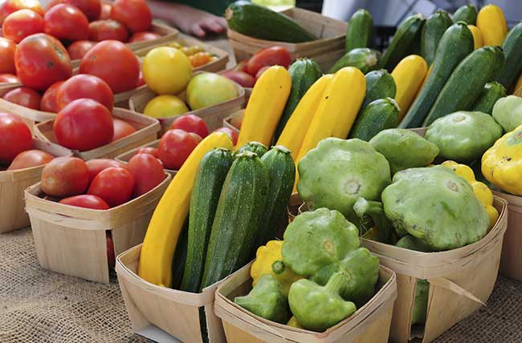
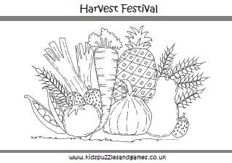
11/4 Ideas for Harvest Festival Obj. TSW discuss ideas for the Harvest Festival to educate the community about what we do, what Farm to Fork is and sustainable agriculture. P. 30 NB
The SSP Grant $$$ was approved!!!!
What activities/ games can we do/ make to help educate others at the Harvest Festival about Farm to Fork?
What sort of fundraising ideas do you have?
What materials do we need to tell Mrs. Collins at Bryte to have set up for us for the Harvest Festival?

Slide 11
Harvest Festival
Educate – Games/ Activities/ Pamplets
Jonah Hernandez
Quincy Gonzalez
Valeria Velarde
Emiliano Rosas
Paige Williams
Fundraise – $ into Greenhouse & Environmental Club Account
Fernando Vega
Ariana Cavett
Nathalie Jaime
Daisy Lopez Velasco
Julien Walker
Sonya Shifrin

Slide 12
Vocabulary Sheet UNIT 3: Key Assignment 2: Conservation Practices P. 31 NB

Slide 13
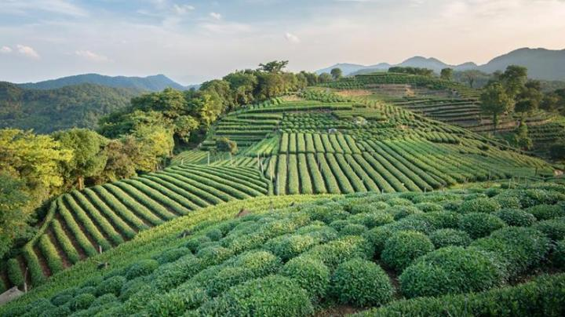
11/5 Green Revolution Obj. TSW watch a video about synthetic pesticides and fertilizers. P. 32 NB
What is the Green Revolution?
What is the difference between synthetic and organic?
What suggestions do you have for our garden?

Slide 14
Thank you cards!!!
For Buying our Home Grown Farm to Fork Pumpkins from our RCHS Garden
Debra Rodriguez
Monika Frank
Kristin Rodriguez
Chris Hanks
* Can we have them signed and delivered by Friday November 6th? We raised $55 on only 4 pumpkins!!! What could we raise next year if we had even more?

Slide 15
11/6 Conservation Practices Obj. TSW understand how cover crop, intercropping and integrated pest management help conserve our soil. P. 34 NB
What is a Cover Crop?
What is Intercropping?
Name some integrated pest management practices.

Slide 16
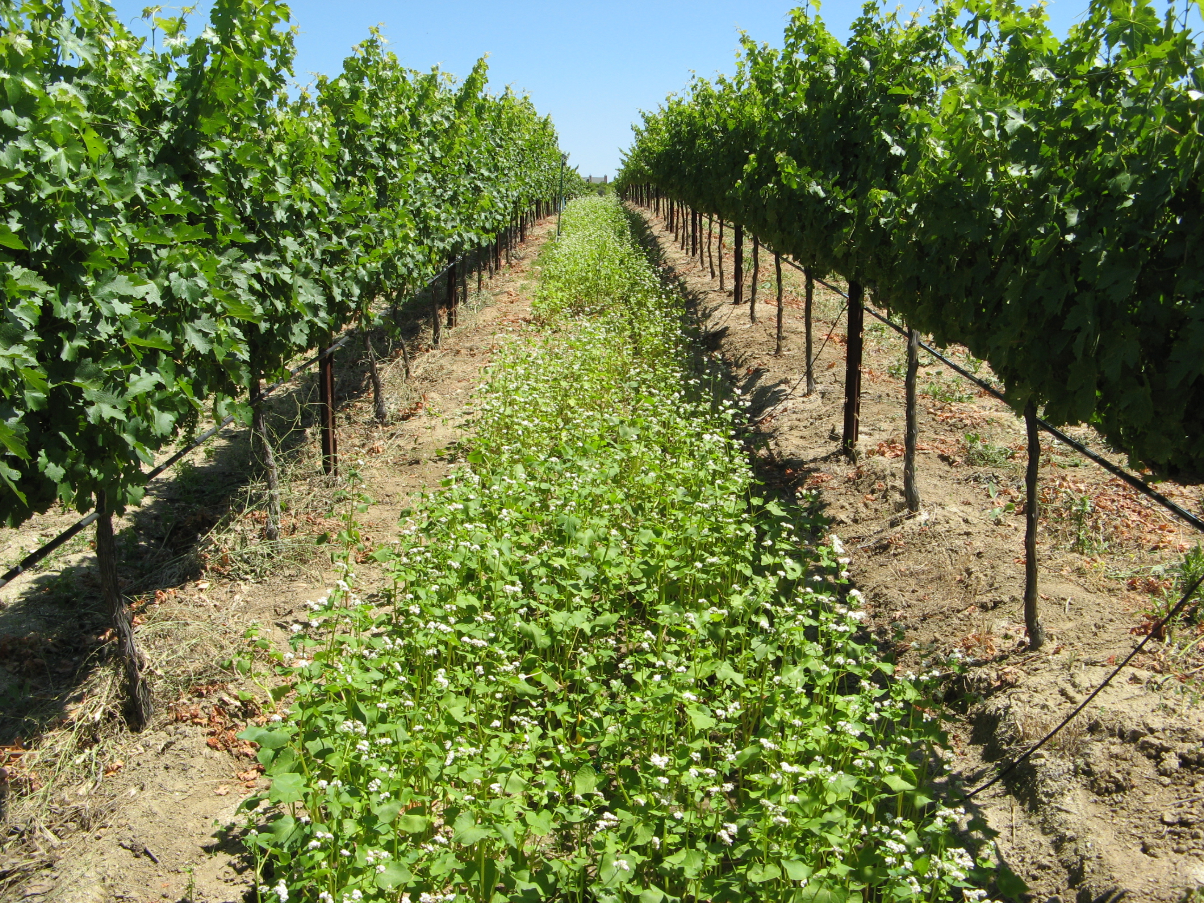
Cover Crop growing a second crop in the same season of another that will improve soil health.
Suppressing weeds
Protecting soil from rain or runoff
Improving soil aggregate stability
Reducing surface crusting
Adding active organic matter to soil
Breaking hardpan
Fixing nitrogen –clover, fava beans
Scavenging soil nitrogen
Suppressing soil diseases and pests
http://covercrops.cals.cornell.edu/

Slide 17
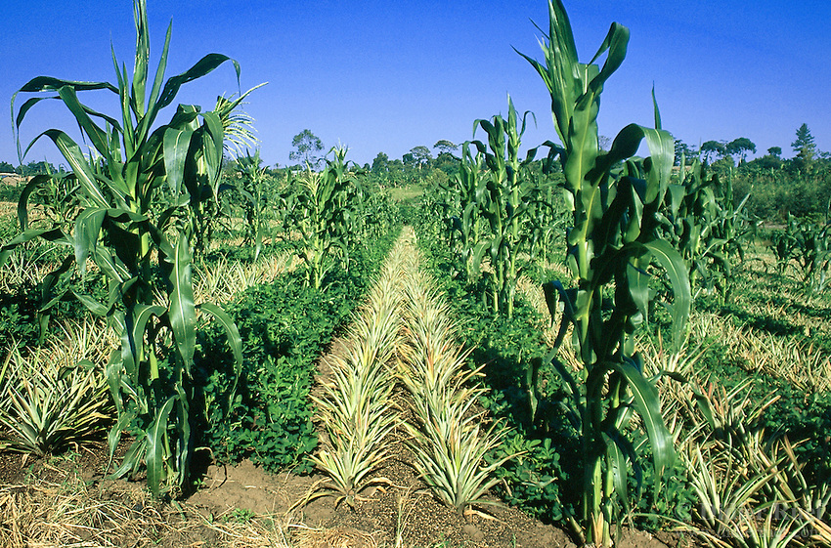
Innercropping – growing two or more crops at the same time in the same field.
Reduces insect/ pest infestations
Reduces plant diseases
Reduces erosion & Protects topsoil
Attracts beneficial insects
Minimize labor to control weeds
Increase in production of land
2 crops harvested instead of one
http://www.oisat.org/control_methods/cultural__practices/intercropping.html

Slide 18
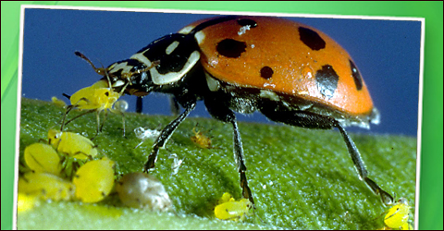
Integrated Pest management
Lady bugs
Butterfly's
Less pesticides
Increased biodiversity

