Slide 1
UNIT 3 Lesson 4 Transportation and Energy
Weeks 14 Nov. 14 – 18th
F2F1

Slide 2
Vocabulary List UNIT 3 Due November 10th
Page 9 notebook
You can use it on your quizzes and tests.
READ Omnivore’s Dilemma CH 9 & 10

Slide 3
Resource Management Assessment tape to page 29 NB
Individually, write a final paragraph using examples to justify the need for sustainable management of resources and practices across countries so that the population of Earth can live within its means. Explain how your examples can help us manage future resources. Why do we care?

Slide 4
Journey 2050 video
Notes Page 29 NB

Slide 5
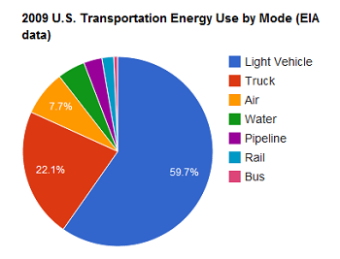
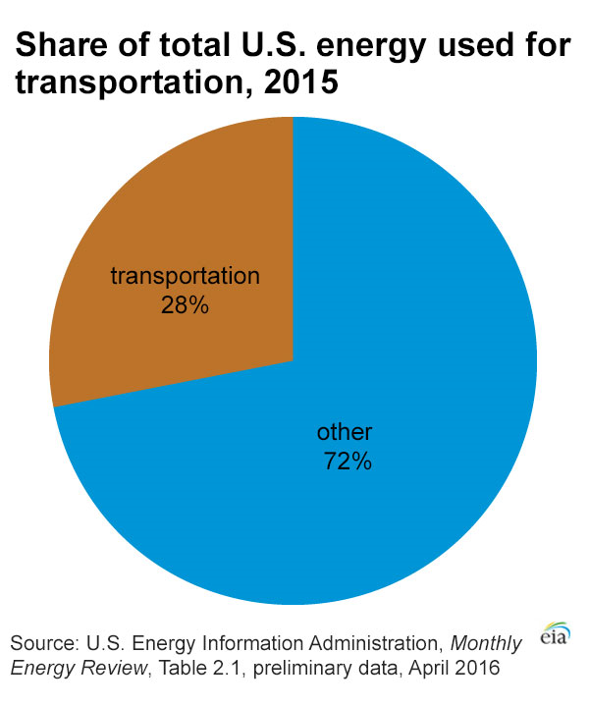
11/14 Transportation & Energy Obj. TSW apply one of the cornerstones of the F2F movement to American cultural norms. P. 34 NB
What ingredients go into making a cheeseburger?
How much energy do you think it takes to produce a cheeseburger in terms of being carbon neutral or increasing your carbon footprint?
What differences might exist between a fast food hamburger and one from a local family owned restaurant?

Slide 6
Cheeseburger Graphic Organizer p. 31 NB
Hamburger
Toping 2
Toping 1
Toping 4
Toping 3

Slide 7
The Cheeseburger Footprint
Notes p. 33 NB
Read the Cheeseburger Footprint article, use a highlighter & pen to annotate the text. After you have read it through once, read it again and:
Circle the Claim
Underline the Evidence for the Claim
Star the Reasoning for the Evidence
Write the significance of the article as it applies to Farm to Fork and Sustainability.

Slide 8
http://www.openthefuture.com/cheeseburger_CF.html
Go to the website and read the article. P. 35 NB
Discuss what you have read with 2 other students around you.
Class discussion on the energy needed to make a hamburger.
AXES Paragraph about the article in your notebook.
Cheeseburger Video
Map the ingredients of a hamburger. How far does the food travel form the farm to the consumers plate?

Slide 9
11/15 Omnivores Dilemma CH 12 & 13 Obj. TSW read chapters 12 & 13 of Omnivores Dilemma to prepare for Kahoot’s Quiz tomorrow. P. 36 NB
What are the Main ideas of Chapter 12 & 13?
How do the main ideas relate to you and the food you eat?
What surprised you about the reading?

Slide 10
11/16 Eating a Cheeseburger Obj. TSW learn about the carbon footprint of eating a cheeseburger. P. 38 NB
What is a carbon footprint?
What kind of energy goes into making a cheeseburger?
Rank the carbon footprint of eating a cheeseburger: High, Medium or Low.

Slide 11
11/17 Along the Way… there are Jobs Obj. TSW learn about potential jobs in the Agriculture & transportation industry. P.40 NB
What are some potential jobs in Agriculture related to transportation and energy?
How many people work in an area related to Agriculture?
Why is this significant?

Slide 12
11/18 Andy Warhal Hamburger Obj. TSW understand the common denominator a fast food hamburger creates. P.42 NB
What do you expect from a fast food hamburger?
What is your favorite memory eating a fast food hamburger?
Why is eating a fast food hamburger a common denominator among all people?

Slide 13
Agriculture Careers
Agricultural careers may be divided into various categories. These include: Agribusiness Management, Agricultural and Natural Resources Communications, Building Construction Management, Agriscience, Resource Development and Management, Parks, Recreations, and Tourism Resources, Packaging, Horticulture, Forestry, Food Science, and Fisheries/Wildlife
http://www.agday.org/education/careers.php

Slide 14
http://www.agday.org/education/careers.php
Go to the following link and research potential jobs in Agriculture.
Write a list of 5 potential jobs that are interesting to you and why.

Slide 15
UNIT 3 Carbon Footprint Transportation & Energy Assessment
Students will compare and contrast the Farm to Fork movement to traditional food grown/ raised in America. Students will explain efficiency in terms of energy due to distance, location and transportation of goods and services for the food.
What does it cost in terms of energy to eat what you think you need or what you want?

