Slide 1
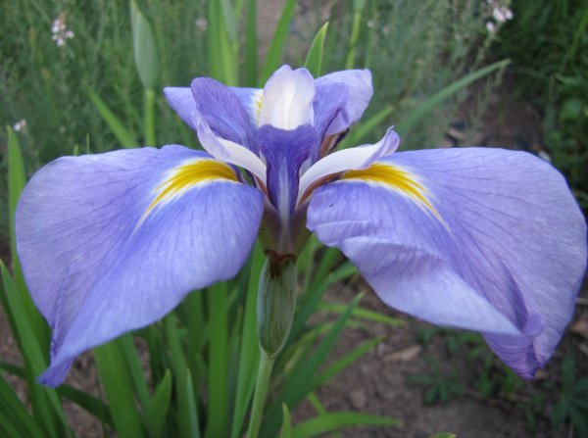
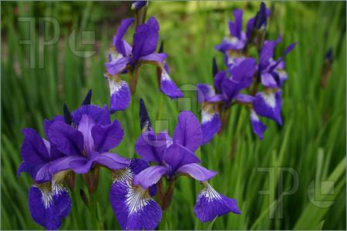
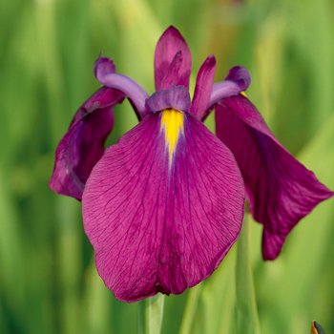
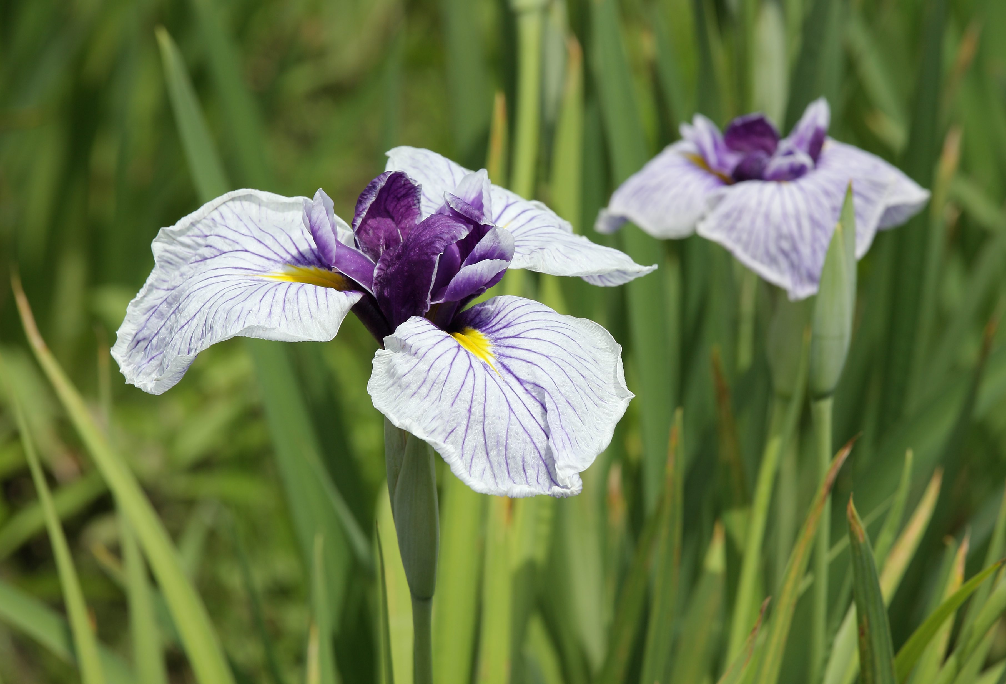
Farm to Fork
Pumpkin Pie Making with Culinary Arts at the Bryte Campus
October 15th, 2015
Cheryle Sutton, Ellen Hoffmann, Robert Rossi, Jennifer McAllister, Chris Hanks, Saraphina, Gilberto, Gilbert Ramos, Quincy Gonzales, Valeria Velarde

Slide 2
We started with this…

Slide 3
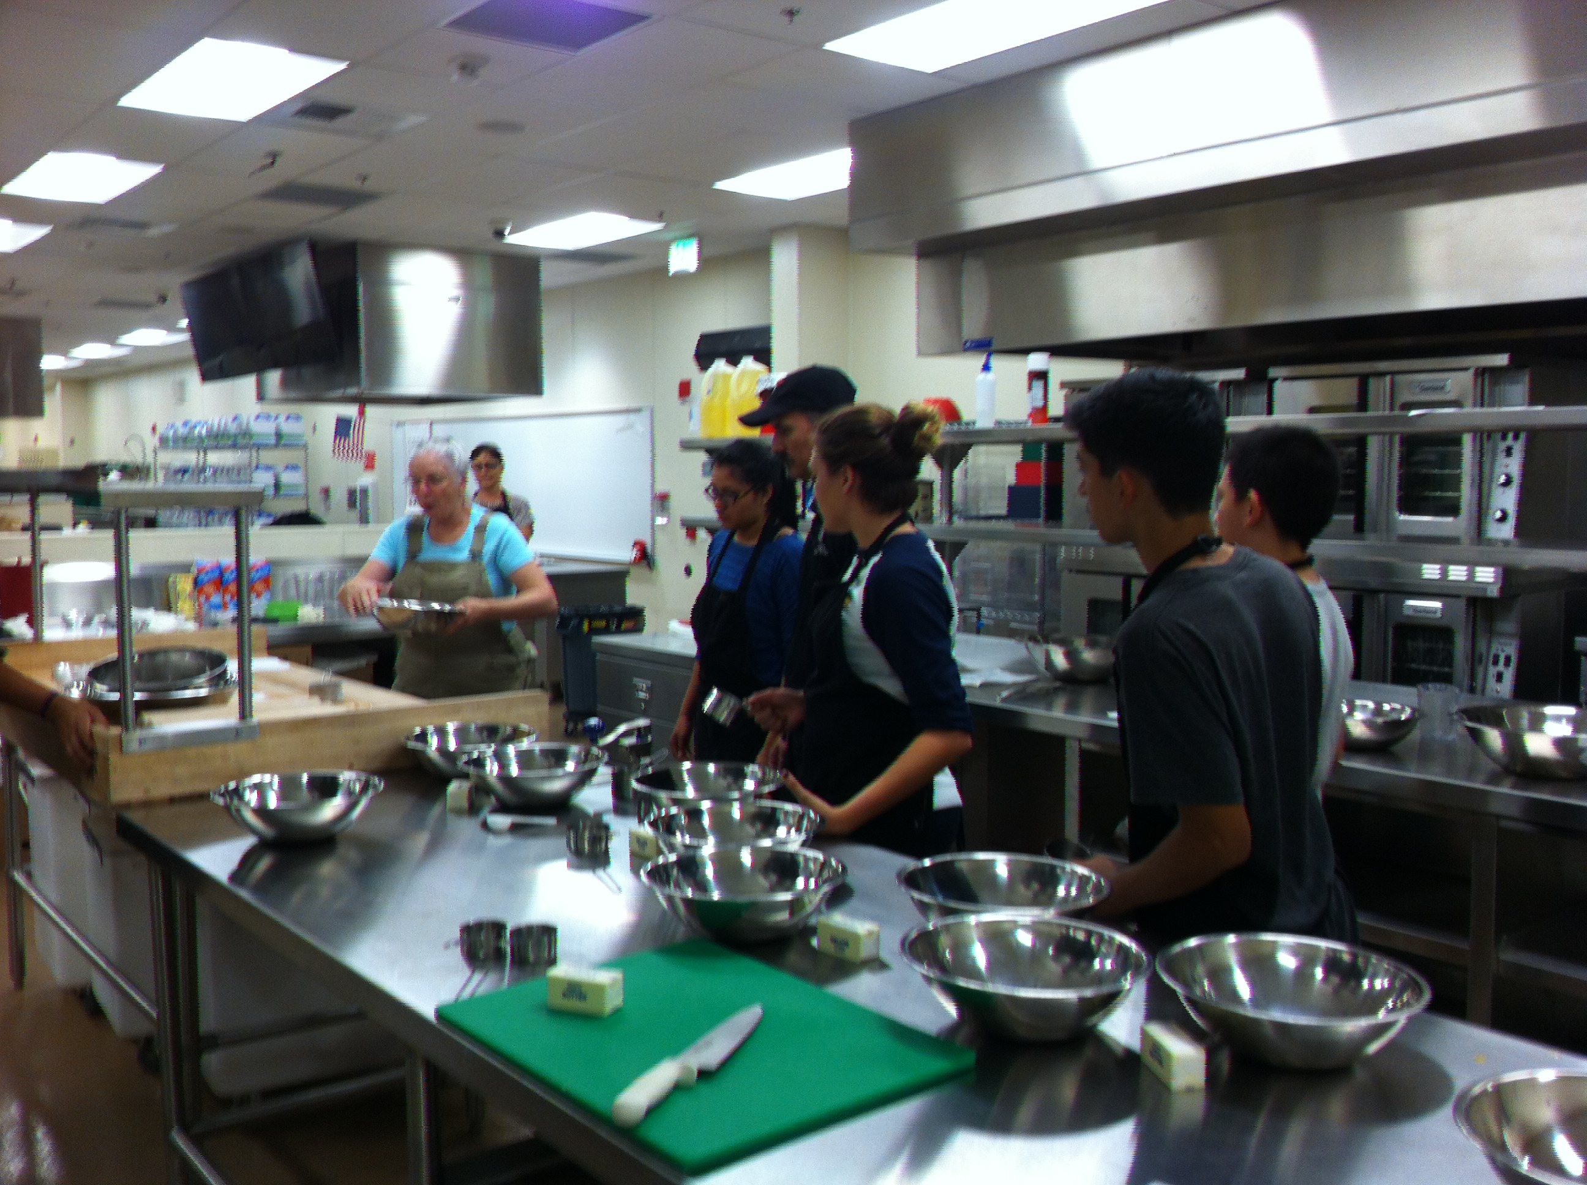
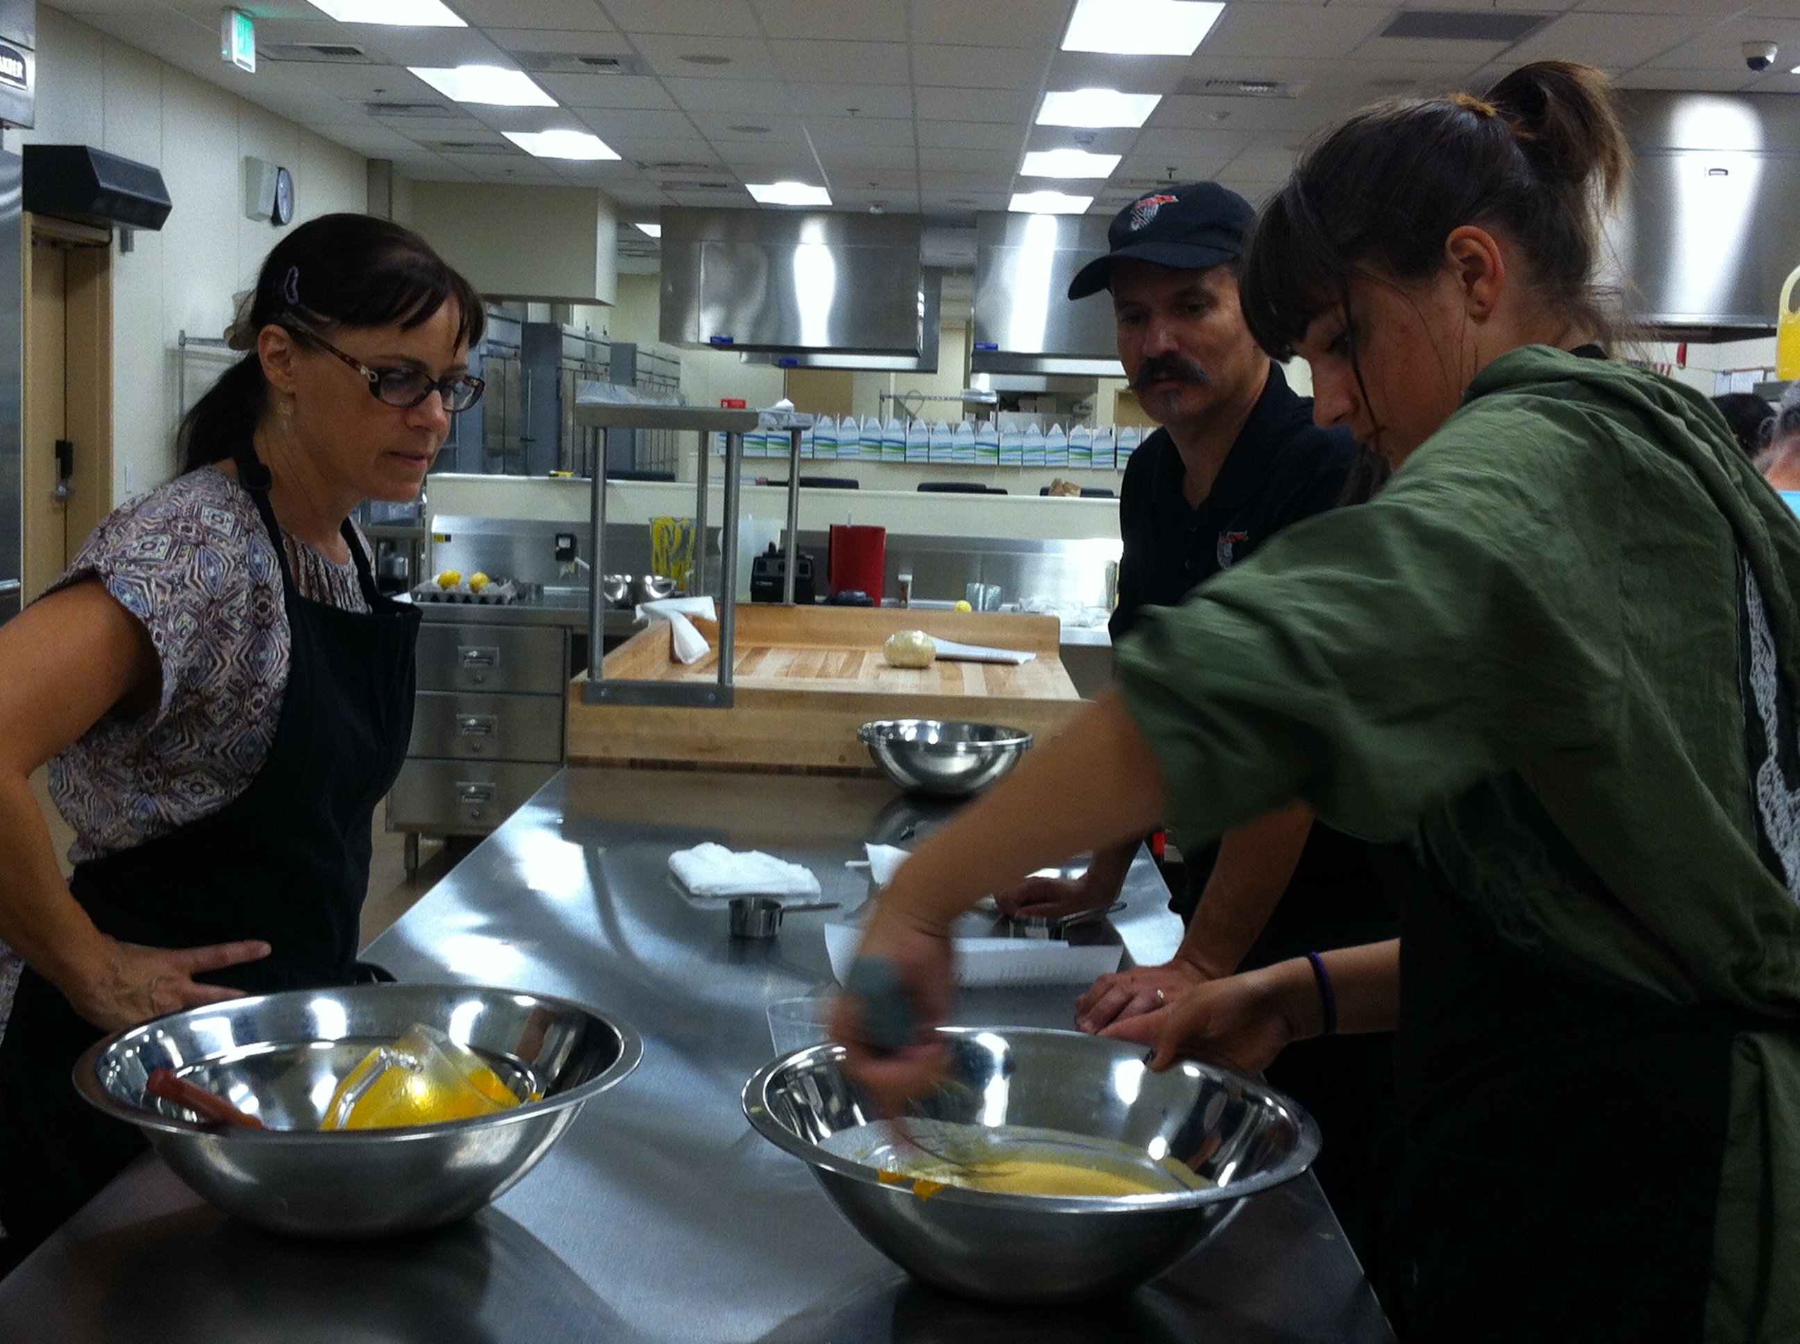
Pumpkin Pie Making Culinary Arts & Farm to Fork Education CAFFE

Slide 4
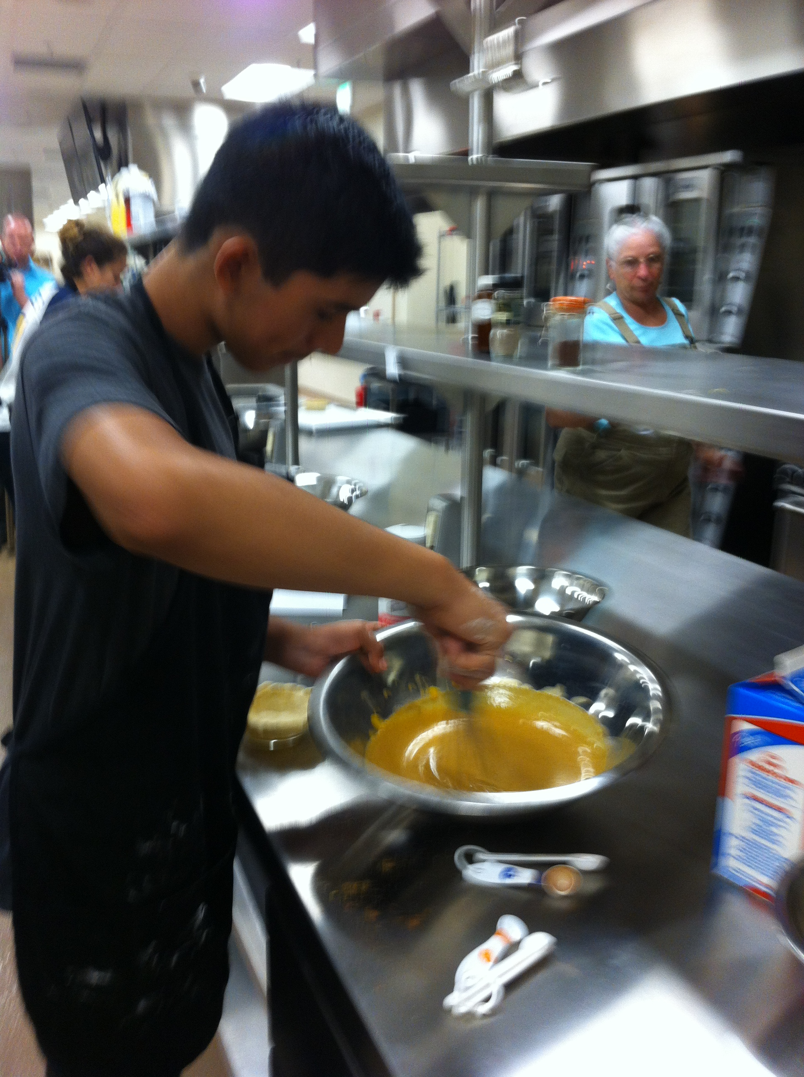
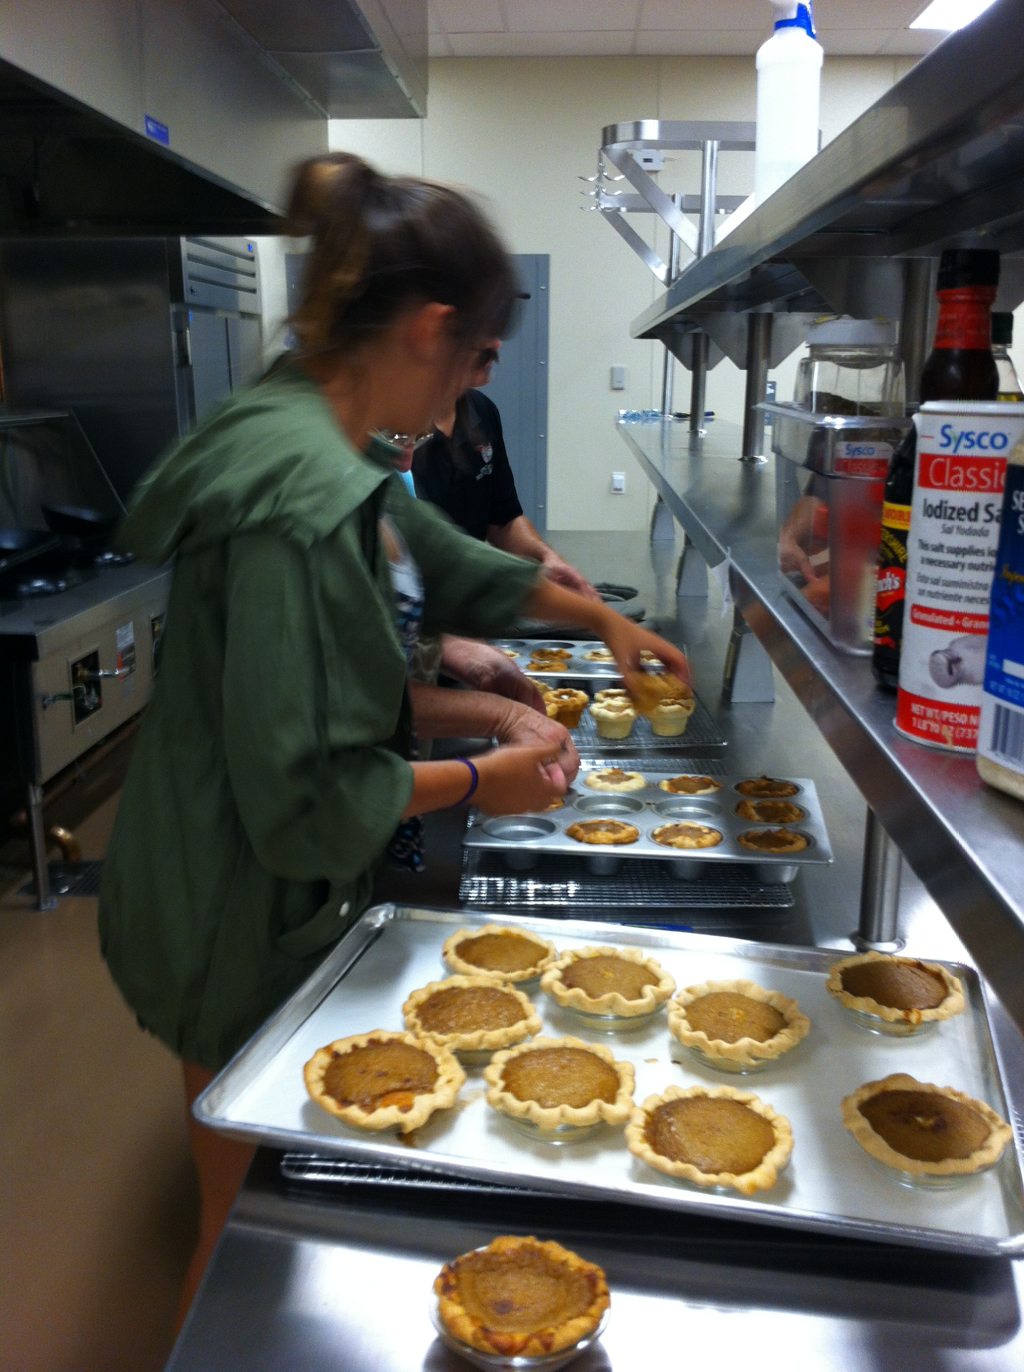
Pumpkin Pie Making Culinary Arts & Farm to Fork Education CAFFE

Slide 5
Pumpkin Pie Making Culinary Arts & Farm to Fork Education CAFFE

Slide 6
And ended with this…

Slide 7
Farm to Fork Notebook Semester 2: UNIT 3 Our Carbon Footprint and UNIT 4 Feeding the World
Open your Notebook to the Center where the book is sewn.
Number the Right side of the page 1
Turn the page, number the left side of the page 2
Odd’s on the right, Evens on the left
Number to page 8

Slide 8
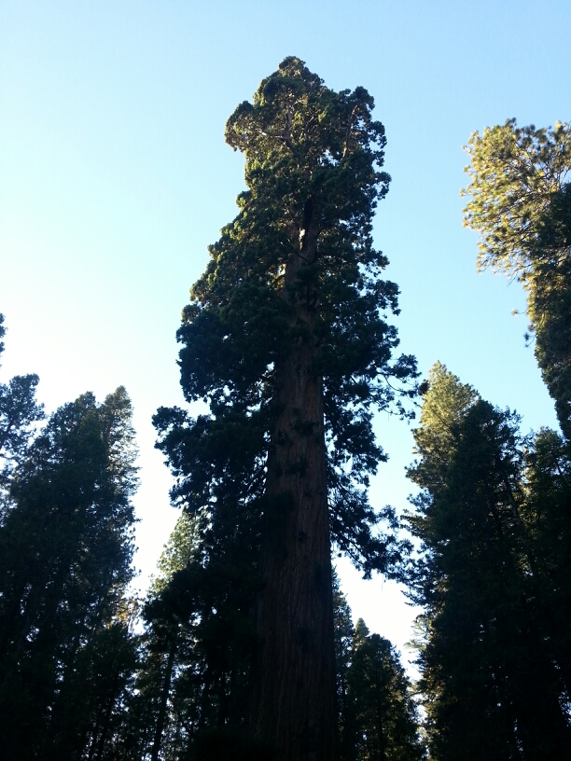
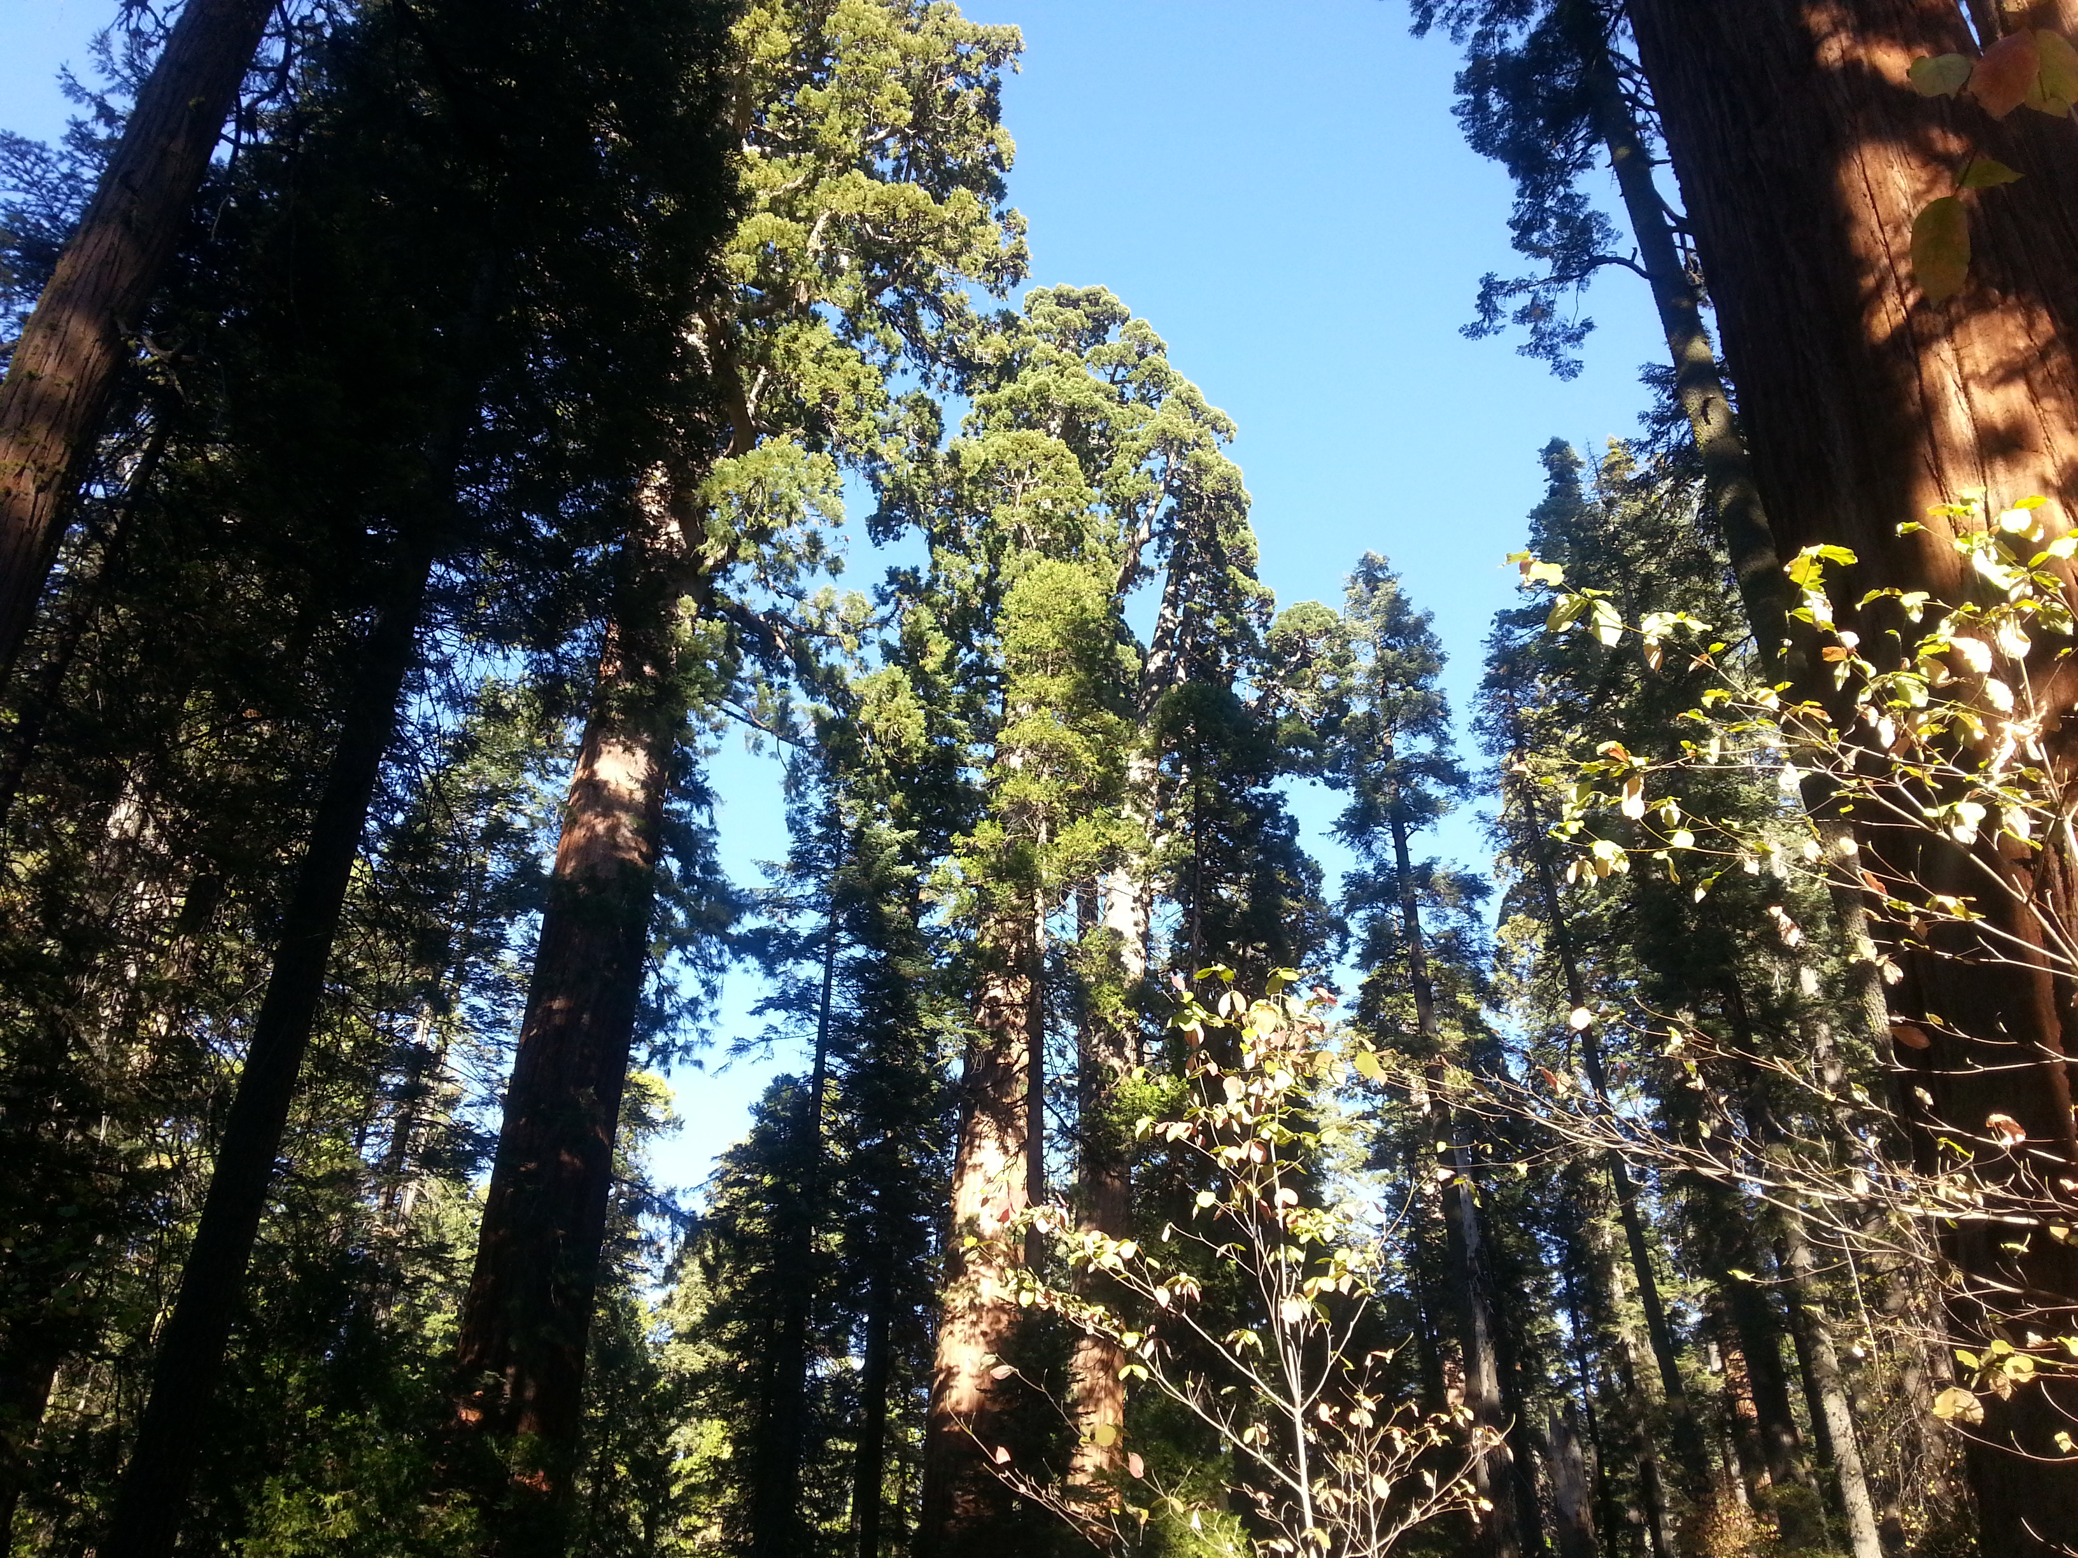
Sequoia Trees – Oldest & largest Organism on earth – 2000 years old.

Slide 9
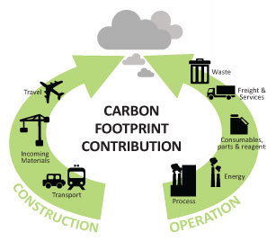
10/19 Our Carbon Footprint: Resources Management Obj. TSW understand and explain how our resources can be limited and our actions have negative impacts on the planet. P. 8 NB
What resources do we need to live our lives?
How are these resources managed?
How is pollution created as a result?
At the Garden:
Fertilize beds for Transplanting Strawberries, Broccoli. Turn Compost, Water, Plant Iris, & Cilantro, Clean and Organize the Greenhouse, Clean area for Zen Garden.

Slide 10
Future Farmers of America Curriculum Council Approved the 3 courses!!! Now they have to be approved through the School Board - November The School Board wants to meet you and see your garden! – When?
Agriculture is the #1 economy in CA
Animal Husbandry class opens doors for better hands on education
Possible Metal Shop
Possible Wood Shop
Possible Auto Shop
Opens the doors for higher education
$10 million was spent on Culinary Facility at Bryte

Slide 11
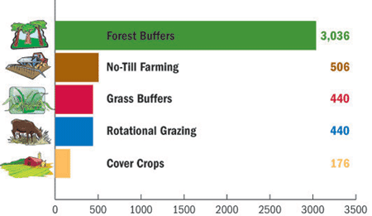
10/21 Our Carbon Footprint Obj. TSW learn about our impact as a population on our available resources. Page 10 NB
Monday you listed resources that needed to be managed: water, food, air, soil. What happens when they are not managed properly?
Name some “best practices” we use at the garden.
How will conservation techniques help us be more sustainable as a society?

Slide 12
Omnivore’s Dilemma
Read Chapters 6 & 7 by Friday.
We will discuss the chapters.

Slide 13
Groups by Leader
Quincey Paige Emiliano Valeria Natalia Madison Ariana
Gilbert Nico Julian William Steven Jordyn Michael
Sonya Karla Jonah Veronika Parker Itzel Mike Bilo
Vadims Hong Alyssa Phillip Arizona Fernando Anastasia
Marcos Ravan Nici Ryan
Categories to work:
Quincey’s- Strawberry bed – Transplanting
Paige – Organize the greenhouse
Emiliano – Turn the compost
Valeria – Delivery to the Cafeteria
Natalia- Journaling the weeks activities
Madison – Watering, evaluating water needs
Ariana – Photographing the weeks activities
Other: Soil added to the stained beds
Plant Irises

Slide 14
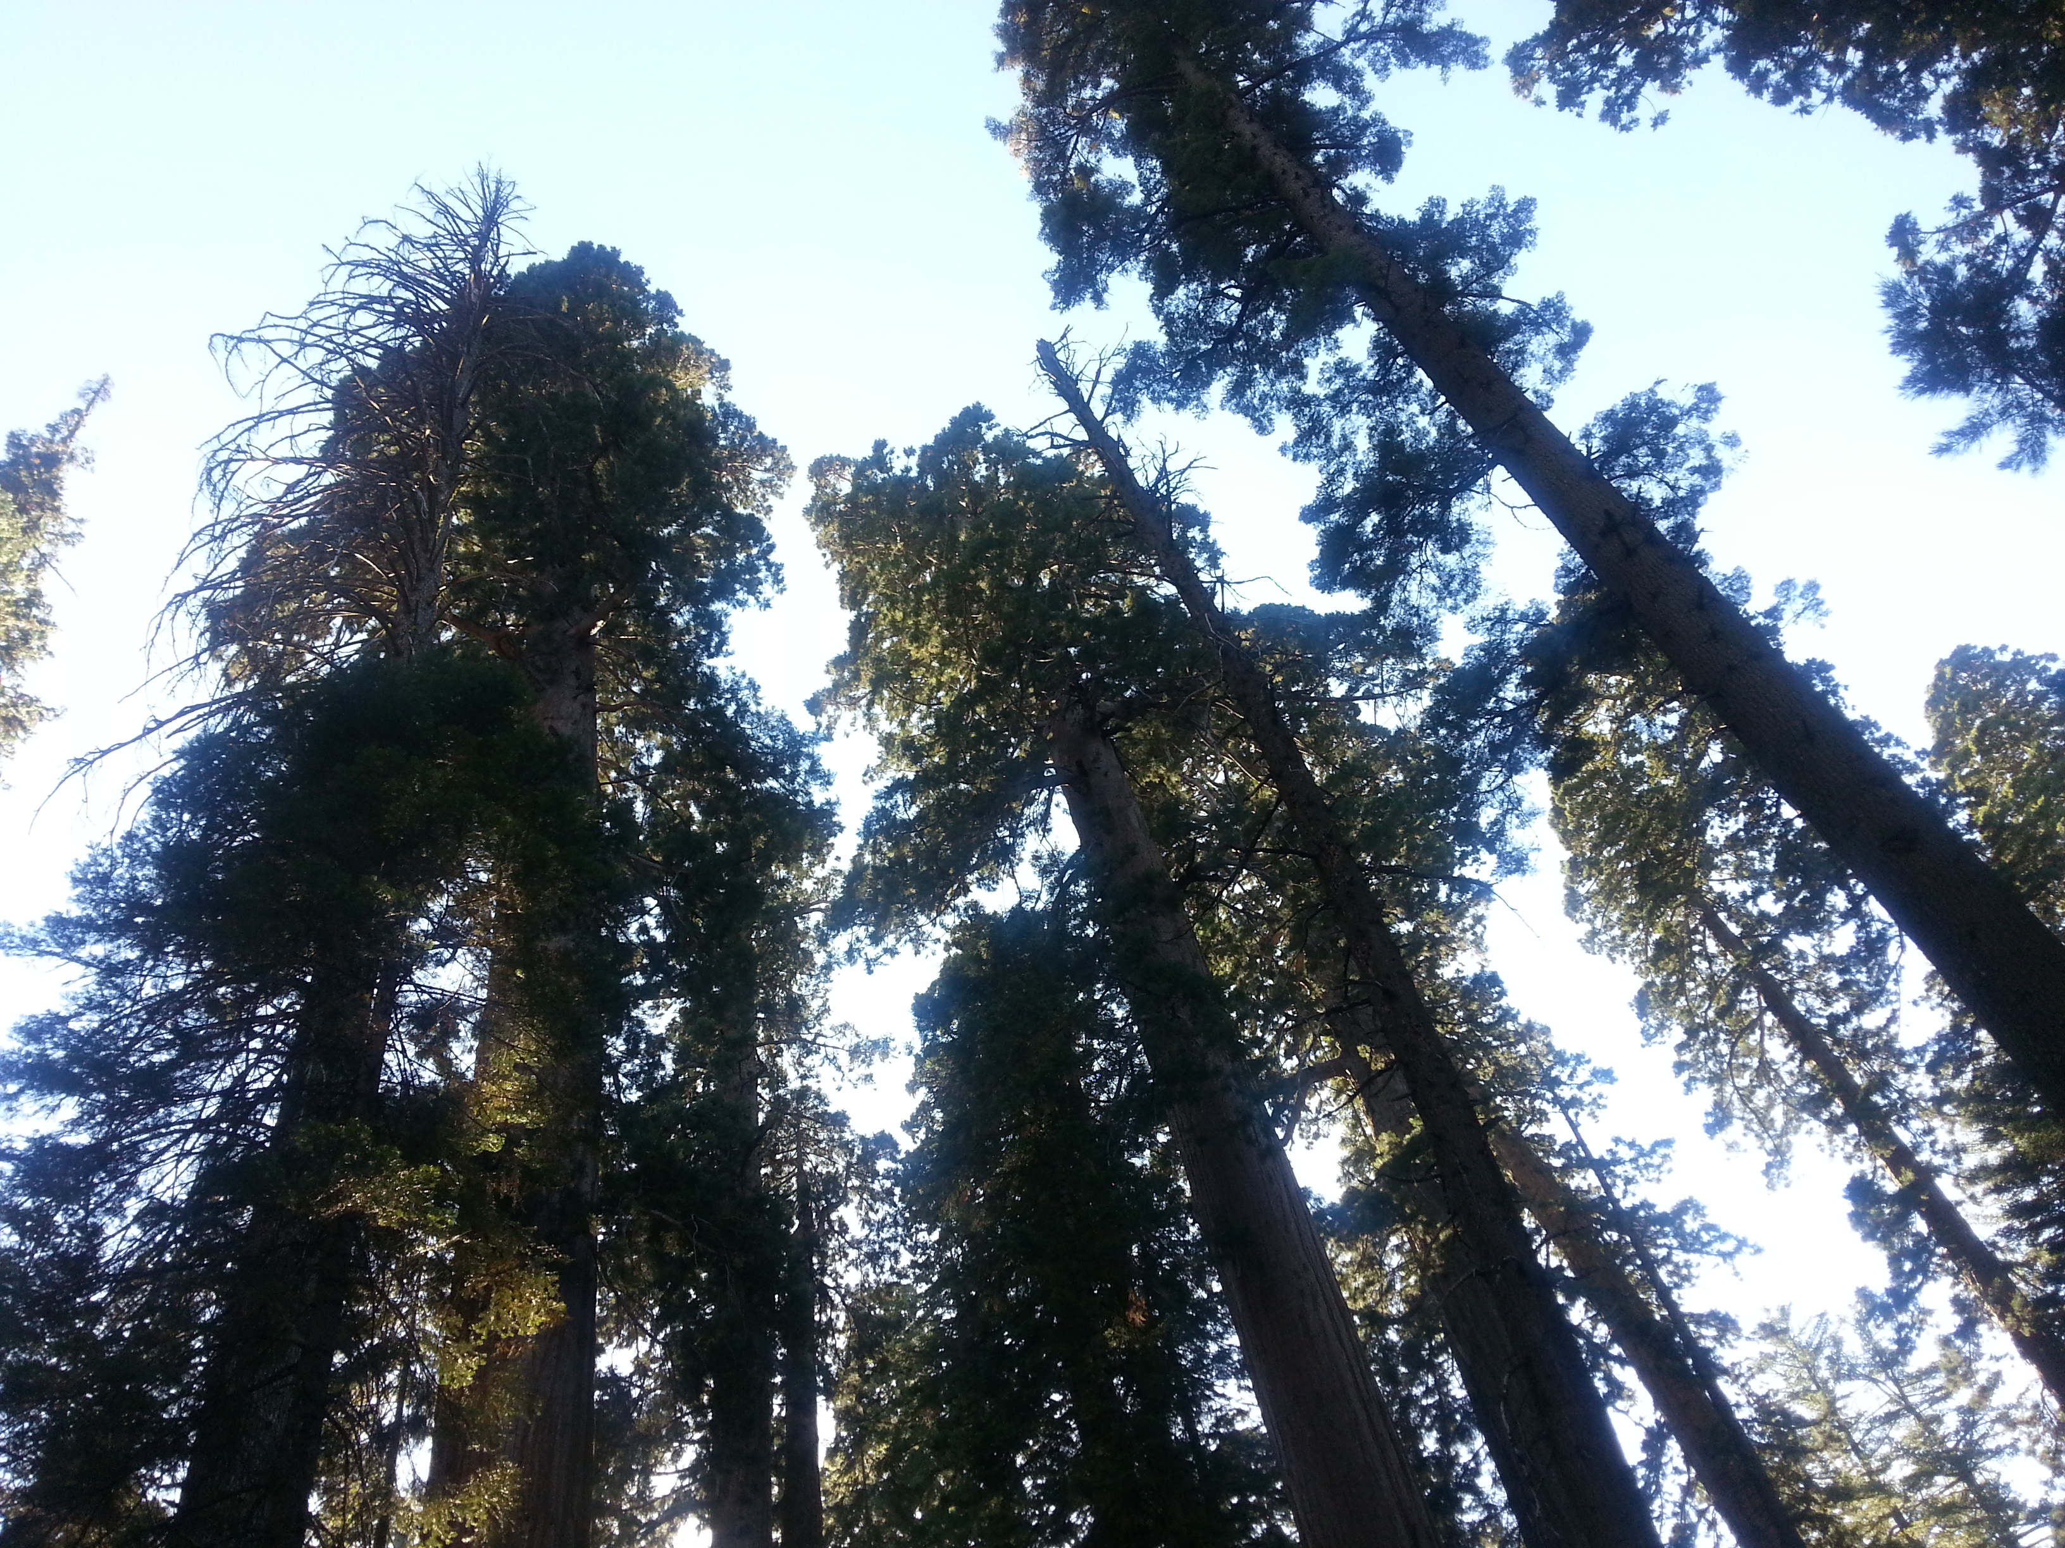
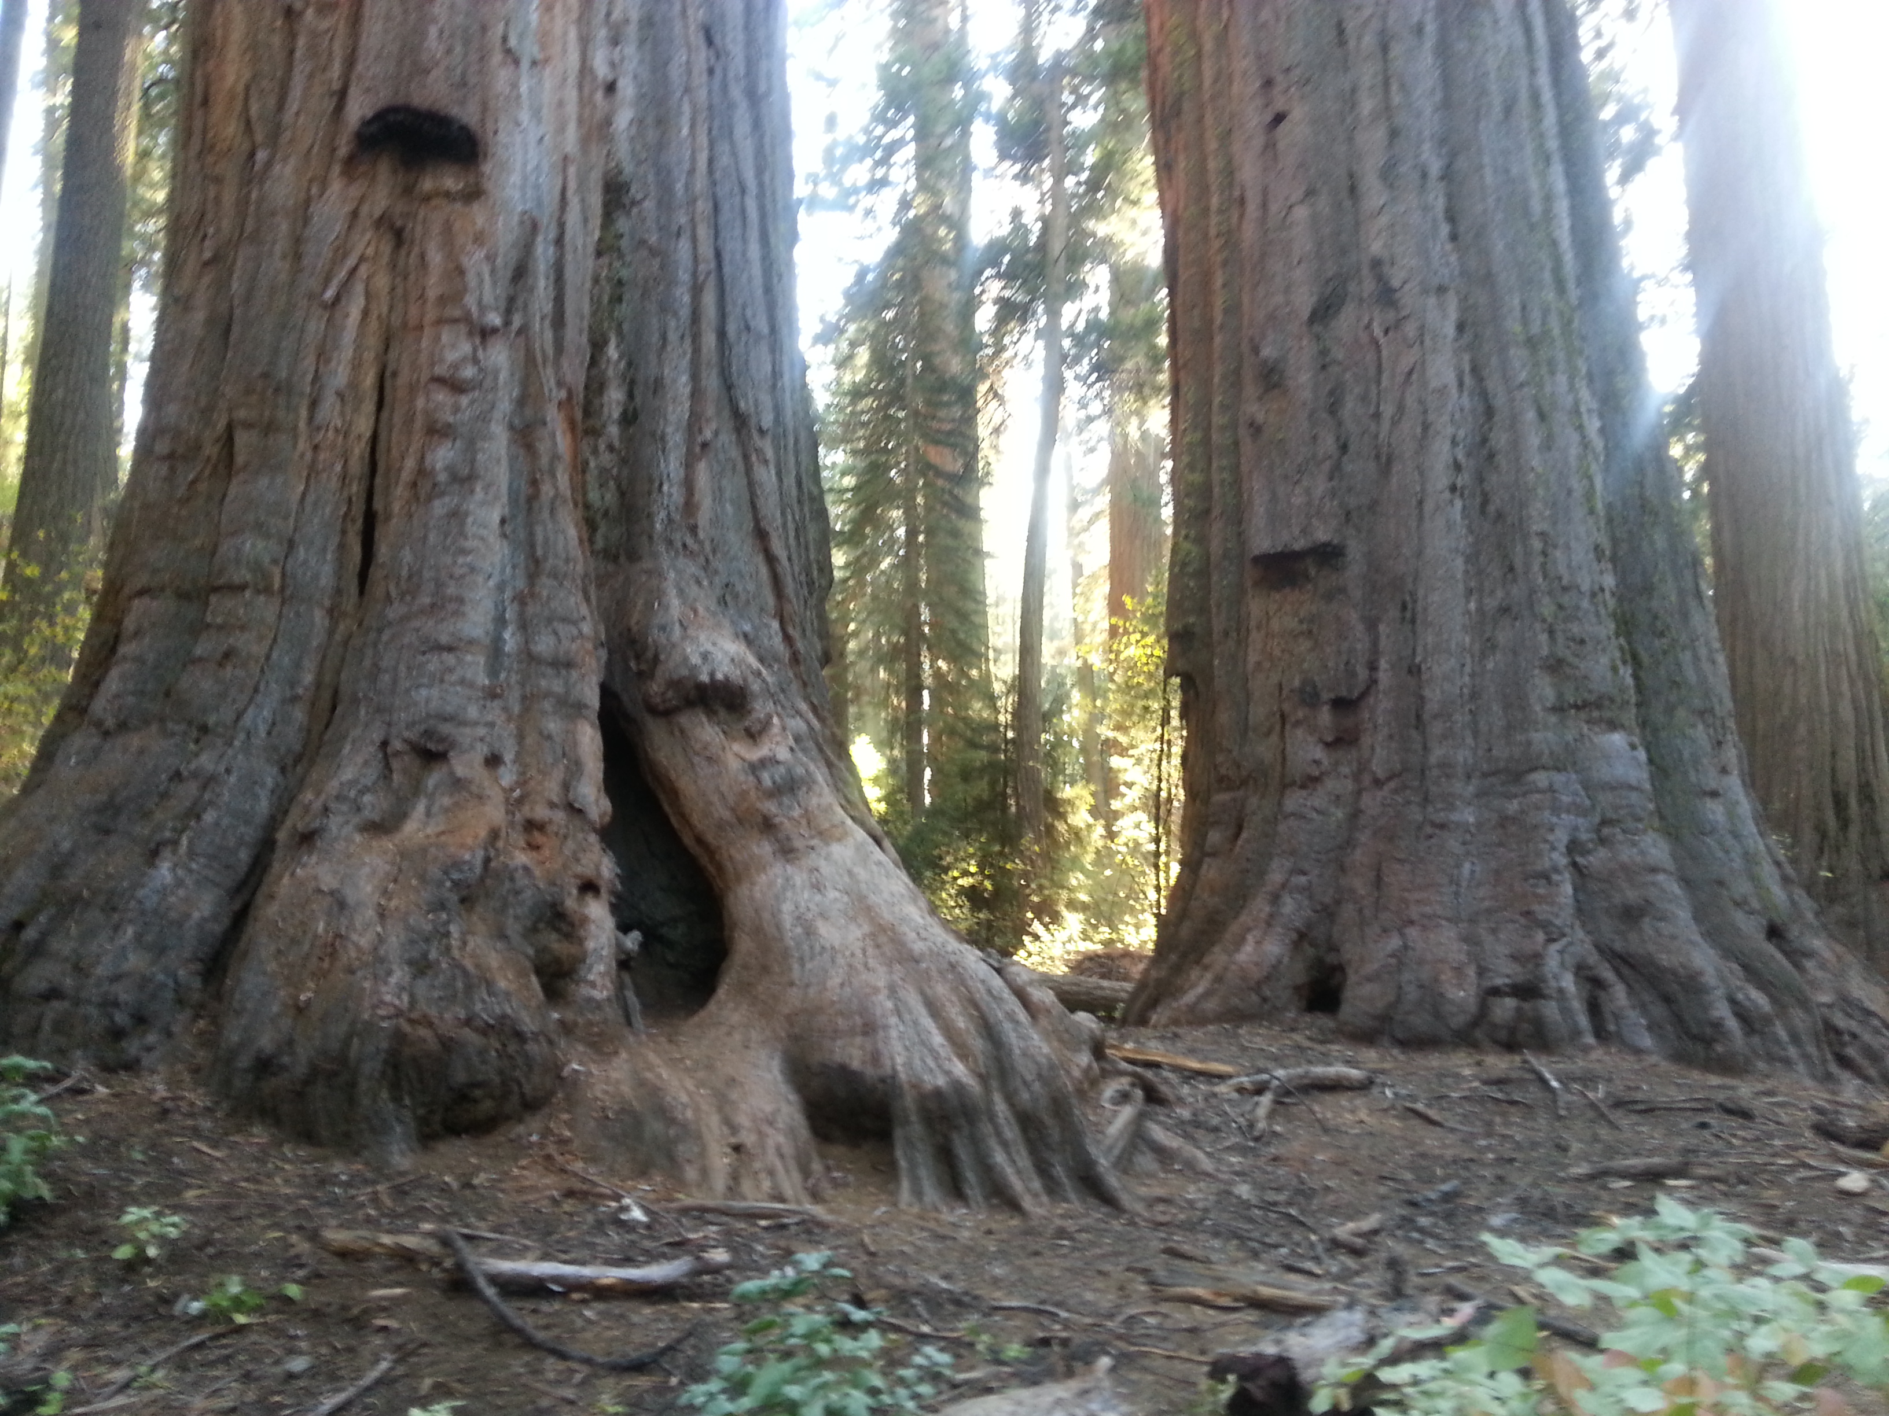

Slide 15
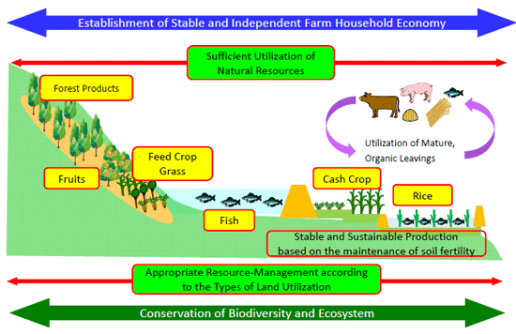

Slide 16
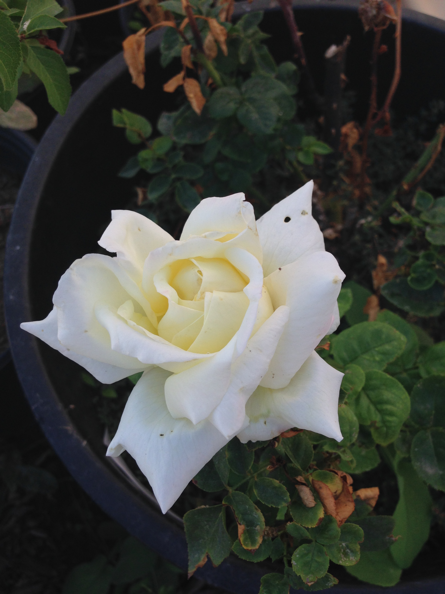
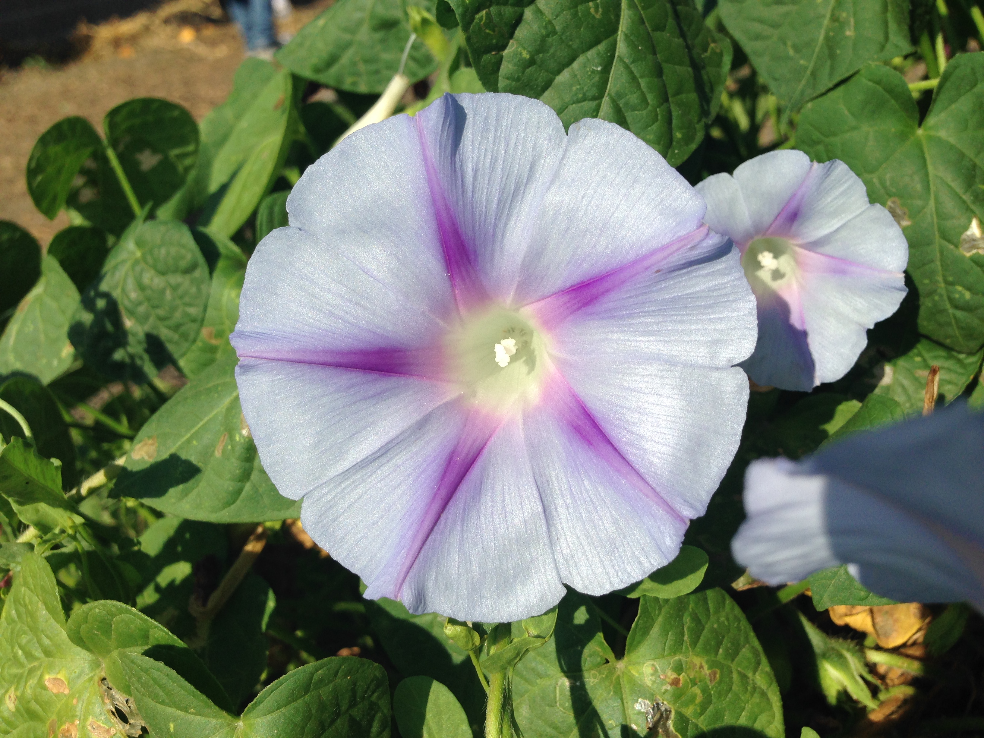
Garden Goodness

Slide 17
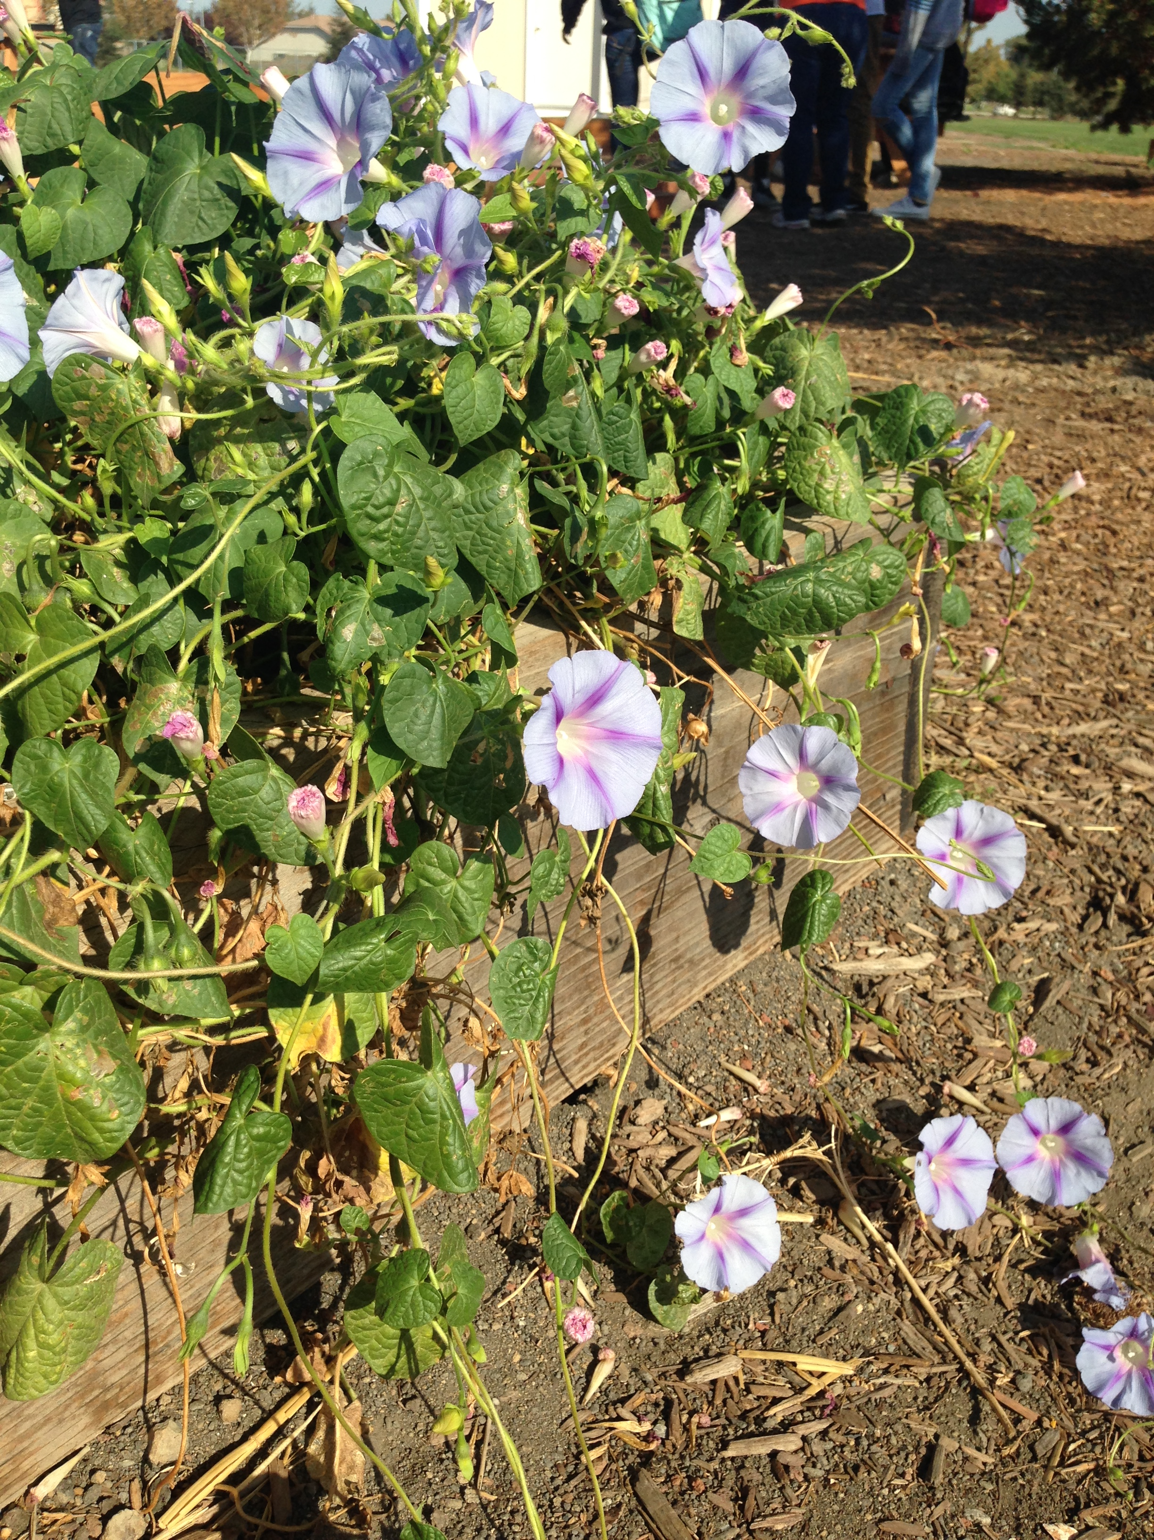
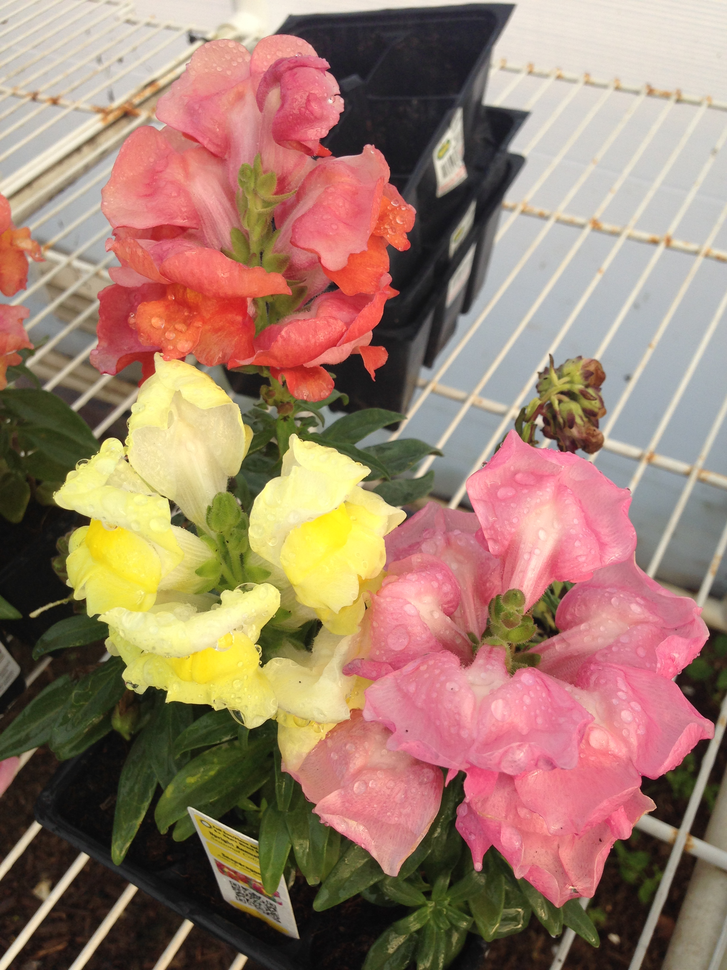

Slide 18
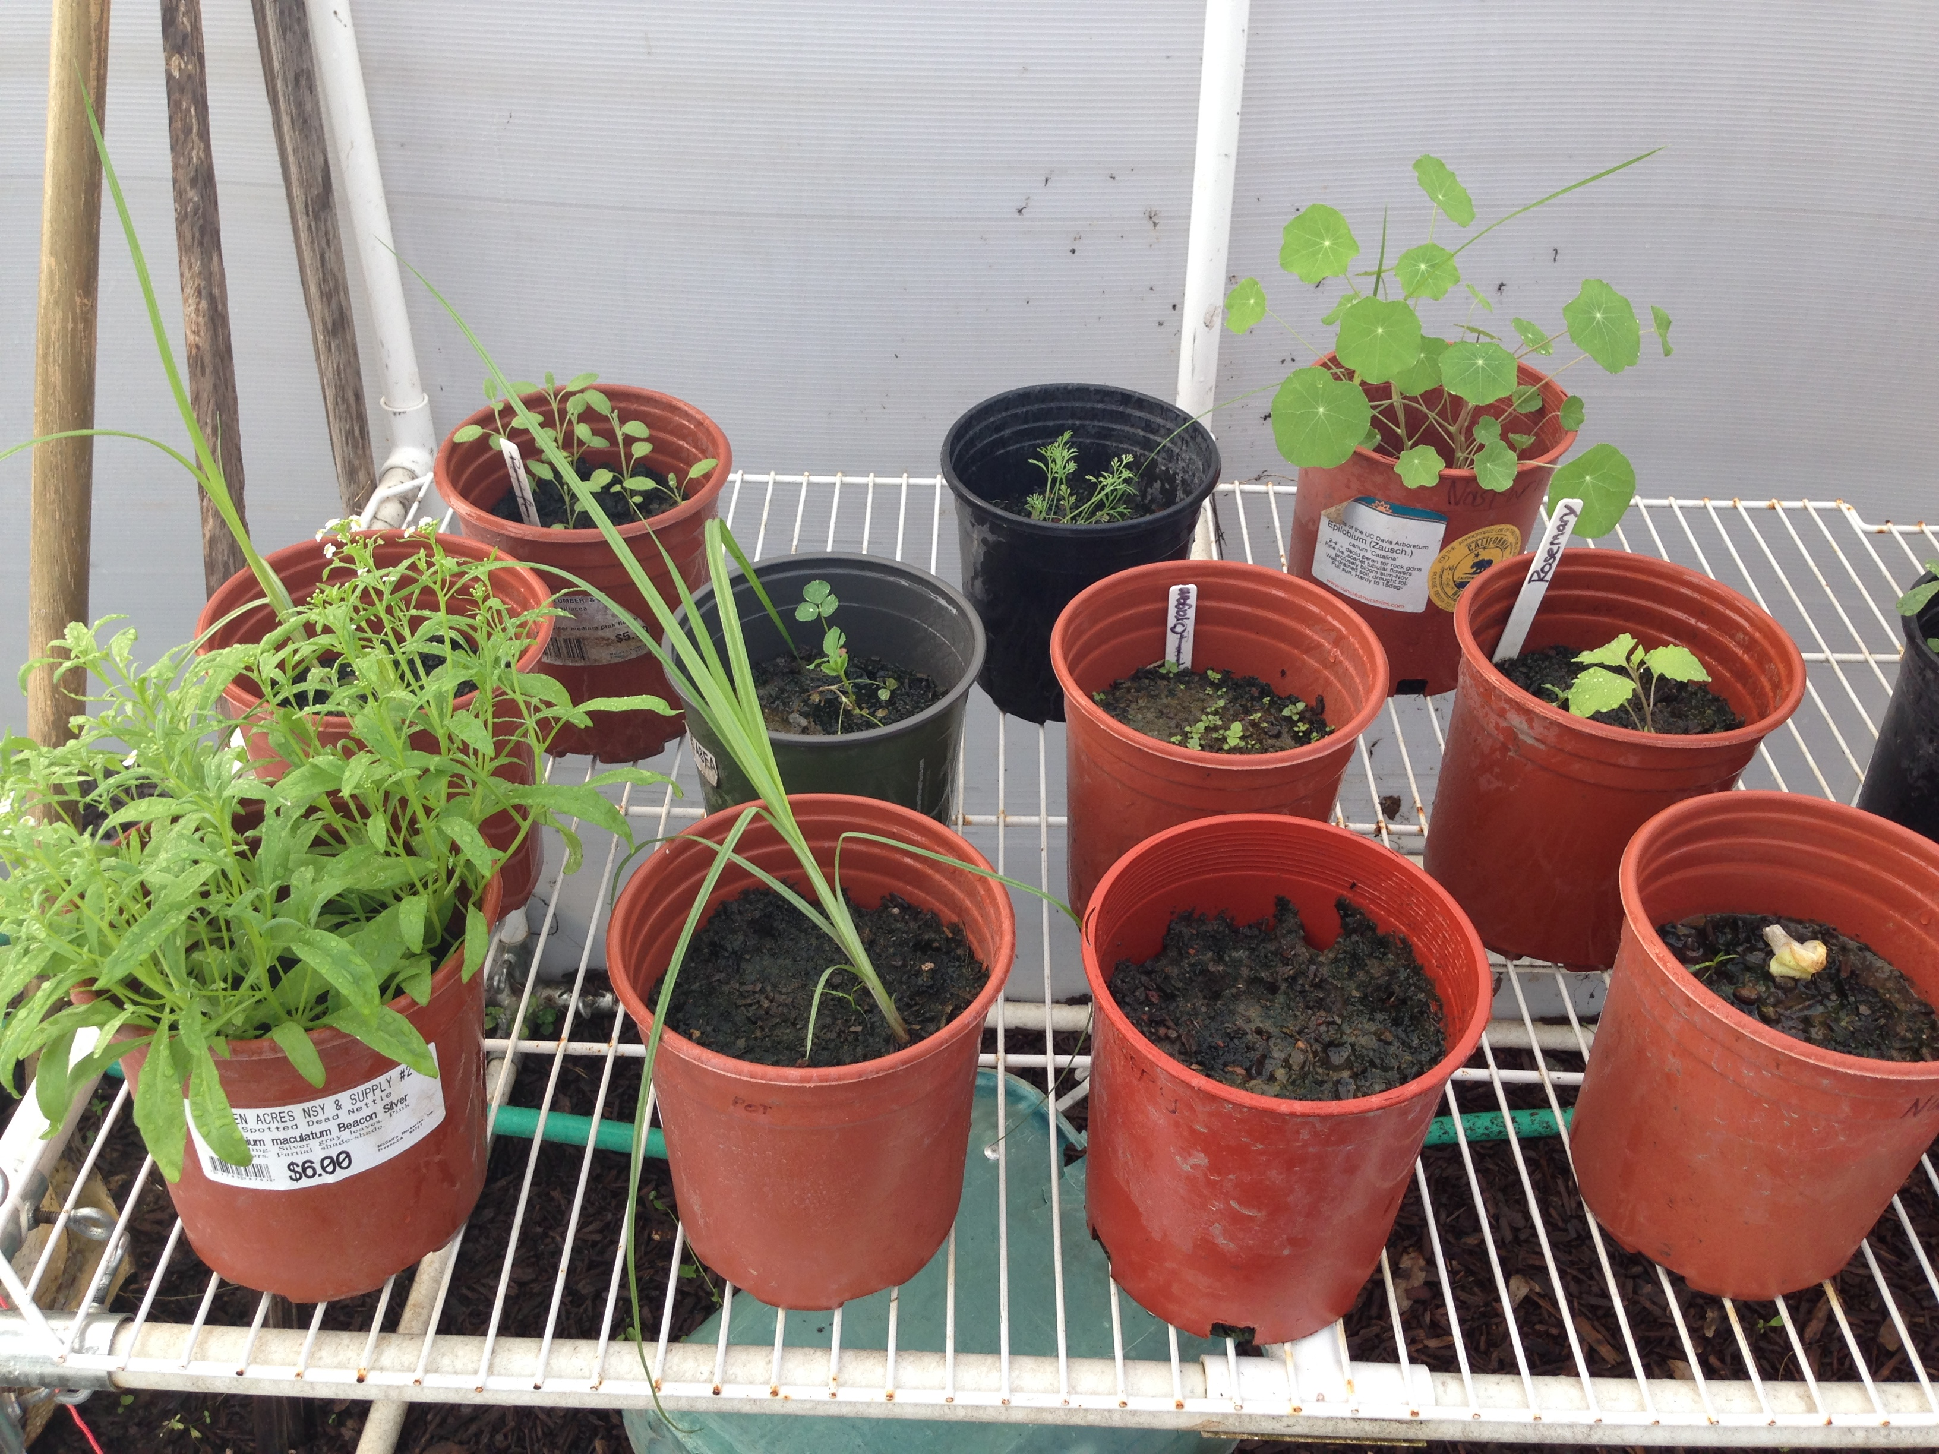

Slide 19
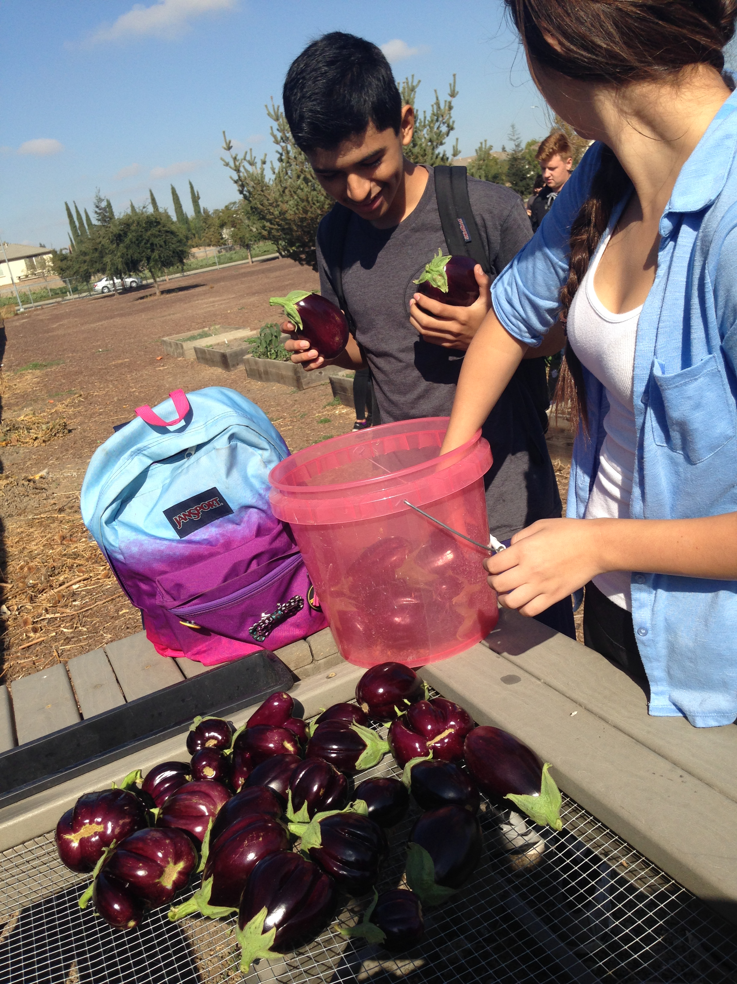
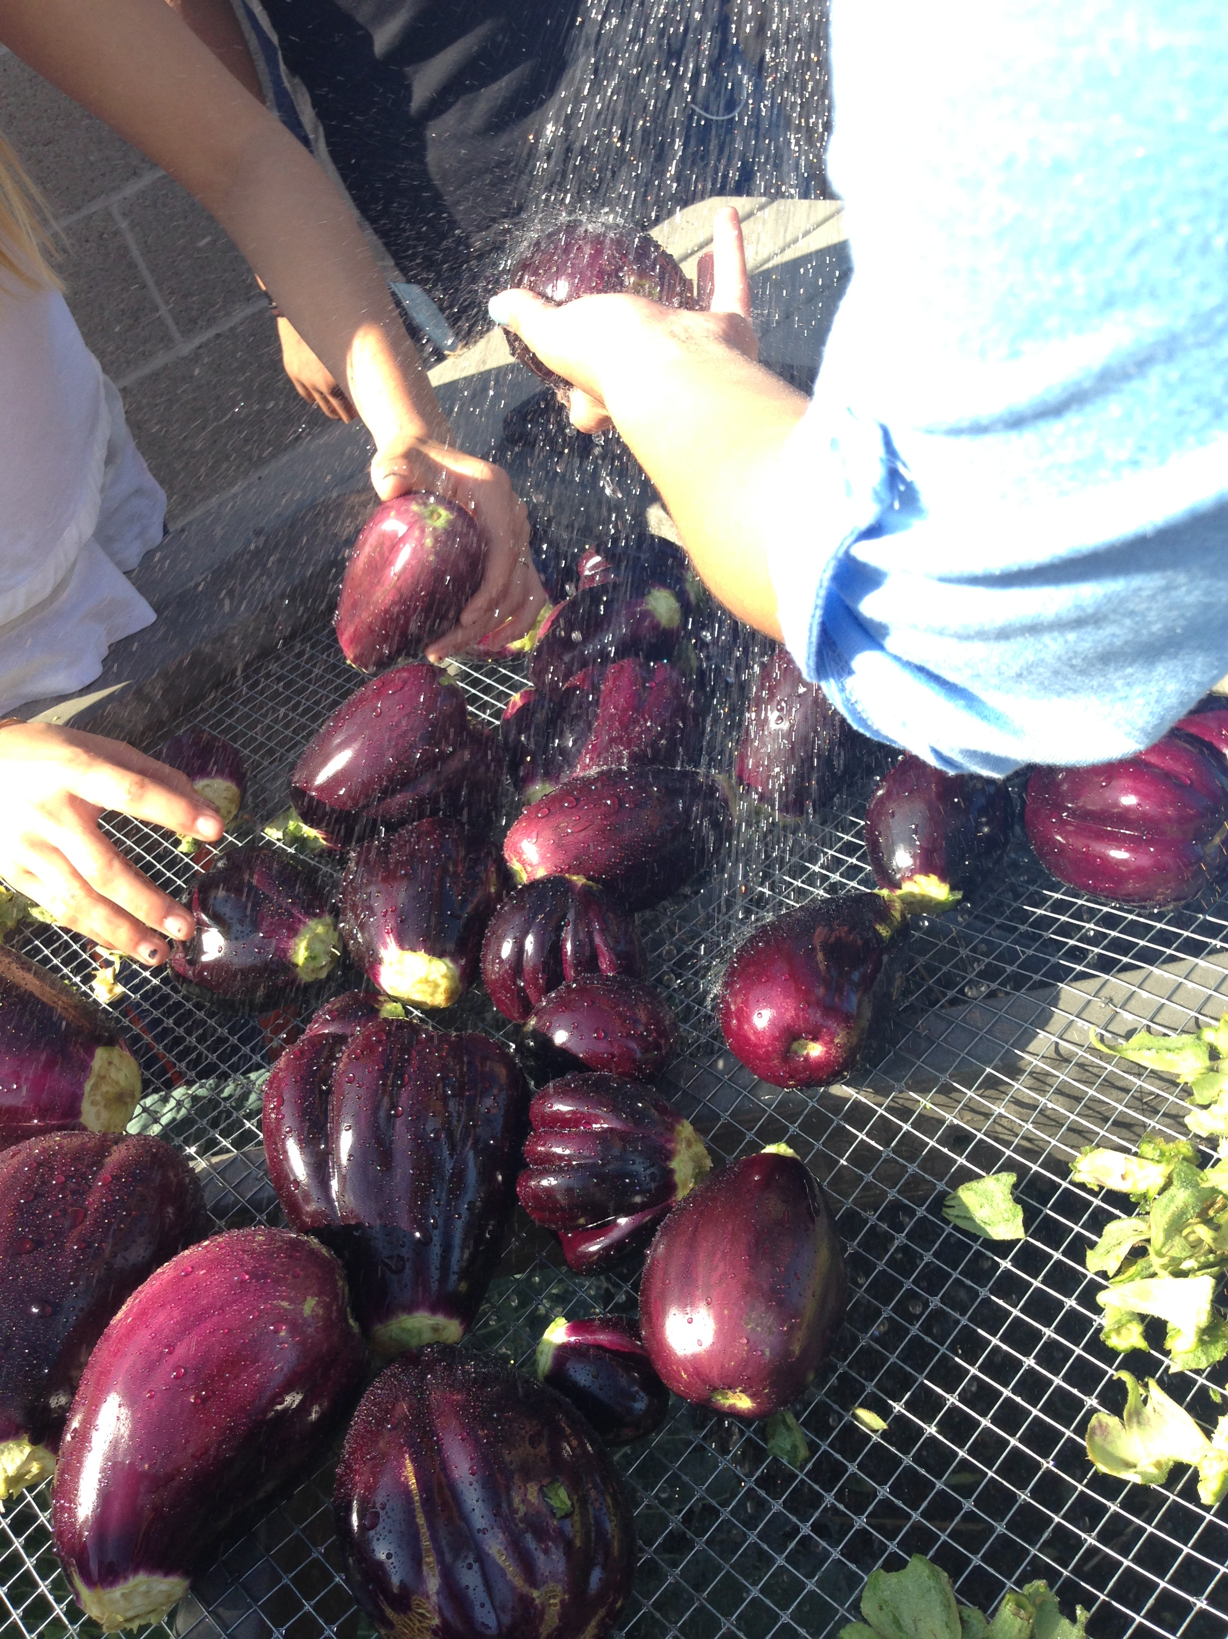

Slide 20
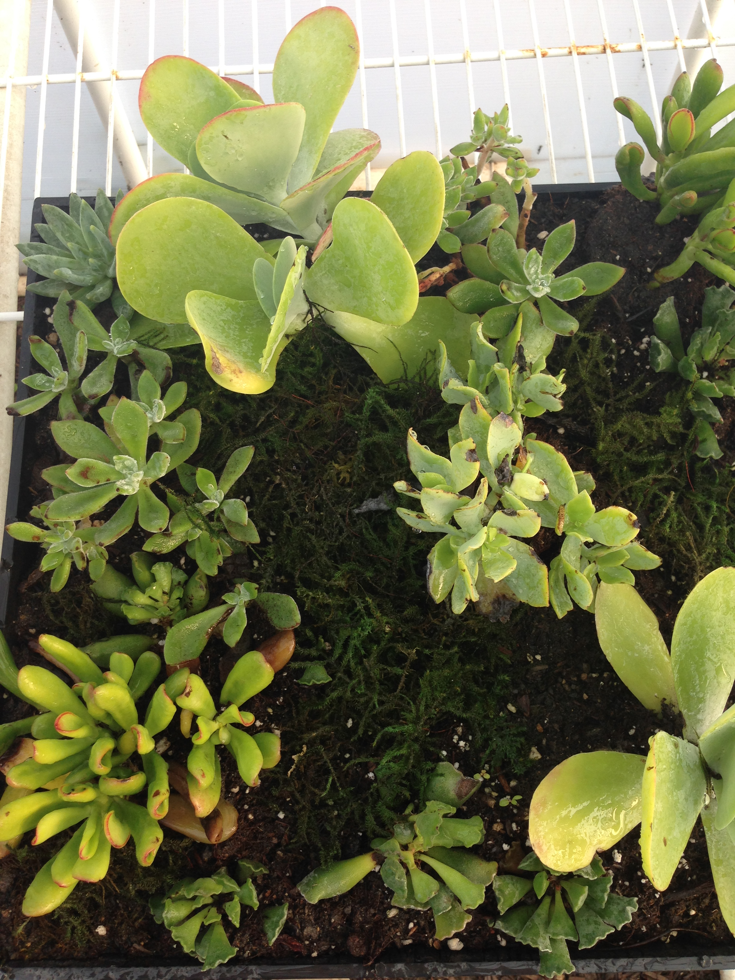
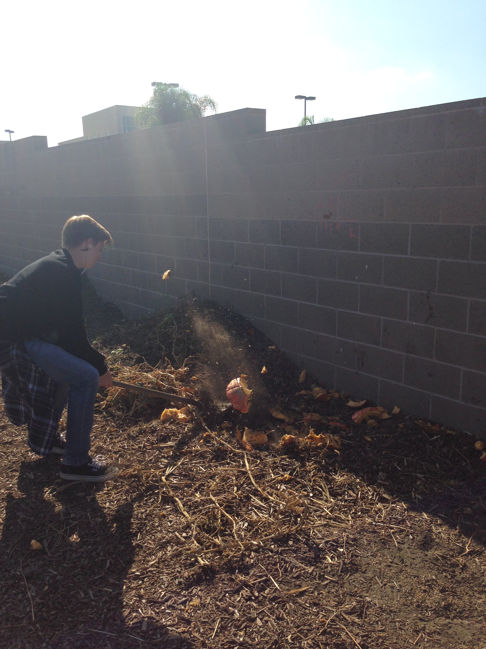

Slide 21
10/22 Our Carbon Footprint Obj. TSW learn how many Earth’s it takes to live their life style. P. 12 NB
What is a Carbon footprint?
What factors might contribute to your carbon footprint?
Predict how many Earth’s it takes to support your lifestyle, if everyone lived like you.

Slide 22
School buying local food to feed students

Slide 23
Vocabulary List
Page 9 notebook
Due by next notebook check.

Slide 24
Footprintnetwork.org P. 13 NB
# of Earth’s Activity
Calculate your own ecological footprint in the USA by taking this lifestyle survey regarding: food consumption, energy usage and transportations choices.
Write # of Earth’s it takes to live your lifestyle on Page 13 NB
What steps could be taken to realistically decrease your footprint.
Then do the Activity again but, with a different country.
Why is your Ecological Footprint different is different countries? Who is one of the largest contributors to pollution?

Slide 25
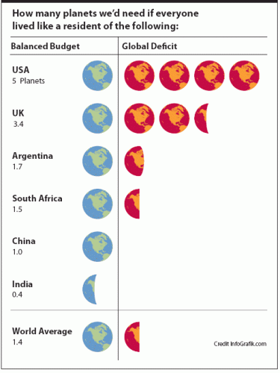
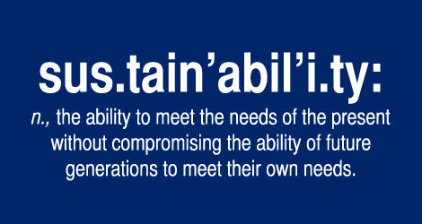
10/23 How many more Earths? Obj. TSW learn about how we need to conserve our resources now to have resources for future generations. P. 14 NB
How close was your prediction as to the number of Earth’s you thought you would use?
What ways can you be more conservative in your day to day life?
What are chapters 6 & 7 about in Omnivores Dilemma?

Slide 26
Page 13NB

Slide 27
Notebook Check Tuesday 10/27 P. 8 – 15 40 points
Date | Title/ Topic | Page #
10/19 | WU – Our Carbon Footprint: Resource Management | 8
10/23 | Vocabulary List – Our Carbon Footprint | 9
10/20 | WU – Our Carbon Footprint | 10
10/20 | Video - GATTACA | 11
10/22 | WU – Our Carbon Footprint | 12
10/22 | Activity: # of Earth’s | 13
10/23 | WU – How many more Earth’s? | 14
10/26 | Brainstorm – Major Pollution Situation World Wide | 15 Notebook Check p. 8 – 15 40 points

Slide 29
Garden
I’m taking roll when I get out there. If you are not there, I will call for a campus aide to find you, escort you to the office. I will write a referral later.
Vocabulary list is due Tuesday.

