Slide 1
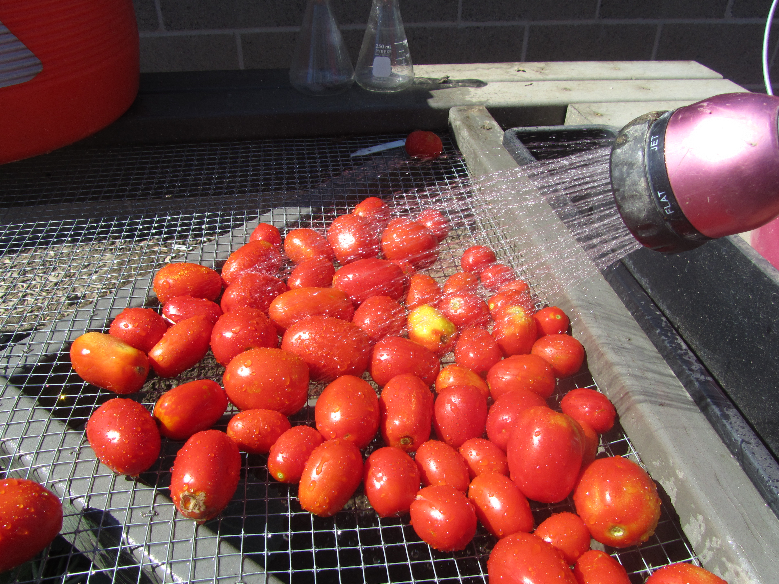
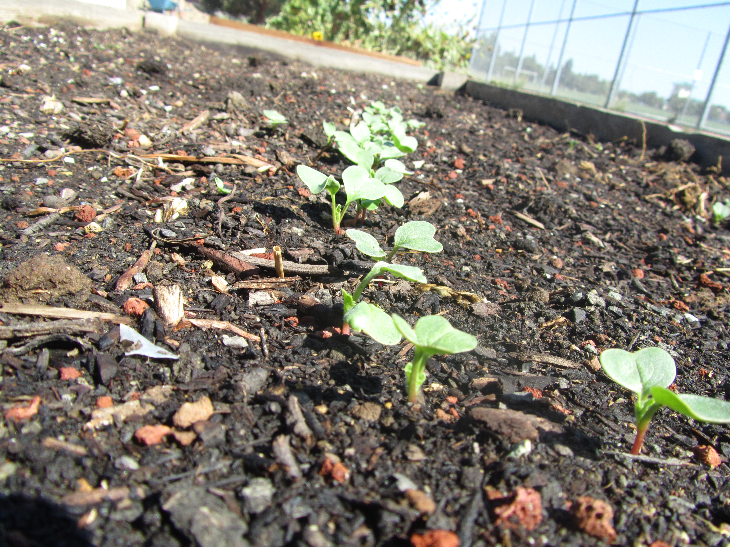
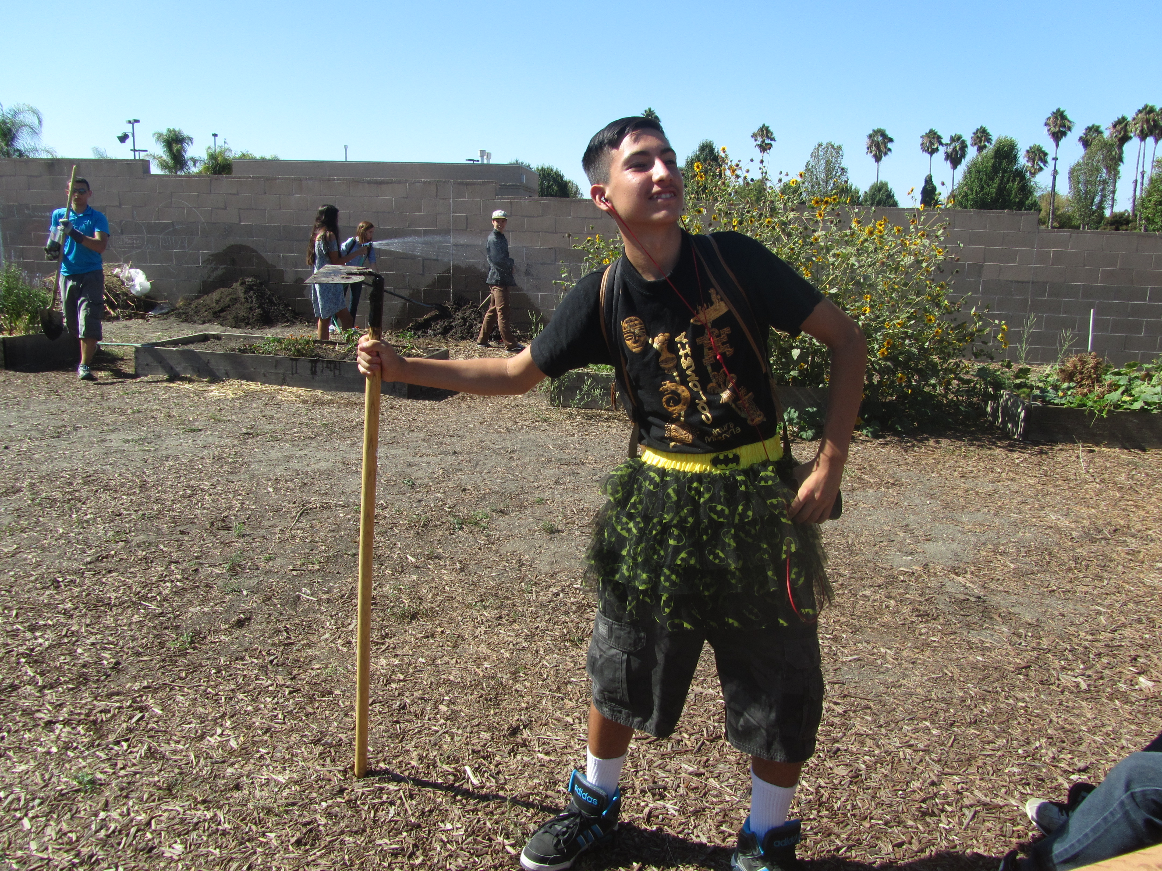
Farm to Fork
Week 5 – Plant Fall Garden, Discuss CH 2 Omnivore’s Dilemma

Slide 2
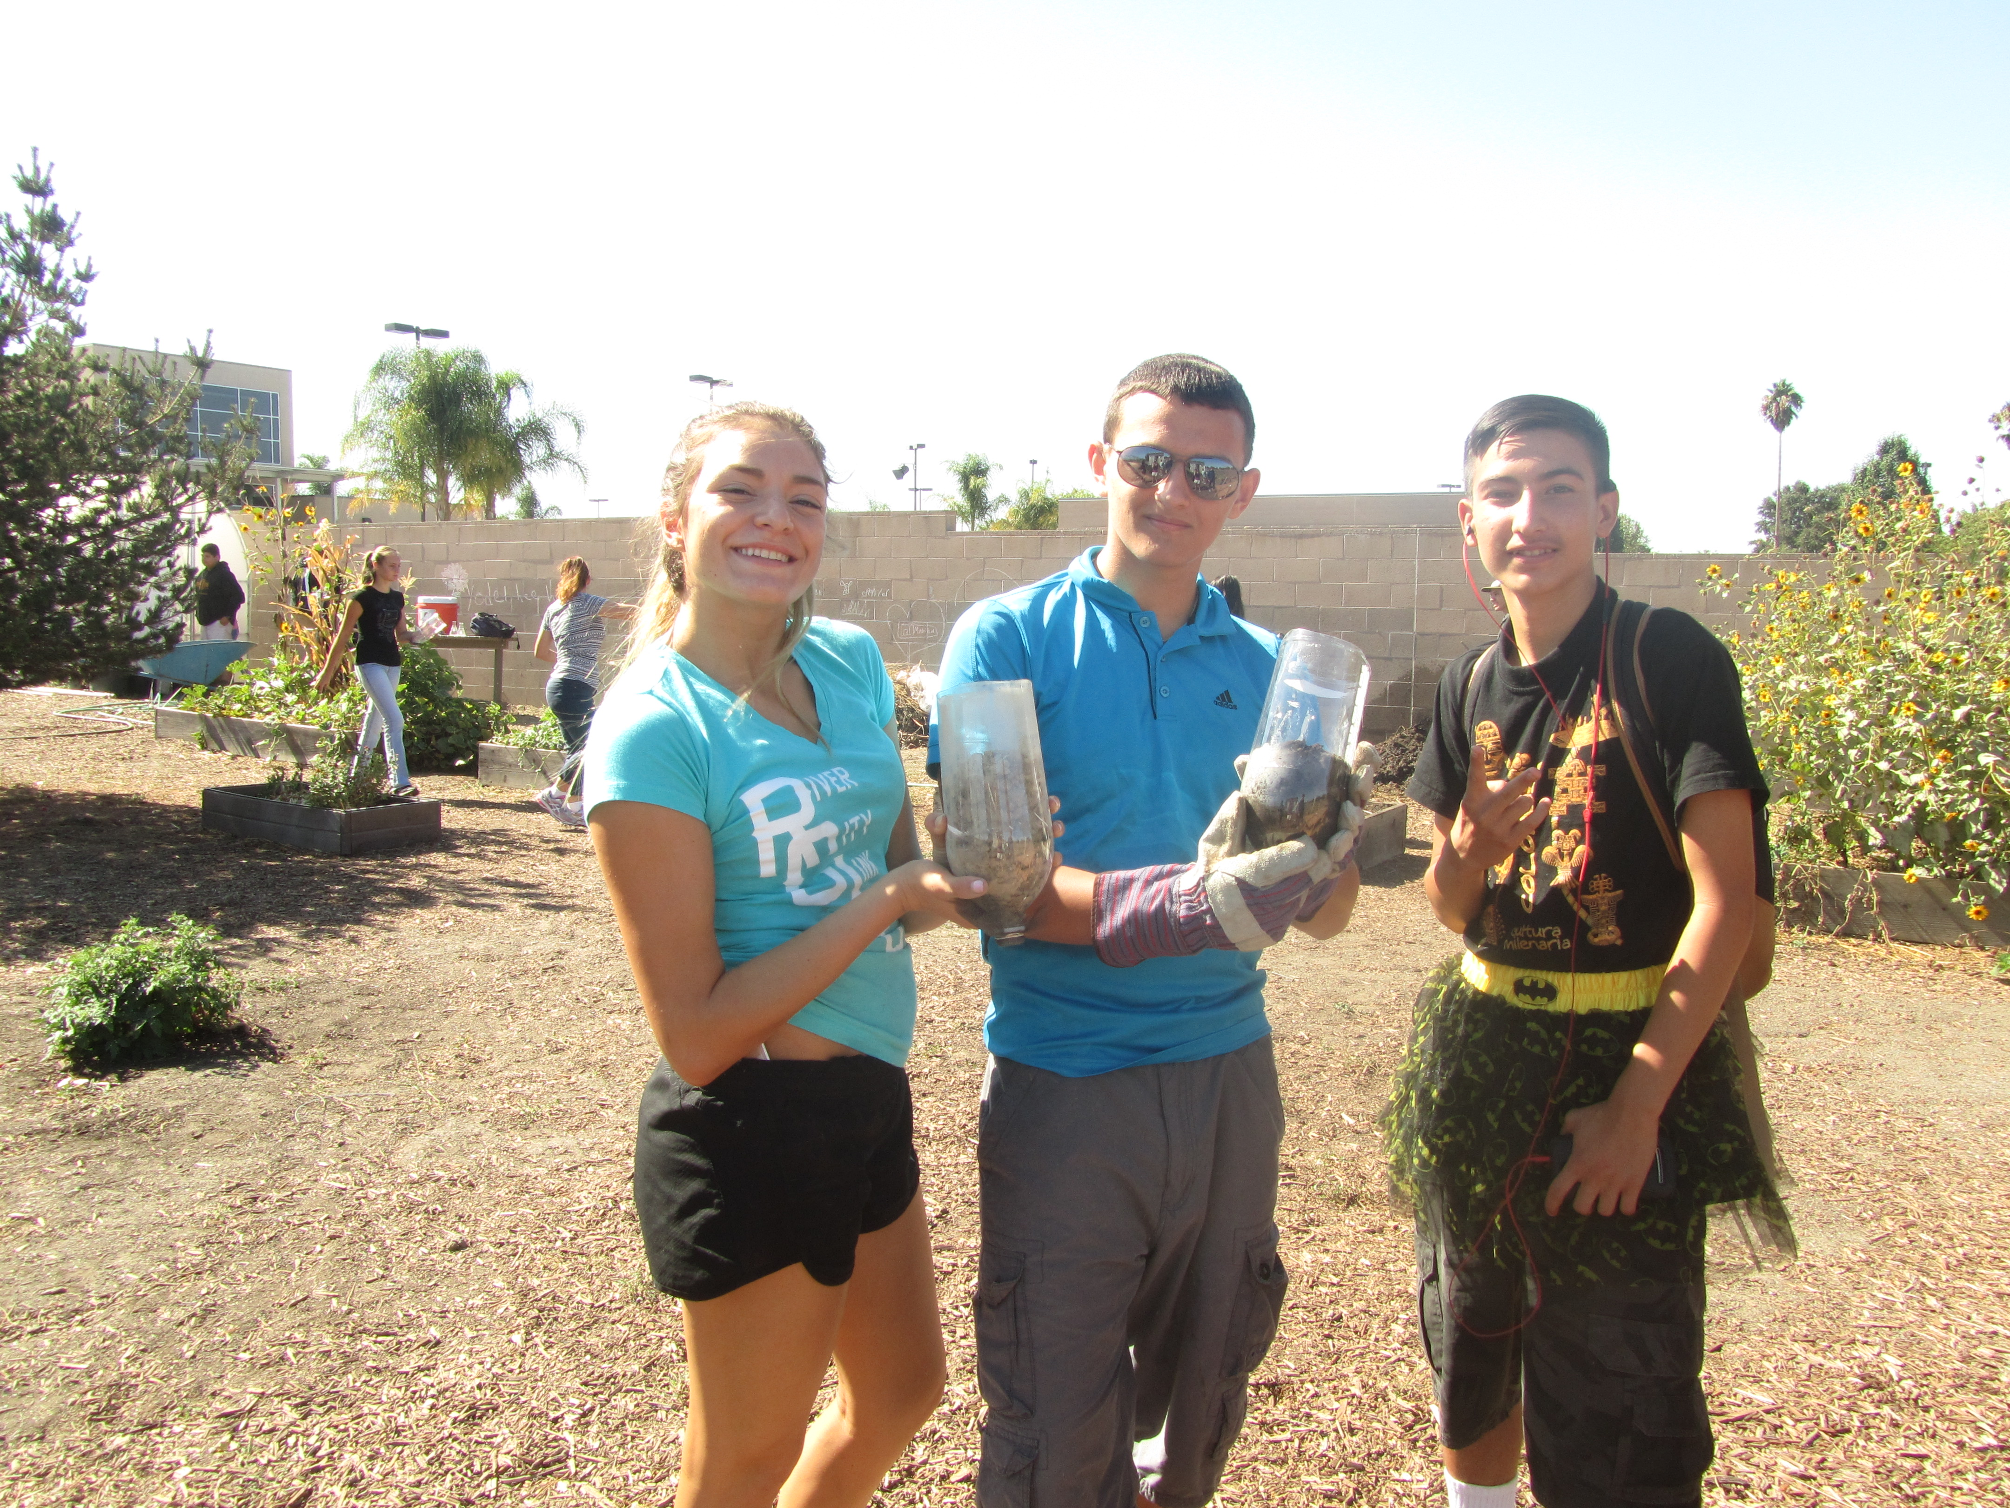

Slide 4
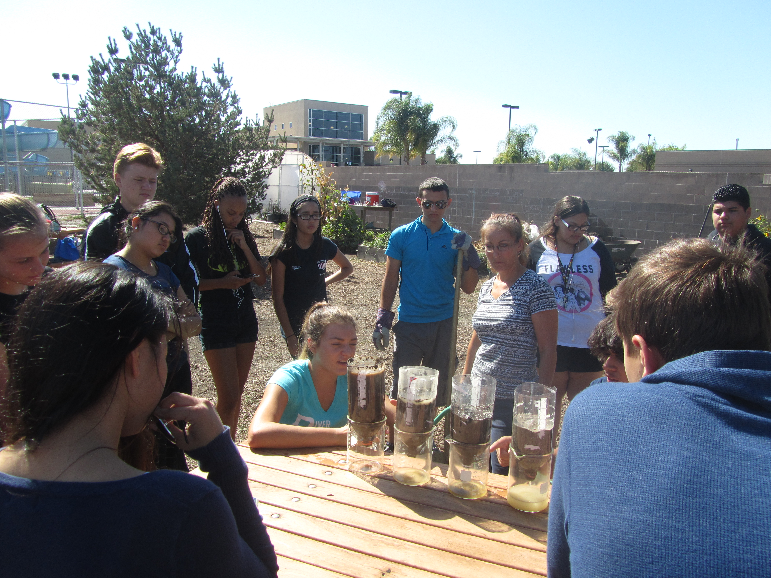

Slide 5
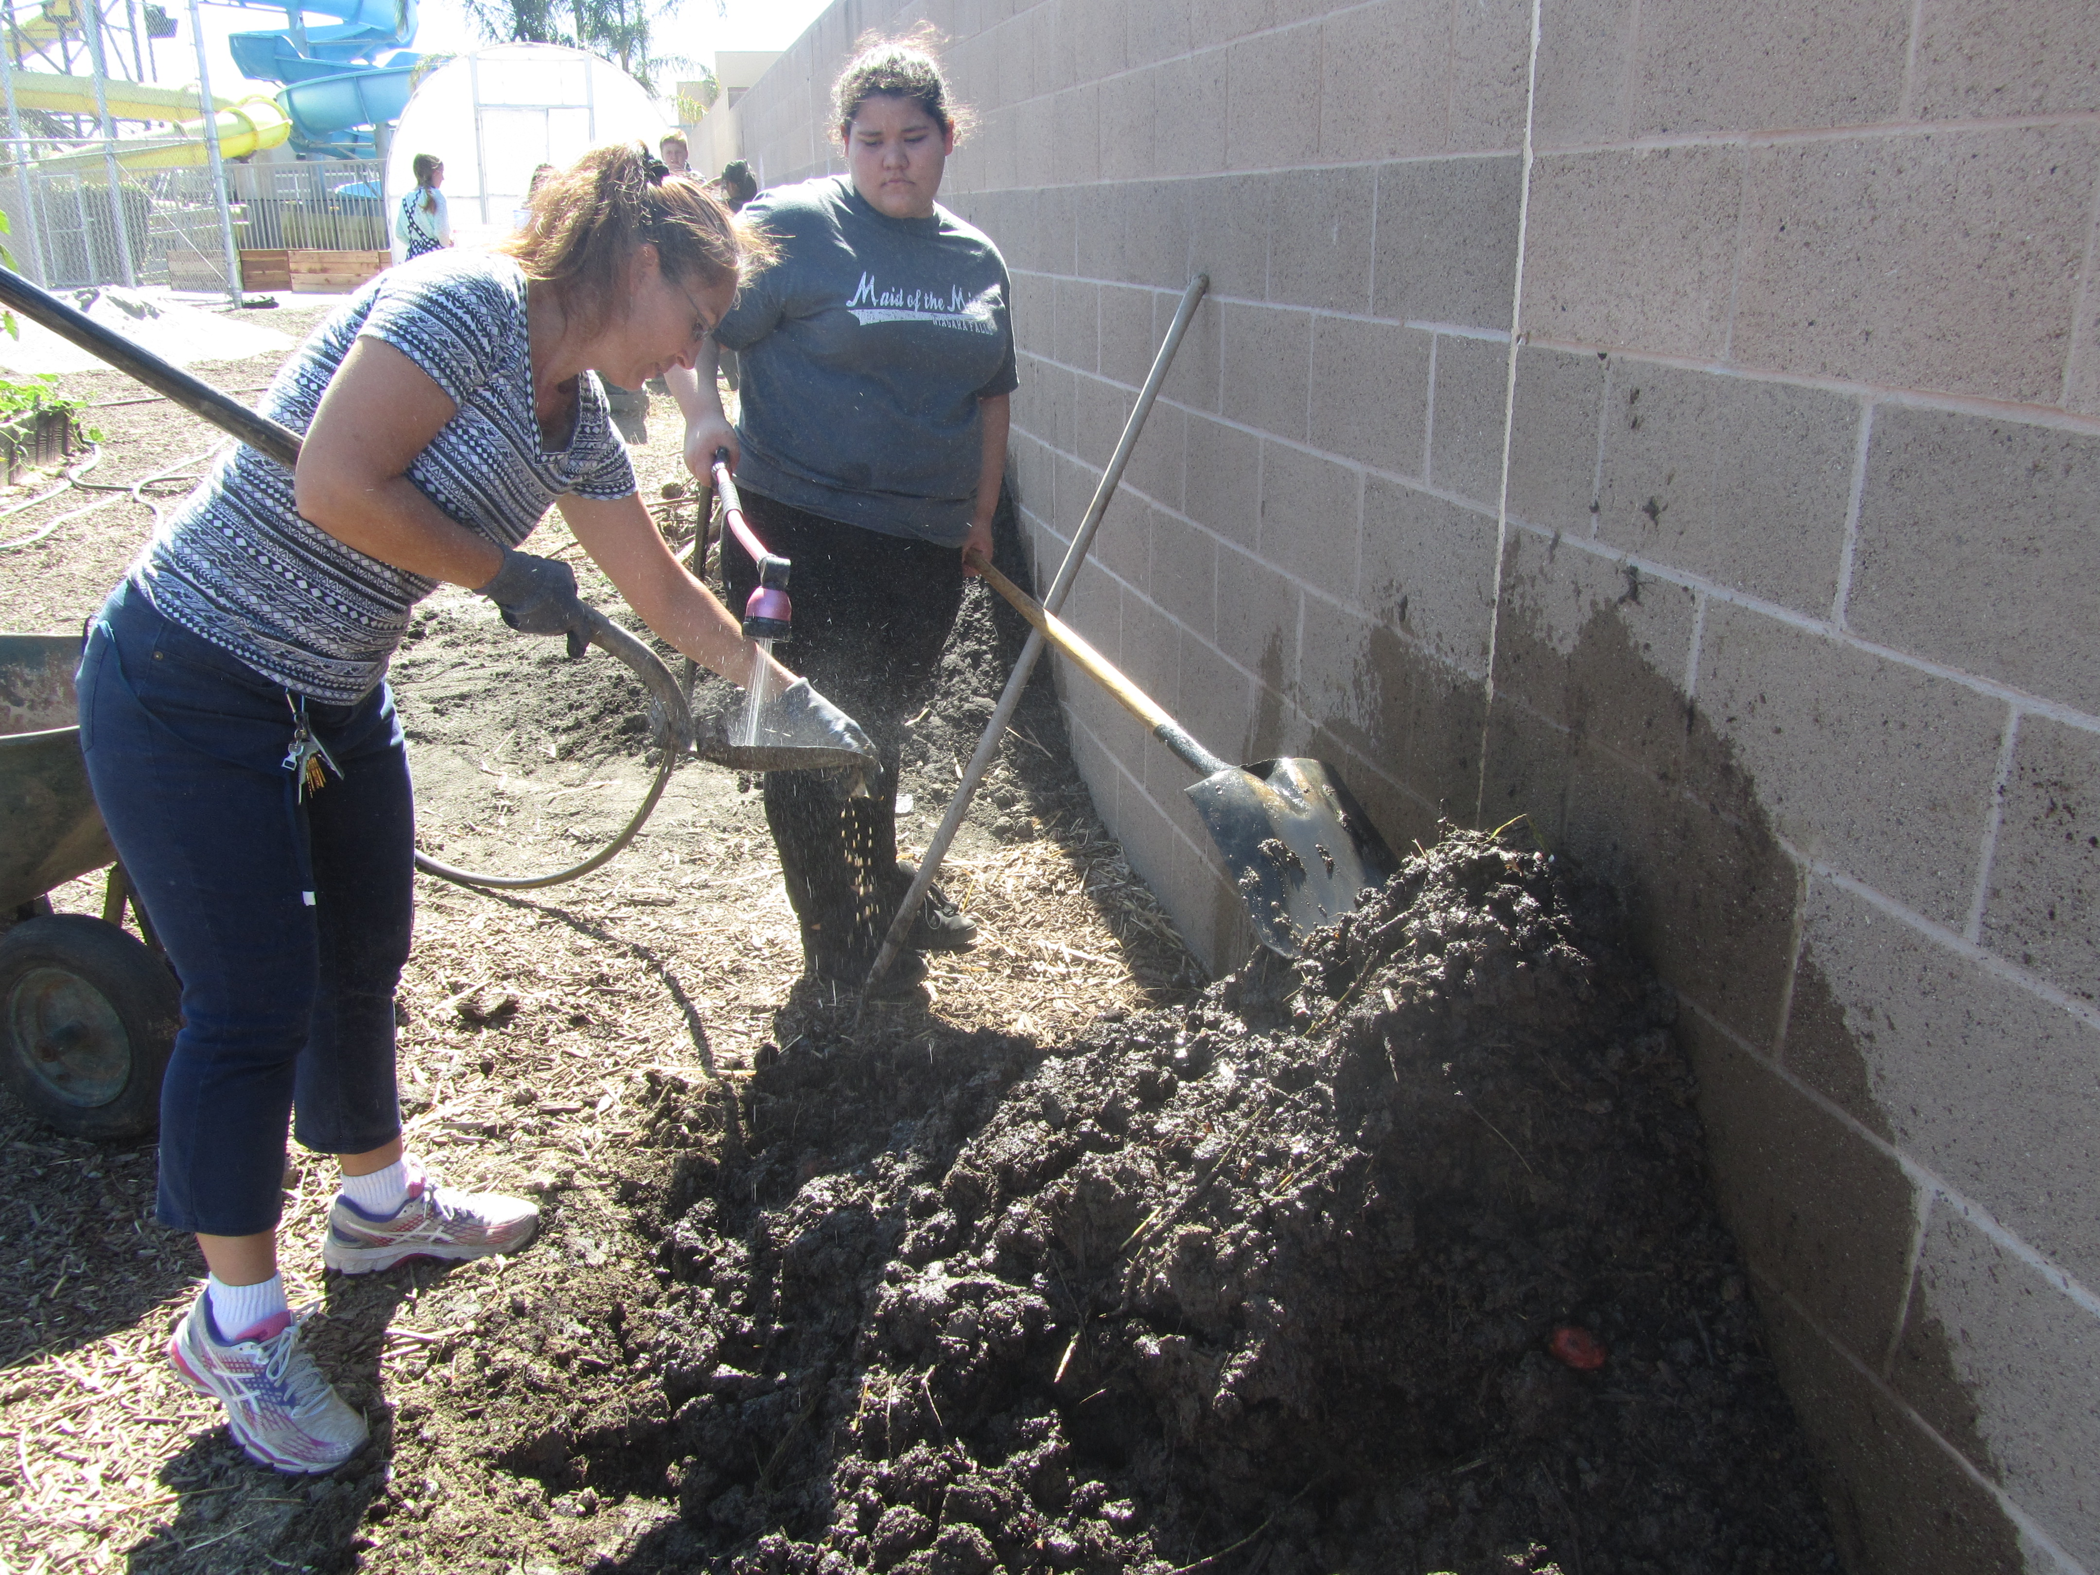

Slide 6
Moving gravel under the watering station

Slide 7
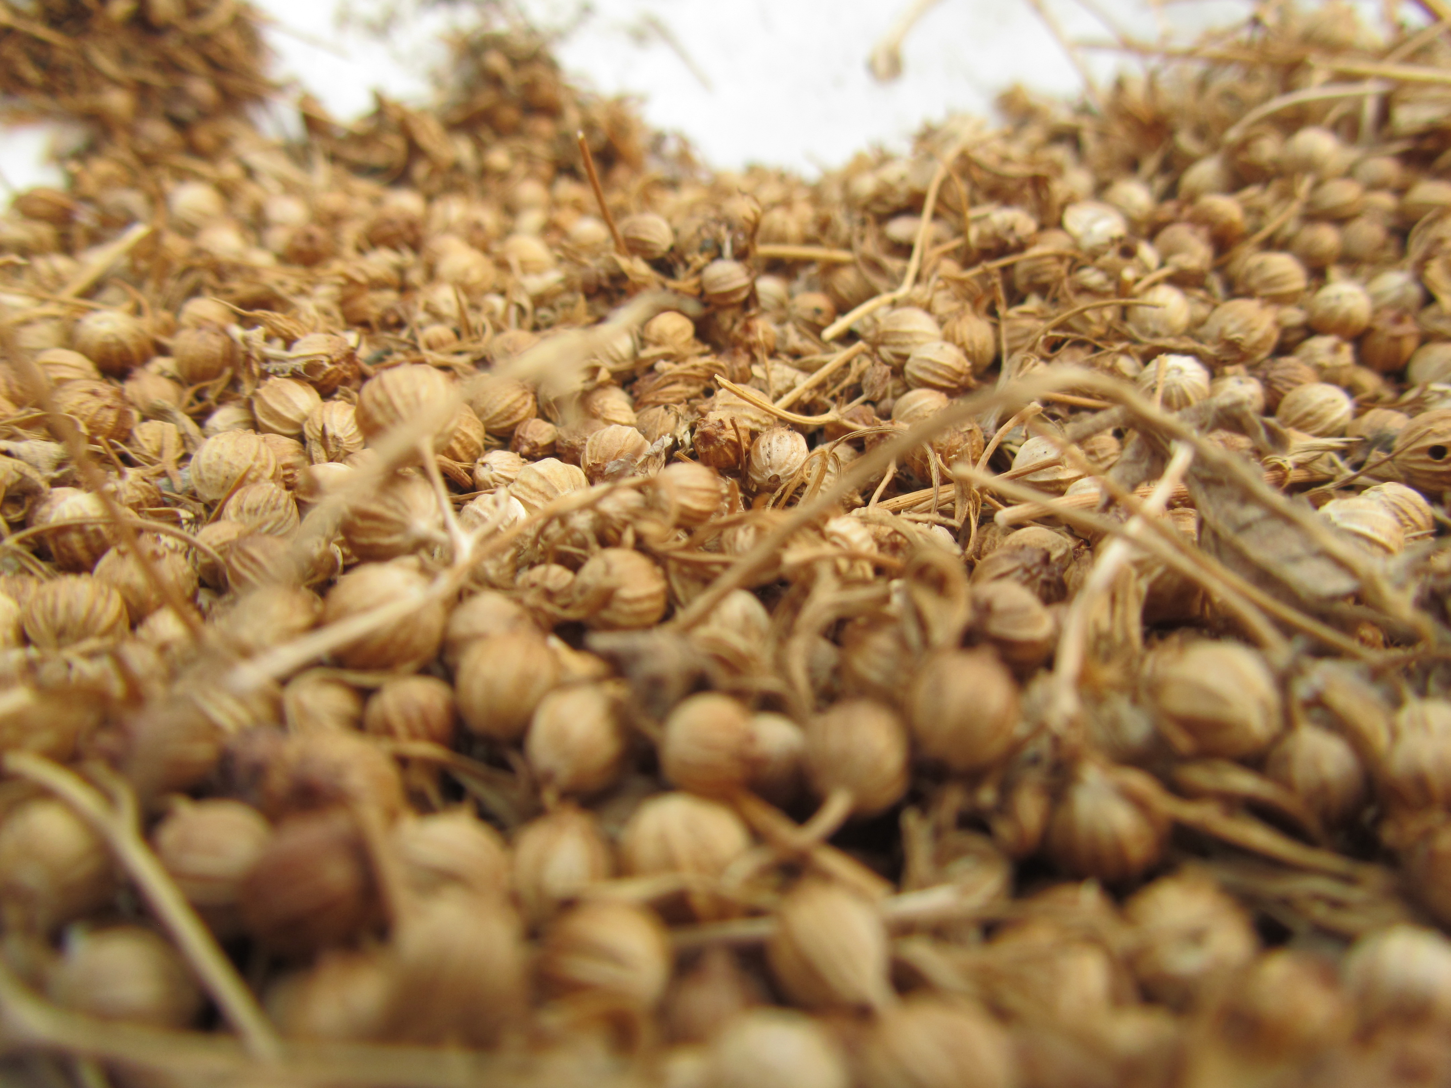

Slide 8
Watering the garden beds

Slide 9
Who’s prettier, the flowers or the girls?

Slide 10
William the Waterer☺

Slide 11
Have you shown McAllister your “ribbon test” yet?

Slide 12
Pretty Flowers – sunflowers need to come out this week:(

Slide 13
Paige – “I Believe” Statement
Officer Elections

Slide 14
Farm to Fork Leadership Offices
2015 Fall Term
President- Organize Officers and communicate objectives, carry through with goals set by class.
Vice President – Support the president in organization of class meetings, communication throughout the class & school/board with overall goals, achievements.
Secretary – Written documentation of class meetings with goals, achievements. Communicate with all levels of officers, class members and McAllister.
Treasurer – Keep track of donations and expenditures, be present at all fundraisers. Return receipts to McAllister.
Videographer- Develop, create, & document our adventures in the garden and beyond.
Publicist/ Journalist – Advertise F2F achievements, goals, communicate with community members about F2F.
Irrigation Specialist – Responsible for the proper amount, quality, and management of water in the garden.

Slide 15
Officer Nominations Select students who are willing to run for the office. Tuesday will be a computer lab day, nominees will type their speech for the election on Wednesday.
President
Vice President
Secretary
Treasurer
Videographer
Publicist/Journalist
Irrigation Specialist

Slide 16
Ribbon Cutting Ceremony

Slide 17
Agenda Week 9/14
Monday
Nominate Officers
0 for participation is sitting on the picnic bench
Take all new tools/seeds/etc. to garden
Move trash cans next to sunflower pile & cut into 4 – 6 “ pieces
Clear 4 more garden beds (Tomatoes and old sunflower bed & zucchini bed)
Prepare to plant Potatoes, Onions, Garlic, Broccoli
Organize Blue Bucket

Slide 18
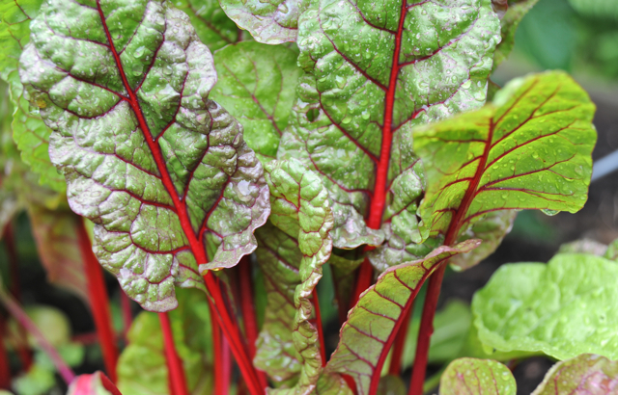
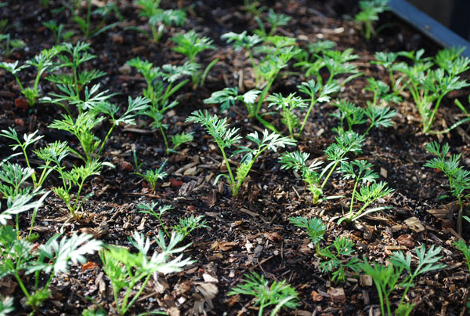
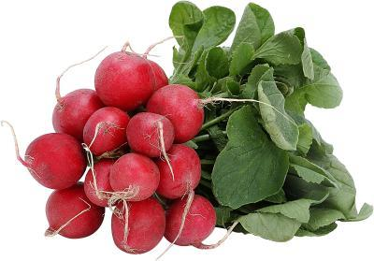
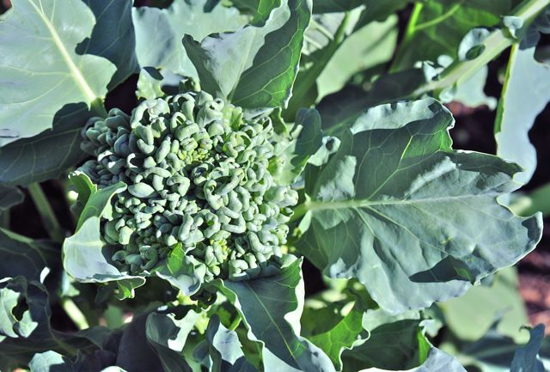
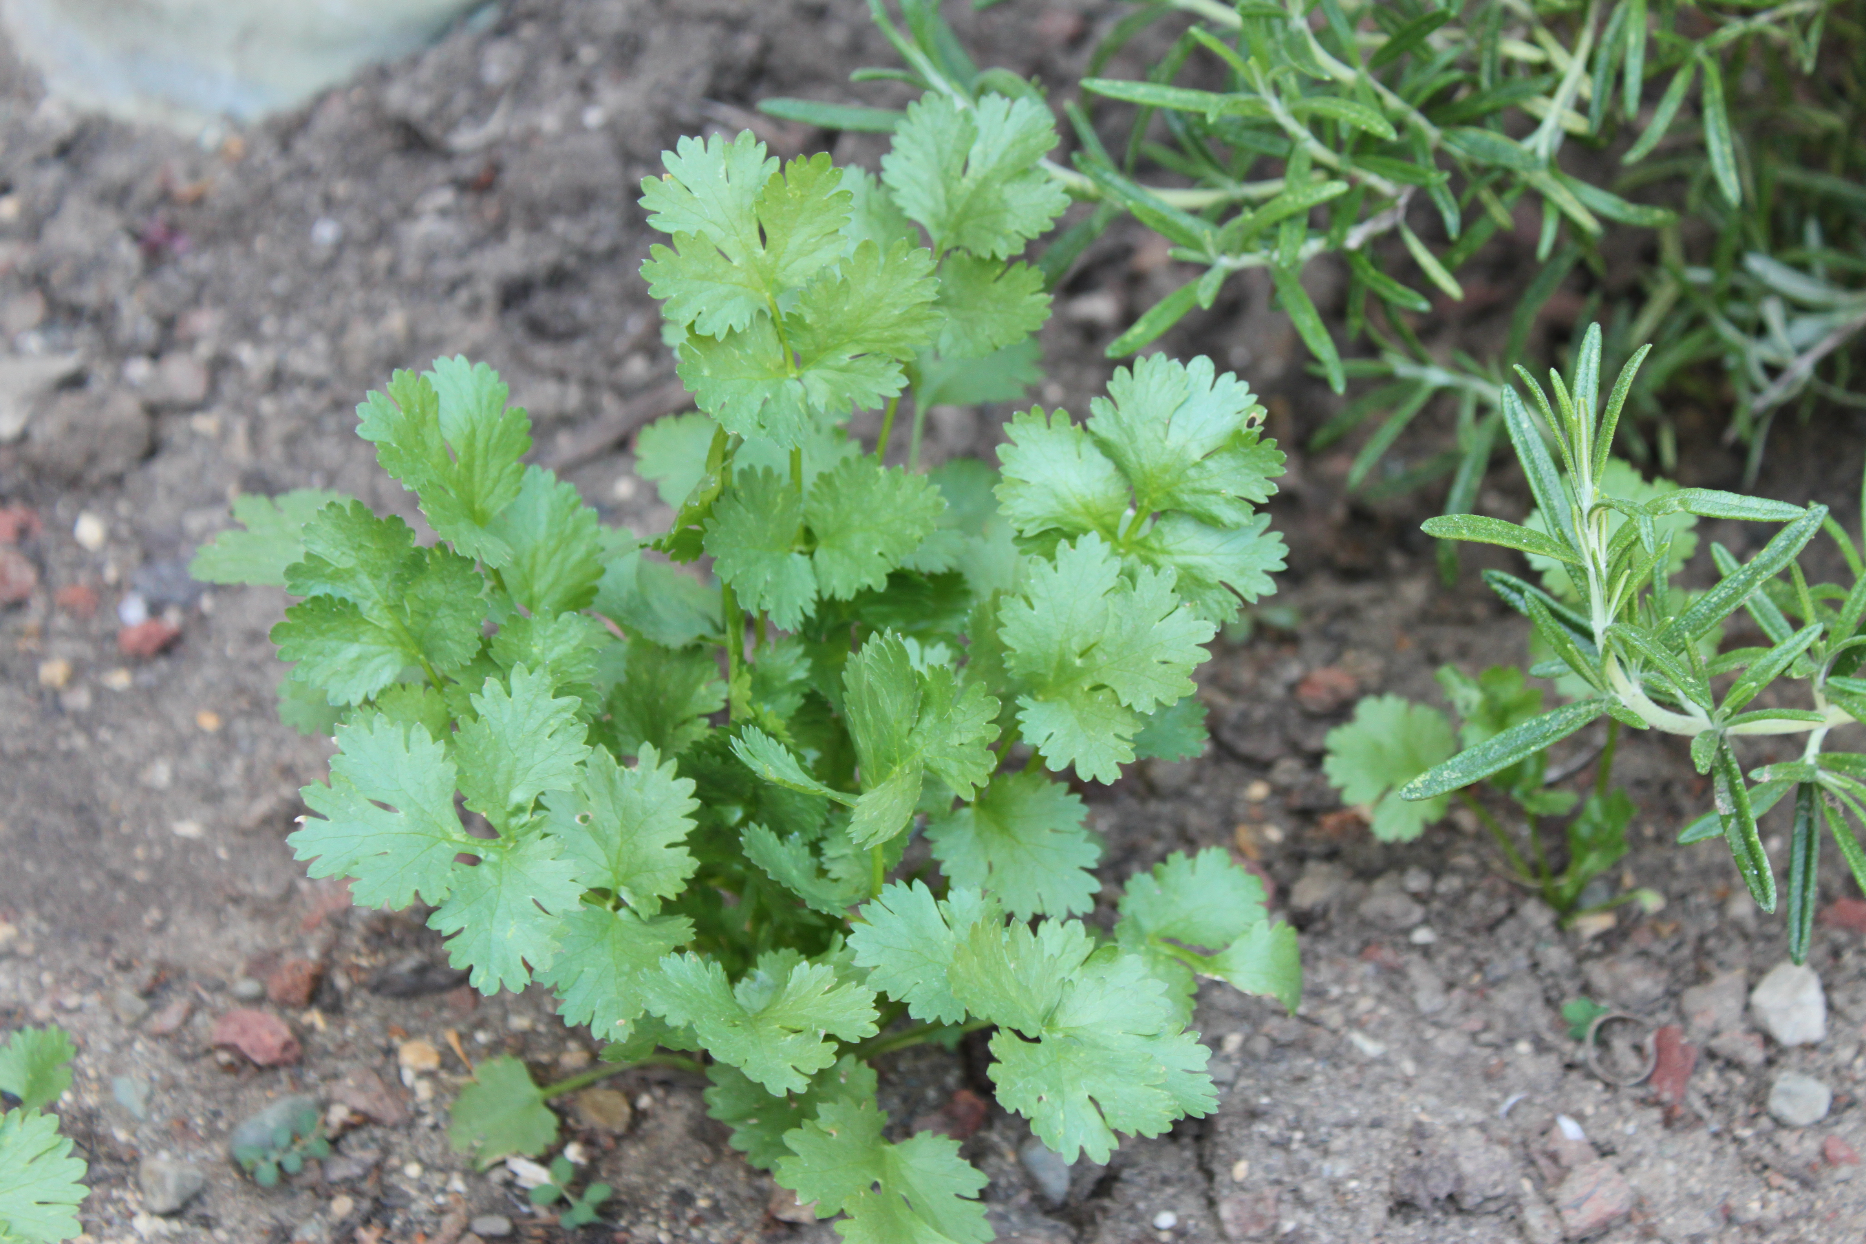
9/14 Steps in planting our Fall Crops page 38NB
List the steps needed when clearing a bed for a Fall crop.
Name as many tools as you can that we use in our garden.
Write the steps to prepare a bed to be seeded.

Slide 19
Agenda 9/15 – Collaboration day Computer Lab
Tuesday
Computer Lab – assignment Fall garden crop – Make a list, find recipe's that will use our harvest. Page 35 NB
Write a summary of CH 1 page 33 notebook
Read CH 2 by Friday.
Potential Officers – work on speeches
Grade Notebooks p. 25 - 34 50 Points

Slide 20
9/15 Leadership Obj. TSW understand why leadership is important in the development of a successful program. P. 40 NB
What are some characteristics of successful leaders.
Why is leadership important?
How can being a leader now help you in your future?

Slide 21
9/16 Officer Elections & Agenda
Garden
Shovel Soil into handicap beds
Move rock to right of the hose bib
Add more sand to compost
Use our good compost in new garden beds
Add worms to compost and new garden beds
Hang trowels and hand shears to peg board in shed
Clean greenhouse
Water plants in greenhouse

Slide 22
9/16 Vegetable Companion Planting Guide Obj. TSW learn about companion planting and how certain plants grow well together and others inhibit growth. P. 42 NB
Look at your vegetable companion planting guide, what grows well with peas?
We will be growing Onions, Garlic and Potatoes this Fall, what should we not plant with them?
If we plant cauliflower, what should we not plant in that bed?

Slide 23
Coming soon…
Octagon Flower bed will be arriving this week
Little kid beds will arrive also.
Plant daffodils & irises into new garden beds.

Slide 24
9/17 Vegetable Planting Guide & Leadership Obj. TSW grow the Farm to Fork Program with new leadership. P. 44 NB
Using your vegetable planting guide on page NB, what grows well with carrots?
What goals you like your new officers to accomplish?
How can you be part of that goal?

Slide 25
9/18 Omnivore’s Dilemma Obj. TSW discuss a new perspective of food after reading Ch 2. P. 46 NB
Discuss Pollan’s second chapter in Omnivore’s Dilemma. How does what he says change the way you think about food?
What is a Hybrid?
What can we use our Zucchmelon for?

