Slide 1
UNIT 2 Cycles in Nature – Phosphorus, Water and Biodigestion
F2F2 Week 7

Slide 2
2/29 Phosphorus Cycle Obj. TSW compare the phosphorus cycle to the other two cycles we have learned. P. 58 NB
Watch the following video link. Answer the 4 questions on the worksheet about the phosphorus cycle.
Tape your worksheet to page 58 NB with the answers☺

Slide 3
AXES paragraph on Phosphorus Cycle p. 59 NB
Why is phosphorus important? How do we benefit?

Slide 4
3/1 Phosphorus Cycle Obj. TSW detail the events of the short and long term cycles for phosphorus. P. 60 NB
Describe some details of the Short Term Cycle.
Describe some details of the Long Term Cycle.
What do the two have in common?

Slide 6
N-P-K Comparison Chart p. 61 NB
For Nitrogen, Phosphorus & Potassium:
How does this nutrient help the plant?
What conditions will increase the nutrient in the soil environment?
What conditions will decrease this nutrient in the soil environment?’
What problems will plants encounter if this nutrient is defiance? What are the plant symptoms?

Slide 7
Call the Plant Doctor
Students will learn the tell tale signs of deficiencies in plants and fill in their NPK Chart. Page 61 NB

Slide 8
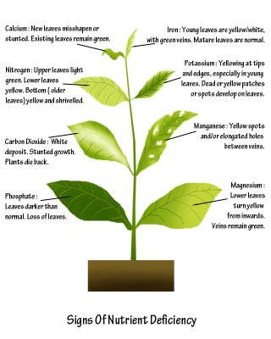

Slide 9
Station #1

Slide 10
Answer no. #1 – nitrogen deficiency Clue(s): general yellowing througout

Slide 11
Station #2

Slide 12
Station #2 phosphorous deficiency Clue(s): dark green, loss of leaves

Slide 13
Station #3

Slide 14
Answer station no. 3– potassium deficiency clue(s): yellowing on leaf edges

Slide 15
Station #4

Slide 16
Answer to no. #4 –nitrogen deficiency clue(s): overall yellowing

Slide 17
Station no. 5

Slide 18
Answer no. 5-Potassium clue(s): yellowing on edges

Slide 19
Station no. 6

Slide 20
Station no. 6-Phosphorus Deficiency clue(s): dark green, red/purple coloring on edges

Slide 21
Station no. 7

Slide 22
Answer no. 7: nitrogen deficiency clue(s): yellowing in middle of stem

Slide 23
Station no. 8

Slide 24
Answer no. 8: phosphorus clue(s): dark green with red/purple edges

Slide 25
Station no. 9

Slide 26
Answer no. 9: potassium clue(s): yellowing on edges of leaves

Slide 27
Station no. 10
These plants

Slide 28
Answer no. 10: nitrogen clue(s): reduced growth and lighter green color
These plants

Slide 29
3/2 Water Cycle Obj. TSW distinguish between the processes of the water cycle. P. 62 NB
Name the 6 processes in the Water Cycle.
What is the difference between Evapotranspiration and Evaporation?
What % of the Earth is covered in Water?

Slide 30
Water Cycle Processes Copy these on page 63. Write the phase change for each process.
Condensation
Precipitation
Run Off
Infiltration – Aquifers (50 % Americans get drinking water form Aquifers)
Evaporation
Evapotranspiration (Transpiration)

Slide 31
3/3 Water Cycle Obj. TSW apply their knowledge of water cycle processes to measure water loss. P. 64 NB
What is Transpiration?
How can plants lose water?
Why do we care?

Slide 32
Foldable p. 65 NB Water Cycle Write a definition, the phase change, is any, and why it is important.
Evaporation
Condensation
Precipitation
Run Off
Infiltration
Evapotranspiration

Slide 33
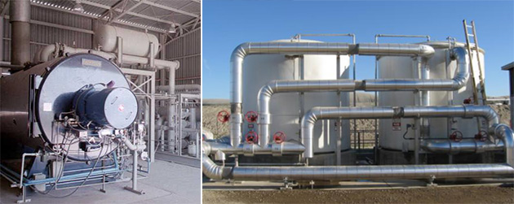
¾ Biodigestion Obj. TSW learn how food can be part of a renewable cycle of energy. P. 66 NB
What does the word sustainability mean?
What is Biodigestion?
How is Biodigestion a sustainable practice?

Slide 34
Activity: Research Clean Natural Gas p. 67 NB
Research the compounds of Clean Natural Gas
Write the Chemical formula for them on page: 67
Draw the Chemical structure for them on page: 67

