Slide 1
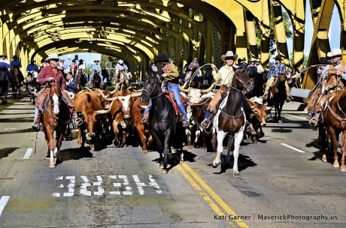
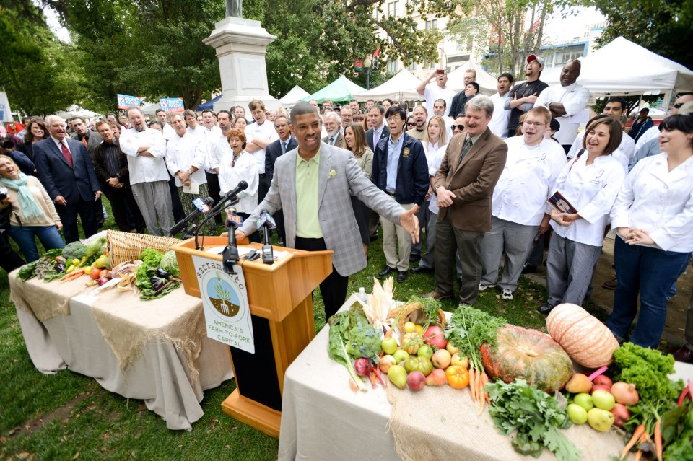
Farm-to-Fork (F2F)
Mrs. McAllister

Slide 2
Erosion
F2F2 Week 1

Slide 3
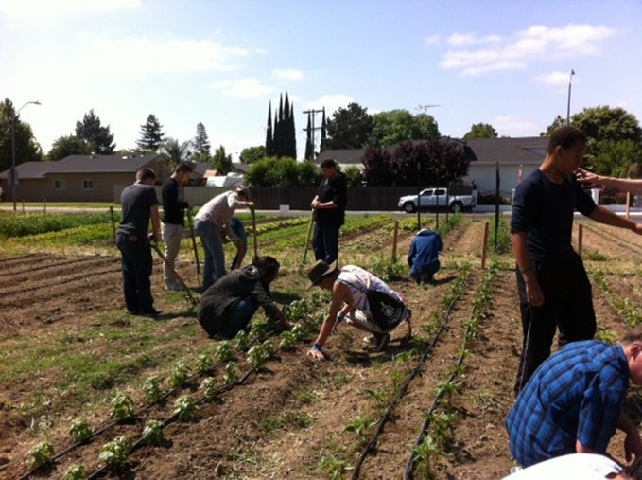
1/20 Farm to Fork Obj. TSW learn about the reasons for Farm to Fork P. 8 NB
Describe Farm to Fork in your own words.
2. Name a Cold Season Vegetable.
3. Name a Warm season fruit or vegetable.

Slide 4
8/21 Soil Erosion Obj. TSW learn about soil erosion and damaging impacts on farming and the environment. P. 10 NB
Look at the picture, how would you describe soil erosion?
What problems could this create for farmers?
What problems could develop down stream?

Slide 5
The Unfortunate Homeowner
View the following picture taken off the coast of Nantucket, near Boston, Massachusetts. Clearly, the homeowner was not happy at the time the photo was taken. In your notebook, title a page “The Unfortunate Homeowner” and attempt to identify the factors that led up to the unfortunate situation. How did the house end up in the ocean? What did the homeowner fail to understand? How could situations like the one in the picture be avoided? Should people be allowed to build homes in similar conditions? Why? Why not? Upon what type of soil do you think the house was built upon

Slide 6
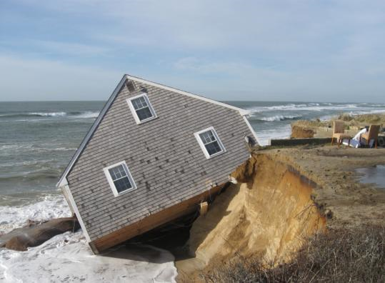
The Unfortunate
Homeowner

Slide 7
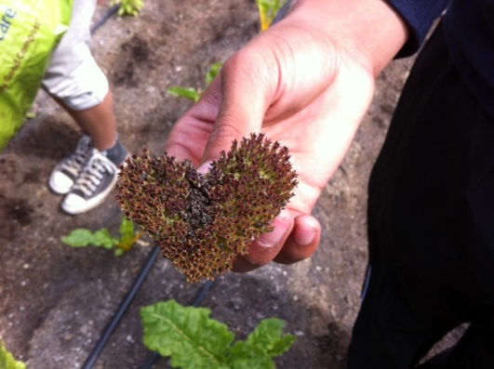
Farm-2-Fork
Day 1 August 19th
Movement strongly supported in Sacramento and spreading throughout the country to eat food grown & raised locally. (50 - 100 miles)
Your average food travels 2000 miles before you eat it. That creates a lot of pollution.
Eating Food grown locally:
Supports local economy’s
Is fresher, more nutritious
Less pollution created
Pride in food grown and raised in area
People become more aware of issues concerning their food
Pesticides
Water regulation
GMO’s Genetically Modified Organisms

Slide 8
Safety
If anyone ever gets hurt you always tell McAllister.
There are Bees at the garden. Allergies?
Tools. Sharp – Do not Run with tools.
Water. Do not spray each other.
Cat Feces. Toxoplasmosis – Wear gloves, always wash your hands after working in the garden and before eating food.
Be constructive in your criticism. No Put Downs.
Wash garden vegetables 3 times before eating.

Slide 9
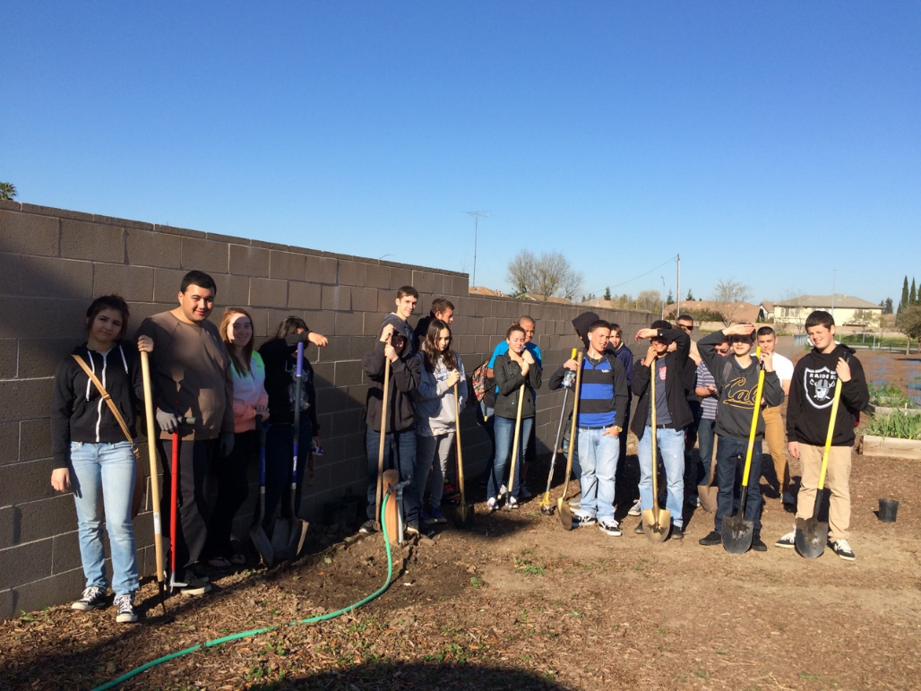
Introductions
Day 2
Stan Mojsich – Principal
Kristin Rodriguez– Vice Principal
Sedikeh Yusufi – Electronics Teacher
Rosie Huizar – Cafeteria Manager
Cheryle Sutton – Culinary Arts Teacher

Slide 10
3x5 card
Day 1
Front: First & Last Name
Back: Goal for Farm to Fork
Something interesting about yourself
Favorite Sport/ Singer/ Hobby/ Food

Slide 11
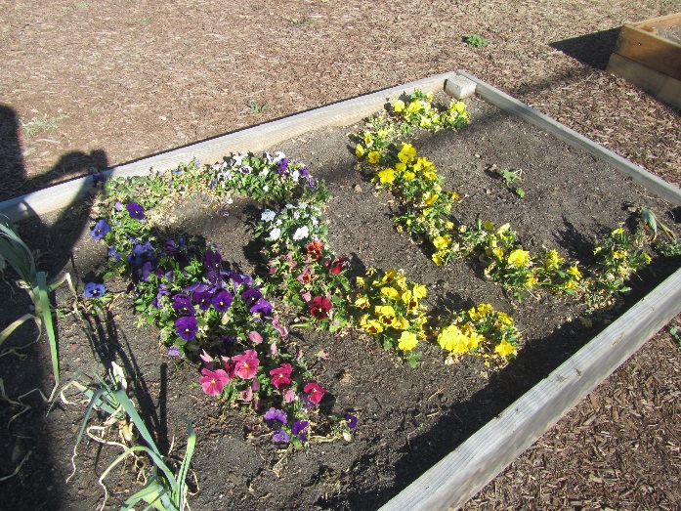
The Goal of Farm-to-Fork Class
Day 1
Grow organic, wholesome food for the Cafeteria at RCHS and Culinary program at Bryte High School.
Educate Family, Friends, and fellow students about F2F.
Rosie Huizar – Head of RCHS Cafeteria
Introduce Rosie
Tour Cafeteria
Cheryle Sutton – Culinary Arts Teacher
We will grow food for Events
RCHS Garden will be a demonstration sight for the community. Walk out to the garden. Set goals, Routines, Duties, Leadership roles.

Slide 12
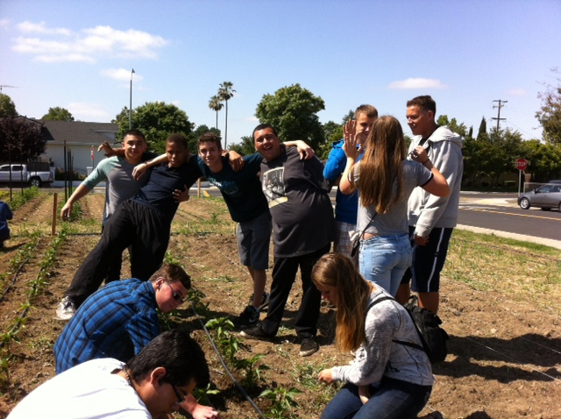
Ice Breaker
Day 1
Squishy Name game.
I love my Neighbor who…

Slide 13
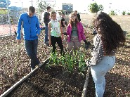
Your mission:
Day 2
Create healthy productive soil from the salvaged soil
Produce healthy fresh food for RCHS & Culinary
Learn how to harvest summer crops and start, transplant, fertilize and grow winter crops.

Slide 14
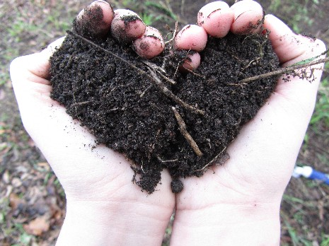
Planting Seeds for the garden
Activity Day 3
Choose what you would like to plant in a container.
Use only 2 seeds
Read how deep they are planted.
Water

Slide 15
Leadership Offices
2015 Spring Term
President- Organize Officers and communicate objectives, carry through with goals set by class.
Vice President – Support the president in organization of class meetings, communication throughout the class & school/ board with overall goals, achievements.
Secretary – Written documentation of class meetings with goals, achievements. Communicate with all levels of officers and class members.
Treasurer – Keep track of donations and expenditures, be present at all fundraisers.
Videographer- Develop, create, & document our adventures.
Publicist – Advertise F2F achievements, goals.

Slide 16
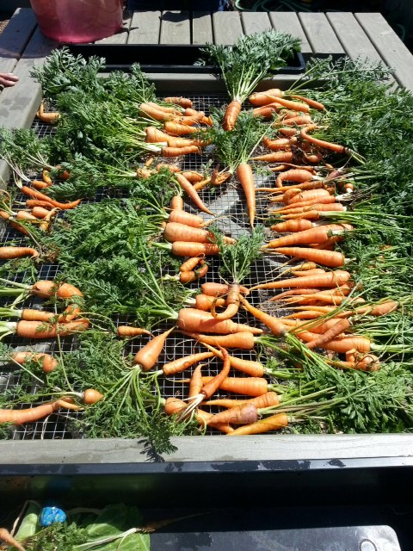
To the Garden…
Day 2
Harvest for the Cafeteria
Pull Weeds
Water
Plant seeds for Spring crop:
Fertilize
Collect Marigold Seeds.
Harvest Coriander Seeds.
Create bouquet of flowers for the front office. – Weekly
Turn compost, & water
Move garden tools to shed.

Slide 17
Fundraisers Events
Special Officer Meetings
Put Carpet under Pumpkins. Silent Auction Oct. 27th – 31st
Salsa Tasting Fundraiser
Flowers for Valentine’s Day
Flowers for Mother’s Day
Flowers for Graduation
Taste our Garden Event
Culinary Events
Science is Awesome Night
End of the Year seedling give away
Plant flower seeds from Clare’s funeral (family)

Slide 18
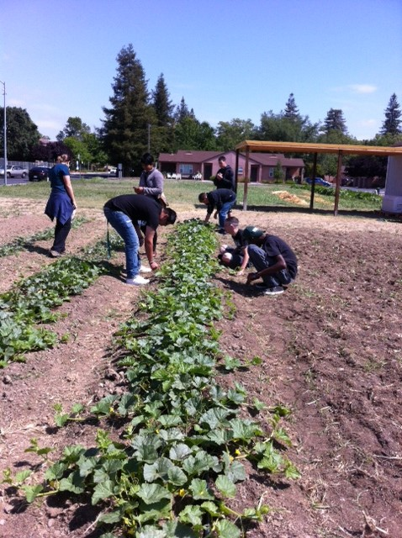
Grading
Projects 40%
Notebook 20%
Participation 20%
Quizzes/ Tests 20%

Slide 19
Ideas for F2F Guest speakers
Rainy Day speakers:
Mayor Cabaldon
Kymberleigh Smith
Broderick Roadhouse – Chris Jodroz
UC Davis Master Gardeners
Sustainable Farmer – Caypay Organics
Rice Cooperative
Yolo Bypass – Cosway Wetland
Family run Farms?
Jason Billington – ROP Construction

Slide 20
1/22 Soil – It’s running away… Obj. TSW learn about stream flow, soil erosion, and nutrient depletion during a Stream table activity. P. 12 NB
Describe the word conservation in terms of soil.
Describe the word deterioration in terms of soil.
Why is soil management important in agroecosystems

Slide 21
Activity – Soil it’s running away p. 13 NB
In your group at your table, fill your tray with 1, 1000 ml of sand poured into the shallow end of the tray.
Get a water bottle ½ - full of water.
Spray the shallow end of the sand and describe what happens in your NB, page 13.
Answer the following questions:
How does the soil erosion happen? Describe your observations in detail.
Why is erosion unhealthy for the agroecosystems?
What steps/ practices could prevent or reduce soil erosion?

Slide 22
Activity- Nutrients – Where did they go? P. 15 NB
Introduction/ discussion:
What are the main plant nutrients and where are they obtained?
What can happen to plants if nutrients become depleted?
How can nutrient depletion occur?

Slide 23
Activity- Nutrients – Where did they go? P. 15 NB
Directions:
Apply food coloring (1 drop only) to three different areas of your tray of sand. On or under the sand. (describe different soil types).
Simulate rain with the hand sprayer.
Describe your general observations of the demonstration.
Explain how nutrient depletion can happen in relation to erosion.
Hypothesize how crops planted year after year without any replenishment or rest become depleted of nutrients.

